Slide 1



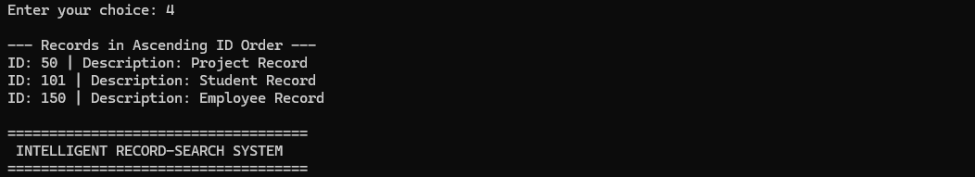
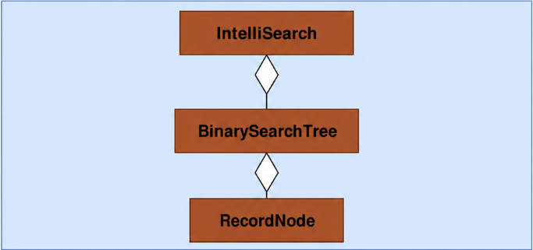
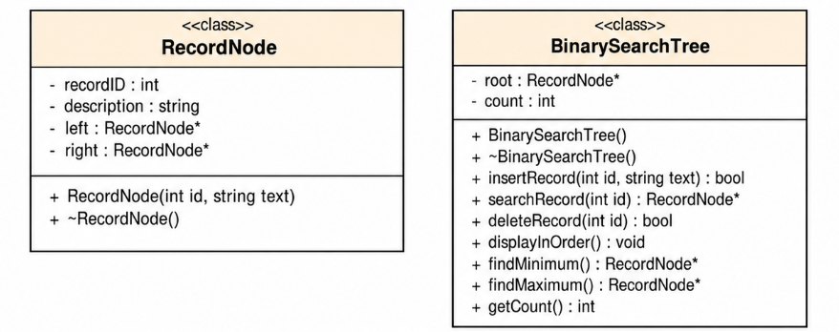
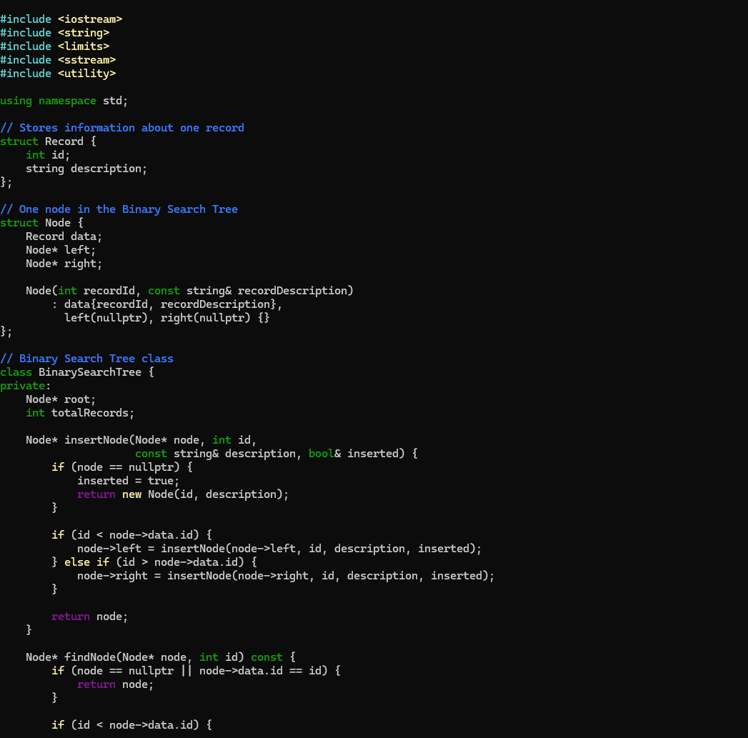



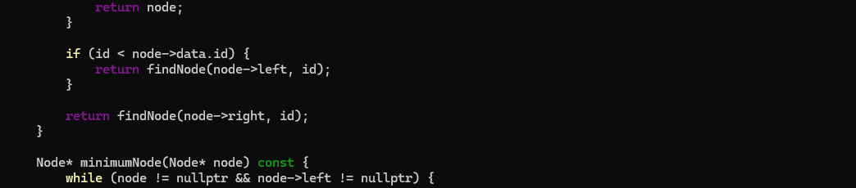
IntelliSearch: Intelligent Record-Search System Using Binary Search Trees,
NagaJayaMadhuPraveen (Praveen) Mahadeva
Faculty Advisor: Dr. Victor Govindaswamy
Concordia University Chicago
Abstract
Further Future Work
Menu Functionality
Output
The following project presents an intelligent record management and retrieval system called “IntelliSearch – Intelligent Record-Search System Using Binary Search Trees.”
The system is designed as a menu-driven C++ application that enables efficient storage, retrieval, and organization of records using a Binary Search Tree (BST). It allows users to perform essential operations such as adding new records, searching for records using unique identifiers, deleting existing records, displaying all records in sorted order, identifying minimum and maximum record IDs, and counting the total number of records. The application demonstrates how hierarchical data organization can support efficient information retrieval in real-world software systems.
The project demonstrates the practical implementation of fundamental Data Structures and Algorithms concepts, including binary trees, nodes, pointers, dynamic memory allocation, and object-oriented programming principles. The BST organizes records according to their unique IDs, enabling systematic insertion, searching, and deletion. Its menu-driven interface and input validation provide a clear and user-friendly way to interact with the application while helping prevent invalid entries and duplicate record IDs.
Furthermore, the system emphasizes efficient data organization and retrieval. Searching, insertion, and deletion can take an average of O(log n) time when the tree is reasonably balanced, while these operations may require O(n) time in the worst case when the tree becomes unbalanced. The project also explores real-world applications of tree-based data structures, including self-balancing red-black trees used in Linux kernel subsystems, demonstrating the importance of tree structures in practical computing environments.
The project is designed with future scalability in mind, allowing potential integration with advanced technologies such as Artificial Intelligence (AI) for intelligent record classification and summarization, and cloud computing for remote data access and storage. These are proposed future enhancements rather than features implemented in the current application.
Artificial Intelligence Integration
Future improvements will include Artificial Intelligence (AI) integration to support intelligent record classification.
Self-Balancing Binary Search Trees
The system can be enhanced by implementing self-balancing tree structures, such as AVL trees or red-black trees, to maintain efficient search, insertion.
Cloud and Database Integration
Future improvements will include integration with cloud-based databases to support persistent record storage, secure data access, and synchronization.
Security and Access Control
The system can be enhanced with user authentication, role-based access controls, and data encryption.
After selecting an option from the menu, the application allows users to add new records, search for existing records using unique IDs, delete records, and display all stored records in ascending order. It also provides options to find the minimum and maximum record IDs and calculate the total number of records. Additionally, the system validates user input and displays appropriate messages for invalid entries, duplicate IDs, and records that cannot be found.
After processing the input, the system displays record information in a clear and organized format. Users can view all records in ascending order, search for specific records using unique IDs, and verify record details instantly.
Uml
Referense
Efficient Record Management:
IntelliSearch organizes records using a Binary Search Tree, enabling efficient insertion, searching, deletion, and retrieval through unique IDs.
Simplicity and Ease of Use:
The menu-driven interface allows users to navigate different options easily and perform record-management operations through clear instructions.
Fast Record Searching:
The BST structure organizes records by unique IDs, supporting efficient searching. Average-case search time can be O(log n) when the tree is reasonably balanced.
Sorted Record Display:
The system displays records in ascending order using in-order traversal, making information easier to review
Structured Programming Approach:
The application demonstrates essential C++ concepts, including pointers, dynamic memory allocation, classes.
Modular Design:
Separate classes and functions divide the program into manageable components, making the application .
Coding Technology for MedTrack
UML Class Diagram
C++ (Programming Language):
C++ is an object-oriented programming language that also supports procedural programming. It allows developers to implement core Data Structures concepts such as pointers, dynamic memory allocation, and C-style strings. These features make it suitable for building efficient and structured applications like MedTrack.
Linux Environment
Code
Linux Environment:
The MedTrack application is designed to run on a Linux system, which provides a stable and open-source environment for development. Tools like the GNU Compiler Collection (g++) are used to compile and execute the program, making it efficient for building and testing C++ applications.
Object-Oriented Programming (OOP)
Object-Oriented Programming (OOP):
The system is developed using object-oriented principles such as encapsulation, modularity, and abstraction. Classes such as RecordNode and BinarySearchTree organize record data and related operations systematically. The RecordNode class stores each record's unique ID, description, and pointers to its left and right child nodes, while the BinarySearchTree class manages all operations.
OOP helps divide the program into manageable components, making the code easier to understand, maintain, and extend. By separating individual record.
Contacts
Bioinformatics And Technology Laboratory (BAT Lab)
- Programming Application Implementation and Design (PAID)
Computer Science Department (CSC@CUC)
Member: NagaJayaMadhuPraveen (Praveen) Mahadeva
Advisor: Dr Visvasuresh (Victor) Govindaswamy
Email: Victor.Govindaswamy@cuchicago.edu
Address: Concordia Chicago University
7400 Augusta Street
River Forest, IL, 60305-1499
Technology Used

