Slide 1
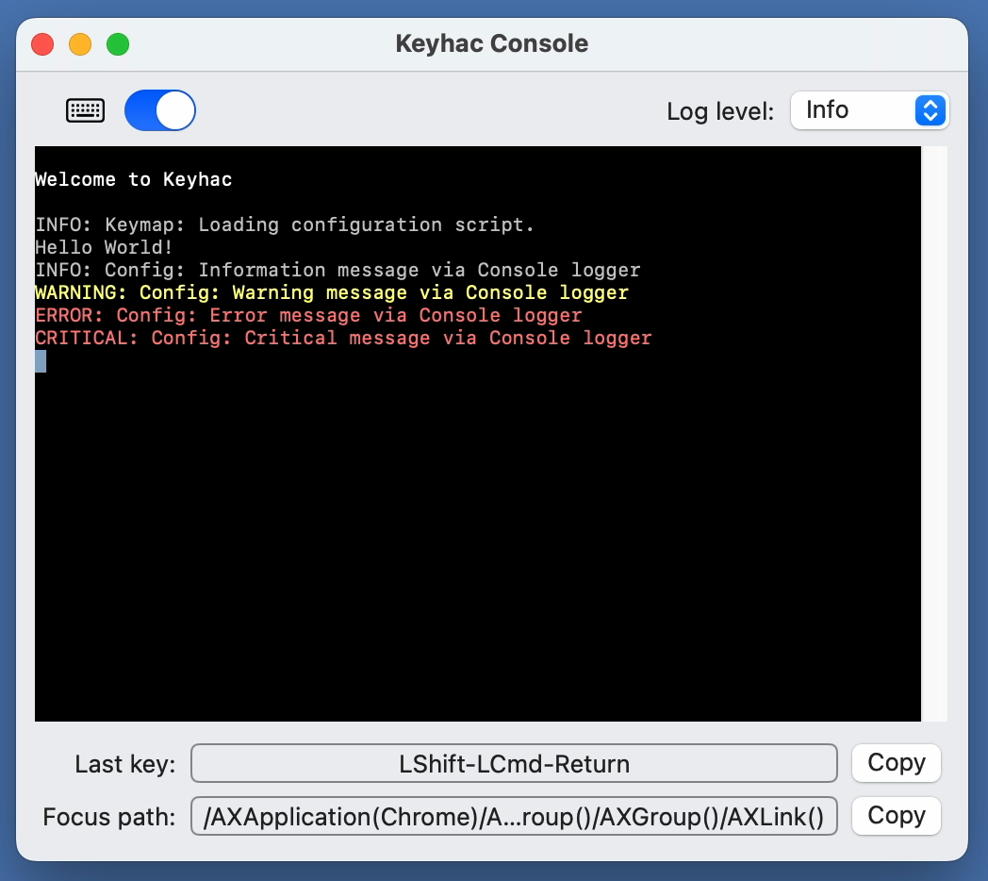
Keyboard hook switch
Log level chooser
Log viewer
Last key down
Copy to clipboard
Current focus path

