Slide 1

FIFA 2022 Soccer Position Predictor
Bhavana Chikkamuduvadi Renuka Gowda
Sumanth Herohalli Umashankar
Karthik Shingte

Slide 2
Introduction
The aim of this project is to analyze Soccer Players’ data from 2022 FIFA dataset and gain insights from the data with respect to player positions. The models used will be KNN and LDA.

Slide 3
Description of Dataset
This dataset was directly obtained from Kaggle and contains very detailed attributes for every player in the latest edition of the FIFA 22 database.
The dataset contains many of the player’s attributes, ranging from their age to their ball control and ranking in the game. Most of the skill set columns are on a ranking from 1 to 100.
The dataset contains 65 attributes and 19,239 observations. Attributes include details about the proficiency of each players’ skill levels in different types of capabilities.
Can we predict a player’s general position (Forward, Goalkeeper etc.) based on the player’s characteristics and ranking of skills?

Slide 4
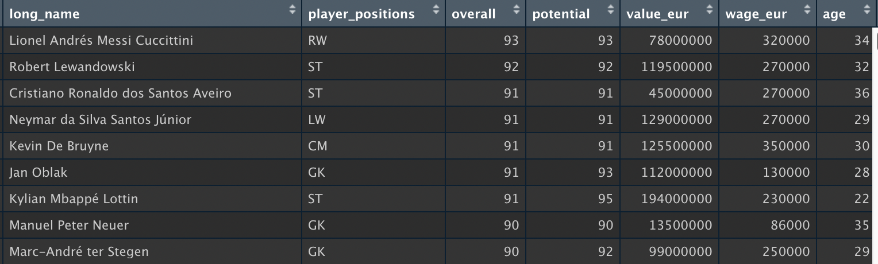
Dataset

Slide 5
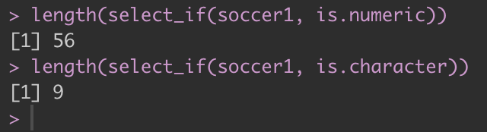
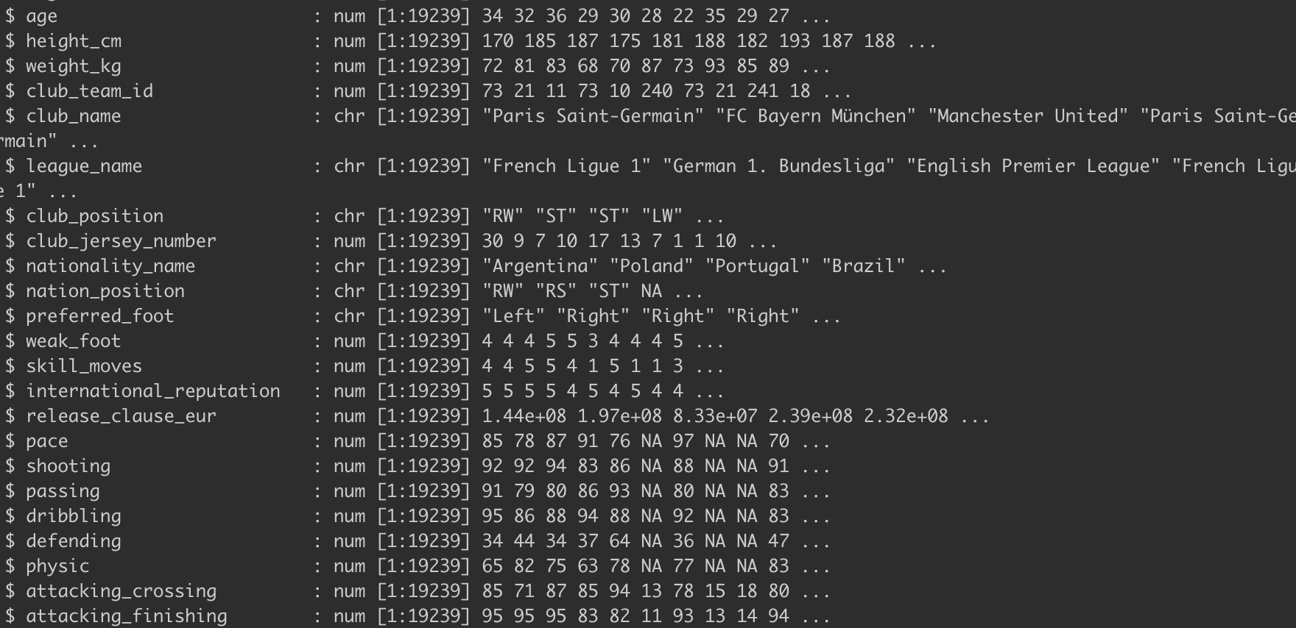
Data Exploration

Slide 6
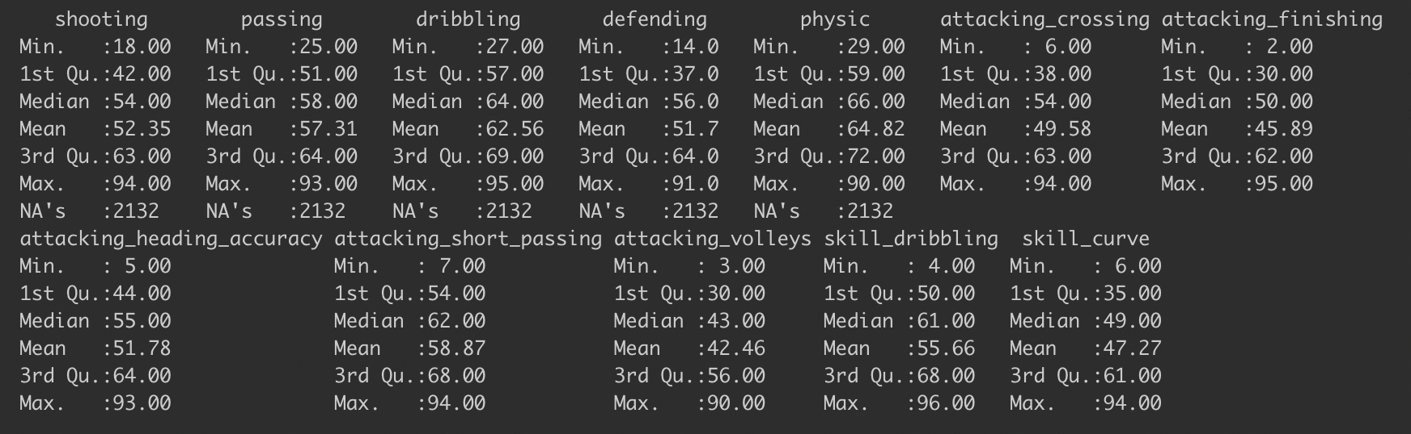
Data Exploration

Slide 7
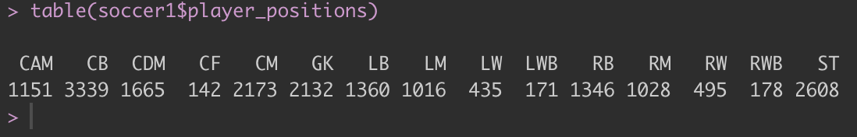
Classification of Interest

Slide 8
Grouping
We can see that there are a lot of divisions within major positions, which we will group in 4 categories i.e., FWD, MID, DEF & GK.
For our analysis we will be taking 500 rows from the dataset, 100 from the top and rest 400 from the complete data randomly sampled.

Slide 9
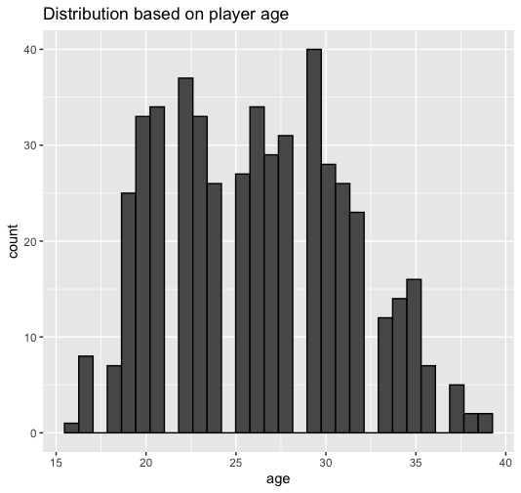
Age distribution in sample

Slide 10
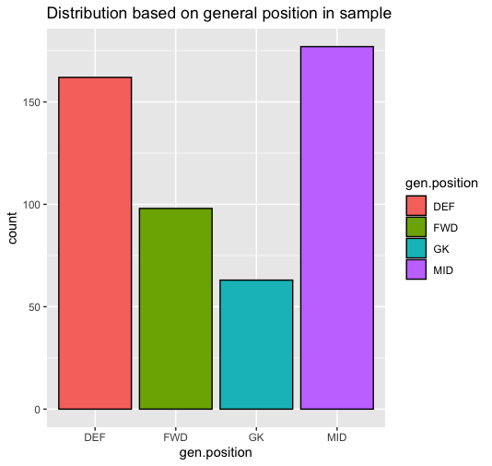
Distribution based on general position in sample

Slide 11
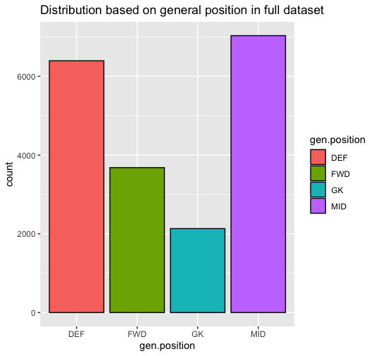
Distribution based on general position in full data

Slide 12
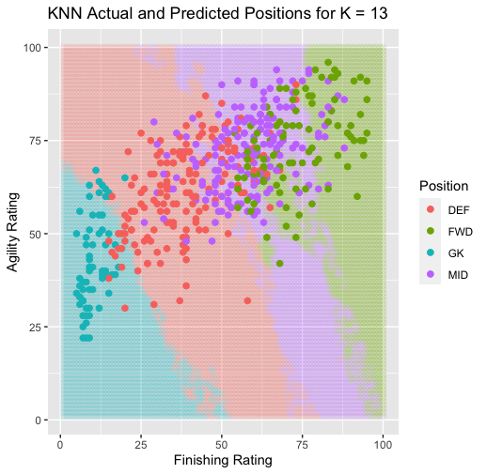
KNN Cluster “Agility” vs “Finishing”

Slide 13
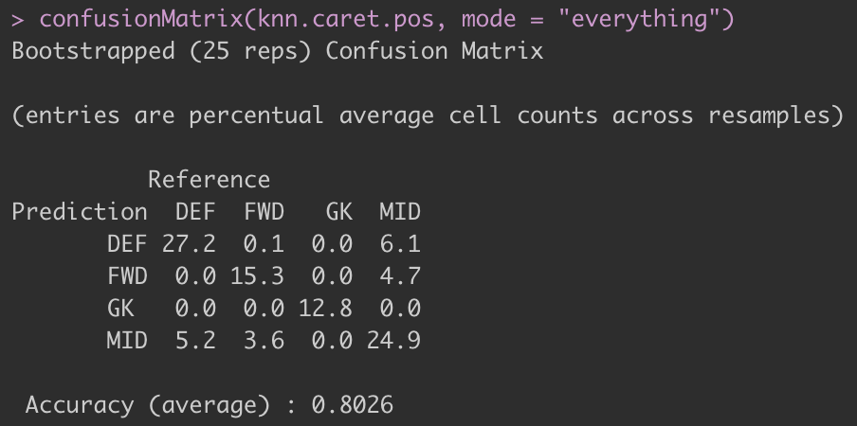
KNN Accuracy

Slide 14
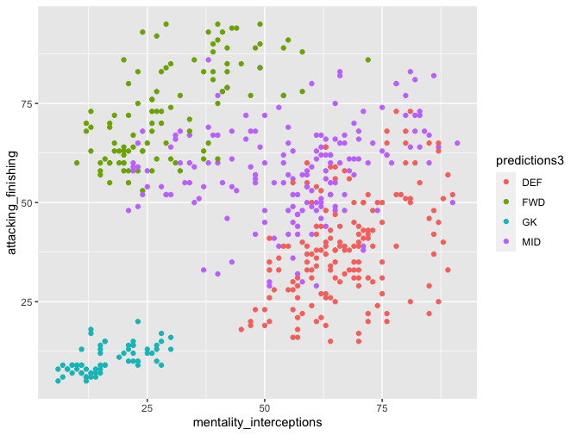
LDA Cluster “Interception” vs “Finishing”

Slide 15
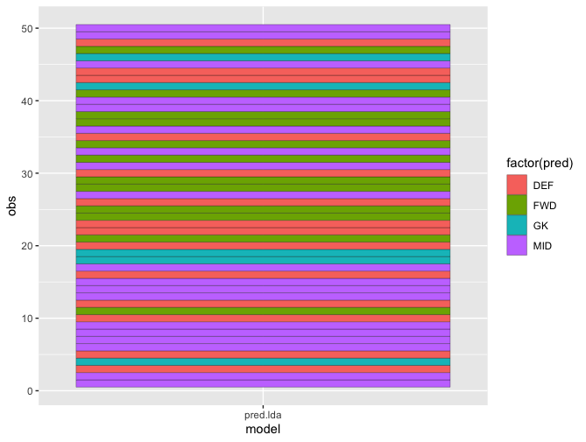
LDA Prediction

Slide 16
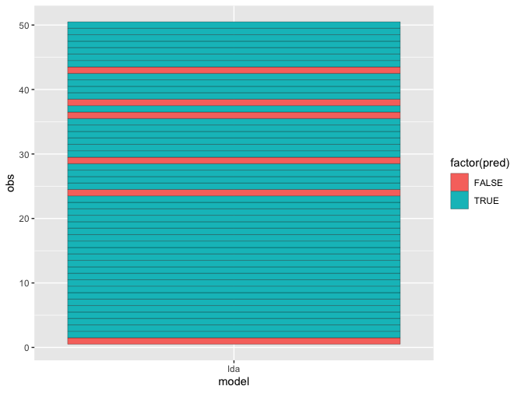
LDA Accuracy

Slide 17
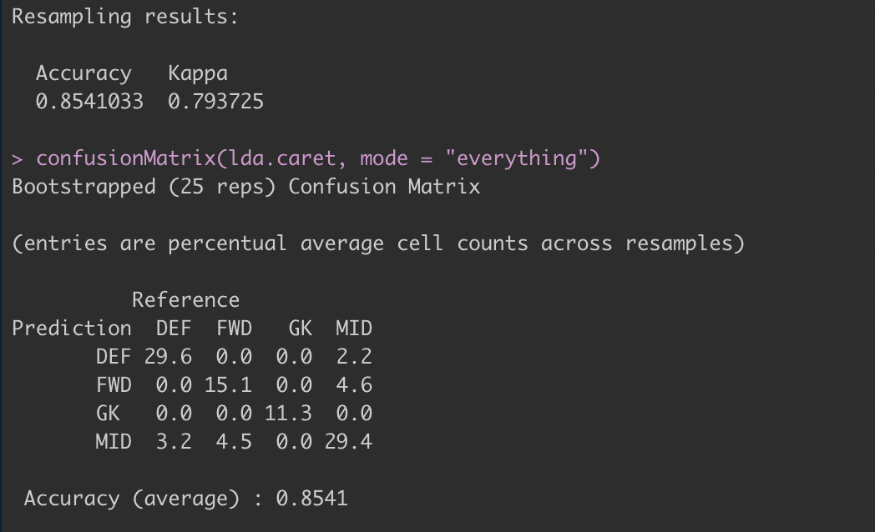
LDA Accuracy

Slide 18
Thank you
Bhavana Chikkamuduvadi Renuka Gowda
Sumanth Herohalli Umashankar
Karthik Shingte

