Slide 1


Mechanism Dynamics and Haptic Performance
Colin Gallacher
Supervisor:
Jozsef Kovecses

Slide 2
Course Introduction
Objectives:

Slide 3
Syllabus

Slide 4
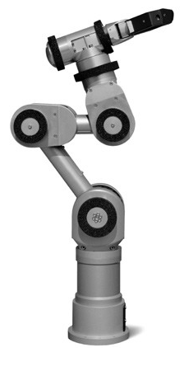
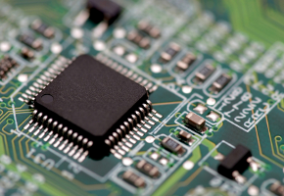
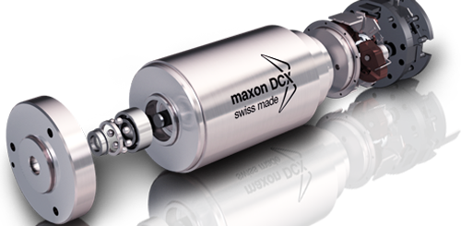
What is a Microcontroller

Slide 5
Touching Our World
Open packages

Slide 6
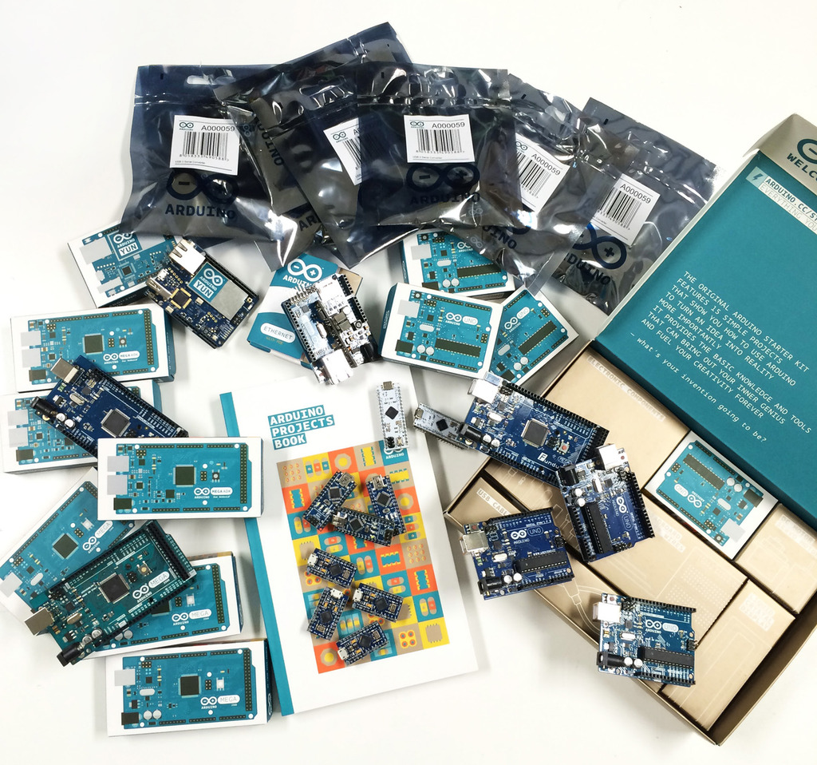
The Arduino

Slide 7
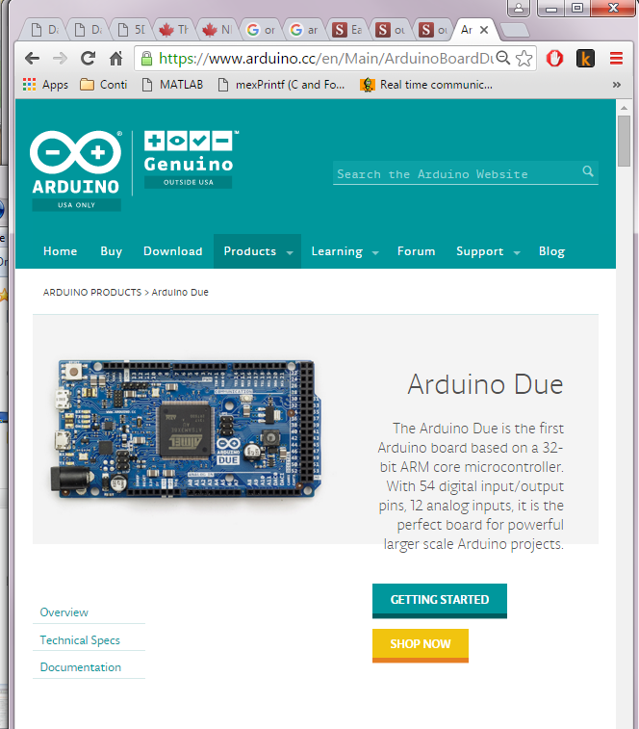

Slide 8
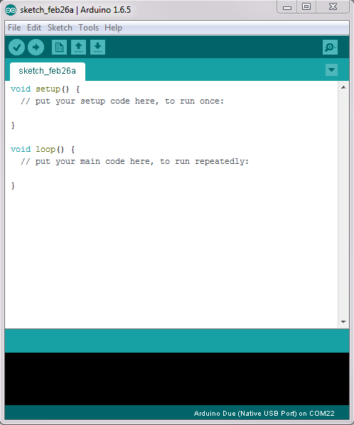
Arduino IDE
Download Arduino 1.6.5
Download Arduino DUE support
Check to make sure the drivers are installed
Check to see if boards can be flashed (teach steps)
Notes:
Create a Package for all the students to use
Walk through the creation of all the boards

Slide 9
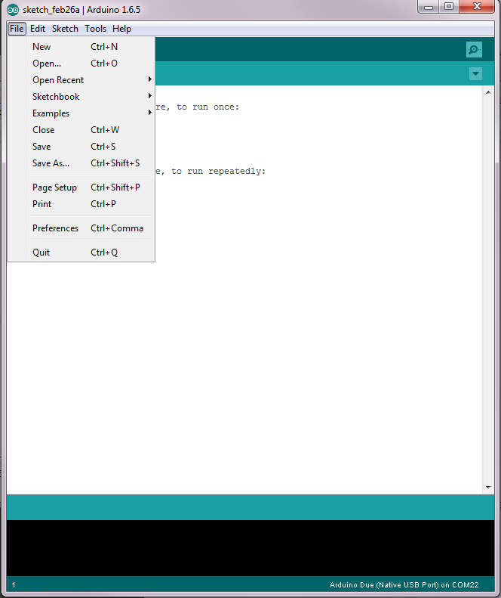
Arduino IDE
Download Arduino 1.6.5
Download Arduino DUE support
Download
Notes:
Create a Package for all the students to use
Walk through the creation of all the boards

Slide 10
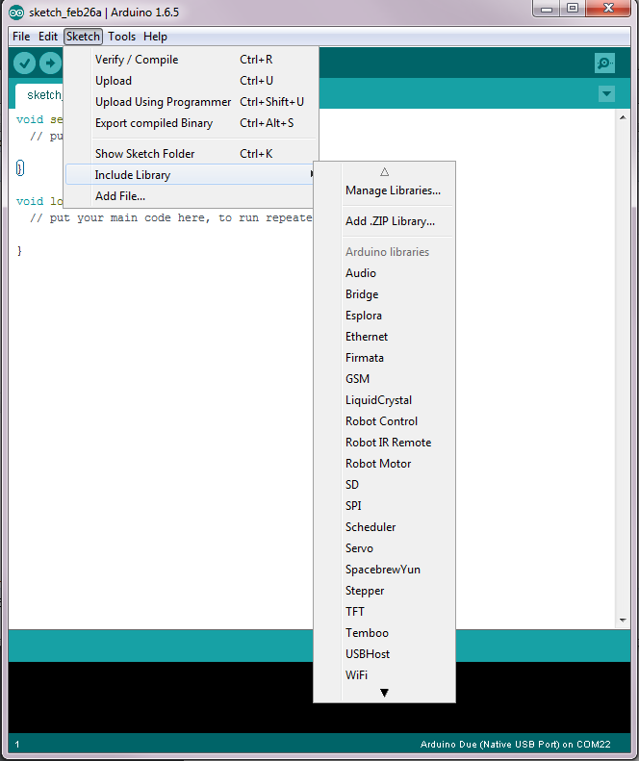

Slide 11
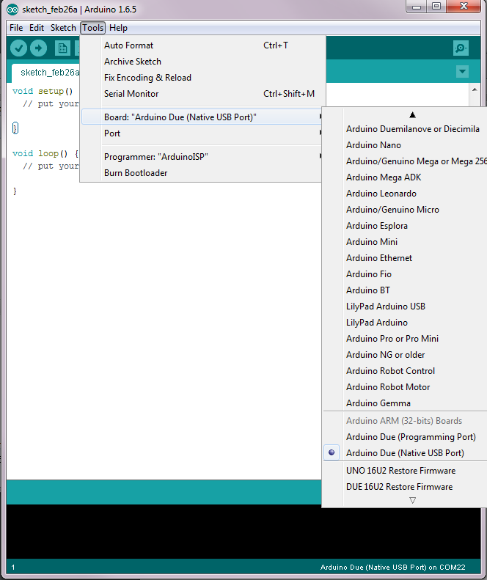

Slide 12
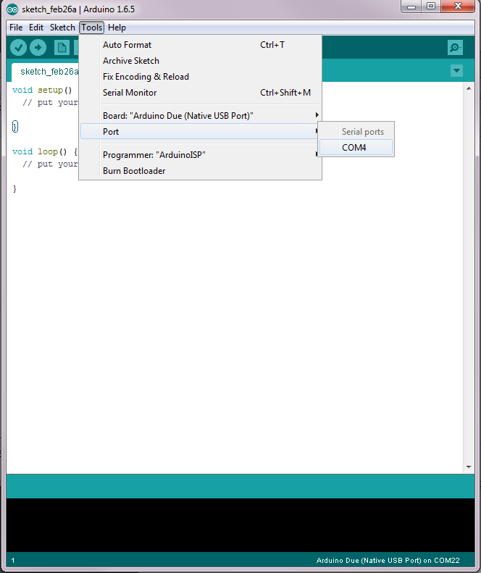

Slide 13
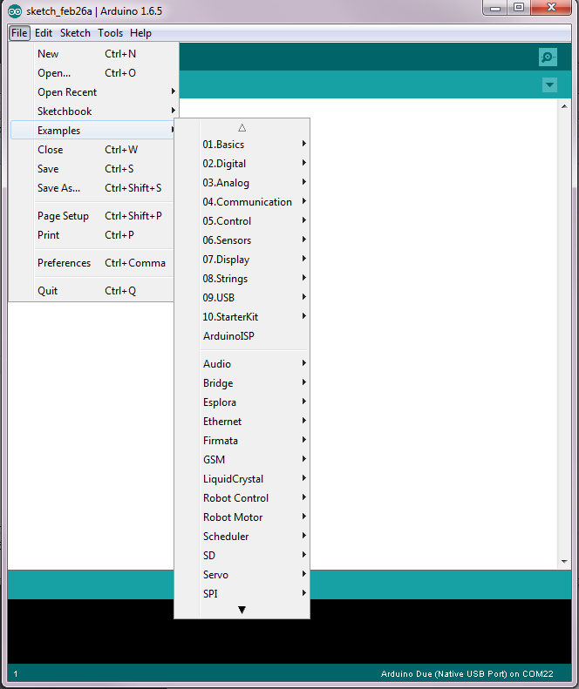

Slide 14
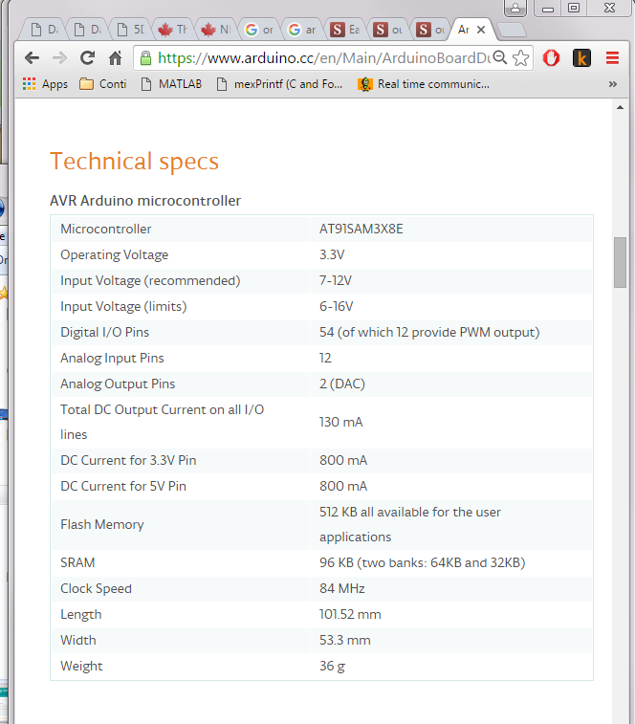

Slide 15
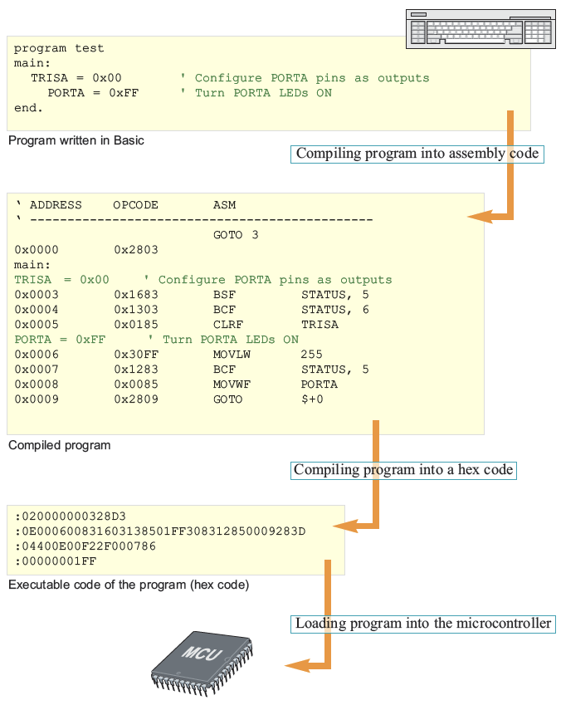
I Can ‘C’ Clearly Now
What happens when we program a microcontroller?

Slide 16
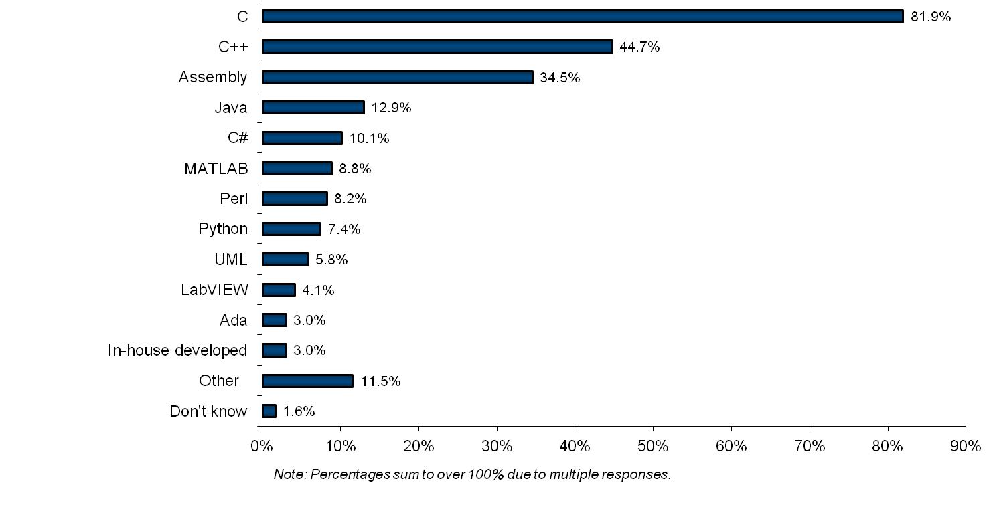
Embedded System Languages
VDC survey of embedded developers

Slide 17
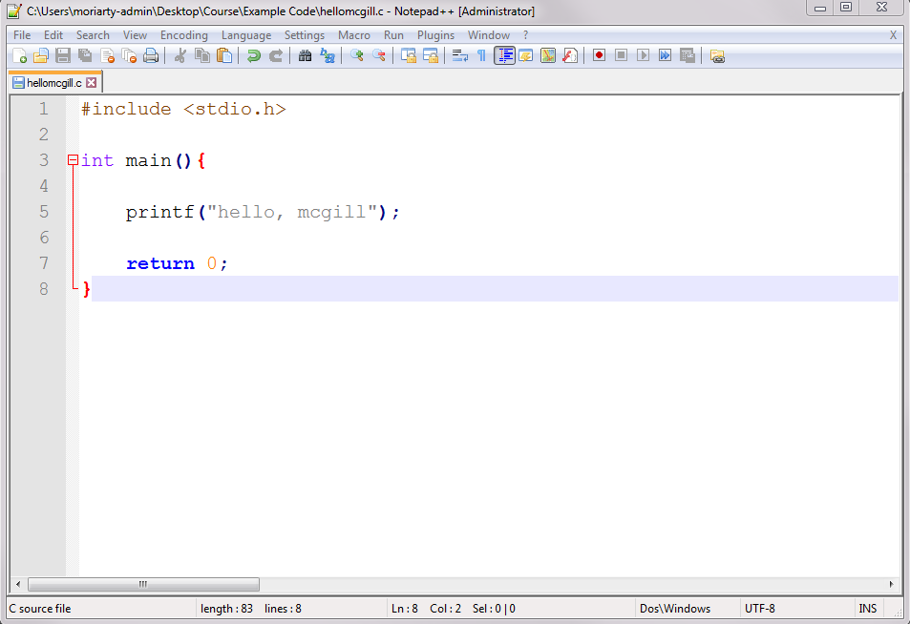
I Can ‘C’ Clearly Now
C(and C++) is a system level language (i.e. can run on your microprocessor with no additional support)
C is available for almost all microcontroller architectures

Slide 18
Arduino’s Flavor of C

Slide 19
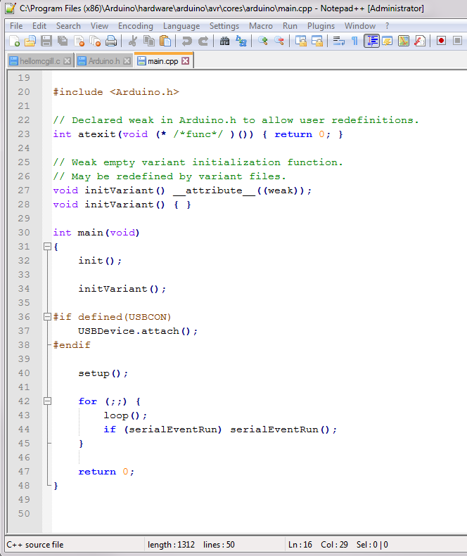
Arduino’s Flavor of C

Slide 20

Libraries and APIs
What is a Programming Library?
A library in C is a group of functions and declarations, exposed for use by other programs
API?
Application Programming Interface

Slide 21
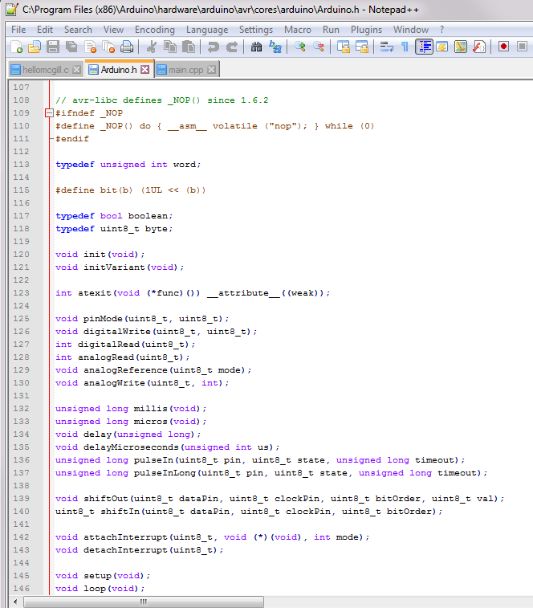
Libraries and APIs
The Arduino Standard Library
Header file:
Arduino.h
Creates ‘wrappers’ that are easy to use commands that control the board

Slide 22
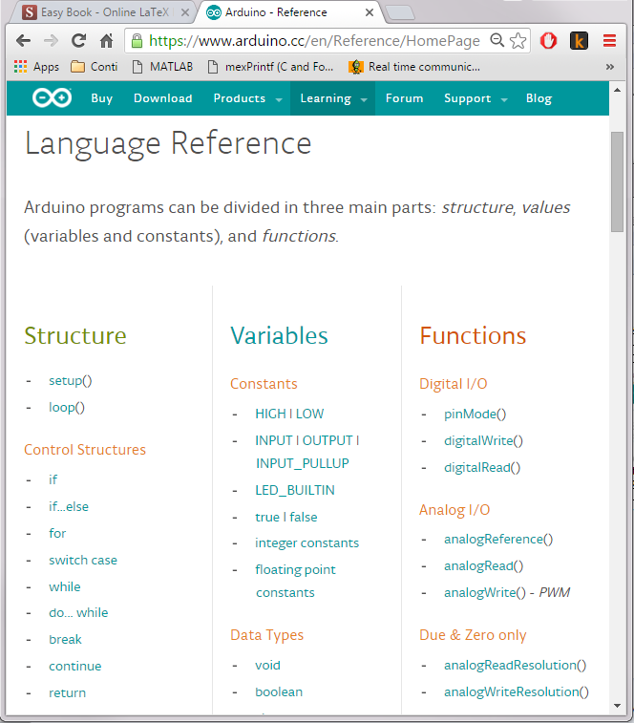
Standard Arduino Library
Includes a bunch of basic functionality to control the Arduino board.

Slide 23
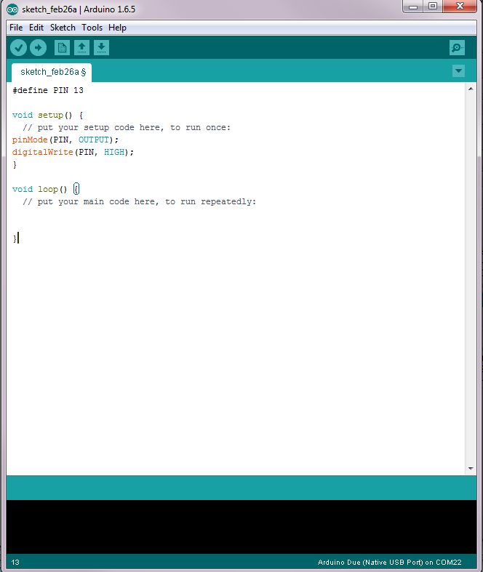
Example: Our First Program
Step 1: Turn on the light

Slide 24
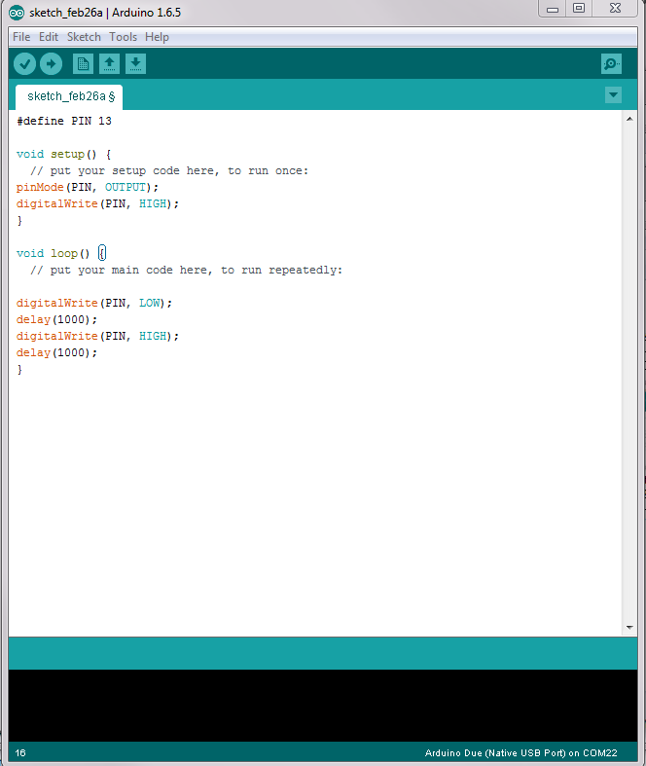
Example: Our First Program
Step 2: Make it Blink!
Question: Why might we not want to use a delay?

Slide 26
Debugging with Arduino

Slide 27
Example: Our First Program
Steps: 1

Slide 28
Example: Our First Program
Steps: 1

Slide 29
Example: Multiple LEDs

Slide 30
Data Sheet and Circuit Diagram

Slide 31
Example: Reading And Writing

Slide 32
Motivation: Domo Arigoto

Slide 33
Sensing

Slide 34
Encoders

Slide 35
Example: Reading Positions

Slide 36
Actuation

Slide 37
DC Motor

Slide 38
Example: Motor Velocity

Slide 39
Control

Slide 40
PD Controller

Slide 41
Hapkit sketch

Slide 42
3D Printing and Homework

