Slide 1


Mechanism Dynamics and Haptic Performance
Colin Gallacher
Supervisor:
Jozsef Kovecses

Slide 2
Course Introduction
Objectives:

Slide 3
Syllabus

Slide 4
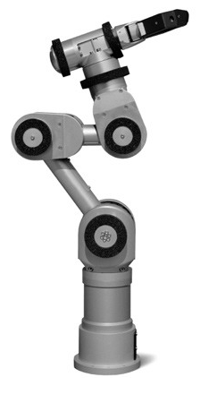
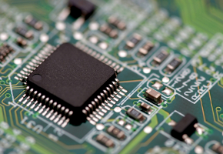

What is a Microcontroller

Slide 5
Touching Our World
Open packages

Slide 6
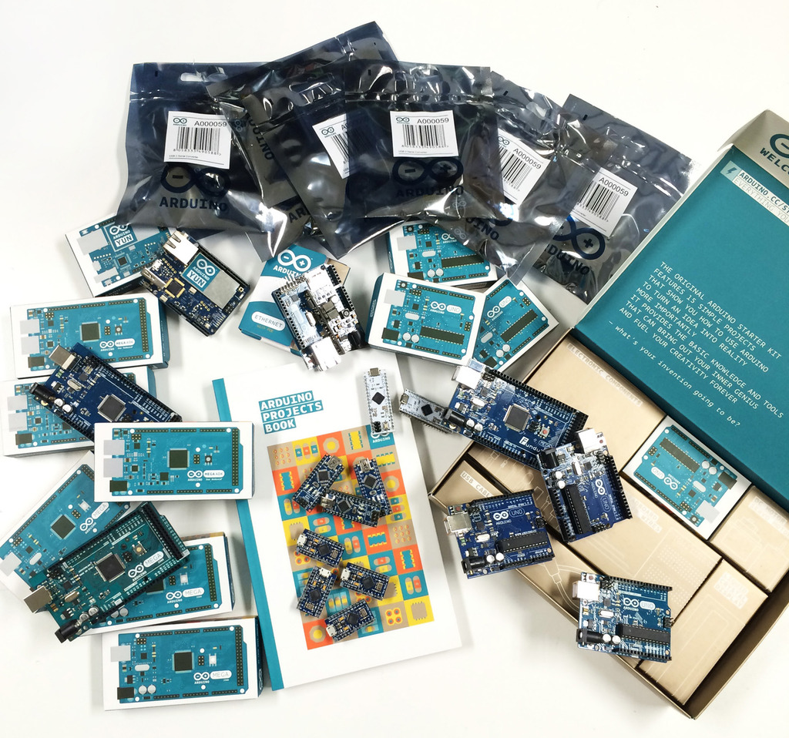
The Arduino

Slide 7
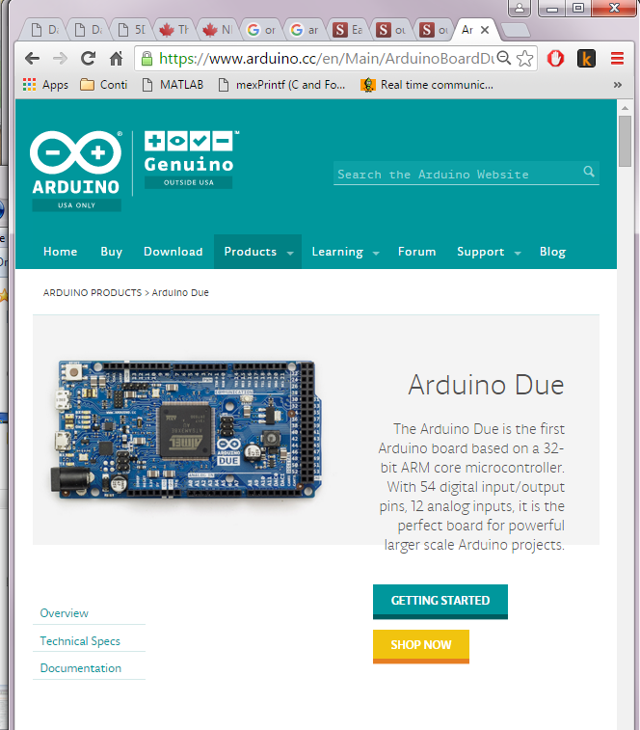

Slide 8
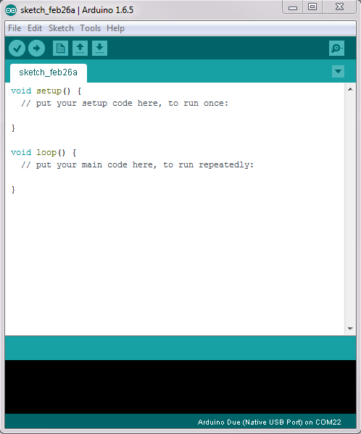
Arduino IDE
Download Arduino 1.6.5
Download Arduino DUE support
Check to make sure the drivers are installed
Check to see if boards can be flashed (teach steps)
Notes:
Create a Package for all the students to use
Walk through the creation of all the boards

Slide 9
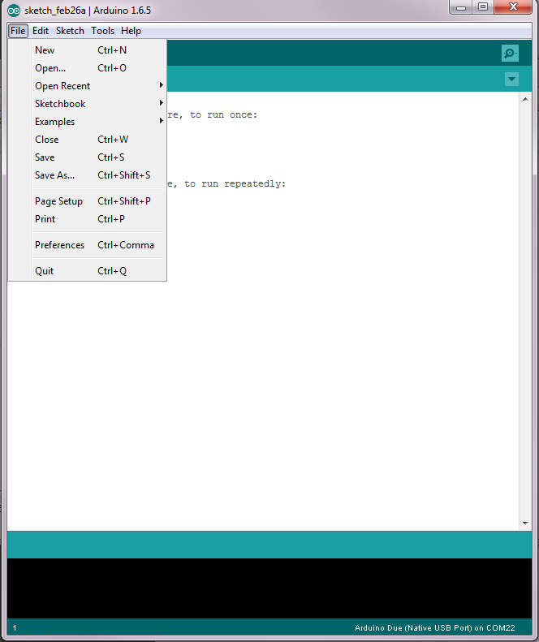
Arduino IDE
Download Arduino 1.6.5
Download Arduino DUE support
Download
Notes:
Create a Package for all the students to use
Walk through the creation of all the boards

Slide 10
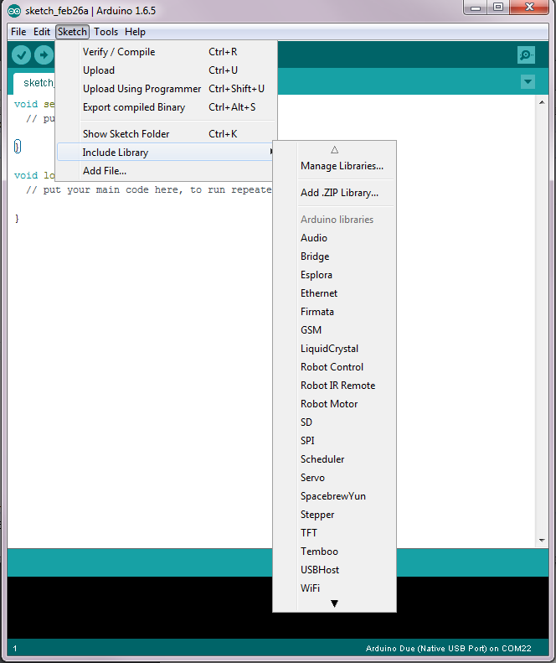

Slide 11
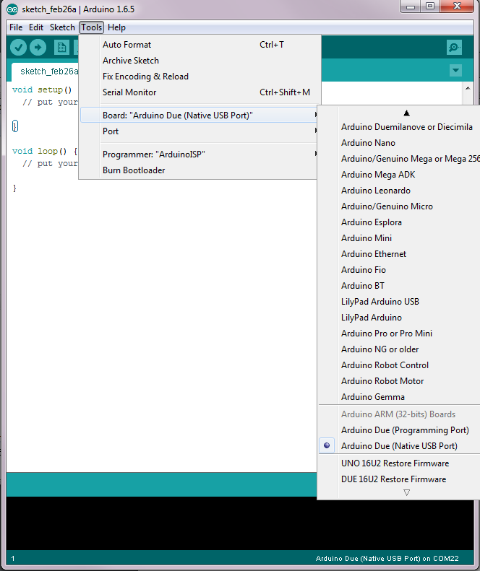

Slide 12
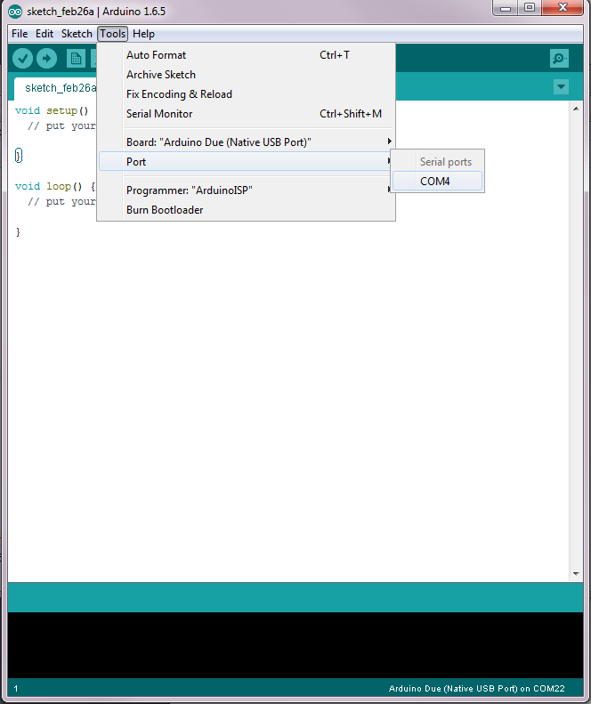

Slide 13
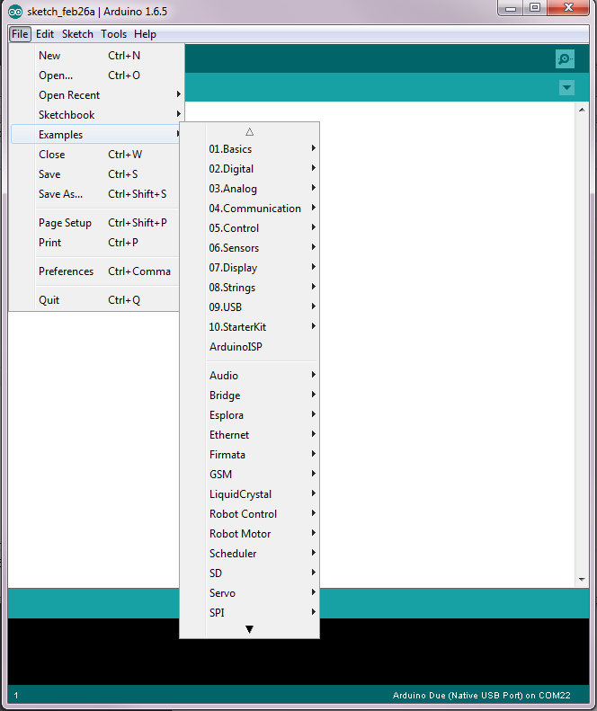

Slide 14
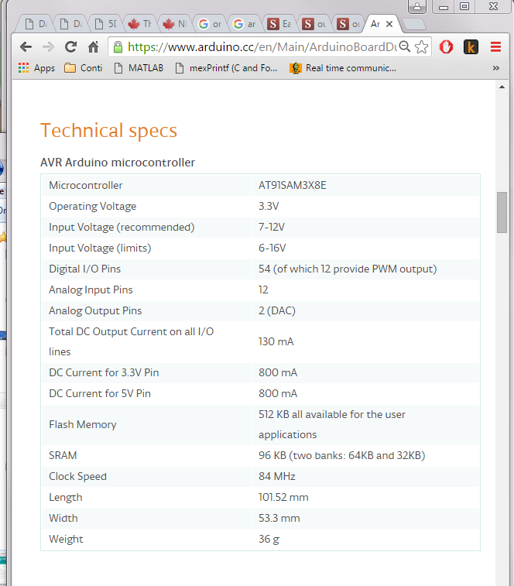

Slide 15
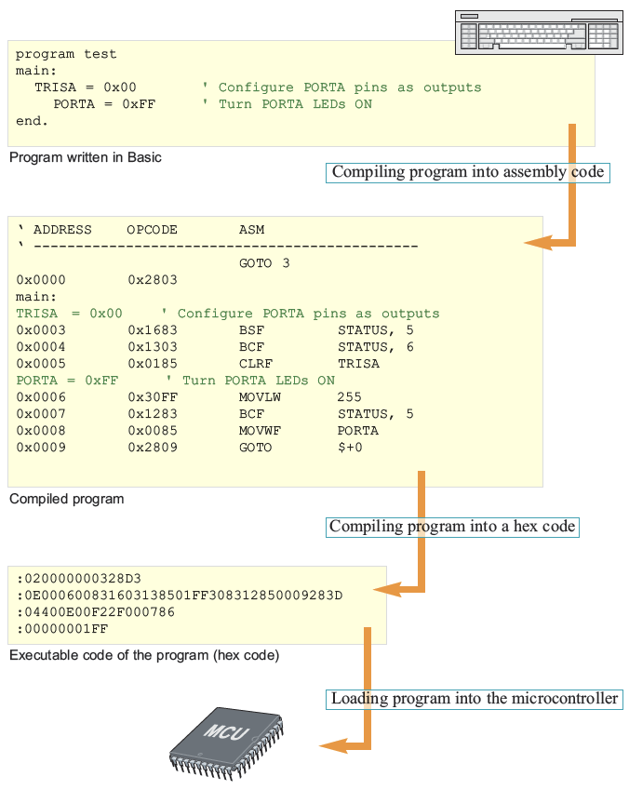
I Can ‘C’ Clearly Now
What happens when we program a microcontroller?

Slide 16
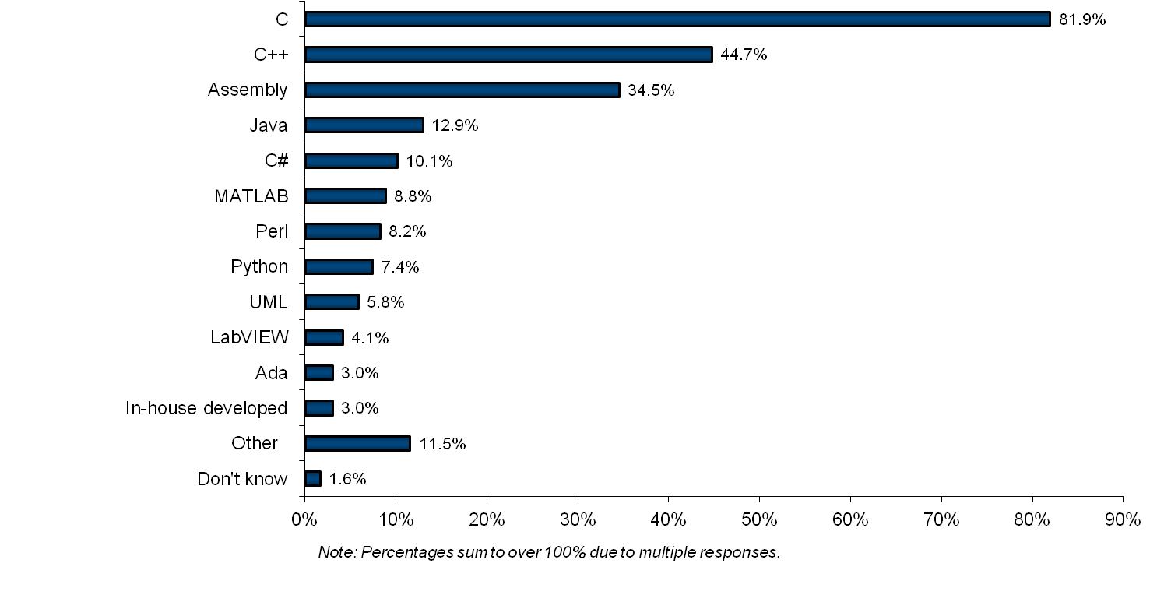
Embedded System Languages
VDC survey of embedded developers

Slide 17
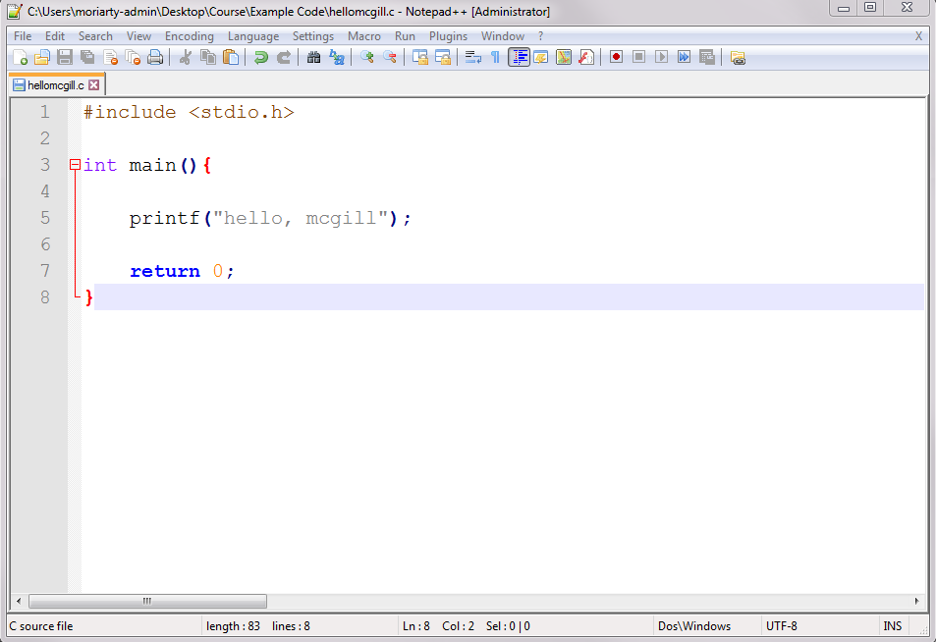
I Can ‘C’ Clearly Now
C(and C++) is a system level language (i.e. can run on your microprocessor with no additional support)
C is available for almost all microcontroller architectures

Slide 18
Arduino’s Flavor of C

Slide 19
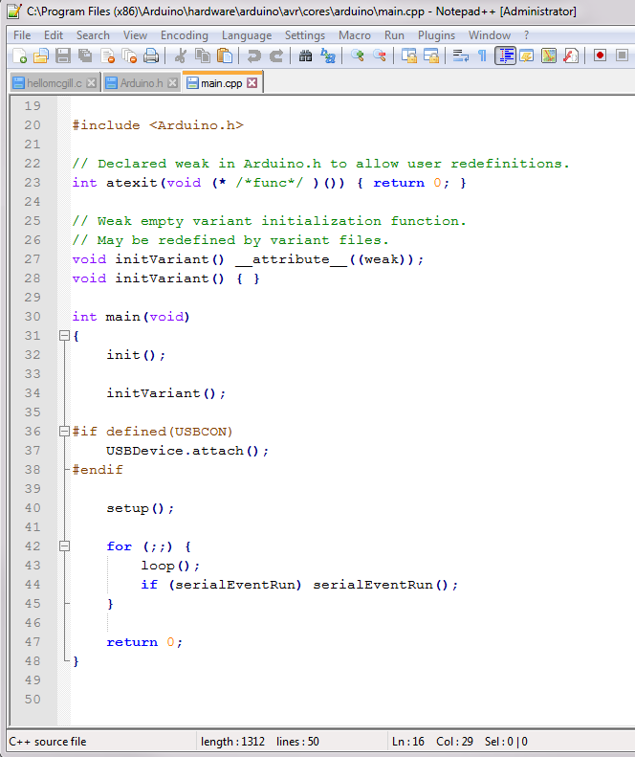
Arduino’s Flavor of C

Slide 20

Libraries and APIs
What is a Programming Library?
A library in C is a group of functions and declarations, exposed for use by other programs
API?
Application Programming Interface

Slide 21
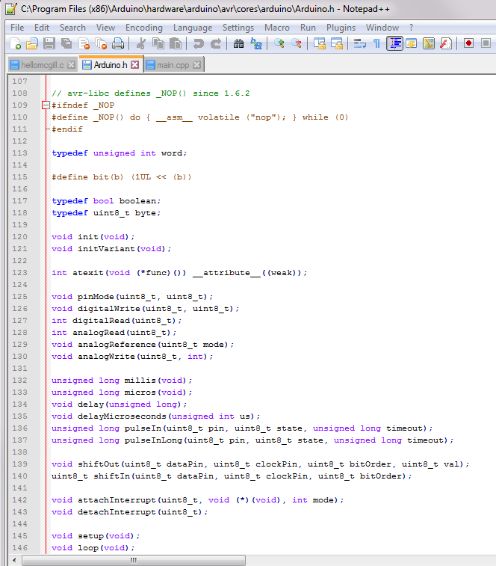
Libraries and APIs
The Arduino Standard Library
Header file:
Arduino.h
Creates ‘wrappers’ that are easy to use commands that control the board

Slide 22
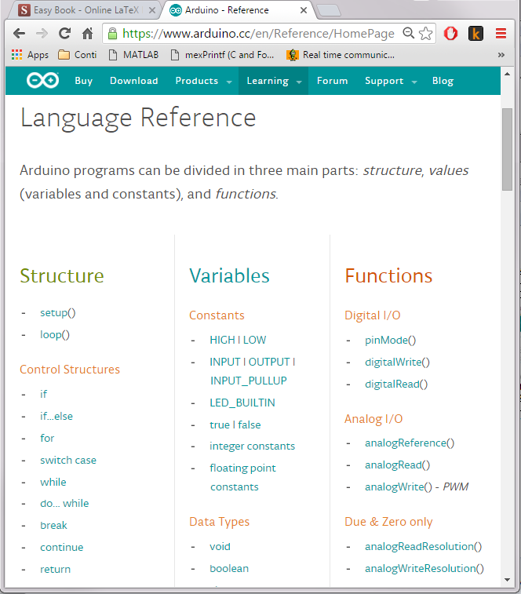
Standard Arduino Library
Includes a bunch of basic functionality to control the Arduino board.

Slide 23
Data
Bit
Nibble
Byte
Word (chomp)
Are these specific to the machine? No this is what the 8 bit vs 16 bit vs 32 bit vs 64 bit means

Slide 24
Data Structures: Archatechture
byte
char
int
word
uint8_t
uint16_t

Slide 25
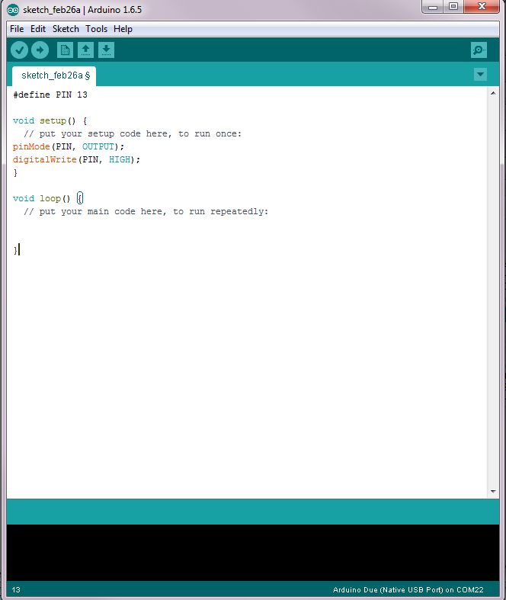
Example: Our First Program
Step 1: Turn on the light
1.0

Slide 26
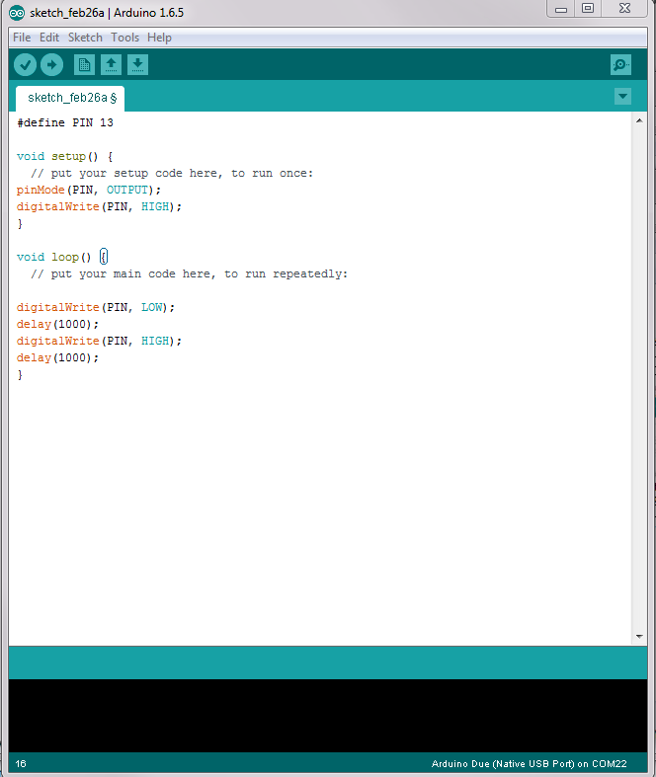
Example: Our First Program
Step 2: Make it Blink!
1.1
Question: Why might we not want to use a delay?

Slide 27
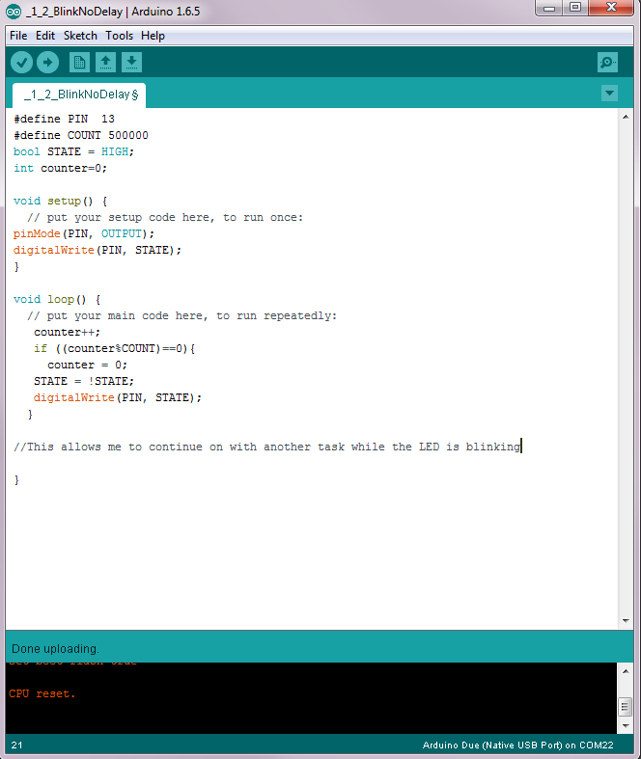
1.2

Slide 28

Debugging with Arduino
Use Serial Port
What is Serial Communication?
Communication through the tin cans

Slide 29
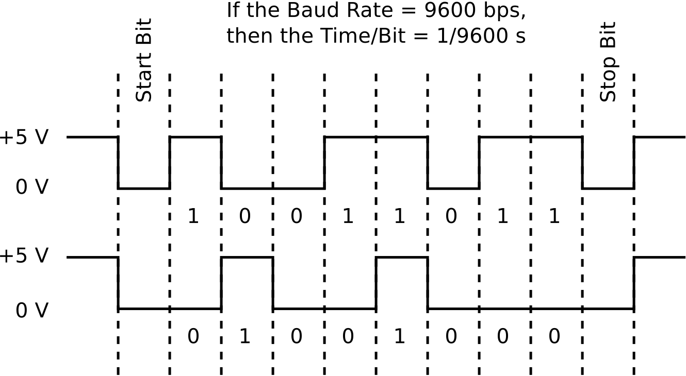
Debugging with Arduino
Use Serial Port
What is Serial Communication?
Communication through the tin cans

Slide 30
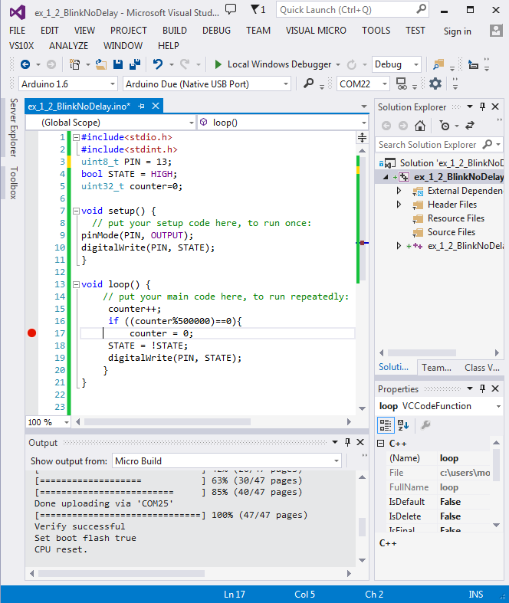
Additional Options
Visual Micro

Slide 31
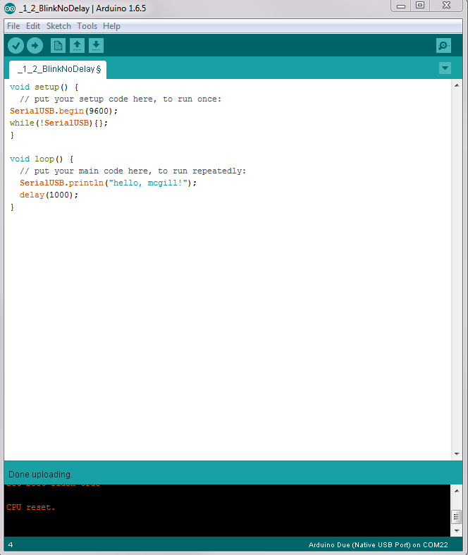
Example: Our First Program
Steps: 1
2.0

Slide 32
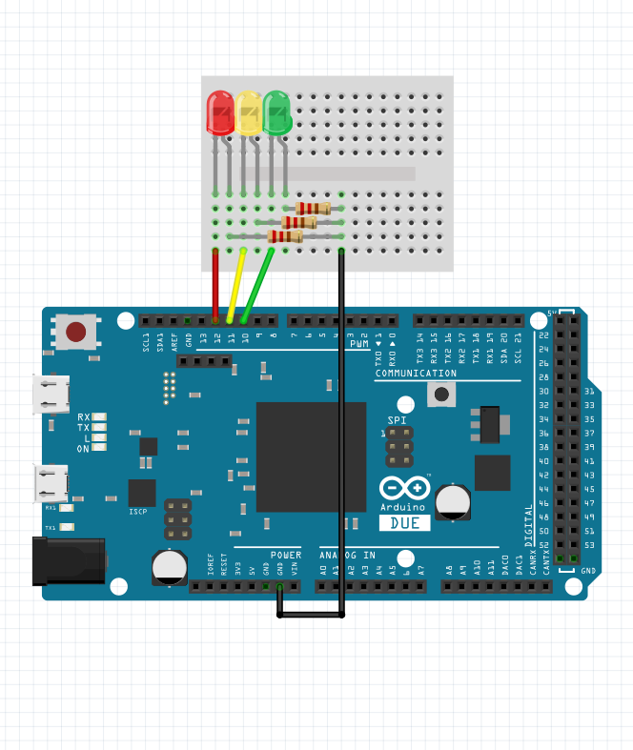
Example: Debug Multiple LEDs
2.1

Slide 33
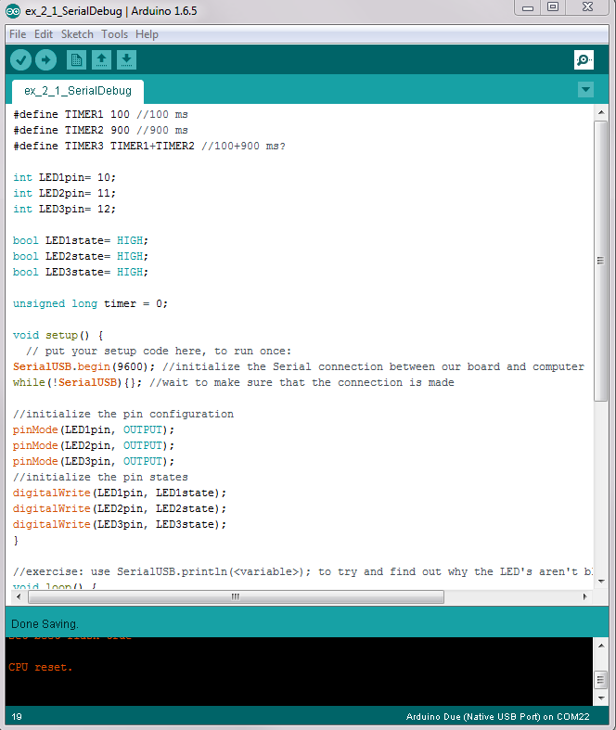
Example: Debug Multiple LEDs
2.1

Slide 34
Data Sheet and Circuit Diagram

Slide 35
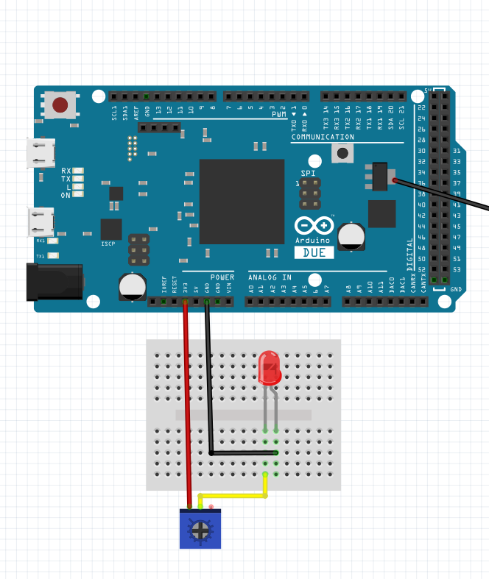
Example: Reading And Writing
3.0

Slide 36
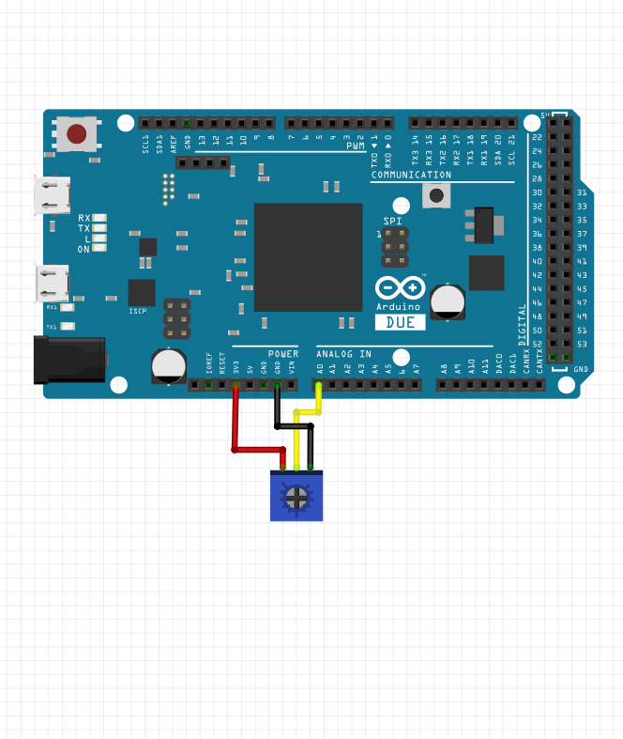
Example: Reading And Writing
3.1

Slide 37
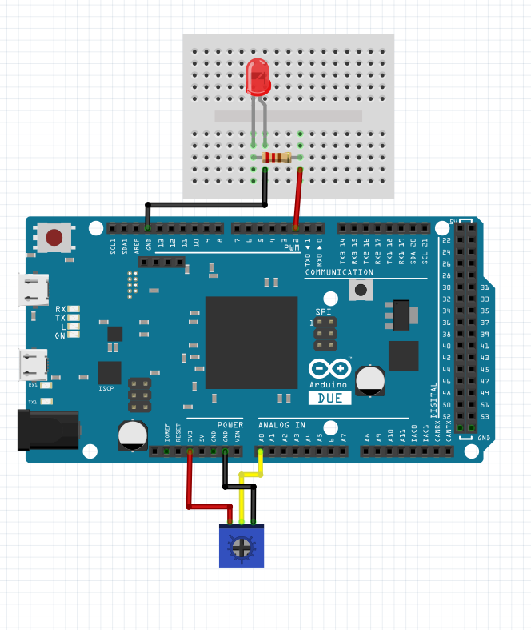
Example: Reading And Writing
3.2

Slide 38
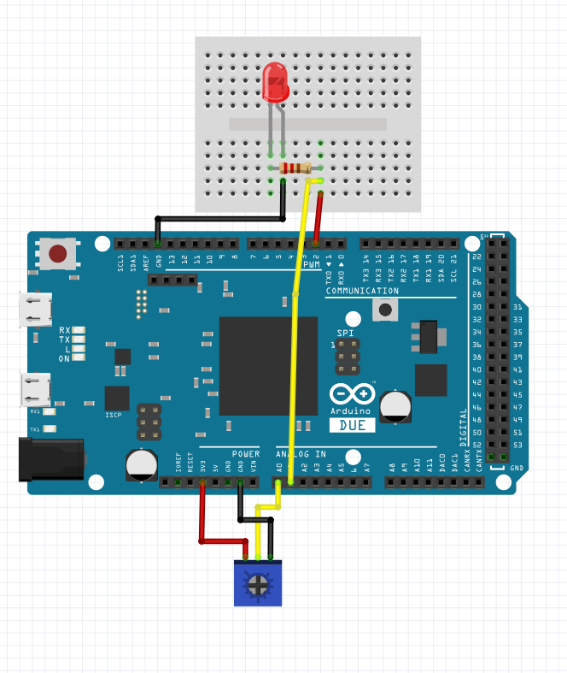
Example: Reading And Writing
3.3

Slide 39
Example: Reading And Writing
3.4

Slide 40
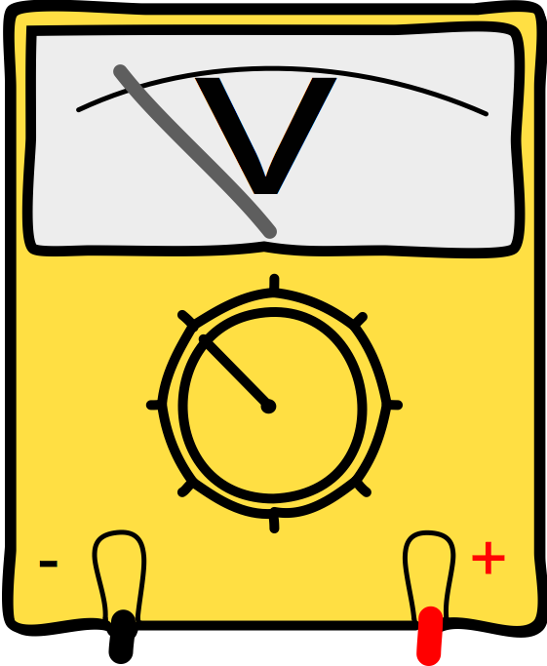
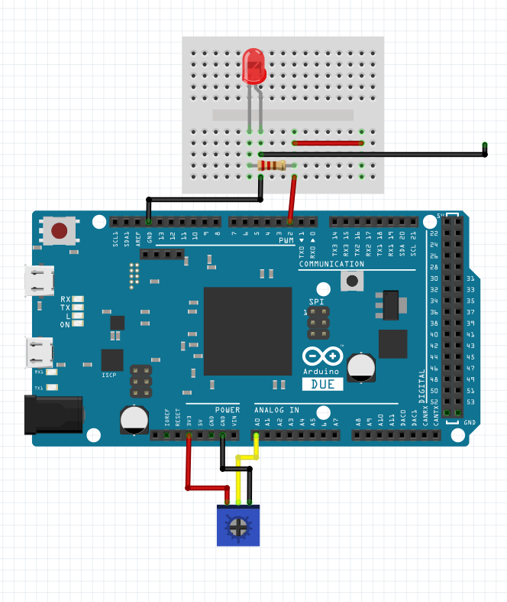
3.5

Slide 41
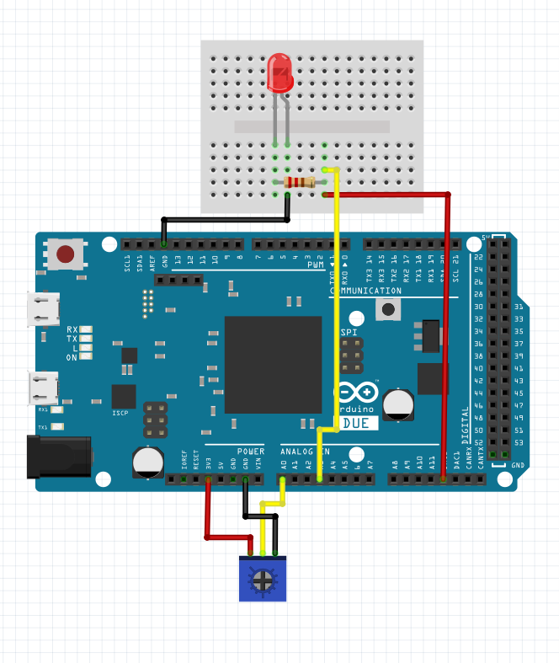
3.6

Slide 42
Motivation: Domo Arigoto

Slide 43
Sensing

Slide 44
Encoders

Slide 45
Example: Reading Positions
4.0

Slide 46
Actuation

Slide 47
DC Motor

Slide 48
Example: Motor Velocity
5.0

Slide 49
Control

Slide 50
PD Controller
6.0

Slide 51
Hapkit sketch
7.0

Slide 52
3D Printing and Homework

