Slide 1
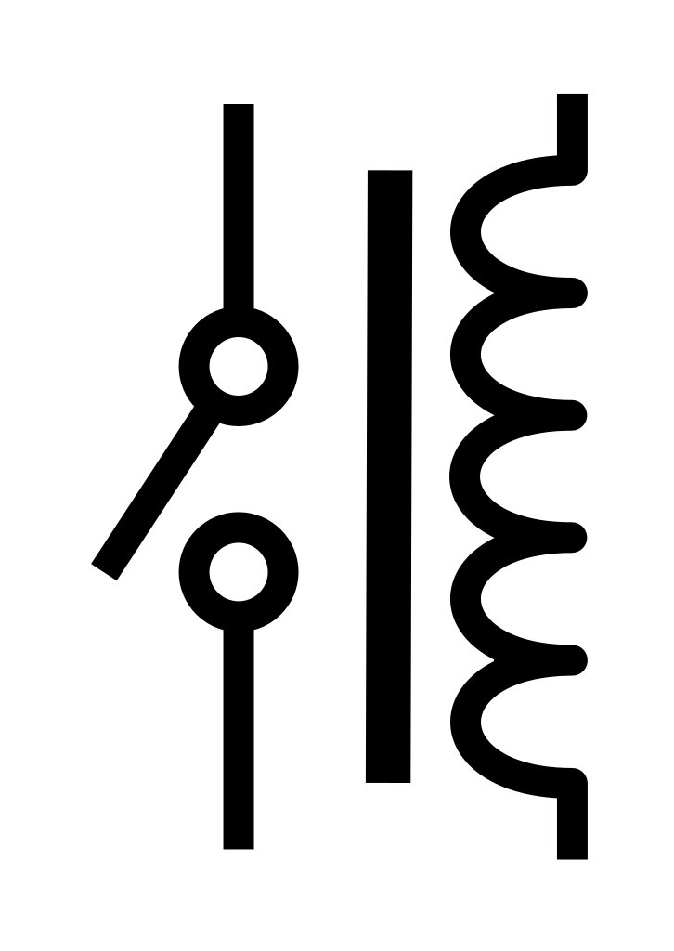
Label
N L R1 R2 R3 R4 L1 L2 L3 L4
Max consumption: 500mA

