Slide 1
Bloomberg Businessweek’s College Rankings - 2021
Tural Sadigov

Slide 2
Question of interest
Can we reproduce Bloomberg Businessweek’s MBA college ranking?
Dr. Anjani Jain (Yale)

Slide 3
Bloomberg data & methodology - 2021 ranking
119 MBA program (we will look at the first 84)
Five variables: Compensation, Learning, Networking, Entrepreneurship, Diversity
Weights for the categories are crowd-sourced
Surveys: students, alumni, recruiters
Key claim: It is intentionally not reproducible!

Slide 4
Data collection and variable creation
Survey - each variable: 1-7
Raw scores weighted
Weighted sum: 1-7
Weighted sum is scaled to 0 - 100 (‘normalized’)
Minimum –> 0, Maximum –> 100
Transformation: $T\left(x\right)=\frac{100}{x_{\left(n\right)}−x_{\left(1\right)}}\left(x−x_{\left(1\right)}\right)$
Crowd-sourced weights are
## Compensation Learning Networking Entrepreneurship ## 0.357 0.258 0.178 0.120 ## Diversity ## 0.086

Slide 5
Toy example - do transformations as Businnessweek
## Comp Lear Comp_weigthed Lear_weighted w_sum scaled_w_sum ## 2 5 1.2 2.0 3.2 0.00000 ## 3 6 1.8 2.4 4.2 83.33333 ## 4 5 2.4 2.0 4.4 100.00000
## Compensation Learning ## 0.6 0.4
## Variance of Compensation is 1
## Variance of Learning is 0.3333333

Slide 6
Toy example - do transformations differently
## Comp Lear Comp_scaled Lear_scaled Comp_weigthed Lear_weighted w_sum ## 2 5 0 0 0 0 0 ## 3 6 50 100 30 40 70 ## 4 5 100 0 60 0 60
## Compensation Learning ## 0.6 0.4
## Variance of Scaled Compensation is 2500
## Variance of Scaled Learning is 3333.333

Slide 7
Toy example - do transformations as Businnessweek but use z-scores instead
## Comp Lear Comp_z Lear_z Comp_weigthed Lear_weighted w_sum ## 2 5 -1 -0.5773503 -0.6 -0.2309401 -0.8309401 ## 3 6 0 1.1547005 0.0 0.4618802 0.4618802 ## 4 5 1 -0.5773503 0.6 -0.2309401 0.3690599 ## scaled_w_sum ## 0.00000 ## 100.00000 ## 92.82032
## Compensation Learning ## 0.6 0.4
## Variance of Variable Z-score is always 1

Slide 8
Dataset
## Rank School Overall.score Compensation Learning ## 1 Stanford 100 100.0 74.8 ## 2 Dartmouth (Tuck) 92 97.3 69.0 ## 3 Harvard 89 94.9 55.4 ## 4 Chicago (Booth) 88 94.5 59.6 ## 5 Northwestern (Kellogg) 88 94.3 59.0 ## 5 Columbia 85 93.1 56.8

Slide 9
Transformation $T$ is not 1-1
## x Tx ## 1 0 ## 2 50 ## 3 100
## x Tx ## 2 0 ## 3 50 ## 4 100

Slide 10
Dr. Jain’s main point
Transformation from 1-7 to 0-100 is linear (but he meant affine, not linear).
$$T\left(x\right)=\frac{100}{x_{\left(n\right)}−x_{\left(1\right)}}\left(x−x_{\left(1\right)}\right)$$
$$Z\left(x\right)=\frac{x−μ_{x}}{σ_{X}}$$
Dr. Jain’s claim:
$$Z\left(T\left(x\right)\right)=Z\left(x\right)$$
Let’s see if that is correct.

Slide 11
Proof of Dr.Jain’s claim
For $a>0$,
$$Z\left(ax\right)=\frac{ax−μ_{ax}}{σ_{ax}}=\frac{ax−aμ_{x}}{aσ_{x}}=Z\left(x\right)$$
and for any $c∈R$,
$$Z\left(x+c\right)=\frac{x+c−μ_{x+c}}{σ_{x+c}}=\frac{x+c−μ_{x}−c}{σ_{x}}=Z\left(x\right)$$
Thus,
$$Z\left(T\left(x\right)\right)=Z\left(\frac{100}{x_{\left(n\right)}−x_{\left(1\right)}}\left(x−x_{\left(1\right)}\right)\right)=Z\left(x−x_{\left(1\right)}\right)=Z\left(x\right)$$

Slide 12
Dr. Jain’s main point is CORRECT.
“If the published ‘normalized scores’ on each index are simply a 0-100 linear re-scaling of the 1-7 raw data, as BBW’s email response indicates, then the published index scores can still be standardized before applying the index weights to them.”
We hope to have this:
$$x_{i}→Z\left(x_{i}\right)→w_{i}Z\left(x_{i}\right)→\sum_{i=1}^{5}{w_{i}}Z\left(x_{i}\right)→T\left(\sum_{i=1}^{5}{w_{i}}Z\left(x_{i}\right)\right)$$
$$\left(1,7\right)→\left(−3,3\right)→\left(−3w,3w\right)→\left(−3,3\right)→\left(0,100\right)$$
But, we only have scaled data (in the range of 0-100)

Slide 13
Dataset
## Rank School Overall.score Compensation Learning ## 1 Stanford 100 100.0 74.8 ## 2 Dartmouth (Tuck) 92 97.3 69.0 ## 3 Harvard 89 94.9 55.4 ## 4 Chicago (Booth) 88 94.5 59.6 ## 5 Northwestern (Kellogg) 88 94.3 59.0 ## 5 Columbia 85 93.1 56.8

Slide 14
One can still standartize
$$T\left(x_{i}\right)→Z\left(T\left(x_{i}\right)\right)=Z\left(x_{i}\right)$$
$$Z\left(x_{i}\right)→w_{i}Z\left(x_{i}\right)→\sum_{i=1}^{5}{w_{i}}Z\left(x_{i}\right)→T\left(\sum_{i=1}^{5}{w_{i}}Z\left(x_{i}\right)\right)$$

Slide 15
Step back: understanding data at hand - correlation matrix
MLR will NOT give accurate estimates of true weights

Slide 16
Standartized columns
## Compensation Learning Networking Entrepreneurship Diversity ## 1 1.754545 1.3245506 1.563697 2.6702624 0.79422338 ## 2 1.649915 1.0365380 1.269983 0.3435291 0.76657341 ## 3 1.556910 0.3611981 1.036740 0.9375887 0.76657341 ## 4 1.541409 0.5697590 1.174958 1.2346185 0.11679917 ## 5 1.533659 0.5399645 1.399563 0.6405589 0.22739904 ## 6 1.487156 0.4307184 1.235429 0.7890738 0.02924094

Slide 17
Weighted sum and ranking accorDing to BB weights
## w_sum w_sum_normalized my_rank BB_rank ## 1 1.635180 100 1 1 ## 2 1.189652 87 2 2 ## 3 1.011982 82 5 3 ## 4 1.064622 84 3 4 ## 5 1.032373 83 4 5 ## 6 0.959150 81 6 5

Slide 18
Compare rankings
## my_rank BB_rank ## 1 1 1 ## 2 2 2 ## 3 5 3 ## 4 3 4 ## 5 4 5 ## 41 32 39 ## 42 54 42 ## 43 49 42 ## 44 50 44 ## 45 47 44 ## 80 71 77 ## 81 83 81 ## 82 70 81 ## 83 82 83 ## 84 84 84

Slide 19
How many schools have ranking error of more than 3? 5? 10?
## # of schools with ranking error of more than three is 56
## # of schools with ranking error of more than five is 46
## # of schools with ranking error of more than ten is 26

Slide 20
Can we back-engineer the weights? Apply Multiple Linear Regression without intercept
## pr_weights MLR_weights ## Compensation 0.357 0.73089644 ## Learning 0.258 0.10019383 ## Networking 0.178 0.02435713 ## Entrepreneurship 0.120 0.04766022 ## Diversity 0.086 0.06960378
## the sum of the coefficents = 0.9727114
## R square = 0.9945974
## Adjusted R square = 0.9942555

Slide 21
Dr. Jain: “a constrained optimization model that minimizes variances from the published ranking”
Model
$$y=w_{1}x_{1}+w_{2}x_{2}+w_{3}x_{3}+w_{4}x_{4}+w_{5}x_{5}+ϵ$$
with i​wi=1 and $w_{i}≥0$. Then minimize
i​yi−w1x1+w2x2+w3x3+w4x4+w5x52

Slide 22
Back-engineered weights through constrained optimization
## pr_weights const_weights ## Compensation 0.357 0.73752838 ## Learning 0.258 0.11863455 ## Networking 0.178 0.00000000 ## Entrepreneurship 0.120 0.07090125 ## Diversity 0.086 0.07293583

Slide 23
LASSO model
## R square is 0.999972
## lasso_weights pr_weights ## Compensation 0.66477615 0.357 ## Learning 0.05277052 0.258 ## Networking 0.11859931 0.178 ## Entrepreneurship 0.02655805 0.120 ## Diversity 0.06846675 0.086

Slide 24
Compare many models
## pr_weights Jain_weights lasso_weights const_weights ## Compensation 0.357 0.5850 0.66477615 0.73752838 ## Learning 0.258 0.0770 0.05277052 0.11863455 ## Networking 0.178 0.1050 0.11859931 0.00000000 ## Entrepreneurship 0.120 0.0790 0.02655805 0.07090125 ## Diversity 0.086 0.1538 0.06846675 0.07293583 ## MLR_weights ## Compensation 0.73089644 ## Learning 0.10019383 ## Networking 0.02435713 ## Entrepreneurship 0.04766022 ## Diversity 0.06960378

Slide 25
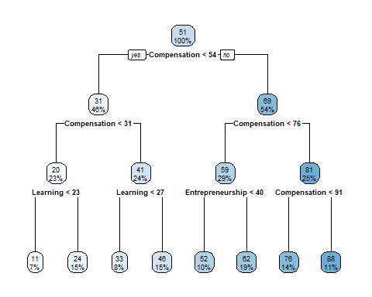
Decision Tree

Slide 26
Decision Tree - important variables
## m1$variable.importance perc provided_weights ## Compensation 41847.861 0.40381234 0.357 ## Networking 26733.308 0.25796395 0.178 ## Learning 12846.825 0.12396587 0.258 ## Entrepreneurship 12446.811 0.12010593 0.120 ## Diversity 9757.146 0.09415191 0.086

Slide 27
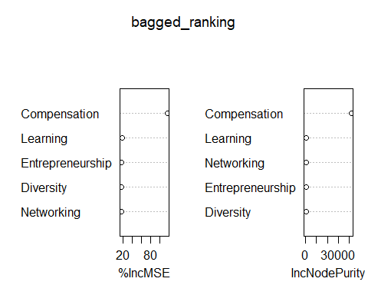
Bagged (Bootstrap Aggregated) model - important variables

Slide 28
Conclusion
Few possibilities
BB did not standardize the data (2018, 2019, 2020, 2021)
Weights provided were not the true weights used
Methodology is not accurately described
Provided data is not accurate
What else?

