Slide 1
Introduction to Spacecraft Simulation
‘Chris Gnam

Slide 2
Overview
Reference Frames and Coordinate Systems
State Space Overview
Orbits Overview
Perturbations/Cowell’s Method
Rotations Overview
Quaternions/Rotational Dynamics
Actuators
Reaction Wheels/Magnetic Torquers
Sensors
GPS/Gyros/Magnetometers/Star Trackers
Basic GNC Algorithms
Simulating

Slide 3
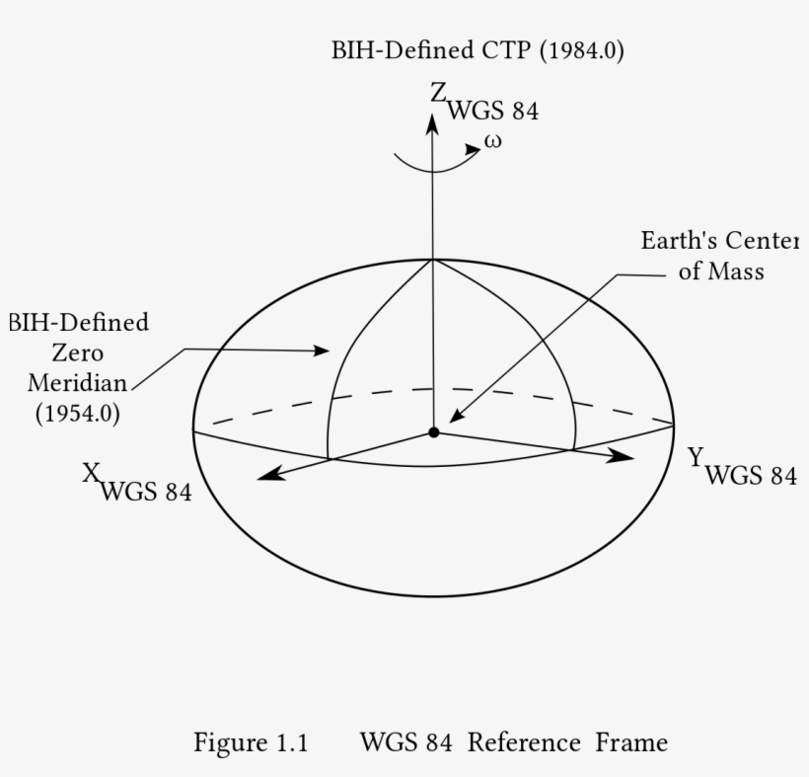
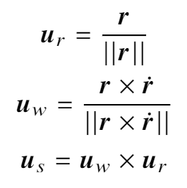
Reference Frames and Coordinate Systems
Earth Centered Inertial
ECI J2000
True Equator Mean Equinox (TEME)
Earth Centered Earth Fixed (ECEF)
Hill Frame (Local Vertical Local Horizontal)
North East Down (NED)
Cartesian Coordinates
World Geodetic System 1984 (WGS-84)

Slide 4
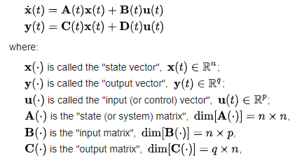
State Space Representation
Allows us to convert a differential equation with an arbitrary number of dimensions, and reduce to a set of first order differential equation
The standard state space representation is a linear representation and thus can only be applied to linear systems
Spacecraft systems are non-linear, but the same concept can be employed. The only difference is it cannot be represented linearly

Slide 5
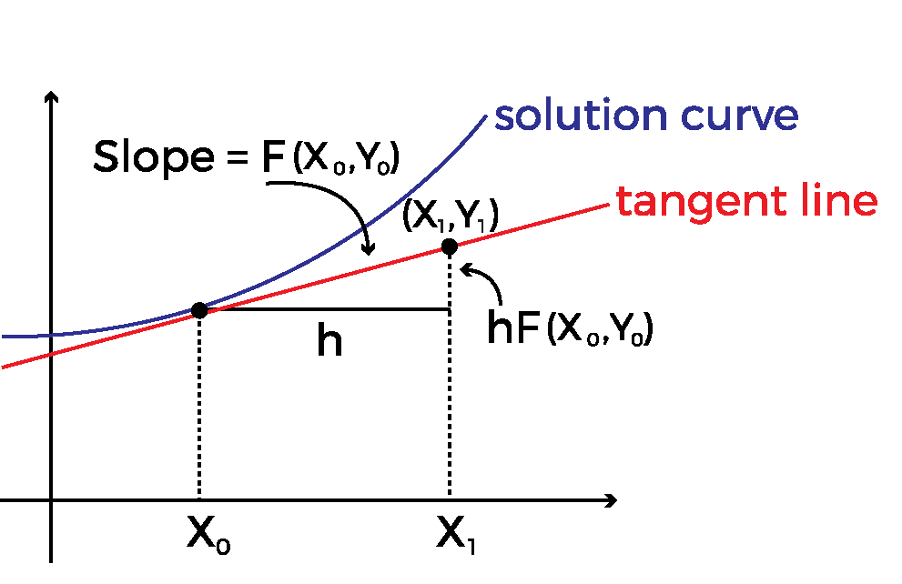
Euler’s Method
Allows us to solve first order differential equations
Also known as 1st Order Runge-Kutta method
Can be improved upon by taking smaller intermediate steps and averaging the slopes
These are known as higher order runge-kutta methods

Slide 6
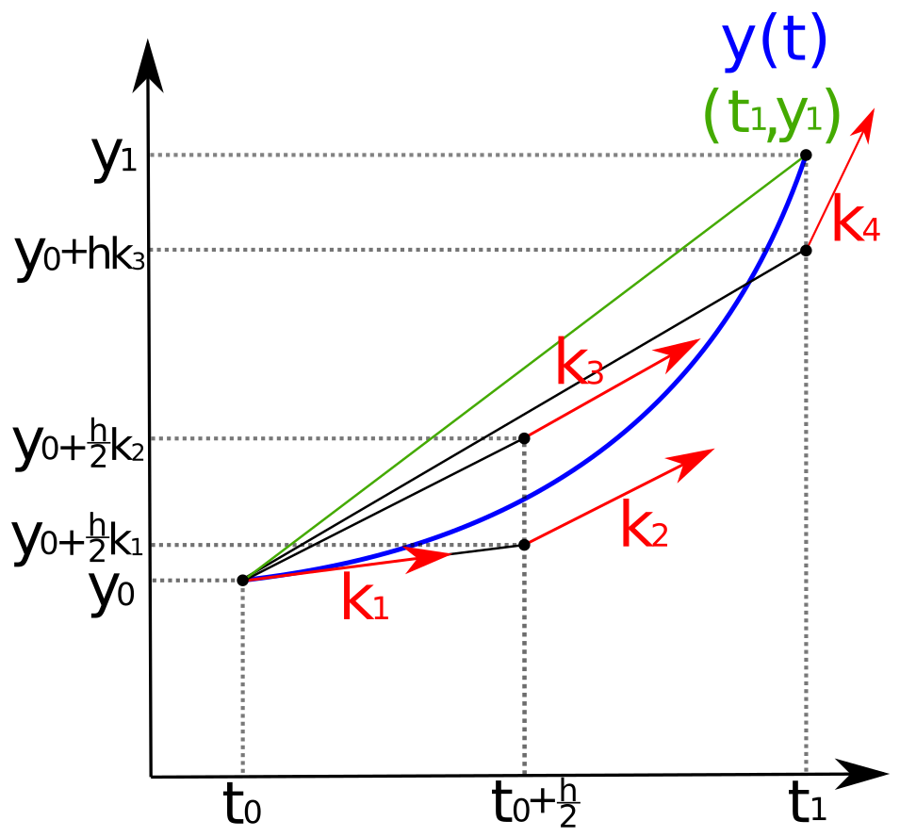
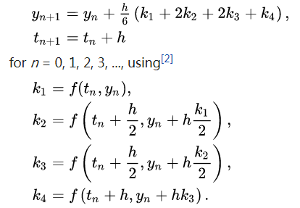
Runge-Kutta 4th Order (RK4)

Slide 7
MATLAB’s ODE45
Dynamic Step Size Solver
Works by running an RK4 and an RK5 in parallel
Each time both are evaluated, their solutions are compared
If they differ by too much, then the step size is decreased
This is repeated until both the RK4 and RK5 solutions match to within some tolerance
Highly accurate
Much more computationally expensive

Slide 8
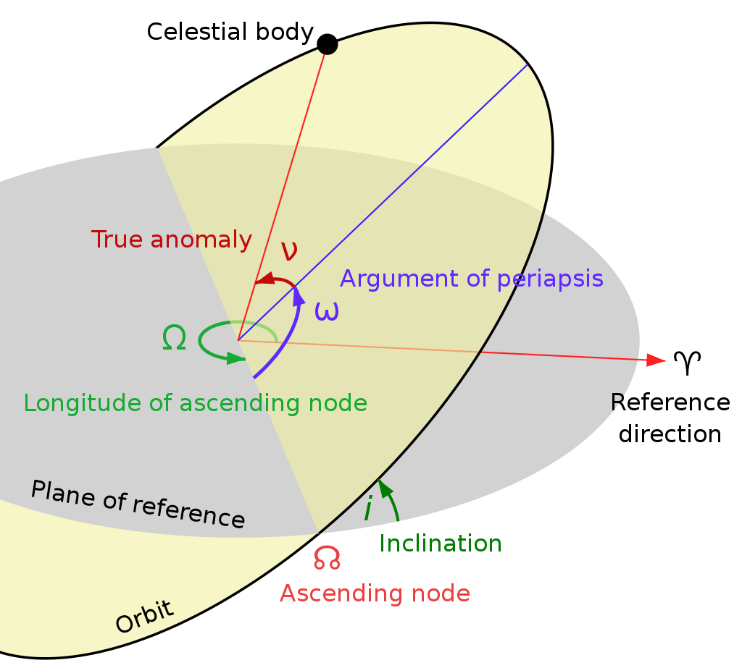
Orbital Parameters
Pros:
Can be useful for sharing information about orbits quickly
Very intuitive to understand
Compact description of orbit at all times
Cons:
Difficult (if not impossible) to include perturbations
Would require transformations to x,y,z coordinates for many operations
Certain analyses become incredibly complex

Slide 9
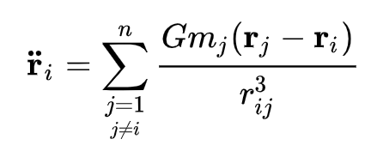
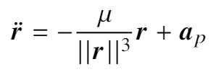
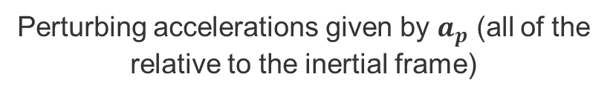
Orbit as ODE with Cowell’s Method
Perturbing accelerations given by $a_{p}$ (all of the relative to the inertial frame)
n Gravitational Bodies
Computationally Efficient
Easy to understand
We can reformat this as a set of first order systems in the state space, and use RK4 to integrate!
Intuitive and easy inclusion of all perturbing forces!

Slide 10
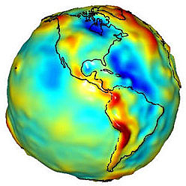
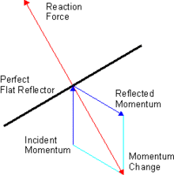
Orbital Perturbations
Most well known is Atmospheric Drag
Earth’s gravity is non-uniform
Most notably, a noticeable bulge at the equator causes “nodal precession” (Sometimes simply referred to as “J2”)
Above 2000km, the dominant non-conservative force is Solar Radiation Pressure (SRP)
N-body effects
Primarily Moon and Sun, though all objects in the universe contribute (in theory)

Slide 11
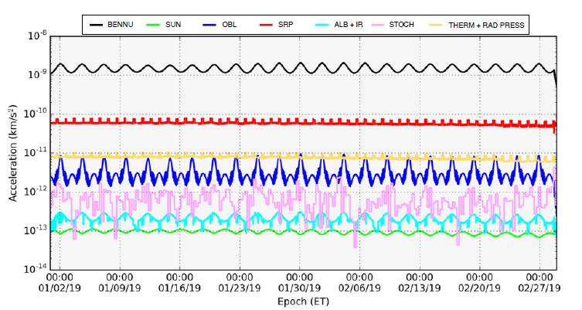
OSIRIS-REx Small Forces Model

Slide 12

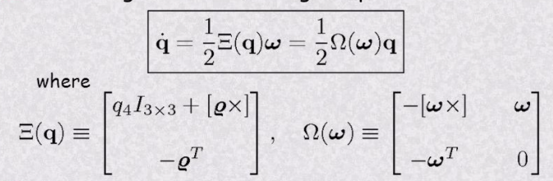
Rotations
Euler’s rotational equations:
Again, first order equations so we can integrate with RK4!
Need quaternion kinematics equations:
Tells us how the quaternion changes given an angular rate

Slide 13
Actuators
Cubesats typically only use attitude control
No thrusters (for the most part)
Some may use differential drag for station keeping
Attitude control for cubesats typically done with:
Reaction Wheels (momentum management)
Magnetic Torquers (momentum dumping)

Slide 14
Reaction Wheels
Provide only an INTERNAL torque
They do NOT change the angular momentum of the entire system
They are sometimes called “momentum transfer” or “momentum storage” devices
You can ONLY use a reaction wheel to transfer momentum in and out of itself, but the angular momentum of the whole spacecraft stays the same
Over time, perturbing torques (due to atmospheric drag, gravity gradients, residual magnetic moments, etc.) will cause the angular momentum of the spacecraft to increase
Eventually, the reaction wheels will become “saturated” (spinning at max speed) and will no longer be able to transfer momentum in and out, resulting in loss of control of the spacecraft
Can exhibit dynamic/static imbalance, as well as transient behavior when crossing “zero”

Slide 15
Magnetic Torquers
Provide only an EXTERNAL torque
They DO change the angular momentum of the entire system
To prevent reaction wheel saturation from occurring, magnetic torquers can be used to “dump” excess momentum off the spacecraft into the Earth’s magnetic field.
This is typically called “momentum desaturation”. Larger spacecraft will use attitude control thrusters for this, though spacecraft as large as Hubble have employed magnetic torquers as they require no fuel and are very simple.
Two main types: Air core and Iron core
When activated, the magnetic field of the torquer will attempt to align with the local earth magnetic field like a compass, thus producing a torque

Slide 16
Sensors
GPS – Requires an expensive unlocked module due to restrictions
Alternative would be to use NORAD TLE’s and the SGP4 algorithm. Could augment with radiometric data
Gyroscopes (typically MEMS) – Provide angular rate data, but will also have a bias that needs to be continually calibrated out
Magnetometers – Provide measurement of the local magnetic field. This can be quite noisy, especially with EMI from other internal components. Also requires knowledge of your spacecraft’s position as well as the earth’s magnetic field (through something like the IGRF) to be useful
Star trackers – Provide angle/vector measurements to multiple stars, along with their corresponding inertial angle/vectors

Slide 17
GNC for Cubesats
Specifically, we’ll only be doing Attitude Determination and Control (ADC)
Need to estimate the spacecraft orientation, angular rate/gyro biases (MEKF)
Need to target some specific states (targeter/guidance)
Need to control the spacecraft using reaction wheels
Need to desaturate using magnetic torquers

Slide 18
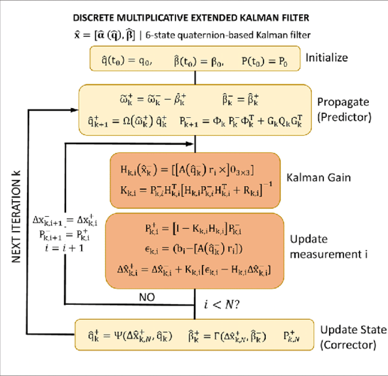
Attitude Determination
Standard algorithm is the Multiplicative Extended Kalman Filter using Dynamic Model Replacement
Algorithm estimates the error angles between previous estimate and new estimate as well as the gyro biases
Once subtracting out the gyro biases from the gyro measurement, the measured angular rate is treated as the dynamics model
Uses vector measurements and gyro measurements

Slide 19
Attitude Targeting
Could be static case (hold a constant attitude) such as would be the case for a space telescope
Could be tracking (such as pointing at a specific point on the ground or at another spacecraft)
Need to write an algorithm that defines what states (angular rate and attitude) you intend to achieve at any point in time, so that the controller can take you from your estimates states to your desired states

Slide 20
Attitude Control
With 3-reaction (linearly independent) wheels, this can be quite simple
Momentum dumping with magnetic torquers is also easy
More complex control schemes are possible, such as a single reaction wheel running in a momentum bias configuration for nadir pointing

Slide 21
Now to Simulate!
Need MATLAB (or can follow along)
Need git (to clone a repository)
We will start with simple orbit and attitude propagation using RK4 and ODE45
Add in perturbations
Do some simple analysis of ground station passes
Simulating magnetometers, gyros and star tracker
Adjust our models to include actuator models
Implement simple 3-axis reaction wheel control

