Slide 1
Optimal Control for Impulsive Rendezvous and Docking with the ISS
Chris Gnam – 10/29/2020

Slide 2
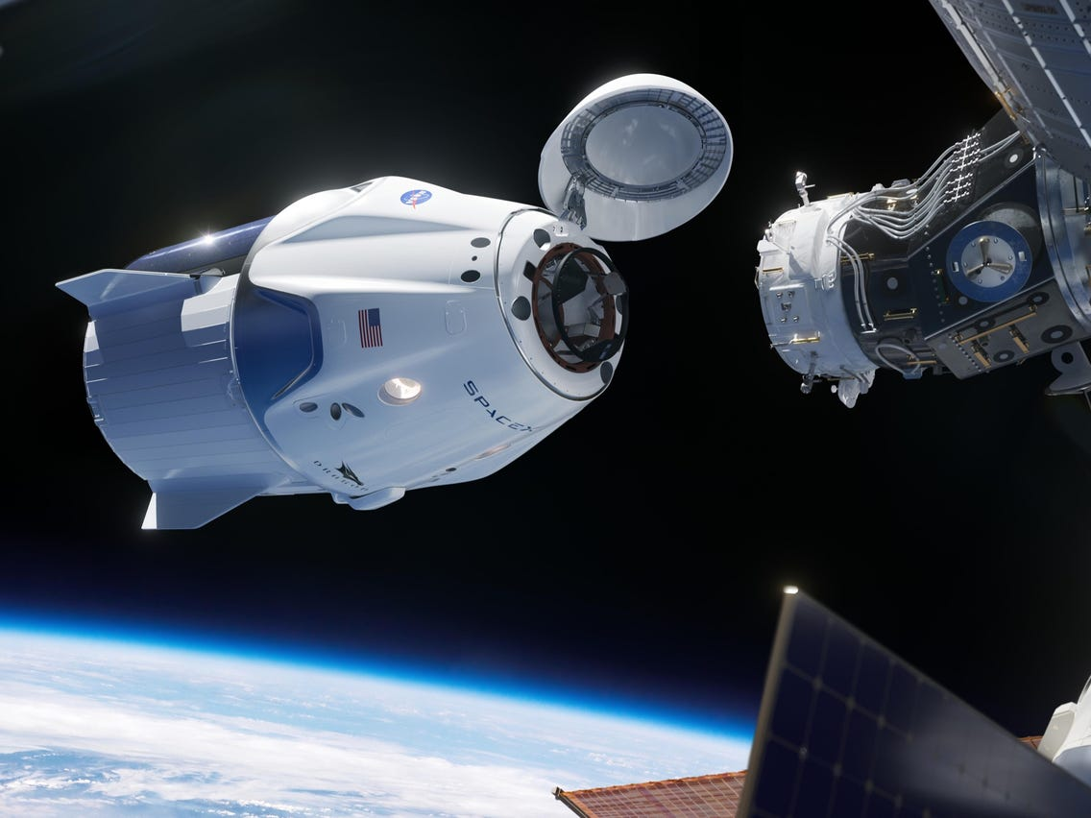
Motivation
Fuel optimal rendezvous and docking can improve mission performance by increasing margin of success and allowing for increased payload capacity
Tangentially related to my research, as I primarily am focused on proximity operations around asteroids
Dynamics around asteroids are very complicated as they are highly perturbed environments
Low Earth Orbit (LEO) and the ISS are well characterized and understood environments making the problem much more approachable, but still useful

Slide 3
Existing Work
Guidance and Control for Multi-stage Rendezvous and Docking Operations in the Presence of Uncertainty - Christopher Michael Jewison (MIT)
Discusses trajectory optimization for rendezvous portions using on-off thrusters
Optimal Rendezvous Guidance Using Linear Quadratic Control - Gun-Hee Moon
Clohessy-Wiltshire equations are used in close proximity as linearization, along with LQR control to perform the terminal docking procedure

Slide 4
Scenario
Spacecraft will be in Low Earth Orbit, with chaser and target in the same orbital plane. Chaser will start half orbit “behind” (along-track direction) the target vehicle.
Two body dynamics will be modeled with the following perturbations for the simulated trajectories:
Attitude dependent atmospheric drag
J2 nodal precession
Solar and Lunar gravity
Actuators will be 6 impulse thrusters, 2 on each axis of the spacecraft
Target and Chaser will both use internal momentum storage devices to maintain LVLH tracking attitude
Docking success once chaser is within a certain region at a certain relative velocity

Slide 5
Approach
Multi-stage approach:
An open loop control solution is first found using a direct method, accounting for constraints and the cost function (fuel usage)
This is used to bring the chaser spacecraft close to the target spacecraft
Dynamics of both chaser and target are calculated inertially
Once the chaser is sufficiently close to the target, a nominal trajectory found which is then treated as a reference trajectory which is tracked via a closed loop control (LQR) algorithm
Dynamics will be modeled using the linearized relative motion equations (CW)
Constraints exist in the form of “keep out zones” around the station, where the chaser spacecraft is not allowed to enter

Slide 6
Project Plan
Code for simulating rendezvous dynamics and navigation are done (as part of work I’ve done previously in my lab)
Attitude control to track LVLH attitude using reaction wheels is completed
Finish reviewing existing work by the end of the month and begin developing plan for implementation
Formulate the formal mathematics of the optimal control problem
Implement the control, and analyze performance
Compare with what is shown in existing work, as well as published requirements for ISS docking

