Slide 1



Smart Distillery Analytics
Date: 19th September 2025

Slide 2

Content
01
Problem Statement
02
Data Preparation
03
Correlation analysis
04
Logistic Regression analysis and model validation
05
SCADA data distribution and it’s preparation
05
06
05
VIF
07
05
ANNOVA and PCA
08
Elbow method and model development
05
2

Slide 3
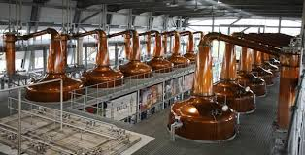
Problem Statement
To analyze and optimize the distillery process by identifying the key process variables influencing flavor profiles.
Scope:
Utilize data from Mashing, Fermentation, Wash Still A/B, and Spirit Still A/B.
Build predictive models to classify the presence (1) or absence (0) of Fruity & Floral flavor.
Identify critical process features impacting flavor quality.
Solution Proposed:
A Predictive Analytics pipeline combining statistical tests, feature selection, and machine learning to discover and validate flavor-driving parameters.
3

Slide 4
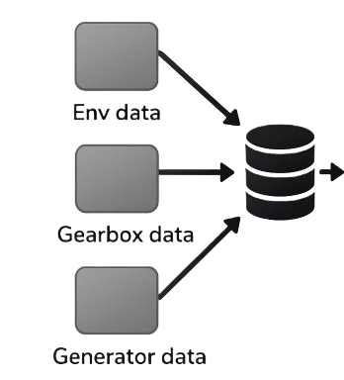






Process (Methodology)
Mashing
Fermentation
Binary prediction 0 means absent 1 means present
Final Data
Feature selection
Machine Learning
Model
Final Output
Wash Still A, B
4

Slide 5
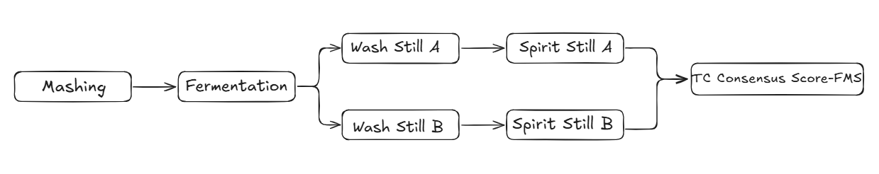
Week-1
Data Preparation
Utilized data from multiple stages-Mashing, Fermentation, Wash still A, Wash still B, Spirit Still A, Spirit Still B-representing the operational phases.
Performed data cleaning and validation to remove duplicates, handle missing values, and ensure consistency across the parameters.
Included all the parameters to capture variations in production.
Merged output from Spirit Still A and B to derive the TC Consensus Score where 1 represent presence and 0 represent absence of that flavor (Cereal/Grainy, Fruity_&_Floral, Fermented, Cooked, Husky, Starchy, Acidic/Solvent).
Number of parameter after joining all the process 235 and number of batches 65.
5

Slide 6
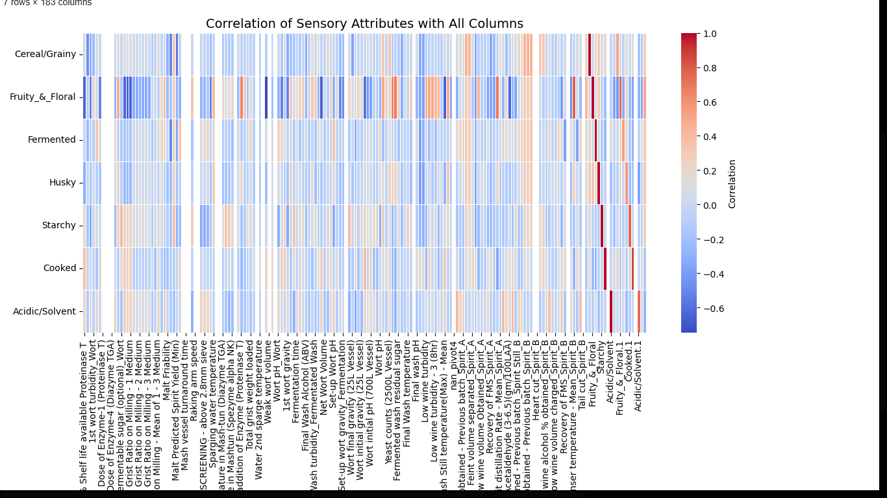
Correlation Analysis
Goal:
- Identify redundant variables through correlation matrix analysis.
Findings:
Multiple parameters showed correlation between 0.3 and -0.3 with target varibales.
High interdependence indicates multicollinearity risk.
Action:
- Retained one representative variable per correlated group.
6

Slide 7
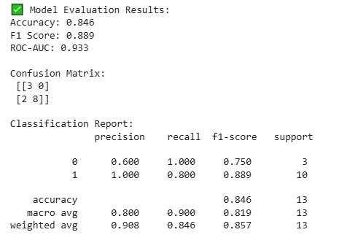
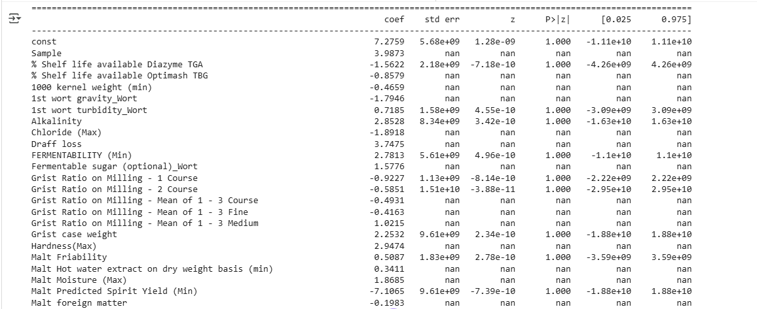
Logistic Regression Analysis
Analysis Reason for Rejection:
Excessive intercorrelation among variables (≥ 0.8).
Impact:
- Unstable regression coefficients.
- Inflated variance in model outcomes.
Decision:
Based on the results, all the independent variables have p-values greater than 0.05, indicating that none of the parameters show a statistically significant relationship with the target variable at the 95% confidence level.
7

Slide 8
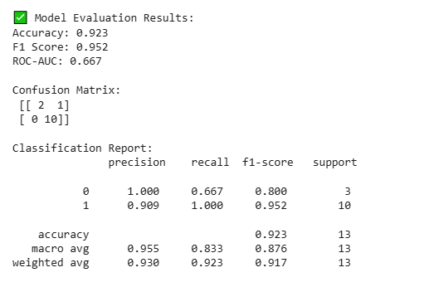
Model Validation Attempt
Logistic Regression
Approach:
Applied Logistic Regression and Random Forest on reduced data.
Findings:
- Models achieved high accuracy and F1-score, despite all parameters being statistically insignificant.
- Contradiction between statistical and empirical performance observed.
Decision:
Reject p-value–based evaluation; explore advanced methods.
8

Slide 9
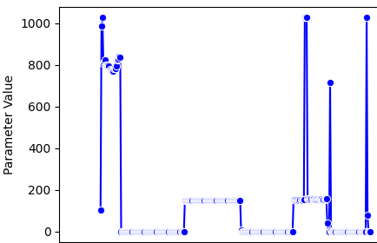
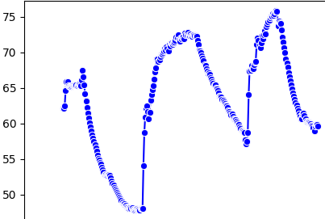
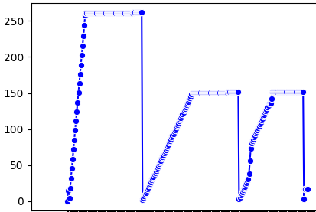
Week-2
Data Distribution (Mashing batch-895)
Water Totalize
Mashing Temperature
Water flow
Data was not sufficient for wash still A, wash still B, spirit still A, spirit still B.
9

Slide 10
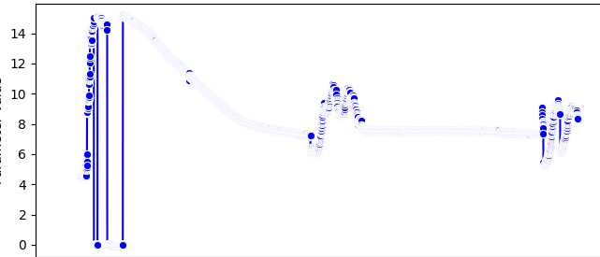
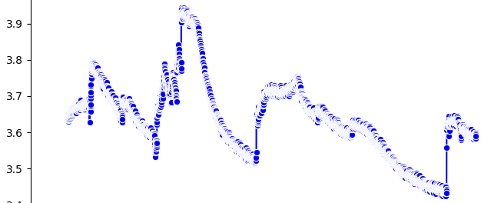
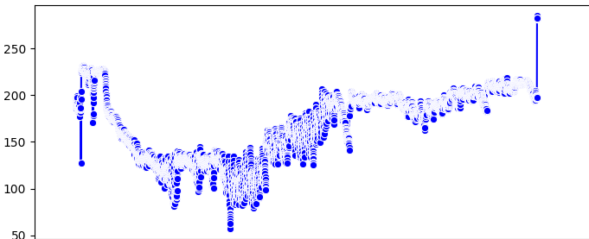
Data Distribution (Fermentation batch-895)
Conductivity Value
Yeast count
pH-value
Scada data distribution was analyzed and statistical summary was calculated for all the features and while comparing it’s correlation with target variable and the p -value no feature was significant so we do not use this data and work on raw data only.
10

Slide 11
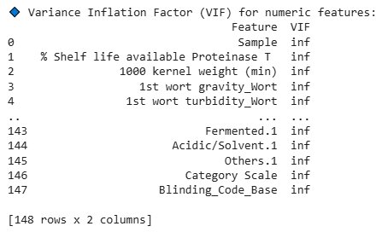
Week-3
VIF
Objective:
Quantify multicollinearity using Variance Inflation Factor (VIF).
What is VIF?
Indicates how much variance of a variable is inflated due to correlation with others.
Interpretation:
VIF ≈ 1 → No collinearity
1–5 → Moderate
10 → High (problematic)
Conclusion:
All parameters show VIF = ∞, indicating severe multicollinearity among predictors. This confirms that many variables are linearly dependent on each other. Hence, we proceed with ANOVA for feature significance testing and PCA for dimensionality reduction to eliminate multicollinearity before model development.
111
11

Slide 12
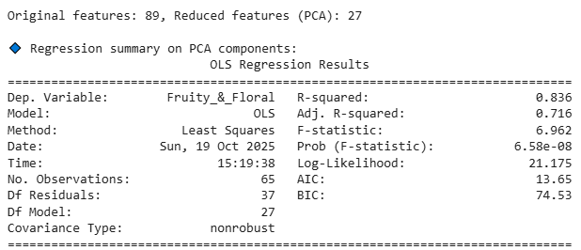
ANOVA & PCA Results
Key Findings:
- ANOVA reduced total 170+ parameters to 89.
- PCA extracted major components capturing 90% data variance by 27 parameters.
- OLS Regression gave following significant PCA components (p < 0.05): x1, x2, x3, x5, x6, x7, x10
% Shelf life were not included in the results because somewhere it was written %Value. But those parameter are also important and accuracy will change after using it.
12

Slide 13
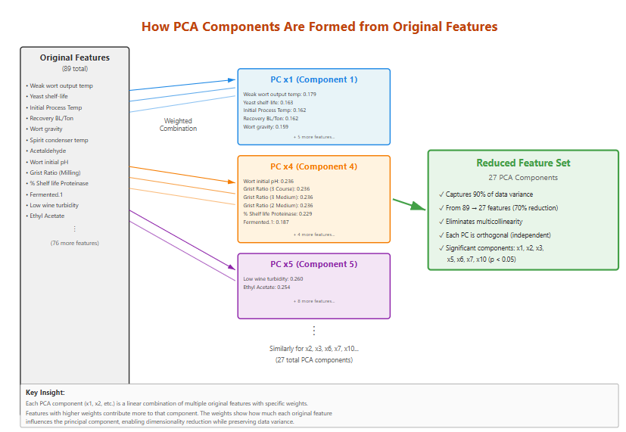
13
13

Slide 14
Final Analytical Path
Selected Approach:
- ANOVA → identify variance-based important parameters.
- PCA → convert correlated variables into independent components.
- OLS Regression → assess component significance (p |t| values).
- Elbow Method → find optimal feature count.
- Logistic & Random Forest Models → validation.
ANOVA
PCA
OLS
ELBOW METHOD
14
14

Slide 15
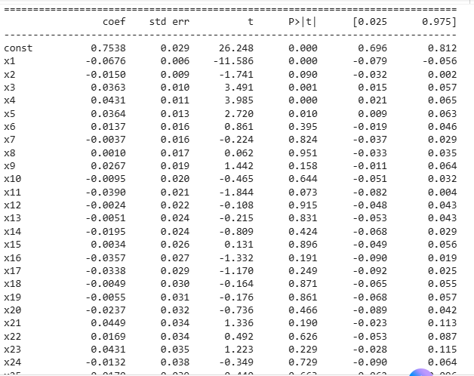
Model Development
Logistic Regression
Models Used: 1. Logistic Regression,
2. Random forest
Observation:
Both models delivered consistent, stable performance.
Improved interpretability and generalization vs earlier attempts.
Significant Components: x1, x3, x4, x5 (p < 0.05) → Statistically significant and strongly influence flavor outcomes
Non-Significant Components: Remaining components show p > 0.05 → Minimal or no impact on flavor variation.
15

Slide 16
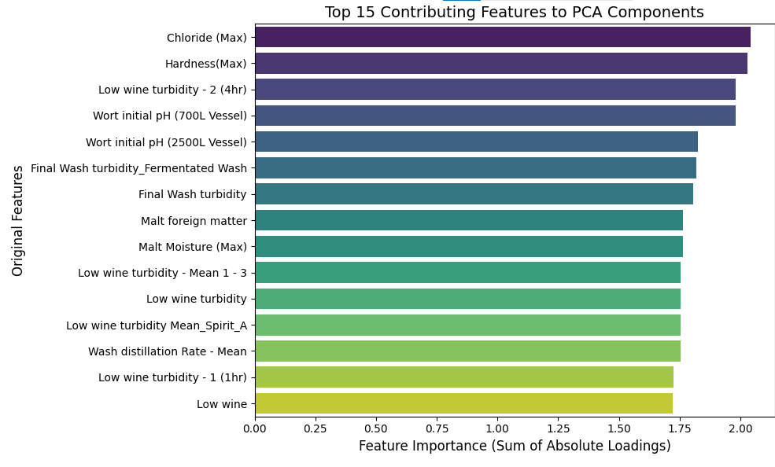
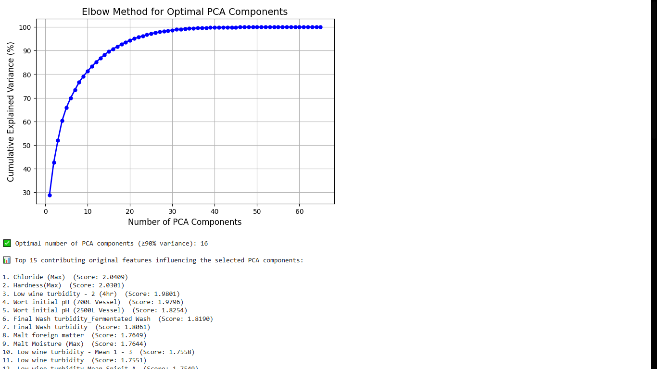
Elbow method output
The feature importance analysis identifies 16 highly significant features that contribute most substantially to the PCA components, with Chloride (Max) and Hardness (Max) emerging as the top contributors.
16​

Slide 17
Features affecting (% Shelf life was not considered)
Fruity_&_Floral
Chloride (Max)
Hardness (Max)
Low wine turbidity-2 (4 hrs)
Wort initial pH (2500L Vessel)
Final Wash turbidity_Fermented Wash
Final Wash turbidity
Malt foreign matter
Cereal/Grainy
Malt Moisture (Max)
Yeast Storage Temperature, deg C
1000 kernel weight (min)
1st wort turbidity Wort
Malt Friability
Recovery of FMS_Spirit_A
Final Wash Alcohol (ABV)
Fermented
Alkalinity
Spirit distillation Rate-Mean_Spirit_B
Recovery of FMS_Spirit_B
Feint Alcohol Strength obtained-Previous batch Spirit_A
Feint Alcohol Strength obtained-Previous batch Spirit_B
Malt foreign matter
Low wineFeint Alcohol Strength obtained-Previous batch Spirit_A
Husky
Wash condenser temperature(Max)-Mean
Sparging water temperature
Low wine
Low wine alcohol % obtained_Low wine
17

Slide 18
Features affecting (% Shelf life was not considered)
Starchy
Malt predicted spirit yield (min)
Wort final gravity (2500 L vessel)
Yeast storage temperature, deg C
Yeast shelf-life at the time of use (C-70 yeast)
Temperature in Mashtun (Optimash TBG)
Malt moisture (Max)
Low wine alcohol % obtained spirit A
Cooked
pH process water
Wort receiver temperature
Spirit condenser temperature-Mean spirit B
Low wine turbidity mean spirit A
Acidic/Solvent
Fermentable sugar (optional )
Temperature in Mashtun (optimash TBG)
Low wine turbidity mean_spirit B
Hardness (max)
Wort final gravity (2500L vessel)
% shelf life available Optimash TBG
Mashing temperature
18

Slide 19
31-10-2025
Features affecting (green text are the parameters which are approved by Steffi )
Cereal/Grainy
Wort final gravity (25L vessel)
Recovery of FMS_Spirit A
Yeast storage temperature, deg C
Malt friability
Final wash alcohol (ABV)
Low wine alcohol % obtained_Spirit_A
Malt moisture (Max)
Final Wash Alcohol %
1st wort gravity_Wort
Low wine
Cereal/Grainy
Recovery of FMS_Spirit_A
Malt moisture (Max)
1000 kernel weight separated spirit B
Feint volume separated spirit_B
Malt hot water extract on dry weight basis (min)
Malt predicted spirit yield (min)
Feint volume obtained –previous batch_Spirit_A
Feint volume charged_spirit_B
Wort final gravity (25L vessel)
Feint volume obtained-previous batch spirit_B
19

Slide 20
4-11-2025
Features affecting (green text are the parameters which were present in both )
Cereal/Grainy
Malt moisture (Max)
Yeast storage temperature, deg C
1000 kernel weight (min)
1st wort turbidity_Wort
Malt friability
Recovery of FMS_Spirit_A
Final wash Alcohol (ABV)
Low wine
Wort final gravity (25L vessel)
Low wine alcohol % obtained_Low wine
Cereal/Grainy
Recovery of FMS_Spirit_A
Malt moisture (Max)
1000 kernel weight separated spirit B
Feint volume separated spirit_B
Malt hot water extract on dry weight basis (min)
Malt predicted spirit yield (min)
Feint volume obtained –previous batch_Spirit_A
Feint volume charged_spirit_B
Wort final gravity (25L vessel)
Feint volume obtained-previous batch spirit_B
20
​

Slide 21
31-10-2025
Features affecting
Fruity_&_Floral
Feint volume separated spirit B
Feint volume charged spirit A
Feint volume obtained-Previous batch spirit B
Feint volume charged spirit B
Feint volume obtained-previous batch spirit A
Yeast shelf life at the time of use (C-70 yeast)
Grist ratio on miling-1 medium
Grist ratio on miling-1 course
Grist ratio on miling-1 fine
Time of addition of enzyme (Proteinase T)
Fruity_&_Floral
Spirit condenser temperature-mean spirit
Weak wort output temperature
Wash condenser temperature (Max)-Mean
Final wash alcohol (ABV)
Low wine turbidity mean_spirit A
Final wash alcohol %
Yeast storage temperature, deg C
Low wine turbidity
Yeast shelf-life at the time of use (C-70 yeast)
Yeast shelf-life at the time of use (Pinnacle M yeast)
21
​

Slide 22
4-11-2025​
​
Features affecting
Fruity_&_Floral
Wort initial pH (700L vessel)
Chloride (Max)
Hardness (Max)
Low wine turbidity-2 (4 hr)
Wort initial pH (2500L vessel)
Wash condenser temperature (Max)-Mean
Low wine turbidity-1 (1hr)
Low wine turbidity-Mean 1-3
Low wine turbidity
Low wine turbidity Mean_Spirit_A
Fruity_&_Floral
Spirit condenser temperature-mean spirit
Weak wort output temperature
Wash condenser temperature (Max)-Mean
Final wash alcohol (ABV)
Low wine turbidity mean_spirit A
Final wash alcohol %
Yeast storage temperature, deg C
Low wine turbidity
Yeast shelf-life at the time of use (C-70 yeast)
Yeast shelf-life at the time of use (Pinnacle M yeast)
22
​

Slide 23
31-10-2025
Features affecting
Fermented
Spirit distillation rate-mean spirit B
Recovery of FMS spirit_B
Malt hot water extract on dry weight basis (min)
Feint alcohol strength obtained-Previous batch spirit A
Feint alcohol strength obtained-Previous batch spirit B
Wort ph_wort
Wort ph
Set-up wort ph
Alkalinity
Malt predicted spirit yield (Min)
Fermented
Set-up wort ph
Alkalinity
Malt foreign matter
Malt hot water extract on dry weight basis (min)
Recovery of FMS_spirit B
Spirit distillation rate-mean_spirit B
Malt predicted spirit yield (min)
Feint alcohol strength obtained-Previous batch spirit A
Feint volume separated spirit B
Low wine
23​
​

Slide 24
4-11-2025​
​
Features affecting
Fermented
Alkalinity
Malt foreign matter
Feint alcohol strength obtained
Recovery of FMS_Spirit_B
Spirit distillation rate-mean_spirit_B
Malt hot water extract on dry weight basis (min)
Set-up wort pH
Low wine alcohol % obtained_Spirit_A
Low wine
Low wine alcohol % obtained_Low wine
Fermented
Set-up wort ph
Alkalinity
Malt foreign matter
Malt hot water extract on dry weight basis (min)
Recovery of FMS_spirit B
Spirit distillation rate-mean_spirit B
Malt predicted spirit yield (min)
Feint alcohol strength obtained-Previous batch spirit A
Feint volume separated spirit B
Low wine
24
​

Slide 25
31-10-2025
Features affecting
Husky
Feint volume separated Spirit B
Feint volume separated spirit A
Feint volume obtained-previous batch spirit B
Feint volume obtained-previous batch spirit A
Feint volume charged spirit B
Low wine alcohol % obtained Low wine
Low wine alcohol % obtained Spirit A
Low wine
Yeast shelf-life at the time of use (Pinnacle M yeast)
Wash still temperature (Max)-Mean
Husky
Low wine alcohol % obtained Low wine
Feint volume separated spirit A
Grist ratio on Miling-1 course
Wash condenser temperature (Max)-Mean
Low wine
Spirit condenser temperature-mean spirit B
Yeast shelf-life at the time of use (Pinnacle M yeast)
Wash still temperature (Max)-Mean
Feint volume obtained-previous batch spirit A
Sparging water temperature
25
​

Slide 26
4-11-2025​
​
Features affecting
Husky
Wash still temperature (Max)-Mean
Low wine
Low wine alcohol % obtained_Low wine
Low wine alcohol % obtained_Spirit_A
Sparging water temperature
Feint volume charged_spirit_A/B
Feint volume obtained-Previous batch_Spirit_B/A
Feint volume charged_Spirit B
Feint volume obtained-Previous batch_Spirit_B/A
Spirit condenser temperature-Mean spirit B
Husky
Low wine alcohol % obtained Low wine
Feint volume separated spirit A
Grist ratio on Miling-1 course
Wash condenser temperature (Max)-Mean
Low wine
Spirit condenser temperature-mean spirit B
Yeast shelf-life at the time of use (Pinnacle M yeast)
Wash still temperature (Max)-Mean
Feint volume obtained-previous batch spirit A
Sparging water temperature
26​
​

Slide 27
Features affecting
Starchy
Yeast storage temperature, deg C
Low wine alcohol % obtained Spirit A
Malt moisture (Max)
Yeast shelf-life at the time use (C-70 yeast)
Low wine alcohol % obtained low wine
Wort final gravity (2500L vessel)
Wort ph_wort
Malt predicted spirit yield (Min)
1st wort gravity
Starchy
Low wine alcohol % obtained Low wine
Malt moisture (Max)
Ph-process water
Set up wort Ph
Screening above 2.8 mm sieve
Yeast storage temperature, deg C
1st wort gravity_wort
Wort ph
Temperature in Mashtun (Proteinase T)
Wort ph_wort
27​
​

Slide 28
Features affecting
Cooked
Grist ratio on miling-1 Medium
Grist ratio on miling-1 fine
Grist ratio on miling-1 course
Time of addition of Enzyme (Proteinase T)
Yeast shelf-life at the time of use (Pinnacle M yeast)
Wash still temperature (Max)-Mean
Spirit condenser temperature-Mean_spirit_A/B
Wort initial ph (2500L vessel )
Low wine turbidity
pH_Process Water
Cooked
Spirit condenser temperature-mean spirit A
Wort receiver temperature
Ph process water
Low wine turbidity
Grist ratio on miling-1 fine
Spirit condenser temperature-Mean_spirit_B
Wash still temperature (Max)-Mean
Yeast shelf-life at the time of use (Pinnacle M yeast)
Grist ratio on miling- 1 Course
Wort initial ph(2500L vessel )
28​
​

Slide 29
Features affecting
Acidic/Solvent
Hardness (max)
Mashing temperature
Draff loss
Low wine turbidity mean_Spirit_B
% shelf life available Diazyme TGA
Wort final gravity (2500 L vessel)
Average ABV in FMS_Spirit_A/B
Fermentable sugar (optional )
Temperature in Mashtun (Optimash TBG)
% shelf life available Optimash TBG
Acidic/Solvent
% shelf life available Diazyme TGA
Wort final gravity (2500 L vessel)
Yeast shelf-life at the time of use (Pinnacle M yeast)
Draff loss
Hardness (max)
Wort final gravity (700 L vessel)
Average ABV in FMS_spirit_A
Strength in PL
Low wine turbidity Mean_spirit_B
Recovery BL/Ton of malt
29​
​

Slide 30
4-11-2025​
​
Features affecting (Mashing)
Cereal/Grainy
Wort receiver temp_avg
Sparging_mashing water flow
Sparging mashing water totalize
Starchy
Sparging_mashing water totalize_avg
Mashing temp_avg
Fruity_&_Floral
Mashing temp_Parameter
Cooked
No feature detected that is important from mashing
Fermented
No feature detected that is important from mashing
Acidic/solvent
No feature detected that is important from mashing
Husky
Sparging _mashing water flow
Wort receiver temp
30
​

Slide 31
4-11-2025​
​
Features affecting (Fermentation)
Cereal/Grainy
No feature was imp from fermentation
Starchy
Fermenter 10 ph probe temp_parameter value avg
Turbidity FTU unit_Parameter value min
Alcohol strength value_parameter value avg
Fruity_&_Floral
Fermenter temp 10_parameter value max/avg
Fermenter 10 ph probe temp_Parameter avg
Turbidity FTU unit_parameter value avg
Alcohol strength value parameter value_max/std
DO value_Parameter value_avg
Cooked
Fermentor temp10 parameter value avg
Do value_Parameter value avg
Fermented
Fermentor temp_10 parameter value avg
Acidic/solvent
Turbidity FTU unit_parameter value_max
Real extract_parameter value std
Husky
Fermentor temp_10 parameter value_avg
31​
​

Slide 32
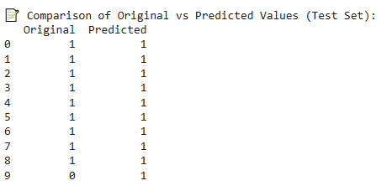
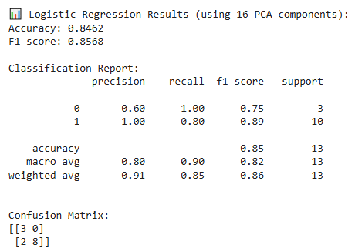

Model validation
The accuracy and F-1 score by logistic regression and Random forest can be compared and model with higher values can be selected with respect to the flavors.
Once the model is approved, we can go for the front hand model development.
32
​

Slide 33
10-11-2025
Model validation output of all flavours
Flavour | Threshold | Accuracy | F1-score
Cereal/Grainy | 0.6/0.7 | 0.93 | 0.89
Fruity_&_Floral | 0.4 | 0.93 | 0.92
Fermented | 0.5/0.6 | 0.93 | 0.89
Husky | 0.6 | 0.86 | 0.79
Starchy | 0.6 | 0.71 | 0.71
Cooked | 0.3 | 0.79 | 0.78
Acidic/Solvent | 0.6 | 0.71 | 0.72
33
​

Slide 34
Inference & Key Insights
Data & Process Understanding:
Comprehensive data collected from all process stages — Mashing, Fermentation, Wash Still, and Spirit Still — ensuring complete process visibility.
Data validation revealed strong interdependence between parameters, indicating process overlap and redundancy
Analytical Learnings:
Statistical evaluation highlighted that multiple parameters influence the flavor outcome in a combined manner rather than individually.
Dimensionality reduction helped focus on a smaller set of meaningful features that truly drive flavor variation.
Key Business Insights
Identified 16 key process parameters that have the highest impact on Fruity & Floral flavor quality.
Chloride (Max) and Hardness (Max) emerged as the top drivers of flavor consistency.
Certain stages show higher contribution to flavor variability — allowing focused monitoring and control.
Business Outcomes
Built a robust analytical framework to link process behavior with final flavor quality.
Provides a clear direction for process optimization and quality improvement initiatives.
Enables the foundation for a predictive flavor quality model for future real-time control and improvement.
34
​

Slide 35
Next week task: 1. Output data of 6 batches I got today (4-11-2025) which I will use it in training the model and feature selection and update the output- done
2. % shelf-life values I got yesterday (3-11-2025) which I will use it and update the feature selection part.- done
3. The diagrammatic representation of the work -done
35
​

Slide 36
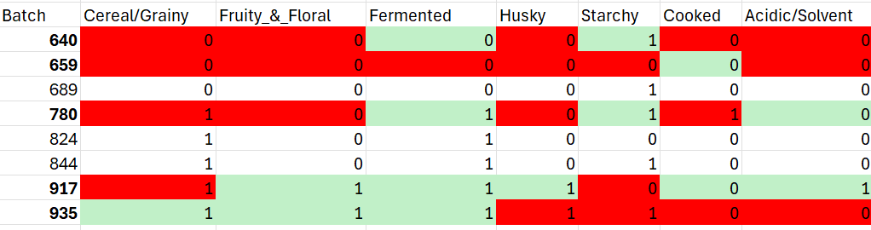
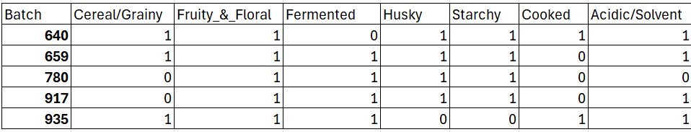
Prediction output
Green-correct prediction
Red-wrong prediction
689, 824 and 844 batches ouput is not available.
For Cereal/Grainy:
0: only 2 batch
1: remaining batches
Thus batch number 640, 659,780,917 and 935 were added in the training and prediction for the batches whose output I don't have.
36

Slide 37
10-11-2025
Data preparation (mashing, fermentation, wash still, spirit still)
Correlation analysis
Modelling (p-value, logistic regression, Naïve Bayes)
SCADA data dis and calculate the correlation and modelling but didn't get the critical feature
Cal VIF (Variance Inflation Factor)
ANNOVA +PCA (elbow method)
OLS regression and got the features having highest importance with respect to each flavor
Model development (Logistic regression and other model )
Used SCADA data with respect to target variable and applied ANNOVA+PCA+OLS
37
​

Slide 38
7-11-2025
Features affecting (green text are the parameters which were present in both )
Cereal/Grainy
Wort final gravity (25L vessel)
Recovery of FMS_Spirit_A
Wort initial gravity (700L vessel)
Fermented wash residual sugar
Final wash volume
Final wash volume obtained
Net wort volume
Fermentation time
Feint alcohol strength obtained-Previous batch_spirit still B
1000 kernel weight (min)
Cereal/Grainy
Fermentation time
Feint alcohol strength obtained-previous batch spirit_B
Feint volume charged_spirit_A
Wort final gravity (25L vessel)
Final wash volume obtained
Low wine
Low wine alcohol % obtained Spirit_A
Feint alcohol strength obtained-Previous batch spirit_Still_B
Low wine alcohol % obtained Low wine
38
​

Slide 39
7-11-2025​
​
Features affecting
Fruity_&_Floral
Wort final gravity (2500 L vessel)
Wort initial pH (700 L vessel)
Time of addition of enzyme (Spezyme alpha NK), Proteinase T
Wash distillation rate-Mean
Fermented wash residual sugar
Final wash turbidity
Final wash turbidity_fermented wash
Set-up wort pH
Wort initial pH(2500 L vessel )
Final wash temperature_Fermented wash
Fruity_&_Floral
Spirit condenser temperature-mean spirit_B
Wash condenser temperature (Max)-Mean
Weak wort output temperature
Low wine turbidity-Mean 1-3
Spirit condenser temperature-Mean_spirit_A
Low wine turbidity
Fermented wash residual sugar
Wash still temperature (Max)-Mean
Low wine turbidity-3 (8 hr)
Initial Process Temperature (2500L)
39
​

Slide 40
7-11-2025​
​
Features affecting
Fermented
Recovery of FMS_Spirit_B
Spirit distillation rate-mean_spirit_B
Final wash volume
Net wort volume
Final wash volume obtained
Grist ratio on Miling-Mean of 1-3 course
Yeast storage temperature, deg C
Malt moisture (max)
Low wine
Set-up wort pH
Alkalinity
Fermented
Set-up wort ph
Low wine
Wort pH_wort
Malt hot water extract on dry weight basis (min)
% shelf-life available Proteinase T
Strength in PL
Wort pH
Low wine alcohol % obtained_Low wine
Recovery of FMS_Spirit_B
40
​

Slide 41
7-11-2025​
​
Features affecting
Husky
Spirit condenser temperature-Mean spirit B
Wash condenser temperature (Max)-mean
% shelf life available optimash TBG
Wash still temperature (max)-mean
Sparging water temperature
Low wine
Husky
% shelf life available Optimash TBG
Low wine
Sparging water temperature
Wash condenser temperature (Max)-Mean
Spirit condenser temperature-Mean_spirit B
Wash still temperature (Max)-Mean
41
​

Slide 42
7-11-2025​
Features affecting
Starchy
Screening-above 2.8 mm sieve
Screening-above 2.5 mm sieve
Draff loss
Screening- below 2.2 mm sieve
Recovery BL/Ton of Malt
Recovery PL/Ton of Malt
Wort pH
Mashing temperature
% shelf-life available Proteinase T
Set-up wort pH
Average ABV in FMS_Spirit_B
Starchy
Screening above 2.5 mm sieve
Final wash temperature
Screening above 2.8 mm sieve
Malt moisture (Max)
Fermentability (Min)
Screening above 2.2 mm sieve
Temperature in Mash-tun (Proteinase T)
Temperature in Mashtun (optimash TBG)
Low wine alcohol % obtained_Spirit_A
Recovery BL/Ton of Malt
19​
​
42
​

Slide 43
7-11-2025​
Features affecting
Acidic/Solvent
Strength in PL_Spirit_A
Strength in PL_Spirit_B
Average ABV in FMS_Spirit_B
Average ABV in FMS_Spirit_A
% shelf-life available Proteinase T
Mashing temperature
% shelf-life available Diazyme TGA
Low wine turbidity Mean_spirit_B
Hardness (Max)
Acidic/Solvent
% shelf life available Diazyme TGA
Mashing temperature
% shelf-life available Proteinase T
Low wine turbidity Mean_spirit_B
Average ABV in FMS_spirit_B
Hardness (Max)
Strength in PL_Spirit_A
Strength_in_PL_Spirit_B
Average ABV in FMS_Spirit_A
43
​

Slide 44
7-11-2025​
Features affecting
Cooked
Spirit condenser feature temperature-mean_spirit_A
Yeast shelf-life at the time of use use (Pinnacle M yeast)
Spirit condenser temperature-mean_spirit_B
Time of addition of enzyme (Proteinase T)
Wash still temperature (Max)- Mean
Wort receiver temperature
Wort initial pH (2500 L vessel )
PH process water
Cooked
Spirit condenser temperature-mean spirit A
Wash still temperature (Max)-Mean
pH_Process water
Yeast shelf-life at the time of use (Pinnacle M yeast)
Spirit condenser temperature-Mean spirit_B
Wort receiver temperature
Wort initial pH (2500L vessel)
Time of addition of Enzyme (Proteinase T)
44​
​

Slide 45
Count of correct features
Flavour | Previously correct | Currently correct
Cereal/Grainy | 2/10 | 5/10
Fruity_&_Floral | 5/10 | 5/10
Fermented | 3/10 | 5/11
Husky | 6/10 | 6/6
Starchy | 5/9 | 8/11
Cooked | 8/10 | 6/8
Acidic/Solvent | 9/10 | 5/9
45

Slide 46
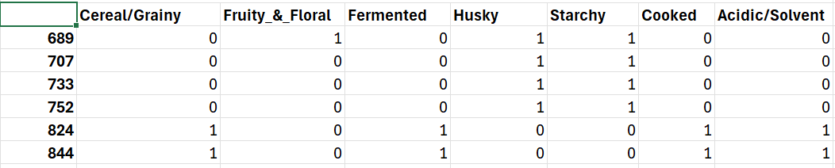
Prediction output
46

Slide 47
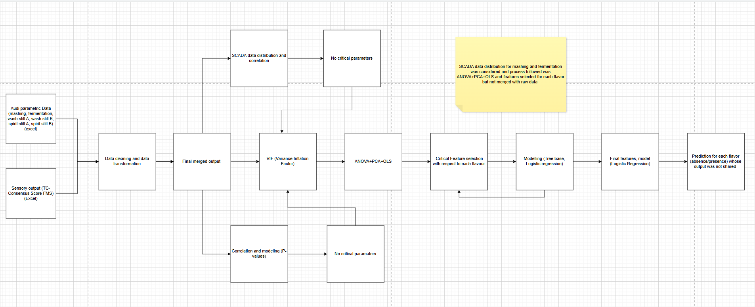
47

Slide 48
13-11-2025
VIF values Cereal/Grainy (threshold=0.5)
No. | Parameter | VIF
1. | Wort final gravity (25 L vessel) | 1.05212
2. | Wort initial gravity 700 L | 1.06317
3. | Fermentation time | 1.09481
4. | Fermented wash residual sugar | 1.65382
5. | Recovery of FMS_Spirit A | 1.95884
6. | Feint alcohol strength obtained-Previous batch spirit still | 2.0902
7. | 1000 kernel weight (min) | 2.22851
8. | Feint volume seperated_spirit_B | 2.62906
Accuracy | F-1 score | Sensitivity | Specificity | CM | CM (test)
0.93 | 0.89 | 1.0 | 1.0 | $$\left[\begin{matrix}4 & 0 \\ 0 & 52\end{matrix}\right]$$ | $$\left[\begin{matrix}0 & 1 \\ 0 & 13\end{matrix}\right]$$
48
​

Slide 49
13-11-2025
VIF values Fruity_&_Floral (threshold=0.6)
No. | Parameter | VIF
1. | Fermented wash residual sugar | 1.068
2. | Wort final gravity (2500L vessel) | 1.249
3. | Wash distillation Rate-Mean | 1.577
4. | Final wash pH | 1.597
5. | Final wash turbidity | 1.733
6. | Low wine turbidity –3 (8 hr) | 1.838
7. | Spirit still tempertaure-mean_spirit_B (max) | 1.948
8. | Wort initial pH (700 L vessel) | 2.058
9. | Time of additon of enzyme (Spezyme alpha NK) | 2.245
10. | Time of addition of enzyme (Proteinase T) | 2.381
Accuracy | F-1 score | Sensitivity | Specificity | CM | CM (test)
0.93 | 0.92 | 1.0 | 0.846 | $$\left[\begin{matrix}11 & 2 \\ 0 & 43\end{matrix}\right]$$ | $$\left[\begin{matrix}2 & 1 \\ 0 & 11\end{matrix}\right]$$
49
​

Slide 50
13-11-2025
VIF values Fermented (threshold=0.5)
No. | Parameter | VIF
1. | Spirit distillation rate-Mean_spirit_B | 1.327
2. | Malt moisture (Max) | 1.393
3. | Grist ratio on Miling-Mean of 1-3 Course | 1.488
4. | Yeast storage temperature, deg C | 1.545
5. | Alkalinity | 1.555
6. | Low wine | 1.579
7. | Set-up wort pH | 1.6745
8. | Feint alcohol strength obtained-Previous batch spirit still B | 2.072
9. | Low wine turbidity Mean_Spirit_B | 2.414
Accuracy | F-1 score | Sensitivity | Specificity | CM | CM (Test)
0.86 | 0.86 | 0.980 | 0.833 | $$\left[\begin{matrix}5 & 1 \\ 1 & 49\end{matrix}\right]$$ | $$\left[\begin{matrix}0 & 1 \\ 1 & 12\end{matrix}\right]$$
50
​

Slide 51
13-11-2025
VIF values Husky (threshold=0.5)
No. | Parameter | VIF
1. | Low wine | 1.166
2. | Sparging water temperature | 1.849
3. | % shelf life available Optimash TBG | 1.905
4. | Wash still temperature (Max)- mean | 2.173
5. | Wash condenser temperature (max)- mean | 2.375
6. | Spirit condenser temperature-mean spirit_B | 4.022
Accuracy | F-1 score | Sensitivity | Specificity | CM | CM (test)
0.86 | 0.79 | 1.0 | 0.200 | $$\left[\begin{matrix}2 & 8 \\ 0 & 46\end{matrix}\right]$$ | $$\left[\begin{matrix}0 & 2 \\ 0 & 12\end{matrix}\right]$$
51
​

Slide 52
13-11-2025
VIF values Starchy (threshold=0.4)
No. | Parameter | VIF
1. | Wort final gravity (700L vessel) | 2.500
2. | Set-up wort pH | 2.833
3. | Average ABV in FMS_Spirit_B | 2.837
4. | Screening-below 2.2 mm sieve | 4.070
5. | % shelf life available Proteinase T | 4.211
6. | Recovery PL/Ton of Malt | 4.359
7. | Temperature in Mash-tun (ProteinaseT) | 4.403
8. | Mashing temperature | 4.849
9. | Temperature in mashtun (optimash TBG) | 5.134
10. | Draff loss | 6.884
Accuracy | F-1 score | Sensitivity | Specificity | CM | CM (test)
0.64 | 0.9 | 0.972 | 0.250 | $$\left[\begin{matrix}5 & 15 \\ 1 & 35\end{matrix}\right]$$ | $$\left[\begin{matrix}1 & 4 \\ 1 & 8\end{matrix}\right]$$
52
​

Slide 53
13-11-2025
VIF values Cooked (threshold=0.5)
No. | Parameter | VIF
1. | Ph_process water | 1.302
2. | Wort initial ph (2500L vessel) | 1.854
3. | Wort receiver temperature | 2.661
4. | Spirit condenser temperature-mean_spirit B | 3.875
5. | Time of addition of enzyme (Proteinase T) | 4.417
6. | Wash still temperature (Max)-mean | 5.196
7. | Yeast shelf-life at the time of use (pinnacle M yeast) | 6.584
Accuracy | F-1 score | Sensitivity | Specificity | CM | CM (test)
0.71 | 0.68 | 0.294 | 1.0 | $$\left[\begin{matrix}39 & 0 \\ 12 & 5\end{matrix}\right]$$ | $$\left[\begin{matrix}9 & 1 \\ 3 & 1\end{matrix}\right]$$
53
​

Slide 54
13-11-2025
VIF values Acidic/Solvent (threshold=0.5)
No. | Parameter | VIF
1. | Hardness(max) | 1.174
2. | Low wine turbidity Mean_spirit_B | 2.822
3. | % shelf life available Diazyme TGA | 2.844
4. | Mashing temperature | 2.957
5. | % shelf life available Proteinase T | 3.293
6. | Average ABV in FMS_spirit_B | 5.029
7. | Strength in PL | 7.218
Accuracy | F-1 score | Sensitivity | Specificity | CM | CM (test)
0.50 | 0.59 | 0.294 | 1.0 | $$\left[\begin{matrix}39 & 0 \\ 12 & 5\end{matrix}\right]$$ | $$\left[\begin{matrix}2 & 3 \\ 4 & 5\end{matrix}\right]$$
54
​

Slide 55
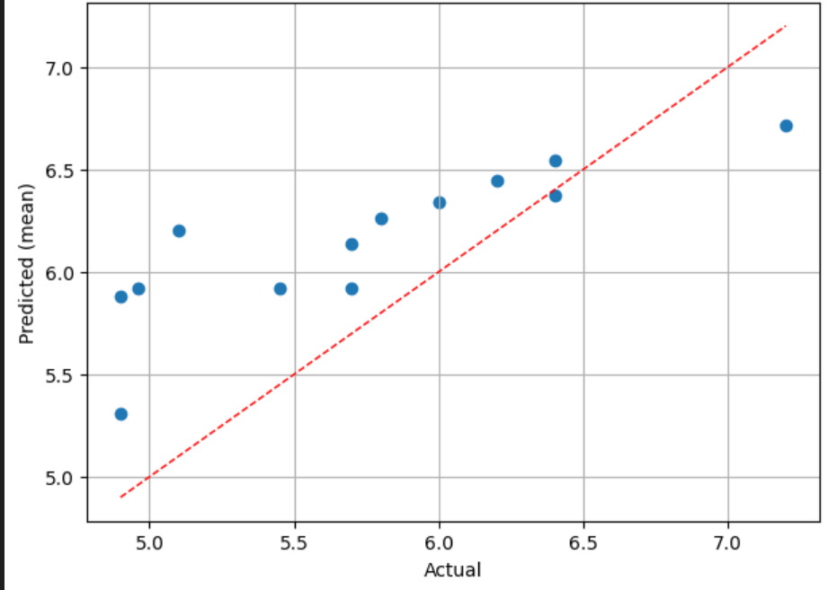
17-11-2025
Predicted value for Methanol (0-8) (gm/100 LAA)
No. | Model | RMSE | MAE | R2
1. | Ridge | 0.598 | 0.534 | 0.288
2. | Gradient boosting | 0.611 | 0.487 | 0.259
3. | SVR | 0.641 | 0.562 | 0.182
4. | Random forest | 0.654 | 0.528 | 0.150
5. | Elastic Net | 0.666 | 0.532 | 0.120
6. | Lasso | 0.668 | 0.532 | 0.115
7. | XGBoost | 0.679 | 0.555 | 0.083
55
​

Slide 56
17-11-2025
Predicted value for Methanol (0-8) (gm/100 LAA)
No | Original values | Predicted value | Lower limit | Upper Limit
419 | 6.2 | 5.91 | 5.588 | 6.220
347 | 6.9 | 6.101 | 5.85 | 6.326
201 | 5.8 | 6.231 | 5.92 | 6.480
665 | 6.8 | 6.646 | 6.233 | 7.111
895 | 6.4 | 6.728 | 6.228 | 7.182
238 | 6 | 6.183 | 5.895 | 6.421
1276 | 5.7 | 5.927 | 5.669 | 6.215
56
​

Slide 57
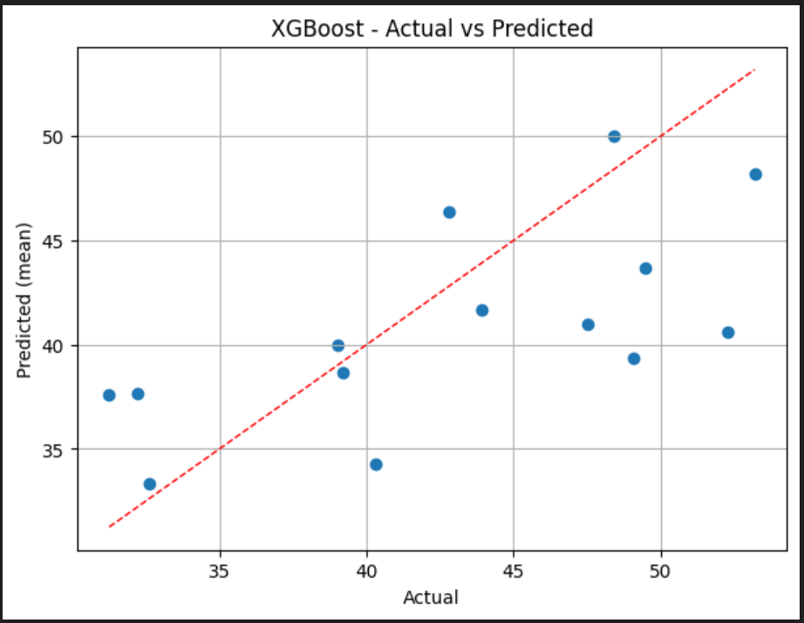
17-11-2025
Predicted value for Acetal (0-6.)(gm/100LAA)
No. | Model | RMSE | MAE | R2
1. | SVR | 0.909 | 0.721 | -0.550
2. | Ridge | 1.229 | 0.905 | -1.832
3. | XGBoost | 1.257 | 0.952 | -1.963
4. | Elastic Net | 1.274 | 0.952 | -2.044
5. | Lasso | 1.296 | 0.966 | -2.149
6. | Random forest | 1.443 | 0.959 | -2.905
7. | Gradient boosting | 1.930 | 1.229 | -5.981
57
​

Slide 58
17-11-2025
Predicted value for Acetal (0-6.0)(gm/100LAA)
No | Original values | Predicted value | Lower limit | Upper Limit
419 | 1 | 0.810 | 0.617 | 1.0323
14 | 1.45 | 1.005 | 0.810 | 1.306
964 | 0.9 | 0.834 | 0.615 | 1.097
92 | 1.2 | 0.993 | 0.787 | 1.302
182 | 1.3 | 1.014 | 0.881 | 1.332
1276 | 1.1 | 1.379 | 1.212 | 1.679
347 | 1.1 | 0.860 | 0.677 | 1.131
58
​

Slide 59
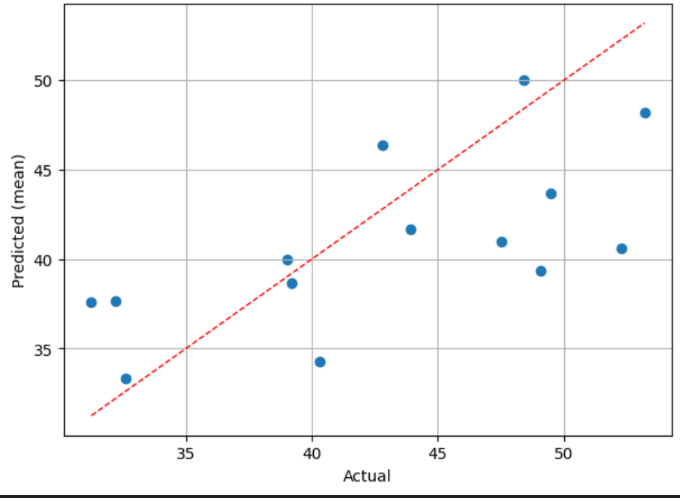
17-11-2025
Predicted value for Ethyl Acetate (20-60)(gm/100LAA)
No. | Model | RMSE | MAE | R2
1. | XGBoost | 5.824 | 4.761 | 0.341
2. | Gradeint boosting | 6.216 | 5.329 | 0.249
3. | Random forest | 6.305 | 5.190 | 0.227
4. | Lasso | 6.539 | 5.265 | 0.169
5. | Elastic net | 6.774 | 5.514 | 0.108
6. | Ridge | 6.799 | 5.540 | 0.102
7. | SVR | 6.807 | 5.499 | 0.099
59
​

Slide 60
17-11-2025
Predicted value for Ethyl Acetate (20-60)(gm/100LAA)
No | Original values | Predicted value | Lower limit | Upper Limit
964 | 48.4 | 49.997 | 41.647 | 54.5001
92 | 39.2 | 38.643 | 31.137 | 44.198
201 | 39 | 40.008 | 35.304 | 46.876
665 | 43.9 | 41.662 | 34.655 | 45.145
182 | 32.6 | 33.345 | 28.996 | 37.976
107 | 49.1 | 39.370 | 32.143 | 44.769
647 | 42.8 | 46.406 | 40.411 | 52.133
60
​

Slide 61
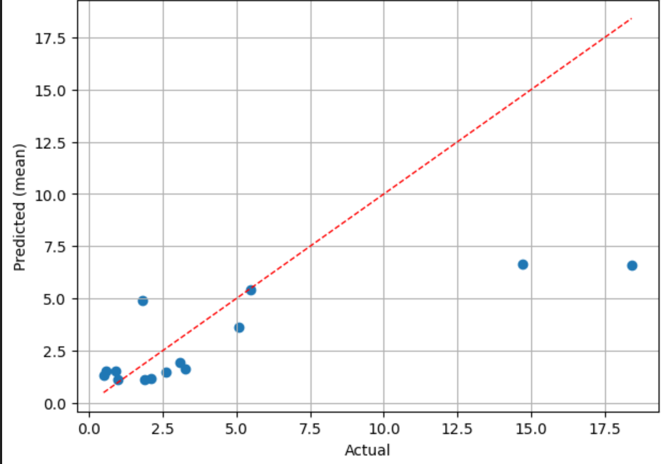
17-11-2025
Predicted value for Acetaldehyde (0-6.5)(gm/100LAA)
No. | Model | RMSE | MAE | R2
1. | XGBoost | 17.285 | 12.958 | 0.362
2. | Elastic net | 17.375 | 15.162 | 0.356
3. | Ridge | 17.396 | 15.402 | 0.354
4. | Random forest | 18.128 | 13.755 | 0.299
5. | SVR | 18.812 | 15.959 | 0.245
6. | Gradient boosting | 20.062 | 14.534 | 0.141
7. | Lasso | 21.342 | 16.813 | 0.028
61
​

Slide 62
17-11-2025
Predicted value for Acettaldehyde (0-6.5)(gm/100LAA)
No | Original values | Predicted value | Lower limit | Upper Limit
964 | 5.5 | 5.403 | 3.380 | 8.766
347 | 1.9 | 1.114 | 0.924 | 1.432
201 | 1 | 1.105 | 0.873 | 1.595
238 | 2.1 | 1.165 | 0.932 | 1.556
107 | 0.9 | 1.545 | 0.921 | 2.346
182 | 0.5 | 1.343 | 0.871 | 2.144
92 | 0.6 | 1.539 | 1.000 | 2.299
62
​

Slide 63
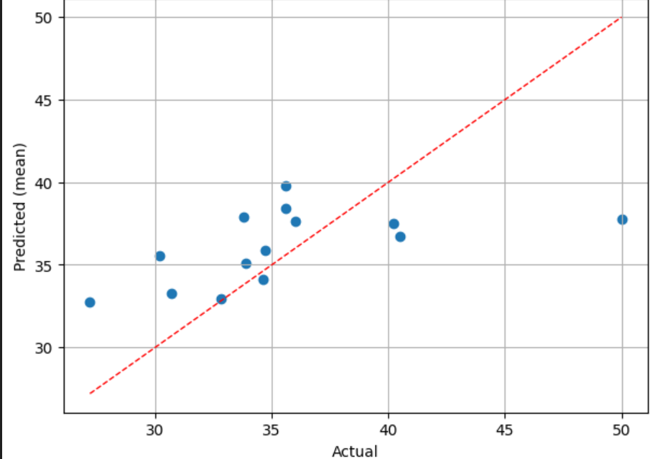
17-11-2025
Predicted value for n-Propanol (25-55)(gm/100LAA)
No. | Model | RMSE | MAE | R2
1. | XGBoost | 4.348 | 3.380 | 0.324
2. | Random forest | 4.488 | 3.451 | 0.279
3. | SVR | 4.633 | 2.931 | 0.232
4. | Elastic net | 4.656 | 3.002 | 0.224
5. | Lasso | 4.864 | 3.201 | 0.154
6. | Ridge | 5.250 | 3.867 | 0.014
7. | Gradient Boosting | 5.302 | 3.974 | -0.005
63
​

Slide 64
17-11-2025
Predicted value for n-Propanol (25-55)(gm/100LAA)
No | Original values | Predicted value | Lower limit | Upper Limit
14 | 34.72 | 35.907 | 33.868 | 38.603
964 | 33.9 | 35.072 | 32.340 | 38.1172
1047 | 34.6 | 34.150 | 32.119 | 36.219
347 | 40.2 | 37.483 | 33.861 | 40.518
895 | 32.8 | 32.962 | 31.073 | 35.188
238 | 35.6 | 38.449 | 34.810 | 40.894
1276 | 36 | 37.618 | 33.614 | 40.623
64
​

Slide 65
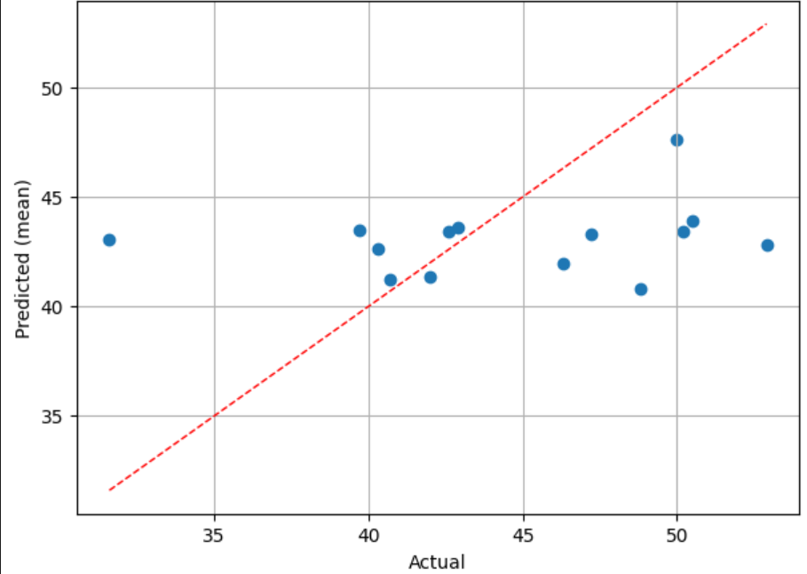
17-11-2025
Predicted value for Iso-butanol (20-60)(gm/100LAA)
No. | Model | RMSE | MAE | R2
1. | Ridge | 5.445 | 4.301 | 0.037
2. | SVR | 6.003 | 4.939 | -0.169
3. | Elastic net | 6.092 | 5.002 | -0.204
4. | Lasso | 6.096 | 5.010 | -0.205
5. | Random forest | 6.150 | 5.091 | -0.227
6. | XGBoost | 6.349 | 5.269 | -0.307
7. | Gradient boosting | 7.750 | 6.749 | -0.948
65
​

Slide 66
17-11-2025
Predicted value for Iso-butanol (20-60)(gm/100LAA)
No | Original values | Predicted value | Lower limit | Upper Limit
419 | 42.6 | 43.405 | 42.060 | 44.874
964 | 42 | 41.32 | 38.77 | 43.586
201 | 50 | 47.640 | 44.254 | 50.481
665 | 40.3 | 42.650 | 39.804 | 45.023
895 | 40.7 | 41.220 | 39.078 | 43.232
182 | 42.9 | 43.630 | 41.182 | 45.828
1276 | 47.2 | 43.274 | 41.472 | 45.240
66
​

Slide 67
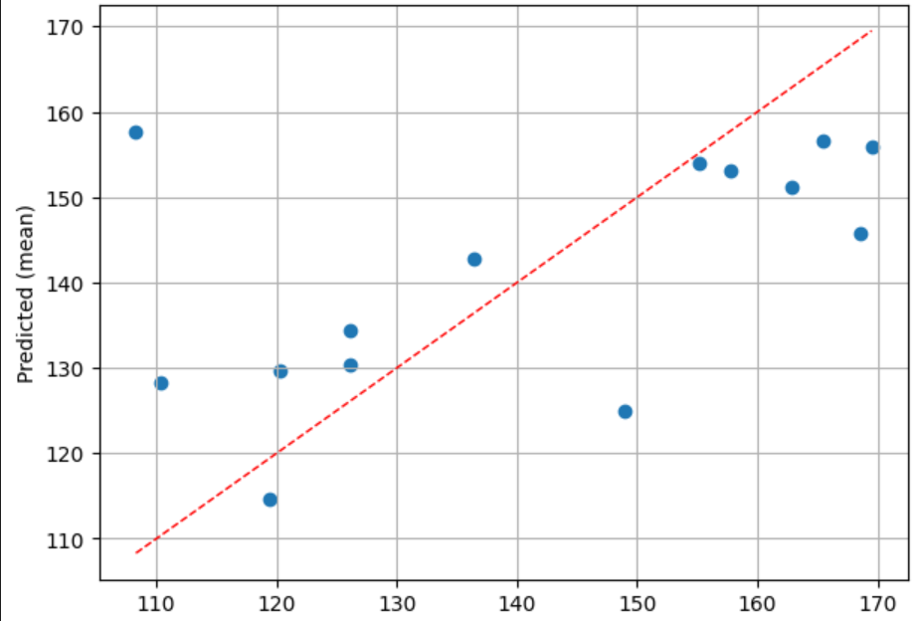
17-11-2025
Predicted value for Iso-Amyl Alcohol (85-200)(gm/100LAA)
No. | Model | RMSE | MAE | R2
1. | Ridge | 5.445 | 4.301 | 0.037
2. | SVR | 6.003 | 4.939 | -0.169
3. | Elastic net | 6.092 | 5.002 | -0.204
4. | Lasso | 6.096 | 5.010 | -0.205
5. | Random forest | 6.150 | 5.091 | -0.227
6. | XGBoost | 6.349 | 5.269 | -0.307
7. | Gradient boosting | 7.750 | 6.749 | -0.948
67
​

Slide 68
17-11-2025
Predicted value for Iso-Amyl Alcohol (85-200)(gm/100LAA)
No | Original values | Predicted value | Lower limit | Upper Limit
964 | 119.4 | 114.677 | 94.973 | 139.8166
347 | 155.1 | 153.891 | 137.396 | 169.153
201 | 165.5 | 156.634 | 142.048 | 168.773
665 | 120.3 | 129.689 | 106.916 | 149.96
238 | 157.7 | 153.043 | 137.03 | 169.074
182 | 136.4 | 142.842 | 128.007 | 160.053
107 | 162.9 | 151.130 | 139.127 | 162.368
68
​

Slide 69
25-11-2025
Why only backward/forward cannot be applied!!
Backward:
It fails due to multi-collinearity
It works best when number of parameter are less than 20
Backward uses a logistic regressiom model
Is slow and can get stuck
Do not reduce dimensionality
Cannot detect interaction between features
Forward:
Number of features is small (30-40)
Multi collinearity is low
Variables have strong correlation
Goal is prediction and not explainability of the features
Sample size is learge and class are balanced.
69
​

Slide 70
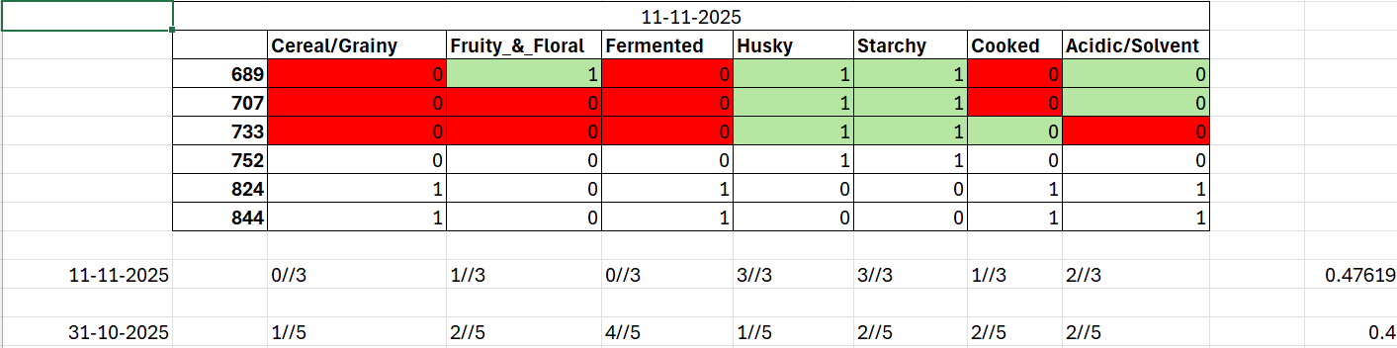
25-11-2025
Prediction Analysis
70
​

Slide 71
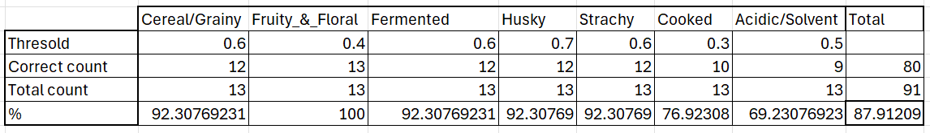
27-11-2025
Prediction Analysis
71
​

Slide 72
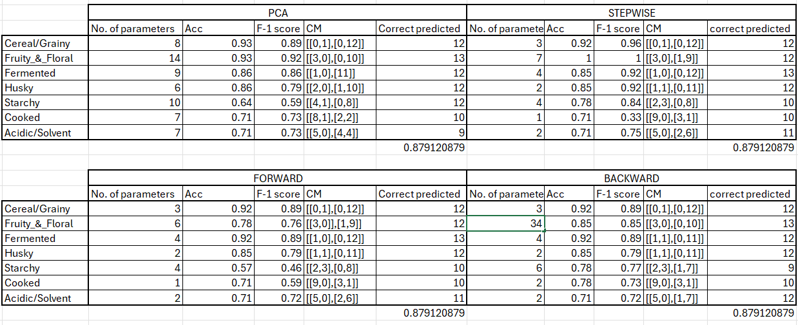
26-11-2025
Prediction Analysis by stepwise, forward, backward
72​

Slide 73
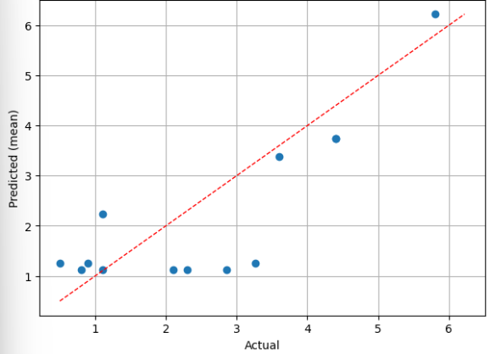
27-11-2025
Predicted value for Acetaldehyde (0-6.5) (gm/100 LAA)
No. | Model | RMSE | MAE | R2
1. | XGBoost | 0.955 | 0.74 | 0.64
2. | SVR | 1.114 | 0.91 | 0.51
3. | Gradient Boosting | 1.139 | 0.92 | 0.49
4. | Random forest | 1.183 | 0.90 | 0.45
5. | Ridge | 1.244 | 1.08 | 0.40
6. | Lasso | 1.265 | 1.08 | 0.37
7. | Elastic net | 1.267 | 1.08 | 0.37
73
​

Slide 74
27-11-2025
Predicted value for Acetaldehyde (0-6.5) (gm/100 LAA)
No | Original values | Predicted value | Lower limit | Upper Limit
1129 | 4.4 | 3.74 | 0 | 6.5
1245 | 1.1 | 1.12 | 0 | 6.5
980 | 4.4 | 3.74 | 0 | 6.5
879 | 3.6 | 3.38 | 0 | 6.5
681 | 5.8 | 6.22 | 0 | 6.5
640 | 1.1 | 2.24 | 0 | 6.5
238 | 2.1 | 1.12 | 0 | 6.5
74
​

Slide 75
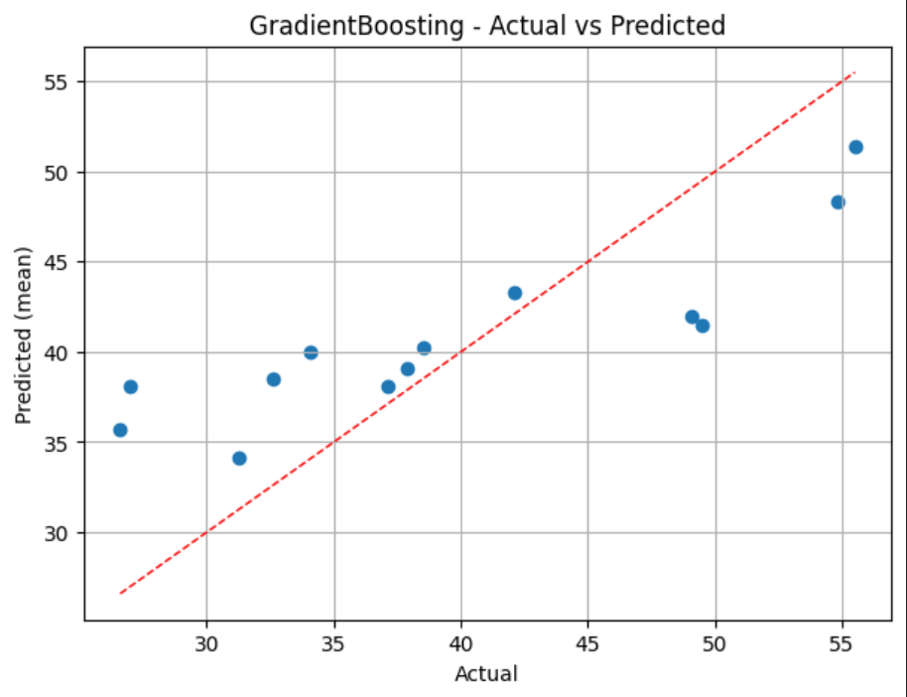
27-11-2025
Predicted value for Ethyl acetate (20-60) (gm/100 LAA)
No. | Model | RMSE | MAE | R2
1. | Gradient boosting | 6.15 | 5.29 | 0.577
2. | XGBoost | 6.27 | 5.39 | 0.560
3. | Random forest | 6.30 | 5.35 | 0.556
4. | ridge | 6.37 | 5.30 | 0.546
5. | lasso | 6.51 | 5.43 | 0.527
6. | Elastic net | 6.55 | 5.49 | 0.521
7. | SVR | 8.21 | 7.08 | 0.246
75
​

Slide 76
27-11-2025
Predicted value for Ethyl acetate (20-60) (gm/100 LAA)
No | Original values | Predicted value | Lower limit | Upper Limit
1245 | 37.9 | 39.05 | 20 | 60
14 | 31.25 | 34.09 | 20 | 60
1260 | 34.08 | 39.99 | 20 | 60
303 | 37.1 | 38.09 | 20 | 60
640 | 38.5 | 40.26 | 20 | 60
681 | 42.1 | 43.30 | 20 | 60
879 | 55.5 | 51.39 | 20 | 60
76
​

Slide 77
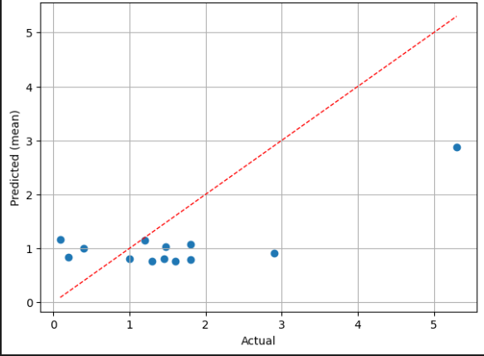
27-11-2025
Predicted value for Acetal (0-6)(gm/100LAA)
No. | Model | RMSE | MAE | R2
1. | Gradient boosting | 1.02 | 0.84 | 0.37
2. | XGBoost | 1.08 | 0.85 | 0.29
3. | Random forest | 1.10 | 0.85 | 0.26
4. | Lasso | 1.17 | 0.85 | 0.17
5. | Ridge | 1.19 | 0.85 | 0.15
6. | Elastic net | 1.19 | 0.85 | 0.14
7. | SVR | 1.27 | 0.91 | 0.02
77
​

Slide 78
27-11-2025
Predicted value for Acetal (0-6)(gm/100LAA)
No | Original values | Predicted value | Lower limit | Upper Limit
1245 | 1.2 | 1.15 | 0 | 6
980 | 0.2 | 0.83 | 0 | 6
303 | 1 | 0.80 | 0 | 6
681 | 0.4 | 0.99 | 0 | 6
1260 | 1.48 | 1.03 | 0 | 6
14 | 1.45 | 0.80 | 0 | 6
238 | 1.8 | 1.07 | 0 | 6
78
​

Slide 79
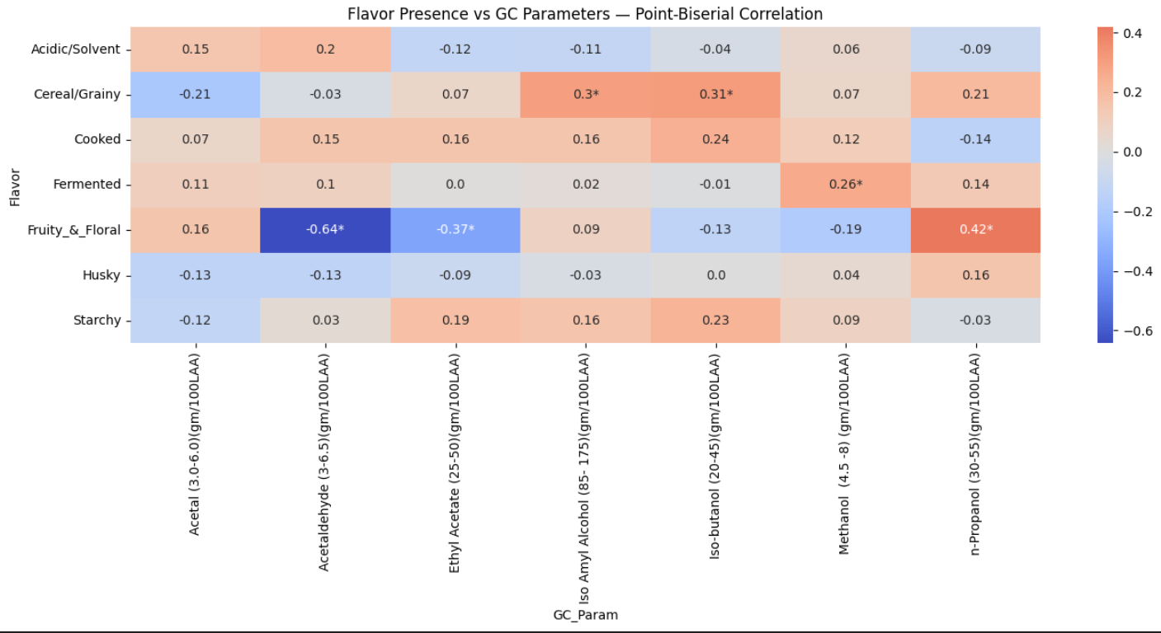
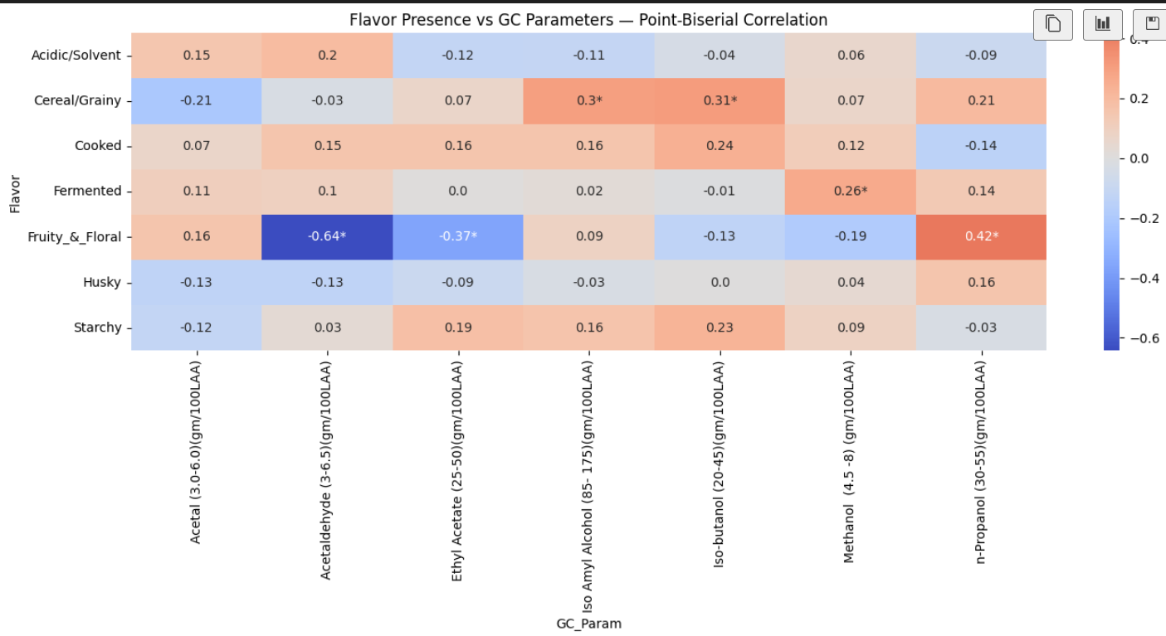
28-11-2025
Correlation between sensory output and GC parameters
79
​

Slide 80
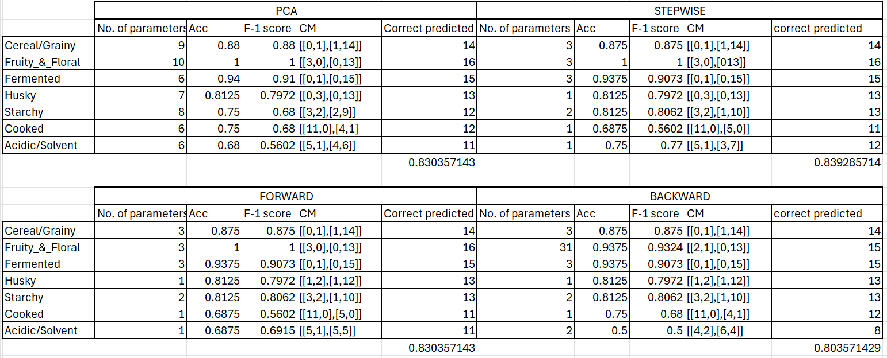
Results after 60 batches for train and 16 for test
79
​

Slide 81
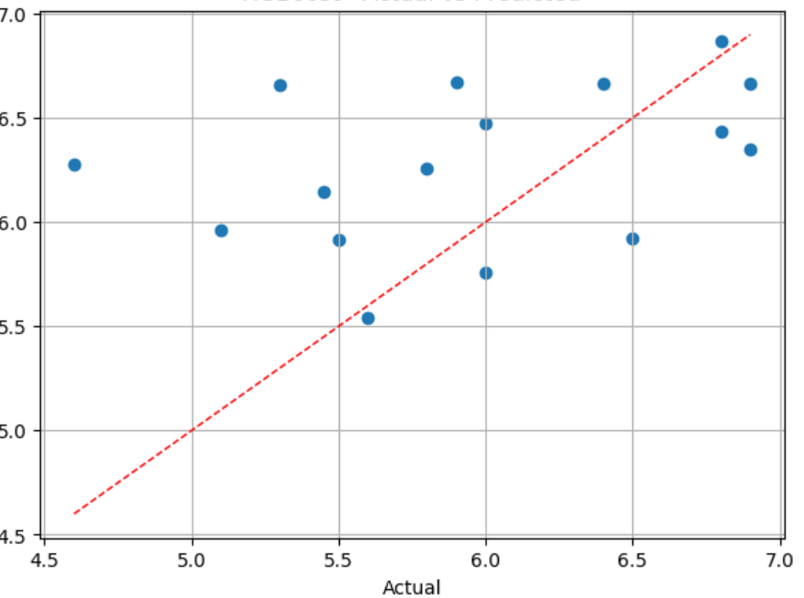
9-12-2025
Predicted value for Methanol (0-8) (gm/100 LAA)
No. | Model | RMSE | MAE | R2
1. | XGboost | 0.693 | 0.559 | -0.04
2. | Graidient boosting | 0.701 | 0.584 | -0.07
3. | SVR | 0.704 | 0.605 | -0.08
4. | Lasso | 0.722 | 0.605 | -0.13
5. | Elastic net | 0.722 | 0.60 | -0.14
6. | Random forest | 0.726 | 0.580 | -0.15
7. | ridge | 0.852 | 0.672 | -0.58
55
​

Slide 82
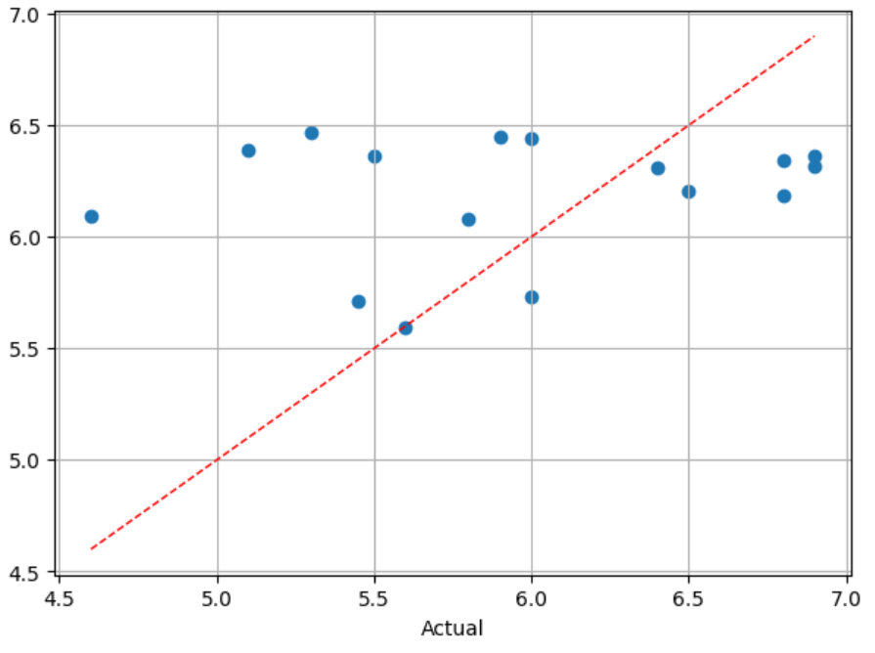
4-12-2025
Predicted value for Methanol_s (0-8) (gm/100 LAA)
No. | Model | RMSE | MAE | R2
1. | svr | 0.697 | 0.573 | -0.06
2. | ridge | 0.737 | 0.593 | -0.18
3. | Elastic net | 0.738 | 0.597 | -0.19
4. | lasso | 0.739 | 0.596 | -0.19
5. | Random forest | 0.786 | 0.624 | -0.35
6. | xgboost | 0.831 | 0.646 | -0.56
7. | Gradient boosting | 0.875 | 0.689 | -0.67
55
​

Slide 83
4-12-2025
Predicted value for Methanol (0-8) (gm/100 LAA)
No | Original values | Predicted value | Lower limit | Upper Limit
689 | 5.6 | 5.54 | 0 | 8
1147 | 6 | 5.755 | 0 | 8
935 | 6.9 | 6.667 | 0 | 8
1180 | 5.5 | 5.91 | 0 | 8
1230 | 6.5 | 5.91 | 0 | 8
347 | 6.9 | 6.35 | 0 | 8
1014 | 6.8 | 6.86 | 0 | 8
56
​

Slide 84
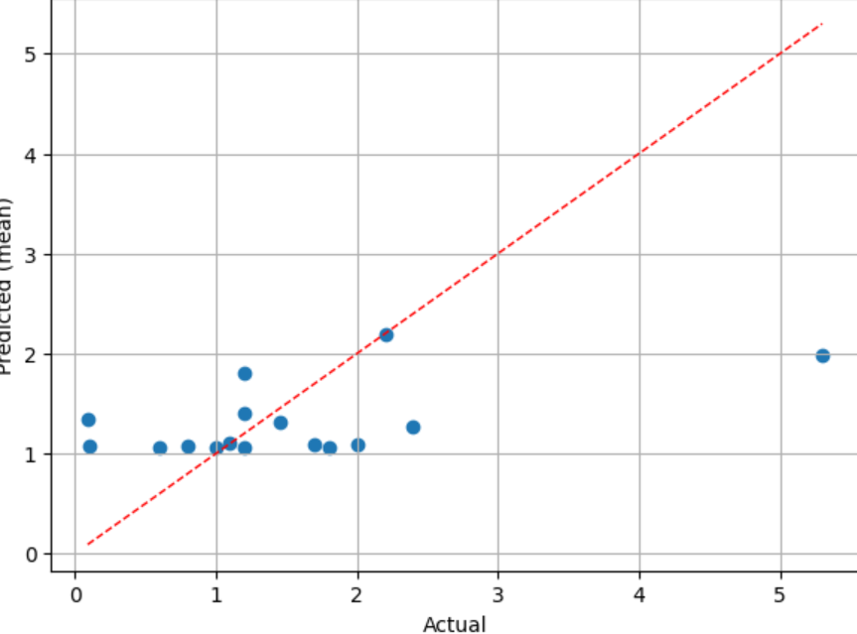
17-11-2025
Predicted value for Acetal (0-6) (gm/100 LAA)
No. | Model | RMSE | MAE | R2
1. | ridge | 1.035 | 0.676 | 0.22
2. | lasso | 1.037 | 0.724 | 0.21
3. | Elastic net | 1.039 | 0.690 | 0.21
4. | Random forest | 1.145 | 0.776 | 0.04
5. | xgboost | 1.19 | 0.810 | -0.04
6. | svr | 1.202 | 0.790 | -0.04
7. | Gradient boosting | 1.242 | 0.875 | -0.12
55
​

Slide 85
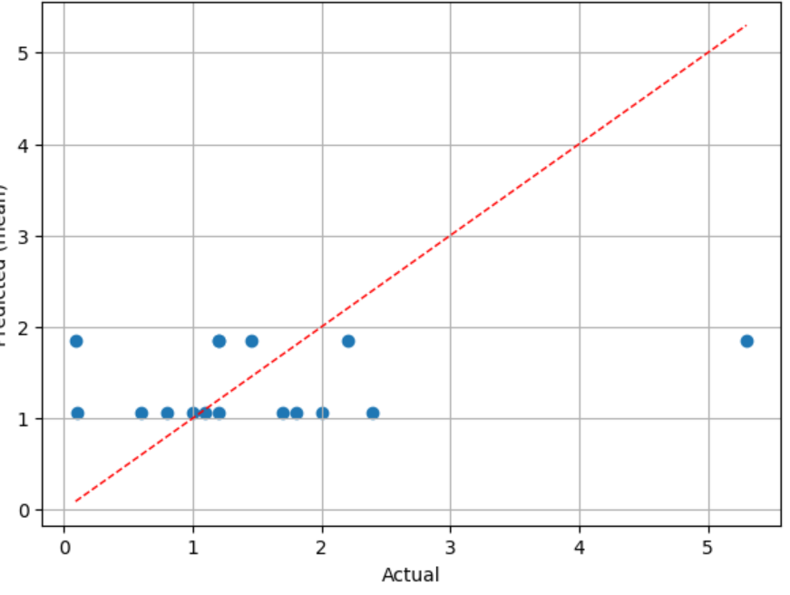
Predicted value for Acetal_s (0-6) (gm/100 LAA)
No. | Model | RMSE | MAE | R2
1. | Elastic net | 1.144 | 0.800 | 0.049
2. | lasso | 1.145 | 0.811 | 0.047
3. | ridge | 1.148 | 0.813 | 0.0043
4. | xgboost | 1.162 | 0.828 | 0.019
5. | Random forest | 1.664 | 0.850 | 0.012
6. | Gradient boosting | 1.209 | 0.880 | -0.06
7. | svr | 1.218 | 0.830 | -0.07
55
​

Slide 86
Predicted value for Acetal (0-6) (gm/100 LAA)
No | Original values | Predicted value | Lower limit | Upper Limit
92 | 1.2 | 1.40 | 5.588 | 6.220
689 | 1.2 | 1.06 | 5.85 | 6.326
1147 | 2.2 | 2.18 | 5.92 | 6.480
935 | 2 | 1.08 | 6.233 | 7.111
347 | 1.1 | 1.11 | 6.228 | 7.182
238 | 1.8 | 1.06 | 5.895 | 6.421
780 | 1 | 1.06 | 5.669 | 6.215
56
​

Slide 87
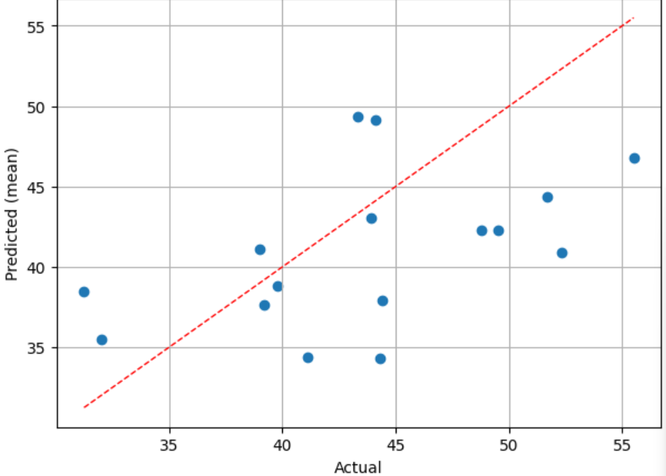
Predicted value for Ethyl_Acetate (20-60) (gm/100 LAA)
No. | Model | RMSE | MAE | R2
1. | Random forest | 6.456 | 5.671 | 0.03
2. | Gradient boosting | 6.580 | 5.483 | 0.00
3. | xgboost | 6.612 | 5.600 | 0.00
4. | elasticnet | 7.001 | 5.813 | -0.12
5. | ridge | 7.378 | 5.890 | -0.25
6. | svr | 7.474 | 6.260 | -0.28
7. | lasso | 7.945 | 6.668 | -0.45
55
​

Slide 88
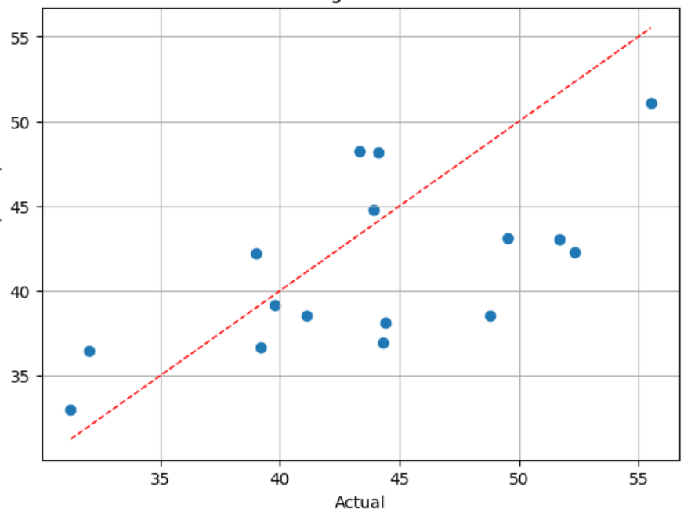
Predicted value for Ethyl_Acetate_s (20-60) (gm/100 LAA)
No. | Model | RMSE | MAE | R2
1. | Gradient boosting | 5.15 | 4.24 | 0.38
2. | Random forest | 5.73 | 5.05 | 0.24
3. | xgboost | 6.14 | 5.08 | 0.13
4. | svr | 6.32 | 5.35 | 0.07
5. | ridge | 6.987 | 6.22 | -0.12
6. | Elastic net | 7.02 | 6.26 | -0.13
7. | lasso | 7.05 | 6.28 | -0.14
55
​

Slide 89
Predicted value for Ethyl_Acetate_s (20-60) (gm/100 LAA)
No | Original values | Predicted value | Lower limit | Upper Limit
689 | 39.8 | 39.15 | 20 | 60
14 | 31.25 | 32.998 | 20 | 60
935 | 44.1 | 48.19 | 20 | 60
665 | 43.9 | 44.78 | 20 | 60
92 | 39.2 | 36.680 | 20 | 60
201 | 39 | 42.182 | 20 | 60
1147 | 32 | 36.478 | 20 | 60
56
​

Slide 90
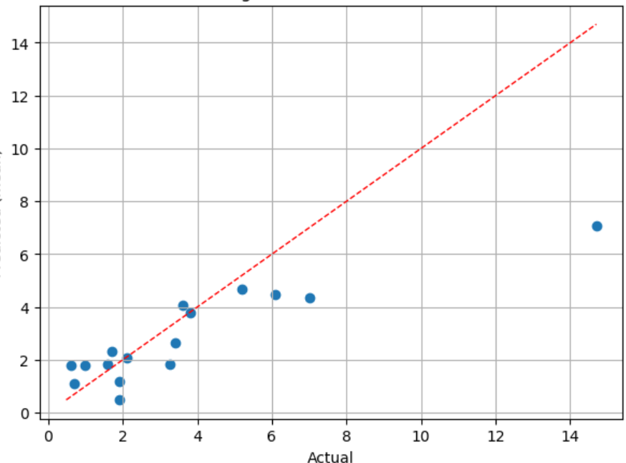
Predicted value for Acetaldehyde (0-6.5) (gm/100 LAA)
No. | Model | RMSE | MAE | R2
1. | ridge | 1.761 | 1.086 | 0.729
2. | Random forest | 2.078 | 1.322 | 0.62
3. | xgboost | 2.185 | 1.460 | 0.583
4. | Gradient boosting | 2.539 | 1.747 | 0.437
5. | Elastic net | 2.946 | 1.907 | 0.243
6. | lasso | 2.954 | 1.937 | 0.239
7. | svr | 2.982 | 1.614 | 0.224
55
​

Slide 91
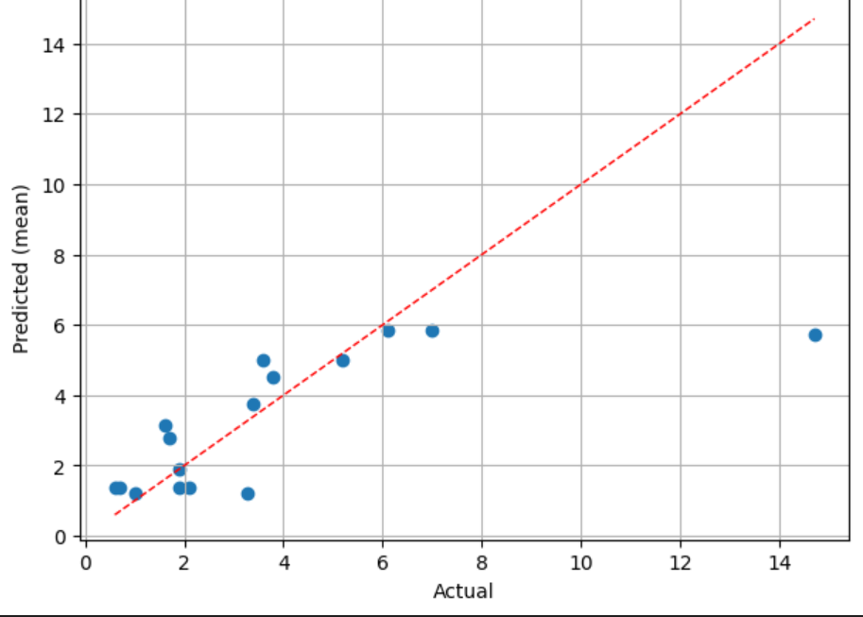
Predicted value for Acetaldehyde_s (0-6.5) (gm/100 LAA)
No. | Model | RMSE | MAE | R2
1. | Random forest | 2.515 | 1.417 | 0.448
2. | Gradient boosting | 2.621 | 1.520 | 0.400
3. | xgboost | 2.693 | 1.622 | 0.367
4. | svr | 3.006 | 1.554 | 0.212
5. | lasso | - | - | -
6. | Elastic net | - | - | -
7. | ridge | - | - | -
55
​

Slide 92
Predicted value for Acetaldehyde (0-6.5) (gm/100 LAA)
No | Original values | Predicted value | Lower limit | Upper Limit
1147 | 1.6 | 1.83 | 0 | 6.5
935 | 3.8 | 3.77 | 0 | 6.5
879 | 3.6 | 4.05 | 0 | 6.5
522 | 0.7 | 1.08 | 0 | 6.5
1230 | 1.7 | 2.30 | 0 | 6.5
347 | 1.9 | 1.20 | 0 | 6.5
1014 | 5.2 | 4.66 | 0 | 6.5
56
​

Slide 93
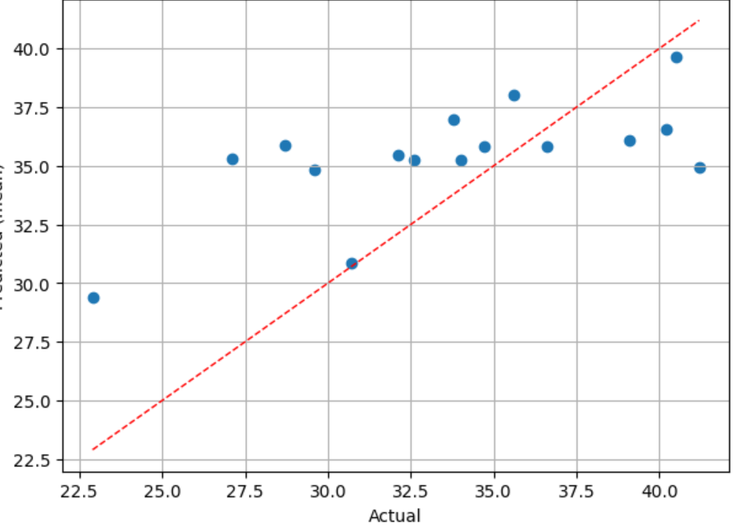
Predicted value for n-Propanol (25-55) (gm/100 LAA)
No. | Model | RMSE | MAE | R2
1. | Elastic net | 3.720 | 3.098 | 0.44
2. | lasso | 3.916 | 3.265 | 0.38
3. | svr | 4.239 | 3.266 | 0.28
4. | Random forest | 4.493 | 3.838 | 0.19
5. | xgboost | 4.899 | 3.983 | 0.04
6. | Gradient boosting | 5.050 | 4.290 | -0.01
7. | ridge | 8.111 | 5.583 | -1.61
55
​

Slide 94

Predicted value for n-Propanol_s (25-55) (gm/100 LAA)
No. | Model | RMSE | MAE | R2
1. | svr | 3.576 | 2.833 | 0.490
2. | Elastic net | 3.917 | 3.209 | 0.388
3. | ridge | 3.919 | 3.158 | 0.388
4. | lasso | 3.933 | 3.243 | 0.383
5. | Random forest | 3.984 | 3.29 | 0.367
6. | xgboost | 4.250 | 3.749 | 0.280
7. | Gradient boosting | 4.304 | 3.924 | 0.262
55
​

Slide 95
Predicted value for n-Propanol_s (25-55) (gm/100 LAA)
No | Original values | Predicted value | Lower limit | Upper Limit
92 | 33.8 | 34.30 | 25 | 55
689 | 22.9 | 27.80 | 25 | 55
201 | 40.5 | 36.93 | 25 | 55
798 | 32.1 | 32.11 | 25 | 55
879 | 32.6 | 33.909 | 25 | 55
347 | 40.2 | 37.25 | 25 | 55
238 | 35.6 | 38.35 | 25 | 55
56
​

Slide 96

Predicted value for Iso_butanol (20-60) (gm/100 LAA)
No. | Model | RMSE | MAE | R2
1. | Random forest | 3.796 | 3.070 | 0.68
2. | xgboost | 4.145 | 3.179 | 0.62
3. | Gradient boosting | 4.477 | 3.288 | 0.56
4. | ridge | 4.508 | 3.638 | 0.55
5. | lasso | 4.738 | 3.342 | 0.51
6. | Elastic net | 5.089 | 3.488 | 0.42
7. | svr | 5.416 | 3.910 | 0.36
55
​

Slide 97

Predicted value for Iso_butanol_s (20-60) (gm/100 LAA)
No. | Model | RMSE | MAE | R2
1. | Random forest | 5.981 | 4.371 | 0.22
2. | Gradient boosting | 6.370 | 4.971 | 0.11
3. | xgboost | 6.596 | 5.026 | 0.05
4. | lasso | 6.664 | 5.278 | 0.03
5. | ridge | 6.777 | 5.411 | 0.00
6. | Elastic net | 6.789 | 5.417 | -0.001
7. | svr | 6.930 | 5.464 | -0.04
55
​

Slide 98
Predicted value for Iso-Butanol (20-60) (gm/100 LAA)
No | Original values | Predicted value | Lower limit | Upper Limit
689 | 32 | 32.77 | 20 | 60
780 | 35.5 | 38.45 | 20 | 60
879 | 41.4 | 41.23 | 20 | 60
1230 | 44 | 46.84 | 20 | 60
665 | 40.3 | 40.67 | 20 | 60
1014 | 42.4 | 41.93 | 20 | 60
1147 | 40.7 | 35.09 | 20 | 60
56
​

Slide 99

Predicted value for Iso_amyl_alcohol (85-200) (gm/100 LAA)
No. | Model | RMSE | MAE | R2
1. | Random forest | 14.45 | 10.93 | 0.66
2. | Elastic net | 15.70 | 12.04 | 0.59
3. | lasso | 16.60 | 12.40 | 0.55
4. | Gradient boosting | 17.83 | 14.51 | 0.48
5. | xgboost | 18.17 | 15.16 | 0.46
6. | ridge | 22.72 | 17.43 | 0.15
7. | svr | 24.01 | 18.07 | 0.06
55
​

Slide 100

Predicted value for Iso_amyl_alcohol_s (85-200) (gm/100 LAA)
No. | Model | RMSE | MAE | R2
1. | lasso | 20.944 | 16.62 | 0.28
2. | Gradient boosting | 21.77 | 17.03 | 0.22
3. | Random forest | 23.22 | 17.76 | 0.12
4. | xgboost | 24.692 | 19.13 | 0.00
5. | Elastic net | 25.357 | 20.42 | -0.04
6. | ridge | 26.637 | 21.47 | -0.153
7. | svr | 26.665 | 20.09 | -0.156
55
​

Slide 101
Predicted value for Iso-amyl_alcohol (85-200) (gm/100 LAA)
No | Original values | Predicted value | Lower limit | Upper Limit
201 | 165.5 | 163.60 | 85 | 200
780 | 110.8 | 114.254 | 85 | 200
879 | 134.4 | 130.484 | 85 | 200
522 | 159 | 161.815 | 85 | 200
1014 | 131.4 | 132.83 | 85 | 200
665 | 120.3 | 133.36 | 85 | 200
935 | 95.9 | 110.36 | 85 | 200
56
​

Slide 102

Correlation between sensory and Gc parameters
56
​

Slide 103

GC parameters range prediction as per sensory output's intensity
56
​

Slide 104

16-12-25
VIF values Cereal/Grainy
No. | Parameter | VIF | Importance score
1. | Wort initial gravity (25L vessel) | 2.421 | 0.060
2. | Screening- below 2.2 mm sieve | 2.292 | 0.063
3. | Final wash temperature_fermented wash | 2.267 | 0.060
4. | Yeast storage temperature, deg C | 1.757 | 0.047
5. | Final wash turbidity | 1.661 | 0.088
6. | Spirit still temperature-mean_spirit_B (max) | 1.507 | 0.072
7. | Wort receiver temperature | 1.506 | 0.042
8. | Low wine alcohol % obtained_spirit_A | 1.138 | 0.031
9. | Wort final gravity (25L vessel) | 1.098 | 0.056
Accuracy | F-1 score | Sensitivity | Specificity | CM | CM (test)
0.93 | 0.90 | 1 | 0.75 | $$\left[\begin{matrix}4 & 0 \\ 0 & 52\end{matrix}\right]$$ | $$\left[\begin{matrix}0 & 1 \\ 0 & 13\end{matrix}\right]$$
48
​

Slide 105

VIF values Fruity_&_Floral
No. | Parameter | VIF | Importance score
1. | Yeast shelf-life at the time of use (C-70 yeast) | 8.801 | 0.0105
2. | Grist ratio on milling-1 Fine | 7.276 | 0.0104
3. | Strength in PL | 6.146 | 0.0104
4. | Avg ABV in FMS spirit B | 5.688 | 0.0103
5. | % shelf life available spezyme alpha NK | 4.273 | 0.0102
6. | Time of addition of enzyme (Proteinase T) | 3.924 | 0.0102
7. | Recovery PL/Ton of malt | 3.378 | 0.0105
8. | Spirit condenser temperature-mean_spirit B | 3.001 | 0.0103
Accuracy | F-1 score | Sensitivity | Specificity | CM | CM (test)
1.0 | 1.0 | 0.87 | 0.76 | $$\left[\begin{matrix}4 & 0 \\ 0 & 52\end{matrix}\right]$$ | $$\left[\begin{matrix}0 & 1 \\ 0 & 13\end{matrix}\right]$$
48
​

Slide 106
VIF values Fermented
No. | Parameter | VIF | Importance score
1. | Set-up wort pH | 1.493 | 0.055
2. | Wort final gravity (700L vessel) | 1.471 | 0.058
3. | Malt foreign matter | 1.296 | 0.069
4. | Low wine alcohol % obtained Spirit A | 1.166 | 0.017
5. | Malt hot water extract on dry weight basis (min) | 1.161 | 0.020
6. | Spirit distillation rate- mean spirit_B | 1.042 | 0.093
Accuracy | F-1 score | Sensitivity | Specificity | CM | CM (test)
0.875 | 0.875 | 0.94 | 0.833 | $$\left[\begin{matrix}4 & 0 \\ 0 & 52\end{matrix}\right]$$ | $$\left[\begin{matrix}0 & 1 \\ 0 & 13\end{matrix}\right]$$
48
​

Slide 107
VIF values Husky
No. | Parameter | VIF | Importance score
1. | Wash still temperature(Max)-mean | 8.203 | 0.060
2. | % shelf-life available Proteinase T | 6.197 | 0.059
3. | Grist ratio on miling-1 course | 5.956 | 0.058
4. | Weak work output temperature | 2.983 | 0.046
5. | Wash condenser temperature (Max)-Mean | 2.494 | 0.160
6. | Sparging water temperature | 1.971 | 0.009
7. | Spirit still temperature-mean spirit_B (Max) | 1.93 | 0.026
Accuracy | F-1 score | Sensitivity | Specificity | CM | CM (test)
0.81 | 0.72 | 0.82 | 0.55 | $$\left[\begin{matrix}4 & 0 \\ 0 & 52\end{matrix}\right]$$ | $$\left[\begin{matrix}0 & 1 \\ 0 & 13\end{matrix}\right]$$
48
​

Slide 108
VIF values Starchy
No. | Parameter | VIF | Importance score
1. | Strength in PL MERGE | 7.589 | 0.022
2. | Average ABV in FMS_spirit_A | 6.047 | 0.019
3. | Draff loss | 4.849 | 0.021
4. | Screening-below 2.2 mm sieve | 3.698 | 0.018
5. | Recovery PL/Ton of Malt | 3.656 | 0.021
6. | Mashing temperature | 2.676 | 0.020
7. | Set-up wort pH | 2.331 | 0.016
8. | Wort final gravity (700L vessel) | 2.116 | 0.016
Accuracy | F-1 score | Sensitivity | Specificity | CM | CM (test)
0.62 | 0.63 | 0.87 | 0.55 | $$\left[\begin{matrix}4 & 0 \\ 0 & 52\end{matrix}\right]$$ | $$\left[\begin{matrix}0 & 1 \\ 0 & 13\end{matrix}\right]$$
48
​

Slide 109
VIF values Cooked
No. | Parameter | VIF | Importance score
1. | % shelf life available optimash TBG | 6.784 | 0.113
2. | Wash still temperature (max)-mean | 5.519 | 0.099
3. | Time of addition of enzyme (Proteinase T) | 3.564 | 0.096
4. | Spirit condenser temperature-mean_spirit_B | 2.148 | 0.085
5. | Wort initial pH (2500 L vessel) | 1.842 | 0.064
6. | Ph_Process water | 1.310 | 0.025
Accuracy | F-1 score | Sensitivity | Specificity | CM | CM (test)
0.68 | 0.56 | 0.36 | 0.82 | $$\left[\begin{matrix}4 & 0 \\ 0 & 52\end{matrix}\right]$$ | $$\left[\begin{matrix}0 & 1 \\ 0 & 13\end{matrix}\right]$$
48
​

Slide 110
VIF values Acidic/Solvent
No. | Parameter | VIF | Importance score
1. | Strength in PL merge | 7.449 | 0.116
2. | Average ABV in FMS spirit _A | 5.379 | 0.108
3. | Wort final gravity (700 L vessel ) | 2.655 | 0.078
4. | Mashing temperature | 2.152 | 0.073
5. | Low wine turbidity Mean_Spirit_B | 2.008 | 0.047
6. | Wort initial gravity 700 L | 1.317 | 0.020
Accuracy | F-1 score | Sensitivity | Specificity | CM | CM (test)
0.5 | 0.5 | 0.83 | 0.52 | $$\left[\begin{matrix}4 & 0 \\ 0 & 52\end{matrix}\right]$$ | $$\left[\begin{matrix}0 & 1 \\ 0 & 13\end{matrix}\right]$$
48
​

Slide 111

Intensity Prediction
48
​

Slide 112

Intensity Prediction
48
​

Slide 113
Intensity Features for Cereal/Grainy
No. | Parameter | VIF
1. | % shelf life available Spezyme alpha NK | 6.078
2. | Time of addition of enzyme (Proteinase T) | 4.234
3. | Sparging water temperature | 3.051
Accuracy | Weighted F-1 | Macro precision | Macro Recall | Correctly predicted
0.87 | 0.87 | 0.86 | 0.80 | 14$\left[\begin{matrix}4 & 0 \\ 0 & 52\end{matrix}\right]$
48
​

Slide 114
Intensity Features for Fruity_&_Floral
No. | Parameter | VIF
1. | Low wine turbidity-3 (8 hr) | 1.095
2. | % shelf life available diazyme TGA | 1.059
3. | Final wash ph_fermented wash | 1.052
Accuracy | Weighted F-1 | Macro precision | Macro Recall | Correctly predicted
0.75 | 0.75 | 0.66 | 0.73 | 12$\left[\begin{matrix}4 & 0 \\ 0 & 52\end{matrix}\right]$
48
​

Slide 115

Intensity Features for Fermented
No. | Parameter | VIF
1. | Yeast shelf-life at the time of use (C-70 yeast) | 9.152
2. | Grist ratio on miling-1 fine | 7.987
3. | Wort initial gravity (2500L vessel) | 7.305
4. | Feint volume seperated_spirit_A | 6.839
5. | Wash still temperature (max)-mean | 6.641
6. | % shelf life available spezyme alpha NK | 5.094
7. | Time of addition of enzyme (Proteinase T) | 4.925
8. | Spirit condenser temperature-mean spirit_B | 3.282
9. | Wort initial pH (2500 L vessel) | 2.320
10. | Ph process water | 1.835
Accuracy | Weighted F-1 | Macro precision | Macro Recall | Correctly predicted
0.75 | 0.72 | 0.59 | 0.41 | 12$\left[\begin{matrix}4 & 0 \\ 0 & 52\end{matrix}\right]$
48
​

Slide 116

Intensity Features for Husky
No. | Parameter | VIF
1. | Spirit still temperature-mean_spirit_B (max) | 1.314
2. | Spirit still temperature-mean_spirit_A (max) | 1.238
3. | Sparging water temperature | 1.063
4. | 1000 kernel weight (min) | 1.051
Accuracy | Weighted F-1 | Macro precision | Macro Recall | Correctly predicted
0.87 | 0.87 | 0.86 | 0.80 | 14$\left[\begin{matrix}4 & 0 \\ 0 & 52\end{matrix}\right]$
48
​

Slide 117
Intensity Features for Starchy
No. | Parameter | VIF
1. | Wort receiver temperature | 2.746
2. | Weak wort output temperature | 2.734
3. | Screening- above 2.8 mm sieve | 2.023
4. | Wort final gravity (700L vessel) | 1.958
5. | Fermentability (min) | 1.590
6. | Recovery of FMS_Spirit_A | 1.309
7. | Grist ratio on milling-mean of 1-3 medium | 1.290
Accuracy | Weighted F-1 | Macro precision | Macro Recall | Correctly predicted
0.50 | 0.50 | 0.51 | 0.48 | 8$\left[\begin{matrix}4 & 0 \\ 0 & 52\end{matrix}\right]$
48
​

Slide 118
Intensity Features for Cooked
No. | Parameter | VIF
1. | Grist ratio on miling-1 medium | 1.170
2. | Final wash turbidity | 1.155
3. | Fermentable sugar (optional) wort | 1.099
Accuracy | Weighted F-1 | Macro precision | Macro Recall | Correctly predicted
0.87 | 0.87 | 0.86 | 0.80 | 14$\left[\begin{matrix}4 & 0 \\ 0 & 52\end{matrix}\right]$
48
​

Slide 119
Intensity Features for Acidic/Solvent
No. | Parameter | VIF
1. | Time of addition of enzyme (spezyme alpha NK) | 1.060
2. | Mashing temperature | 1.060
Accuracy | Weighted F-1 | Macro precision | Macro Recall | Correctly predicted
0.4 | 0.39 | 0.35 | 0.41 | 6$\left[\begin{matrix}4 & 0 \\ 0 & 52\end{matrix}\right]$
48
​

Slide 120

EDA for intensity:
Acidic/Solvent
48
​

Slide 121


EDA for intensity:
Husky
48
​

Slide 122


EDA for intensity:
Cereal/Grainy
48
​

Slide 123


EDA for category scale:
1214-2 and 489
1260-1 and 1294-1
48
​

Slide 124


EDA for category scale:
107 and 257
347 and 398
48
​

Slide 125

EDA for category scale:
1276-1 and 182
48
​

Slide 126

Prediction for Category Scale:
48
​

Slide 127

Features in each components
48
​

Slide 128

Prediction for Category Scale:
48
​

Slide 129

Prediction for Category Scale by PCA:
48
​

Slide 130

Prediction for Category Scale by Stepwise:
48
​

Slide 131

Prediction for Category Scale by Forward:
48
​

Slide 132

Prediction for Category Scale by Backward:
48
​

Slide 133


Thank You!

