Slide 1
Networking
Sockets

Slide 2
Jackbox Party Pack
HOST
4
1
3
2

Slide 3
The Normal Way The Web Works
1
2
REQUEST
3
RESPONSE
4

Slide 4
What We Need To Do
A
MESSAGE
B

Slide 5
Web Sockets
1
2
REQUEST
3
ACCEPT
4
SOCKET
ACCEPT
Notes:
Allows information to go back and forth

Slide 6
Web Sockets
Allow information to be sent either way at any time.
You use websockets by listening for events on them.
Events are similar to mousePressed
It’s similar to a subscription (Twitter or YouTube notification)

Slide 7
Sockets.io
This is the library that we’re using to use web sockets.
Once a socket is made, we can emit (send) and listen (receive).

Slide 8
What We Need To Do
A
MESSAGE
B

Slide 9
What Sockets.io Allows Us To Do
A
MESSAGE
MESSAGE
B

Slide 10
Sockets.io
socket.emit(“action”, data);
socket.on(“action”, function(data) {
// do something with the data
});
A
EMIT
ON
B

Slide 11
5
4
1
emit
2
3
Notes:
There’s a small problem: how can the server distinguish between people you want to send a message to and people you don’t?
You send a message to the server…

Slide 12
5
4
1
2
3
Notes:
…and the server sends it to everyone connected to the server. Including the sender! This causes three problems. First, it’s a lot of traffic. Only computers that are listening for the event you emitted, but every computer is receiving and parsing

Slide 13
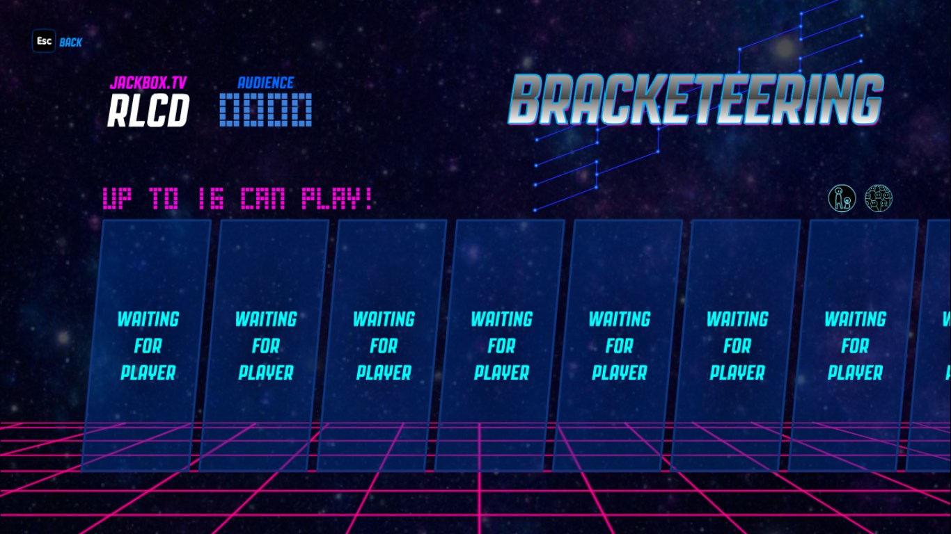
Rooms

Slide 14
Rooms
A
C
A
B
A
Notes:
A server will only send a message to other computers in the same room.

Slide 15
Rooms
socket.emit(“join”, “room-code”);
Default room on my server is “imm120”.
Notes:
The way I wrote my server, this is how you join a room.

Slide 16
IDs
Problem: every message is sent to every computer in the room
Including the sender
This isn’t always a problem
A problem in a multiplayer game.
Not a problem in most collaborative experiences.
Socket.io assigns an ID to every socket connection.
My server sends this data with every message (packet).
The Sockets Template saves this ID for you automatically.
Notes:
What about that sending back to yourself problem?

Slide 17
Sockets Template
http://alpha.editor.p5js.org/crhallberg/sketches/B14CRNOjG

Slide 18

Add Your Circle To The Screen
Add your name

Slide 19
Add Your Circle To The Screen
Add your name
Send a color

Slide 20
Next Time, in IMM120
Brett Taylor will be here to talk about game design
Strings, data files, basic analysis
Maybe a deep end on artificial intelligence
April 30th – Final Project Idea Exploration
May 7th – Reading Day, I will be here
May 14th – Final Exam Period
May 15th, 11:59pm – Final Projects are due
Notes:
April 30th is the last day of mandatory attendance.

Slide 21
April 27th
If you have a project or a project idea that would be good to entertain a group of people as a casual exhibit, talk to me.
Fun house mirror
Interactive art
Museum installation kind of deal
I’d be happy to help

Slide 22
Try Another Networking Idea
Pong
Collaborative Whiteboard
Chat room

