Slide 1

Task-related suppression of correlated activity in A1 predicts behavior performance but not changes in neural discrimination
Charles Heller¹, Daniela Saderi¹, and Stephen David¹
¹Oregon Health and Science University
APAN 2020
Poster number: 158

Slide 2
Stimulus-independent variability, neural population coding, and behavior
Stimulus A
Stimulus B
Neuron 2
Neuron 2
Neuron 1
Neuron 1
Selective attention (Cohen et al., 2009)
Task-engagement (Downer et al., 2015)
Perceptual learning (Ni et al., 2018)
Arousal (Schwartz et al., 2019)
Poster number: 158

Slide 3

Suppression of noise correlation predicts go / no-go task performance
Piezo spout
Narrowband noise
Target tone
Noise
(1.0-4.0 sec)
in noise
Pupil
9
camera
Frequency (KHz)
Target
2.6
0.8
tone
0.3
012
Time (sec)
1.0
0.8
0.6
Cummulative Probability
0.4
Catch, n: 274
0.2
-5 dB, n: 289
0 dB, n: 222
0.0
Inf dB, n: 144
0.00
0.25
0.50
0.75
1.00
1.25
Reaction time (s)
Poster number: 158

Slide 4
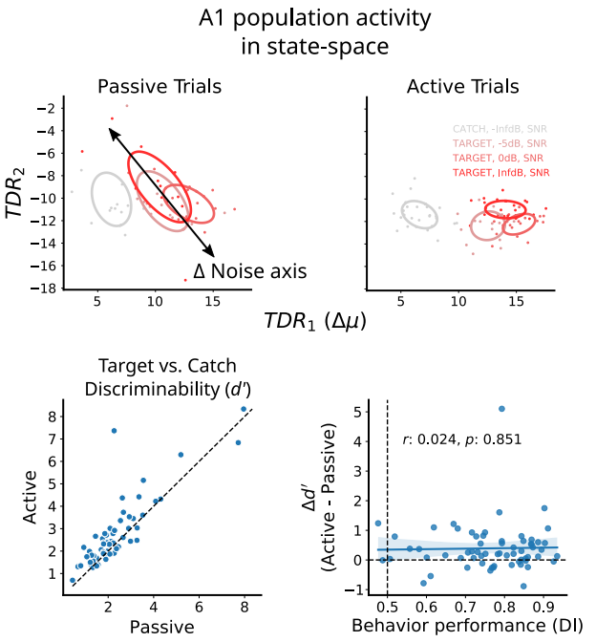
Neural decoding of stimulus identity is unrelated to task performance
Visit poster 158 to
… find out how changes in task difficulty affect the role noise plays in stimulus decoding
… learn more about dimensionality reduction methods for studying population coding
Poster number: 158

