Slide 1

9:15 am - Group 3-Group Midterm Project
Prepared by: David Rabinovich
This Photo by Unknown author is licensed under CC BY.

Slide 2

Making the data model, naming domains, and creating constraints
Meet the team:
David Rabinovich
Rabina Aryal
Seungwon Chun
Cristian Molina
This Photo by Unknown author is licensed under CC BY-NC.

Slide 3
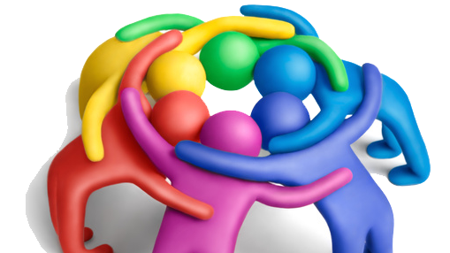
Our Assignments:
David Rabinovich: Make PowerPoint, Conceptual data model, make VHDX file
Rabina Aryal: Work on project Planner and to-do list.
Seungwon Chun: Work on the top-level domains, UDT, relationships.
Cristian Molina: Creating triggers and loading the data in Postgresql and Mysql, cloning work to GitHub, work on Physical and Logical Data Model and FET DDL.

Slide 4
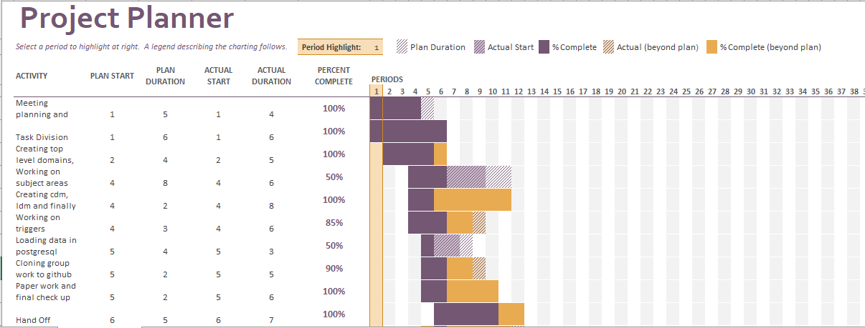
Project Planner

Slide 5
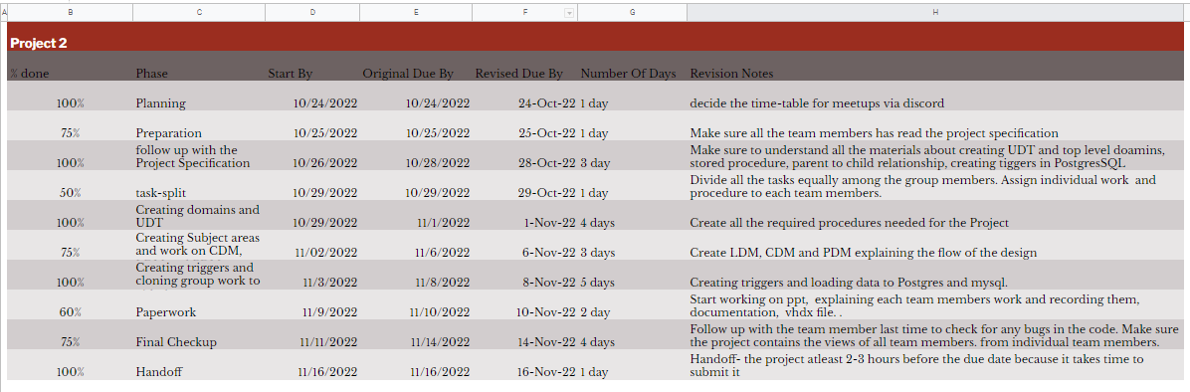
To- Do list

Slide 6
UDT
UDT stands for User Defined Data type.
A UDT is a data type that is derived from an already existing data type
We use udt's to standardize our naming of the data types to simplify naming the type of data each of our columns use.

Slide 7
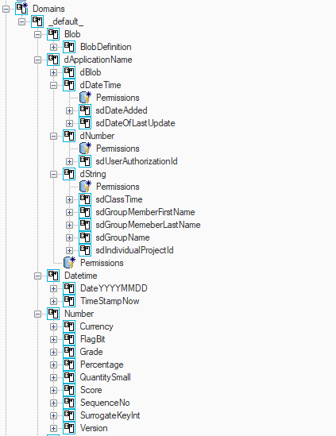
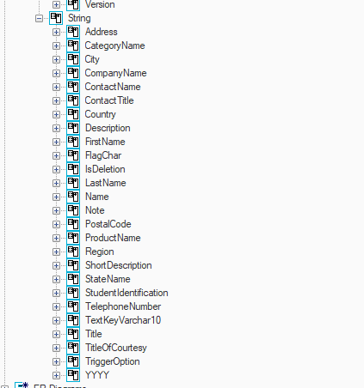
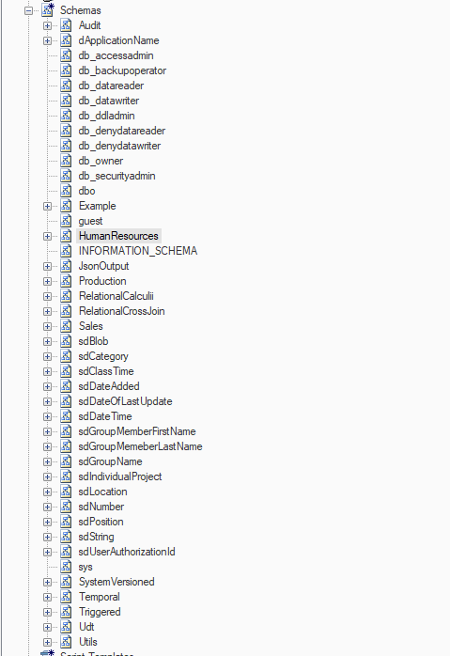
Our UDT part 1

Slide 8
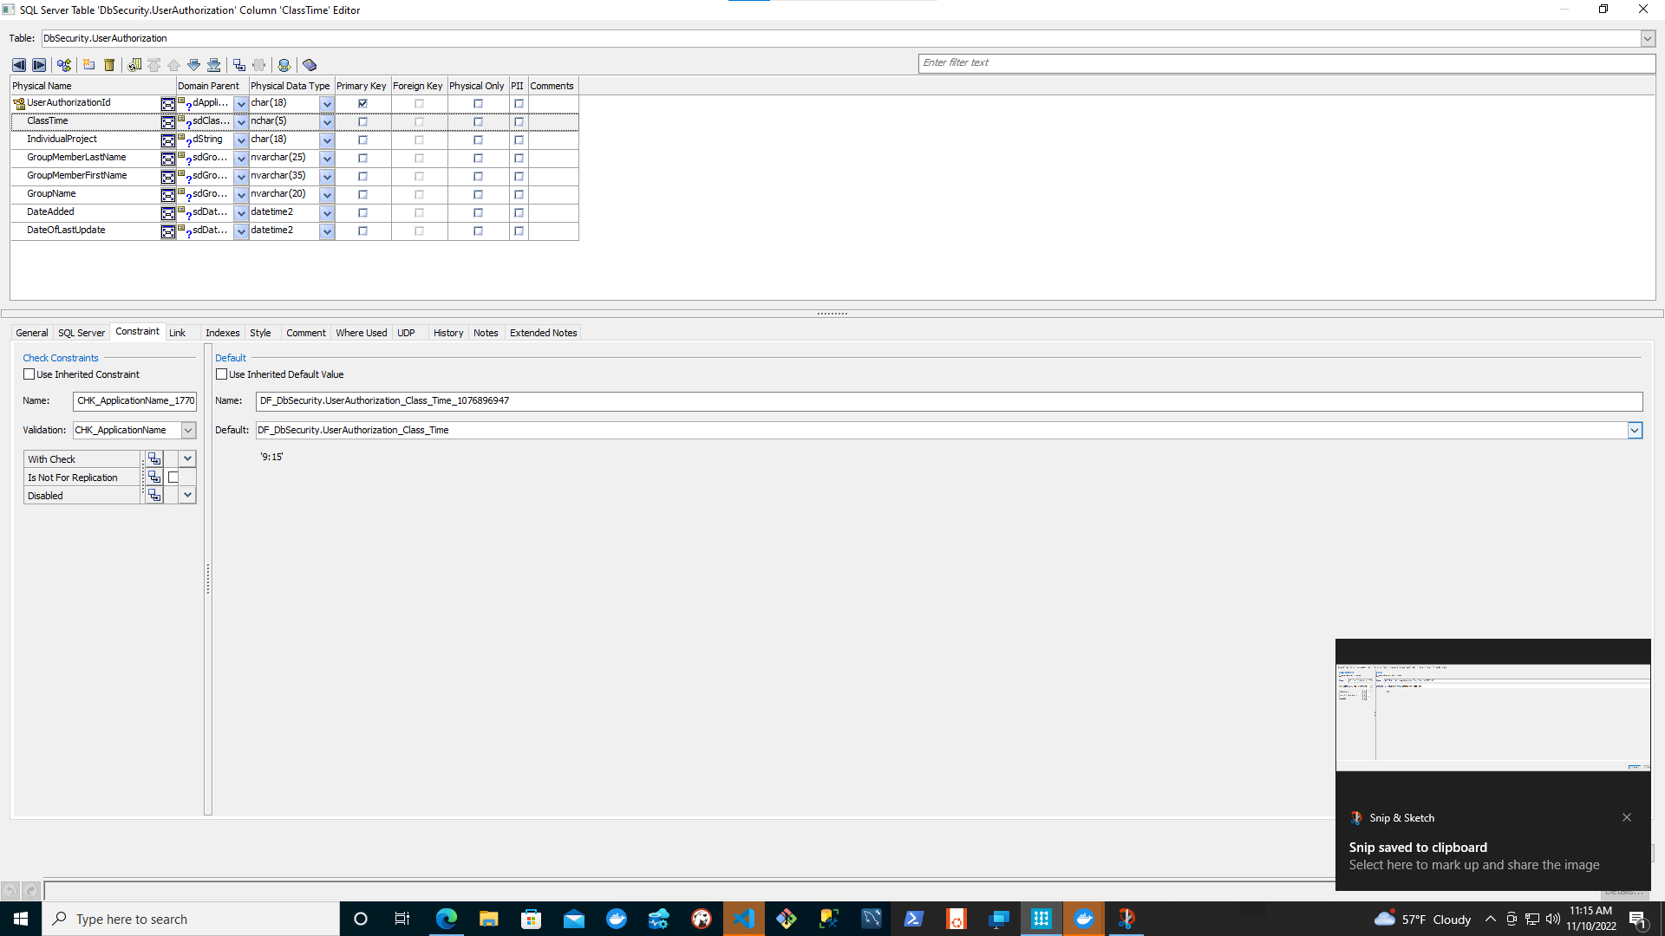
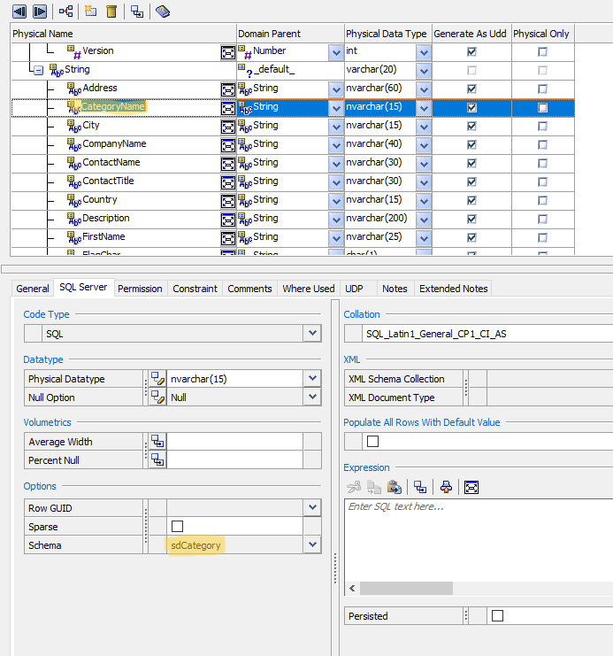
Our UDT part 2

Slide 9
Data model
The data model is the finished product with all of our data types put together in a cohesive model.
The model consists of 3 parts- the conceptual, logical, and physical
The Conceptual model is simple and abstract, it shows the definition of each of the core values of the project
The Logical model is the design guide for the finished product. It focuses on relations, keys, and attributes
The Physical model is the finished product with User defined data types included

Slide 10
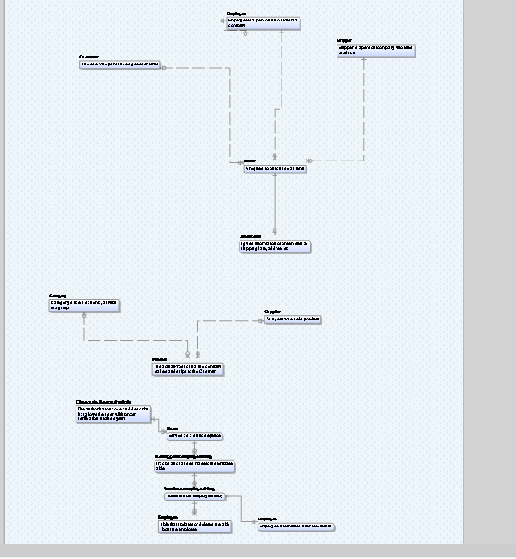
Conceptual Data Model

Slide 11
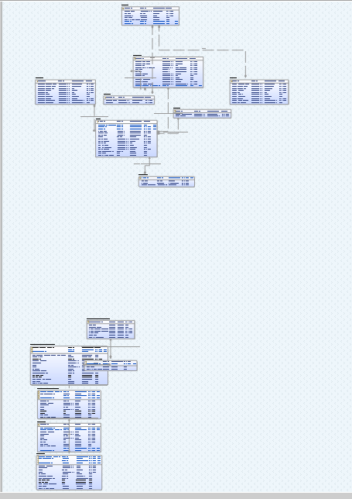
Logical Data Model

Slide 12
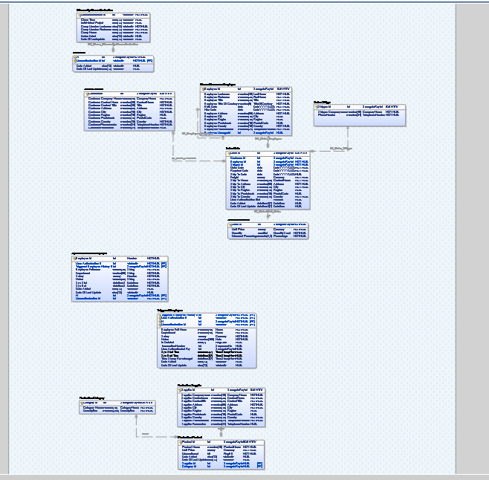
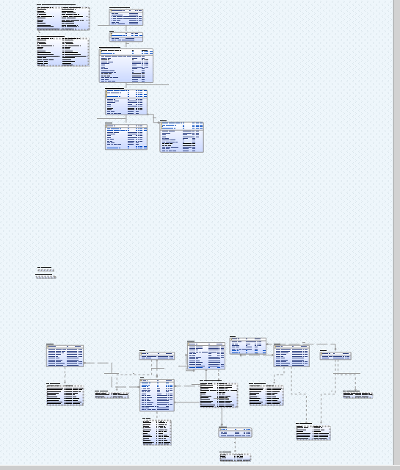
Physical Data Models

Slide 13
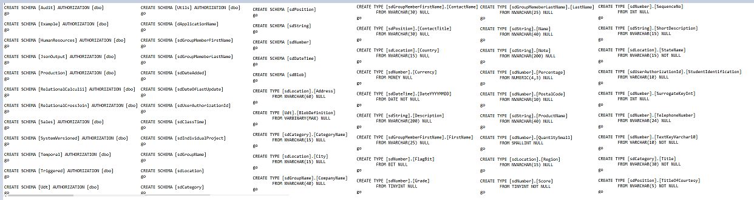
Forward Engineering

Slide 14
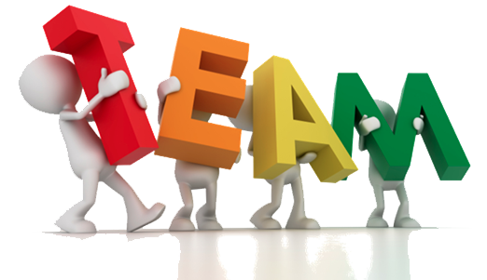
Benefits of the project
This Project helped us know the skills that are required in real working world.
It mainly helped us develop stronger communication skill.
More effective product, creativity and motivation as compared to individual projects.
Much lighter workload cause the work was divided among each team member.
It helped us planned and manage time.
Accountable to each other.

