Slide 1





#BusinessDoctor turns the crisis into a business opportunity by
offering quick and adaptive business transformation solutions
#1 ONE WAY IN
FOR
INFORMATION RESOURCES
#2 BUSINESS ADVICE
#3 OPEN CO-CREATION CHALLENGES
Powered by
Notes:
I liked a lot the idea of Think-Thank. We do not "only" connect but perhaps we could underline the creation and accumulation of knowledge. (Depending on the business model we want to go for: we could think about naming it experts and "crowed-founded" knowledge and expertise that we gather very fast because the environment is changing very fast). The other question is if we want to name it an open-source.
To transform the challenge into a chance to rethink business with Business Model Innovation

Slide 2
Challenge
Covid-19 is a humanitarian AND business disaster
More than 30 000 people given notice in March only – and many more in the gig economy or with short term contracts
Estimates of 350 000 people at risk of losing their jobs in a near future, working in businesses threatened by bankruptcy
Companies need assistance in the short and medium term – and one way in to enable quick help and appropriate coordinated measures
Businesses need solutions that fit their specific needs - adaptive model
The government need cost efficient tools to keep businesses afloat

Slide 3
Solution
What?
#BusinessDoctor is a digital platform that provides solutions for business model transformation in order for small and medium-size companies to survive and thrive through the crisis.
Businesses in need of urgent help get connected with multi-disciplinary teams from partners such as RISE Swedish Research Institutes, other key partners (TBD), and a community of volunteers.
#BusinessDoctor transforms the challenges of this crisis into a resilient business opportunity in the following ways:
One way in for information resources: access to information about all available support resources.
Business advice to SMEs from Business Doctor-team on how to restructure their business model during the crisis.
Open co-creation challenges with specific SMEs challenges where everyone can contribute to co-creating resilient, adaptive business model solutions.
Who?
How?

Slide 4
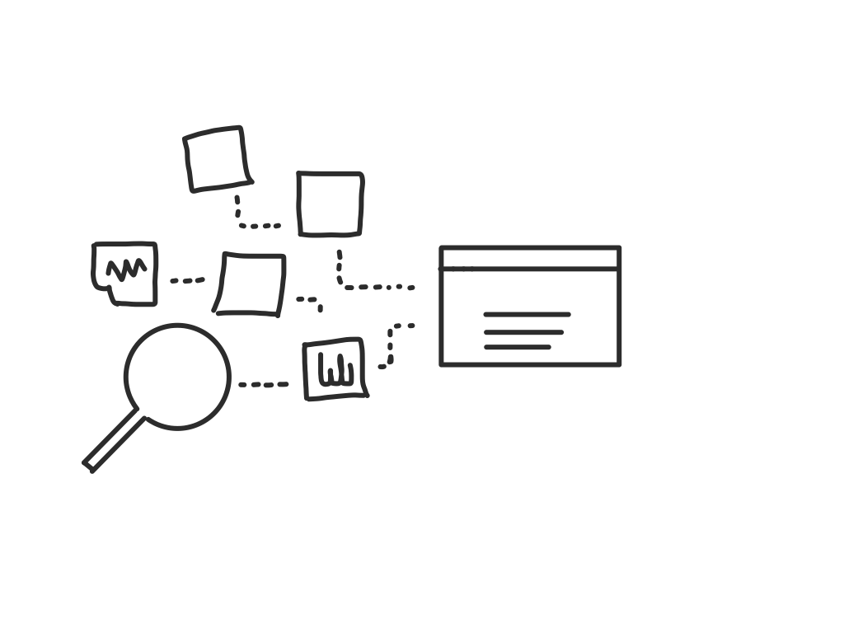
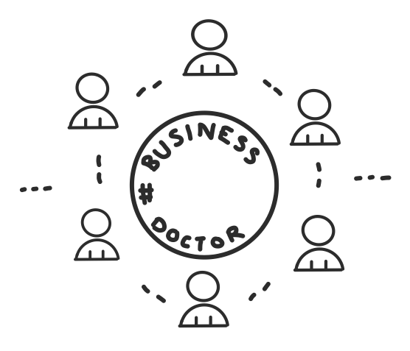

#1 Information resources
#2 Expert advice from BusinessDoctor
How to transform physical shop into virtual shop?
How to apply for grants
How to apply for loans
Forecasts and prognoses
Where do I find personnel if I want to hire/where can my staff go while on layoff?
Online sessions (1 hour introductory discussion + 3 hours expert advice):
Current consumer trends
Growing and functioning markets
Supply chain and digital delivery
Production processes
Sustainability & circular economy
Best practice

Slide 5
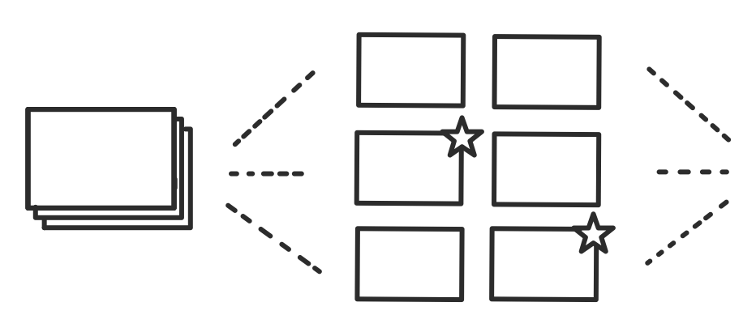
#3 Co-creation challenge - solving business problems in co-team
1 Explore
Our scouts review the challenges with your current business model, summarize and visualize it in a brief.
2 Connect
We build your project teams, choosing the mix of BusinessDoctor experts, industry volunteers and volunteers from the community.
3 Co-create
The co-creative sprint kicks off! Teams brainstorm new business models solutions, documenting in writing and drawing.
4 Validate
Selection of the most resilient business model concept for implementation at a company. Connecting all necessary business model partners together.

Slide 6
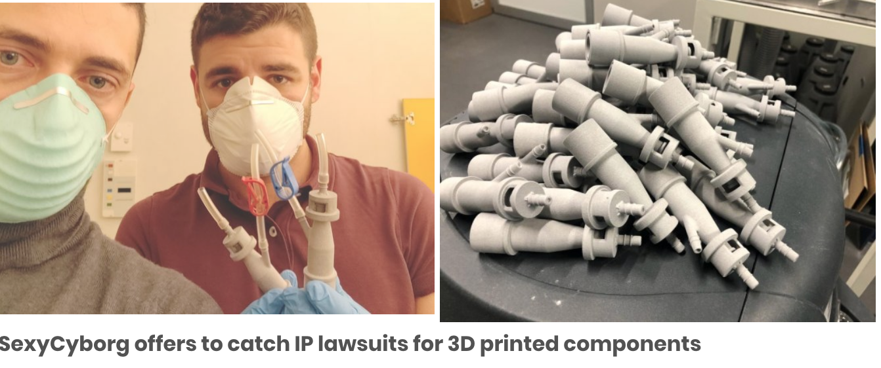
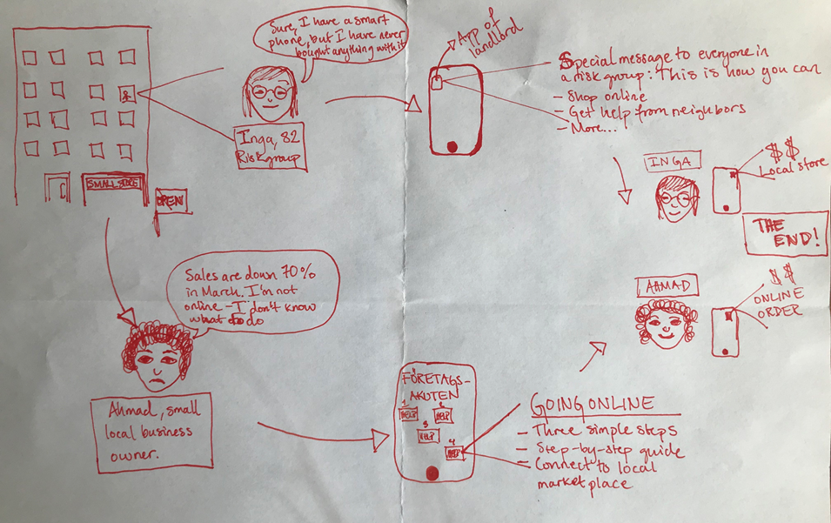
Company case examples
The business owner, Ahmad, gets help through the mobile application for Business Doctor.
He follows simple steps to bring his shop online, and is connected with customers through local partnering network (here, the housing company, which already has an app and can push information to people in their homes).
This reflects the possible networks already in the team of #BusinessDoctor.
At the beginning of March, A 3D-printer company in Italy has designed and printed 100 life-saving respirator valves in 24 hours for a hospital that had run out of them.
It was the beginning of a collaboration between the 3D printing community and health systems all over Europe.
The lesson learned in Italy helped, for example, the UK to do the same and bring it to the next level.
They started coordinating different private 3D printer owners, each of them is able to print what is needed, in the quality is needed and send where is needed.

Slide 7
The TEAM
 | Name | Role | Work role / Work place | E-mail
1 | Tatjana Karpenja | Lead | Project manager Sustainability at RISE Research Institutes of Sweden | Tatjana.Karpenja@ri.se
2 | Nerina Finetto | Narrative strategist | Content developer, producer, founder of tracesdreams.com | Nerina@tracesdreams.com
3 | Beatrice Nordling | Concept developer | Business developer at Uppsalahem | beatrice.nordling@uppsalahem.se
4 | Joachim Pettersson | Mentor | Solutions architecht, associate at join.se | jpettersson@sandvine.com
5 | Susanna Nissar | Design thinking, user centered innovation processes | Service Designer, founder of Social Innovation Booster | susanna@innovationbooster.org
6 | Cecilia Brown?
7 | Rio

