Slide 1
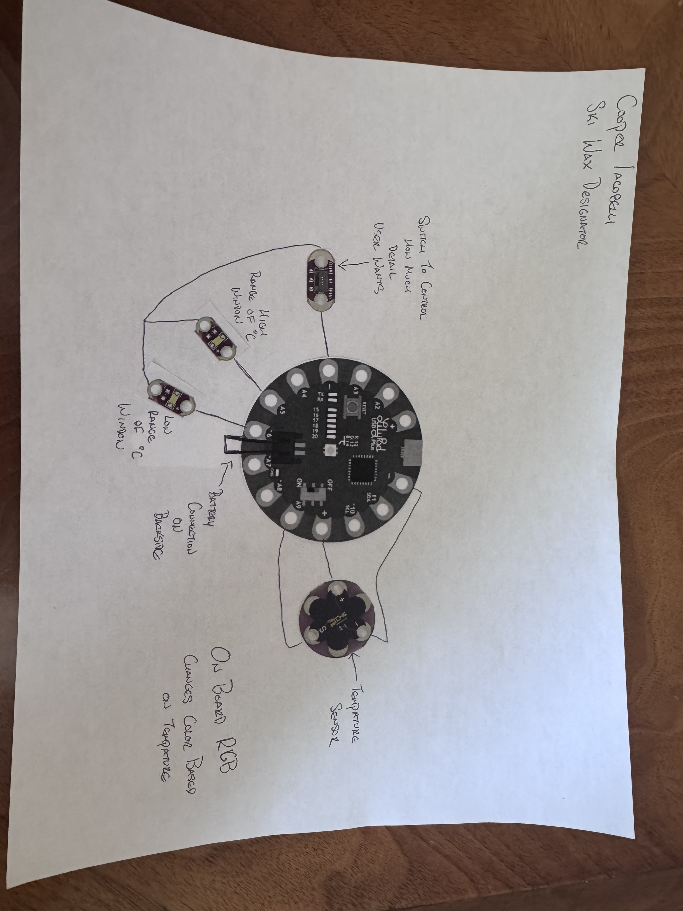
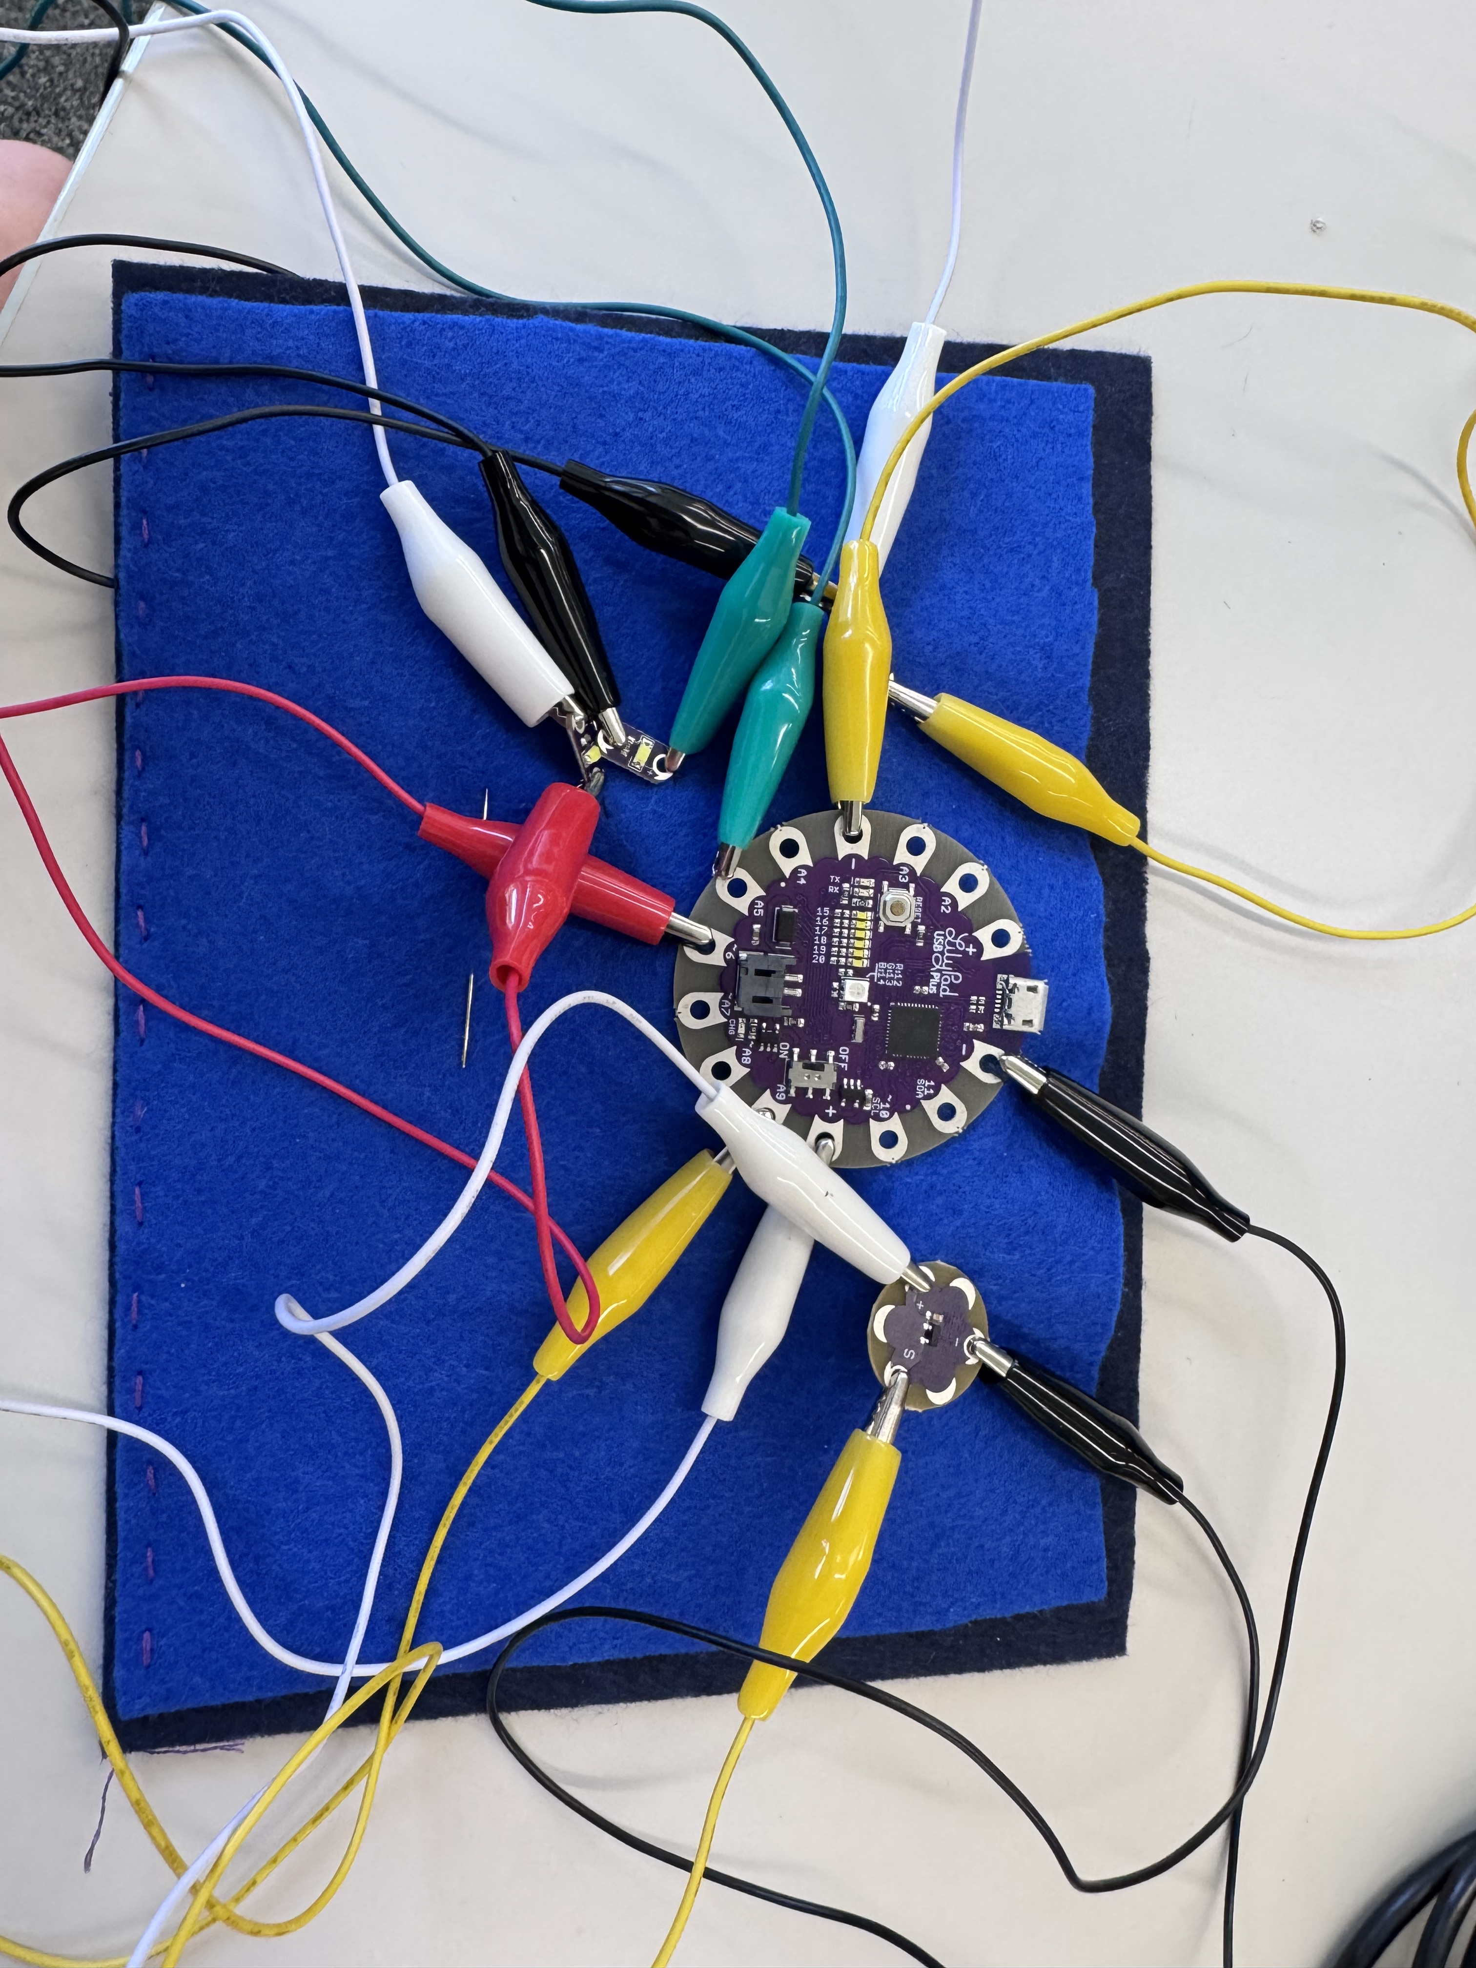
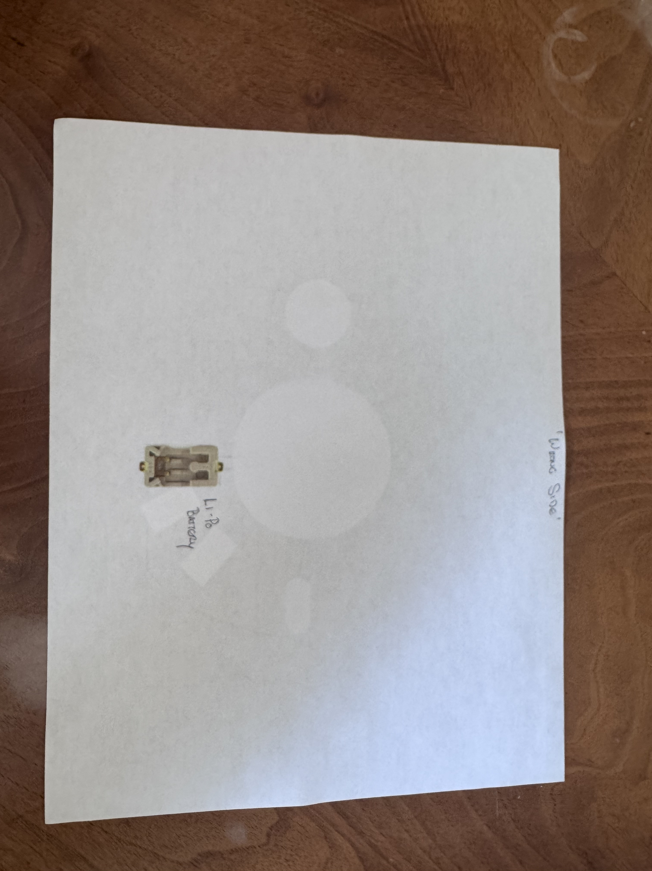
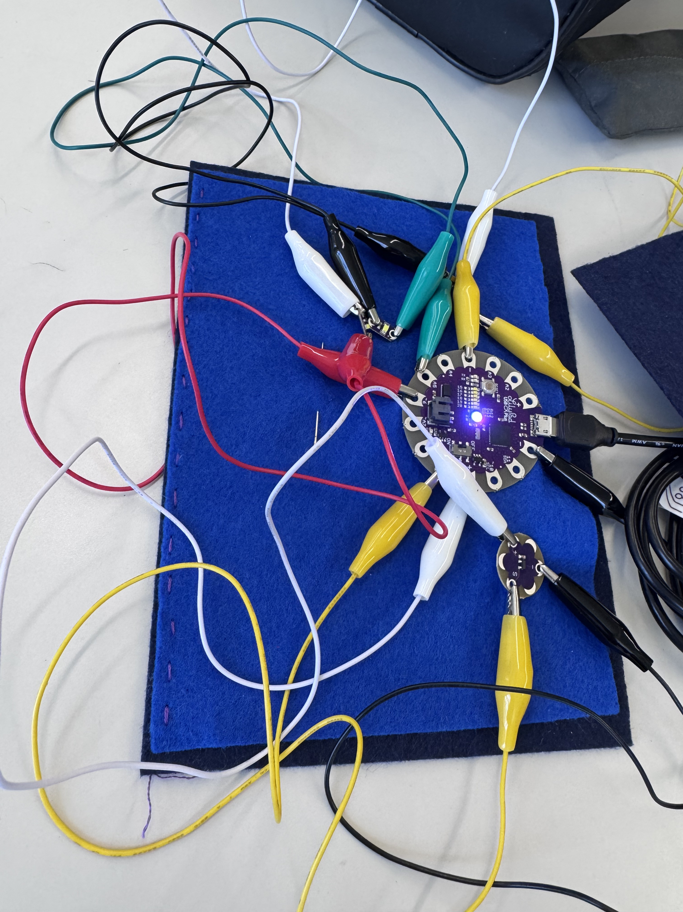
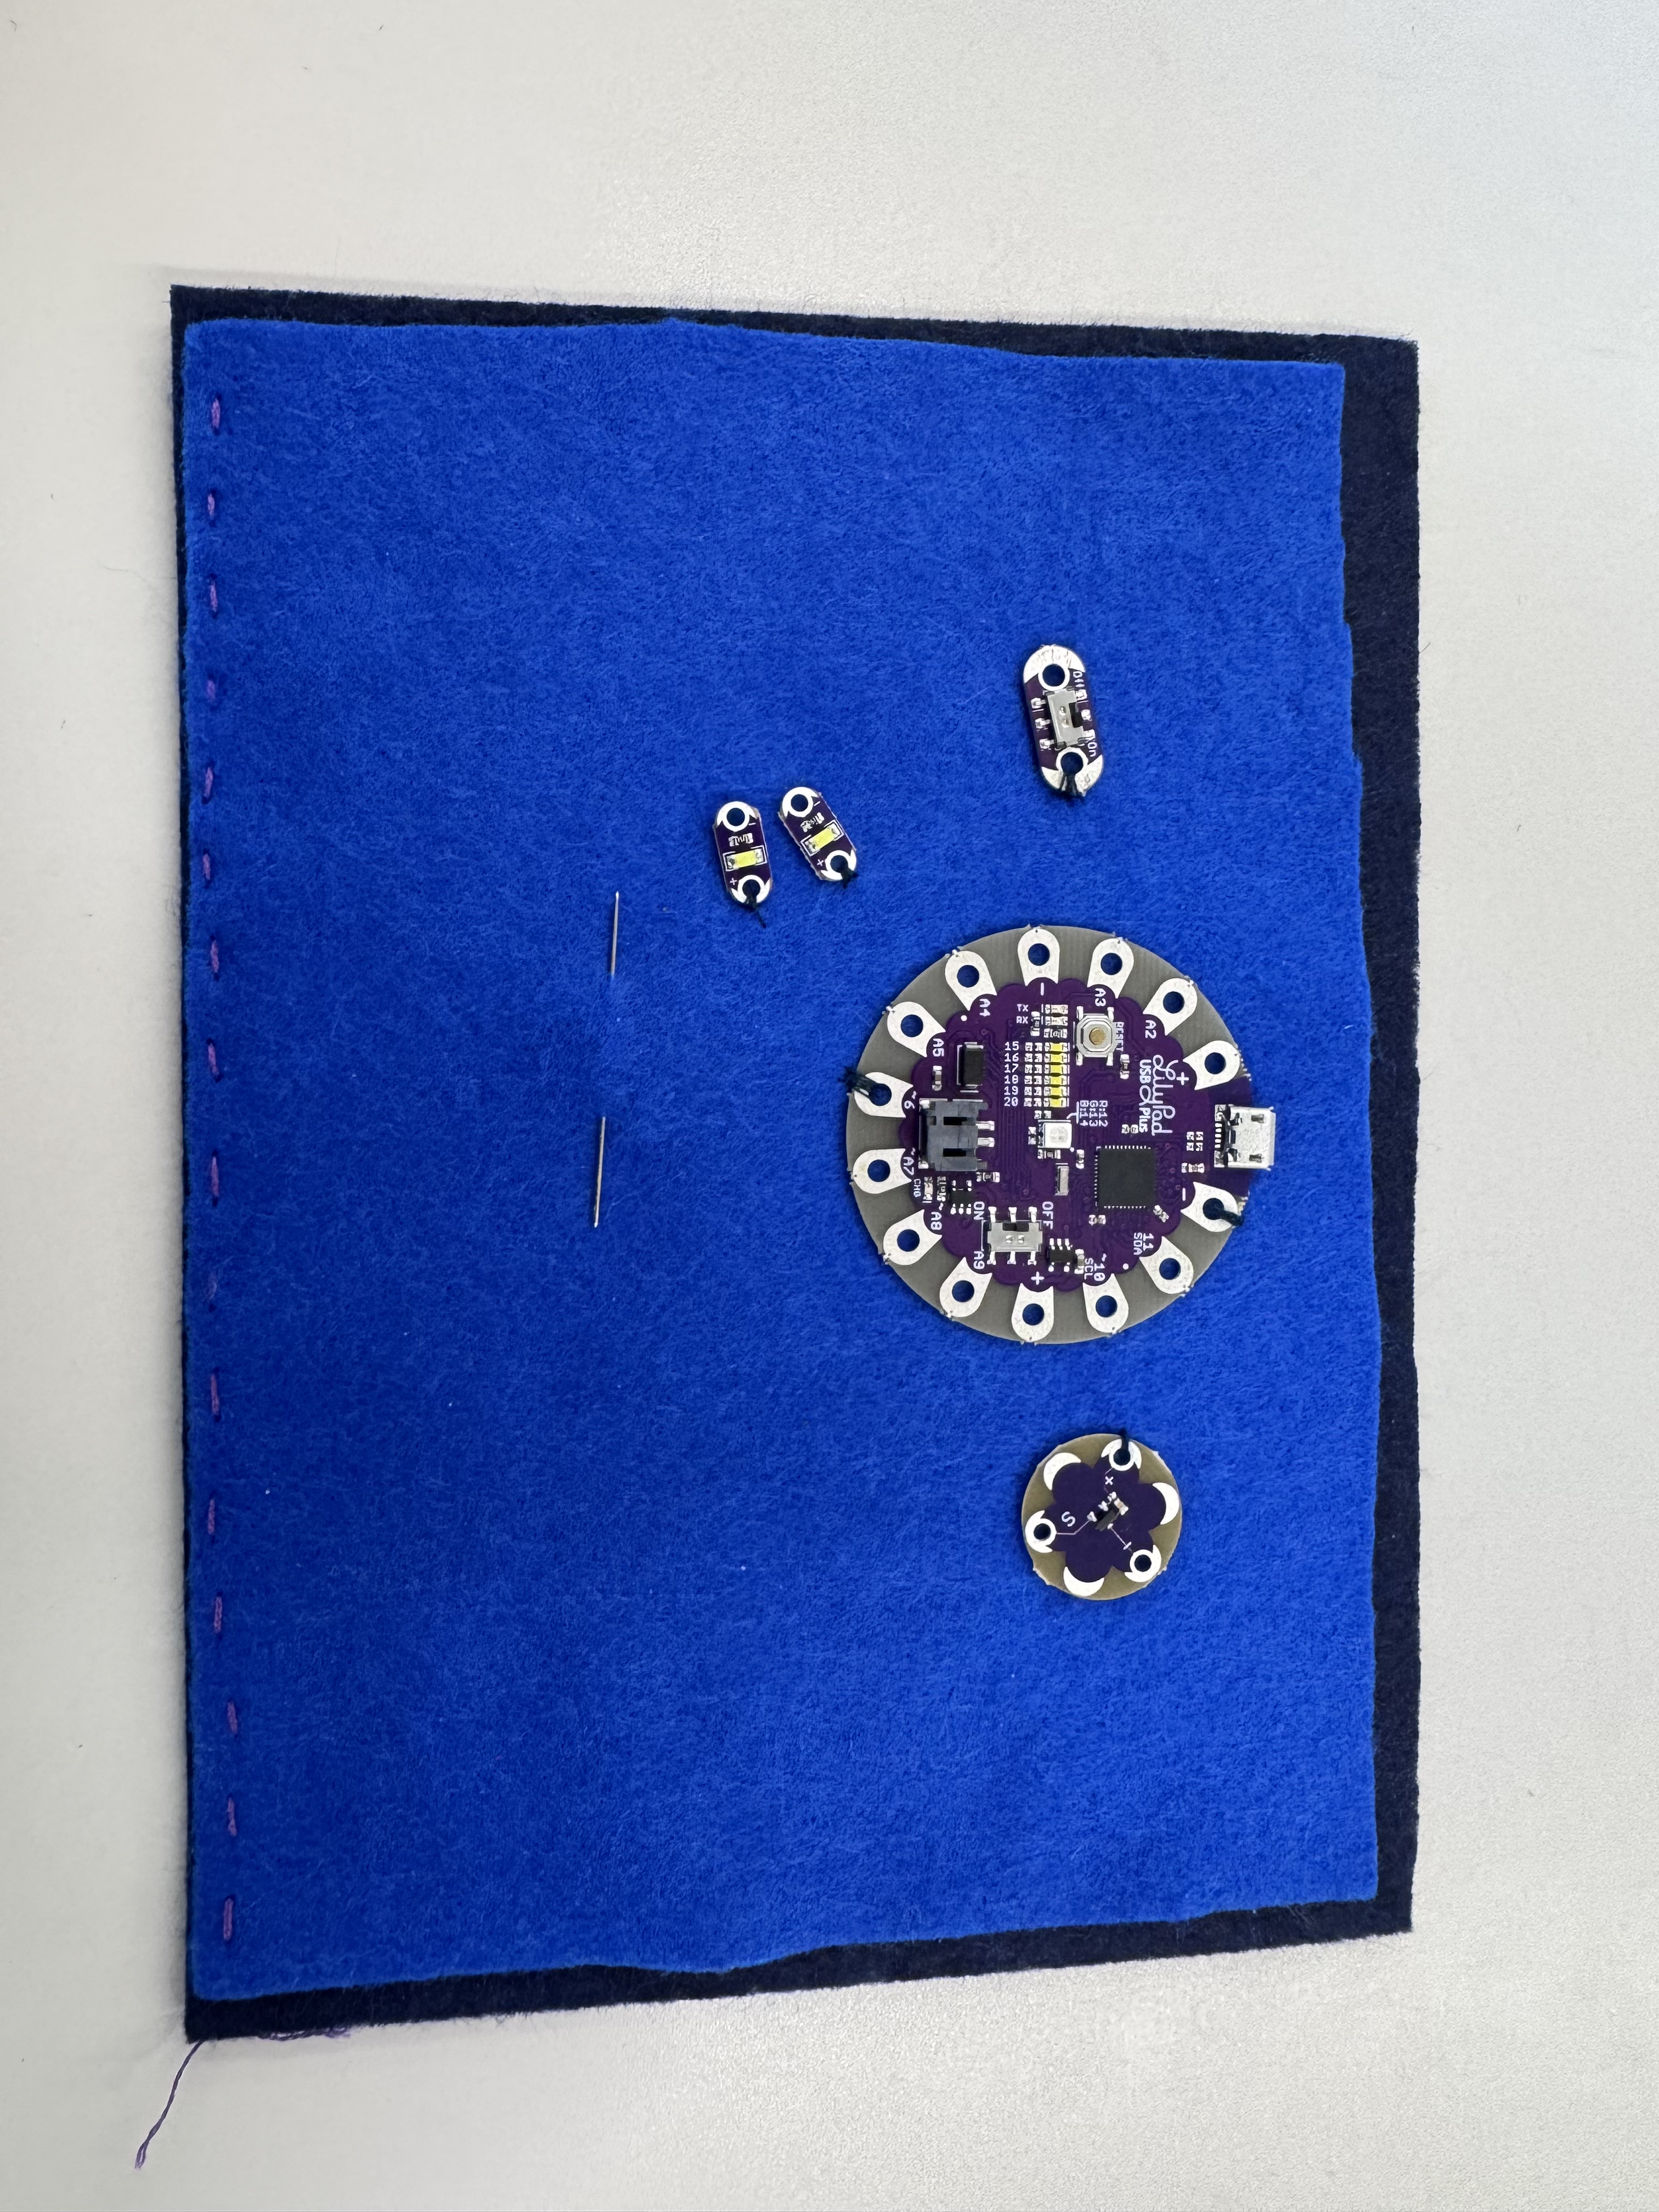
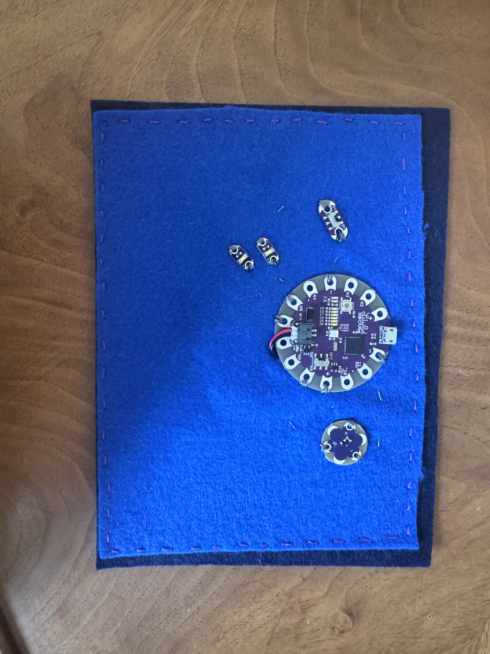
What to Wax
Project Description:
My project is a temperature sensor that directs users to the appropriate wax based on the temperature.
The colors that appear on the RGB are coordinated to the wax colors of Swix products.
The two off board LEDs alert users if the temperature is overlapping with the wax above or below the color shown by the on board.
It is important and interesting to me as it solves a common problem in an exciting way.
I learned how to effectively translate real world data into ranges that guide my code.
Highly useful gadget!
Motivation:
It is important and interesting to me as it solves a real problem in an exciting way.
What I Am Most Proud Of:
- The simplicity of my design and its effectiveness.

