Slide 1

Sequencing Quality Control
Dr Adam Cribbs

Slide 2
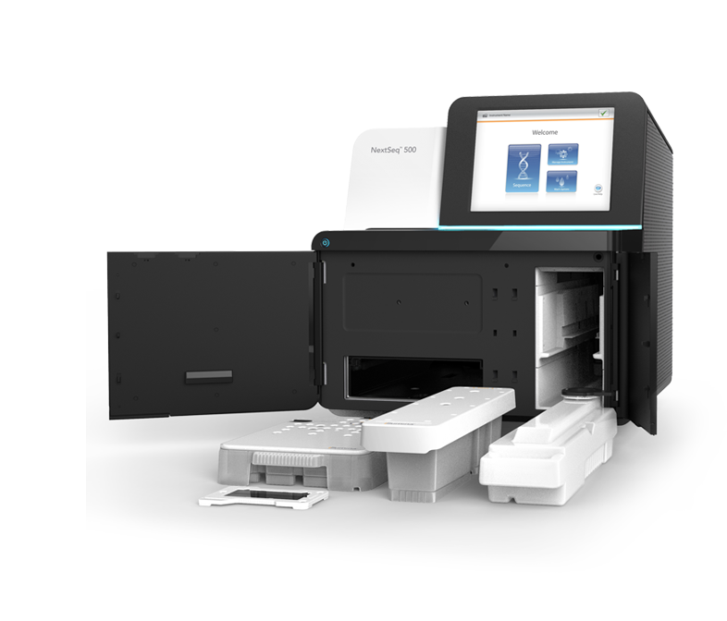
Agenda for this talk
01
Why is QC Important
02
Illumina Sequencing and QC
03
Phred Score Encoding
04
BAM Alignment

Slide 3
Quality Control
At each stage of the analysis you should always check what you are looking at is good quality
QC of the read quality and mapping quality are the most important

Slide 4
Quality Control Packages
Developed QC packages
FastQC
BamQC
FastQ Screen
Developed application specific QC
Bismark (bisulphite methylation)
HiCUP (Hi-C genome structure)
Developed data visualisation QC
SeqMonk (generic sequencing visualisation / analysis)
RNA-Seq QC
Small RNA QC
Duplication QC
MultiQC – collates statistics on many popular software

Slide 5
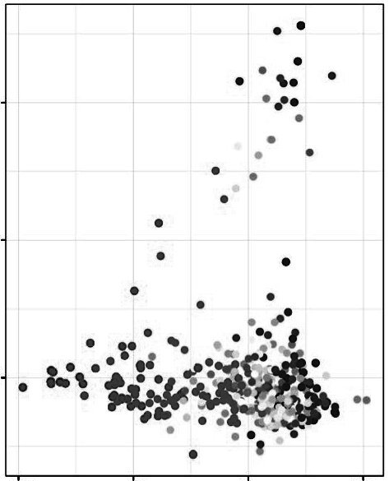
If you see something unusual then its time to investigate further
Single Cell RNA-Seq
Each dot is a cell
An outgroup is clearly visible
What is it?
PC2
PC1

Slide 6
If you see something unusual then its time to investigate further
Genes loaded on PC2
Gene Description
Arhgef4 Rho guanine nucleotide exchange factor (GEF) 4
Cflar CASP8 and FADD-like apoptosis regulator
Als2 amyotrophic lateral sclerosis 2 (juvenile) homolog (human)
Cxcr2 chemokine (C-X-C motif) receptor 2
Col4a3 collagen, type IV, alpha 3
Sag retinal S-antigen
Gpr35 G protein-coupled receptor 35
Acmsd amino carboxymuconate semialdehyde decarboxylase
Qsox1 quiescin Q6 sulfhydryl oxidase 1
9430070O13Rik RIKEN cDNA 9430070O13 gene
Mrps14 mitochondrial ribosomal protein S14
Scyl3 SCY1-like 3 (S. cerevisiae)
Ildr2 immunoglobulin-like domain containing receptor 2
Atp1a2 ATPase, Na+/K+ transporting, alpha 2 polypeptide
Slamf8 SLAM family member 8
Wdr38 WD repeat domain 38
Exd1 exonuclease 3'-5' domain containing 1
Serf2 small EDRK-rich factor 2

Slide 7
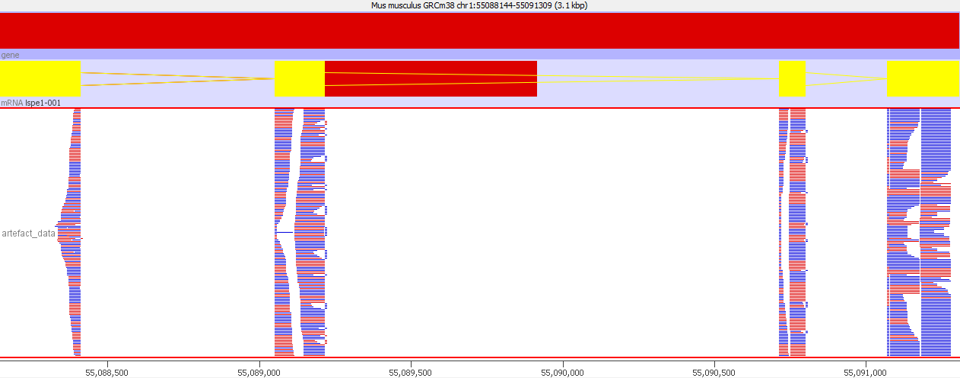
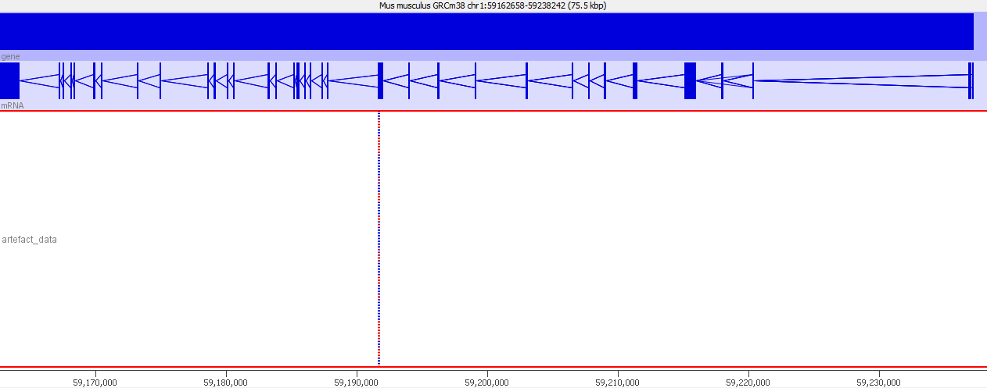
If you see something unusual then its time to investigate further
Normal Gene
PCA Gene

Slide 8
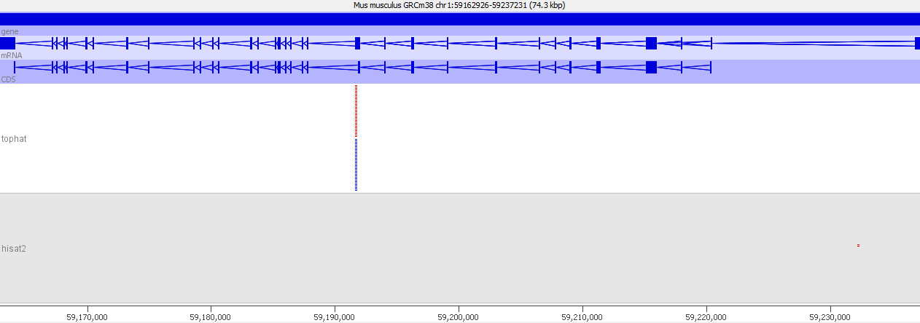
If you see something unusual then its time to investigate further
PC2
Conclusion: The separation in the original graph was a technical artefact of no biological interest. If we'd published this it would have mislead others. Even if we find it we've wasted some time and effort.
PC1

Slide 9
What is the point of QC?
Technical problems don't cause pipelines to fail
Technical problems don't prevent hits being generated
Technical hits often look biologically real
Unexpected, interesting effects can easily be missed
Finding problems through follow-on work is slow and expensive!
QC saves you time and effort! (and money)

Slide 10
Phred Scores
Start from (p) - the probability that the reported call is incorrect
Initial transformation to a Phred score - positive integer from floating point
Phred = -10 * (int)log₁₀(p)
p=0.1 Phred = 10
p=0.01 Phred = 20
p=0.001 Phred = 30

Slide 11
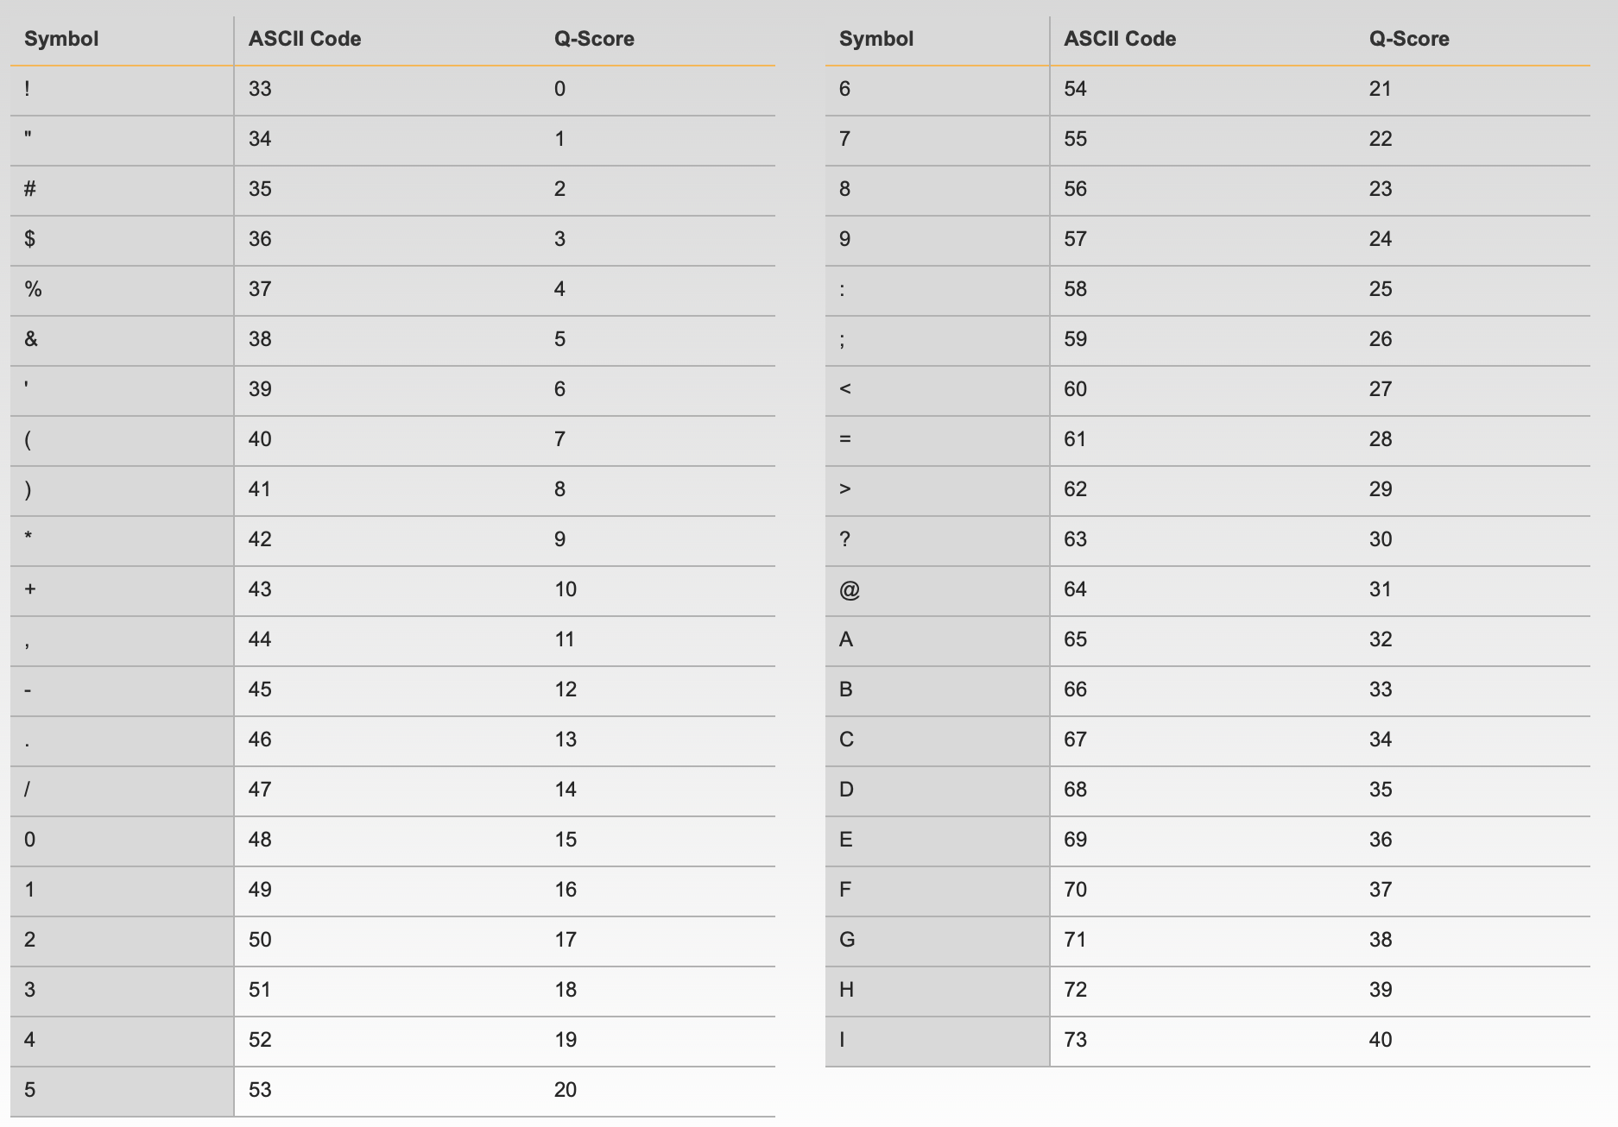
Phred Score Encoding
Translation of Phred score to single ASCII letter
Based on standard ASCII table
Can't translate directly as low values are non-printing
Two original standards
Illumina = Phred+64
Sanger = Phred+33
Now most data is Phred33, the quality score is represented as the character with an ASCII code equal to its value + 33.

Slide 12
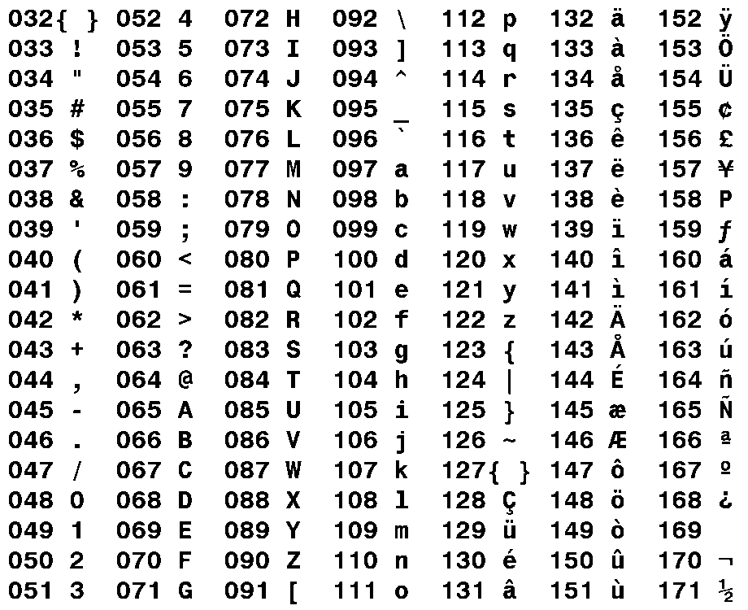
Phred Score Encoding
:GBGGGGGGGGGDGGDEDGGDGGGGDHHDHGHHGBGG:GG
: = ASCII 58
Phred33 encoding so Phred = 25
p = 10^^{(25/-10)}
p = 0.003

Slide 13
Phred Score Encoding
:GBGGGGGGGGGDGGDEDGGDGGGGDHHDHGHHGBGG:GG
G = ASCII 71
Phred33 encoding so Phred = 38
p = 10^^{(38/-10)}
p = 1.6e-4

Slide 14
Quality Assessment Software

Slide 15
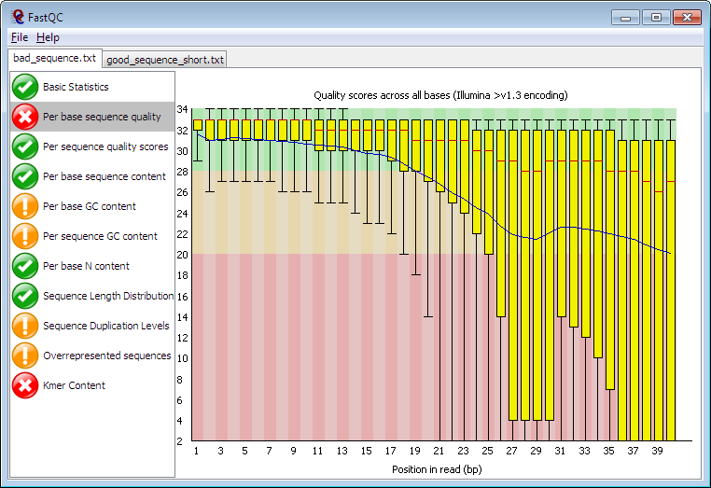
FastQC
Reads raw fastq files
Performs multiple checks
Pass/warn/fail
Compares to genomic library
HTML Report
http://www.bioinformatics.babraham.ac.uk/projects/fastqc/

Slide 16
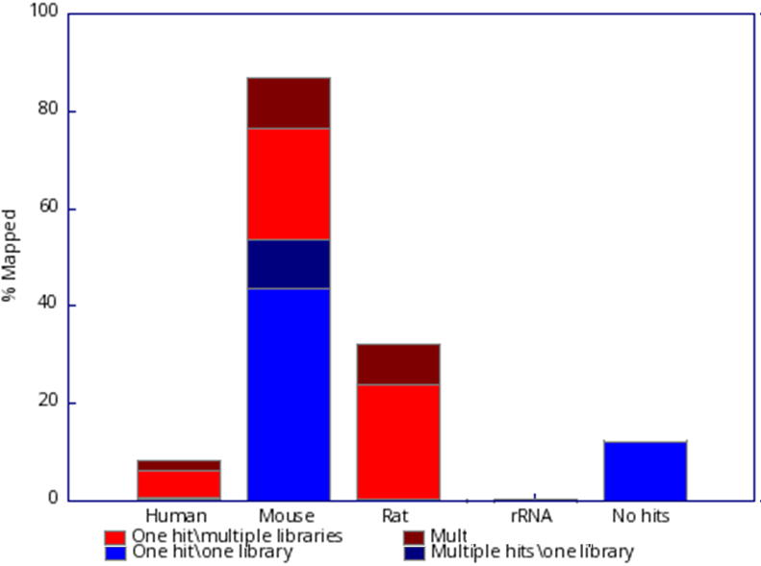
FastQ Screen
Reads fastq files
Maps against a range of species / contaminants
Identifies unexpected sequences in your library
http://www.bioinformatics.babraham.ac.uk/projects/fastq_screen/

Slide 17
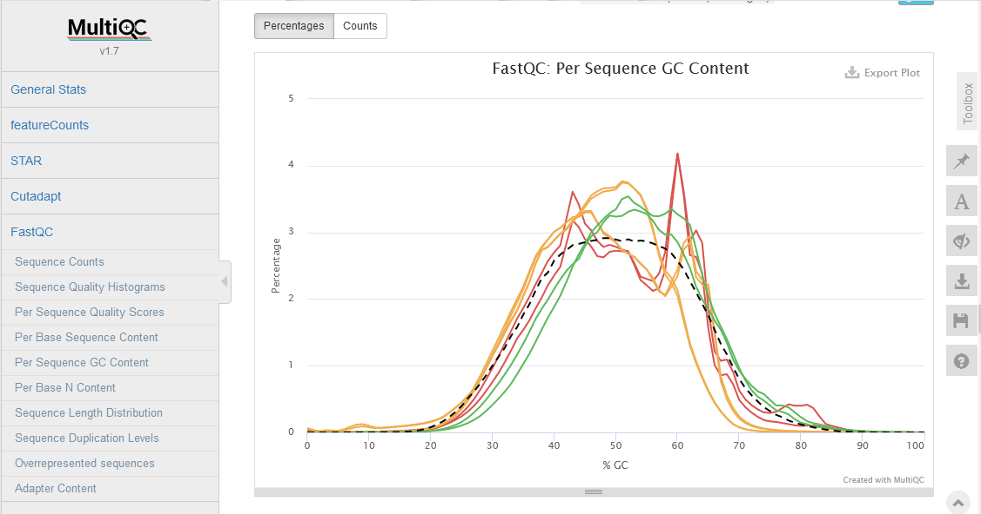
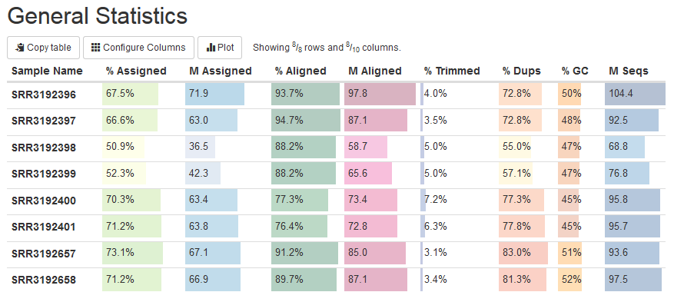
MultiQC
Aggregates QC information from multiple samples
Large number of programs supported
Combined HTML report
https://multiqc.info/

Slide 18
What to look for in fastq data with respect to quality?

Slide 19
Base Call Qualities (Phred scores)
For most runs, quality should be good for most reads through the whole run
If quality deteriorates we should understand how and why
Good (Illumina) quality is generally Phred > 28 – 30
Concerning (Illumina) quality is Phred < 20

Slide 20
Base Call Qualities – Per Cycle
Phred Score
Cycles of Chemistry

Slide 21
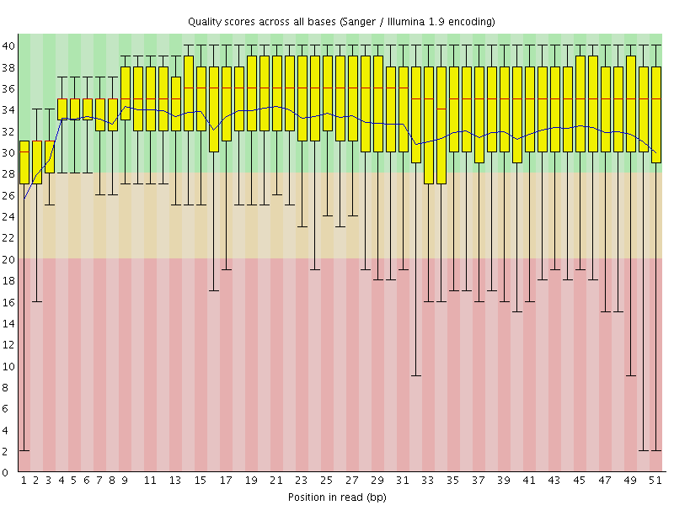
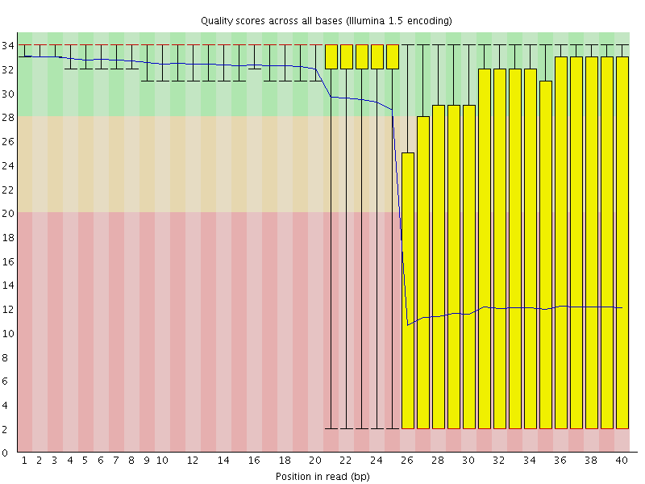
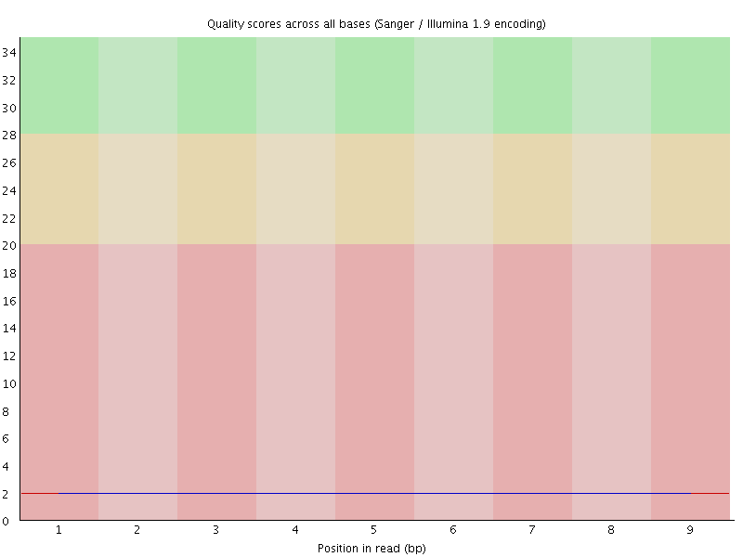
Base Call Qualities – Per Cycle
Read 1
Read 2

Slide 22
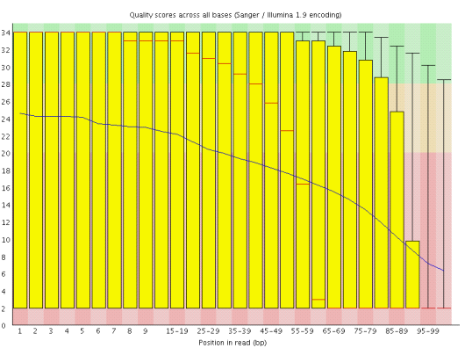
Diagnosing Poor Base Call Qualities
Not everything is bad
Can see identify why some parts are bad and others aren't?
May help to fix future runs

Slide 23
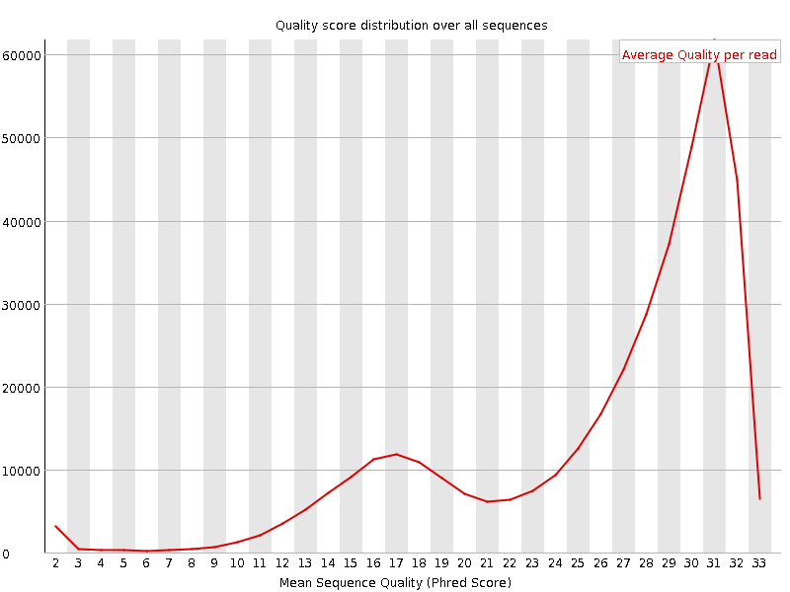
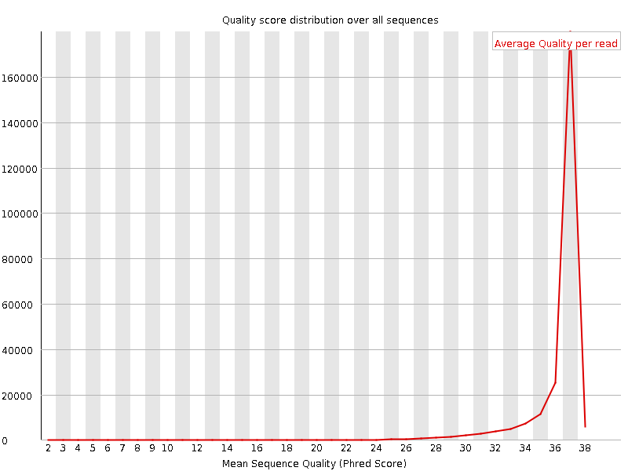
Per Read Quality
Are all reads equally affected?
Is there a subset of reads which are always poor whilst others are good?

Slide 24
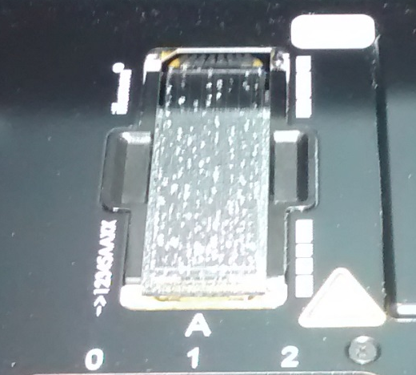
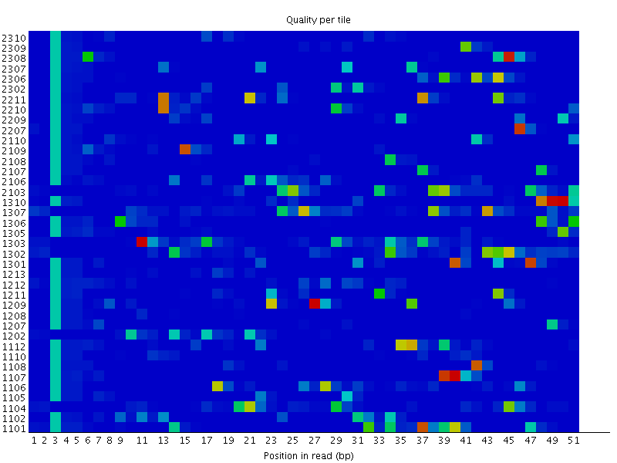
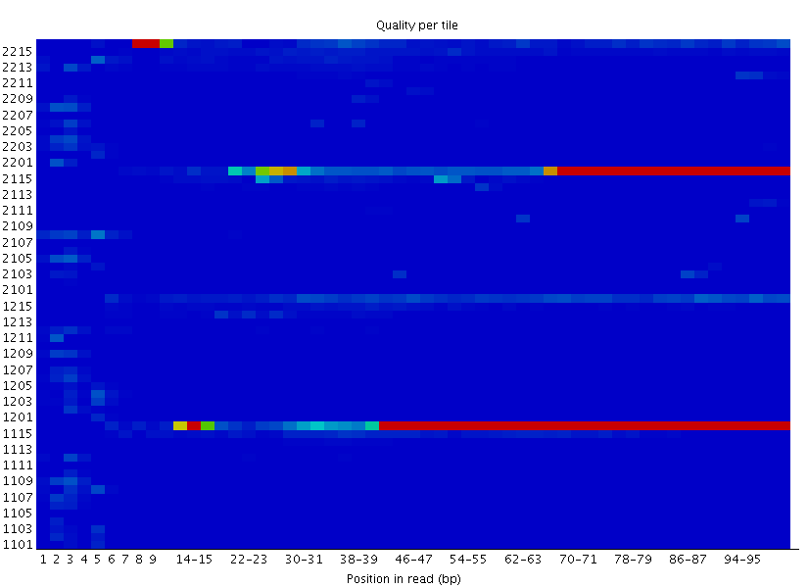
Positional Quality
Random Patterning
Tiles
Lanes
Top
Bottom
Position Specific
Patterning

Slide 25
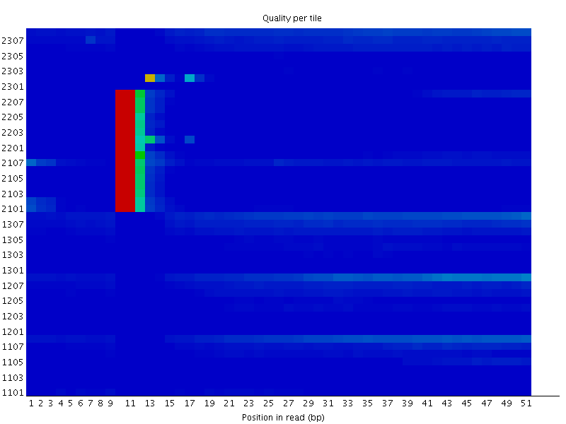
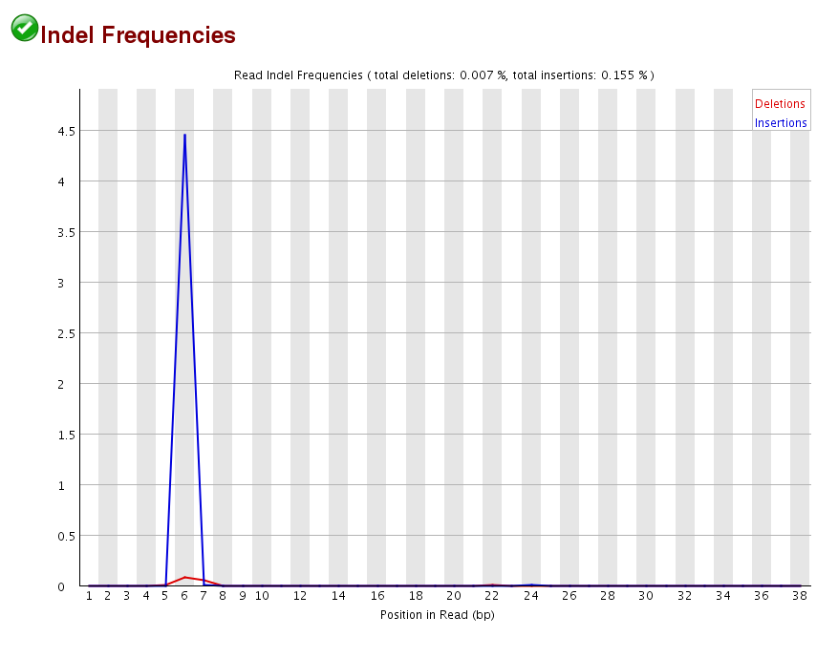
Positional Quality

Slide 26
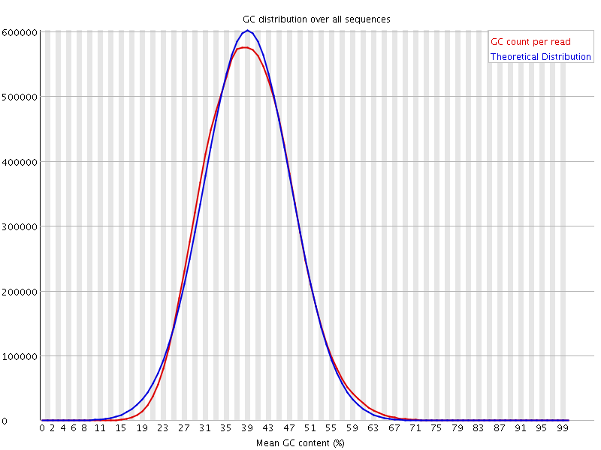
Library QC Content
Generic summary of library composition at a read level
Should generally expect a normally distributed set of values centred on the overall GC content
Can spot subsets with unusual biases

Slide 27
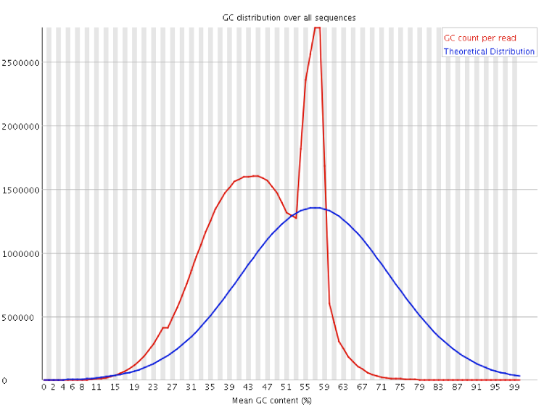
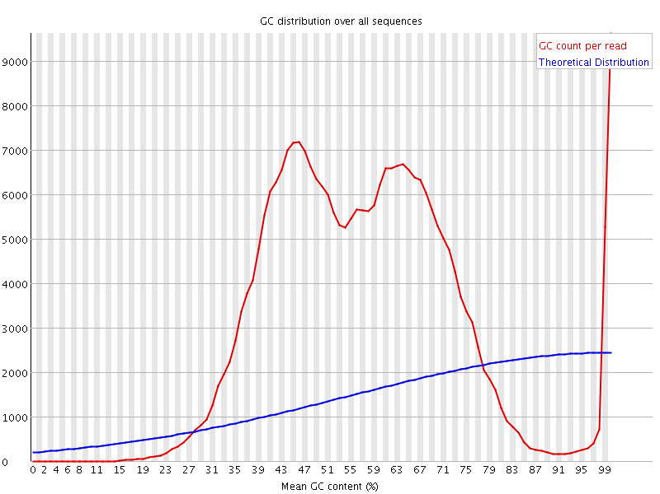
Library QC Content
Specific Contamination
Broad Contamination

Slide 28
Library Base Composition
For every chemistry cycle we can look at the number of ATGC we call
Most libraries have random start positions so the composition should be the same for all cycles
Balance between GATC can vary
GC content of the species (GC separates from AT)
Systematic biases per library type

Slide 29
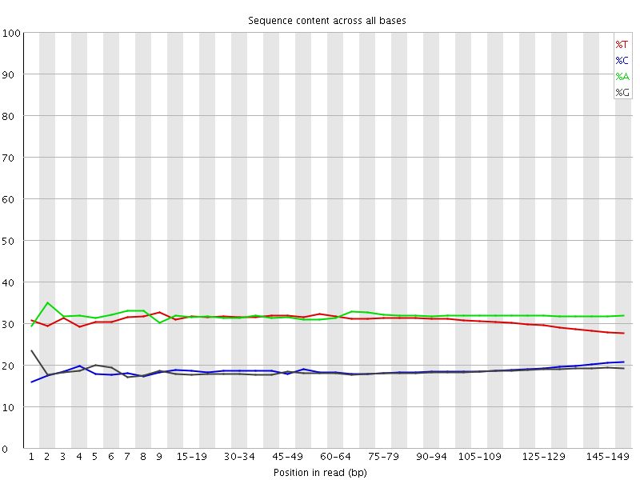
Library Base Composition
GC separate to AT
Lines mostly flat
Curve at the end
(see later)

Slide 30
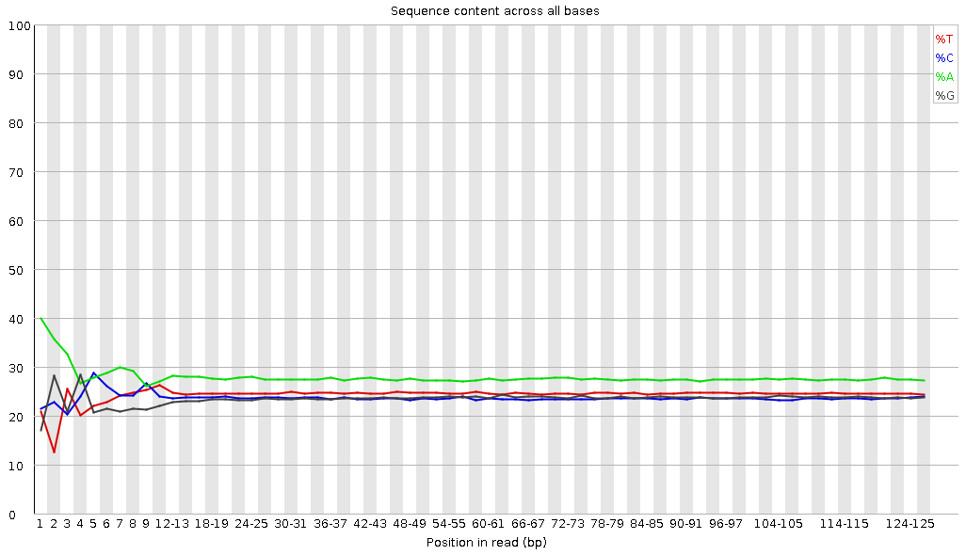
Library Base Composition
3' RNA Sequence
High degree of polyA
Odd composition at 5' end

Slide 31
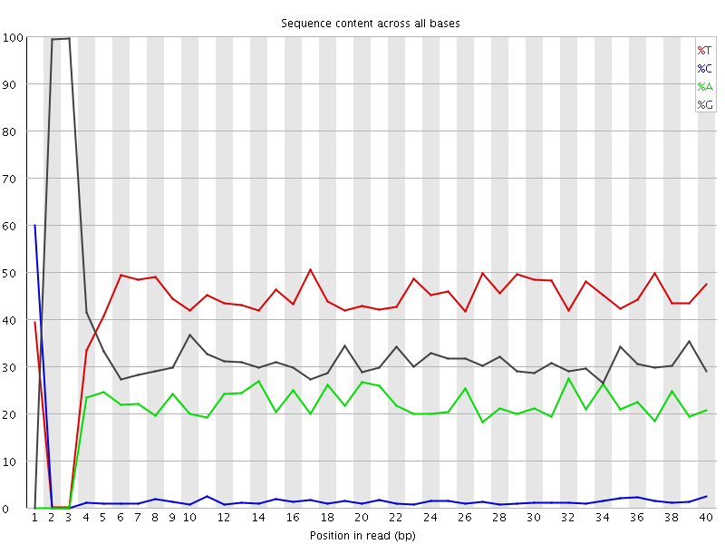
Library Base Composition
Bisulphite treated – C is converted to T
Restriction based fragmentation – can see remains of recognition site at 5' end

Slide 32
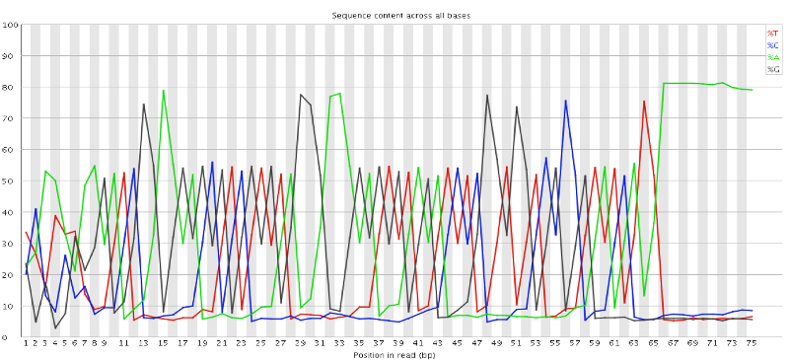
Library Base Composition
Very low diversity
One or two sequences dominate

Slide 33
Duplication
The exact same sequence appears more than once in your library
The sequences come from different biological molecules and the duplication is coincidental
Deep sequencing
Highly present sequences (repeats for example)
Restricted diversity libraries (amplicon sequencing, restricted libraries)
The sequences come from the same biological and the duplication is technical
PCR duplicates

Slide 34
Duplication
Most sequences are unique
High diversity (or low coverage)

Slide 35
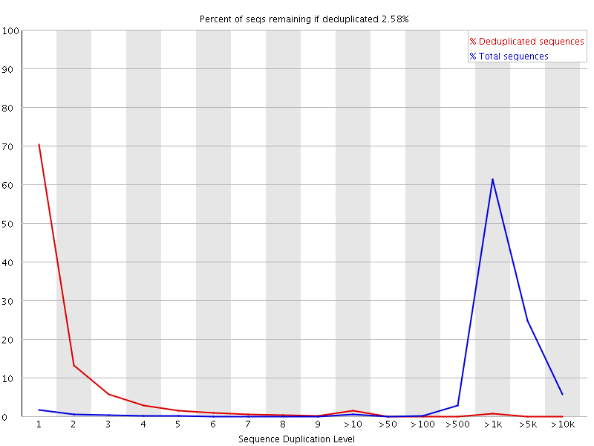
Duplication
Most sequences are present many times
Highly duplicated (low diversity)

Slide 36
Overrepresented Sequences
Extreme duplication – the exact same sequence is a significant proportion of the whole library (which might not be duplicated overall)
Normally comes from artificial sequences (primers, adapters, vectors etc)
Can search a database of known sequences to find matches

Slide 37
Overrepresented Sequences
PolyA – Common in RNA-Seq
PolyG – Empty space in 2-colour chemistry
PolyN – Quality too poor to make any calls
Specific sequences – Normally Adapter Dimers

Slide 38
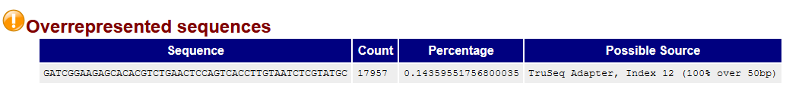
Adapter Dimer
Barcode
Adapter
Insert
Adapter
Barcode
Barcode
Adapter
Adapter
Barcode

Slide 39
Read-through Adapters
Read 1
Primer
Adapter
Insert
Adapter
Read 1
Primer
Adapter
Insert
Adapter

Slide 40
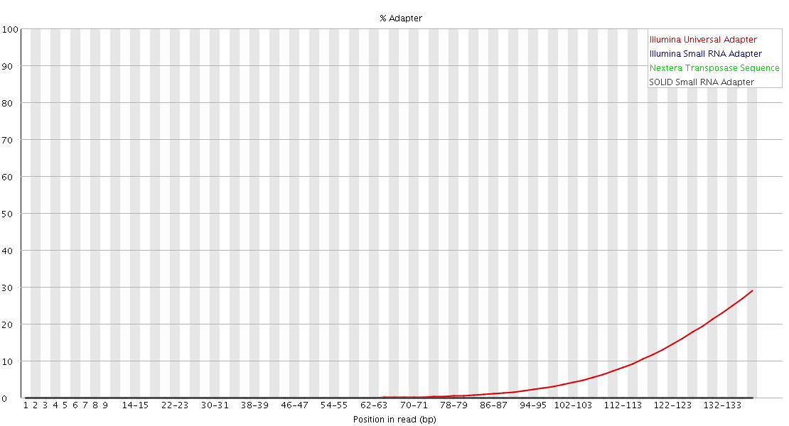
Read-through Adapters

Slide 41
Mapping Statistics
Time loading forward index: 00:01:10
Time loading reference: 00:00:05
Multiseed full-index search: 00:20:47
24548251 reads; of these:
24548251 (100.00%) were paired; of these:
1472534 (6.00%) aligned concordantly 0 times
21491188 (87.55%) aligned concordantly exactly 1 time
1584529 (6.45%) aligned concordantly >1 times
94.00% overall alignment rate
Time searching: 00:20:52
Overall time: 00:22:02
If reads don’t map then you will want to know where they align to

Slide 42
Mapping issues may relate to contamination
Map your reads against a range of reference genomes
Any species you normally work with
Common lab contaminants (E coli and Human)
Artificial sequences (adapters, vectors)
Known problematic sequences (rRNA)
Classify matches as
Unique to one species
Single or multiple mapping

Slide 43
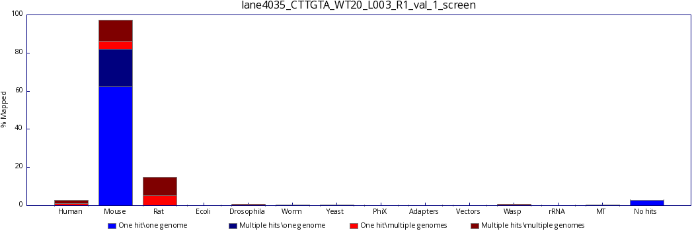
Good Quality Mapping

Slide 44
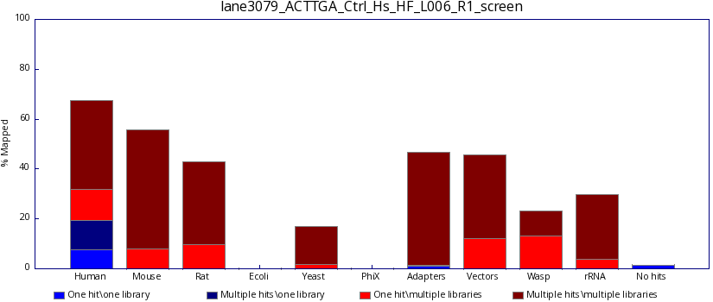
Bad Quality Mapping

Slide 45

Aggregated Statistics
Individual QC reports are useful but can be difficult to interpret without context
The simplest way to spot a local QC problem is that one sample doesn't look like the rest
We can aggregate and plot a range of QC statistics to make this easier

Slide 46
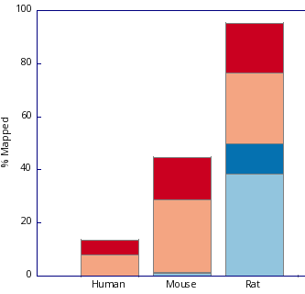
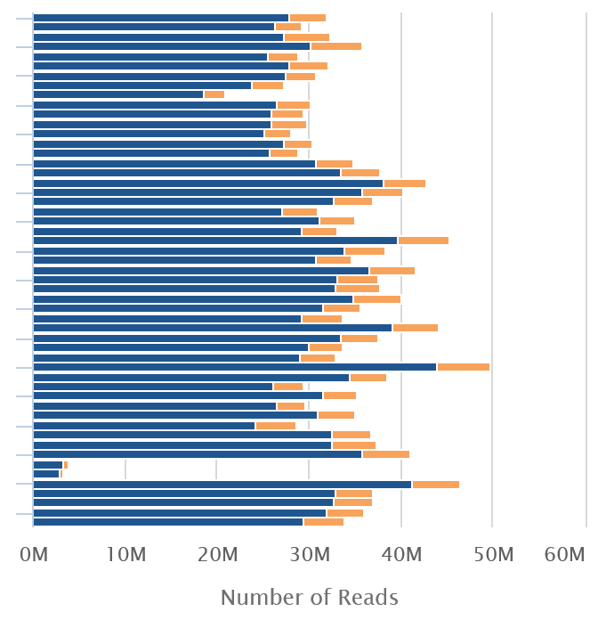
Aggregated Statistics
FastQ Screen

Slide 47
Aggregated Statistics
We expect replicated samples to behave similarly to each other
We expect samples which have been treated differently to differ in their quantitation
We can use the clustering of samples based on data as a sanity check on sample tracking

