Slide 1




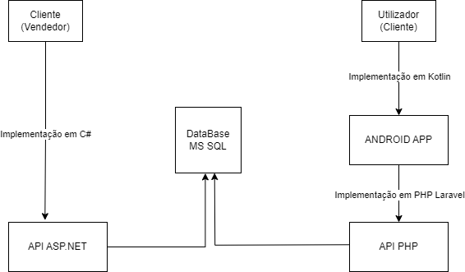
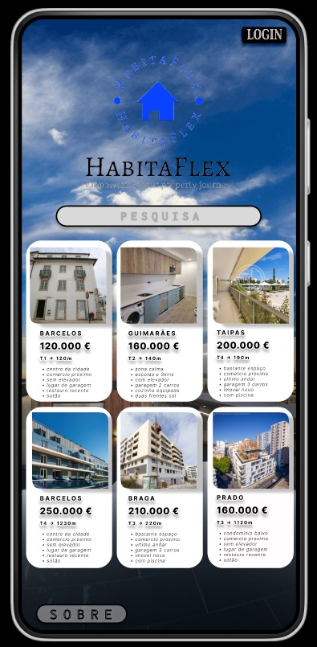
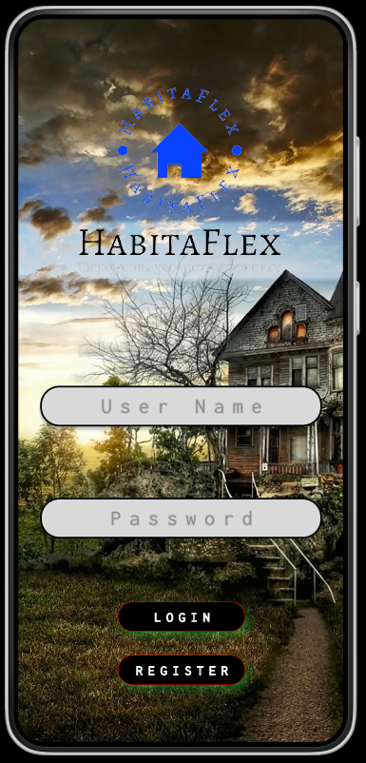
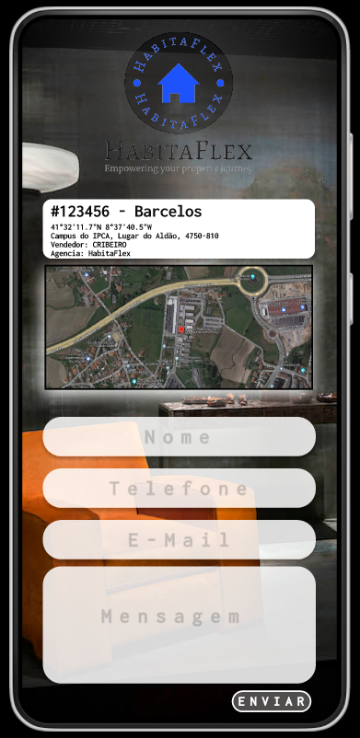

HABITAFLEX
Bruno Fernandes | Carlos Ribeiro | Rosário Silva
Students in Information Systems Engineering
Profª Edite Joana Vilas Boas & Profª Patrícia Leite
BACKGROUND
OBJECTIVES
The property sector is one of the fundamental pillars of the global economy, representing a significant portion of the world's investment and wealth.
For decades, buying, selling and renting property followed a traditional model in which personal interaction and direct negotiation were the norm.
However, the advance of information technologies and increasing globalisation have drastically changed this scenario.
The proposed platform aims to revolutionise users' daily lives by:
Reducing the time needed to find the ideal property through an advanced search system.
Simplifying the listing process for sellers and agents, making it more intuitive.
Facilitate direct communication between the parties involved.
Providing a user experience optimised for mobile devices, allowing properties to be searched and negotiated on the move.
METHODOLOGY
This project seeks to address and solve the challenges of the property market by designing a digital platform.
The aim is to detail and record all the effort and planning associated with the Applied Project, Mobile Device Programming and Information Systems Integration disciplines, thus contributing to the practical and theoretical training of the students involved.
RESULTS AND CONCLUSIONS
BIBLIOGRAPHY
Write here...
Write here...
Up to 5 references
CONTACTS
a18576@alunos.ipca.pt (Bruno Fernandes)
a18596@alunos.ipca.pt (Carlos Ribeiro)
a21138@alunos.ipca.pt (Rosário Silva)
eboas@ipca.pt (Profª Edite Joana Vilas Boas)
patricialeite@ipca.pt (Profª Patricia Leite)

