Slide 1



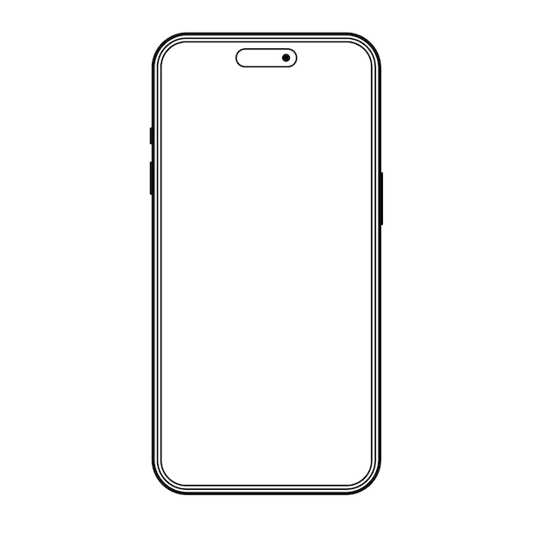
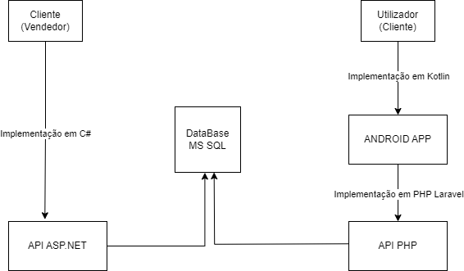
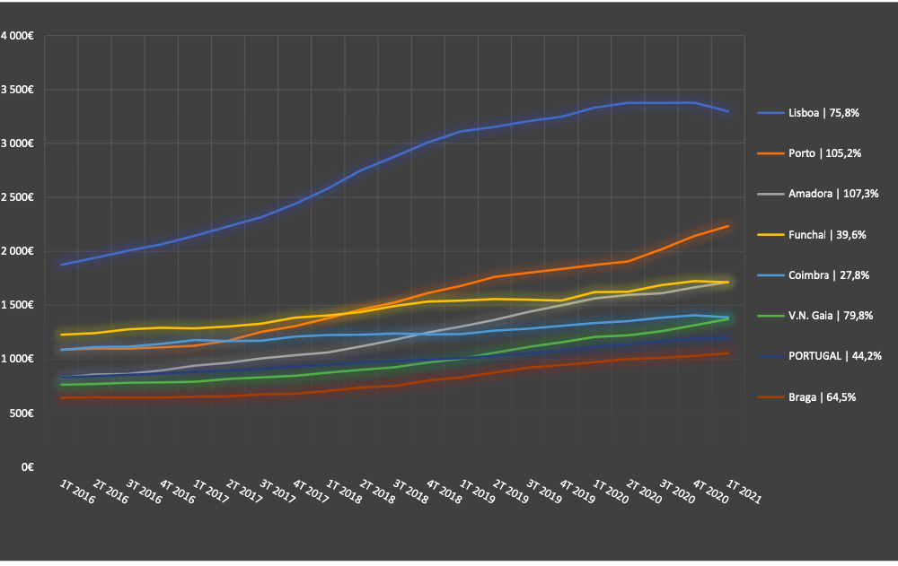
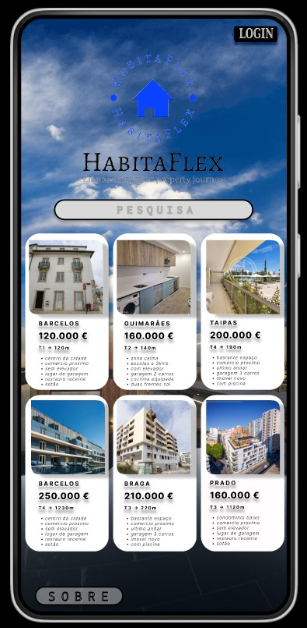
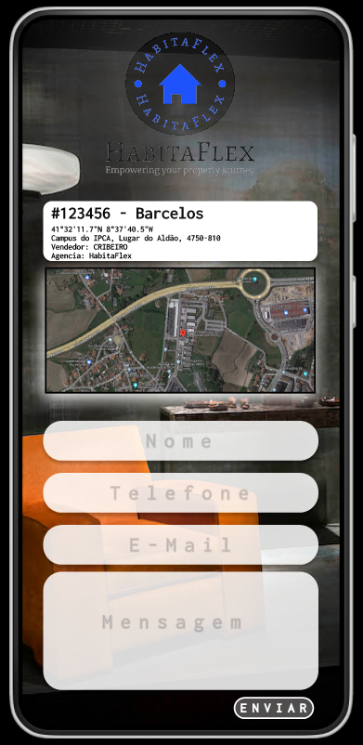
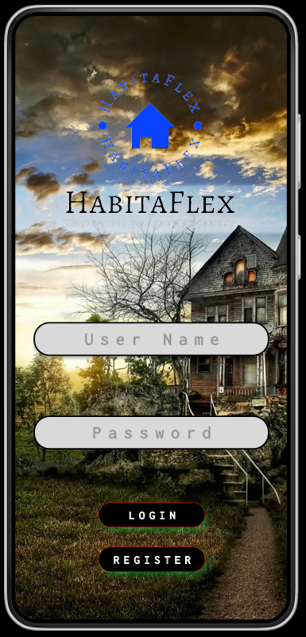

HABITAFLEX
Bruno Fernandes | Carlos Ribeiro | Rosário Silva
Students in Information Systems Engineering
Profª Edite Joana Vilas Boas & Profª Patrícia Leite
BACKGROUND
OBJECTIVES
The real estate sector is one of the fundamental pillars of the global economy, representing a significant portion of global investment and wealth.
For decades, the buying, selling, and renting of properties followed a traditional model in which personal interaction and direct negotiation were the norm.
However, the advancement of information technologies and the increasing globalization have drastically changed this landscape.
The proposed platform aims to revolutionise users' daily lives by:
Reducing the time needed to find the ideal property through an advanced search system.
Simplifying the listing process for sellers and agents, making it more intuitive.
Facilitate direct communication between the parties involved.
Providing a user experience optimised for mobile devices, allowing properties to be searched and negotiated on the move.
METHODOLOGY
This project aims to address and solve the specific challenges of the real estate market through the design of a digital platform.
The intention is to detail and record all the effort and planning associated with the disciplines of Applied Project, Integration of Information Systems, and Mobile Device Programming, thereby contributing to the practical and theoretical training of the involved students.
RESULTS AND CONCLUSIONS
BIBLIOGRAPHY
The obtained results not only highlight the effectiveness of the platform in achieving its stated objectives but also its ability to enhance user efficiency and satisfaction. The platform emerges not merely as a technological tool but as a transformative agent, positively shaping the way real estate transactions are conducted. This success signifies not only the present but also anticipates a promising future for the industry, driven by innovation and a focus on the genuine needs of its stakeholders.
https://laravel.com/
https://learn.microsoft.com/en-us/dotnet/csharp/
https://kotlinlang.org/docs/home.html
CONTACTS
a18576@alunos.ipca.pt (Bruno Fernandes)
a18596@alunos.ipca.pt (Carlos Ribeiro)
a21138@alunos.ipca.pt (Rosário Silva)
eboas@ipca.pt (Profª Edite Joana Vilas Boas)
patricialeite@ipca.pt (Profª Patricia Leite)

