Slide 1

Understanding COVID-19 Incident and Google Mobility Data Relationship using Data Science Regis University MSDS692 Data Science Practicum 1
Martha Dunne August 23, 2020

Slide 2
Introduction
January 30, 2020 the COVID-19 outbreak was declared a Public Health Emergency of International Concern by the WHO
Countries have responded with various forms of social distancing and travel restrictions to slow down the spread of the epidemic
Cell phone location tracking offers opportunities for contact tracing, quarantine enforcement, and mobility tracking
Relating COVID-19 incidents with mobility patterns can assist with planning for policies as lockdowns are relaxed

Slide 3
Goal
Investigate relationship between COVID-19 incidents
and cell phone mobility location data
COVID-19 data is sourced from John Hopkins, with global data for countries tracking confirmed cases, deaths and recovered cases.
Mobility data is sourced from Google ‘COVID-19 Community Mobility Reports’, with global data for countries tracking movement trends over time across 6 high-level categories.

Slide 4
John Hopkins COVID-19
John Hopkins Whiting School of Engineering Center for Systems Science and Engineering (JHU CSSE)
3 wide format CSV files;
cases, deaths, recovered
Coverage from January 22nd
through current to yesterdays reporting
187 countries
Field | Type
Province/State | string
Country/Region | string
Lat | float
Long | float
1/22/2020 | integer
. . .
daily to current | integer

Slide 5
John Hopkins COVID-19 File Cleanup Issues
Convert 3 wide format CSV files to long format and merge;
Naming values columns to cases, deaths, recovered
Aggregate(sum) countries which report at province level
Review Country names compared to Mobility file
More countries, but not row for row match with Mobility
No records for North Korea
Records for cruise ships from early outbreaks
Rename Country/Region to country for merge
Rename country ‘Taiwan*’ to ‘Taiwan’

Slide 6
COVID-19 Community Mobility Reports
Google
1 long format CSV file
Coverage from February 15th
through 3 days ago
(for file preparation)
135 countries
Countries report at
several levels
Field | Type
country_region_code | string
country_region | string
sub_region_1 | string
sub_region_2 | string
metro_area | string
iso_3166_2_code | string
census_fips_code | string
date | date
retail_and_recreation_percent_change_from_baseline | integer
grocery_and_pharmacy_percent_change_from_baseline | integer
parks_percent_change_from_baseline | integer
transit_stations_percent_change_from_baseline | integer
workplaces_percent_change_from_baseline | integer
residential_percent_change_from_baseline | integer

Slide 7
Google Mobility Rules
track movement trends over time by across six high-level categories, locations in category vary per region
record a percentage point increase or decrease in visits with relation to a baseline (except residential which measures in duration units)
track visits and length of stay changes compared to a baseline.
for each region-category, each day of the week baseline is the median day value during the five-week baseline period from January 3 to Feb 6, 2020. Avoid comparing day-to-day changes.
do not infer that larger changes mean more visitors or smaller changes mean less visitors.

Slide 8
Mobility Categories
Grocery & pharmacy – food markets, drug stores, and pharmacies. Frequently defined as essential and remain accessible in lockdown.
Transit stations - public transport hub may include seaports, taxi stands, highway rest stops, car rental agencies.
Retail & recreation - restaurants, shopping, libraries, movie theaters.
Workplaces - places of work (that allow active mobile devices)
Residential - places of residence. This shows a change in duration, where the other categories measure a change in total visitors. Do not compare the change in the Residential category with other categories.
Parks - local and national parks, beaches, marinas, castles, national forests, campgrounds.

Slide 9
Mobility File Cleanup Issues
Select only country rows which report at country level
Rename Country/Region to country for merge
Rename the lengthy category fields to shorter names;
e.g. , retailrec, grocerrx, parks, transit, work, reside, parks
Review Country names compared to COVID-19 file
Fewer countries, but not row for row match with COVID-19
No records for China, North or South Korea, Iran, Syria
Records for cruise ships from early outbreaks
Rename country ‘United States’ to ‘US’ to match COVID-19 file

Slide 10
Merge File Issues
Inner join merge on country (string) and date (datetime) fields
Merged file is limited by mobility data dates February 15th through to three days ago (time required for Google file preparation)
Generate delta column to expose the daily change in cases and deaths; ie. casesdelta and deathsdelta
Final merged columns list;
country, date, cases, deaths, casesdelta, deathsdelta,
retailrec, grocerrx, parks, transit, work, reside, parks
All fields except country and date are integer

Slide 11
Merge File Structure
Field | Type
country_region | string
date | date
cases | integer
deaths | integer
casesdelta | integer
deathsdelta | integer
retailrec | integer
grocerrx | integer
parks | integer
transit | integer
work | integer
reside | integer

Slide 12
Analysis & Reality
Worst & Best Countries at managing COVID-19
The worst countries are easy to define, select count of the maximum total and daily cases and deaths; United States, Brazil and India
The best countries are more difficult. Including a country population dataset here would have helped. Also note, Taiwan has low cases, but it did not participate in a typical lockdown with restricted mobility. They wore masks, closed borders, enforced quarantines, followed medical officials and kept their businesses and retail open. I selected a count of minimums, referred to current news articles, and initially selected New Zealand, Australia, Singapore and Canada in this category.

Slide 13
Worst & Best Countries COVID-19 Incident Counts
8/14/2020 | 2019 population | cases total | deaths total | cases daily | deaths daily
Taiwan | 23,773,876 | 481 | 7 | 0 | 0
New Zealand | 4,917,000 | 1609 | 22 | 7 | 0
Australia | 25,364,310 | 23,035 | 379 | 293 | 4
Singapore | 5,703,570 | 55,580 | 27 | 83 | 0
Canada | 37,589,260 | 123,605 | 9,068 | 425 | 5
India | 1,366,417,750 | 2,525,922 | 49,036 | 64,732 | 996
Brazil | 211,049,530 | 3,275,520 | 106,523 | 50,644 | 1,060
US | 328,239,520 | 5,313,252 | 168,452 | 64,294 | 1,342
Global | n/a | 20,420,761 | 734,275 | 297,341 | 9,878

Slide 14
Worst & Best Countries COVID-19
Daily Cases Statistics
Casesdelta Daily cases | TA | NZ | AU | SI | CA | US | IN | BR | Merged file total
count | 182 | 182 | 182 | 182 | 182 | 182 | 182 | 182 | 22797
mean | 2.54 | 8.84 | 126.48 | 305.02 | 679.11 | 29193.6 | 13878.7 | 17997.4 | 894.45
std | 5.26 | 20.36 | 166.76 | 281.98 | 595.36 | 20982.7 | 18934.8 | 18853.3 | 4574.82
min | -2 | -1 | 0 | 0 | 0 | 0 | 0 | 0 | -10034
25% | 0 | 0 | 10 | 55.75 | 242.75 | 18209.3 | 176.75 | 830.5 | 0
50% | 0 | 1 | 25.5 | 237.5 | 469.5 | 25594.5 | 4491.5 | 11805 | 22
75% | 2 | 3 | 218.5 | 464.5 | 1128.3 | 45179.5 | 19384.3 | 30901.3 | 289
max | 27 | 89 | 716 | 1426 | 2778 | 77255 | 66999 | 69074 | 77255

Slide 15
Worst & Best Countries COVID-19
Daily Cases Pearson Correlation
Correlation | TA | NZ | AU | SI | CA | US | BR | IN
cases | -0.29 | -0.202 | 0.621 | 0.188 | -0.022 | 0.862 | 0.857 | 0.989
deaths | -0.408 | -0.475 | 0.486 | 0.378 | -0.117 | 0.805 | 0.894 | 0.992
casesdelta | 1 | 1 | 1 | 1 | 1 | 1 | 1 | 1
deathsdelta | 0.147 | 0.068 | 0.658 | 0.167 | 0.781 | 0.367 | 0.9 | 0.885
retailrec | -0.221 | -0.571 | -0.08 | -0.789 | -0.782 | -0.175 | 0.021 | -0.083
grocerrx | -0.103 | -0.555 | -0.131 | -0.587 | -0.683 | -0.208 | 0.485 | 0.28
transit | -0.273 | -0.526 | -0.237 | -0.798 | -0.73 | -0.33 | -0.052 | -0.011
work | 0.058 | -0.615 | -0.115 | -0.737 | -0.64 | -0.425 | 0.046 | 0.063
parks | -0.003 | -0.537 | -0.039 | -0.769 | -0.369 | 0.55 | -0.015 | -0.289
reside | 0.182 | 0.614 | 0.123 | 0.744 | 0.721 | 0.221 | 0.132 | -0.078

Slide 16
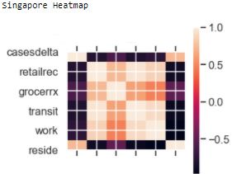
Daily Cases Pearson Correlation
Singapore Heatmap

Slide 17
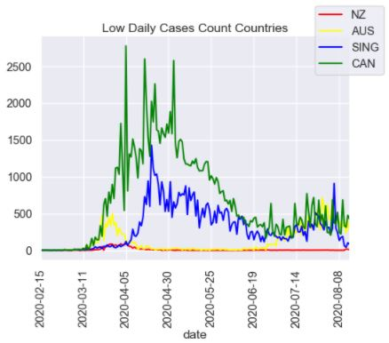
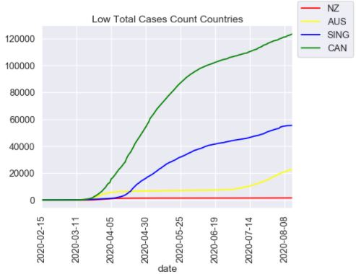
Low Daily & Total Case Count Countries

Slide 18
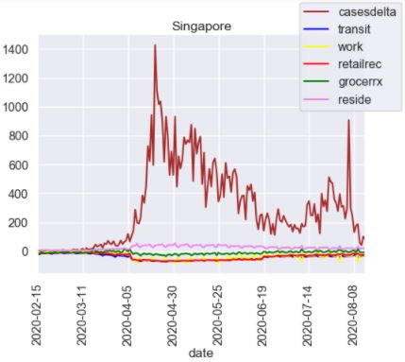
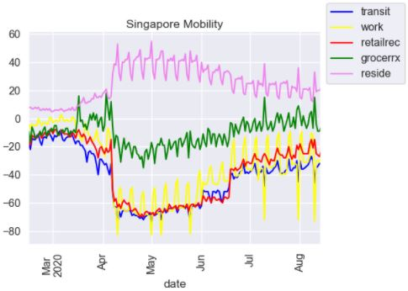
Low Daily & Total Case Count Country - Singapore

Slide 19
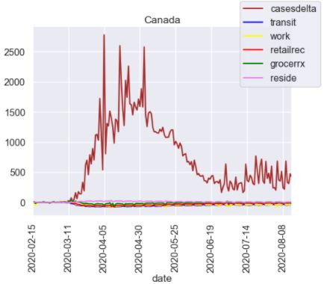
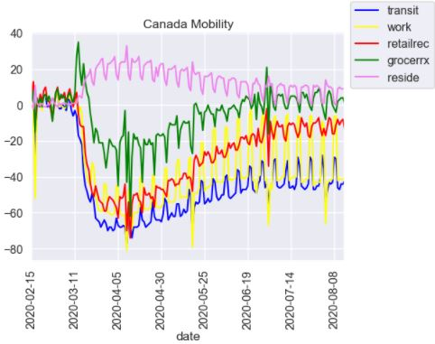
Low Daily & Total Case Count Country - Canada

Slide 20
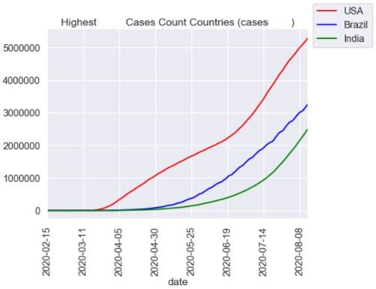
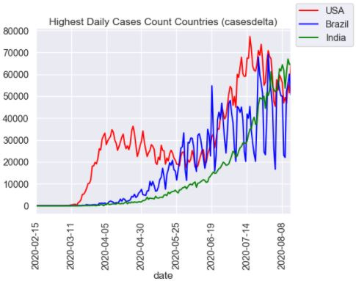
High Daily & Total Case Count Countries

Slide 21
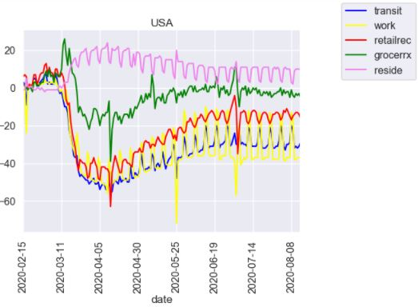
High Daily & Total Case Count Country - USA

Slide 22
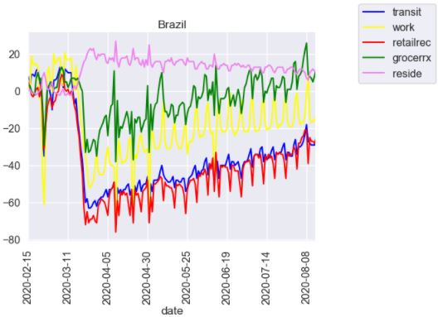
High Daily & Total Case Count Country - Brazil

Slide 23
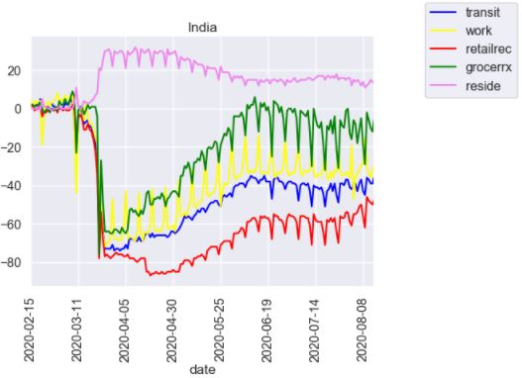
High Daily & Total Case Count Country - India

Slide 24
Initial Modeling Linear Regression New Zealand
70/30 split of training and test sets using train_test_split.
The outcome(dependant) variable was casesdelta.
The predictor(independent) variable was retailrec.
The mean absolute percent errors were around 40%, low accurate forecast system.
This is when I began investigating more best case countries.
Regression Model | CVrmse | 30%rmse | Gradient | R Value | Rsquared | Rsquared adj | MAPE
Simple Linear | 0.3127 | 0.4434 | 1.0132 | 0.7809 | 0.6098 | 0.5448 | 42.5016
Lasso | 0.3118 | 0.4428 | 1.0183 | 0.7824 | 0.6121 | 0.5474 | 42.4198
Random Forest | 0.3259 | 0.41191 | 1.0069 | 0.8199 | 0.6722 | 0.6176 | 36.4441
SVR (scaling) | 0.304 | 0.42932 | 0.9556 | 0.8187 | 0.6702 | 0.6153 | 40.697

Slide 25
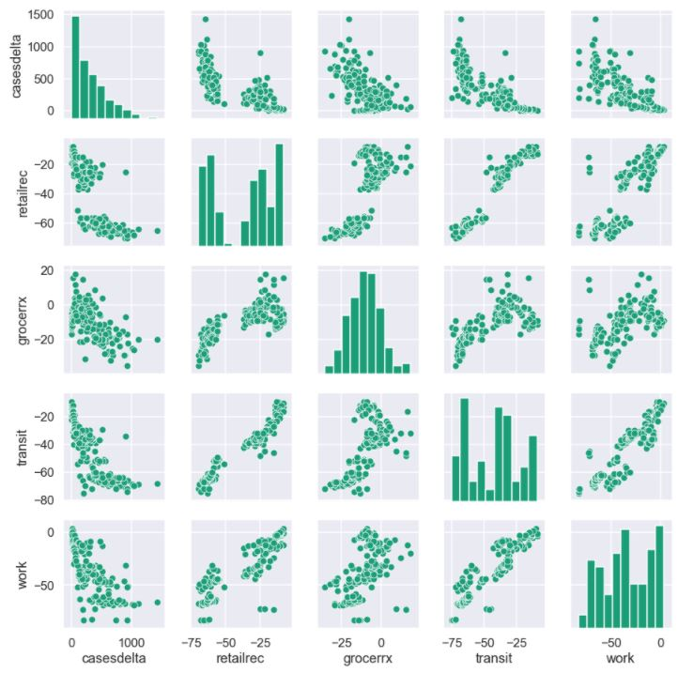
Singapore
Pairplot

Slide 26
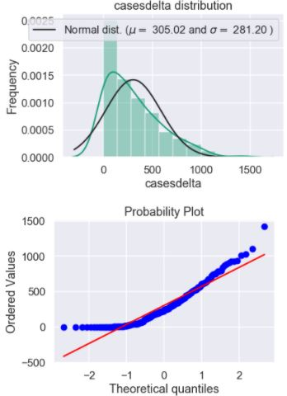
Singapore
Distribution
Skew right

Slide 27
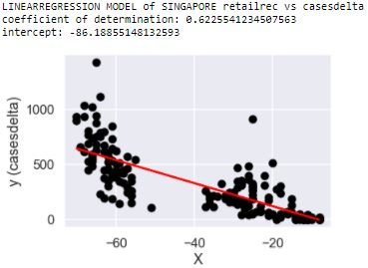
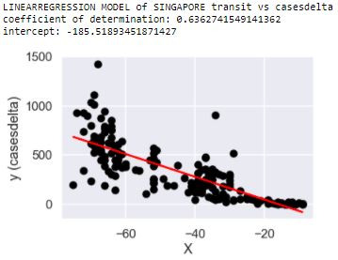
LinearRegression Line for Singapore
retailrec & transit

Slide 28
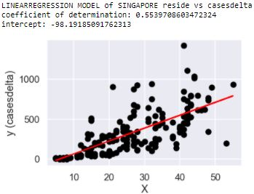
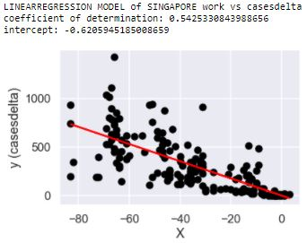
LinearRegression Line for Singapore
reside & work

Slide 29
Conclusions
I was not able to prove or disprove my hypothesis during the timeframe of this project
I made several iterations through from analysis to linear regression, each time discovering a new data wrangling or modeling preparation step. But I was not able to complete time series regression or null hypothesis testing
Visualization was a major part of this project, which leads into exploring an interactive data science tool like Tableau
I learned a lot but need to remedy gaps in my python library knowledge, and my understanding of regression and modeling

Slide 30
Conclusions
Visualization plots of COVID-19 and mobility data for the best, ‘good’ countries like New Zealand and Singapore does confirm the theory that strict mobility lockdowns at the start of COVID-19 cases, which are maintained for at least 2 weeks AFTER daily case counts are stabilized a 0, does result in maintaining some control of the spread or the virus.
Inversely, countries which neglected to restrict mobility, like the United States, or removed restrictions at the first sign of daily counts decreasing, are seeing a much higher incidence of spread.

Slide 31
Mobility Data Afterthoughts
Cell phone ownership demographics. India currently has outbreaks in extremely poor, densely packed slums. Cell phone location data is likely not reporting impoverished, high risk locations.
Global differences in data collection and reporting. Within the United States, even within the state of Colorado, there were differences in how cases, deaths and recovered cases were reported.
Indications are that the infections are much higher than recorded. Antibody testing in Delhi, Mumbai and Pune India indicate the 23% of the populations had the antibodies so had been infected at one point.

Slide 32
Project Documents
https://github.com/mabdunne/RegisDataSciencePracticumI

Slide 33
References
"COVID-19 Data Repository by the Center for Systems Science and Engineering (CSSE) at Johns Hopkins University“, https://github.com/CSSEGISandData/COVID-19
https://raw.githubusercontent.com/CSSEGISandData/COVID-19/master/csse_covid_19_data/csse_covid_19_time_series/
time_series_covid19_confirmed_global.csv
time_series_covid19_deaths_global.csv
time_series_covid19_recovered_global.csv
Google LLC "Google COVID-19 Community Mobility Reports“, https://www.google.com/covid19/mobility/, Accessed: August 17, 2020
https://www.gstatic.com/covid19/mobility/Global_Mobility_Report.csv
https://benalexkeen.com/correlation-in-python/
https://blog.google/technology/health/covid-19-community-mobility-reports/
https://datascience.stackexchange.com/questions/68291/python-and-gridsearchcv-how-to-eliminate-input-contains-nan-error-when-using-cro
https://ourworldindata.org/covid-mobility-trends converted the raw data into the rolling seven-day average.
https://pythonbasics.org/seaborn-pairplot/
https://realpython.com/linear-regression-in-python/#simple-linear-regression
https://scikit-learn.org/stable/modules/cross_validation.html#cross-validation
https://scikit-learn.org/stable/modules/generated/sklearn.linear_model.LinearRegression.html#sklearn.linear_model.LinearRegression.score
https://stats.stackexchange.com/questions/58391/mean-absolute-percentage-error-mape-in-scikit-learn
https://time.com/5851633/best-global-responses-covid-19/, Bremmer, Ian (June 12, 2020) ‘The Best Global Responses to COVID-19 Pandemic’,
https://towardsdatascience.com/cleaning-financial-time-series-data-with-python-f30a3ed580b7
https://towardsdatascience.com/visualizing-data-with-pair-plots-in-python-f228cf529166
https://www.aljazeera.com/news/2020/08/millions-infected-coronavirus-delhi-survey-200821102647796.html
https://www.forbes.com/sites/johnkoetsier/2020/06/05/the-100-safest-countries-in-the-world-for-covid-19/#795f154f68c5
https://www.kaggle.com/c/house-prices-advanced-regression-techniques#evaluation
https://www.kaggle.com/nickelkumawat/linear-regression-house-prices
https://www.ritchieng.com/pandas-variability/

