Slide 1
Some Techniques in Deterministic Modeling for Mathematical Biology
By: Ryan Borek, Dallas Hamann,
Heather Parsons, Carrie Ruda,
Carissa Staples, Erik Wolf

Slide 2
Content
I. Introduction
Pendulum Model
Nondimensionalization
Regular Perturbation Calculations
Solution and Conclusions

Slide 3
Introduction
This project was initiated from a study on mathematical biology, which used the methods of nondimensionalization and regular perturbation theory. Last semester we studied biochemical modeling, which uses the aforementioned techniques in order to solve difficult bio-chemical approximations.
Our presentation, however, uses a physics model to describe how these techniques can be applied.

Slide 4

Pendulum Motion Model
p
L
Objective:
To form a differential equation to model the motion of a simple pendulum.
s
F₁
F₂
Earth’s Surface

Slide 5



Pendulum Motion Model
p
What we know
L
L = Length of Weightless Rod
p = Fixed Point of Suspension
s
F₁
A “bob” of mass m
F₁ = tension in the Rod
F₂ = mg where g is gravity
F₂
s = distance from the “bob” to the bottom of the arc
= Angle of Rod relative to plane perpendicular to earth
Earth’s Surface
Notes:
Newton’s Second Law of Motion F=ma.
Let’s take a closer look at the Forces working on the bob so we can form a differential equation.

Slide 6
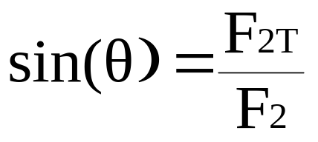
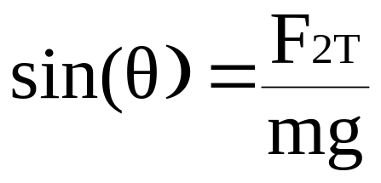
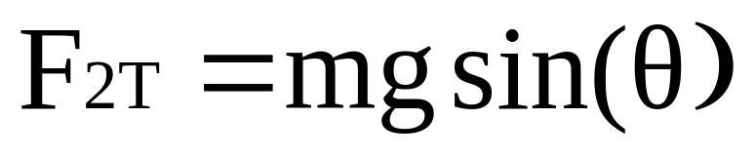
Pendulum Motion Model
p
Find the Tangential Acceleration
L
Any Force on an arc can be broken down into the sum of a tangential and normal force.
s
F₁
m
F_{2T}
F₂=mg
F_{2N}
Earth’s Surface
Notes:
Now lets look at the arclength to find the acceleration of the change in arclength.

Slide 7

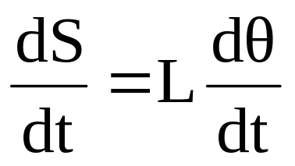
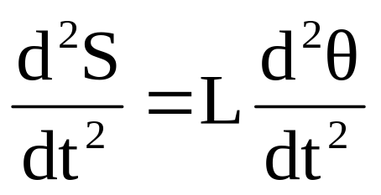
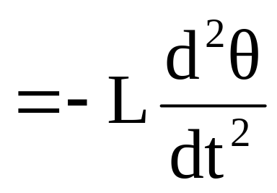
Pendulum Motion Model
p
Find Acceleration of change in the ArcLength
Use the Arc Angle Formula
L
s
F₁
m
F_{2T}
F₂=mg
So in this case, the acceleration of change in traversed arc length is
F_{2N}
Earth’s Surface

Slide 8
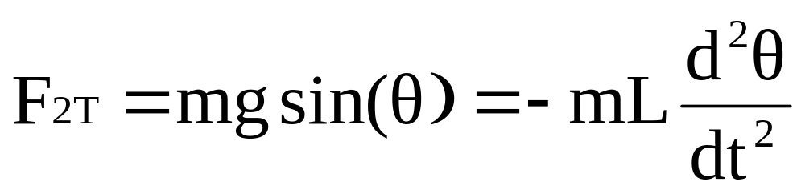
Pendulum Motion Model
If you magnify an arc many times it begins to look flat. For this reason we can set the tangential force equal to the force derived from using the acceleration of decrease in arc length.
Therefore:

Slide 9
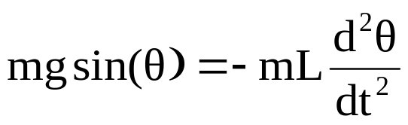
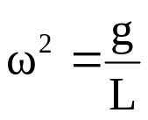
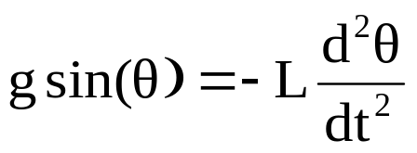
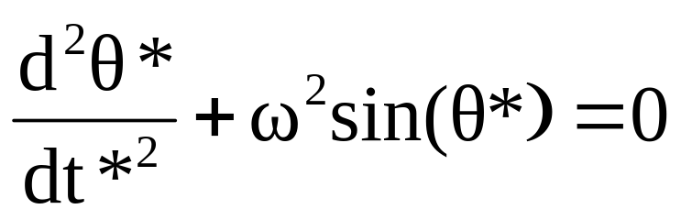
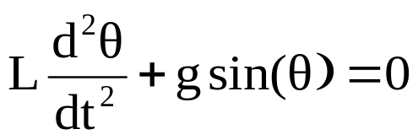
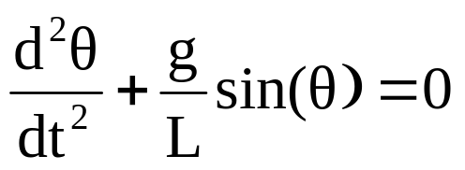
Pendulum Motion Model
A differential equation can now be formed.
Let and * denote a variable with dimension.
(a non-linear differential equation)

Slide 10
Nondimensionalization
Nondimensionalization is a technique of dimensional analysis that creates dimensionless variables, which allows differential equations to be stated in a dimensionless form. This is useful to scientists and engineers because it simplifies complex equations and puts the problem in a form amenable to the techniques of perturbation theory.

Slide 11
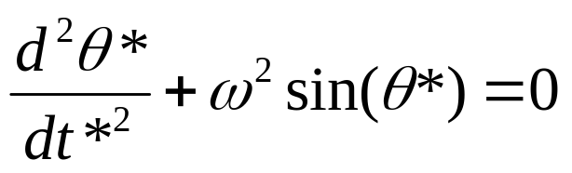
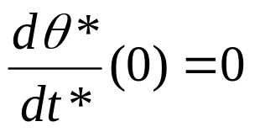
The differential equation of our Pendulum Model is:
First list variables and parameters with their dimensions
Variable Dimension
θ*(dependent) L (length)
t*(independent) T (time)
ω T⁻¹
a L
Conditions: θ*(0) = a and

Slide 12
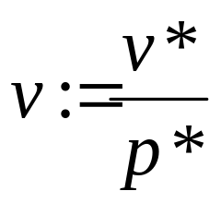
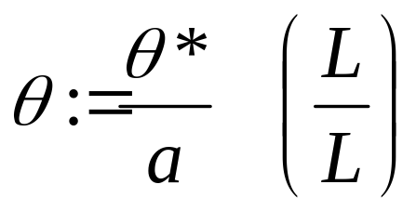
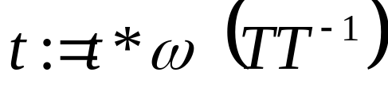
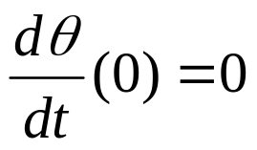
Next for each variable v*, let p* (known as the intrinsic reference quantity) be some combination of the parameters that have the same dimension as v*. The the new dimensionless variable, v is defined as
Our new dimensionless variables are now:
With new conditions: θ(0) = 1 and

Slide 13
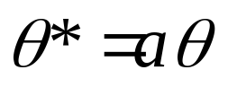
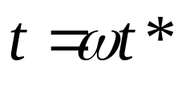
Now rewrite the dimensional variable
θ* in terms of the parameter and the
dimensionless variable, leaving
the dimensionless variable t.
Next we will change our dimensional differential equation to a dimensionless equation by substitutions.

Slide 14
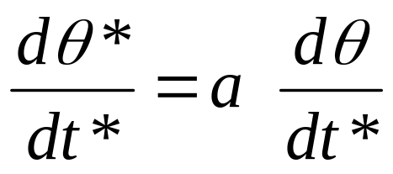
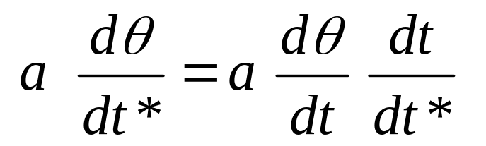
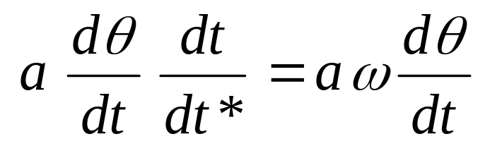
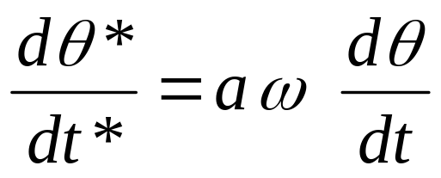
Next find the derivative of θ*.
By the chain rule:
Now with substitution:

Slide 15
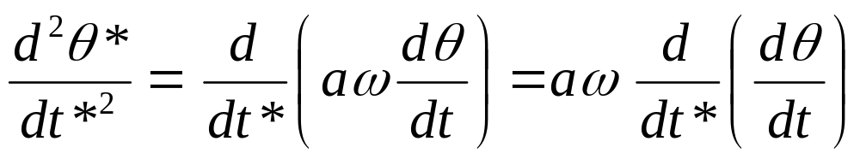
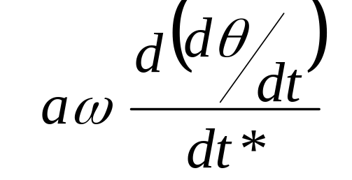
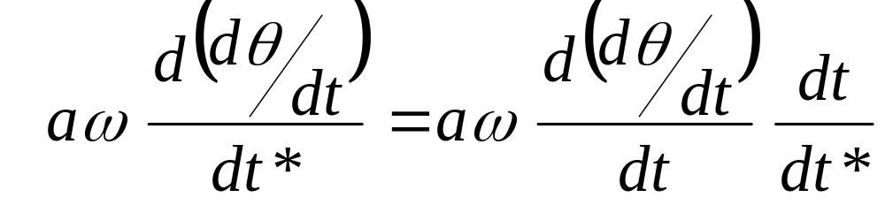
Next find the 2nd derivative of θ*.
Rewrite as:
By the chain rule:

Slide 16
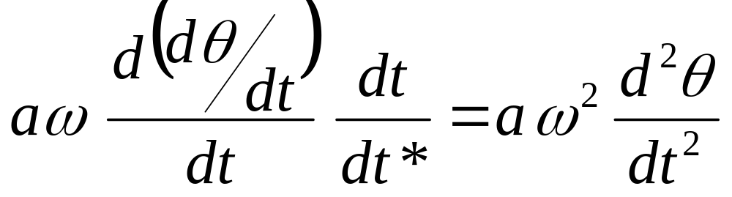
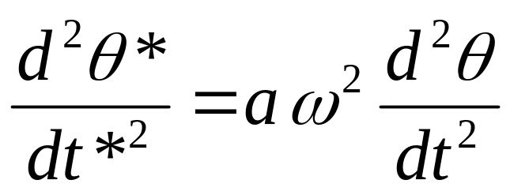
Now with substitution:

Slide 17
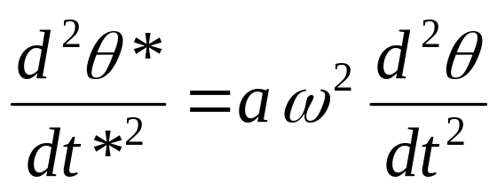
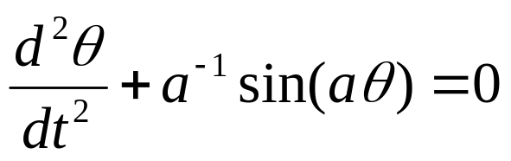
Finally we can rewrite our original model:
Substituting in:
We get the new dimensionless model:
With initial conditions: θ(0) = 1 and

Slide 18
The Series Method of Regular Perturbation Calculations
An effective method of approximating solutions for scaled differential equations.
5 step process

Slide 19
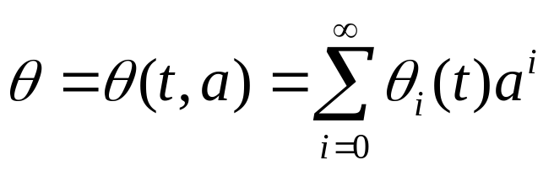
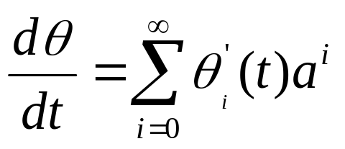
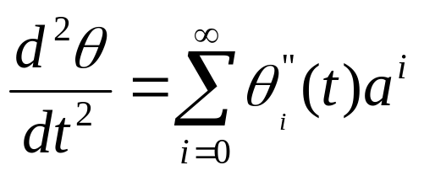
Assumptions
The dependent variable can be expressed in a series of the small parameter.
Thus,

Slide 20

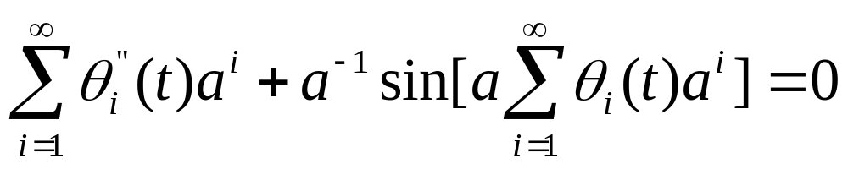
Step A:
Substitute the power series into the differential equation.
Recall : The pendulum model differential equation.
Substituting:

Slide 21
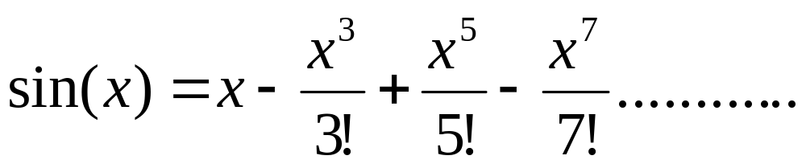
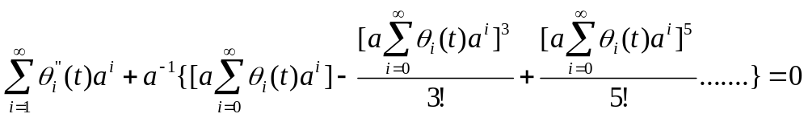
Step B:
Expand all quantities so that each term is written as a power series in a.
Recall:

Slide 22
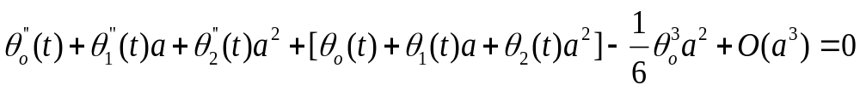
Step B (Continued):
(Note : We are using only powers of a no greater than 2)
The equation from the previous page simplifies into
the following:

Slide 23
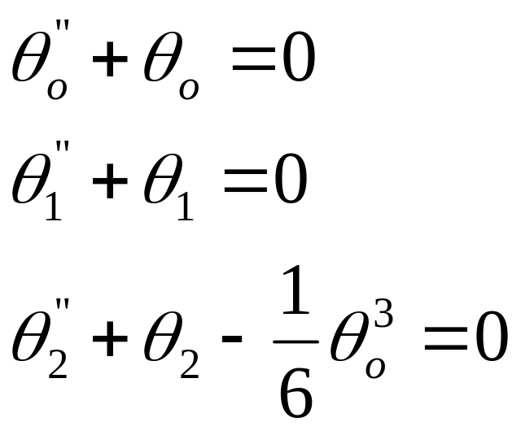
Step C:
Collect all terms in the equation and equate to zero the successive coefficients in the series.
3 Differential Equations :

Slide 24
Step C (Continued):
Remark : The original non-linear differential equation has been replaced by a sequence of linear differential equations. This is a characteristic feature of perturbation methods.

Slide 25
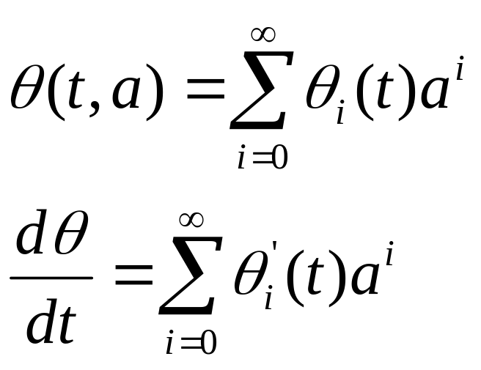
Step D:
Substitute the power series into the original initial (or boundary) conditions, expand and equate the coefficients to zero and obtain a set of new initial (or boundary) conditions to supplement the sequence of differential equations obtained in Step C.

Slide 26
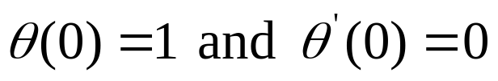
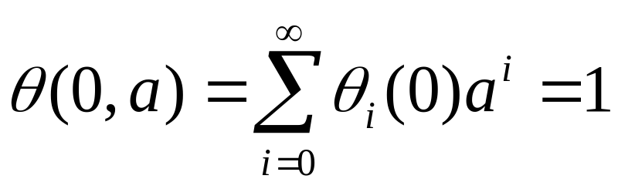
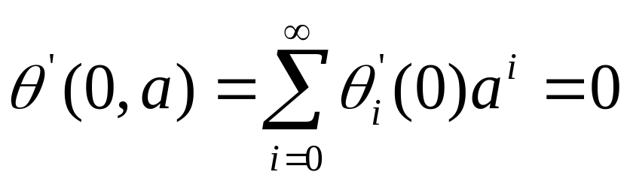
Step D (Continued):
We will now plug in our initial conditions and as a result we get (a) and (b)
Initial conditions:
(a)
(b)

Slide 27
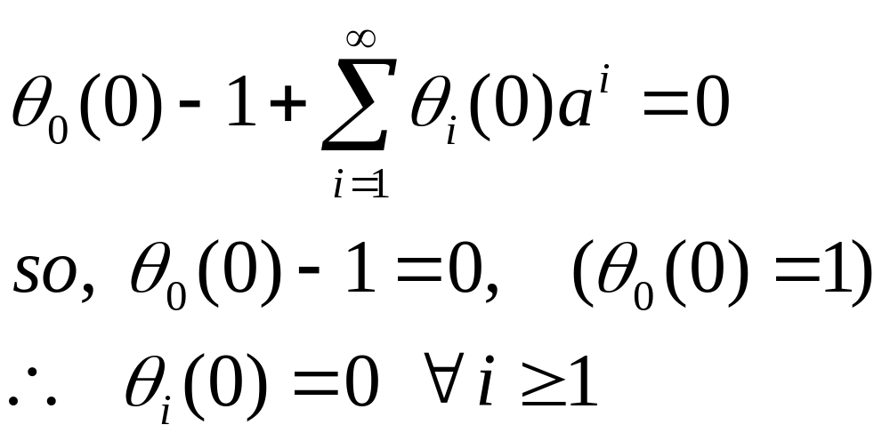
Step D (Continued):
We will now expand and equate the coefficients to zero and obtain a set of new initial or boundary conditions.
(a)

Slide 28
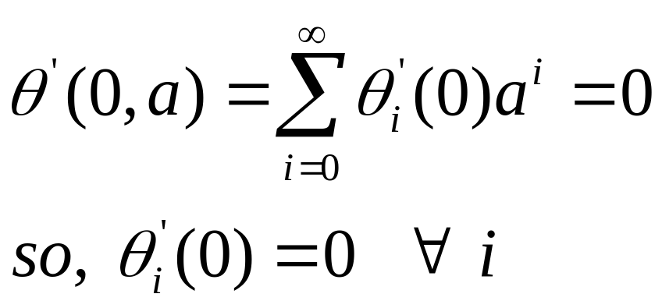
Step D (Continued):
(b)

Slide 29
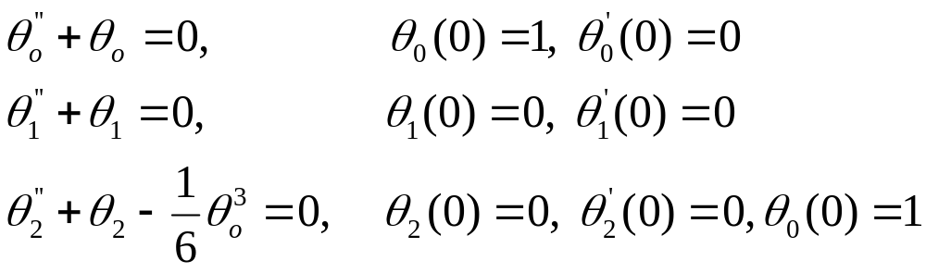
Step D (Continued):
We will now supplement the sequence of differential equations obtained in Step C with our new boundary conditions found in (a) and (b).

Slide 30
Step E:
Solve the linear differential equations in sequence.
1)
2)
3)

Slide 31
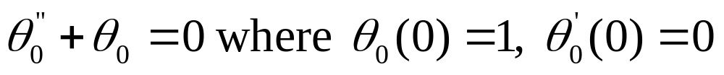
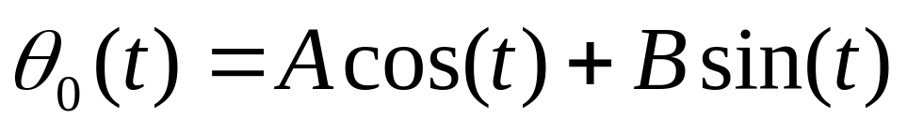
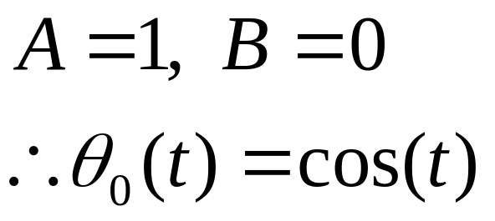
Step E (Continued):
Solving 1)

Slide 32


Step E (Continued):
Solving 2)

Slide 33



Step E (Continued):
Solving 3)

Slide 34

Step E (Continued):
This non-homogeneous differential equation can be solved using the method of “undetermined coefficients,” which gives the following result:

Slide 35

Finally, an approximation:
By expanding the power series of
to powers of a no greater than 2, we achieve the following:

Slide 36
Conclusion
Nondimensionalization and Perturbation methods are effective ways of approximating solutions to differential equations. In the study of enzyme kinetics (physical chemistry), chemical reactions are modeled by non-linear differential equations. Their solutions are approximated by the Quasi-Steady-State Approximation and Equilibrium Approximation, which utilize the methods of nondimensionalization and perturbation that were demonstrated earlier.
Notes:
This project was initiated from a study on mathematical biology, which used the methods of nondimensionalization and regular perturbation theory. Last semester we studied biochemical modeling, which uses the afore mentioned techniques.
Our presentation, however, uses a physics model to describe how these techniques can be applied.

Slide 37
Bibliography
Mathematics Applied to Deterministic Problems in the Natural Sciences by Lin and Segal, SIAM 1988

Slide 38
Special Thanks to:
Dr. Steve Deckelman
All for coming!

