Slide 1

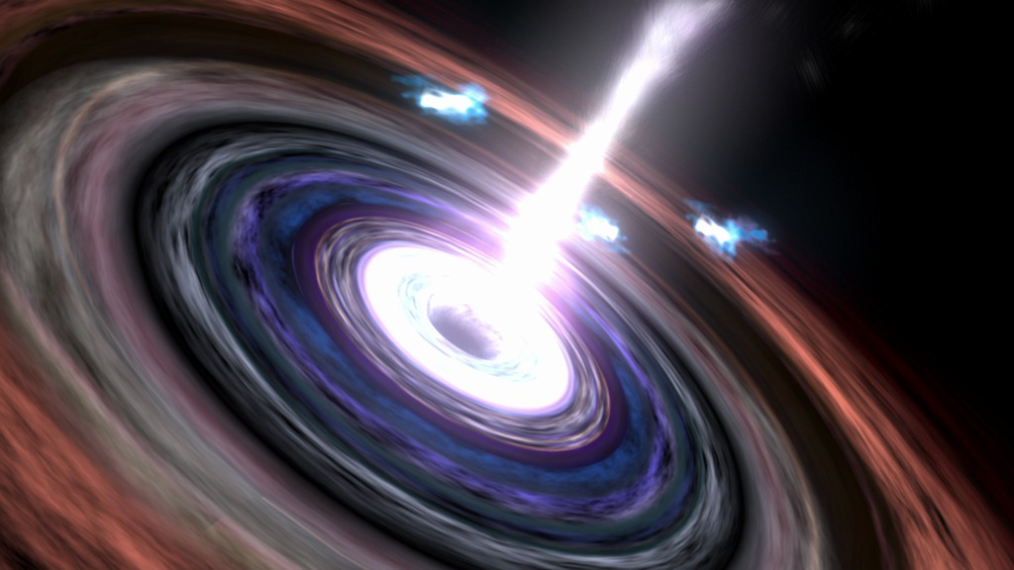
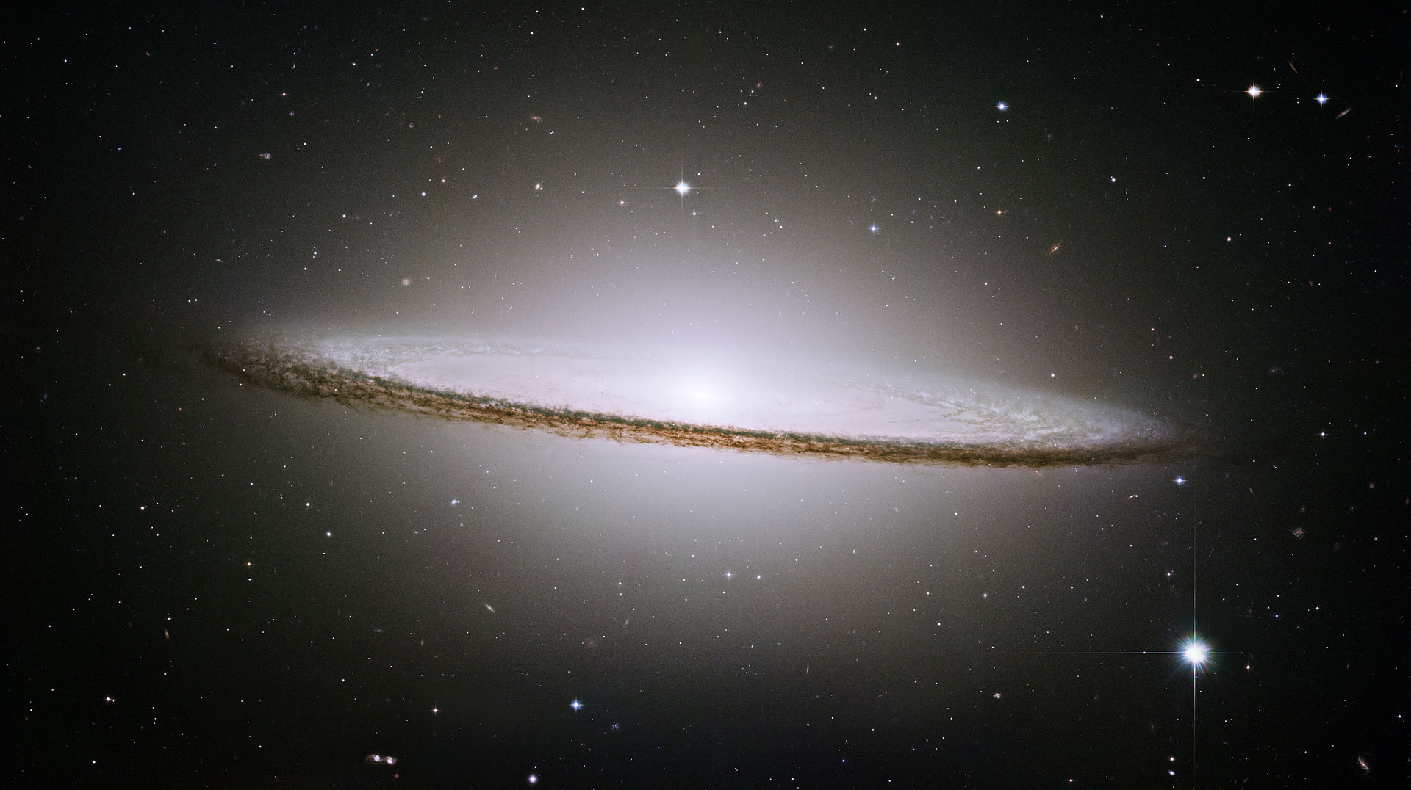
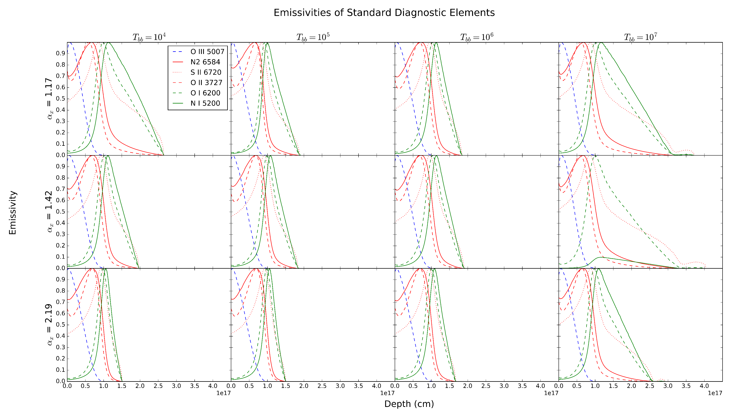
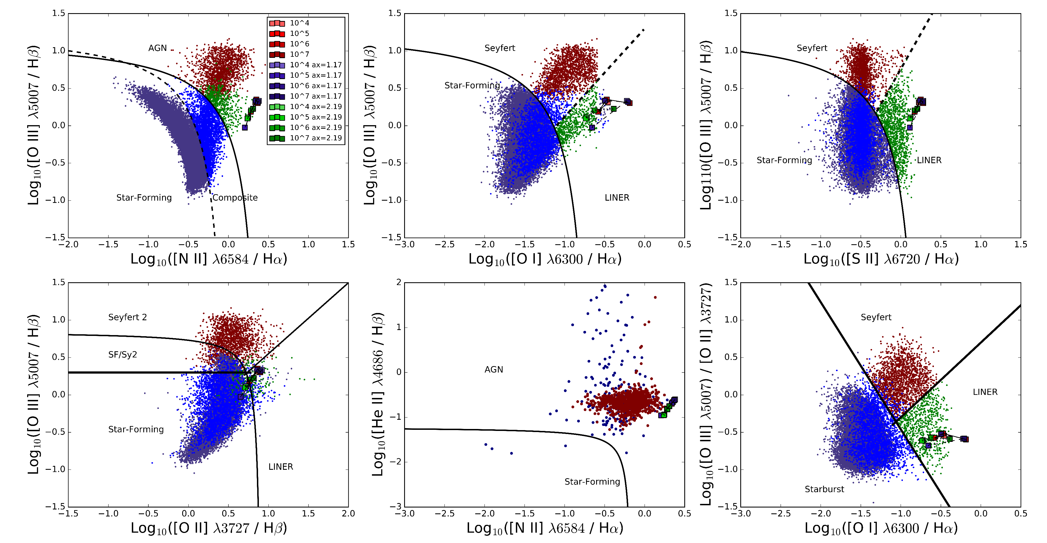
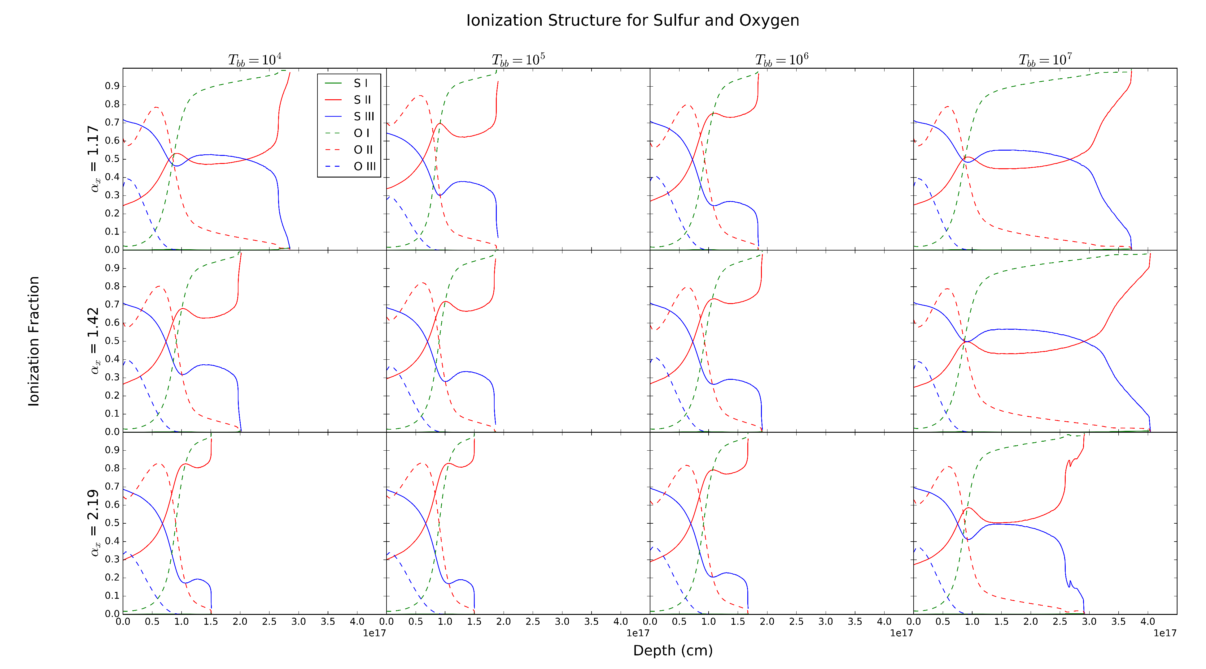
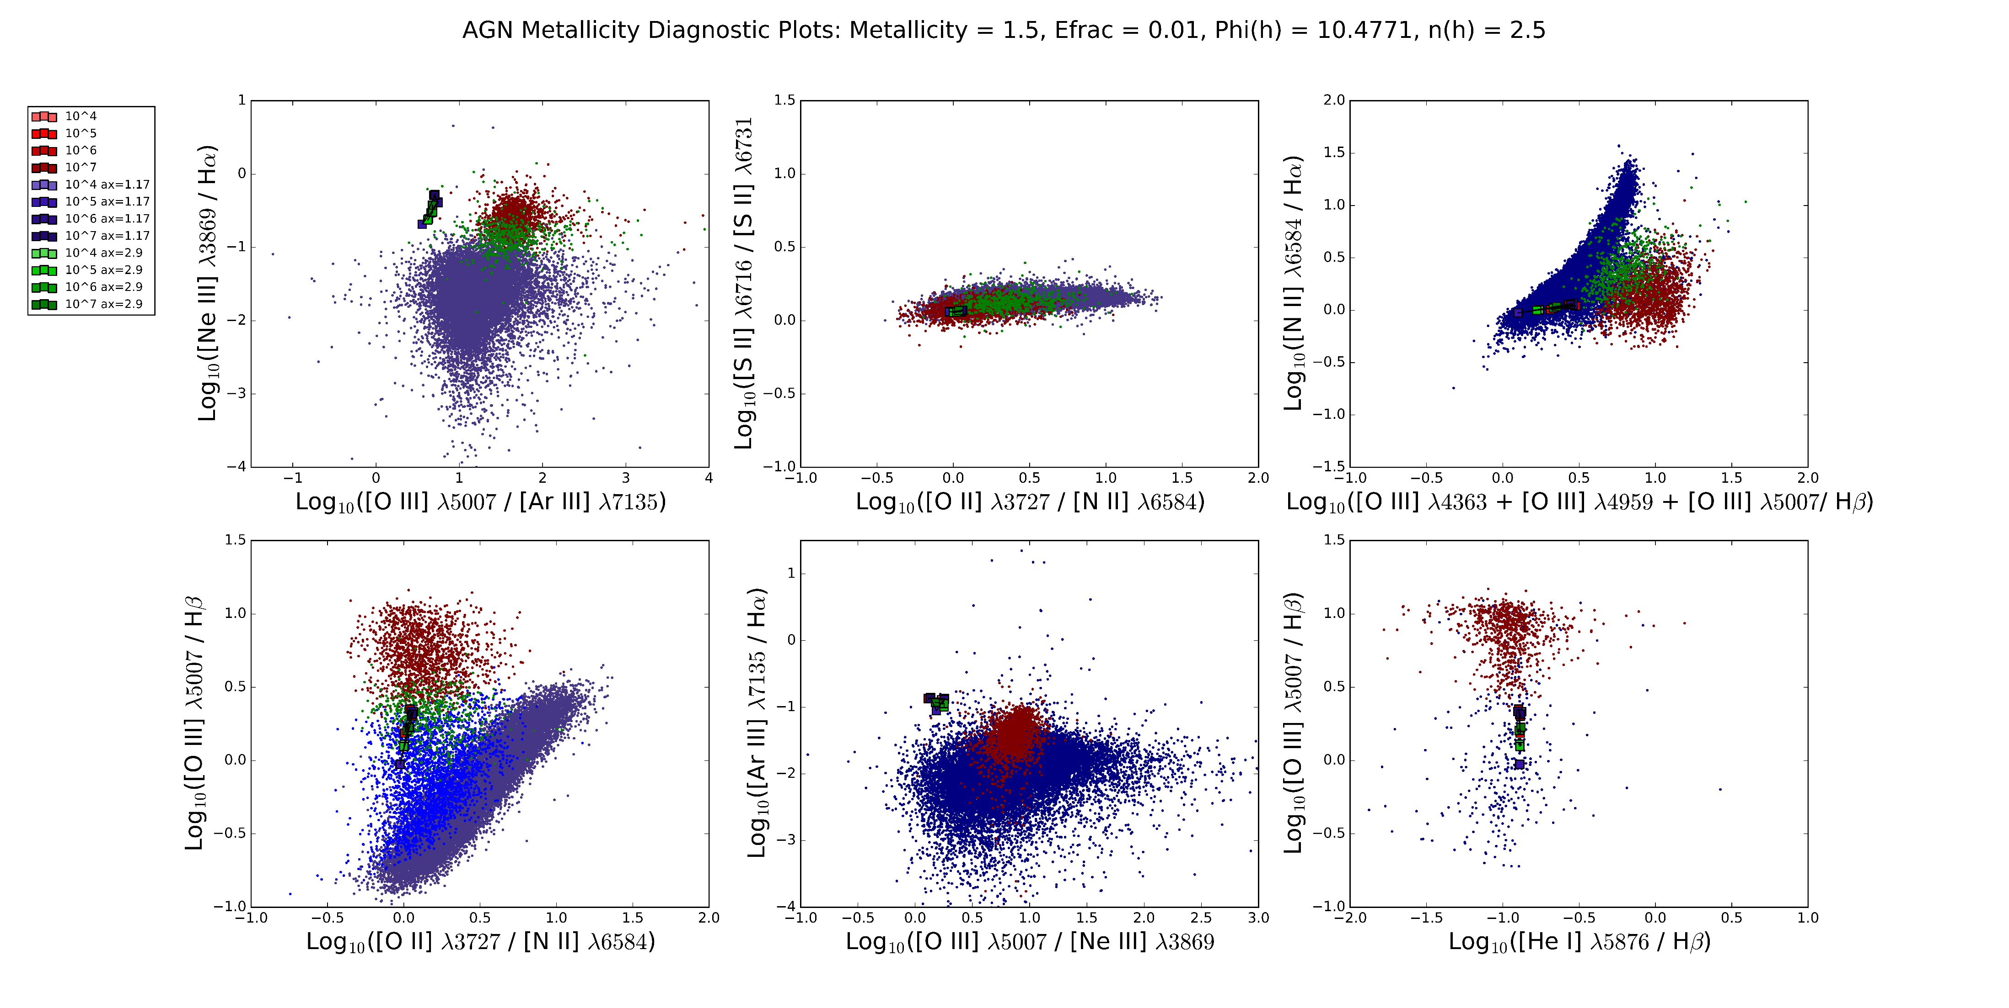
Investigating Simulations of Emission Lines from the Narrow Line Region of Seyferts and LINERS
Christopher Greene (Faculty Mentor: Dr. Chris Richardson)
Department of Physics
Abstract
This research investigates photoionization models of the Narrow Line Region (NLR) of Seyfert galaxies and Low-Ionization Nuclear Emitting Region (LINER) galaxies with the use of the astrophysical code CLOUDY. Groves et al. 2004 attempted to resolve the apparent uniformity of emission line ratios in the NLR through introducing dusty, radiation pressure-dominated photoionization models of AGN. This model assumed a simple power law relation for the Spectral Energy Distribution (SED). Grupe et al. 2010 found a correlation between α_{uv} and α_{x}, and by constraining α_{uv} as a function of α_{x} we developed a photoionization model for the ionizing spectrum of a typical Seyfert Narrow Line Region. The incident SED is based upon the spectral indices α_{uv,} α_{x,} α_{ox ,} and the blackbody accretion disk temperature T_{bb .} We set the value of α_{ox} based on the average of data collected in Grupe et al. 2010, and fix the value of α_{uv} to α_{x} based on their linear correlation. To check the validity of our model, simulations were run across a range of blackbody accretion disk temperatures and α_{x}, while fixing the hydrogen density, ionization parameter, and elemental abundance of clouds in the NLR. The emission lines produced by these simulations were plotted using standard diagnostic diagrams and compared to emission line data obtained from the Sloan Digital Sky Survey. Our model produces emission lines without significant variation between simulations with α_{x} = 1.42, 1.17, and 2.19, with T_{bb} ranging from 10­­⁴ K to 10⁷ K, except with regard to [O I] λ6300/Hα, where our simulated spectra started to fall on the boundary between Seyferts and LINERs. This leads us to examine the ability of our photoionization model to create emission line spectra that are typical of LINERs, as debate still continues over the primary excitation mechanism for LINERs. To adjust our model to fit LINERs, we lower the value of the ionization parameter and discuss the preliminary results within the context of literature involving the nature of LINERs.
Results
We examine emission line ratios as they allow us to constrain the SED and study the effects of AGN density, elemental abundances, excitation mechanism, and ionization parameter.
The first plot is known as the Baldwin-Phillip-Terlevich (BPT) diagram.
The top three plots were introduced in Osterbrock & Veilleux 1983 to categorize galaxies by atomic excitation mechanism which are empirically derived.
Bottom three plots come from Lamareille 2010, Shirazi et al. 2012, and Kewley et al. 2006 respectively.
Red indicates that the galaxy is a Seyfert, blue indicates a composite AGN and Star-forming galaxy, purple indicates star-forming galaxies, and green indicates LINERS.
Galaxies are separated based on the equations that set the boundary lines.
http://www.nasa.gov/mission_pages/chandra/multimedia/galaxy-centaurusA.html
Higher α_{x} values decrease the depth at which emission occurs for standard AGN diagnostic elements.
Increasing temperature increases the depth of emission.
N I and O I appear most susceptible to temperature variation.
Methods
We set up the incident radiation curve from:
For baseline curve, the blackbody temperature T_{BB} is set to 10⁶ K based on the mean value of past research, α_{x} = -1.59, α_{uv} = -0.6, α_{ox} = -1.42 (Grupe et al. 2010).
We also constrain the incident radiation curve by describing the elemental abundances, hydrogen density, and photon flux of the cloud, derived from Groves et al 2004.
Stopping boundary condition for simulations is when the fraction of electron to total hydrogen densities falls below 0.01 which allows us to simulate deep enough into the cloud to produce the required emissions.
We fit the values of α_{x} and α_{uv} using Ordinary Least Squares regression, producing the line:
We run simulations varying T_{BB} between 10⁴ K and 10⁷ K
The value of α_{x} is varied according to the standard deviation of the mean, 0.51, and the value of α_{uv} is changed accordingly.
Optical data obtained via the Sloan Digital Sky Survey (SDSS)
Simulated ratios fall into the expected regions of the diagrams.
[N II] λ6584 appears slightly overpredicted.
Ionization Structure follows similar trend as emissivity.
In all simulations, there is an insignificant amount of S I.
Interesting bump for S II and S III around 1e17 cm.
Conclusions
The lack of significant variation between our three models indicates that our regression is a good fit.
This model acts as an accurate predictor of LINER galaxy emission ratios
Emissivity and Ionization Fraction profiles are most affected by temperature
Future Work
Investigate metallicity variation in simulations.
Examine weaker emission lines
Determine physical cause of the S II/S III bump in ionization fraction and emissivity profiles.
References
Baldwin J. A., PhillipsM.M., Telervich R., 1981, PASP, 93, 5
Grupe, D., Komassa, S., Leighly, K., Page, K., 2010, ApJS, 187, 64
Groves, B., Dopita, Michael., Sutherland, R. 2004, ApJS, 153, 75
Groves B. A., Heckman T.M., Kauffmann G., 2006, MNRAS, 371, 1559
Kewley, L. J., & Dopita, M. A. 2002, ApJS, 142, 35
Ryden, B., Peterson, B., 2010, Foundations of Astrophysics, (Addison-Wesley)
Ferland, G. J.; Porter, R. L.; van Hoof, P. A. M.; Williams, R. J. R.; Abel, N. P.; Lykins, M. L.; Shaw, G.; Henney, W. J.; Stancil, P. C., 2013, RevMexAA, 49, 137
OsterbrockD. E., FerlandG. J., 2006, Astrophysics of Gaseous Nebulae and Active Galactic Nuclei. University Science Books, California
Lamareille, F. 2010, A&A, 509, A53
Peterson, B. M. 1993, PASP, 105, 247
Richardson C. T., Allen J. T., Baldwin J. A., Hewett P. C., Ferland G. J., 2014, MNRAS, 437, 2376
Shirazi, M., & Brinchmann, J. 2012, MNRAS, 421, 1043
Veilleux S., Osterbrock D. E., 1987, ApJS, 63, 295 (VO87)
Emission Lines of different elements at the same ionization level act as a diagnostic of abundances.
Our simulations are accurate for strong emission lines, but are significantly off for weaker emission lines such as [Ar III] λ7135.
Acknowledgements
I would like to thank the Elon College Fellows program, my research mentor Dr. Chris Richardson, and the Elon Department of Undergraduate Research.
This project was conducted as a part of Elon University’s Summer Undergraduate Research Experience, 2016.

