Slide 1

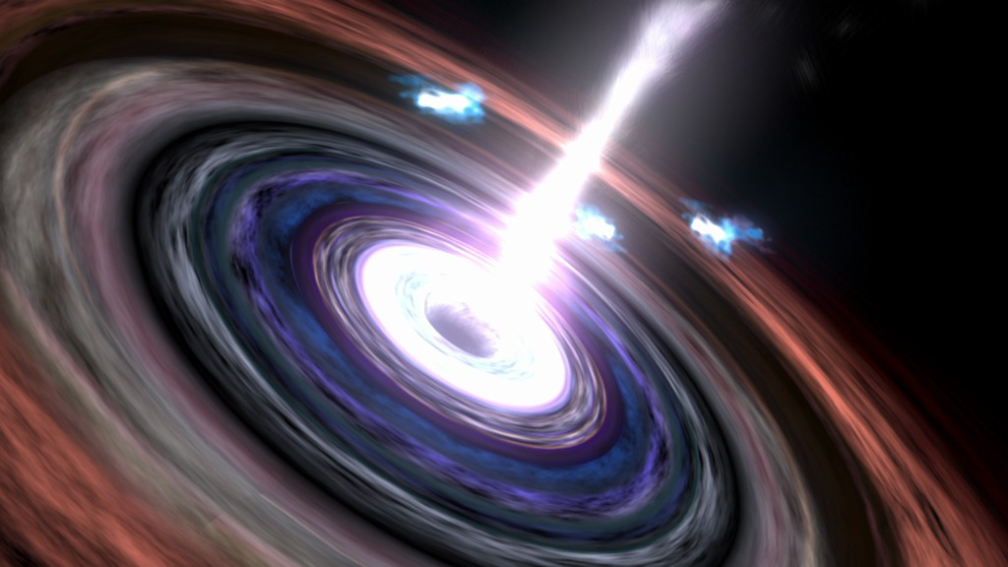
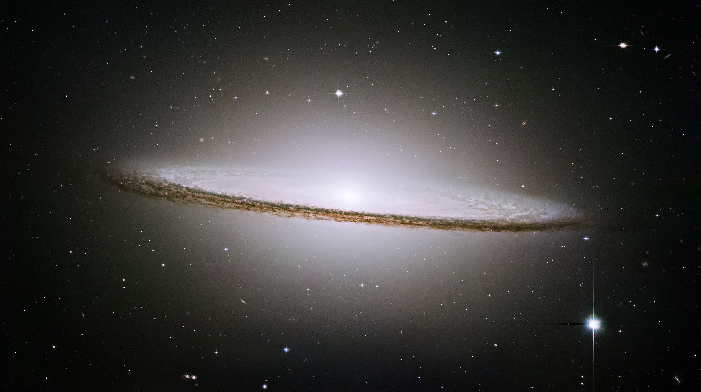
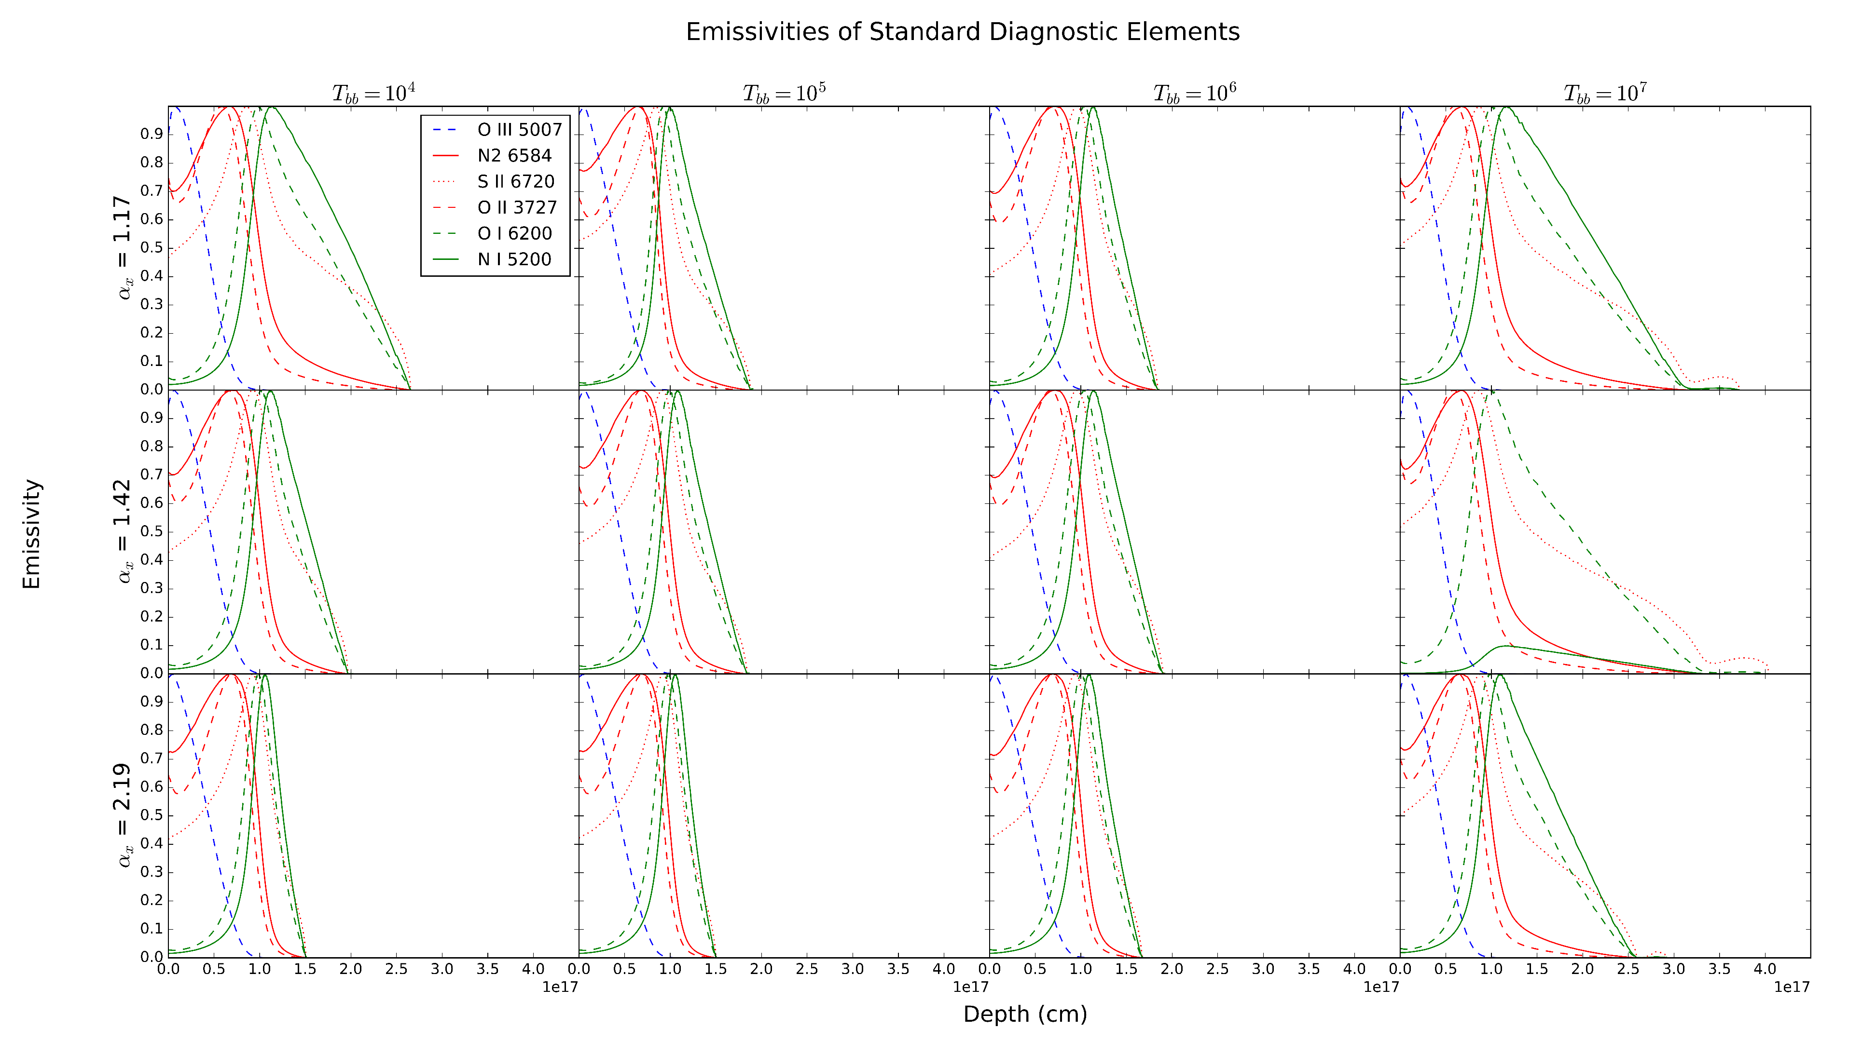
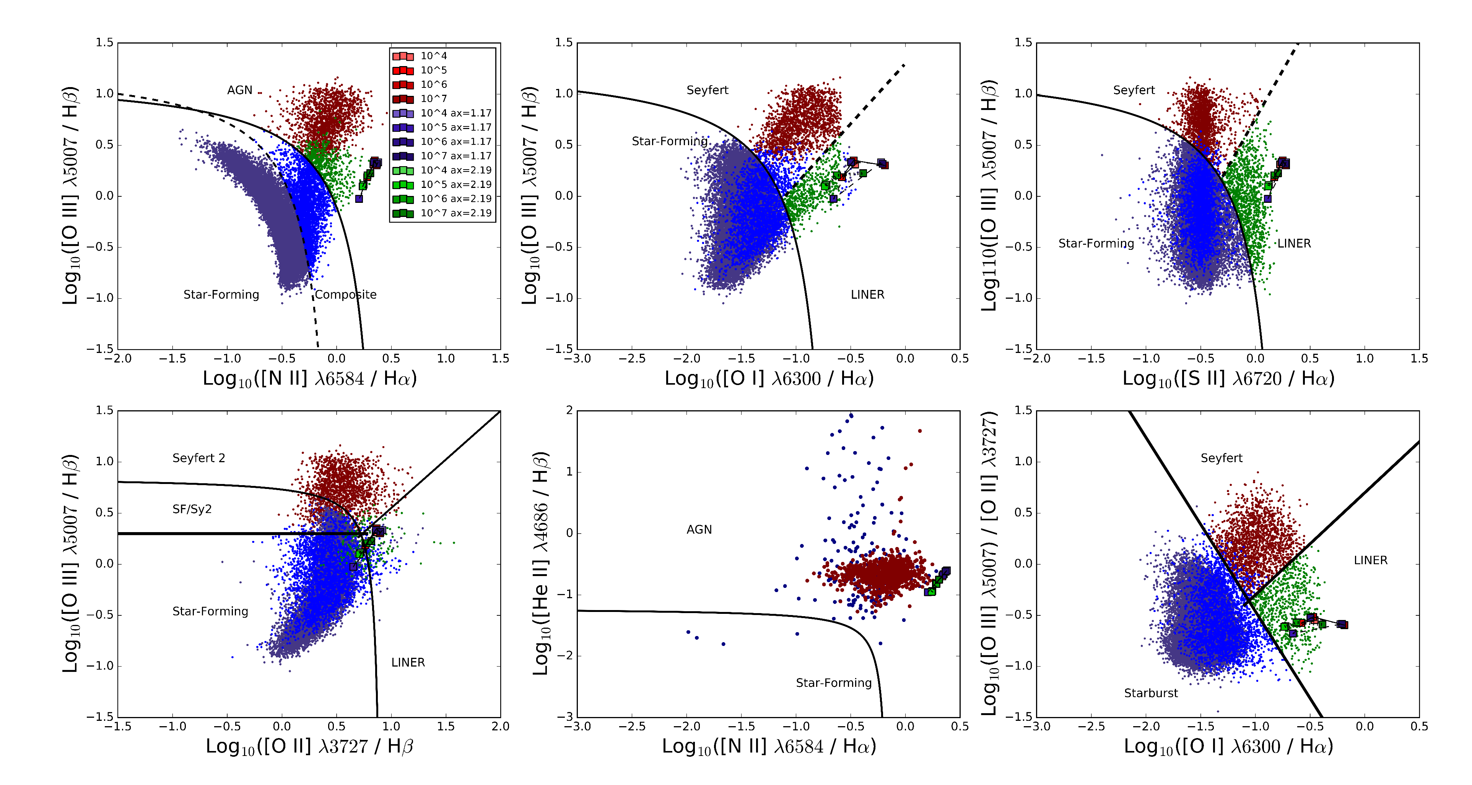
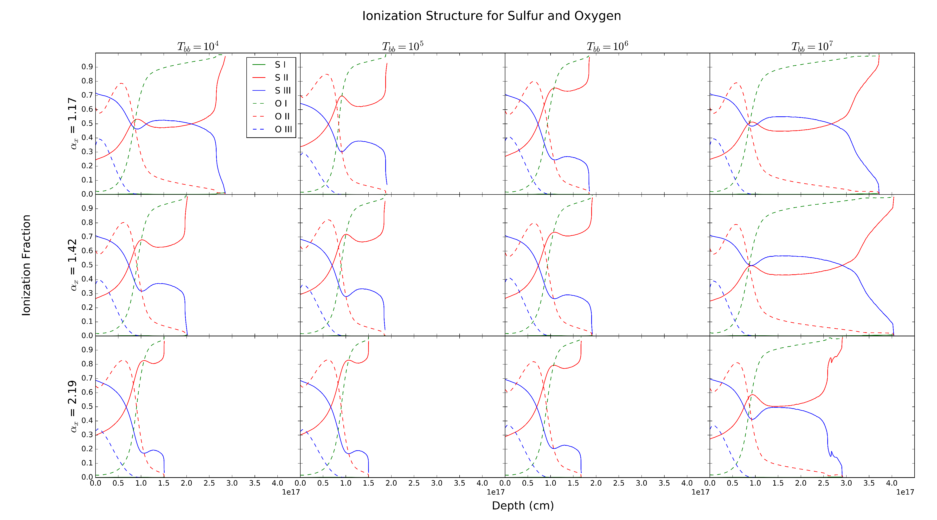
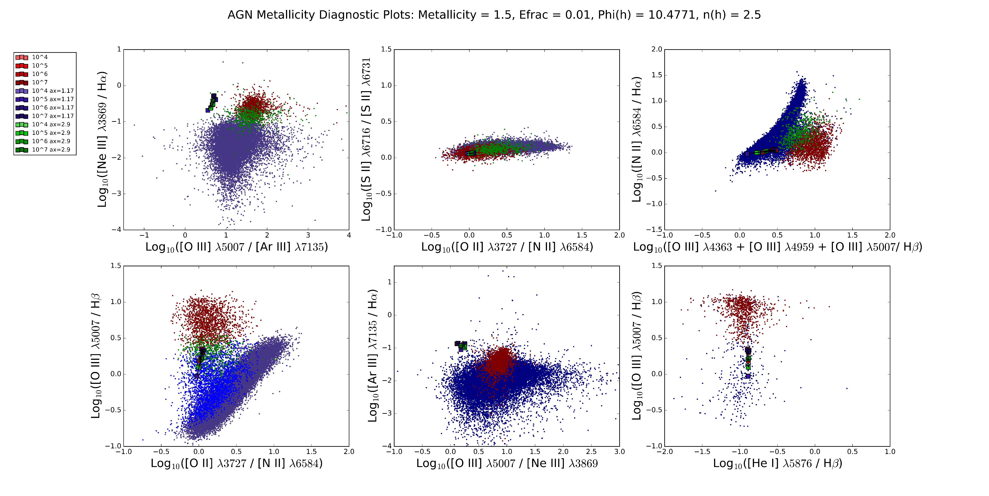
Investigating Simulations of Emission Lines from the Narrow Line Region of Seyferts and LINERS
Christopher Greene (Faculty Mentor: Dr. Chris Richardson)
Department of Physics
Results
We examine emission line ratios as they allow us to constrain the SED and study the effects of AGN density, elemental abundances, excitation mechanism, and ionization parameter.
The first plot is known as the Baldwin-Phillip-Terlevich (BPT) diagram.
The top three plots were introduced in Osterbrock & Veilleux 1983 to categorize galaxies by atomic excitation mechanism which are empirically derived.
Bottom three plots come from Lamareille 2010, Shirazi et al. 2012, and Kewley et al. 2006 respectively.
Red indicates that the galaxy is a Seyfert, blue indicates AGN-Starwhile blue indicates star-forming galaxies, composite galaxies, and LINERS.
Galaxies are separated based on the equations that set the boundary lines.
Background Information
Photoionization models act as excellent predictors of emission lines from Active Galactic Nuclei (AGN).
http://www.nasa.gov/mission_pages/chandra/multimedia/galaxy-centaurusA.html
Methods
We set up the incident radiation curve from:
For baseline curve, the blackbody temperature T_{BB} is set to 10⁶ K based on the mean value of past research, α_{x} = -1.59, α_{uv} = -0.6, α_{ox} = -1.42 (Grupe et al. 2010).
We also constrain the incident radiation curve by describing the elemental abundances, hydrogen density, and photon flux of the cloud, derived from Groves et al 2004.
Stopping boundary condition for simulations is when the fraction of electron to total hydrogen densities falls below 0.01 which allows us to simulate deep enough into the cloud to produce the required emissions.
We fit the values of α_{x} and α_{uv} using Ordinary Least Squares regression, producing the line:
We run simulations varying T_{BB} between 10⁴ K and 10⁷ K
The value of α_{x} is varied according to the standard deviation of the mean, 0.51, and the value of α_{uv} is changed accordingly.
Optical data obtained via the Sloan Digital Sky Survey (SDSS)
Conclusions
The lack of significant variation between our three models indicates that our regression is a good fit.
This model acts as an accurate predictor of LINER galaxy emission ratios
Future Work
Examine the physical cause of the zig-zag pattern in our simulated values through individual simulations of galaxies.
Examine the effects of ionization parameter variation on our model to determine if we can utilize it in determining LINER galaxies.
Analyze the variation of [O I] with regard to ionization parameter and the LINER-Seyfert Boundary.
References
Baldwin J. A., PhillipsM.M., Telervich R., 1981, PASP, 93, 5
Grupe, D., Komassa, S., Leighly, K., Page, K., 2010, ApJS, 187, 64
Groves, B., Dopita, Michael., Sutherland, R. 2004, ApJS, 153, 75
Groves B. A., Heckman T.M., Kauffmann G., 2006, MNRAS, 371, 1559
Kewley, L. J., & Dopita, M. A. 2002, ApJS, 142, 35
Ryden, B., Peterson, B., 2010, Foundations of Astrophysics, (Addison-Wesley)
Ferland, G. J.; Porter, R. L.; van Hoof, P. A. M.; Williams, R. J. R.; Abel, N. P.; Lykins, M. L.; Shaw, G.; Henney, W. J.; Stancil, P. C., 2013, RevMexAA, 49, 137
OsterbrockD. E., FerlandG. J., 2006, Astrophysics of Gaseous Nebulae and Active Galactic Nuclei. University Science Books, California
Lamareille, F. 2010, A&A, 509, A53
Peterson, B. M. 1993, PASP, 105, 247
Richardson C. T., Allen J. T., Baldwin J. A., Hewett P. C., Ferland G. J., 2014, MNRAS, 437, 2376
Shirazi, M., & Brinchmann, J. 2012, MNRAS, 421, 1043
Veilleux S., Osterbrock D. E., 1987, ApJS, 63, 295 (VO87)
Acknowledgements
I would like to thank the Elon College Fellows program, my research mentor Dr. Chris Richardson, and the Elon Department of Undergraduate Research.
This project was conducted as a part of Elon University’s Summer Undergraduate Research Experience, 2016.

