Slide 1

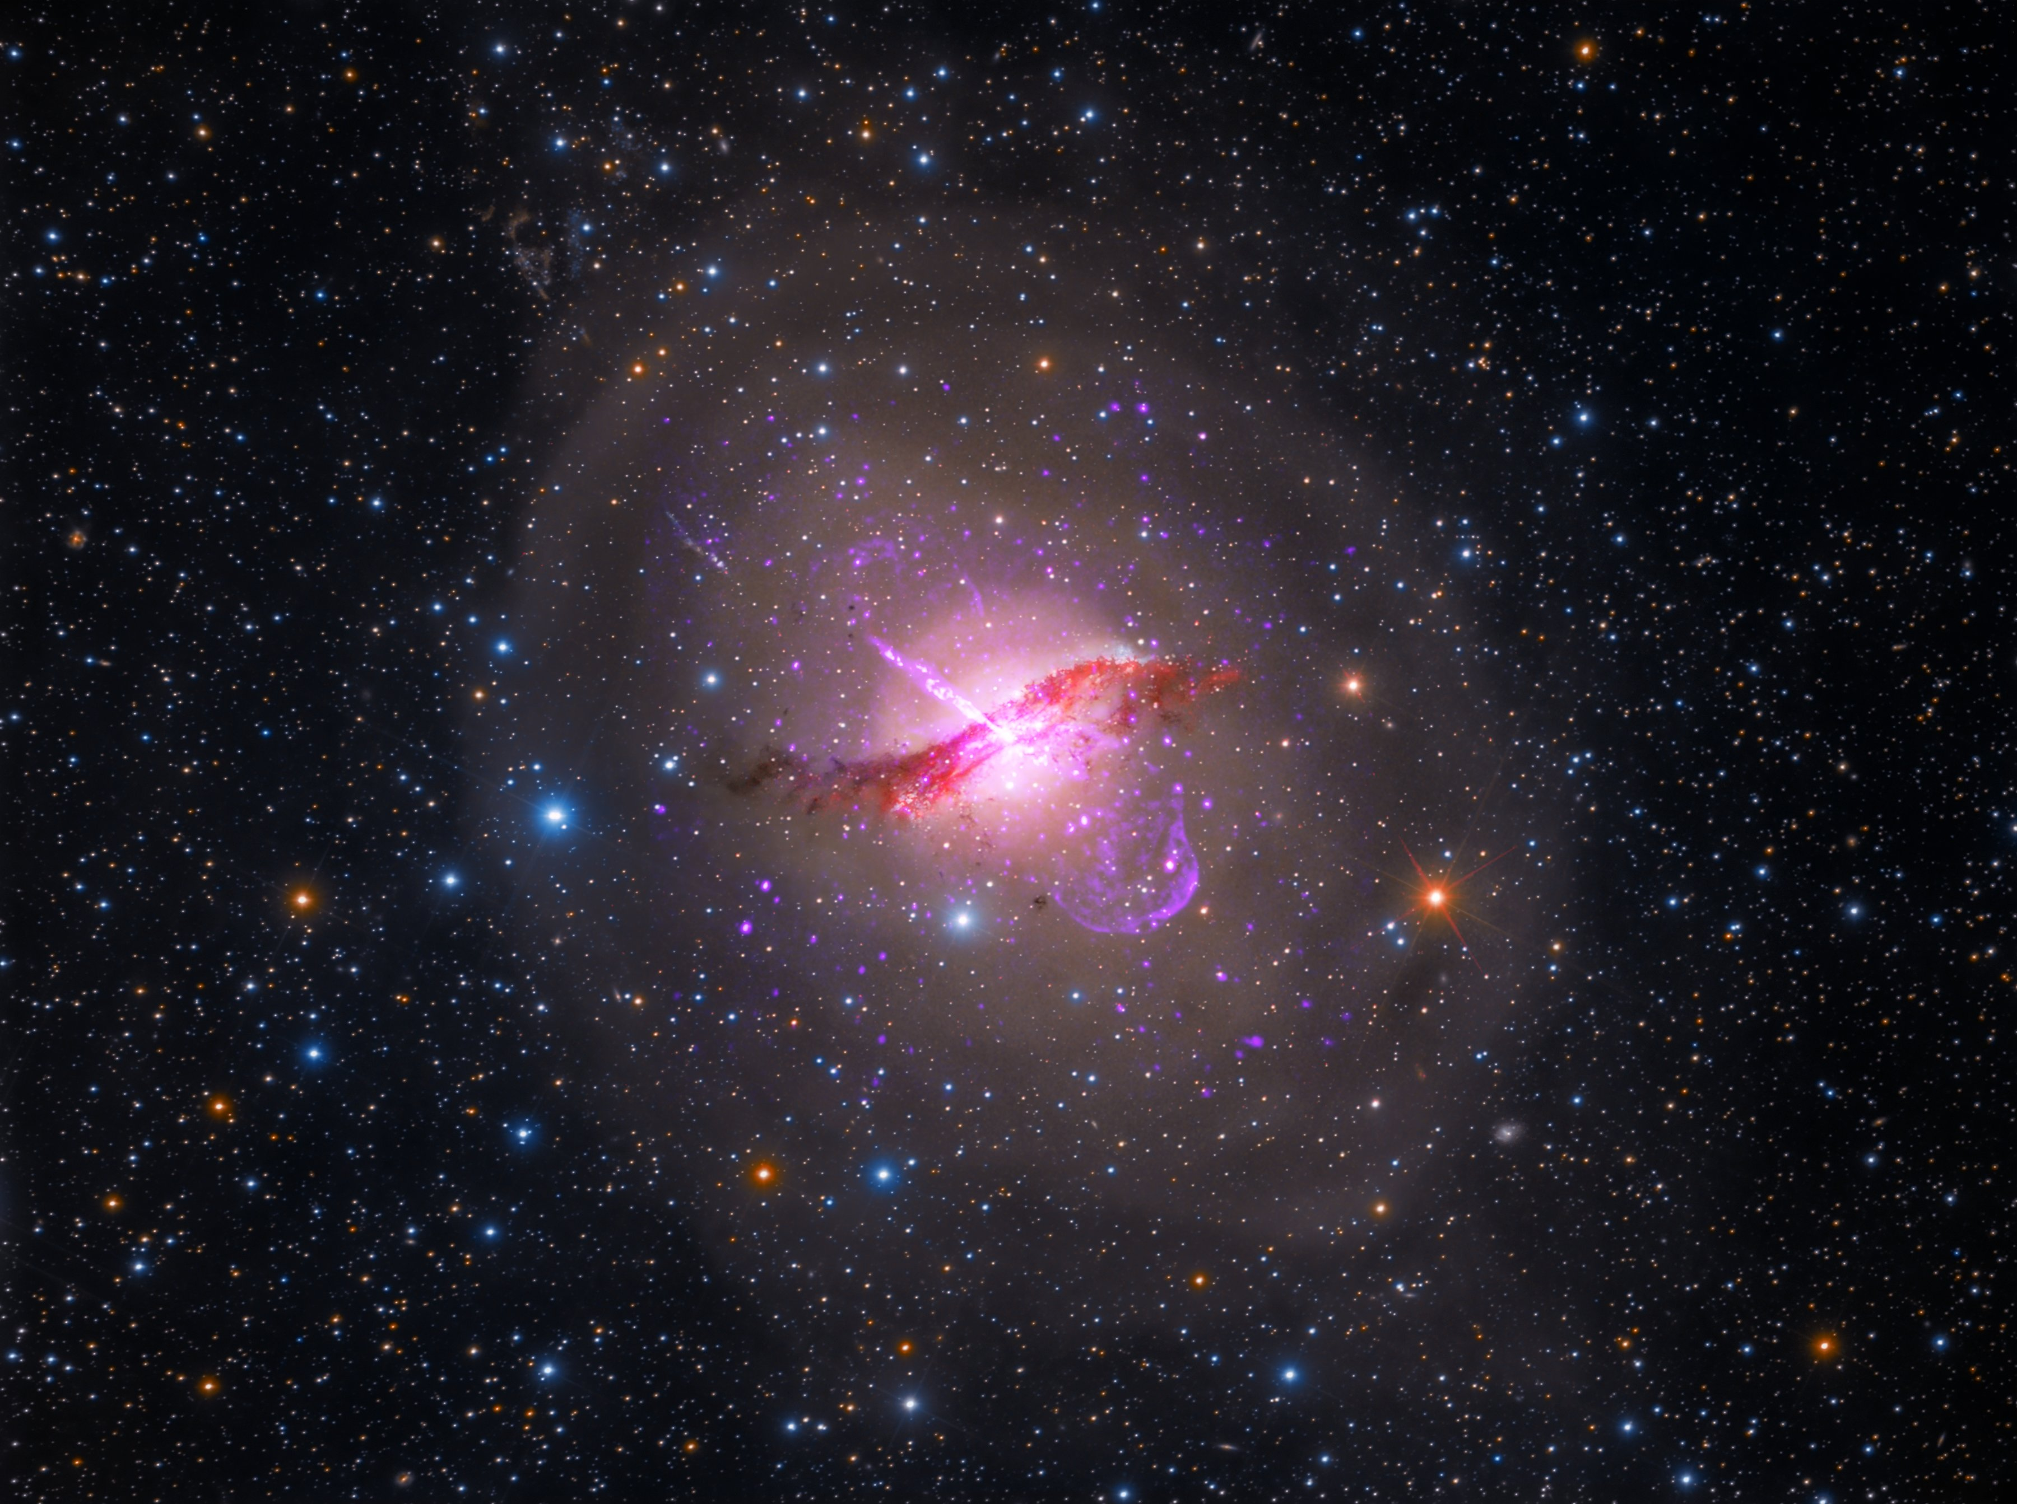
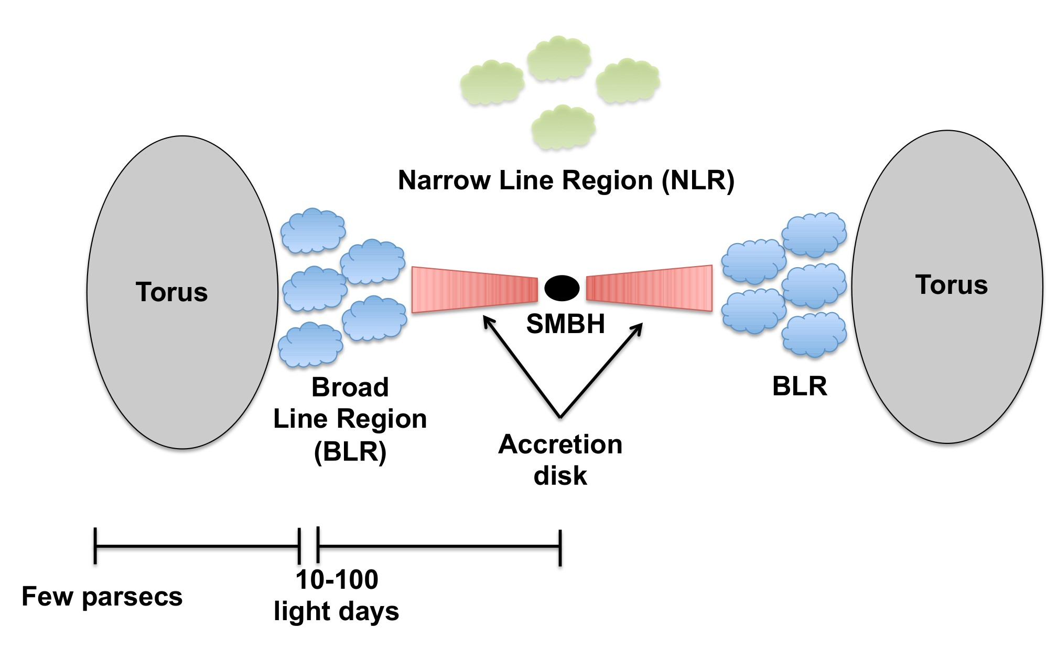
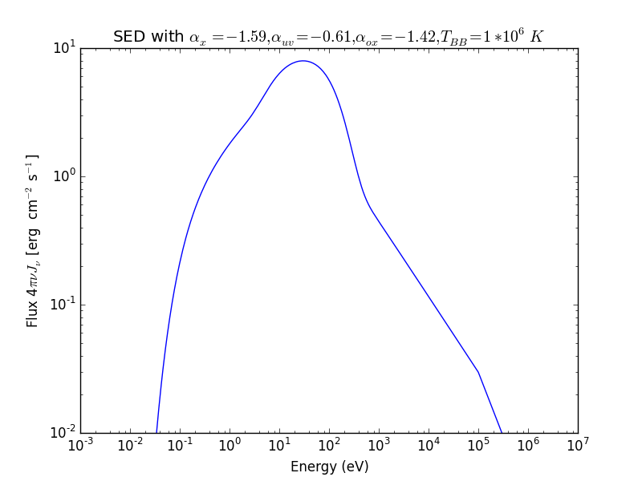
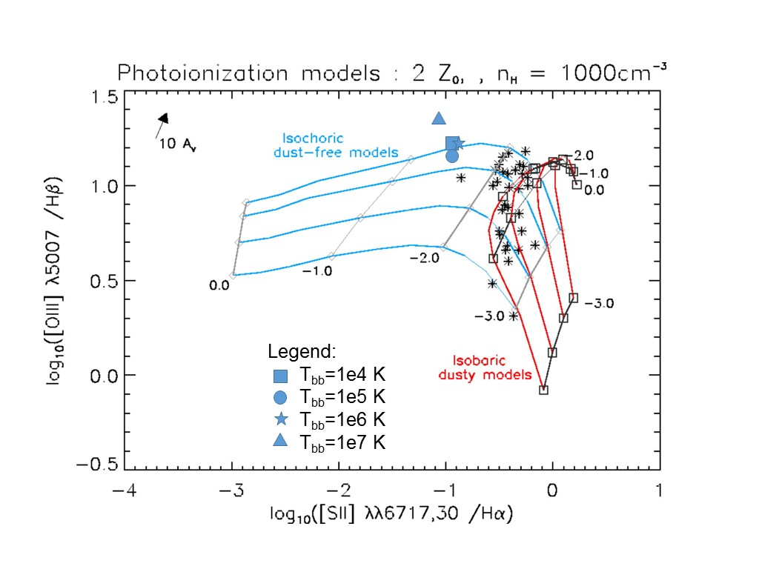
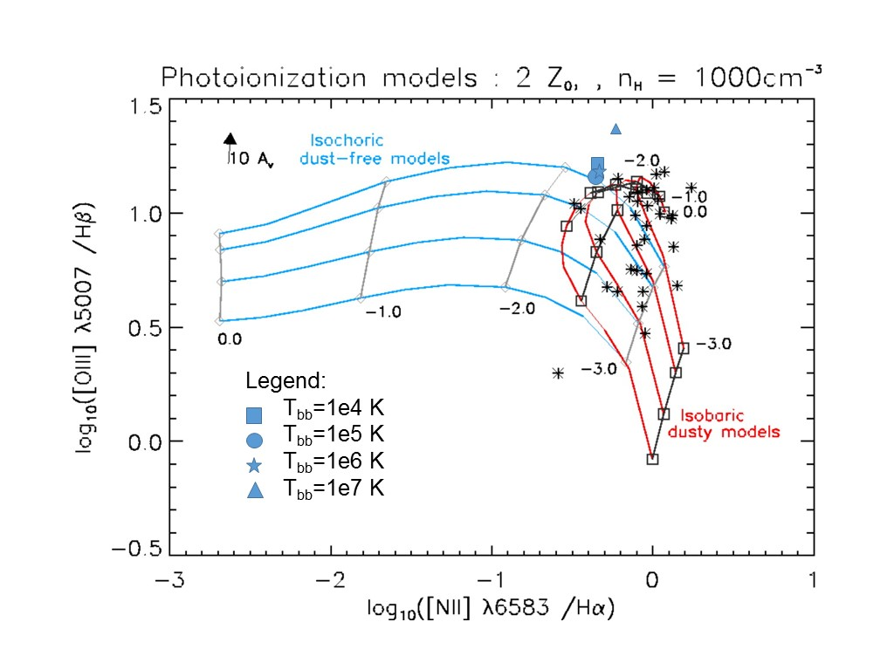
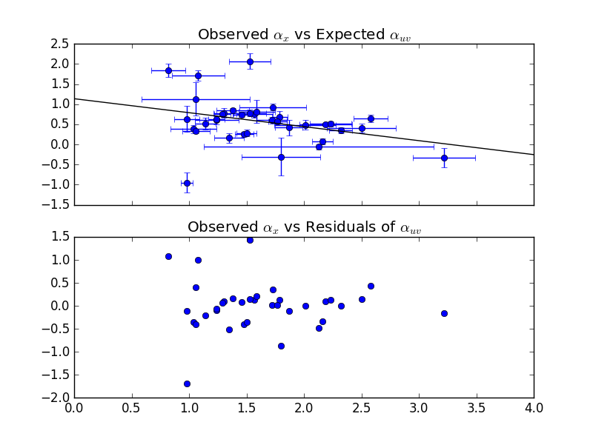
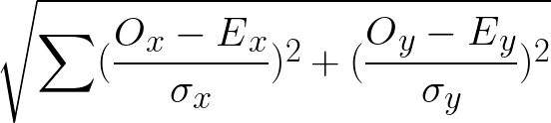
Simulations of Emission Lines from the Narrow Line Region in Seyfert Galaxies
Christopher Greene (Faculty Mentor: Dr. Chris Richardson)-Department of PHY
Abstract
One of the biggest questions in astronomy and astrophysics is “How do galaxies form?” Due to the large time scales involved, the only way to learn about the galactic formation is through studying galaxies outside the Milky Way through observation and simulation. The accretion disk of matter surrounding supermassive black holes in the center of certain galaxies produce more light than all of the stars within the galaxy, called active galactic nuclei (AGN). When modeling gas clouds in the narrow line region (NLR), researchers produce a spectral energy distribution (SED) representing the spectrum of light generated by the AGN. The can be empirically parametrized into a double broken power-law model using spectral indices, α_{x}, α­­_{ox,} and α_{uv}, which determine the slope of the curve at different wavelengths of light. One aim of our research is to synthesize a regression model with data from previous studies that will compute all the spectral indices based on one index. We statistically confirm our regression analysis with a Chi Square and by plotting the residuals of our regression. Using the mean values of the spectral indices provided by past research, we run an incident spectral energy distributions in the program Cloudy. Preliminary results so far have shown that our regression model is statistically significant, and we have constrained the incident SED. The spectral indices are varied based on the regression model and the SEDs are supplied to Cloudy to simulate gas clouds in the narrow line region. We fit our model to emission line ratios produced by the simulated gas cloud as a consistency check for understanding the SED and elaborate on future work that can elucidate whether or not a more complex NLR model provide a more accurate prediction of emission line ratio observations than models using a single power law.
http://www.nasa.gov/mission_pages/chandra/multimedia/galaxy-centaurusA.html
Background
Active Galactic Nuclei (AGN) are generally structured according to the width of the emission lines observed in each region.
Emission lines from the ionization and de-ionization of different elements used to learn about the AGN, through simulations with programs such as CLOUDY and MAPPINGSIII.
Models of the incident radiation curve from the accretion disk in Cloudy are computed from using the spectral slope indices α_{x} , corresponding to the x-ray spectrum (100 eV- 100,000 eV), α_{uv}, corresponding to the ultraviolet spectrum (10 eV-100 eV^{)3,} and α_{ox} is the ratio of x-rays to optical light.
Research has shown that a correlation exists between α_{x} and α_{uv} and between α_{x} and α_{ox}².
This leads to the question:
How does constraining the spectral indices with regression models of past data affect simulations of the Spectral Energy Distribution (SED) across the AGN sequence?
Temperature of the blackbody T_{BB} determined from ()
Incident radiation curve given by³:
Using Cloudy, model the AGN cloud and produce emission lines.
http://www.nasa.gov/mission_pages/chandra/multimedia/galaxy-centaurusA.html
From our simulations varying the blackbody temperature, we plot the line ratios produced by CLOUDY over the data produced by Groves et al. 2004.
http://www.isdc.unige.ch/~ricci/Website/Active_Galactic_Nuclei.html
Results
We produce residual plots of our observed values of alphax vs expected alphax and observed alphauv vs expected alphauv.
Methods
Data from Grupe et al. 2010 is fit to a linear regression model scripted in Python.
Use Chi-Square test to determine goodness of fit for a 2-D model using the equation:
Supply the incident spectral energy distribution, element abundances, dust grains, and initial density to CLOUDY.
Conclusions
Our regression model is statistically significant.
Our line ratios match closely with those produced by Groves.
We can model our SED by constraining the spectral indices.
Future Work
Vary the spectral indices of the incident radiation curve according to our regression models.
References
Grupe, D., Komassa, S., Leighly, K., Page, K., 2010, ApJS, 187, 64
Groves, B., Dopita, Michael., Sutherland, R. 2004, ApJS, 153, 75
Ryden, B., Peterson, B., 2010, Foundations of Astrophysics, (Addison-Wesley)
Ferland, G. J.; Porter, R. L.; van Hoof, P. A. M.; Williams, R. J. R.; Abel, N. P.; Lykins, M. L.; Shaw, G.; Henney, W. J.; Stancil, P. C., 2013, RevMexAA, 49, 137
Acknowledgements
I would like to thank the Elon College Fellows program and my research mentor Dr. Chris Richardson.

