Slide 1
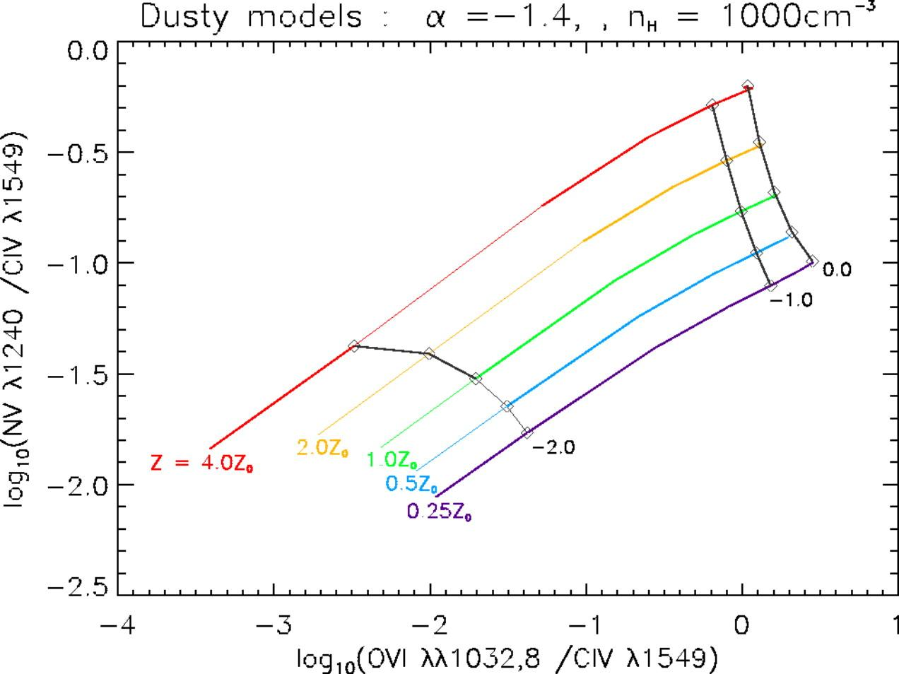
Fig. 9. from Dusty, Radiation Pressure–Dominated Photoionization. II. Multiwavelength Emission Line Diagnostics for Narrow‐Line Regions
Groves, Dopita, & Sutherland 2004 ApJS 153 75 doi:10.1086/421114
http://dx.doi.org/10.1086/421114
© 2004. The American Astronomical Society. All rights reserved. Printed in U.S.A.
Information:
Thank you for downloading this PowerPoint slide from The Astrophysical Journal Supplement Series. This slide was designed to be edited; you can:
- Remove components (including this text box!)
- Resize components
- Apply a style or theme
- Please remember to include the original article citation information.

