Slide 1

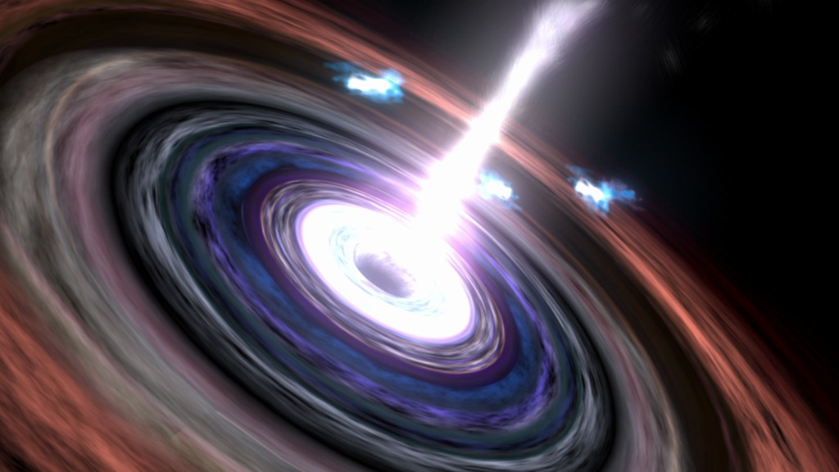
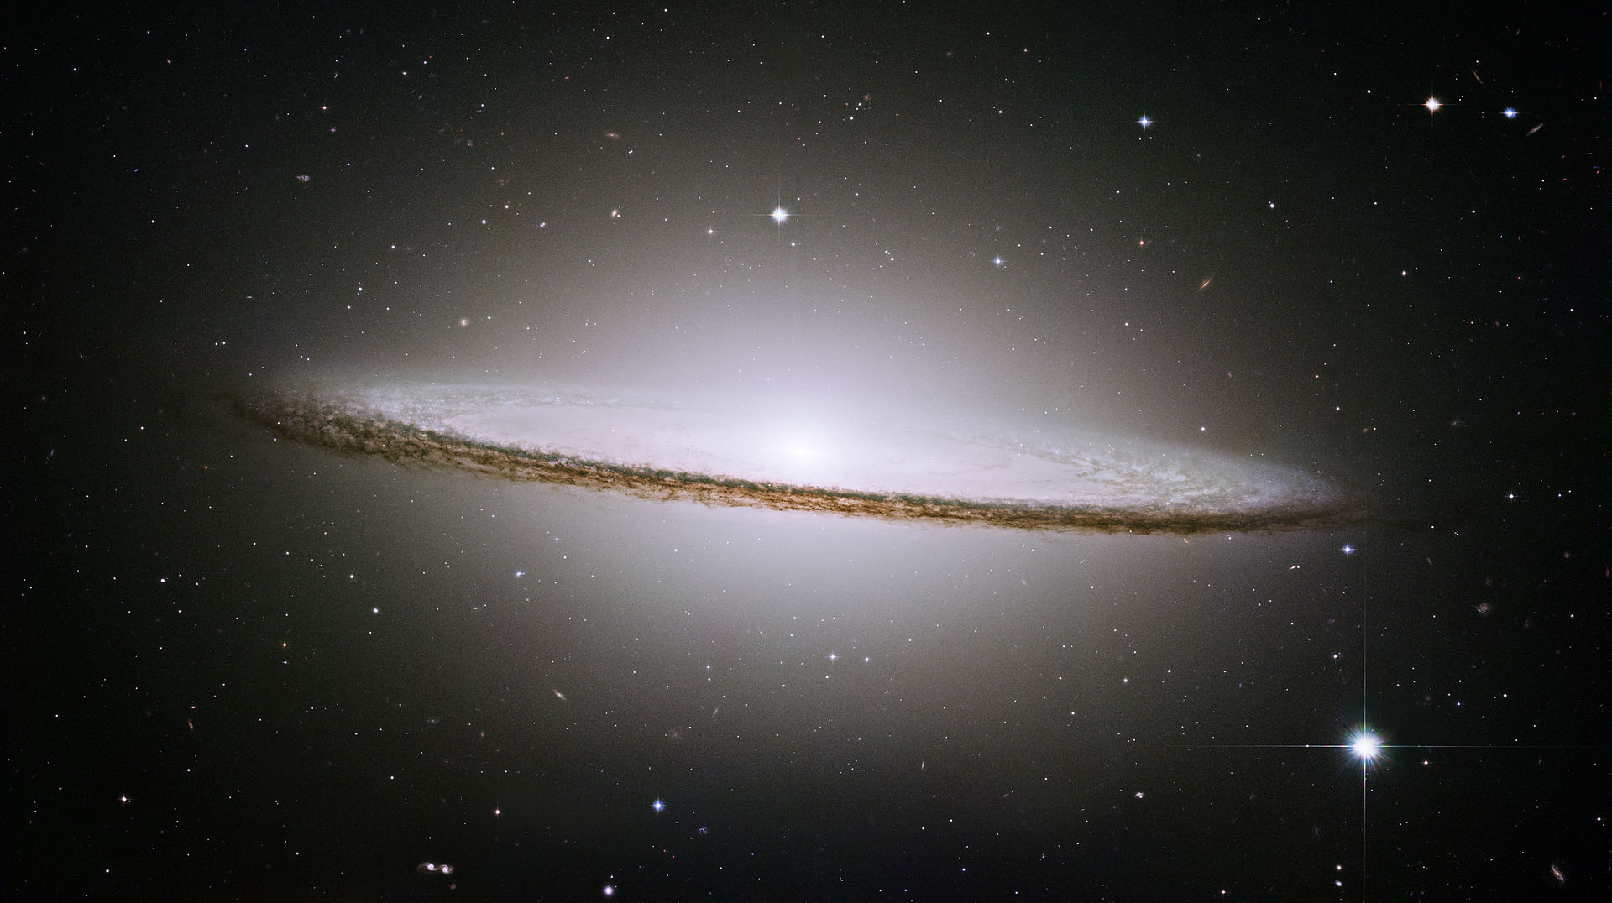
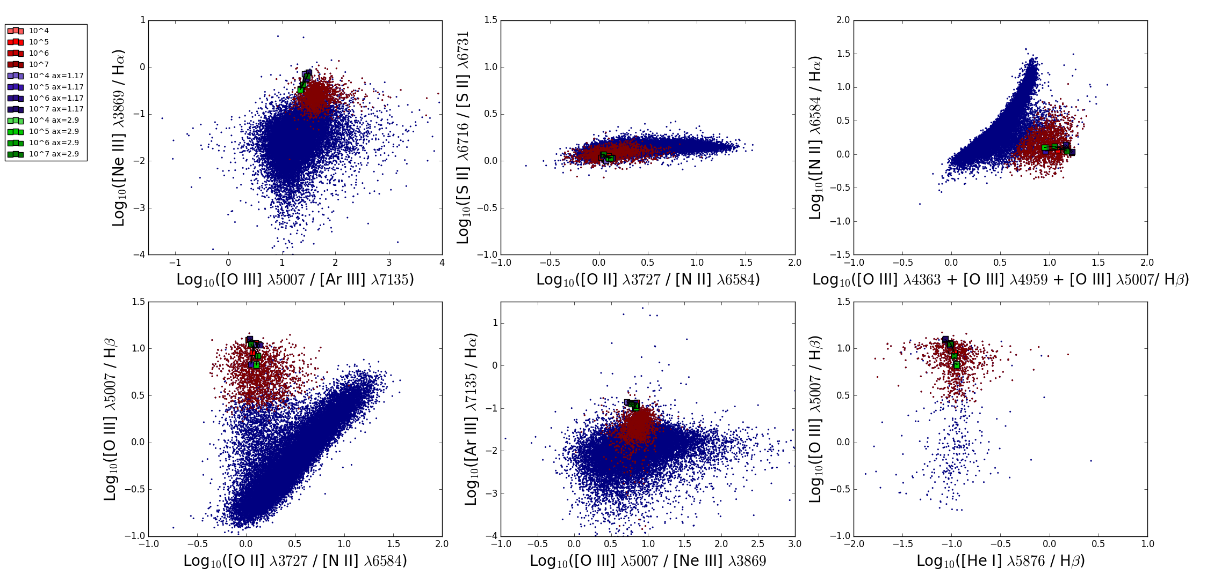
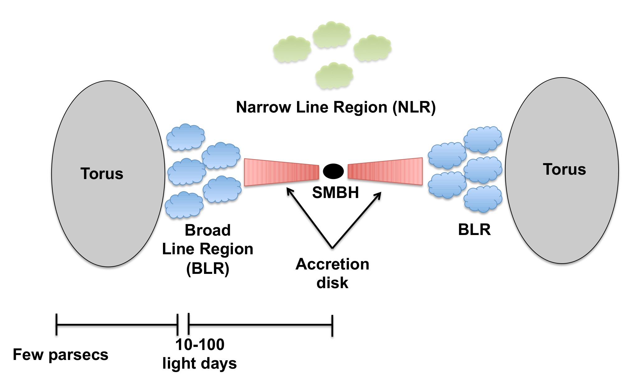
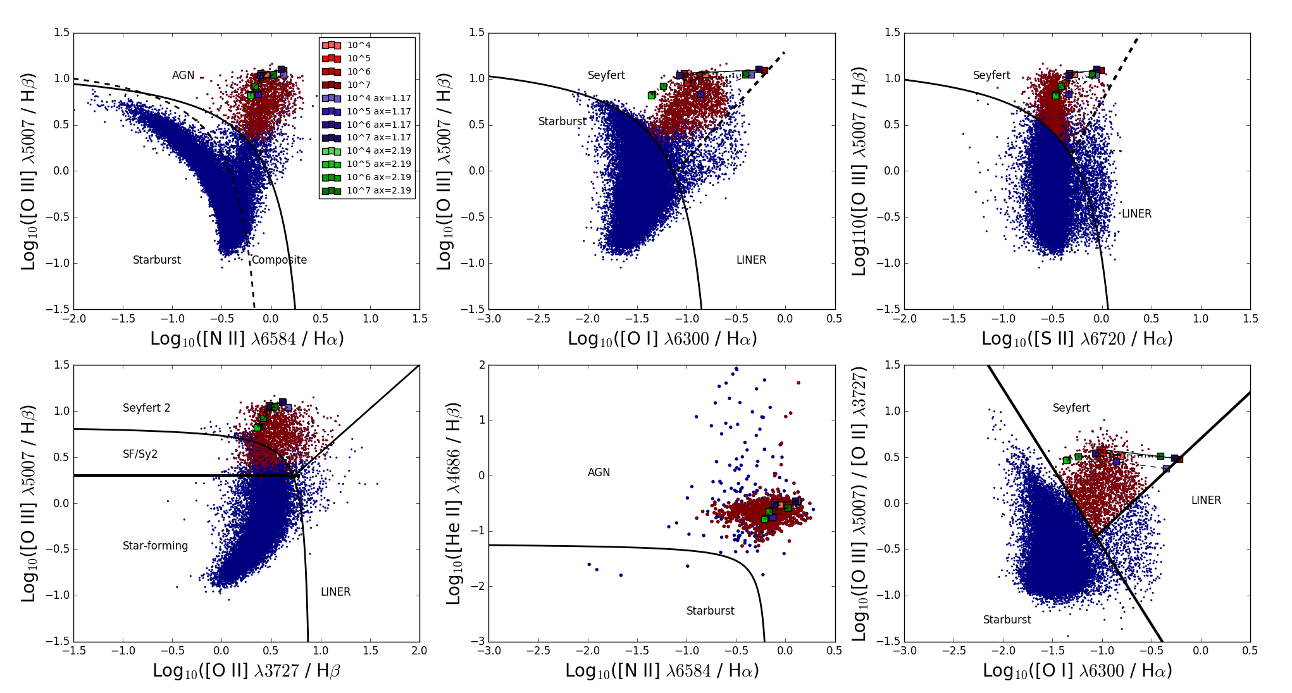
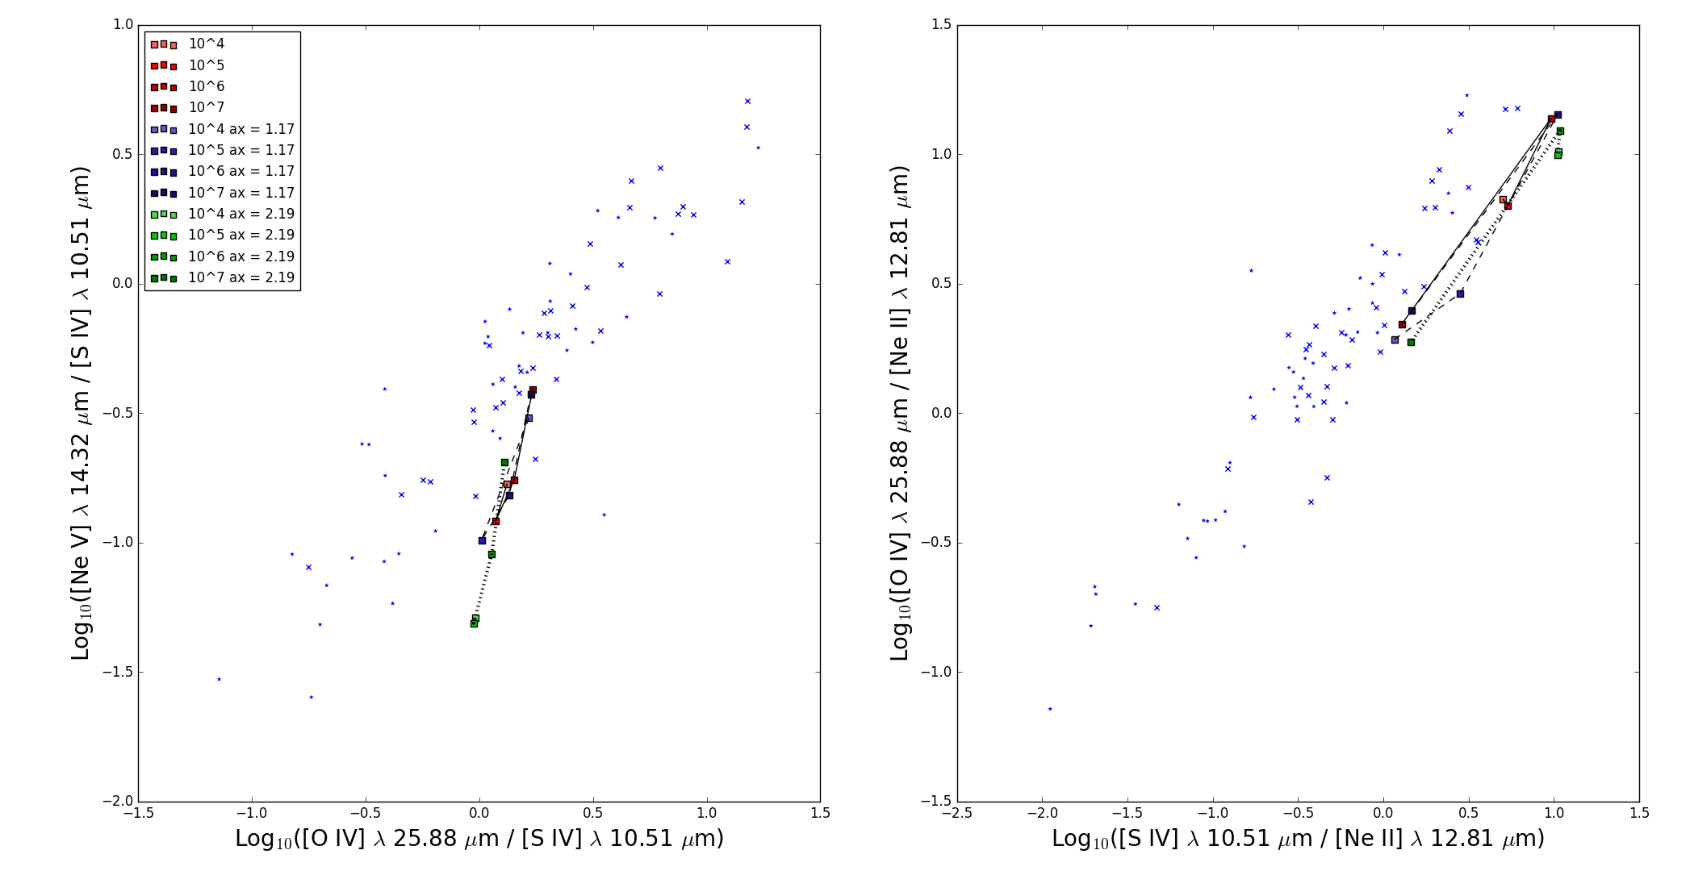
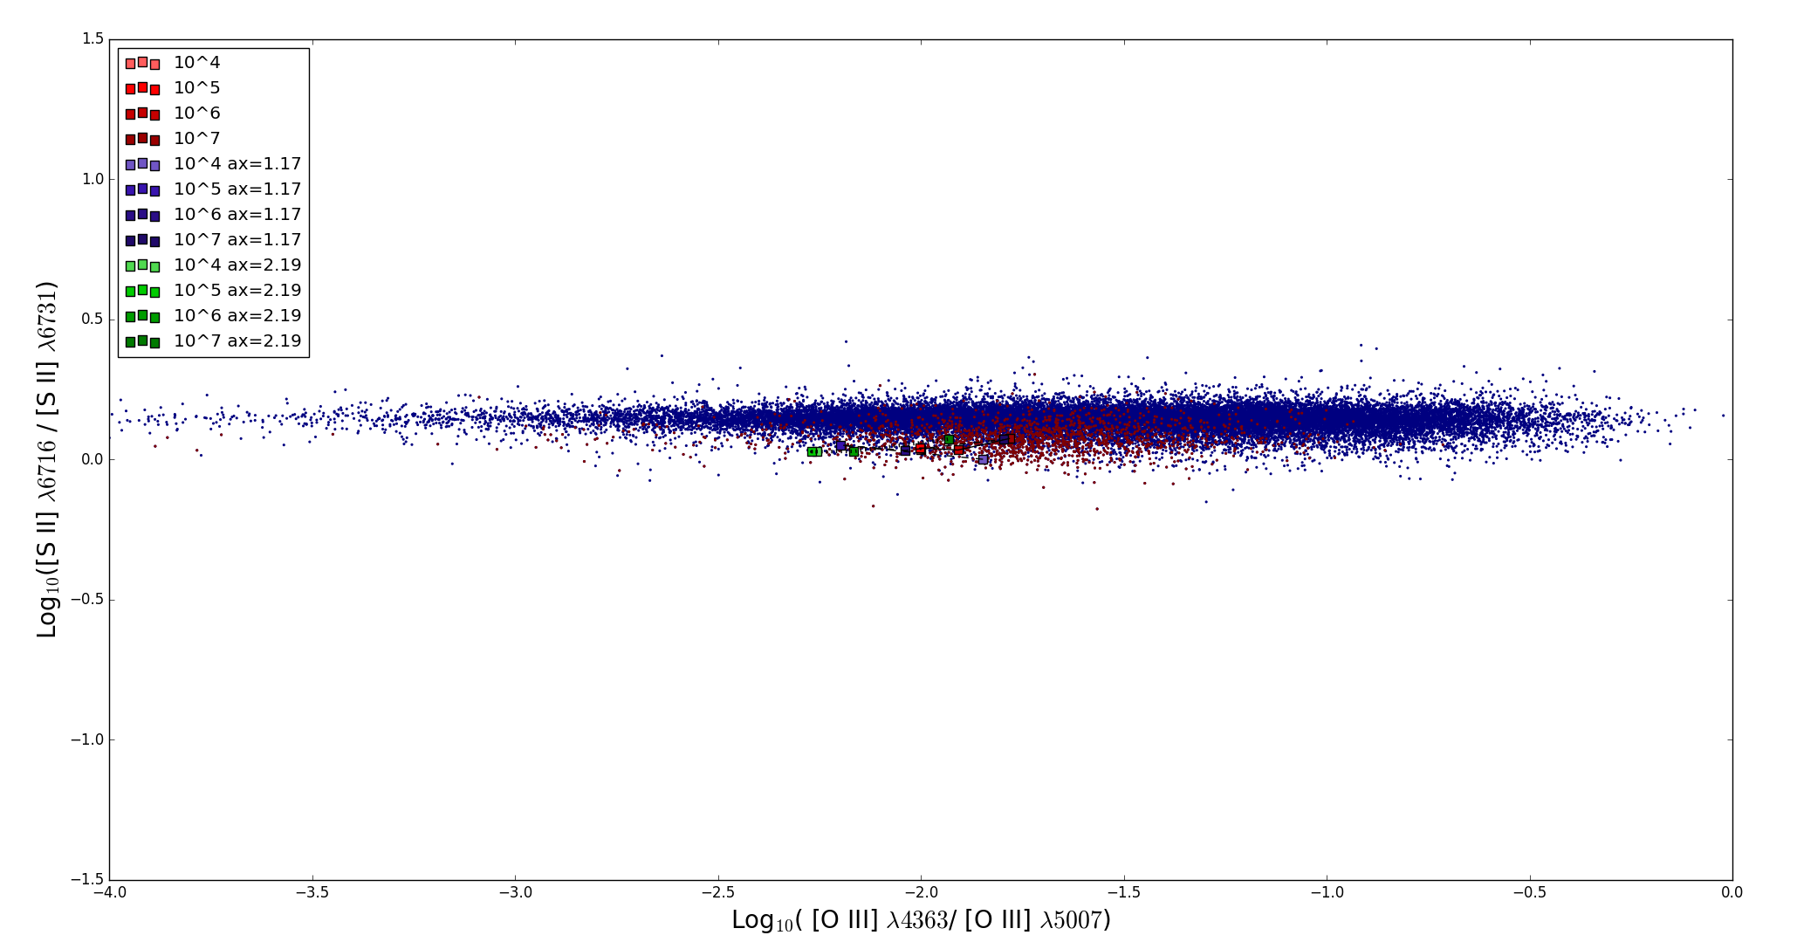
Simulations of Emission Lines from the Narrow Line Region in Active Galaxies
Christopher Greene (Faculty Mentor: Dr. Chris Richardson)
Department of Physics
Results
We examine emission line ratios as they allow us to constrain the SED and study the effects of AGN density, elemental abundances, excitation mechanism, and ionization parameter.
The first plot is known as the Baldwin-Phillip-Terlevich (BPT) diagram.
The top three plots were introduced in Osterbrock & Veilleux 1983 to categorize galaxies by atomic excitation mechanism which are empirically derived.
Bottom three plots come from Lamareille 2010, Shirazi et al. 2012, and Kewley et al. 2006 respectively.
The black lines act as boundaries between the type of galaxy.
Star-Forming/Starburst galaxies are galaxies with high rates of star formation.
Composite galaxies exhibit characteristics of both active galaxies and star-forming galaxies.
Low Ionization Nuclear Emission Region (LINER) galaxies are characterized by emission lines of weakly ionized or neutral atoms.
Red indicates that the galaxy is a Seyfert, while blue indicates star-forming galaxies, composite galaxies, and LINERS.
Galaxies are separated based on the equations that set the boundary lines.
Markers indicate the model used.
Red markers indicate our baseline SED, with lighter shades representing lower temperatures.
Blue markers indicate a SED with α_{x} = -2.19, α_{uv} = -0.38, α_{ox} =-1.42
Green markers indicate a SED with α_{x} = -1.17 , α_{uv} = -0.73, α_{ox} =-1.42
Most plots have little variation between models. An interesting result is the zig-zag pattern based on temperature that shows up in many of the plots.
[O I] plots show largest variation, with higher temperature models coming close to crossing the LINER-Seyfert boundary. Lowering the ionization parameter would likely cause these models to cross the boundary.
Density diagnostic from Ferland & Osterbrock 2006.
Emissions from elements at the same ionization level, but different wavelengths act as indicators of density.
[O III] 4363 / [O III] 5007 is sensitive to electron temperature.
[S II] 6716 / [S II] 6731 is insensitive to other factors and acts as a strong indicator of density.
Models show little variation outside of temperature.
Background
Active Galactic Nuclei (AGN) are galaxies with supermassive black holes in the centers of galaxies whose accretion disks and interactions with magnetic fields produce more light than all the stars in the galaxy combined.
Study of AGN allows us to understand more fully the processes involved in galaxy evolution.
Many researchers believe that some AGN are formed when two galaxies merge.
In about 4 billion years the Milky Way galaxy and the Andromeda galaxy will begin merging, studying AGN may tell us what will happen after the merger.
AGN are generally structured according to the width of the emission lines observed in each region.
Lots of research on the Broad Line Region (BLR) (Korista et al. 1997), where there are broad emission lines, but not as much on the Narrow Line Region (NLR) (Richardson et al. 2014), where there are narrow emission lines.
Emission lines from the ionization of different elements used to learn about the AGN, through simulations with programs such as CLOUDY (Ferland et al. 2013) and MAPPINGSIII (Allen et al. 2008).
Models of the incident radiation curve from the AGN in CLOUDY are computed from using the spectral slope indices α_{x}, corresponding to the X-ray spectrum (10² eV- 10⁵ eV), α_{uv} corresponding to the ultraviolet spectrum (10¹ eV-10² eV), and α_{ox} is the ratio of x-rays to optical light.
Grupe et al. 2010 found a correlation between α_{x} and α_{uv} and between α_{x} and α_{ox}.
This leads to the question:
How does constraining the spectral indices with regression models of past data affect simulations of Emission Lines of the Narrow Line Region of an Active Galactic Nuclei?
http://www.nasa.gov/mission_pages/chandra/multimedia/galaxy-centaurusA.html
Diagnostic plots for elemental abundances in the optical spectrum derived from different elements at the same ionization level.
[O III]/[Ar III] vs [Ne III] / Hα compares elements with high ionization potentials. [Ne III] / Hα is also sensitive to ionization parameter
[He I] / H-beta depends linearly on Helium abundance.
[O II] / [N II] affected weakly by ionization parameter and density, allowing it to act as a strong abundance diagnostic.
[O III] 4363 + [O III] 4959 + [O III] 5007/ Hβ is insensitive to ionization and geometrical factors and increases with decreasing oxygen abundance
Our simulations show little variation between models.
http://www.isdc.unige.ch/~ricci/Website/Active_Galactic_Nuclei.html
Methods
We set up the incident radiation curve from:
For baseline curve, the blackbody temperature T_{BB} is set to 10⁶ K based on the mean value of past research, α_{x} = -1.59, α_{uv} = -0.6, α_{ox} = -1.42 (Grupe et al. 2010).
We also constrain the incident radiation curve by describing the elemental abundances, hydrogen density, and photon flux of the cloud, derived from Groves et al 2004.
Stopping boundary condition for simulations is when the fraction of electron to total hydrogen densities falls below 0.01 which allows us to simulate deep enough into the cloud to produce the required emissions.
We fit the values of α_{x} and α_{uv} using Ordinary Least Squares regression, producing the line:
We run simulations varying T_{BB} between 10⁴ K and 10⁷ K
The value of α_{x} is varied according to the standard deviation of the mean, 0.51, and the value of α_{uv} is changed accordingly.
Optical data obtained via the Sloan Digital Sky Survey (SDSS)
Abundance diagnostic plots for Infrared emissions.
Both ratios act as a strong abundance indicator and have strong ionization potentials
Models seem to under predict the data.
Conclusions
The lack of significant variation between our three models indicates that our regression is a good fit.
This model does not act as a strong indicator of diagnostic ratios for emissions in the infrared spectrum.
The under-prediction of the IR plots may be a result of simulation parameters preventing enough of each element from being produced.
Future Work
Examine the physical cause of the zig-zag pattern in our simulated values through individual simulations of galaxies.
Examine the effects of ionization parameter variation on our model to determine if we can utilize it in determining LINER galaxies.
Analyze the variation of [O I] with regard to ionization parameter and the LINER-Seyfert Boundary.
References
Baldwin J. A., PhillipsM.M., Telervich R., 1981, PASP, 93, 5
Grupe, D., Komassa, S., Leighly, K., Page, K., 2010, ApJS, 187, 64
Groves, B., Dopita, Michael., Sutherland, R. 2004, ApJS, 153, 75
Groves B. A., Heckman T.M., Kauffmann G., 2006, MNRAS, 371, 1559
Kewley, L. J., & Dopita, M. A. 2002, ApJS, 142, 35
Ryden, B., Peterson, B., 2010, Foundations of Astrophysics, (Addison-Wesley)
Ferland, G. J.; Porter, R. L.; van Hoof, P. A. M.; Williams, R. J. R.; Abel, N. P.; Lykins, M. L.; Shaw, G.; Henney, W. J.; Stancil, P. C., 2013, RevMexAA, 49, 137
OsterbrockD. E., FerlandG. J., 2006, Astrophysics of Gaseous Nebulae and Active Galactic Nuclei. University Science Books, California
Lamareille, F. 2010, A&A, 509, A53
Peterson, B. M. 1993, PASP, 105, 247
Richardson C. T., Allen J. T., Baldwin J. A., Hewett P. C., Ferland G. J., 2014, MNRAS, 437, 2376
Shirazi, M., & Brinchmann, J. 2012, MNRAS, 421, 1043
Veilleux S., Osterbrock D. E., 1987, ApJS, 63, 295 (VO87)
Acknowledgements
I would like to thank the Elon College Fellows program, my research mentor Dr. Chris Richardson, and the Elon Department of Undergraduate Research.
This project was conducted as a part of Elon University’s Summer Undergraduate Research Experience, 2016.

