Slide 1

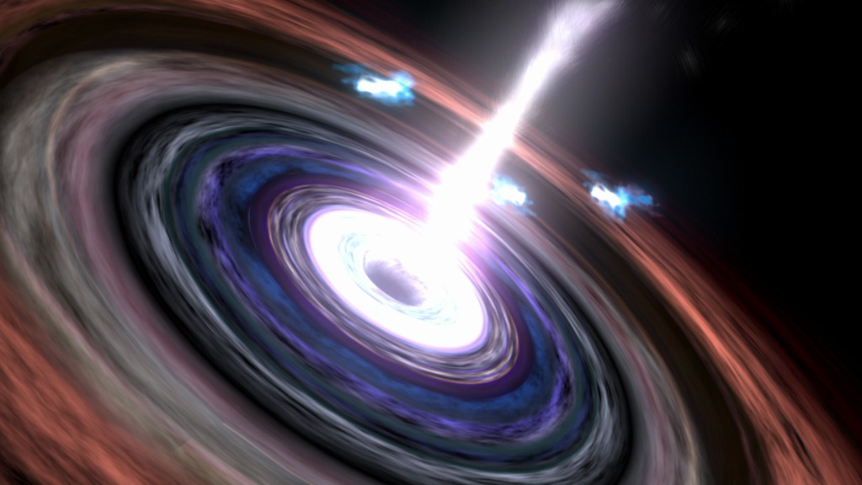
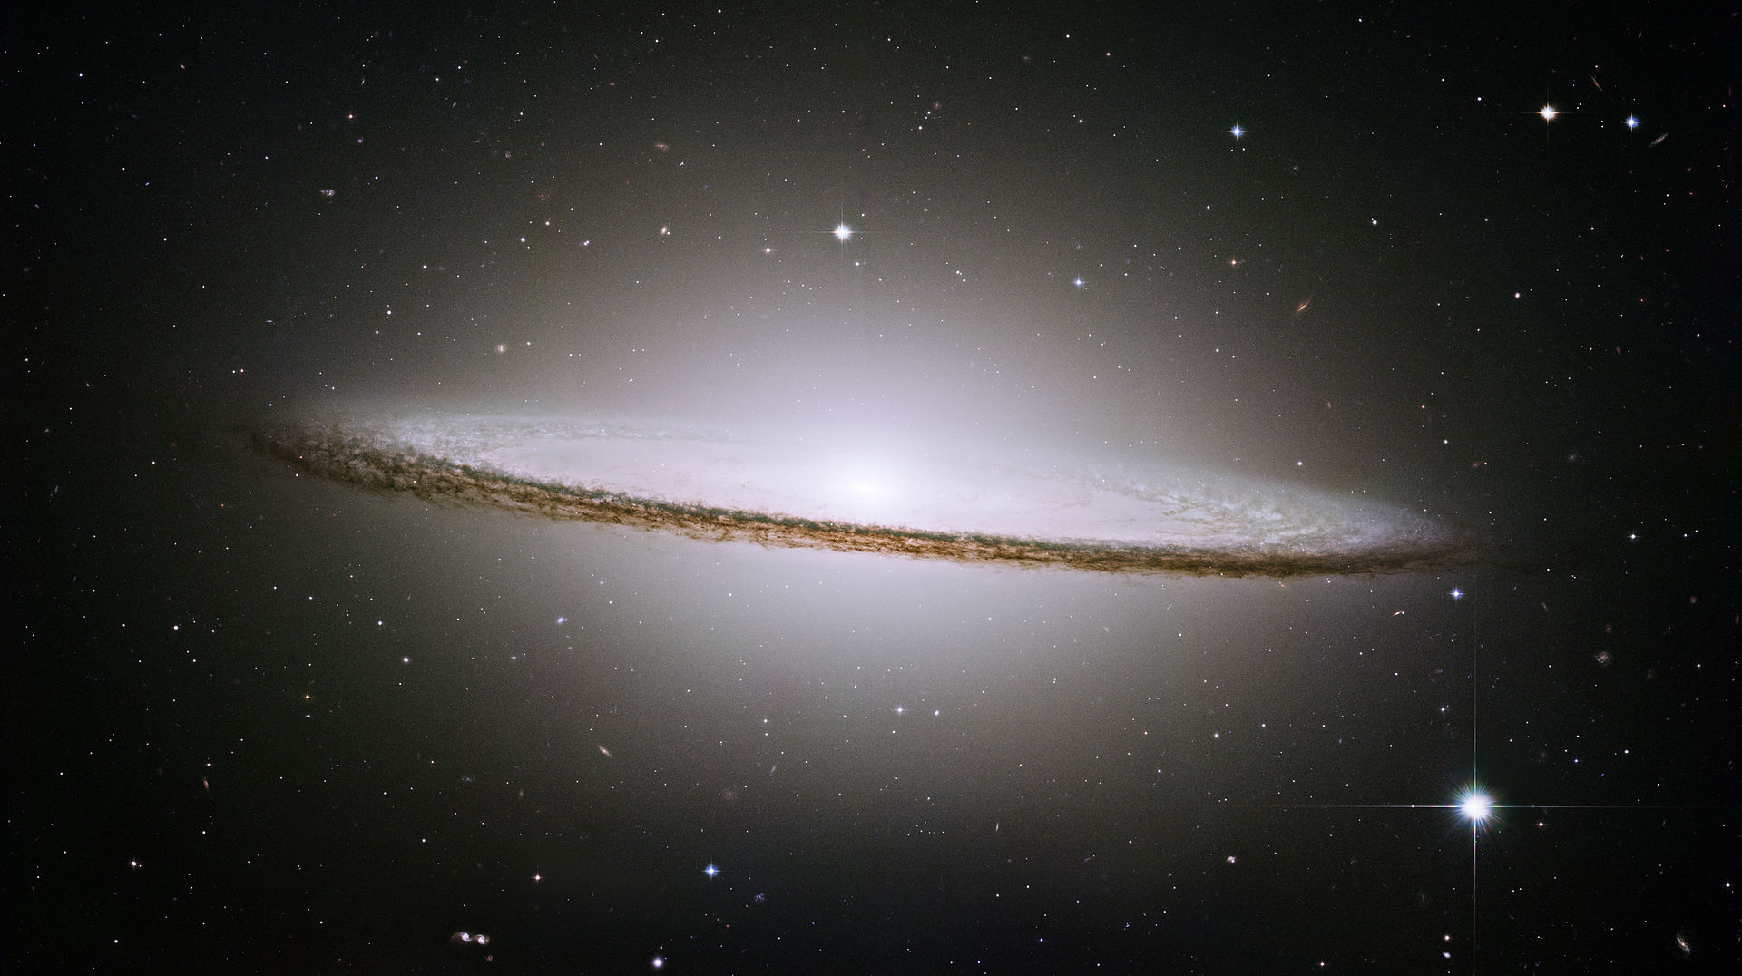
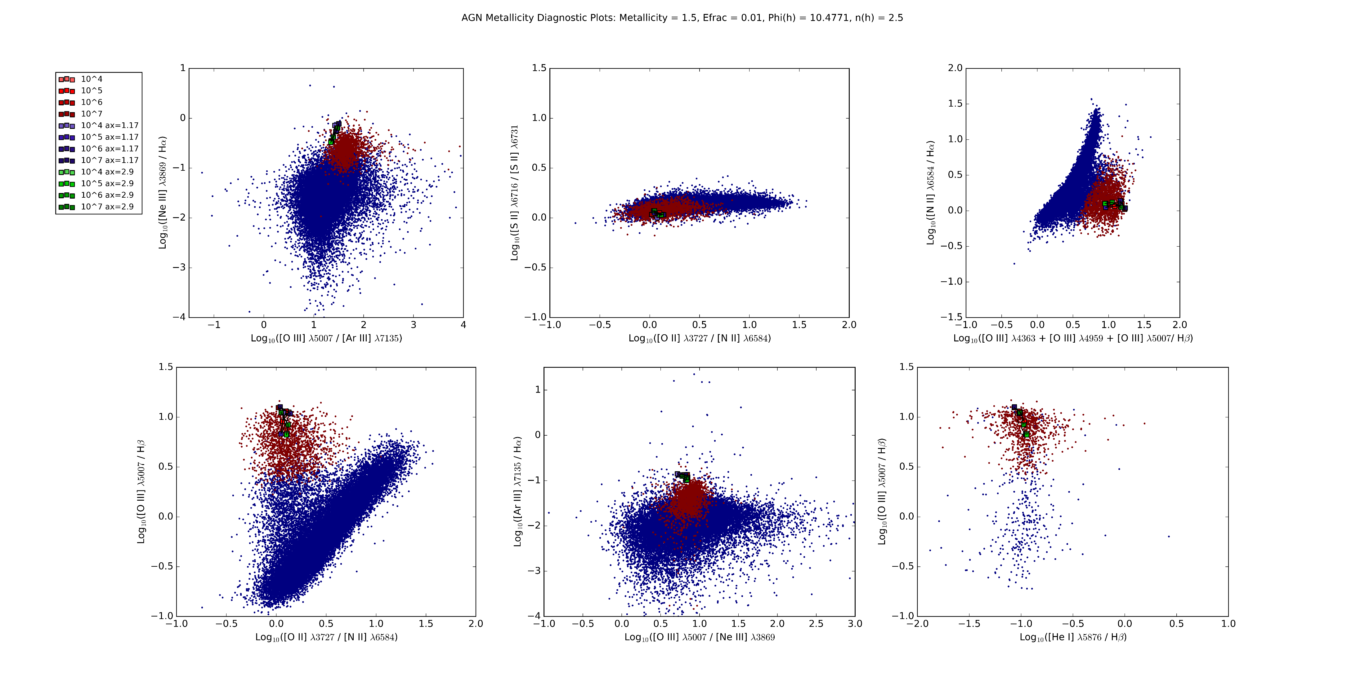
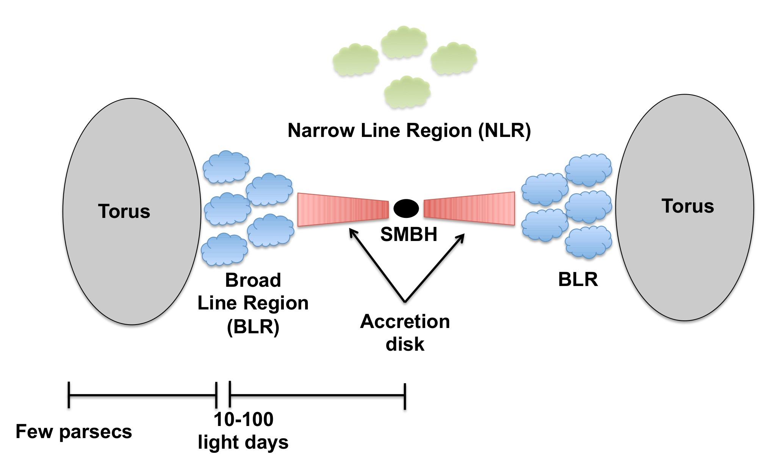
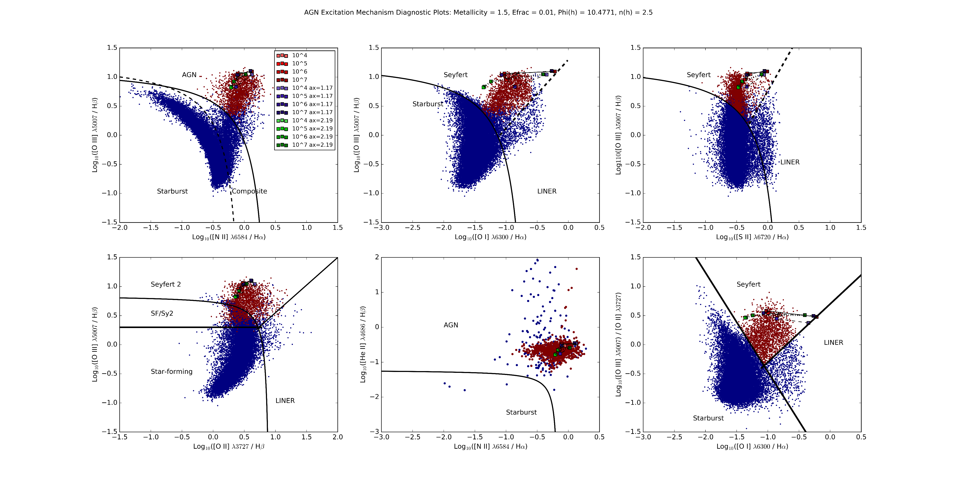
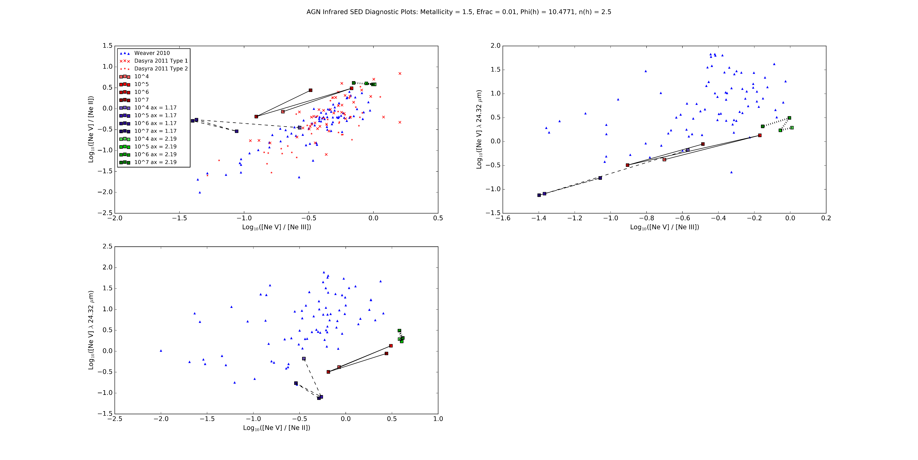




Simulations of Emission Lines from the Narrow Line Region in Seyfert Galaxies
Christopher Greene (Faculty Mentor: Dr. Chris Richardson)
Department of Physics
Abstract
Background
Study of Active Galactic Nuclei (AGN) allows us to understand more fully the processes involved in galactic evolution.
Many researchers believe that some AGN are formed when two galaxies merge.
In about 4 billion years the Milky Way galaxy and the Andromeda galaxy will begin merging, studying AGN may tell us what will happen after the merger.
AGN are generally structured according to the width of the emission lines observed in each region.
Lots of research on the Broad Line Region (BLR), where there are broad emission lines, but not as much on the Narrow Line Region (NLR), where there are narrow emission lines.
Emission lines from the ionization of different elements used to learn about the AGN, through simulations with programs such as CLOUDY and MAPPINGSIII.
Models of the incident radiation curve from the accretion disk in Cloudy are computed from using the spectral slope indices α_{x}, corresponding to the X-ray spectrum (10² eV- 10⁵ eV), α_{uv} corresponding to the ultraviolet spectrum (10¹ eV-10² eV), and α_{ox} is the ratio of x-rays to optical light.
Research has shown that a correlation exists between α_{x} and α_{uv} and between α_{x} and α_{ox}.
This leads to the question:
How does constraining the spectral indices with regression models of past data affect simulations of the Spectral Energy Distribution (SED) of the Narrow Line Region of an Active Galactic Nuclei?
The value of α_{x} is varied according to the standard deviation of the mean, which is 0.51, and the value of α_{uv} is changed accordingly.
The lines determining the boundaries between each region are
For [N II] vs [O III]:
For [O I] vs [O III]:
For [S II] vs [O III]
For [O II] vs [O III]
http://www.nasa.gov/mission_pages/chandra/multimedia/galaxy-centaurusA.html
Results
Top three plots are Baldwin-Phillip-Terlevich (BPT) diagrams that are used to determine the excitation mechanism of the cloud.
Bottom three plots come from Lamareille 2010, Shirazi et al. 2012, and Kewley et al. 2006 respectively.
http://www.isdc.unige.ch/~ricci/Website/Active_Galactic_Nuclei.html
Methods
We set up the incident radiation curve from:
For baseline curve, the blackbody temperature T_{BB} is set to 10⁶ K, α_{x} = -1.59, α_{uv} = -0.6, α_{ox} = -1.42.
We fit the values of α_{x} and α_{uv} using Ordinary Least Squares regression, producing the line:
Conclusions
The residual plots appear to be random, indicating that our model is a good fit.
Our line ratios do not fall along the data as strongly as we would like, especially [O III]/Hβ vs [O I]/Hα, indicating that we need to adjust the model.
Future Work
Complete statistical analysis of our model, namely our chi square test.
Consider using an isobaric (constant pressure) model as opposed to an isochoric (constant density) model to help match our produced line ratios to the data.
References
Grupe, D., Komassa, S., Leighly, K., Page, K., 2010, ApJS, 187, 64
Groves, B., Dopita, Michael., Sutherland, R. 2004, ApJS, 153, 75
Ryden, B., Peterson, B., 2010, Foundations of Astrophysics, (Addison-Wesley)
Ferland, G. J.; Porter, R. L.; van Hoof, P. A. M.; Williams, R. J. R.; Abel, N. P.; Lykins, M. L.; Shaw, G.; Henney, W. J.; Stancil, P. C., 2013, RevMexAA, 49, 137
Acknowledgements
I would like to thank the Elon College Fellows program and my research mentor Dr. Chris Richardson.

