Slide 1
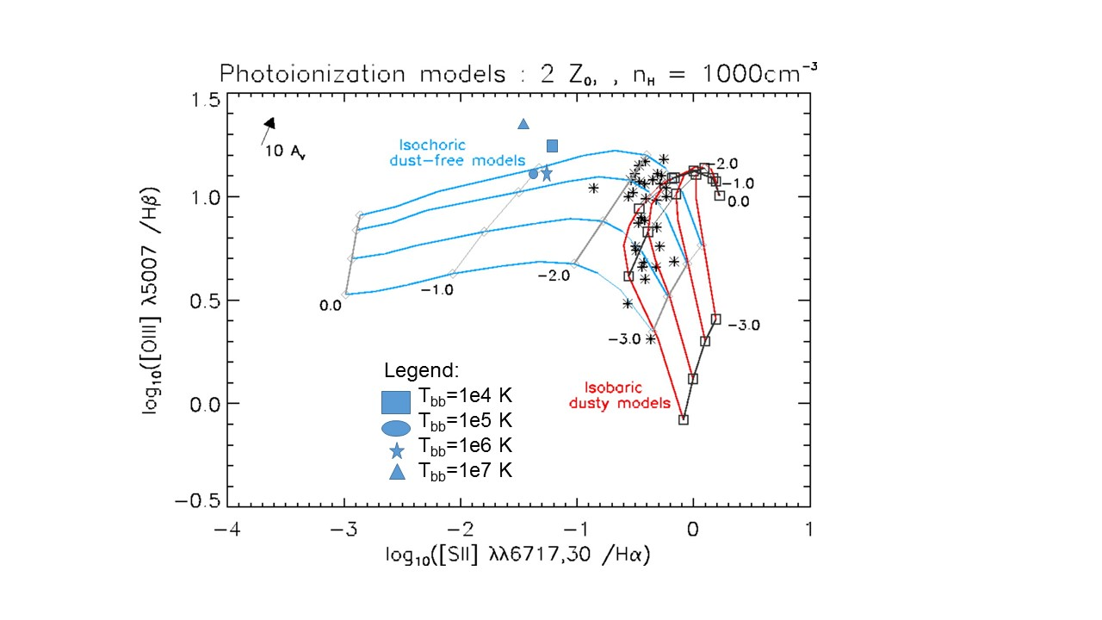
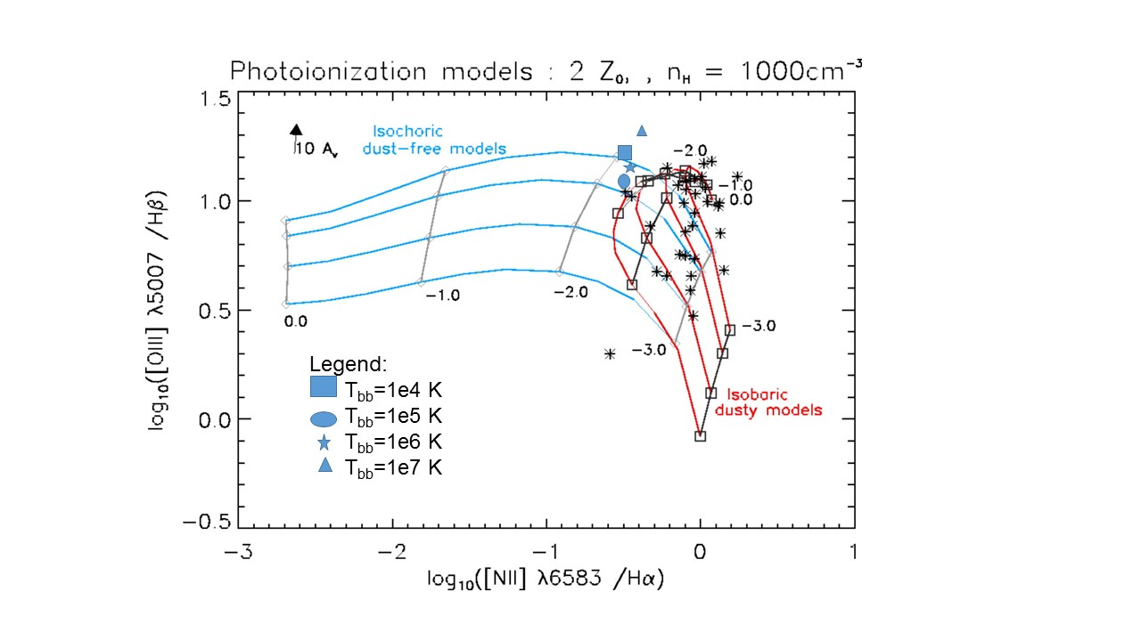
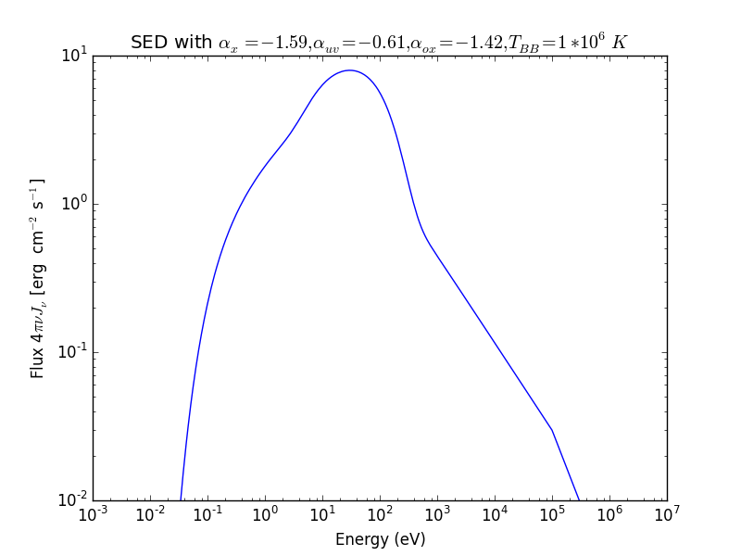
Simulations of Emission Lines from the Narrow Line Region in Seyfert Galaxies
Christopher Greene (Faculty Mentor: Dr. Chris Richardson)-Department of PHY
Abstract
Methods
Methods go here
One of the biggest questions in astronomy and astrophysics is “How do galaxies form?” Due to the large time scales involved, the only way to learn about the galactic formation is through studying galaxies outside the Milky Way through observation and simulation. The accretion disk of matter surrounding supermassive black holes in the center of certain galaxies produce more light than all of the stars within the galaxy, called active galactic nuclei (AGN). When modeling gas clouds in the narrow line region (NLR), researchers produce a spectral energy distribution (SED) representing the spectrum of light generated by the AGN. The can be empirically parametrized into a double broken power-law model using spectral indices, α_{x}, α­­_{ox,} and α_{uv}, which determine the slope of the curve at different wavelengths of light. One aim of our research is to synthesize a regression model with data from previous studies that will compute all the spectral indices based on one index. We statistically confirm our regression analysis with a chi square test. Using the mean values of the spectral indices provided by past research, we craft an SED in the program Cloudy. Preliminary results so far have shown that our regression model is statistically significant, and thus we have constrained the incident SED. The spectral indices are varied based on the regression model and the SEDs are supplied to Cloudy to simulate gas clouds in the narrow line region. We fit our model to emission line ratios produced by the simulated gas cloud as a consistency check for understanding the SED and elaborate on future work that can elucidate whether or not a more complex NLR model provide a more accurate prediction of emission line ratio observations than models using a single power law.
Background
Insert Background here.
Results
Discuss Chi-Square Value
Include Residual plots?
Groves images

