Slide 1

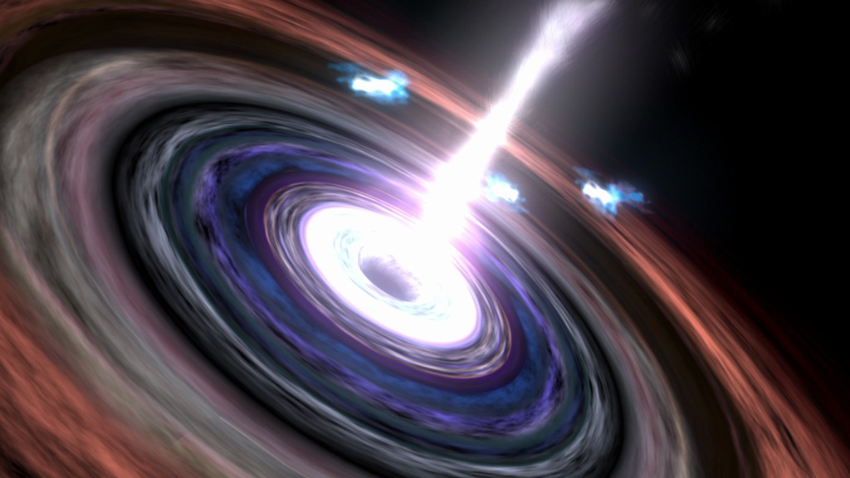
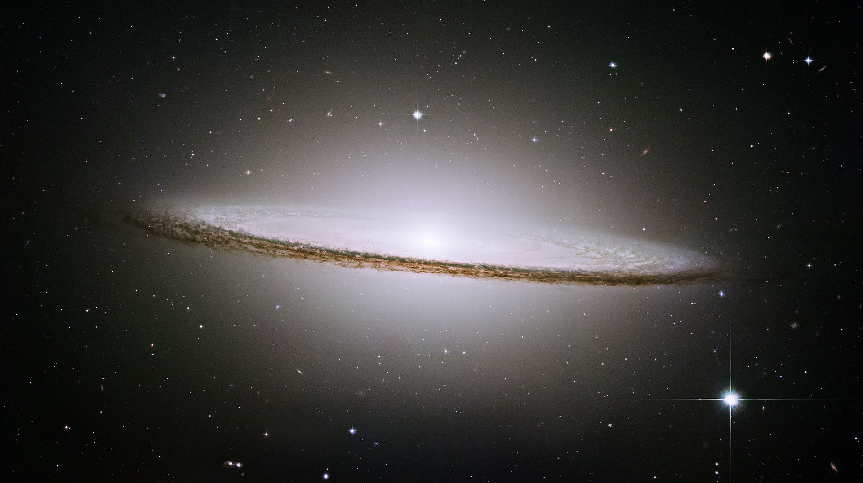
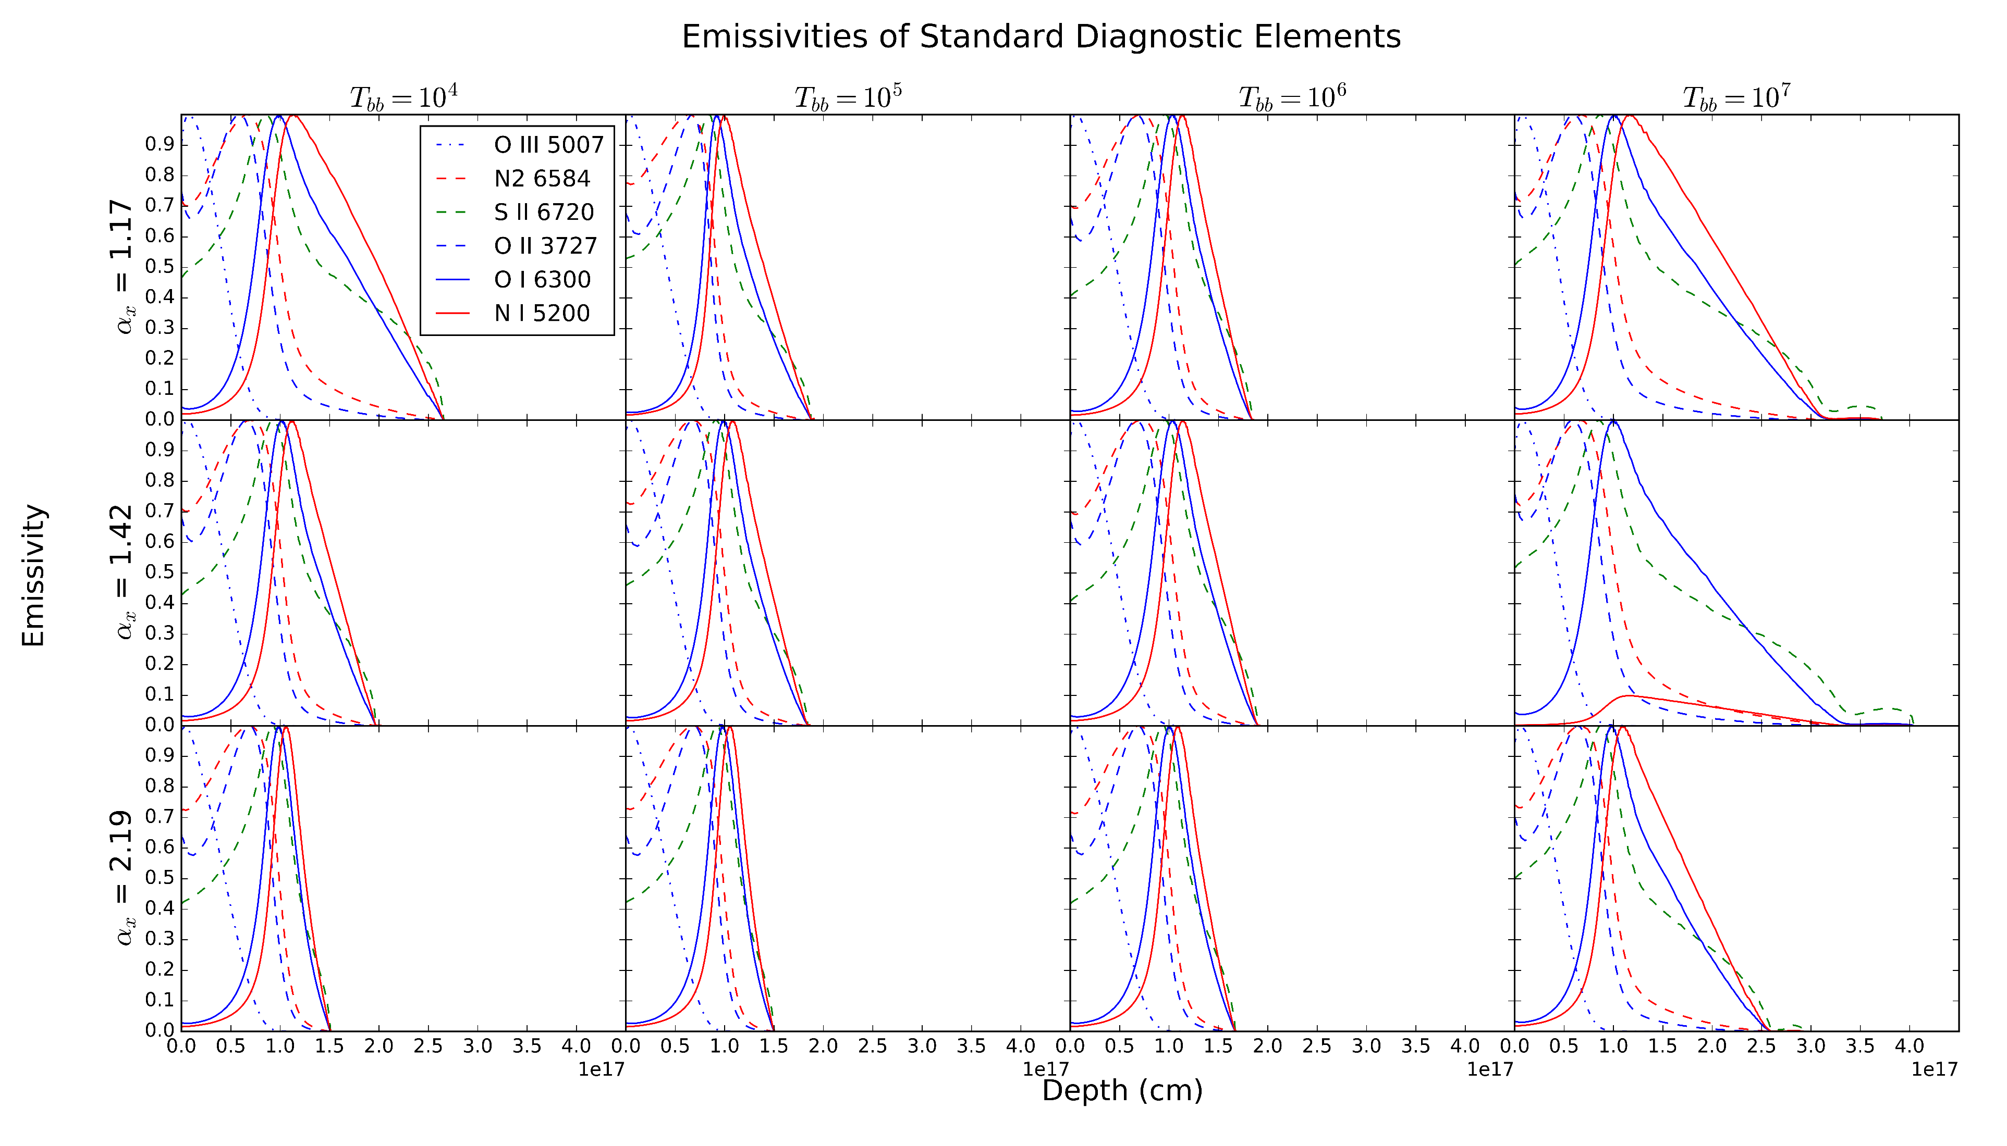
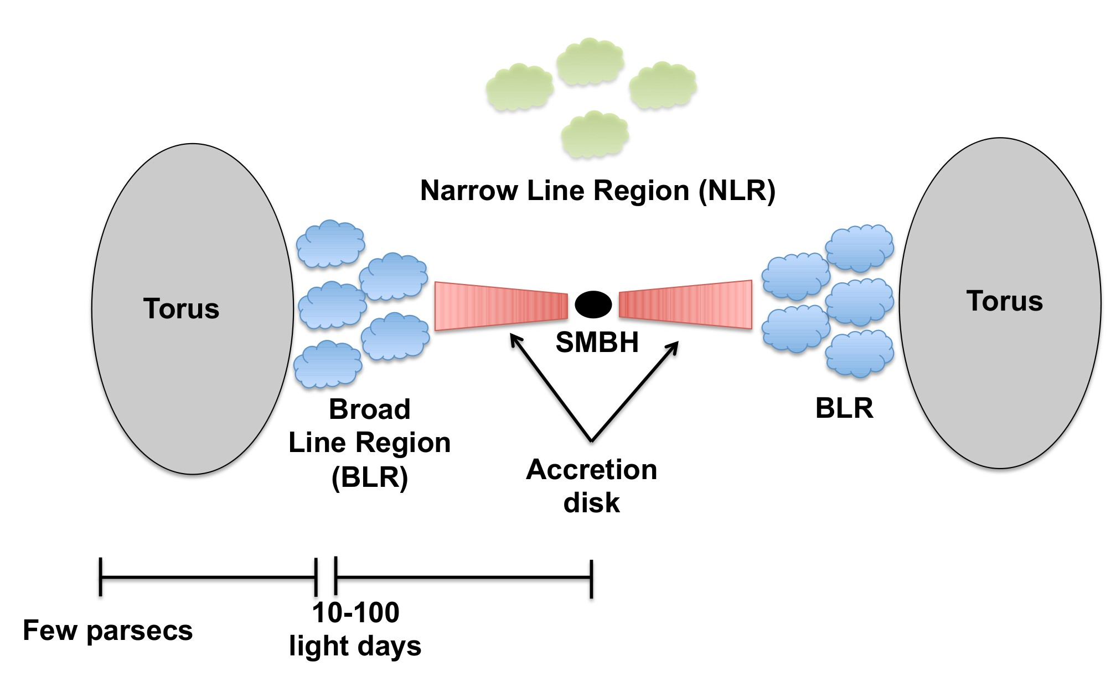
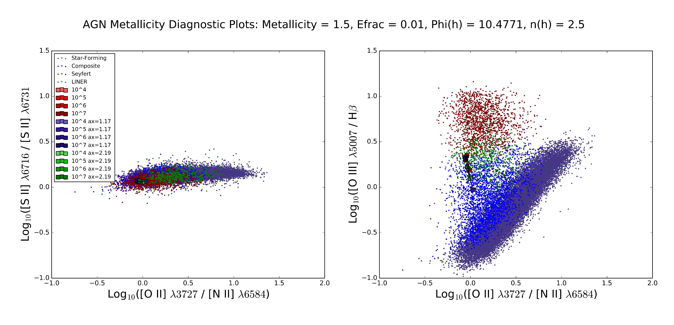
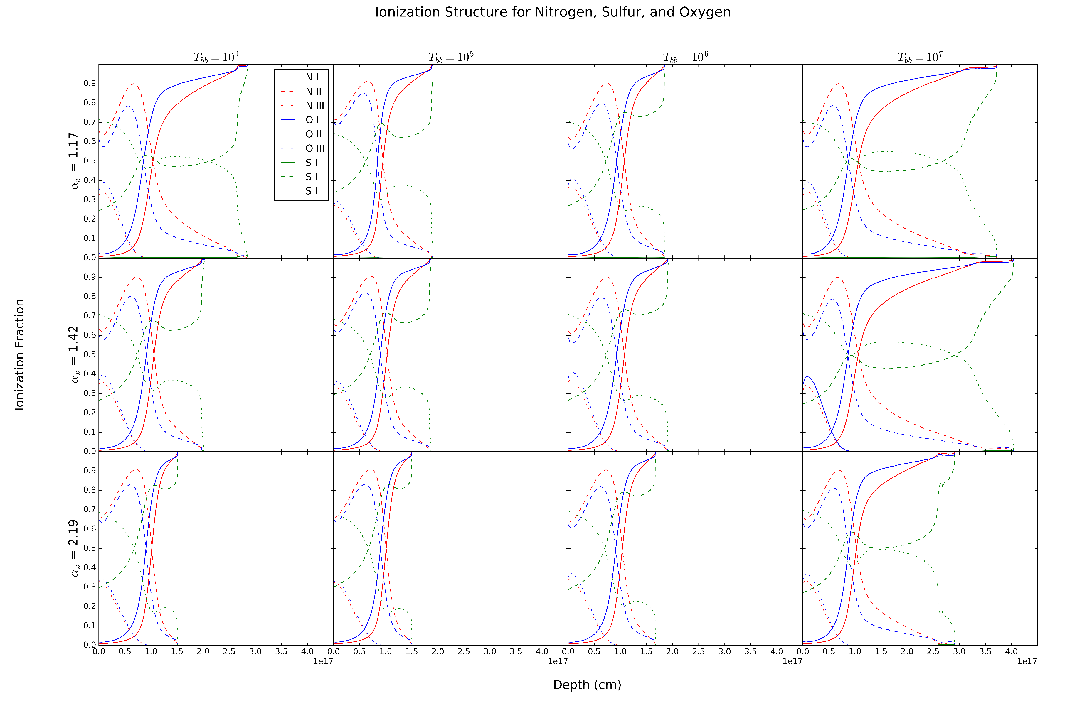
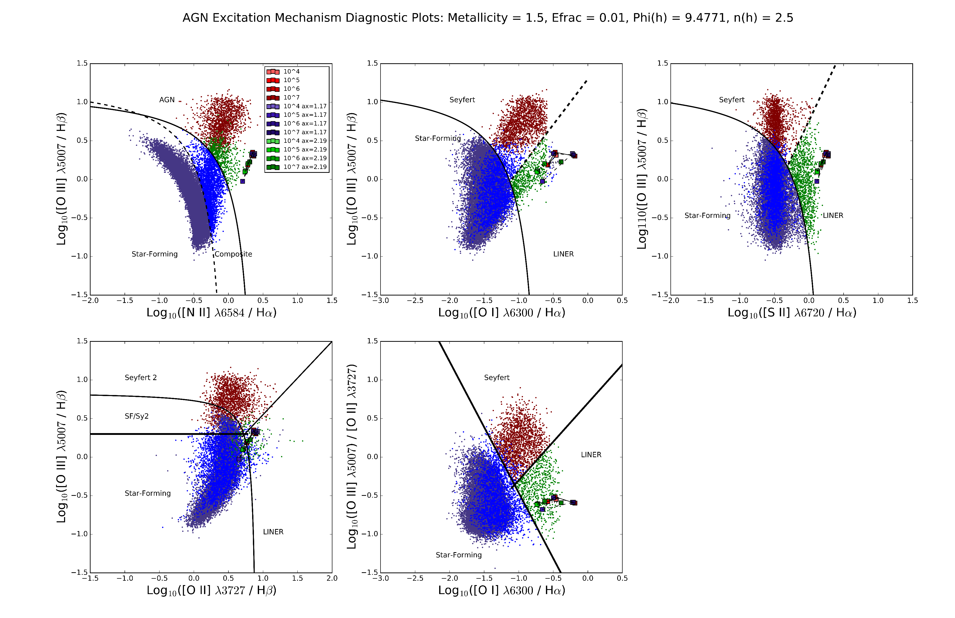
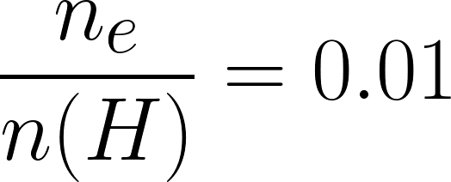
Investigating Simulations of Emission Lines from the Narrow Line Region of LINERS
Christopher Greene, Chris Richardson
Elon University
Background
Low-Ionization Nuclear Emission Region (LINER) galaxies are a subset of Active Galactic Nuclei (AGN) .
Computational modeling of LINERs has proven difficult due to a lack of understanding of the physical mechanism that drives LINER activity.
Photoionization models of Seyfert galaxies have proven successful and this project looked to examine the viability of photoionization models for LINERs.
Results
The ratio [O II] 3727/ [N II] 6584 is sensitive to elemental abundances, and was used to constrain our abundance set.
Variation in α_{x} does not significantly affect the simulated values.
At a metallicity of 1.5, it appears that [O II] 3727/ [N II] 6584 is slightly underpredicted when compared to [S II] 6716 / [S II] 6731.
After constraining metallicity, diagnostic plots of excitation mechanism were produced.
The BPT diagram and diagnostics from empirically derived from Osterbrock & Veilleux 1983 were produced, as well as plots of ratios found by Lamareille 2010 and Kewley et al 2006.
[N II] 6584 appears at the fringe of observed LINERs, indicating that our densities may be overestimated.
[S II] 6720 also falls close to the edge of our observational data, falling off the group of data with larger T_{bb.}
To examine these peculiarities, plots of the ionization structure and emissivity of nitrogen, oxygen, and sulfur were produced.
The high emissivity of O I is typical of LINER emission.
Increasing α_{x} decreases the depth of peak emissivity, while increasing T_{bb} increases how deep the elements will emit.
http://www.nasa.gov/mission_pages/chandra/multimedia/galaxy-centaurusA.html
Methods
We set up the incident radiation curve from:
For baseline curve, the blackbody temperature T_{BB} is set to 10⁶ K based off of previous photoionization models.
Spectral indices are determined from the average value of observations, α_{x} = -1.59, α_{uv} = -0.6, α_{ox} = -1.42 (Grupe et al. 2010).
Photon flux and hydrogen density of a simulated cloud constrain the degree of ionization within the cloud. The ratio of photon flux to hydrogen density is the ionization parameter.
Values for elemental abundances are provided to the simulation.
The stopping boundary condition for the simulation is based on electron fraction:
We fit the values of α_{x} and α_{uv} using Ordinary Least Squares regression, producing the line:
We run simulations varying T_{BB} between 10⁴ K and 10⁷ K
The value of α_{x} is varied according to the standard deviation of the mean, 0.51, and the value of α_{uv} is changed accordingly.
α_{ox} is kept constant at -1.42 for all simulations.
Optical data is obtained via the Sloan Digital Sky Survey (SDSS) DR12
S II and S III have the most interesting ionization structure, with higher temperatures significantly lengthening the depth where there is more S II and S III. This could explain the overprediction in our diagnostic diagrams.
Conclusions
Ionization structure profiles indicate that our simulations overestimate nitrogen abundance.
Emissivity and Ionization Fraction profiles are most affected by temperature
Peak emissivity varies with α_{x}
Future Work
Adjust nitrogen scaling to fit observational data.
Examine T_{bb} ranges between 10⁶ and 10⁷ K to determine the cause of the elongation of emissivity and ionization.
References
Baldwin J. A., PhillipsM.M., Telervich R., 1981, PASP, 93, 5
Grupe, D., Komassa, S., Leighly, K., Page, K., 2010, ApJS, 187, 64
Groves, B., Dopita, Michael., Sutherland, R. 2004, ApJS, 153, 75
Groves B. A., Heckman T.M., Kauffmann G., 2006, MNRAS, 371, 1559
Kewley, L. J., & Dopita, M. A. 2002, ApJS, 142, 35
Ryden, B., Peterson, B., 2010, Foundations of Astrophysics, (Addison-Wesley)
Ferland, G. J.; Porter, R. L.; van Hoof, P. A. M.; Williams, R. J. R.; Abel, N. P.; Lykins, M. L.; Shaw, G.; Henney, W. J.; Stancil, P. C., 2013, RevMexAA, 49, 137
OsterbrockD. E., FerlandG. J., 2006, Astrophysics of Gaseous Nebulae and Active Galactic Nuclei. University Science Books, California
Lamareille, F. 2010, A&A, 509, A53
Peterson, B. M. 1993, PASP, 105, 247
Richardson C. T., Allen J. T., Baldwin J. A., Hewett P. C., Ferland G. J., 2014, MNRAS, 437, 2376
Shirazi, M., & Brinchmann, J. 2012, MNRAS, 421, 1043
Veilleux S., Osterbrock D. E., 1987, ApJS, 63, 295 (VO87)
Acknowledgements
I would like to thank the Elon College Fellows program, my research mentor Dr. Chris Richardson, and the Elon Department of Undergraduate Research.
This project was conducted as a part of Elon University’s Summer Undergraduate Research Experience, 2016.

