Slide 1

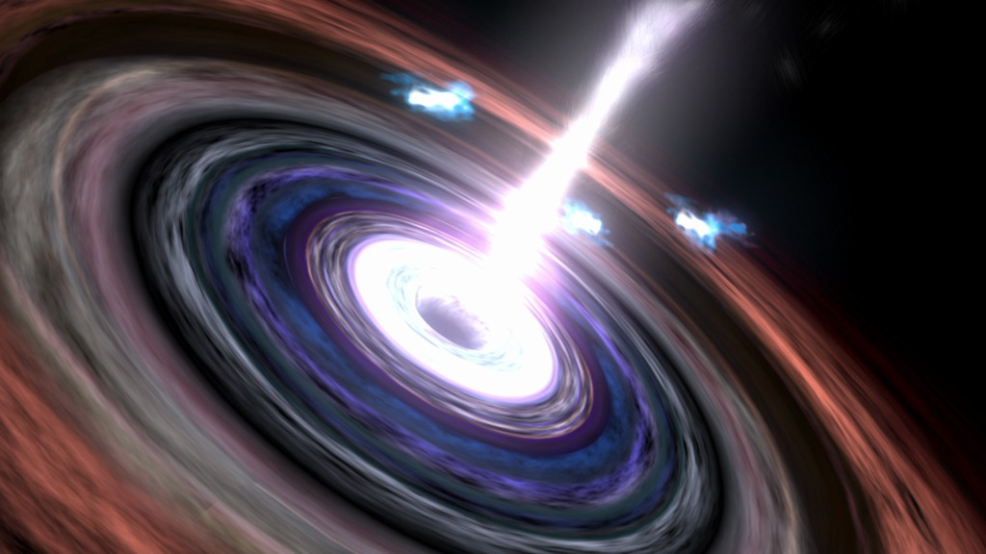
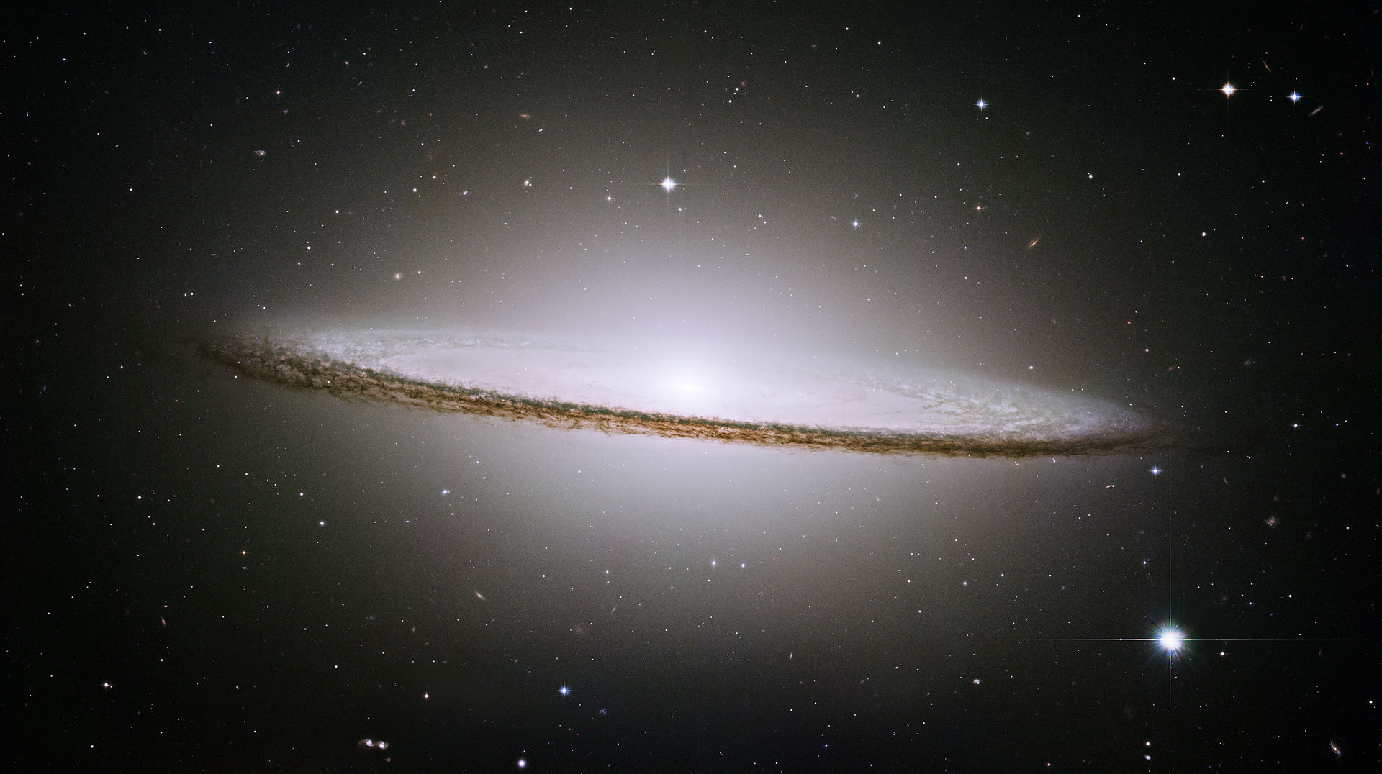
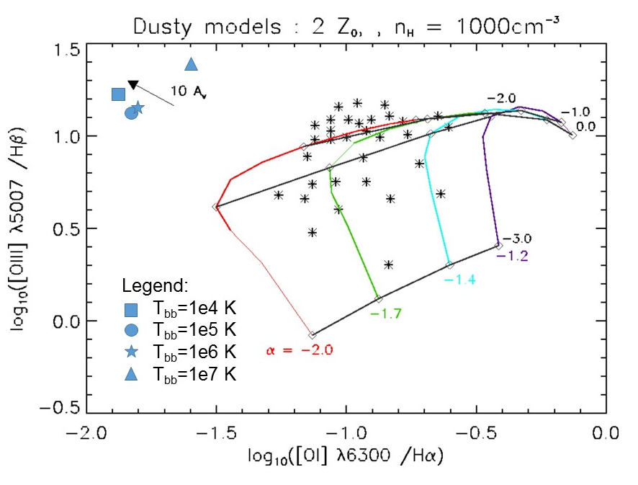
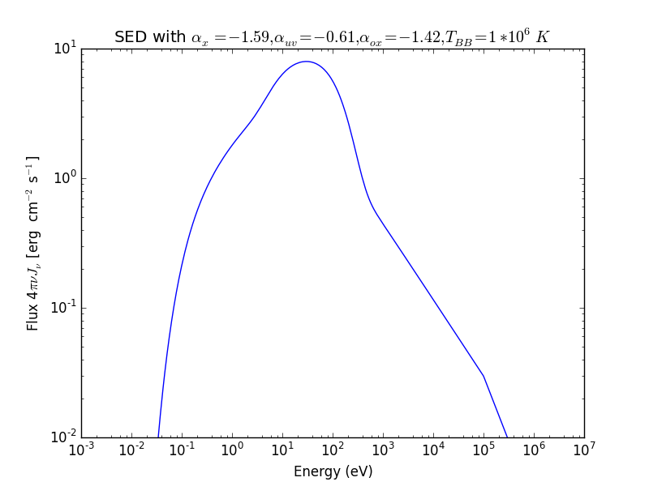
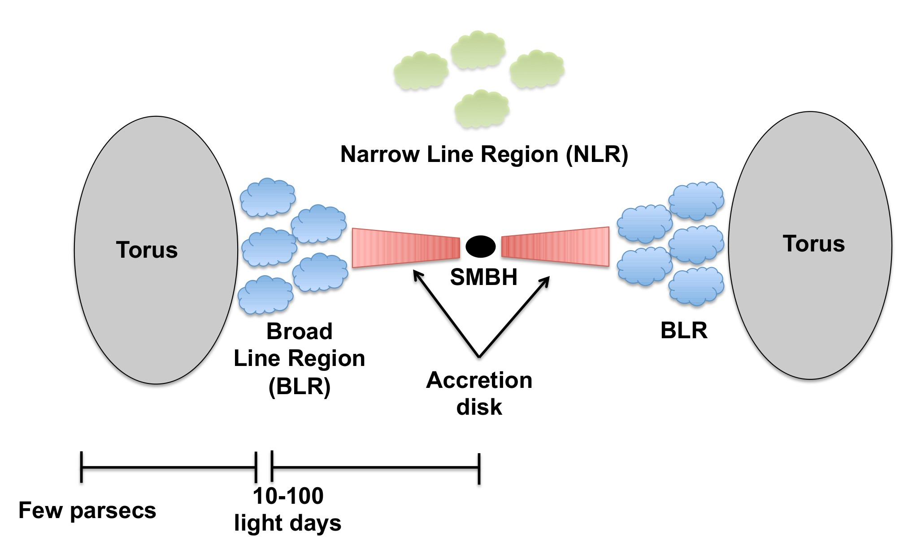
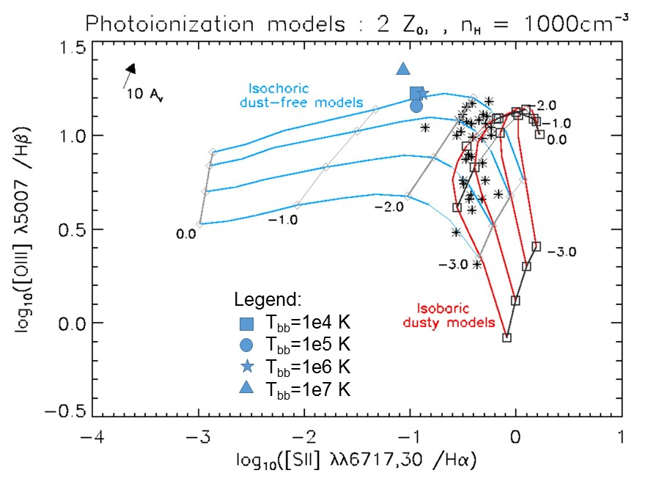
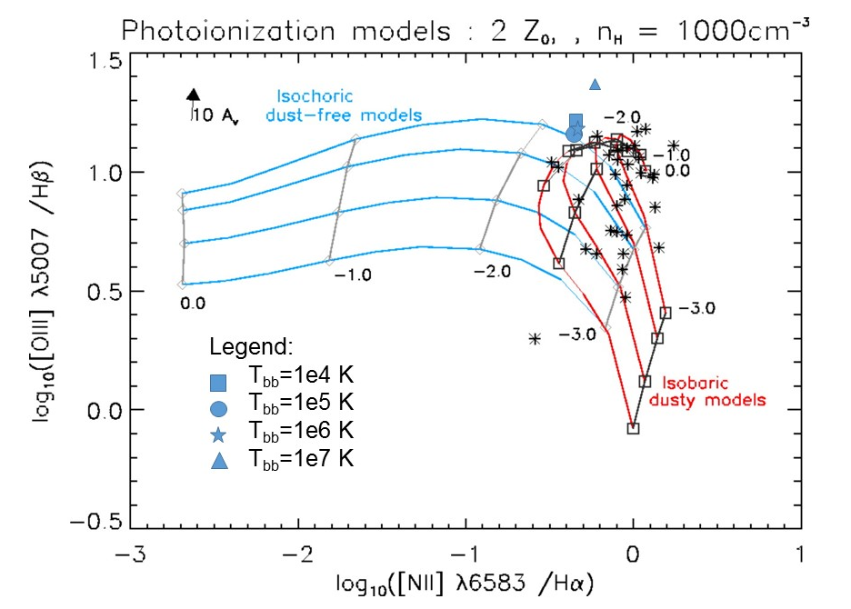
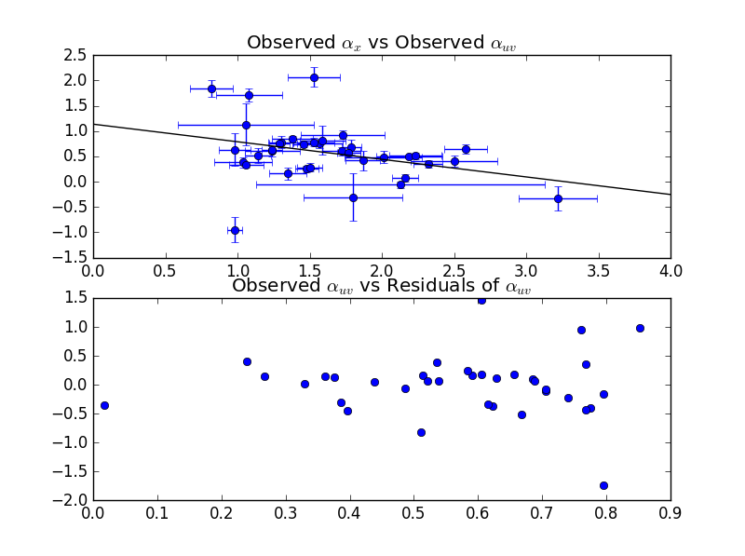

Simulations of Emission Lines from the Narrow Line Region in Seyfert Galaxies
Christopher Greene (Faculty Mentor: Dr. Chris Richardson)
Department of Physics
Abstract
One of the biggest questions in astronomy and astrophysics is “How do galaxies form?” Due to the large time scales involved, the only way to learn about the galactic formation is through studying galaxies outside the Milky Way through observation and simulation. The accretion disk of matter surrounding supermassive black holes in the center of certain galaxies produce more light than all of the stars within the galaxy, called active galactic nuclei (AGN). When modeling gas clouds in the narrow line region (NLR), researchers produce a spectral energy distribution (SED) representing the spectrum of light generated by the AGN. The can be empirically parametrized into a double broken power-law model using spectral indices, α_{x}, α­­_{ox,} and α_{uv}, which determine the slope of the curve at different wavelengths of light. One aim of our research is to synthesize a regression model with data from previous studies that will compute all the spectral indices based on one index. We statistically test our model by plotting the residuals of our regression. Using the mean values of the spectral indices provided by past research, we run an incident spectral energy distributions in the program CLOUDY. CLOUDY produces a set of emission lines that we superimpose onto plots of past data to determine the accuracy of our model.
Background
Study of Active Galactic Nuclei (AGN) allows us to understand more fully the processes involved in galactic evolution.
Many researchers believe that some AGN are formed when two galaxies merge.
In about 4 billion years the Milky Way galaxy and the Andromeda galaxy will begin merging, studying AGN may tell us what will happen after the merger.
AGN are generally structured according to the width of the emission lines observed in each region.
Lots of research on the Broad Line Region (BLR), where there are broad emission lines, but not as much on the Narrow Line Region (NLR), where there are narrow emission lines.
Emission lines from the ionization of different elements used to learn about the AGN, through simulations with programs such as CLOUDY and MAPPINGSIII.
Models of the incident radiation curve from the accretion disk in Cloudy are computed from using the spectral slope indices α_{x}, corresponding to the X-ray spectrum (10² eV- 10⁵ eV), α_{uv} corresponding to the ultraviolet spectrum (10¹ eV-10² eV), and α_{ox} is the ratio of x-rays to optical light.
Research has shown that a correlation exists between α_{x} and α_{uv} and between α_{x} and α_{ox}.
This leads to the question:
How does constraining the spectral indices with regression models of past data affect simulations of the Spectral Energy Distribution (SED) of the Narrow Line Region of an Active Galactic Nuclei?
Temperature of the blackbody T_{BB} is set to 10⁶ K
Incident radiation curve is calculated:
We supply the blackbody temperature T_{BB}, initial hydrogen number density n_{H} (10³ cm⁻³), log of photon flux per unit area φ(H) (13.5), element abundances, metal depletion, dust grains, and cosmic background radiation to CLOUDY.
CLOUDY produces a list of emission lines that we plot over data provided by Groves et al. 2004 to determine if the simulations are a good predictor of emission.
http://www.nasa.gov/mission_pages/chandra/multimedia/galaxy-centaurusA.html
http://www.nasa.gov/mission_pages/chandra/multimedia/galaxy-centaurusA.html
http://www.isdc.unige.ch/~ricci/Website/Active_Galactic_Nuclei.html
Results
We perform a linear regression on the data from Grupe et al. 2010 and plot it over the observed values of α_{x} and α_{uv}, as well as plot the residuals of α_{uv}.
Methods
Data from Grupe et al. 2010 is fit to a linear regression model scripted in Python.
Use Chi-Square test to determine goodness of fit for a 2-D model using the equation:
Conclusions
The residual plots appear to be random, indicating that our model is a good fit.
Our line ratios do not fall along the data as strongly as we would like, especially [O III]/Hβ vs [O I]/Hα, indicating that we need to adjust the model.
Future Work
Complete statistical analysis of our model, namely our chi square test.
Consider using an isobaric (constant pressure) model as opposed to an isochoric (constant density) model to help match our produced line ratios to the data.
References
Grupe, D., Komassa, S., Leighly, K., Page, K., 2010, ApJS, 187, 64
Groves, B., Dopita, Michael., Sutherland, R. 2004, ApJS, 153, 75
Ryden, B., Peterson, B., 2010, Foundations of Astrophysics, (Addison-Wesley)
Ferland, G. J.; Porter, R. L.; van Hoof, P. A. M.; Williams, R. J. R.; Abel, N. P.; Lykins, M. L.; Shaw, G.; Henney, W. J.; Stancil, P. C., 2013, RevMexAA, 49, 137
Acknowledgements
I would like to thank the Elon College Fellows program and my research mentor Dr. Chris Richardson.

