Slide 1
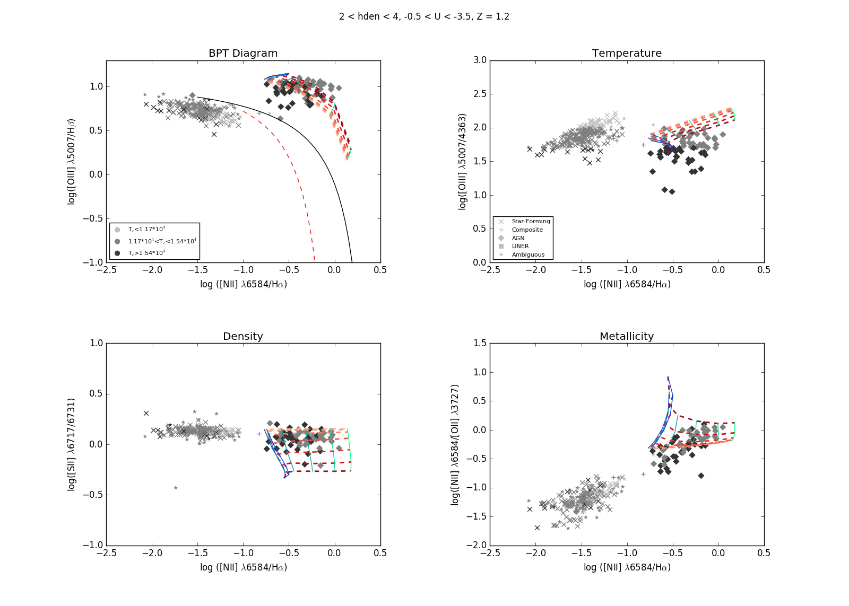
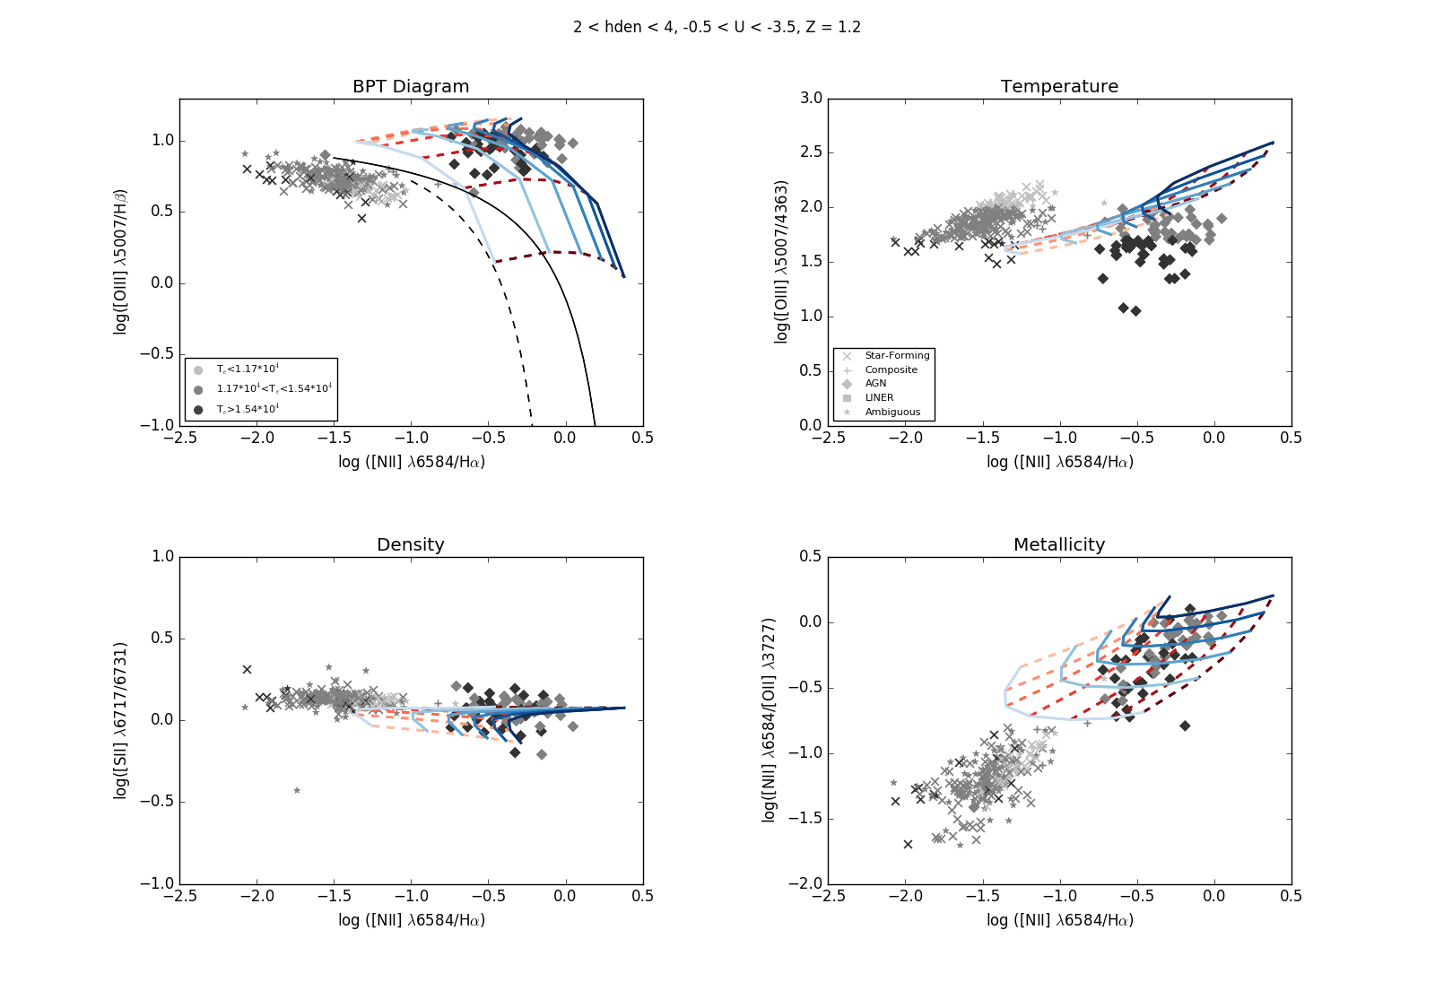
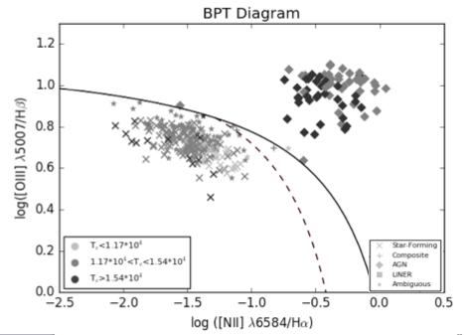
Investigating the Temperature Problem in High Temperature Emission Line Galaxies
Samuel Jenkins (Faculty Mentor: Dr. Christopher Richardson), Department of Physics
Introduction
Results
Spectra from radiation
Galaxies classified as Star-Forming (SF), Active Galactic Nuclei (AGN), Composites, LINERs or Ambiguous Objects
Active Galactic Nuclei with “active” Supermassive Black Holes at their centers
Black hole “accretes” hot gas
Accretion radiation passes through gas clouds in the outer galaxy
Emission Lines from spectra tell us properties of clouds and AGN providing the radiation
High temperature AGN are outliers in our data, hence “Temperature Problem”
Vary density from 2 to 4 and ionization from -3.5 to -0.5
We still miss a large portion of our high temperature AGN
Vary metallicity from 0.5 to 2.0
On the BPT Diagram we see that most of our high temperature AGN have a metallicity between 0.6 and 1.2.
Highest temperature density and ionization simulations still miss our highest temperature data
High density and low ionization produce the highest temperatures
Low metallicity creates significantly higher temperatures
Even lowest metallicity and lowest ionization simulations miss our hottest AGN
Density and ionization simulations cover almost all data
Highest density simulations exceed highest density in data set so we have reached the upper bound of density
Metallicity does not affect density
Methods
Using CLOUDY to simulate galaxies with different physical parameters
Varying metallicity, ionization parameter and density one at a time
Finding reasonable values for each parameter with help from literature
Varying two at a time to create evenly spaced grid simulations
Plotting these simulations on top of our data
Adjusting simulation parameters to cover high temperature AGN on all plots.
Density and ionization simulations cover much of the data but miss highest temperature AGN
Metallicity simulations cover all data with highest temperature galaxies evenly scattered throughout
Acknowledgements
References
This project was done as part of Elon University’s Summer Undergraduate Research Experience, Summer 2017. I would like to thank Elon University’s Undergraduate Research Program and my research mentor, Dr. Chris Richardson.

