Slide 1
Sanofi Accelerator Trials management solution
Notes:
We were order to create a solution to help/assis manage clinical trials.
As for any tool/app one implicite objective is to make user live easear. And in the context of trial study, why not try to make the collected data mor reilable

Slide 2
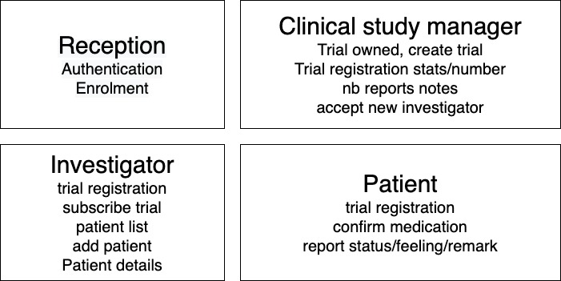
User roles and views

Slide 3
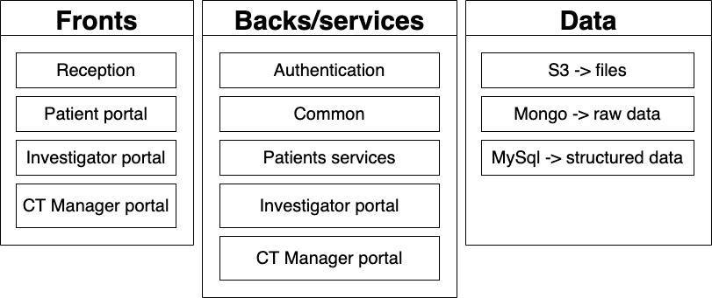
App basic structure

Slide 4
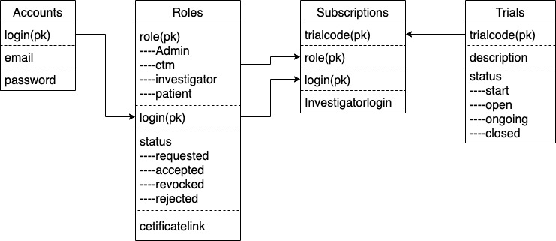
Relational database - Mysql

Slide 5
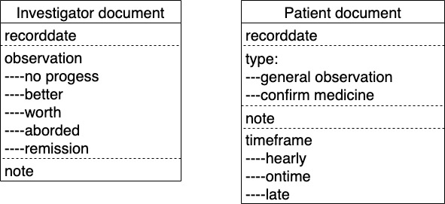
NoSql database – MongoDB -document

Slide 6
Project - structur
Express
1 main start file
1 file per services
4 react front
1 admin interface
Notes:
How to make all this reals What do we have
What have been done.
Add mechanisme to ease the management of the routes

Slide 7
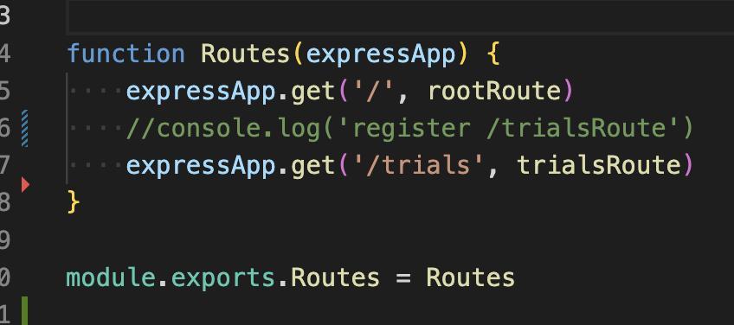
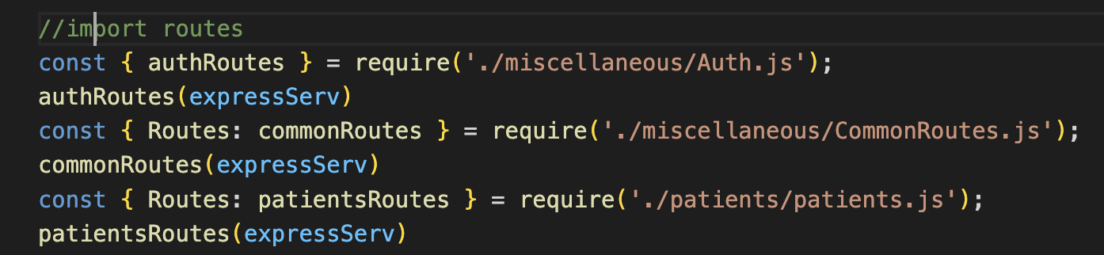
Route management
Notes:
Add mechanisme to ease the management of the routes

Slide 8
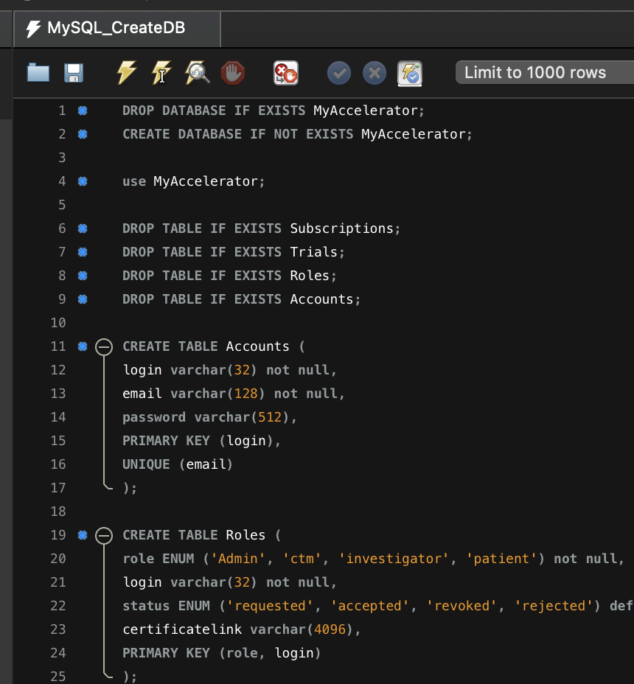
SQL script for database schema creation
Notes:
We have one data structure so , create the schema

Slide 9
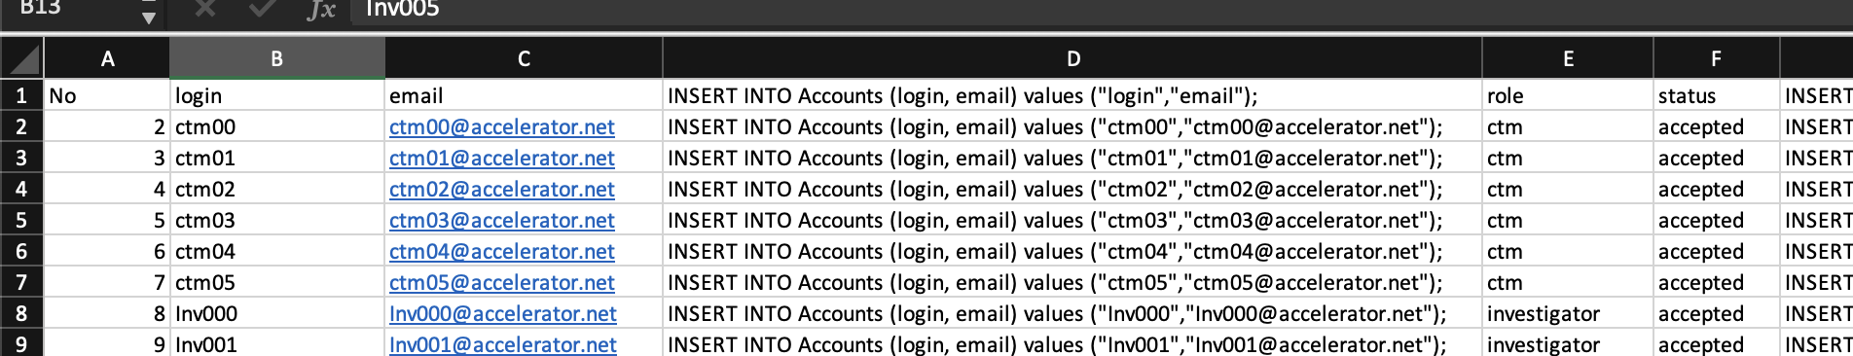
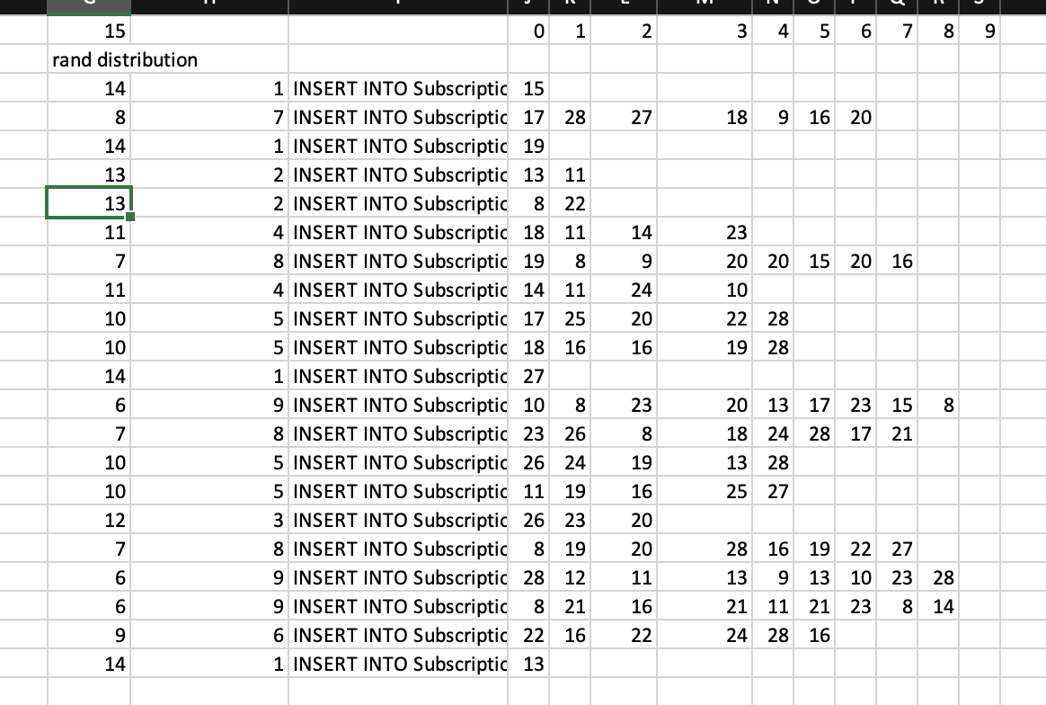
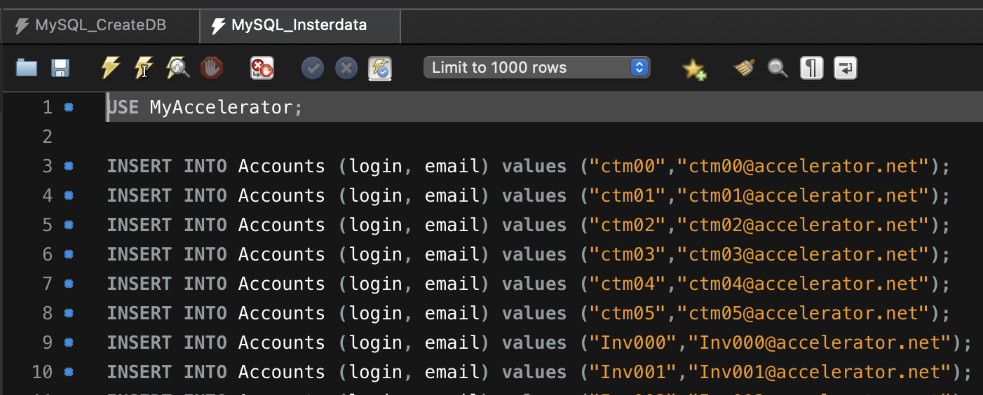
Dev Dataset
Notes:
If we have a front, it is to display somethins.
So let generate some dummy data
And generate sql commandes via Excel
Next generate

Slide 10
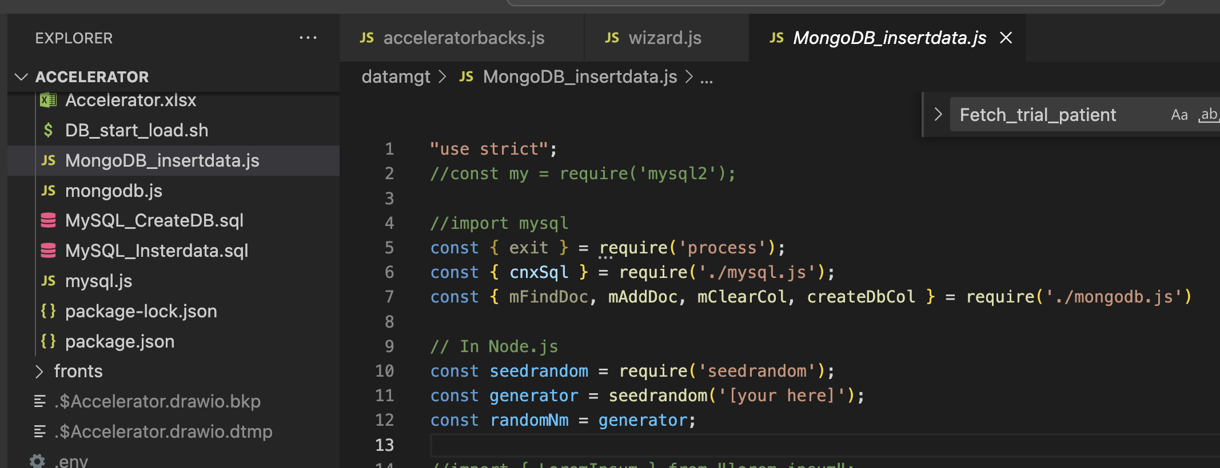
Dataset for Mongo with JS
Notes:
After having sweet with excel, use javascript

Slide 11
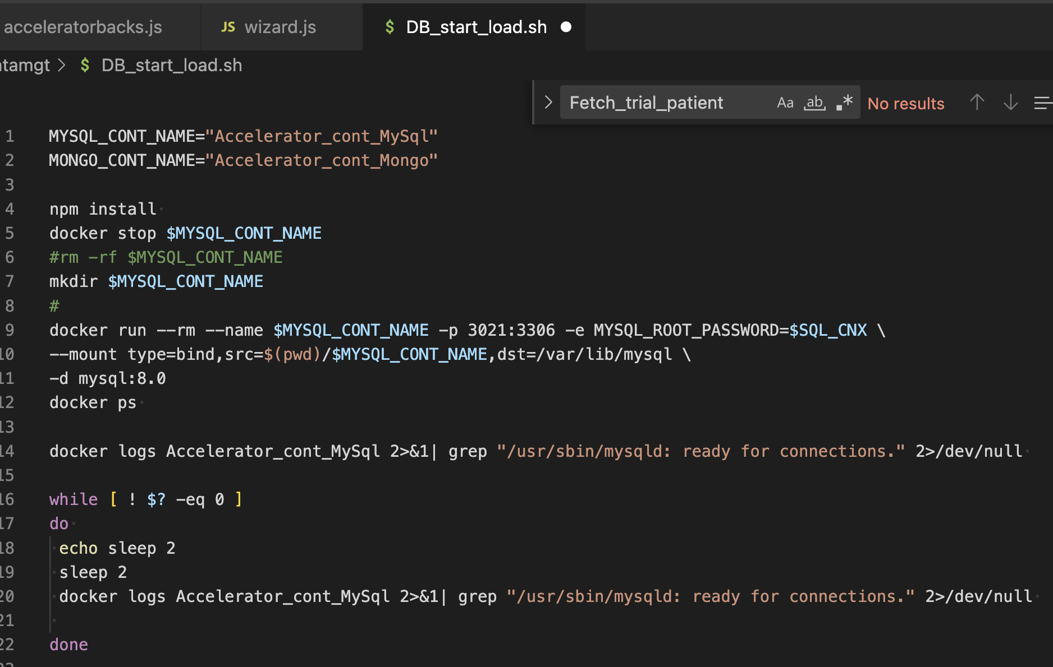
Generate database environment

Slide 12
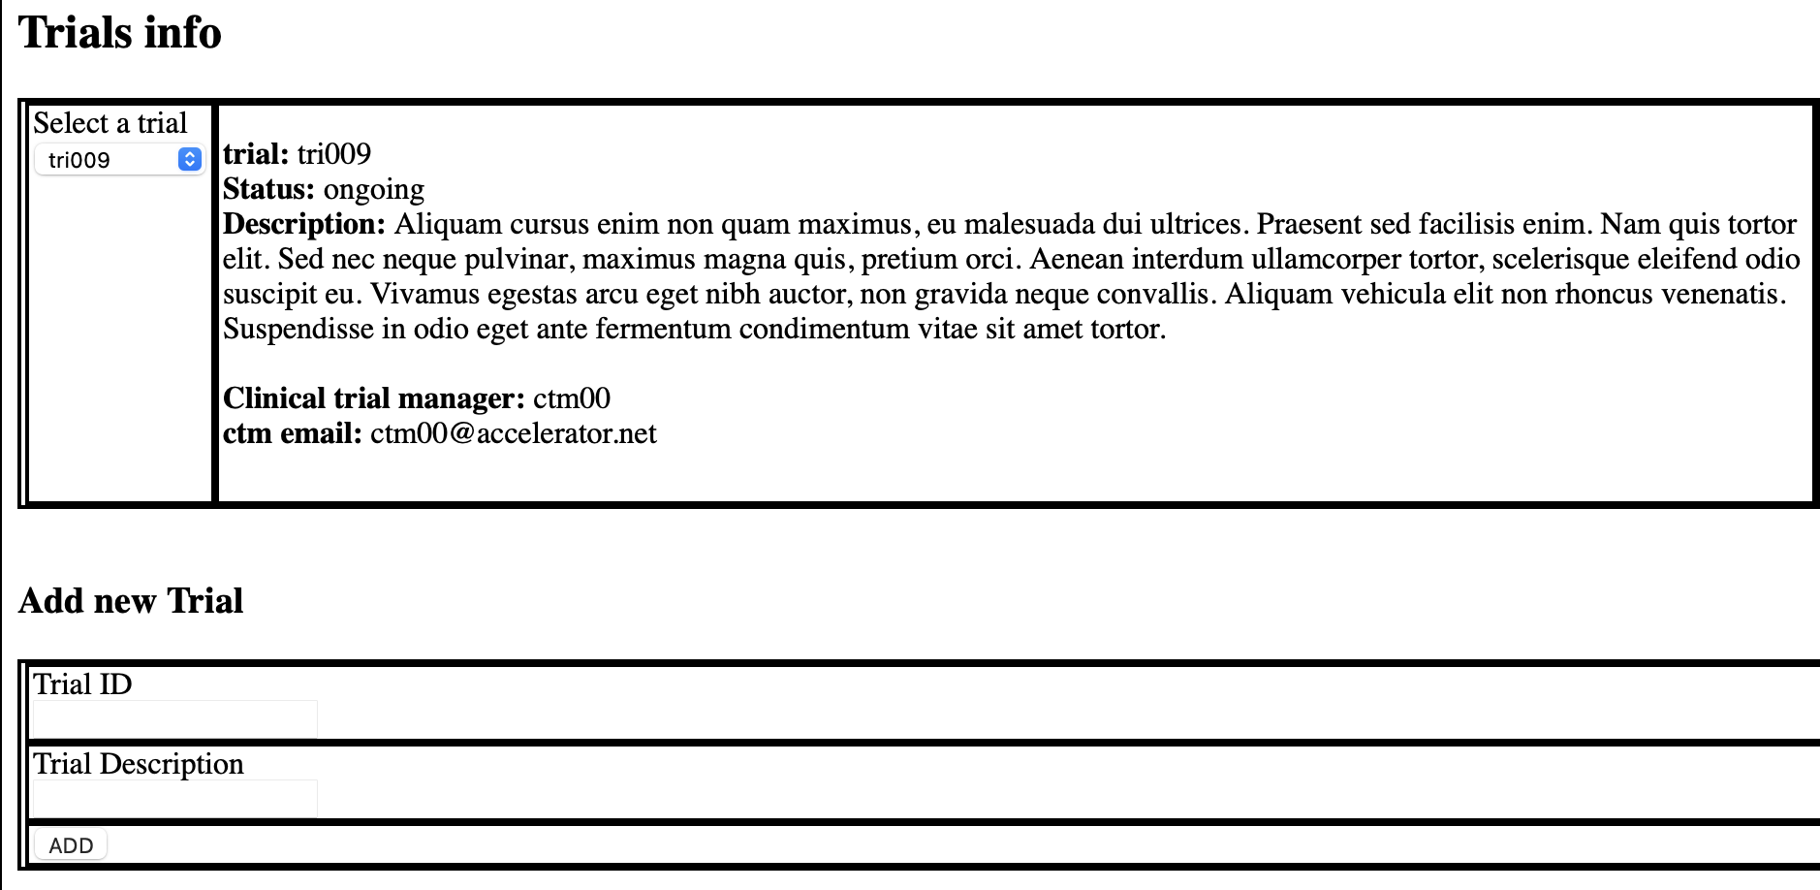
Display

