Slide 1
Task scheduling in virtual machine
Rishi Bhardwaj , 10503869

Slide 2
What is scheduling
scheduling is the method by which threads, processes or data flows are given access to system resources (e.g. processor time, communications bandwidth). This is usually done to load balance and share system resources effectively or achieve a target quality of service. The need for a scheduling algorithm arises from the requirement for most modern systems to perform multitasking (executing more than one process at a time) and multiplexing (transmit multiple data streams simultaneously across a single physical channel).

Slide 3
Problem Statement
Task scheduling is a technique used to schedule task on virtual machines. Task scheduling aims to optimize resource use, maximize throughput, minimize response time, and avoid overload of any one of the resources. Application Load Balancer on Xen is a very important tool in today’s world as we are completing transferring our work on cloud platforms so scheduling of task properly on various servers is very important. Our tool helps the client as the application requested by client is directly transferred to the most suitable server according to its need. So by use of this the client does not need to manually select the server.

Slide 4
Contd.
In general we generally allocate the work to that machine that is next in queue. For this we have to dynamically manage our workload on all virtual machines to check weather which machine have lowest workload. And as a complete check on load, memory of various servers is maintained from time to time so we have the complete status of all the servers all the time. By this we are able to utilize the resources completely and efficiently. Thus, the throughput and response time is improved efficiently.

Slide 5
XEN Hypervisor
The Xen hypervisor runs directly on the hardware and is responsible for handling CPU, Memory, and interrupts. It is the first program running after exiting the bootloader. On top of Xen run a number of virtual machines, a running instance of a virtual machine in Xen is called a domain or guest. A special domain, called domain 0 contains the drivers for all the devices in the system. Domain 0 also contains a control stack to manage virtual machine creation, destruction, and configuration.

Slide 6
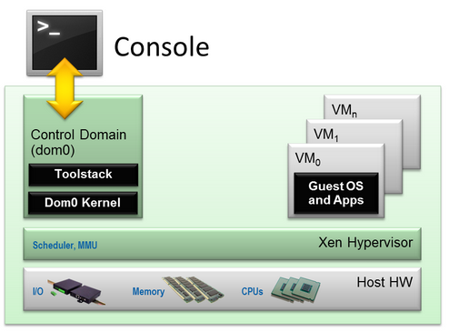
Xen architecture
Xen server architecture

Slide 7
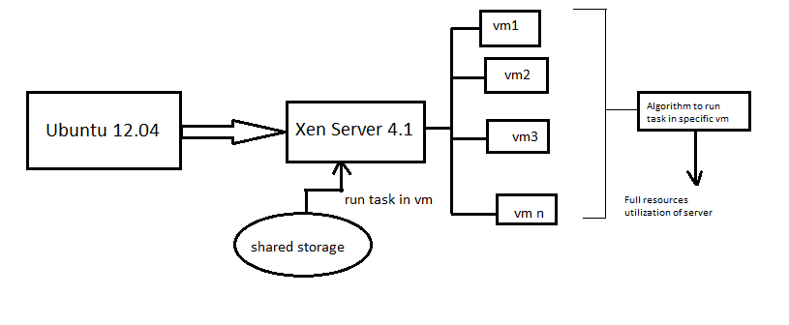
Flow diagram

Slide 8
Thank You

