Slide 1
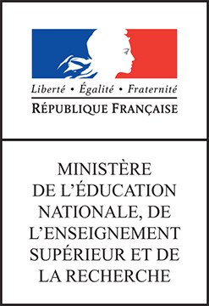

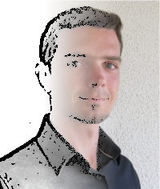




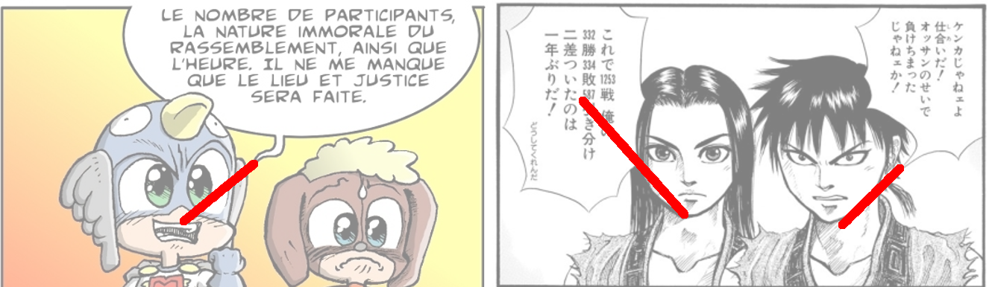

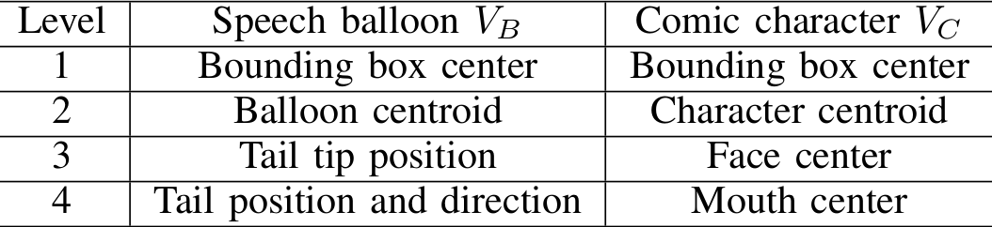
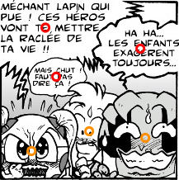
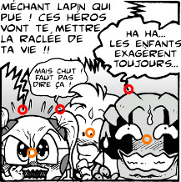
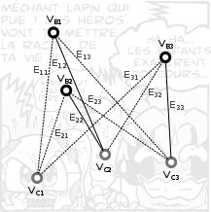
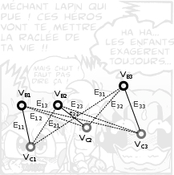
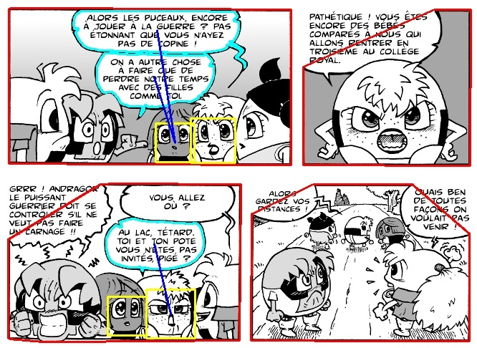
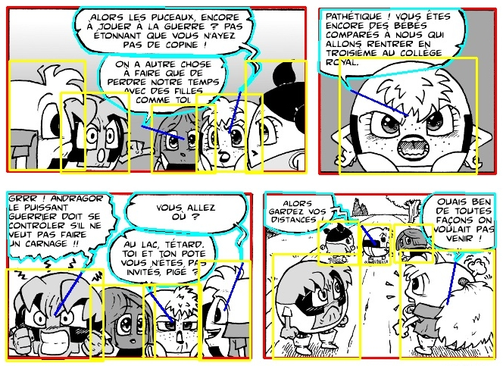
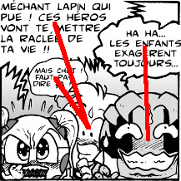
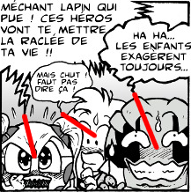
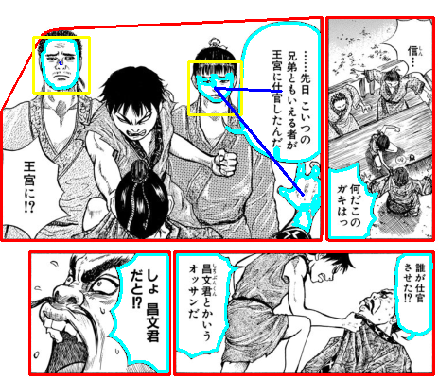
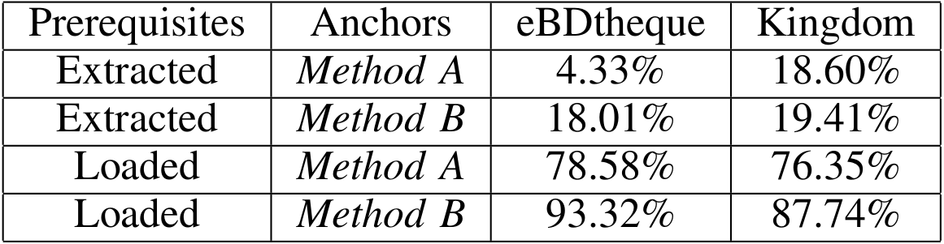
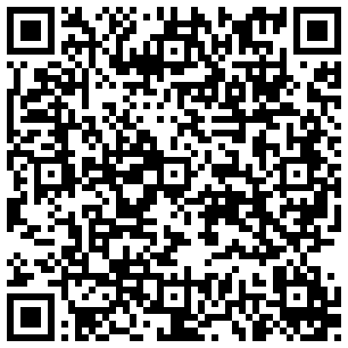
13th IAPR International Conference on Document Analysis and Recognition - ICDAR 2015 – Nancy, France
Speech balloon and speaker association for comics
and manga understanding
Christophe Rigaud¹, Nam Le Thanh¹, J.-C. Burie¹, J.-M. Ogier¹, Motoi Iwata², Eiki Imazu², Koichi Kise²
¹Laboratory L3i, University of La Rochelle, Avenue Michel Crépeau 17042 La Rochelle, France
²Graduate School of Engineering, Osaka Prefecture University, 1-1 Gakuen-cho, Nakaku, Sakai, Osaka 599-8531, Japan
{christophe.rigaud, tle05 jcburie, jmogier }@univ-lr.fr, {iwata, imazu_e, kise}@cs.osakafu-u.ac.jp
Presentation
Context
Important cultural heritage
Scanned and digital-born comics and manga
Unsupervised approach
Applications
Character's interaction and situation analysis
Text-to-speech with adaptive voice and tone
Contributions
Association method
Anchor points
Prerequisites: anchor points of balloons and characters
Geometric graph from all anchor point combination
Optimal 2-tuples considering Euclidean distance (L*)
Related to previously extracted elements (e.g. balloons, characters)
From coarse (level 1) to fine (level 4) and more
[1]
Anchor point level 2
Anchor point level 3
Input
Evaluation
Prerequisites extracted automatically
Prerequisites loaded from GT
Process
Level 2
[2]
Output
Level 3
66% correct
100% correct
Level 2
Level 3
References
Conclusion
Dataset http://ebdtheque.univ-lr.fr + TODO
TODO 22 different comics characters that appear 352 times in 34 pages
TODO 3 window sizes = 2, 1 and 0.5 times the query height
TODO Confidence threshold C = 100%
TODO 90.3% recall and 46.7% precision in average
[1] W. Sun and K. Kise, “Similar partial copy recognition for line drawings
using concentric multi-region histograms of oriented gradients,” in
Proceedings of the IAPR Conference on Machine Vision Applications,
ser. MVA2011, Nara Japan, 2011.
[2] C. Guérin, C. Rigaud, A. Mercier, and al., “ebdtheque: a representative database of comics,” in Proceedings of International Conference on
Document Analysis and Recognition (ICDAR), Washington DC, 2013.
Supported by the Higher Education and Research Ministry and the French foreign affair office.
Contribution
One-to-one speech balloon/comic character link
Robust against missing panels
Adaptive to different level of information (tail)
Perspectives
Consider tail direction
Handle out-of-panel speakers and multi-speakers
Source: https://github.com/crigaud/publication/tree/master/2015/ICDAR/speech_balloon_and_speaker_association_for_comics_and_manga_understanding
Image credits: “Kingdom” from Yasuhisa Hara published by Shueisha Inc. Japan and “Bubblegôm Gôm” “Le Magicien LoseCyb” from Studio Cyborga Goven, France.
Notes:
Introduction du contexte, des besoins et des problèmes qui se posent
Pose de la problématique et du contenu du poster
On ne parle pas de ce qu’est une bd numérique mais de ce que l’on peut tirer d’une bd papier
« A piece of art is thought for a medium and has to be rethought when the medium is changed ».
__
Etat de l’art, ce qui a été fait (tentative de normalisation, indexation, ontologie de Rissen)
Ce qui manque
__
Contribution, présentation de l’ontologie et de sa finalité
Rapprochement inédit avec le contenu image de la bande dessinée

