Slide 1
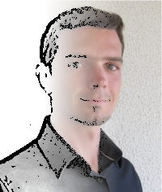


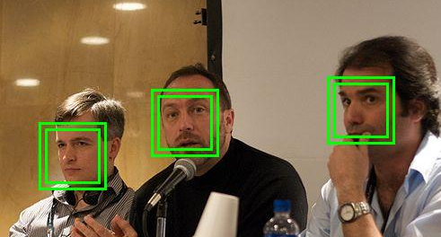
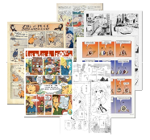
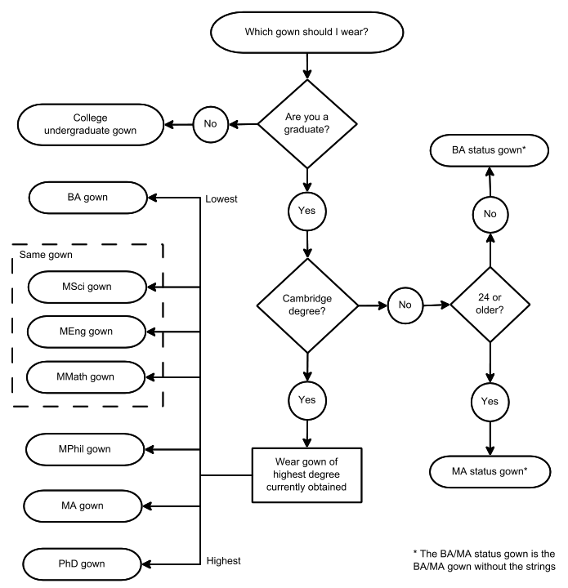
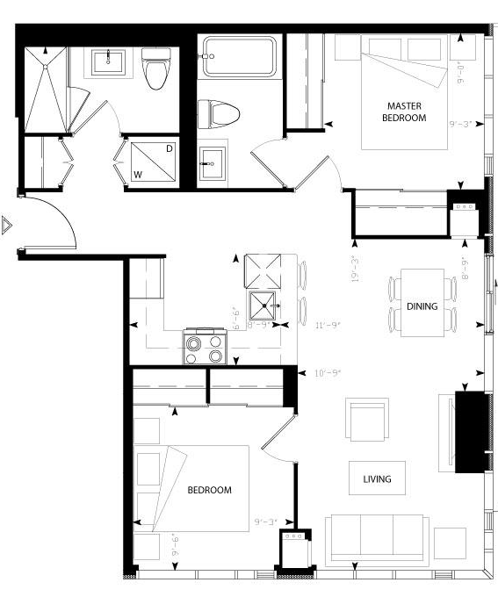
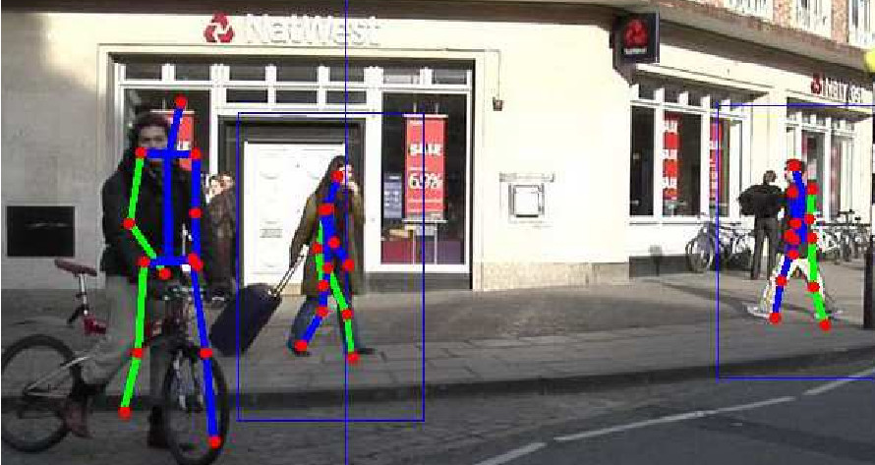
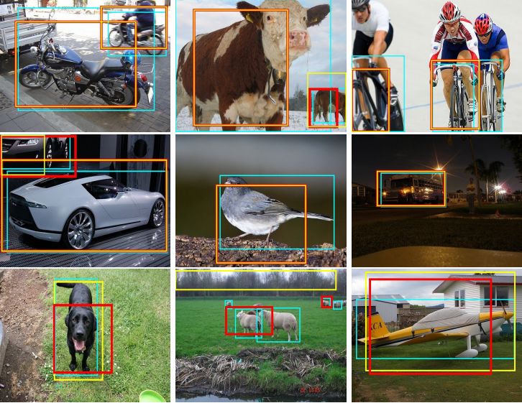
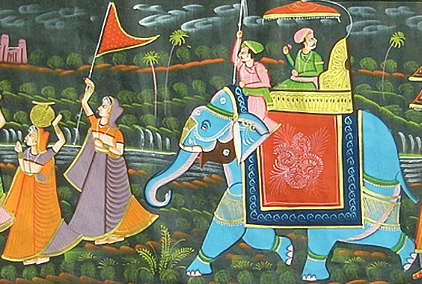

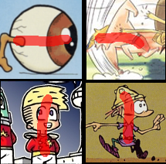
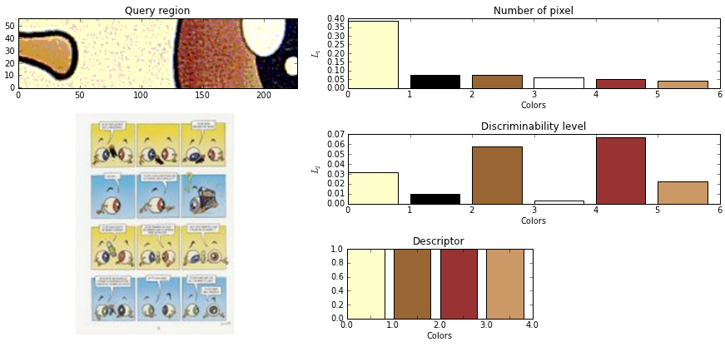
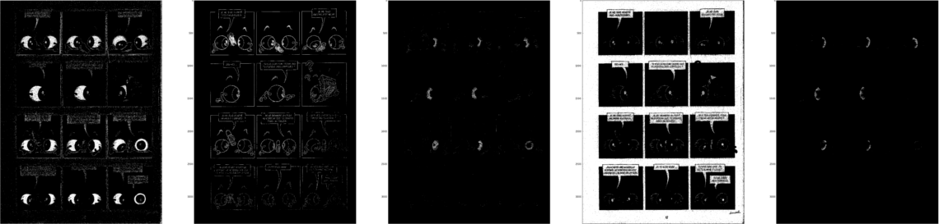
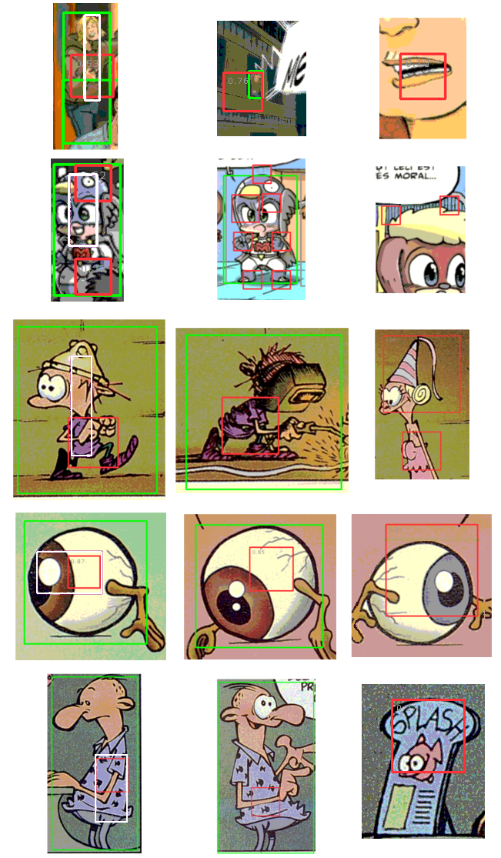
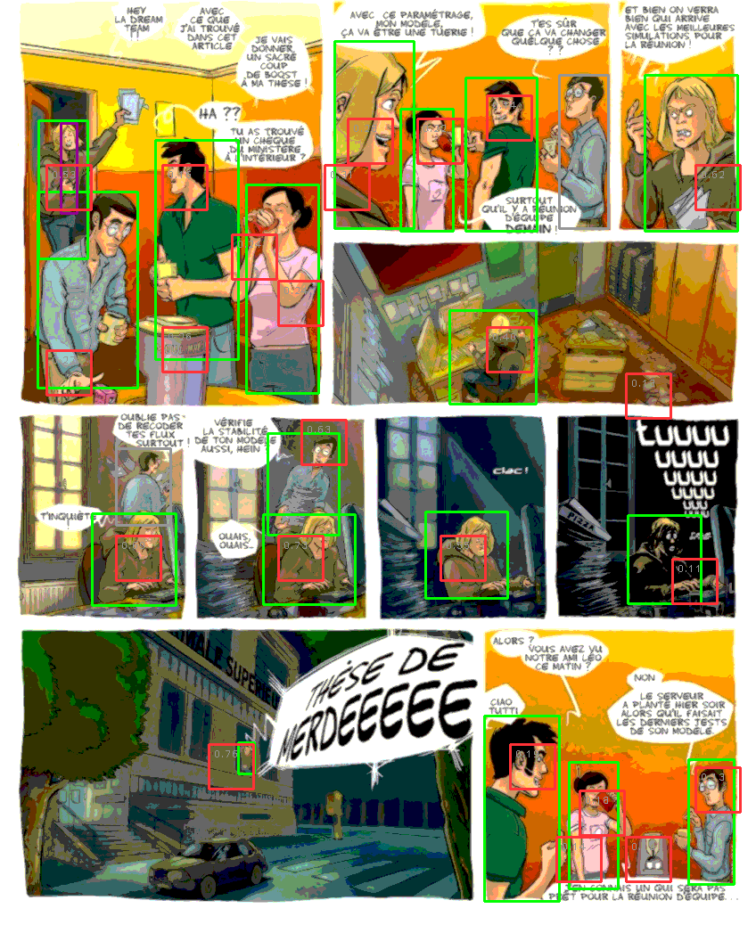

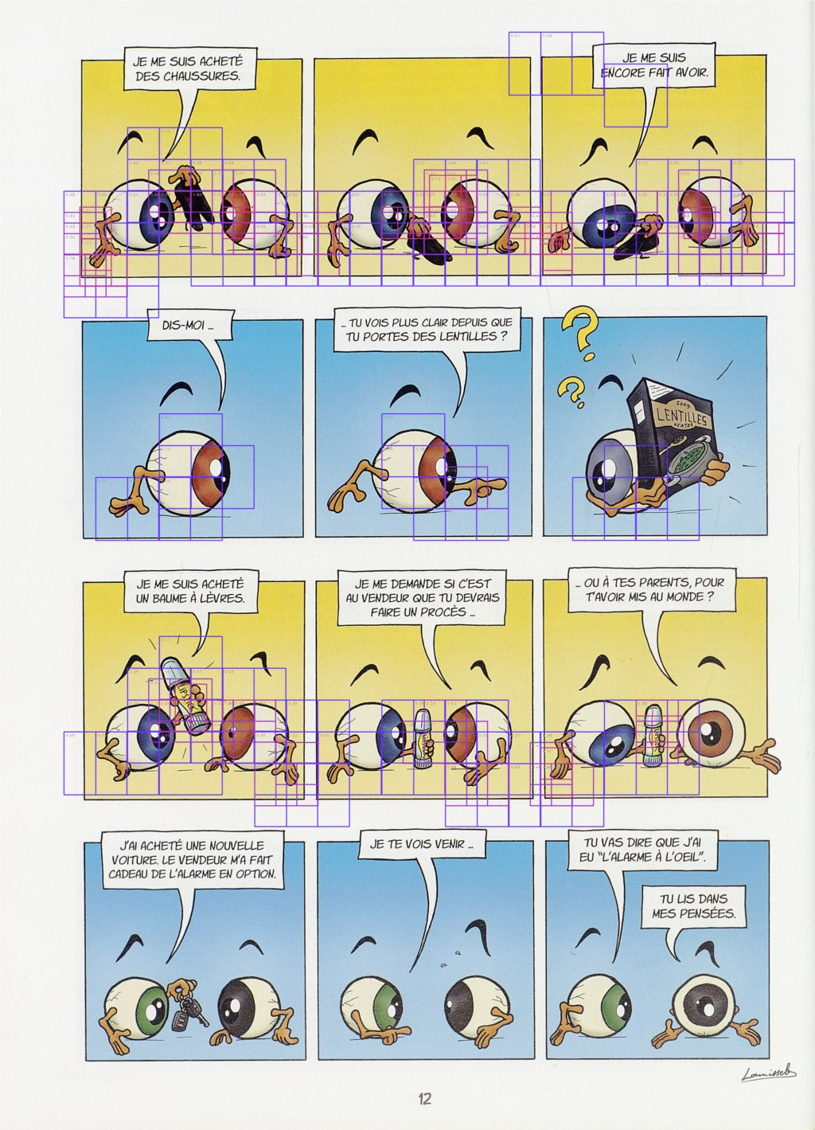
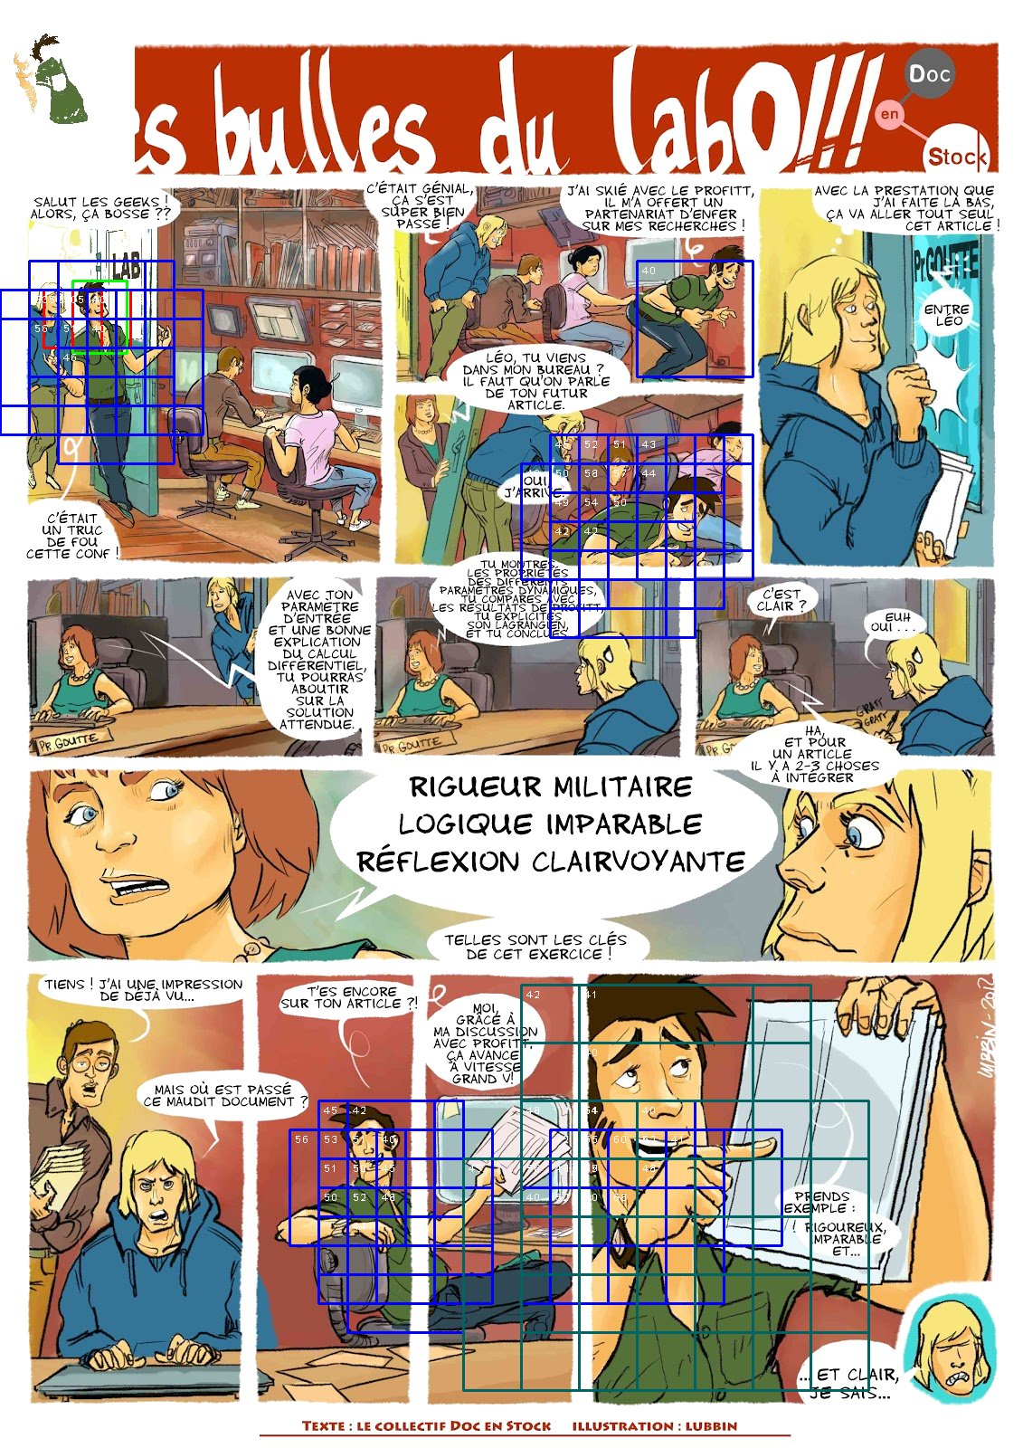
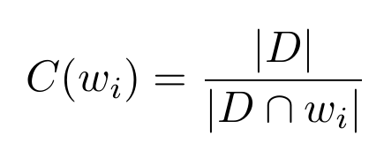
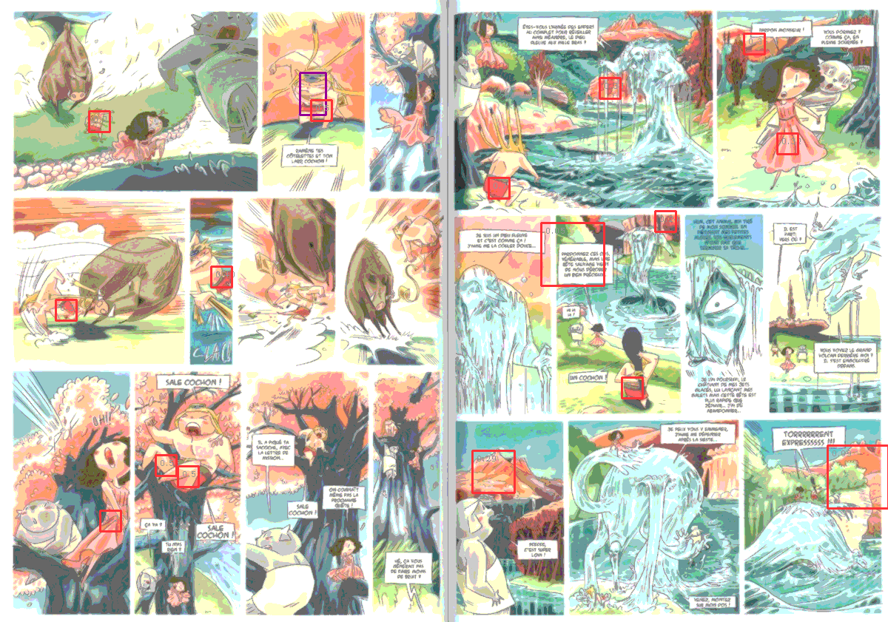
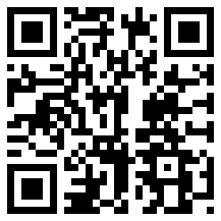
11th IAPR International workshop on Document Analysis System - DAS 2014
Color descriptor for content-based drawing retrieval
Christophe Rigaud¹² - Dimosthenis Karatzas² - Jean-Christophe Burie¹ - Jean-Marc Ogier¹
¹Laboratory L3i, University of La Rochelle, Avenue Michel Crépeau 17042 La Rochelle, France
²Computer Vision Center, Universitat Autnoma de Barcelona, E-08193 Bellaterra (Barcelona), Spain
{christophe.rigaud, jean-marc.ogier, jean-christophe.burie}@univ-lr.fr, {dimos}@cvc.uab.es
Presentation
Context
Comics represent an important part of cultural heritage
Digitization of thousands of comic books
Content Based Drawing Retrieval
Applications
Information retrieval: semantic query, full text search, story analysis
Augmented reading experience: make comics characters speak
Real scene
Comics
Drawing
Contributions
1. User query input
2. Query description
Highlight of pixel using finger or pointing device
Quick and user friendly
One object at a time
Color reduction
N most discriminant and dominant colors
Descriptor (color palette)
3. Complex object detection
4. Sample results
Query Correct Wrong
Query 1
Query 2
Discriminant masks of the descriptor D
Complex object detection (hero)
Query 1
Current issues:
Define the object (query)
Robust to scale, rotation, translation, deformation, occlusion
Proposed method:
Binary colour descriptor (colour presence/absence)
Part-based description
Spatial relation “between”
Colour to shape learning and retrieval
...
Aims:
Speech and speaker association
Content reflowing
Comics colorization
Confidence C of a given sliding window wi
Multi scale sliding window detection
Color legend: white = query, red = detection, green = ground truth
Experiments
Conclusion
References
Dataset http://ebdtheque.univ-lr.fr
22 different comics characters that appear 352 times in 34 pages
Descriptor size = 6
3 window sizes = 2, 1 and 0.5 times the query height
Confidence threshold C = 100%
90.3% recall and 46.7% precision in average
Contribution
Robust descriptor to scale, rotation, translation, deformation and occlusion
Content Based Drawing Retrieval
Limited to colored comics
Perspectives
Speech balloon and speaker association
Unsupervised comics understanding
Image credits: http://ebdtheque.univ-lr.fr/
Online: https://github.com/crigaud/publication/tree/master/2014/DAS/color_descriptor_for_content-based_drawing_retrieval
Notes:
Introduction du contexte, des besoins et des problèmes qui se posent
Pose de la problématique et du contenu du poster
On ne parle pas de ce qu’est une bd numérique mais de ce que l’on peut tirer d’une bd papier
« A piece of art is thought for a medium and has to be rethought when the medium is changed ».
__
Etat de l’art, ce qui a été fait (tentative de normalisation, indexation, ontologie de Rissen)
Ce qui manque
__
Contribution, présentation de l’ontologie et de sa finalité
Rapprochement inédit avec le contenu image de la bande dessinée

