Slide 1
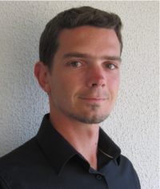



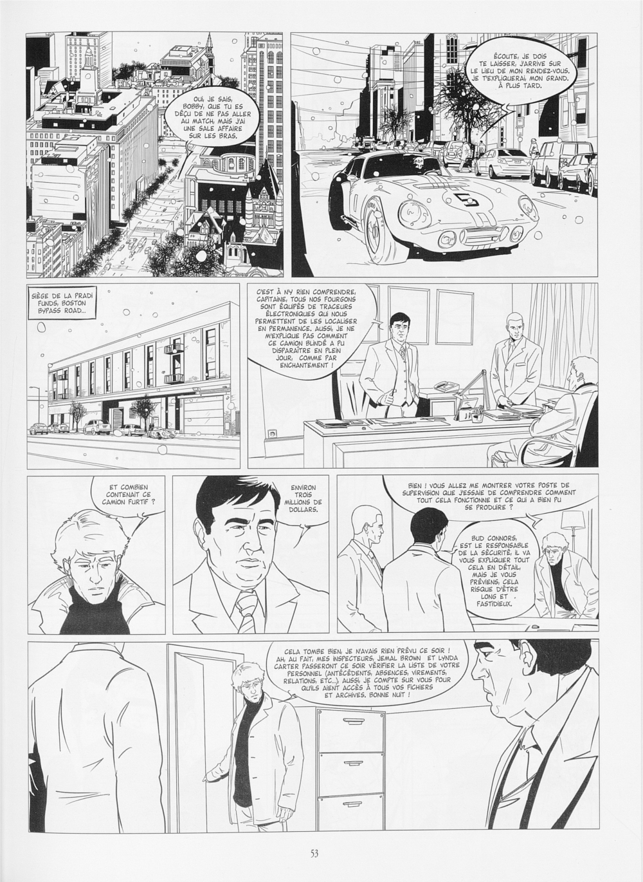

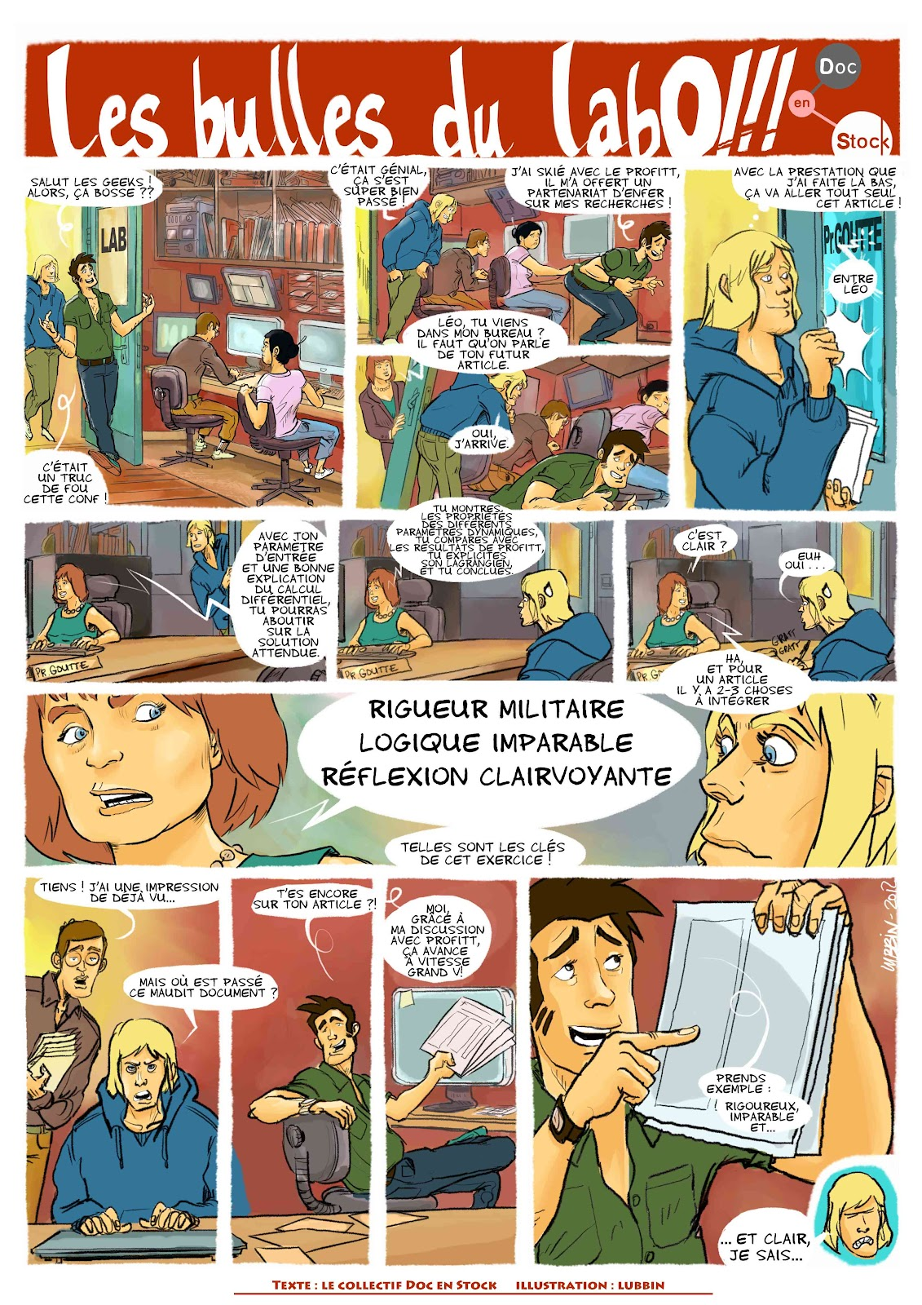
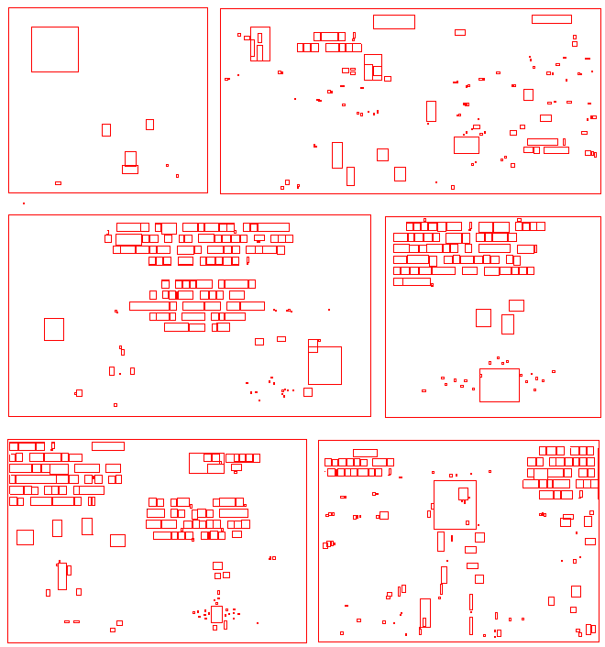
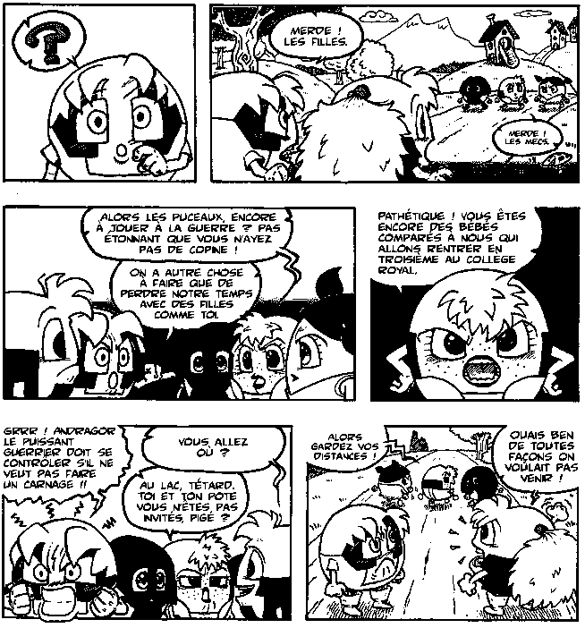
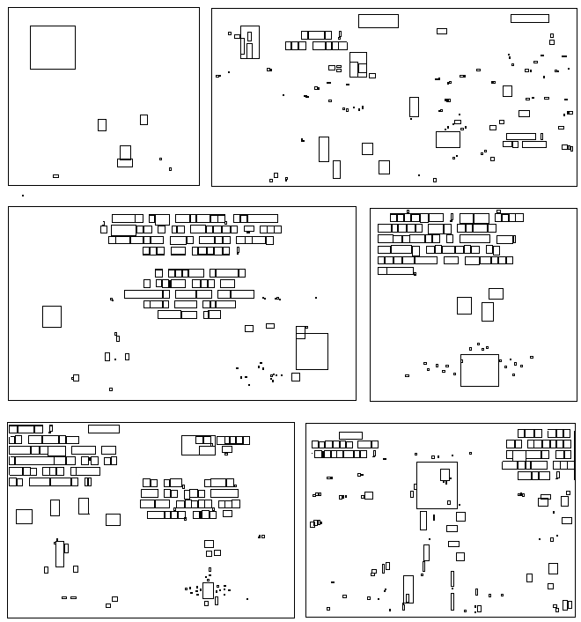


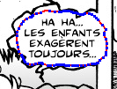
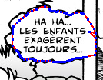
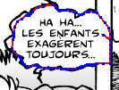
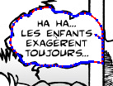
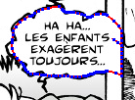
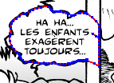
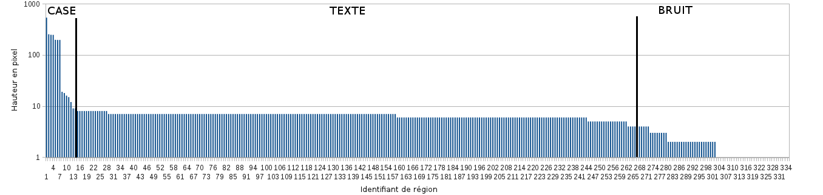
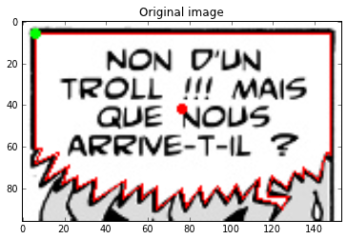
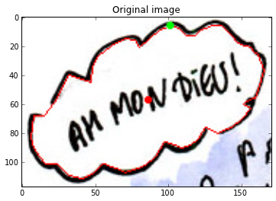
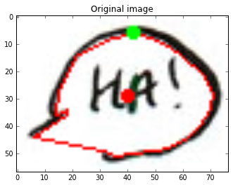

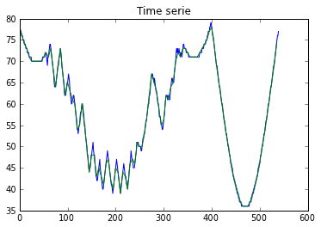
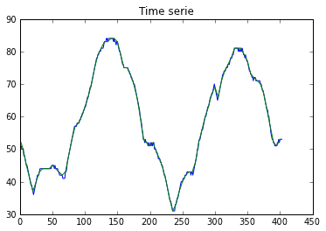
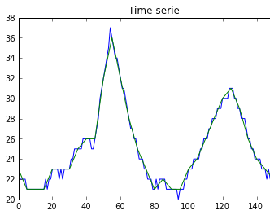
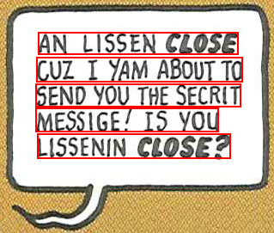
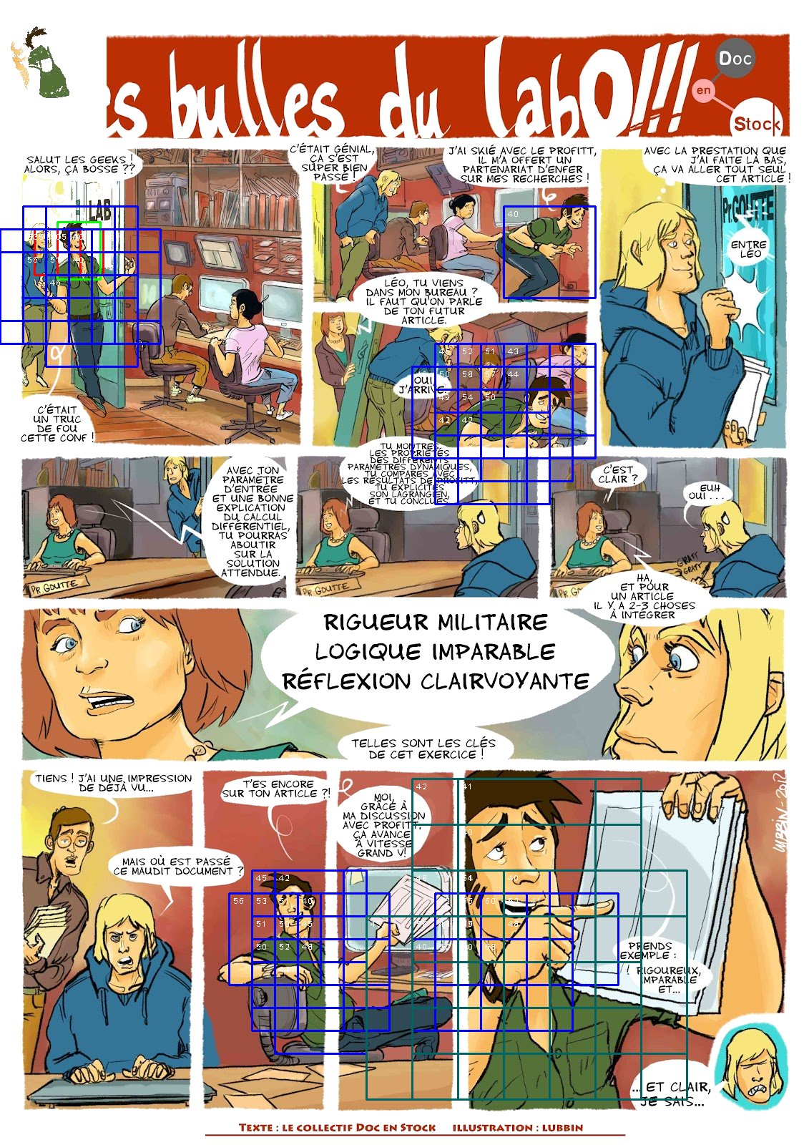

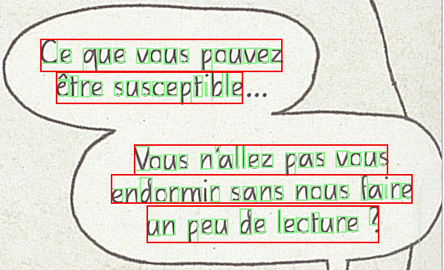
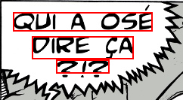
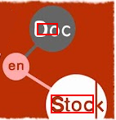
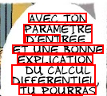
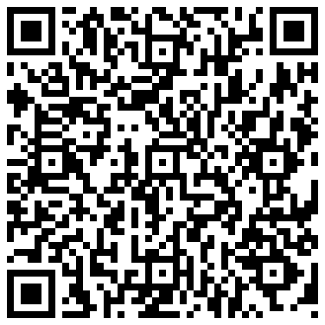
ICDAR 2013 Doctoral Consortium - Washington, DC - August 25, 2013
Segmentation and indexation of complex objects: detection and recognition of complex objects in comic books
Christophe Rigaud, supervised by Jean-Christophe Burie, Dimosthenis Karatzas and Jean-Marc Ogier
christophe.rigaud@univ-lr.fr www.christophe-rigaud.com
Presentation
Context
Comics represent an important part of cultural heritage
Digitization of thousands of comic books
Content Based Image Retrieval
Objectives
Information retrieval (semantic query, full text)
Augmented reading experience
Unstructured
Comics books
Colour posters
Real scenes
Complex background
Teaching
blackboard
Contributions
Frame detection^{[1]}
Balloon detection^{[3]} and classification^{[4]}
Connected component bounding box
Height classification (3 class k-mean)
Topological filtering
Active contour model adaptation
Based on previous text localisation
Contour time series classification
Connected component detection and selection. Image credit: Cyb, Studio Cyborga.
Active contour initialisation and detection evolution
Connected component bounding box histogram, ordered by height.
eBDtheque
database^{[5]}
Text localisation^{[2]}
Minimum Connected Component Thresholding (MCCT)
Text/graphic separation
Text line localisation
Recall and precision > 75%
Contour time series. Barycentre in red, start point in green, anticlockwise.
Complex object detection (hero)
Current issues:
Define the object (query)
Robust to scale, rotation, translation, deformation, occlusion
Proposed method:
Binary colour descriptor (colour presence/absence)
Part-based description
Spatial relation “between”
Colour to shape learning and retrieval
...
Aims:
Speech and speaker association
Content reflowing
Comics colorization
Publications
[1] C. Rigaud, N. Tsopze, J-C. Burie and J-M Ogier, Robust Frame and text extraction from comic books, Graphics Recognition. New Trends and Challenges, volume 7423 of Lecture Notes in Computer Science (LNCS), pp. 129-138. Springer Berlin Heidelberg, 2013
[2] C. Rigaud, D. Karatzas, J. Van de Weijer, J-C Burie and J-M Ogier. Automatic text localisation in scanned comic books. International Conference on Computer Vision Theory and Applications (VISAPP), pp. 814-819. SCITEPRESS Digital Library, 2013.
[3] C. Rigaud, D. Karatzas, J. Van de Weijer, J-C Burie, J-M Ogier, An active contour model for speech balloon detection in comics. In proceedings of the 12th International Conference on Document Analysis and Recognition (ICDAR), 2013
[4] C. Rigaud, D. Karatzas, J-C Burie, J-M Ogier, Speech balloon contour classification in comics. In proceedings of the 10th IAPR International Workshop on Graphics Recognition (GREC), 2013
[5] C. Guérin, C. Rigaud, A. Mercier et al., eBDtheque: a representative database of comics. In proceedings of the 12th International Conference on Document Analysis and Recognition (ICDAR), 2013
Online: https://github.com/crigaud/publication/tree/master/2013/ICDAR_DC/segmentation-and-indexation-of-complex-object-in-comics/
Notes:
Introduction du contexte, des besoins et des problèmes qui se posent
Pose de la problématique et du contenu du poster
On ne parle pas de ce qu’est une bd numérique mais de ce que l’on peut tirer d’une bd papier
« A piece of art is thought for a medium and has to be rethought when the medium is changed ».
__
Etat de l’art, ce qui a été fait (tentative de normalisation, indexation, ontologie de Rissen)
Ce qui manque
__
Contribution, présentation de l’ontologie et de sa finalité
Rapprochement inédit avec le contenu image de la bande dessinée

