Slide 1


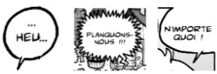



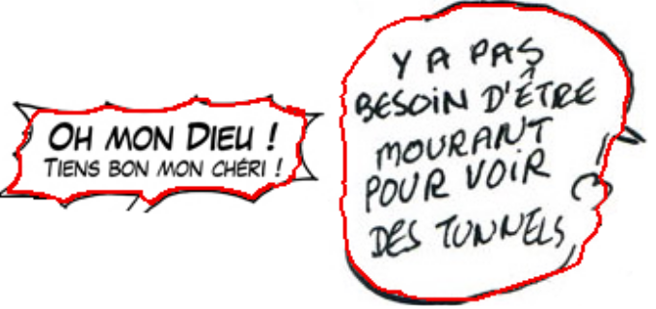

12th International Conference on Document Analysis and Recognition - ICDAR 2013
An active contour model for speech balloon
detection in comics
Christophe Rigaud¹ , Dimosthenis Karatzas² , Joost Van de Weijer² , Jean-Christophe Burie¹, Jean-Marc Ogier¹
¹ Laboratory L3i, University of La Rochelle, Avenue Michel Crépeau 17042 La Rochelle, France
² Computer Vision Center, Universitat Autnoma de Barcelona, E-08193 Bellaterra (Barcelona), Spain
{christophe.rigaud, jean-marc.ogier , jean-christophe.burie}@univ-lr.fr, {dimos, joost}@cvc.uab.es
Presentation
Context
Comics represent an important cultural heritage
Digitization of thousands comics albums
Content Based Image Retrieval
Objectives
Detect closed and suggested speech balloons outline
Make the link between text and graphic
  Character localization
  Speech tone information
  Easy Medium Hard
(speech balloon detection difficulty level)
Main idea
Experiments
The problem of speech balloon outline detection can be posed as the fitting of a closed contour around text areas.
Dataset/material
EBDtheque subset [2]
- add features here
Contributions
Evaluation
Bounding box (intro + example)
Pixel level (intro + example)
- add features here
Active contour model adaptation
(3 formula + legend)
Active contour initialisation
Detection (algorithm + different step images)
Algorithm
Results (Image + table)
compute Eext energy
for each text area do
compute Etext energy
active contour initialization
do
n=0
for each points of the snake do
examine neighbourhood position energies
if one position reduce the current energy then
move point to this position
n=n+1
end if
end for
while n > 0
end for
Conclusion & Perspectives
We have proposed and evaluated a new method based on connected components and contrast ratio to localize text lines in comics books. Future work will be focused on different categories of text and the detection of speech balloons.
References
[1] Roudier, N. Les terres creusees, Acte sur BD. Actes Sud. 2011
[2] eBDtheque database, website: http://ebdtheque.univ-lr.fr
[3] Neumann, L. and Matas, J. Real-time scene text localization and recognition. Computer Vision
and Pattern Recognition (CVPR), pages 1485–1490. 2012
[4] Clavelli, A. and Karatzas, D. Text segmentation in colour posters from the Spanish civil war era.
Proceedings of the 2009 10th ICDAR, pages 181–185, Washington. IEEE Computer Society. 2009
[5] Tombre, K., Tabbone, S., Plissier, L., Lamiroy, B., andDosch, P. Text/graphics separation revisited. Workshop on Document Analysis Systems (DAS), pages 200–211. Springer-Verlag. 2002
Source: https://github.com/crigaud/publication/tree/master/2013/ICDAR/an_active_contour_model_for_speech_balloon_detection_in_comics/poster/
Notes:
Introduction du contexte, des besoins et des problèmes qui se posent
Pose de la problématique et du contenu du poster
On ne parle pas de ce qu’est une bd numérique mais de ce que l’on peut tirer d’une bd papier
« A piece of art is thought for a medium and has to be rethought when the medium is changed ».
__
Etat de l’art, ce qui a été fait (tentative de normalisation, indexation, ontologie de Rissen)
Ce qui manque
__
Contribution, présentation de l’ontologie et de sa finalité
Rapprochement inédit avec le contenu image de la bande dessinée

