Slide 1



Lehigh University, Bethlehem, PA, USA - August 21 2013
Speech balloon contour classification in comics
Christophe Rigaud
Dimosthenis Karatzas
Jean-Christophe Burie
Jean-Marc Ogier

Slide 2
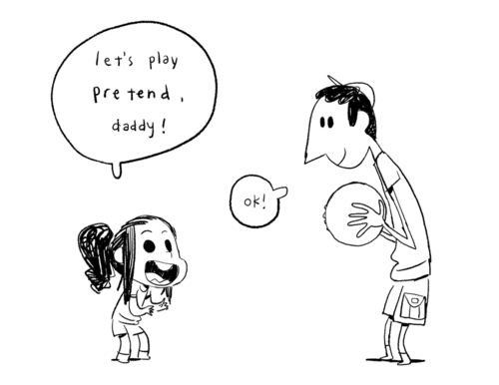
Summary
Project
Speech balloons
Detection
Classification
Evaluation
Conclusion
http://www.tumblr.com
Notes:
First, I will present the project I'm working on
And then focus on the speech balloon part to explain how do we detect and classify them.
Finally, I will show you our last results, conclude this presentation and answer your questions.

Slide 3
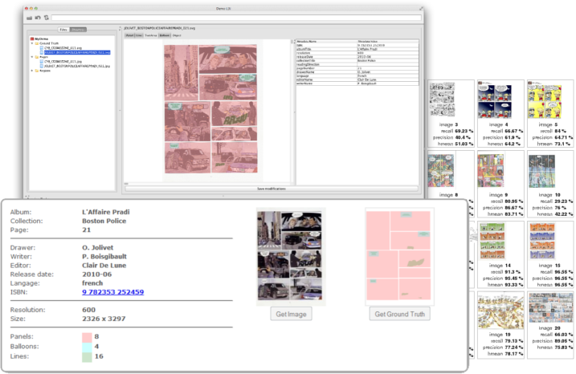
Project
L3i project: eBDtheque
  June 2011 – September 2014
  Participants
    2 doctoral researchers
    5 assistant professors
    3 professors
  Comic books
    Cultural heritage
    Need to be valorized by the new technologies
  Objective: comics content understanding
    Augmented reading experience
    Information retrieval (e.g. semantic query, full text search)
    New dataset http://ebdtheque.univ-lr.fr
  Progress
    Panels, text lines, balloons, people

Slide 4
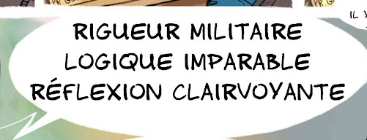





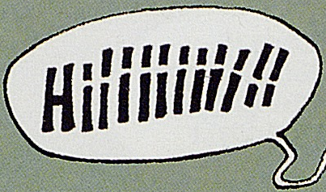
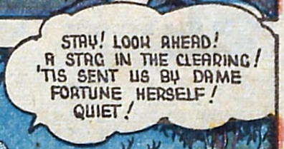



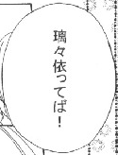
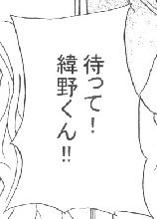
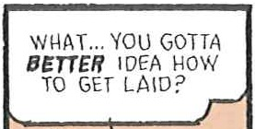
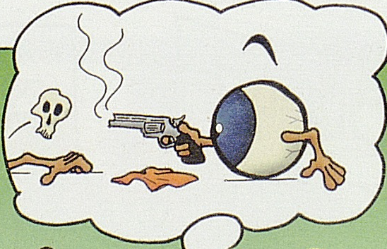
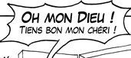
Speech balloons
Where is the semantic information? What can we infer?
Smooth contour: dialogue, conversation...
Wavy contour:
Thought, dream, insinuation...
Zigzag contour: exclamation, event, action...
Image credits: eBDtheque dataset

Slide 5



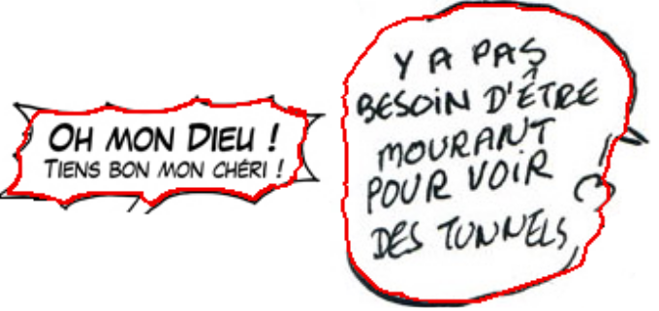
Detection
An active contour model for speech balloon detection in comics
Christophe Rigaud, Dimosthenis Karatzas, Joost van de Weijer, Jean-Christophe Burie, & Jean-Marc Ogier.
In 12th International Conference on Document Analysis and Recognition (ICDAR), 2013
Initialization
Detection
Results

Slide 6
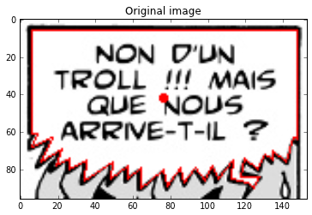
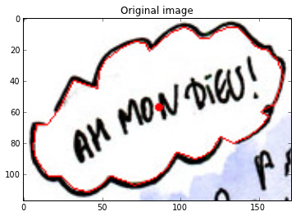
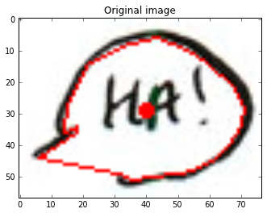
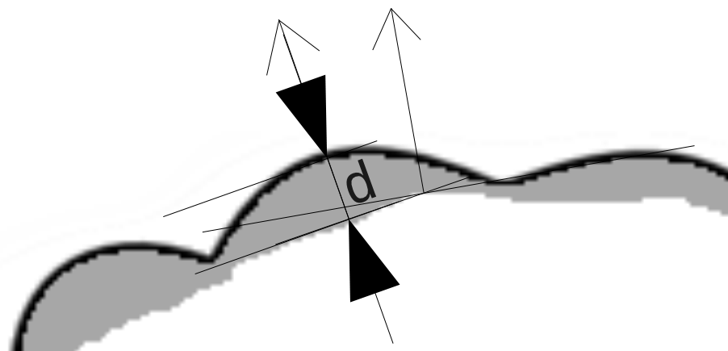
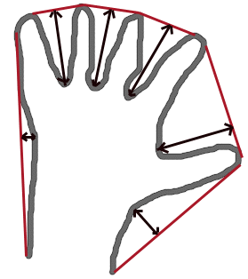
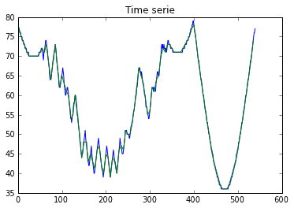
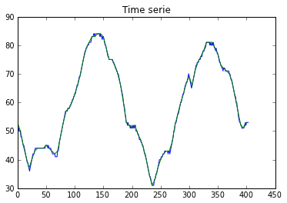
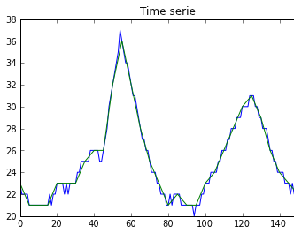
Classification
Metrics: convexity defect, derivative, frequency, defect perimeter percentage
Original proposition

Slide 7
Evaluation
eBDtheque subset
  20 speech balloons
  Pixel level ground truth
  Type {smooth, zigzag, wavy}
  Tail direction
ADD RESULTS HERE

Slide 8
Conclusion
Shape and contour are sentimentally different
Contours are more discriminant than shapes
Next step: tail detection and link to the speakers

