Slide 1

Osaka Prefecture University - Intelligent Media Processing Group
Segmentation and indexation of graphical complex objects
from comic books
Christophe Rigaud
Visiting researcher from January 12 to March 23, 2013
01/03/13 - christophe-rigaud.com

Slide 2
Plan
Institutions
Project and dataset
Thesis research
Collaborations
01/03/13 - christophe-rigaud.com

Slide 3
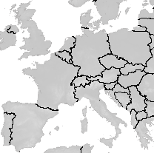
Christophe Rigaud
Doctoral researcher (2nd year)
Segmentation and indexation of complex objects from comic books
Advisers: Jean-Christophe Burie¹, Jean-Marc Ogier¹
Dimos Karatzas²
¹L3i
La Rochelle University (ULR)
80 members
Image and document analysis group
  Comics project
²CVC
Barcelona University (UAB)
175 members
Document analysis group
  Comics team
France
Spain
01/03/13 - christophe-rigaud.com

Slide 4
Comics project
L3i lab (La Rochelle, France)
June 2011 – September 2014
Participants: 2 PhD students, 5 assistant professors, 3 professors,
Comic books:
  Cultural heritage
  Need to be valorized by the new technologies
Objectives:
  Augmented reading experience
  Information retrieval (semantic query, full text)
  Dataset for scientists
01/03/13 - christophe-rigaud.com

Slide 5
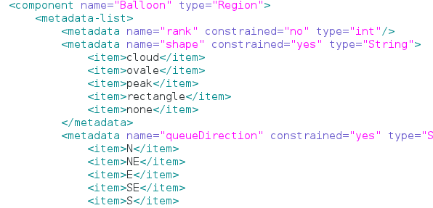
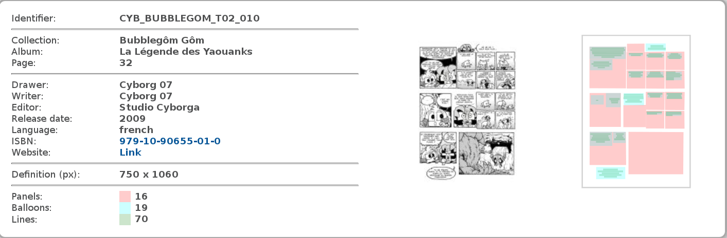
eBDtheque: comics database and ground truth
Just submitted to ICDAR'13
100 ground truth pages
  ~800 frames
  ~600 balloons
  ~4500 text lines
http://ebdtheque.univ-lr.fr/database/
01/03/13 - christophe-rigaud.com

Slide 6
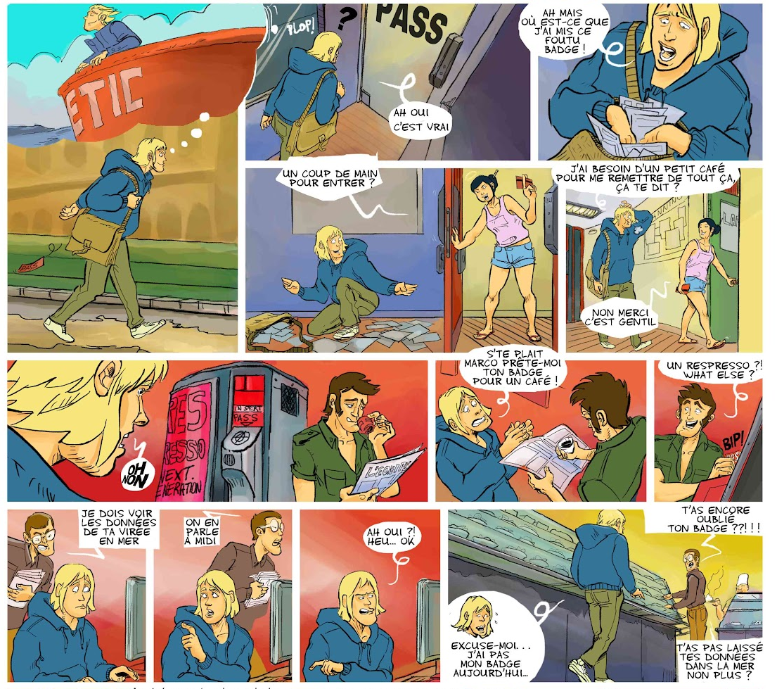
Segmentation and indexation of complex objects
Frame detection
Text localization
Speech balloon detection
Object detection
LUBBIN - Les Bulles du Labo - http://bulles.doc-en-stock.fr/
01/03/13 - christophe-rigaud.com

Slide 7
Segmentation and indexation of complex objects
Frame detection
Text localization
Speech balloon detection
Object detection
LUBBIN - Les Bulles du Labo - http://bulles.doc-en-stock.fr/
01/03/13 - christophe-rigaud.com

Slide 8
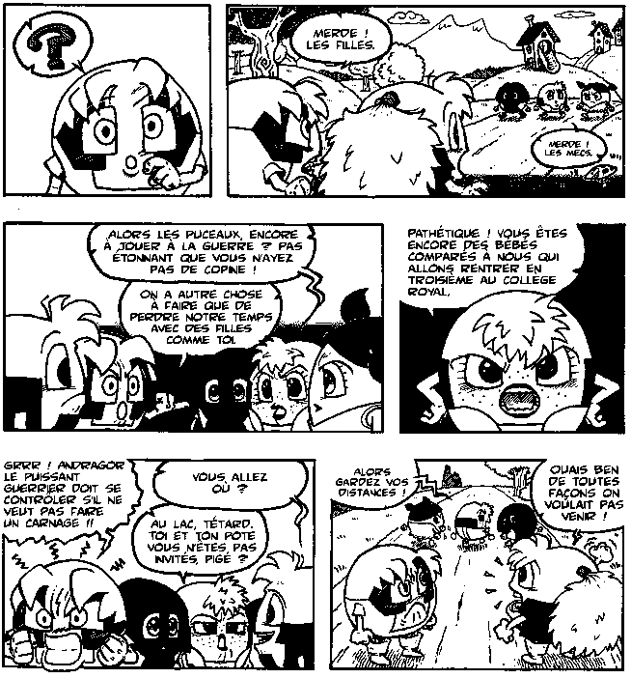
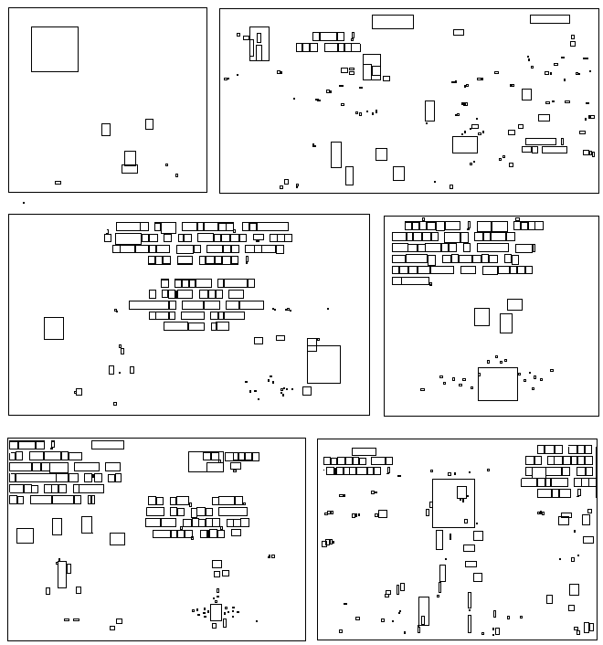

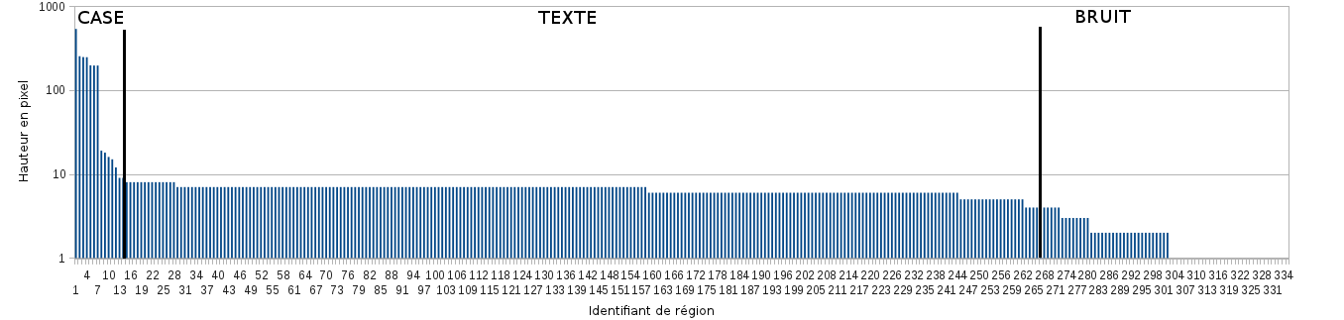
Frame extraction [1]
Binary image Connected components Filtering
Connected component height
[1] Robust frame and text extraction from comic books
Christophe Rigaud, Norbert Tsopze, Jean-Christophe Burie, Jean-Marc Ogier
Lecture Note in Computer Science (LNCS), Graphics Recognition. New Trends and Challenges, vol. 7423, pp.129-138, 2013
01/03/13 - christophe-rigaud.com

Slide 9
Segmentation and indexation of complex objects
Frame detection
Text localization
Speech balloon detection
Object detection
LUBBIN - Les Bulles du Labo - http://bulles.doc-en-stock.fr/
01/03/13 - christophe-rigaud.com

Slide 10
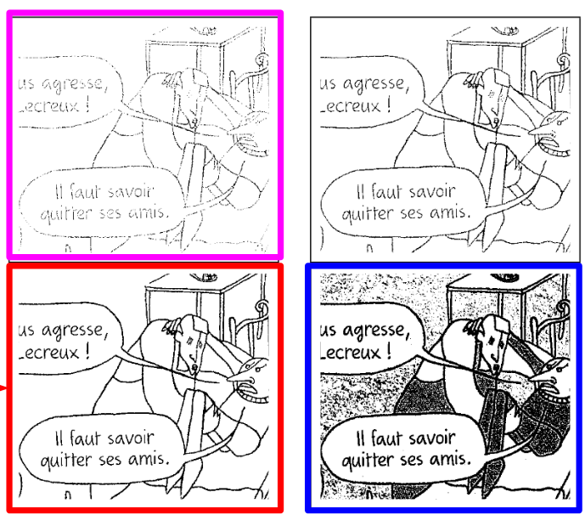
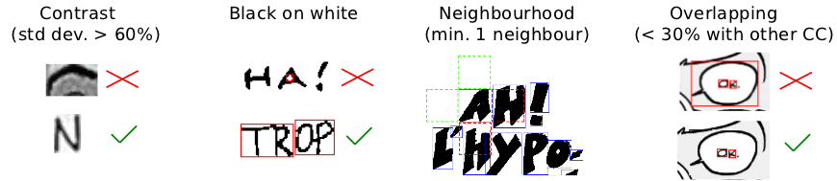
Text localization [2]
Minimum Connected Component Thresholding
Text graphic segmentation
Text line localization (consecutive alignments)
75% recall and precision
[2] Automatic Text Localisation in Scanned Comic Books
Rigaud, Christophe and Karatzas, Dimosthenis and Van de Weijer, Joost and Burie, Jean-Christophe and Ogier, Jean-Marc
Proceedings of the 8th International Conference on Computer Vision Theory and Applications (VISAPP), 2013
01/03/13 - christophe-rigaud.com

Slide 11
Segmentation and indexation of complex objects from comic books
Frame detection
Text localization
Speech balloon detection
Object detection
LUBBIN - Les Bulles du Labo - http://bulles.doc-en-stock.fr/
01/03/13 - christophe-rigaud.com

Slide 12
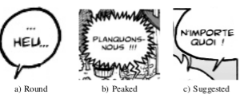
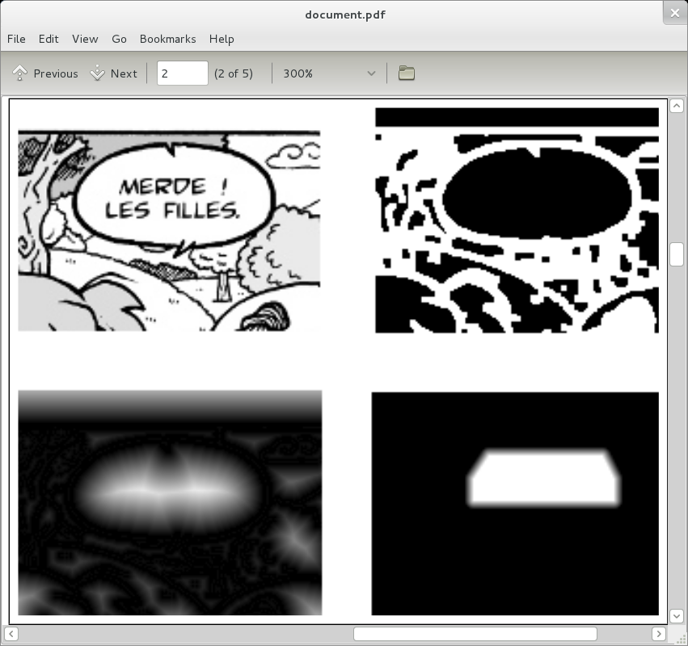
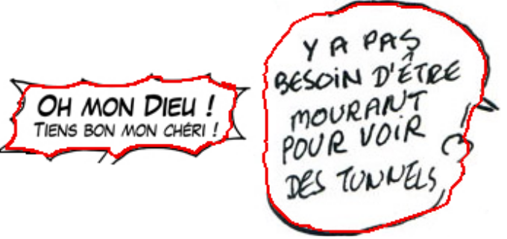
Speech balloon detection [3]
Closed and suggested balloon
Active contour from text area
92% recall and precision
[3] An active contour model for speech balloon detection in comics
Rigaud, Christophe and Karatzas, Dimosthenis and Van de Weijer, Joost and Burie, Jean-Christophe and Ogier, Jean-Marc
Pending acceptance...
01/03/13 - christophe-rigaud.com

Slide 13
Segmentation and indexation of complex objects from comic books
Frame detection
Text localization
Speech balloon detection
Object detection
LUBBIN - Les Bulles du Labo - http://bulles.doc-en-stock.fr/
01/03/13 - christophe-rigaud.com

Slide 14
Object detection
Aim: localize important character in comic books
Ideas of research
  Keypoint detection (e.g. SIFT, HOG)
  Adjacency/topology frame description
  Subgraph maching
Collaborations
01/03/13 - christophe-rigaud.com

Slide 15
Collaborations
08/2012 - agreement for scientific cooperation with La Rochelle University
09/2012 - research stay of Masaki, Atsushi, Motoi and Weihan (La Rochelle)
10/2012 - research stay of Elodie (Osaka)
01/2013 - research stay of Romain and Christophe (Osaka)
02/2013 - manga pages for eBDtheque dataset
03/2013 - character detection in comics???
01/03/13 - christophe-rigaud.com

Slide 16

Collaborations
08/2012 - agreement for scientific cooperation with La Rochelle University
09/2012 - research stay of Masaki, Atsushi, Motoi and Weihan (La Rochelle)
10/2012 - research stay of Elodie (Osaka)
01/2013 - research stay of Romain and Christophe (Osaka)
02/2013 - manga pages for eBDtheque dataset
03/2013 - character detection in comics???
01/03/13 - christophe-rigaud.com

