Slide 1


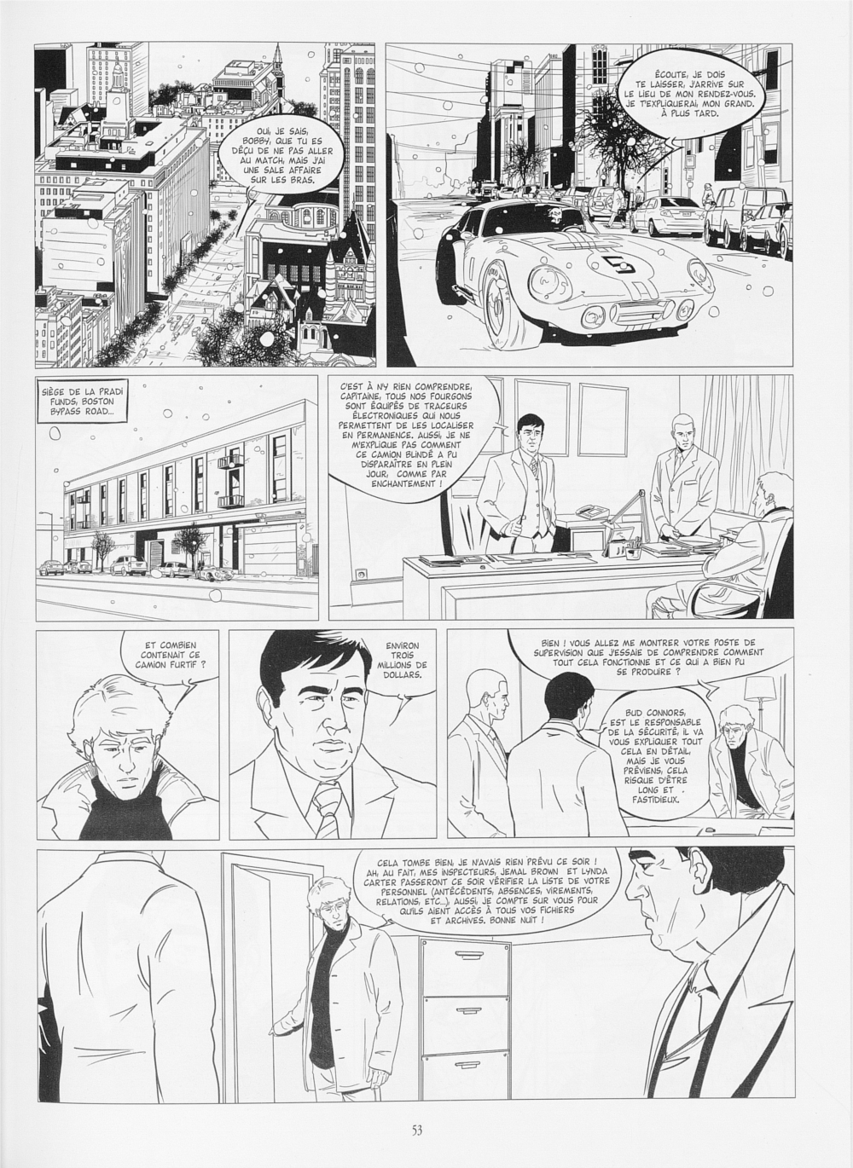
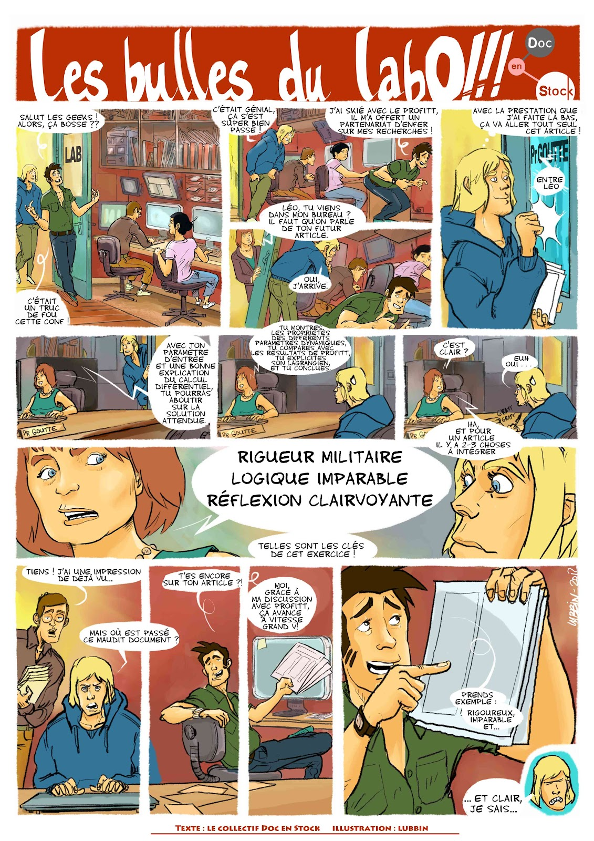
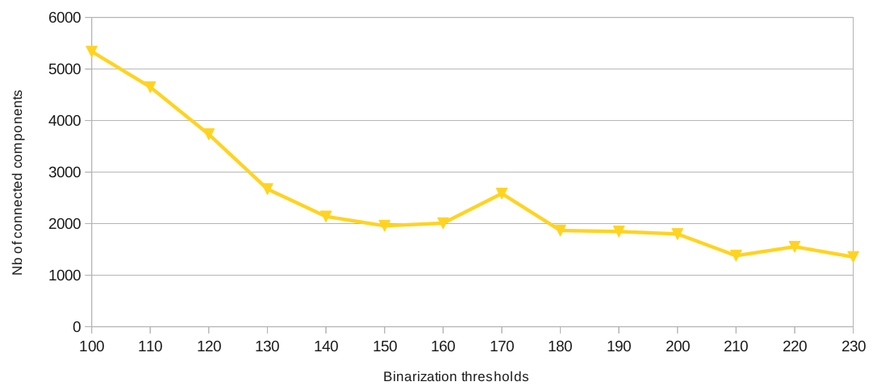
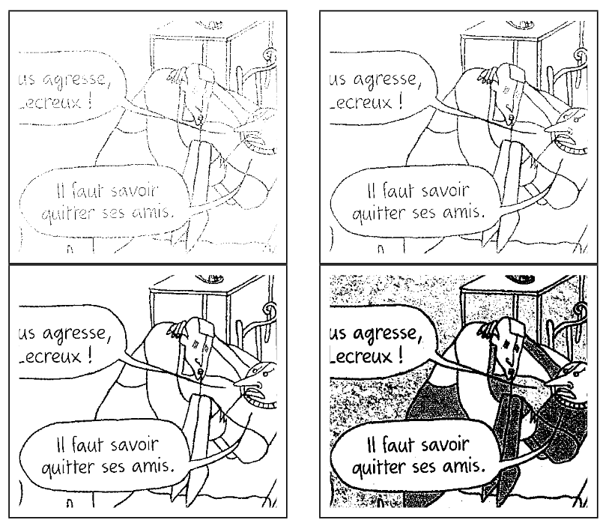
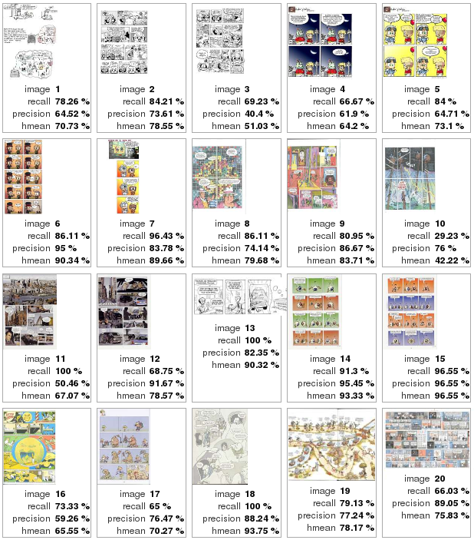


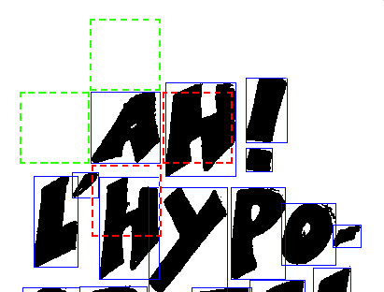

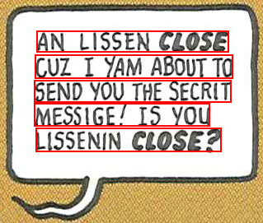
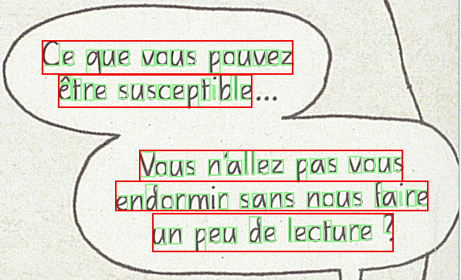
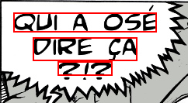


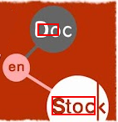


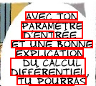
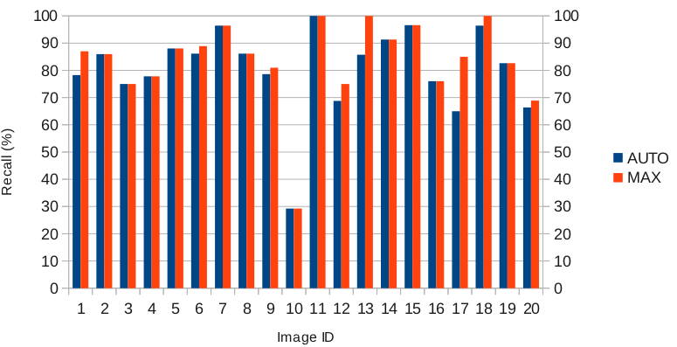
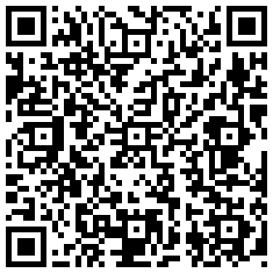
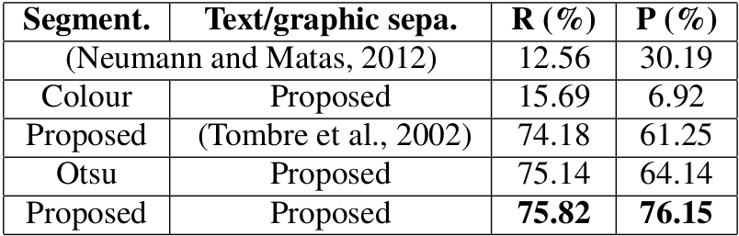
8th International Conference on Computer Vision Theory and Applications - VISAPP 2013
Automatic Text Localisation
in Scanned Comic Books
Christophe Rigaud¹ , Dimosthenis Karatzas² , Joost Van de Weijer² , Jean-Christophe Burie¹, Jean-Marc Ogier¹
¹ Laboratory L3i, University of La Rochelle, Avenue Michel Crépeau 17042 La Rochelle, France
² Computer Vision Center, Universitat Autnoma de Barcelona, E-08193 Bellaterra (Barcelona), Spain
{christophe.rigaud, jean-marc.ogier , jean-christophe.burie}@univ-lr.fr, {dimos, joost}@cvc.uab.es
Presentation
This work presents a novel approach for automatic text localization in scanned comics book pages, an essential step towards a fully automatic comics book understanding. We focus on speech text as it is semantically important and represents the majority of the text present in comics books.
Documents
Comics books
Colour posters
Unstructured
Complex background
Teaching
blackboard
Real scenes
Signboard
Photography
Contributions
Experiments
1) Minimum Connected Component Thresholding (MCCT)
Dataset
eBDtheque [2]
- 1700 text lines
- 100 to 300 DPI
- Text line level
First minimum
Image credit [1]
Results
2) Text / graphic separation
Contrast Black on white Neighbourhood Overlapping
3) Text line localisation
We consider letters are on the same text line if:
Letter i
Letter j
AND
Applications
Conclusion & Perspectives
Evaluation
Comics text localization can be used for image compression, OCR training or content retargeting and reflowing.
Associated with OCR system, new uses may appear as automatic translation and speech synthesis.
We have proposed and evaluated a new method based on connected components and contrast ratio to localize text lines in comics books.
Future works will consider other category of text and speech balloons.
References
[1] Roudier, N. Les terres creusees, Acte sur BD. Actes Sud. 2011
[2] eBDtheque database, website: http://ebdtheque.univ-lr.fr
[3] Neumann, L. and Matas, J. Real-time scene text localization and recognition. Computer Vision
and Pattern Recognition (CVPR), pages 1485–1490. 2012
[4] Clavelli, A. and Karatzas, D. Text segmentation in colour posters from the Spanish civil war era.
Proceedings of the 2009 10th ICDAR, pages 181–185, Washington. IEEE Computer Society. 2009
[5] Tombre, K., Tabbone, S., Plissier, L., Lamiroy, B., andDosch, P. Text/graphics separation revisited. Workshop on Document Analysis Systems (DAS), pages 200–211. Springer-Verlag. 2002
[3]
[4]
[5]
Notes:
Introduction du contexte, des besoins et des problèmes qui se posent
Pose de la problématique et du contenu du poster
On ne parle pas de ce qu’est une bd numérique mais de ce que l’on peut tirer d’une bd papier
« A piece of art is thought for a medium and has to be rethought when the medium is changed ».
__
Etat de l’art, ce qui a été fait (tentative de normalisation, indexation, ontologie de Rissen)
Ce qui manque
__
Contribution, présentation de l’ontologie et de sa finalité
Rapprochement inédit avec le contenu image de la bande dessinée

