Slide 1


Segmentation and indexation of complex objects in comic book images
European Ph.D. defense
Segmentation and indexation of complex objects in comic book images
Christophe Rigaud
December 11th, 2014
Jointly supervised by:
Jean-Christophe Burie¹
Dimosthenis Karatzas²
Jean-Marc Ogier¹
¹L3i – Université de La Rochelle
²CVC - Universitat Autònoma de Barcelona

Slide 2
Outlines
Introduction
Document image analysis
State of the art of comics analysis
Contributions
Experimentations
Conclusions

Slide 3
Outlines
Introduction
  Comic books
  History of comics art
  Market place
  Comics project
  Objectives of the thesis
Document image analysis
State of the art of comics analysis
Contributions
Experimentations
Conclusions

Slide 4
Comic books
One of the most popular and familiar forms of graphic content
“juxtaposed pictorial and other images in deliberate sequence, intended to convey information and/or to produce an aesthetic response in the viewer” Mc Cloud, 1993
“a visual medium used to express ideas via images, often combined with text or visual information” Wikipédia, 2014

Slide 5
History of comics art
Prehistory: painting of animals and hunters in caves
1846: Rodolphe Töpffer, the inventor of the “bandes dessinées”
1930s: magazine-style comic books in the US
1950s: massive production of manga in Japan (Osamu Tezuka)
1971: the term of ninth art is attributed to comics art (Francis Lacassin)
1996: explosion of the Internet bubble and webcomics
2007: adaptation to social media sites and mobile devices
Notes:
Rodolphe Töpffer is a Francophone Swiss artist
Francis Lacassin, auteur du livre Pour un neuvième art, la bande dessinée17, mais ce livre ne date que de 1971, 7 ans après les articles de Spirou

Slide 6
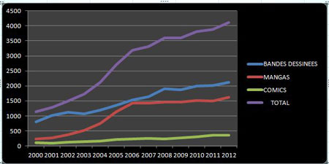
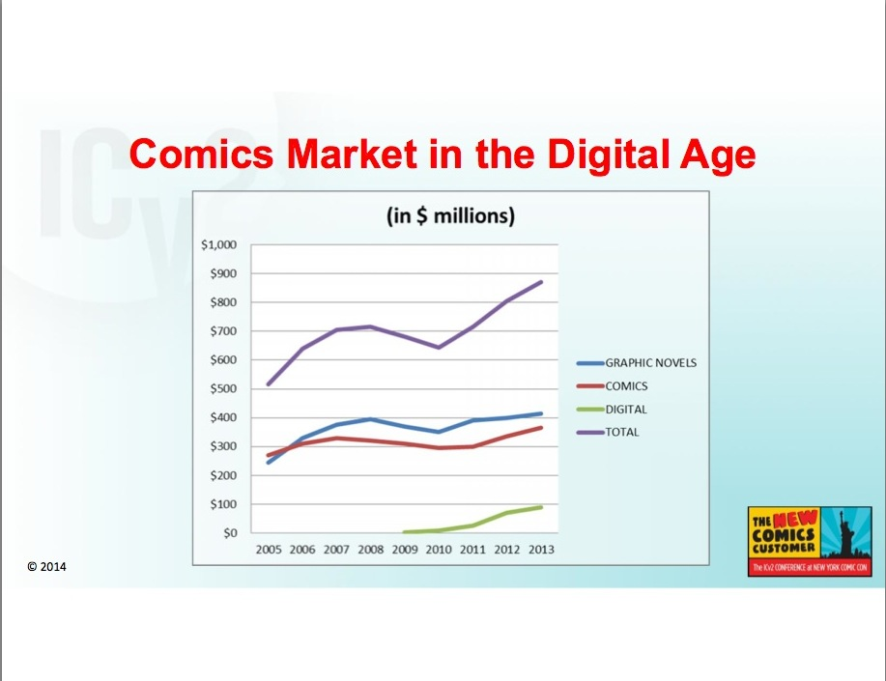
Market place
Francophone comics production
Infographie (c) L’Agence BD d’après les chiffres de Gilles Ratier/ACBD.
Comics market in the US
Milton Griepp's White Paper, ICv2 Conference 2014

Slide 7
Comics project (eBDtheque)
What?
  Add value to paper-based comics using the new technologies
Why?
  Answer to a real need from librarians, advertisers, readers
  Text/image search, reflowable document, augmented reading, translation assistant
How?
  Extracting content of digitalized comic books (e.g. panel, balloon, text, comic characters)
  Retrieving relations between the elements (e.g. read before, said by, thought by, addressed to)
Supported by L3i lab
2 Ph.D. student, 6 professors, 1 engineer and post doc (one year)
Public founding
  CPER 2007-2013 (State-Region Project Contract)
  PHC-Sakura 2014-2016 (France/Japan Bilateral Joint Research Project)

Slide 8
Objectives of the thesis

