Slide 1




Segmentation and indexation of complex objects in comic book images
European Ph.D. defense
Segmentation and indexation of complex objects in comic book images
Christophe Rigaud
December 11th, 2014
Jointly supervised by:
Jean-Christophe Burie¹
Dimosthenis Karatzas²
Jean-Marc Ogier¹
¹L3i – Université de La Rochelle
²CVC - Universitat Autònoma de Barcelona

Slide 2
Outlines
Introduction
Document image analysis
State of the art of comics analysis
Contributions
Experimentations
Conclusions

Slide 3
Outlines
Introduction
  Comic books
  History of comics art
  Market place
  Comics project
  Objectives of the thesis
Document image analysis
State of the art of comics analysis
Contributions
Experimentations
Conclusions

Slide 4
Comic books
One of the most popular and familiar forms of graphic content
“juxtaposed pictorial and other images in deliberate sequence, intended to convey information and/or to produce an aesthetic response in the viewer” Mc Cloud, 1993
“a visual medium used to express ideas via images, often combined with text or visual information” Wikipédia, 2014

Slide 5
History of comics art
Prehistory: painting of animals and hunters in caves
1846: Rodolphe Töpffer, the inventor of the “bandes dessinées”
1930s: magazine-style comic books in the US
1950s: massive production of manga in Japan (Osamu Tezuka)
1971: the term of ninth art is attributed to comics art (Francis Lacassin)
1996: explosion of the Internet bubble and webcomics
2007: adaptation to social media sites and mobile devices
Notes:
Rodolphe Töpffer is a Francophone Swiss artist
Francis Lacassin, auteur du livre Pour un neuvième art, la bande dessinée17, mais ce livre ne date que de 1971, 7 ans après les articles de Spirou

Slide 6
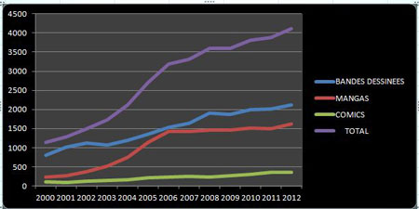
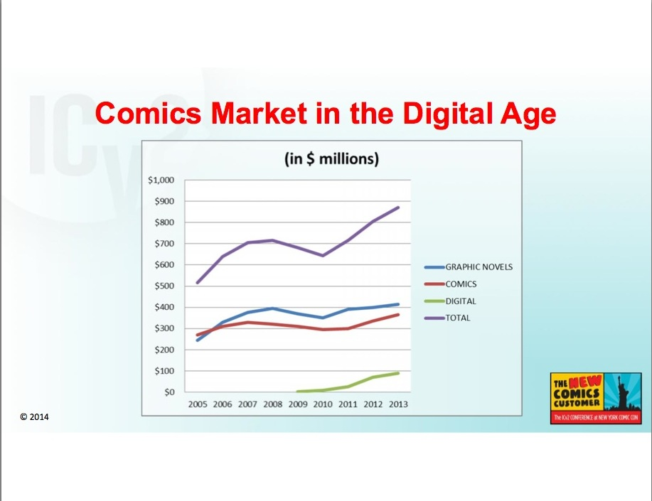
Market place
Francophone comics production
Infographie (c) L’Agence BD d’après les chiffres de Gilles Ratier/ACBD.
Comics market in the US
Milton Griepp's White Paper, ICv2 Conference 2014

Slide 7
Comics project (eBDtheque)
What?
  Add value to paper-based comics using the new technologies
Why?
  Answer to a real need from librarians, advertisers, readers
  Text/image search, reflowable document, augmented reading, translation assistant
How?
  Extracting content of digitalized comic books (e.g. panels, balloons, text, comic characters)
  Retrieving the semantic of the elements (e.g. read before, said by, thought by, addressed to)
Supported by L3i lab
2 Ph.D. student, 6 professors, 1 engineer and post doc (one year)
Public founding
  CPER 2007-2013 (State-Region Project Contract)
  PHC-Sakura 2014-2016 (France/Japan Bilateral Joint Research Project)
  PIA-Big Data 2015-2017??? (future investment project with French company/labs)

Slide 8
Objectives of this thesis
Propose generic methods for content extraction of digitalized comic books
Indexation of content???
Duration 36 months
Challenges:
  Recent field of research with a largely unknown
  The documents are semi-unstructured, free-form and with complex background

Slide 9
Outlines
Introduction
Document analysis
State of the art of comics analysis
Contributions
Experimentations
Conclusions

Slide 10
Outlines
Introduction
Document analysis
  Conception to interpretation
  Document type comparison
  Comic books creation process
State of the art of comics analysis
Contributions
Experimentations
Conclusions

Slide 11
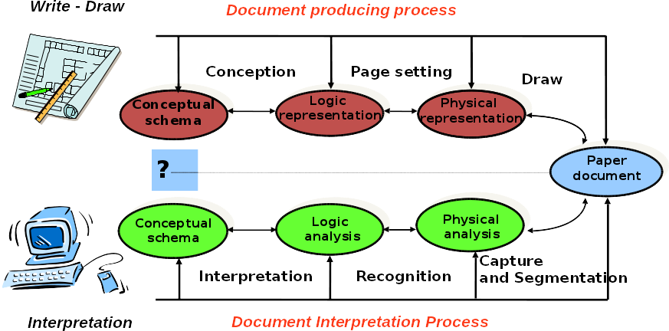
Conception to interpretation
Handbook of Document Image Processing and Recognition. Springer, 2014
Notes:
Low-level: pre-processing, feature extraction
Middle-level: classification, recognition
High-level: interpretation, understanding

Slide 12
Document types comparison
 | Mixed content | Complex background | Free-form | Structured | Uniqueness
Logic diagram | Yes | No | No | Yes | No
Engineering drawings | Yes | No | No | Yes | No
Maps | Yes | Yes | No | No | Yes
Musical scores | No | No | No | Yes | No
Architectural drawings | Yes | No | No | Yes | No
Logo and trademarks | Yes | Yes | Yes | Yes | No
Formulas | No | No | No | Yes | (Yes)
Comics | Yes | Yes | Yes | (No) | (Yes)
Notes:
Logo and trademarks are considered as structured in the context of document (not true for real scene)
Comics panels are not structured but page layout yes

Slide 13
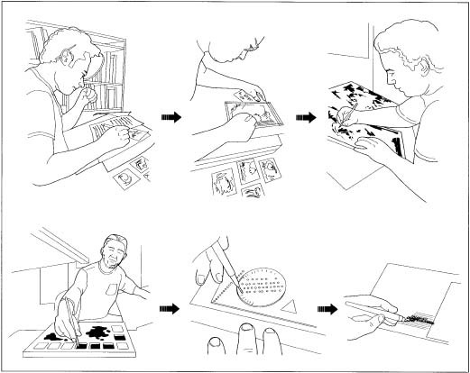
Comic books production
Synopsis and scenario
Pencil drawing
Inking
Flatting and colouring
Lettering and sound effects
http://www.madehow.com/Volume-6/Comic-Book.html

Slide 14
Comic books interpretation
Content processing
Comic
book
images
Extraction
Recognition
Understanding
Output
information

Slide 15
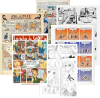
Comic books interpretation
Extraction
Recognition
Understanding
Output
information

Slide 16
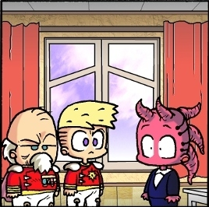
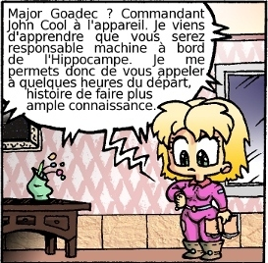
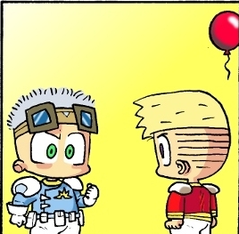
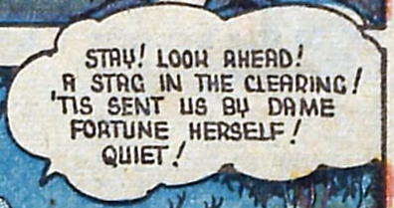







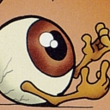


Comic books interpretation
Panels
Balloons
Text
Comics character
Comic
book
images
Recognition
Understanding
Output
information

Slide 17
Comic books interpretation
Panel type, sequence
Balloon type, sequence
Text type, tone
Comic character labelling
Comic
book
images
Extraction
Understanding
Output
information

Slide 18
Comic books interpretation
Character mood
Action in the story
Timestamps
Meaning of text
Comic
book
images
Extraction
Recognition
Output
information

Slide 19
Comic books interpretation
– IMAGE 1 –
Contains 2 panels, 2 different
characters and 2 balloons
* PANEL 1 *
Contains 2 characters
saying 2 balloons
Character 1's name is “Bob”
Bod is often represented in
blue and dark green
Character 2's name is “Tom”
Tom is always represented in
yellow, purple and grey
Bob is shouting to Tom:
“Be quiet!!!”
Tom answers quietly “not yet”
* PANEL 2 *
Contains 2 characters,
same as panel 1, not talking
Bob and Tom are fighting
Comic
book
images
Extraction
Recognition
Understanding

Slide 20
Outlines
Introduction
Document analysis
State of the art of comics analysis
Contributions
Experimentations
Conclusions

