Slide 1





Segmentation and indexation of complex objects in comic book images
European Ph.D. defense
Segmentation and indexation of complex objects in comic book images
Christophe Rigaud
December 11th, 2014
Jointly supervised by:
Jean-Christophe Burie¹
Dimosthenis Karatzas²
Jean-Marc Ogier¹
¹L3i – Université de La Rochelle
²CVC - Universitat Autònoma de Barcelona
Notes:
Check if my salary comes from CDA, CG or region and update logo

Slide 2
Outlines
TODO

Slide 3
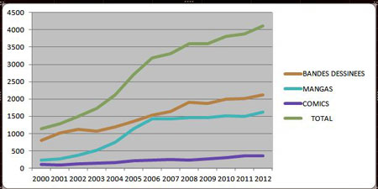
Market place: production
Bandes dessinées
Japanese manga
American comics
Total
Francophone comics production
Infographie (c) L’Agence BD d’après les chiffres de Gilles Ratier/ACBD.

Slide 4
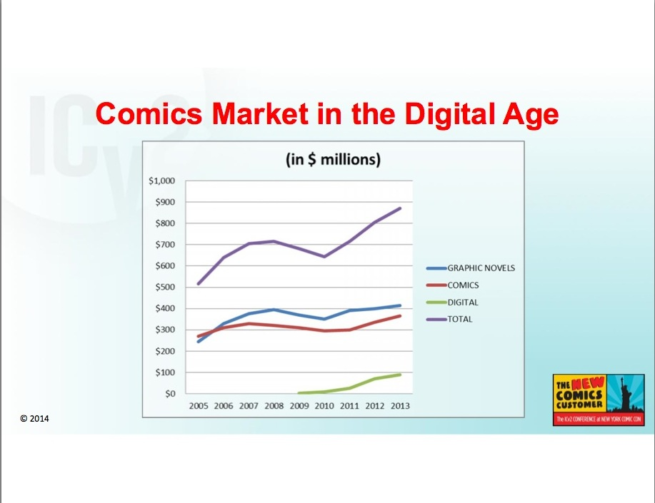
Market place: sales
Comics market in the US
Milton Griepp's White Paper, ICv2 Conference 2014

Slide 5
Document types comparison
 | Mixed content | Complex background | Free-form | Structured | Uniqueness
Logic diagram | Yes | No | No | Yes | No
Engineering drawings | Yes | No | No | Yes | No
Maps | Yes | Yes | No | No | Yes
Musical scores | No | No | No | Yes | No
Architectural drawings | Yes | No | No | Yes | No
Logo and trademarks | Yes | Yes | Yes | Yes | No
Formulas | No | No | No | Yes | (Yes)
Comics | Yes | Yes | Yes | (No) | (Yes)
Notes:
Logo and trademarks are considered as structured in the context of document (not true for real scene)
Comics panels are not structured but page layout yes

Slide 6
Interpretation process
Interpretation process of comics analysis
Comic
book
images
Extraction
Recognition
Understanding
Output
information

Slide 7
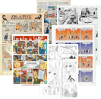
Interpretation process
Extraction
Recognition
Understanding
Output
information

Slide 8
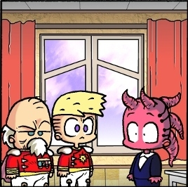
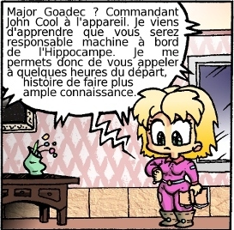
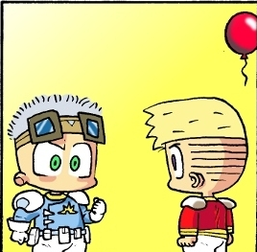
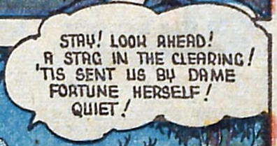

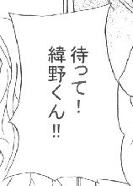








Interpretation process
Panels
Balloons
Text
Comics character
Comic
book
images
Recognition
Understanding
Output
information

Slide 9
Interpretation process
Panel type, sequence
Balloon type, sequence
Text type, tone
Comic character labelling
Comic
book
images
Extraction
Understanding
Output
information

Slide 10
Interpretation process
Character mood
Action in the story
Timestamps
Meaning of text
Comic
book
images
Extraction
Recognition
Output
information

Slide 11
Interpretation process
– IMAGE 1 –
Contains 2 panels, 2 different
characters and 2 balloons
* PANEL 1 *
Contains 2 characters
saying 2 balloons
Character 1's name is “Bob”
Bod is often represented in
blue and dark green
Character 2's name is “Tom”
Tom is always represented in
yellow, purple and grey
Bob is shouting to Tom:
“Be quiet!!!”
Tom answers quietly “not yet”
* PANEL 2 *
Contains 2 characters,
same as panel 1, not talking
Bob and Tom are fighting
Comic
book
images
Extraction
Recognition
Understanding

Slide 12
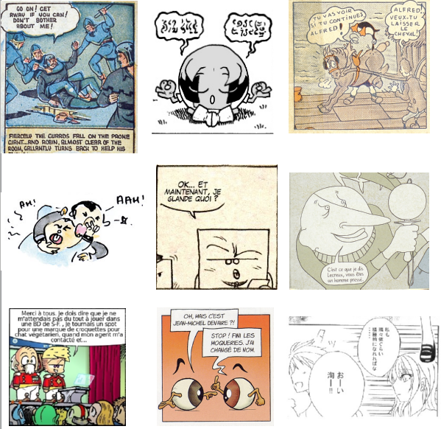
Panel and layout analysis
Challenges
  Diversity of comic books
  Semi-structured layout
Panel extraction
  White line cut
  Recursive X-Y cut algorithm
  Gradient
  Connected-components
  Polygon detection
  Corners and line segments
Layout
  Reading order (Z-path)
Conclusions
  Problem solved for common manga and European comics if treated separately
  Remaining difficulties are for connected, nested and implicit panels
  No approach tested over all comics styles, no dataset, no reproductive results

Slide 13
Panel and layout analysis
Challenges
  Diversity of comic books
  Semi-structured layout
Panel extraction
  White line cut
  Recursive X-Y cut algorithm
  Gradient
  Connected-components
  Polygon detection
  Corners and line segments
Layout
  Reading order (Z-path)
Conclusions
  Problem solved for common manga and other comics if treated separately
  Remaining difficulties are for connected, nested and implicit panels
  No approach tested over all comic book styles, no dataset, no reproductive results

Slide 14


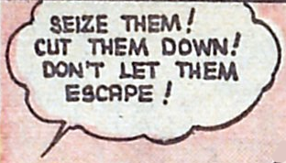
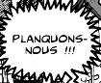
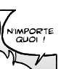
Balloon analysis
Image Shape Contour
Challenges
  Diversity of balloons intra/inter comics
  Implicit balloons
  (Interface between text and graphics)
Extraction
  Shape vs contour
  Blob detection [Arai 2011, Ho 2012]
Classification
  Speech tone information (contour)
Tail detection
  Indicate the position of the emitter
Oval Smooth
Rectangle Smooth
Oval Wavy
Oval Spiky
Conclusions
  Closed balloon solved (sequential)
  Implicit, classification and tail were not explored
Oval /
implicit
Smooth / Implicit
Notes:
Intro on contour/shape difference
Arai [8] proposed a blob detection method based
on connected component detection with four filtering rules applied to manga analysis.
The rules are based on blob minimum size, white pixel occurrence, inclusion of vertical
straight lines and width to length ratio (Figure 2.6). Another connected component
approach proposed by Ho [68] uses HSV colour space to make a first selection of bright
blobs and then consider as balloons the blobs with a ratio between the text area and
the blob bounding box higher than sixty per cent.
Implicit balloons: nor studied yet but active contour model initialised from text seems to be a good approach

Slide 15
Balloon analysis
Image Shape Contour
Challenges
  Diversity of balloons intra/inter comics
  Implicit balloons
  Interface between text and graphics
Extraction
  Shape vs contour
  Blob detection [Arai 2011, Ho 2012]
Classification
  Speech tone information (contour)
Tail detection
  Indicate the position of the emitter
Oval Smooth
Rectangle Smooth
Oval Wavy
Oval Spiky
Conclusions
  Closed balloon solved (sequential)
  Implicit, classification and tail were not explored
Oval /
implicit
Smooth / Implicit
Notes:
Intro on contour/shape difference
Arai [8] proposed a blob detection method based
on connected component detection with four filtering rules applied to manga analysis.
The rules are based on blob minimum size, white pixel occurrence, inclusion of vertical
straight lines and width to length ratio (Figure 2.6). Another connected component
approach proposed by Ho [68] uses HSV colour space to make a first selection of bright
blobs and then consider as balloons the blobs with a ratio between the text area and
the blob bounding box higher than sixty per cent.
Implicit balloons: nor studied yet but active contour model initialised from text seems to be a good approach

Slide 16
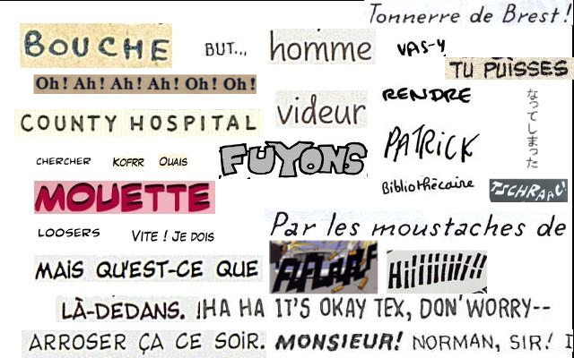
Text extraction and recognition
Challenges
  Non-standard fonts
  Multi-script/orientation/scale
  Complex background (sound effects)
  Short length, hyphenation
  Voluntary spelling mistakes
Extraction
  Scene text localization
  Connected-components approach
  SVM and Bayesian classifier
  Sound effects have not been investigated yet
  TOADD: http://dl.acm.org/citation.cfm?id=2549547
Recognition
  At is early stage
  OCR trained for a specific comics font
Conclusions
  Speech text studied but not solved
  Captions and sound effects unexplored
  Text recognition not usable yet
  (Next: automatic font learning?)

Slide 17
Text extraction and recognition
Challenges
  Non-standard fonts
  Multi-script/orientation/scale
  Complex background (sound effects)
  Short length, hyphenation
  Voluntary spelling mistakes
Extraction
  Scene text localization
  Connected-components approach
  SVM and Bayesian classifier
  Sound effects have not been investigated yet
Recognition
  At is early stage
  OCR trained for a specific comics font
Conclusions
  Speech text have been studied but not solved
  Captions and sound effects unexplored
  Text recognition not usable yet
  (Next: automatic font learning?)

Slide 18



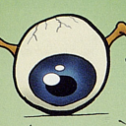
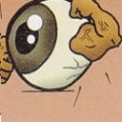



Comic character extraction
Challenges
  Hand-drawn, stroke-based
  Intra/inter class variability
  Scale, deformation, posture, occlusion
Extraction & recognition
  Manga faces [Cheung2008, Sun2010, Kohei2012]
  Cartoons [Khan2012]
Conclusions
  Preliminary results
  Complex and versatile structure
  Contains most of the interesting information

Slide 19
Comic character extraction
Challenges
  Hand-drawn, stroke-based
  Intra/inter class variability
  Scale, deformation, posture, occlusion
Extraction & recognition
  Manga faces [Cheung2008, Sun2010, Kohei2012]
  Cartoons [Khan2012]
Conclusions
  Preliminary results
  Complex and versatile structure
  Contains most of the interesting information

Slide 20
Outlines
Introduction
Document analysis
State of the art of comics analysis
Contributions
Experimentations
Conclusions

Slide 21

Introduction
Content-driven (sequential)
Comic
page
image
Panel
extraction
Text
extraction
Balloon
extraction
Tail
extraction
Character
extraction
Comic
page
description
Content-driven (independent)
Knowledge-driven (independent)
Panel
Panel
Image
Image
Text
Text
Description
Description
Balloon
Balloon
Tail
Knowledge
Tail
Character
Character
Notes:
Explain why these three approaches

Slide 22
Introduction
Content-driven (sequential)
Comic
page
image
Panel
extraction
Text
extraction
Balloon
extraction
Tail
extraction
Character
extraction
Comic
page
description
Content-driven (independent)
Knowledge-driven (independent)
Panel
Panel
Image
Image
Text
Text
Description
Description
Balloon
Balloon
Tail
Knowledge
Tail
Character
Character
Notes:
Explain why these three approaches

Slide 23
Introduction
Content-driven (sequential)
Comic
page
image
Panel
extraction
Text
extraction
Balloon
extraction
Tail
extraction
Character
extraction
Comic
page
description
Content-driven (independent)
Knowledge-driven (independent)
Panel
Panel
Image
Image
Text
Text
Description
Description
Balloon
Balloon
Tail
Knowledge
Tail
Character
Character
Notes:
Explain why these three approaches

Slide 24
Introduction
Content-driven (sequential)
Comic
page
image
Panel
extraction
Text
extraction
Balloon
extraction
Tail
extraction
Character
extraction
Comic
page
description
Content-driven (independent)
Knowledge-driven (independent)
Panel
Panel
Image
Image
Text
Text
Description
Description
Balloon
Balloon
Tail
Knowledge
Tail
Character
Character
Notes:
Explain why these three approaches

Slide 25
Introduction
Content-driven (sequential)
Comic
page
image
Panel
extraction
Text
extraction
Balloon
extraction
Tail
extraction
Character
extraction
Comic
page
description
Content-driven (independent)
Knowledge-driven (independent)
Panel
Panel
Image
Image
Text
Text
Description
Description
Balloon
Balloon
Tail
Knowledge
Tail
Character
Character
Notes:
Explain why these three approaches

Slide 26
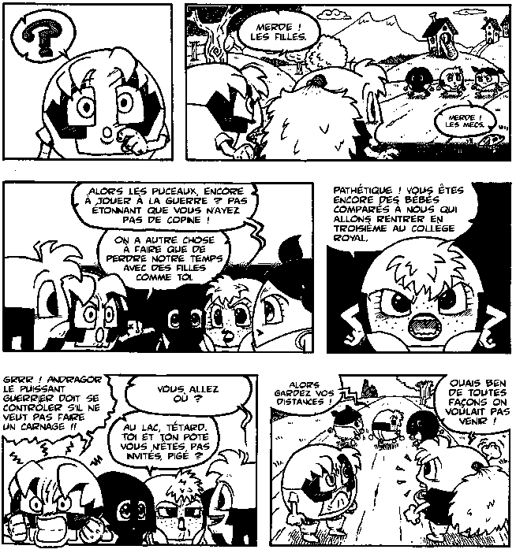
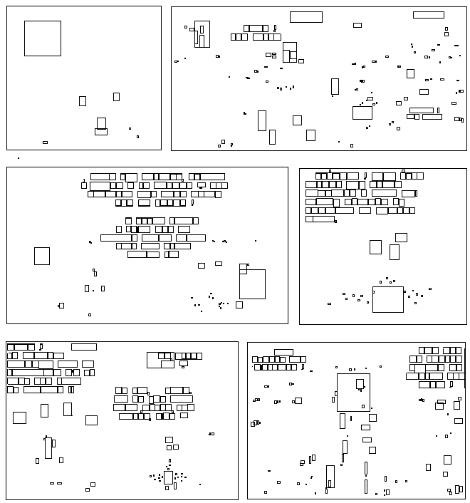
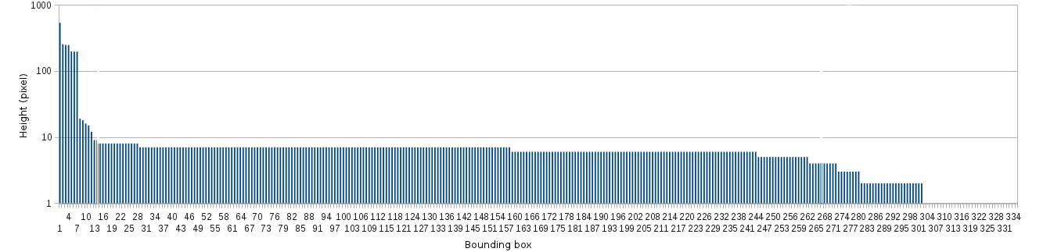
Panel and text extraction
Comic
page
image
Panel
extraction
Text
extraction
Balloon
extraction
Tail
extraction
Character
extraction
Comic
page
description
Binary image
Connected-component (CC) bounding boxes
Histogram of heights of CC
Notes:
Explain why these three approaches

Slide 27
Panel and text extraction
CC height (pixel)
Histogram of height (descendent order)
Notes:
Explain why these three approaches

Slide 28
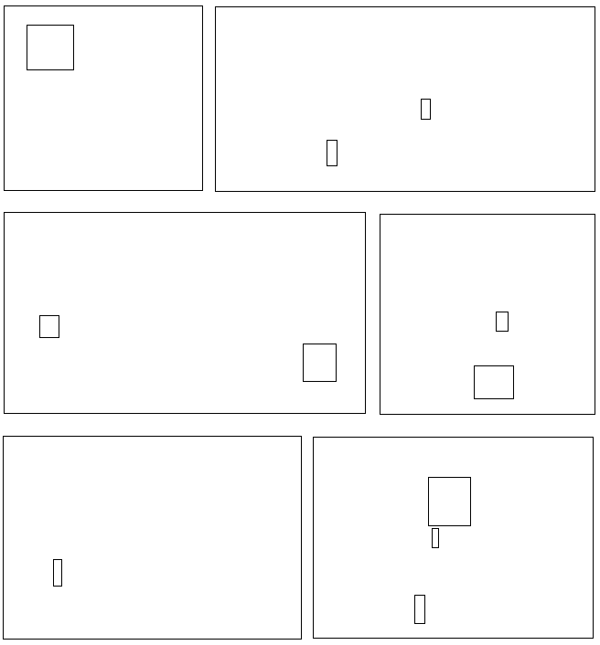
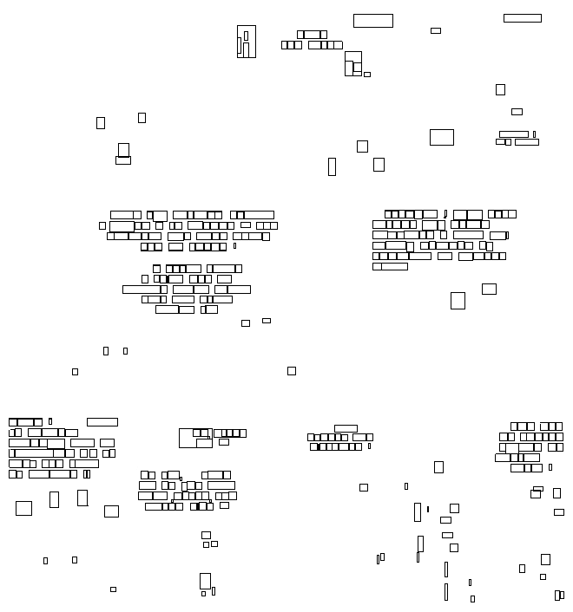

Panel and text extraction
K-means clustering (k=3)
CC height (pixel)
Panels
Text
Noise
Notes:
Explain why these three approaches

Slide 29


Balloon extraction
Comic
page
image
Panel
extraction
Text
extraction
Balloon
extraction
Tail
extraction
Character
extraction
Comic
page
description
Regular balloon
Implicit balloon
Literature
  Top-down approaches: extract white blobs and then text inside
  Limited to regular balloons
Contribution
  Bottom-up approaches: extract text and then surrounding balloons
  Appropriate for regular and implicit balloons

Slide 30
Balloon extraction
Comic
page
image
Panel
extraction
Text
extraction
Balloon
extraction
Tail
extraction
Character
extraction
Comic
page
description
Regular balloon
Implicit balloon
Literature
  Top-down approaches: extract white blobs and then text inside
  Limited to regular balloons
Contribution
  Bottom-up approaches: extract text and then surrounding balloons
  Improvement of regular and a first approach for implicit balloon extractions

Slide 31
Regular balloon extraction
Assumptions
  Panels and text block positions are known
  Balloons contain text
  Text is fully contained and centred in balloons
Proposition → structural analysis
  Extract closed contours that includes centred text

Slide 32
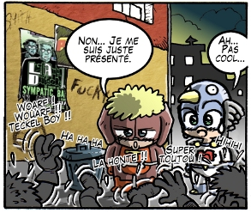

Regular balloon extraction
Assumptions
  Panels and text block positions are known
  Balloons contain text
  Text is fully contained and centred in balloons
Proposition → structural analysis
  Extract closed contours that includes centred text
Original image
Expected result

Slide 33
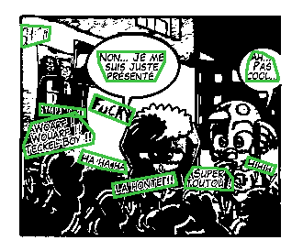
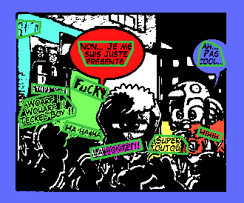

Regular balloon extraction
Original image
Text block positions (green)
Regions including text blocks (coloured)
Regions including aligned text block

Slide 34

Implicit balloon extraction
Prerequisites
  Text block positions are known
  Implicit balloons contain text
Observation
  Text is fully included and centred in balloons
Proposition
  Extract implicit balloons from text regions by inflating a deformable contour
  Adaptation of active contour model (snake)
Original image and text locations
Expected result

Slide 35
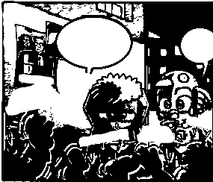


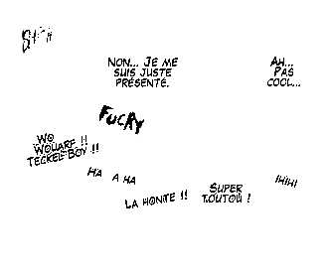

Implicit balloon extraction
Energy function:
E = E_{int} + E_{ext}
E_{int} = E_{cont} + E_{curv}
E_{ext} = E_{edge} + E_{text}
Text block positions
Notes:
Explain the equation
Internal energy
- elastic force
- rigid force

Slide 36
Implicit balloon extraction
Text-free image
Text only image

Slide 37
Implicit balloon extraction
External energy E_{edge} (distance transform)
External energy E_{text}

Slide 38
Implicit balloon extraction
Final external energy E_{ext}

Slide 39

Implicit balloon extraction
Initial snake positions

Slide 40

Implicit balloon extraction
Final balloon detections
The snake is attracted to the “dark side”

Slide 41
Balloon extraction
General conclusion
  Relies on the performance of text extraction
  First bottom-up approaches for regular and implicit balloons
Regular balloons
  Accurate pixel-level extraction (appropriate for contour analysis)
  Multi-script according to the text extraction abilities
  Not suitable for implicit balloons
Implicit balloons
  First time studied
  Appropriate for all type of balloons containing text (regular and implicit)
  Over-detection if not only speech text blocks are given as input
  Not able to extract details on the contour (tail, peaks, etc.)
  Time consuming (active contour)

Slide 42
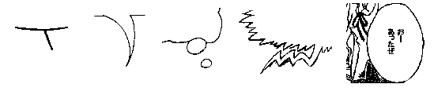
Tail extraction
Comic
page
image
Panel
extraction
Text
extraction
Balloon
extraction
Tail
extraction
Character
extraction
Comic
page
description
Stroke
Comma
Circle
Zigzag
Absent
Definitions
  Tail: a pointer that indicates where is the emitter (speaker) of the balloon
  Tail tip: the extremity of the tail, the closest part to the emitter
  Tail direction: direction pointed by the tail
Literature
  First time studied in image processing
Objectives
  Detection of the tail tip position and orientation
  Focus on comma, zigzag and absent types

Slide 43
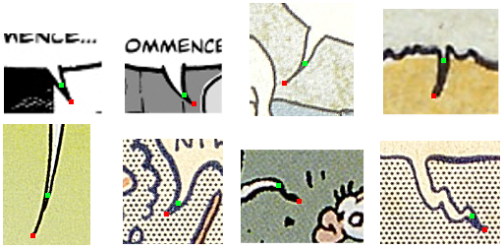
Tail extraction
Challenges
  Tail tip position definition
  Tail direction definition
Tip from background
Tip from contour
Direction of the tail
Different interpretation of tail tip positions and directions
Notes:
Position: in background or edge border
Direction: origin2tip, last part of the tip

Slide 44
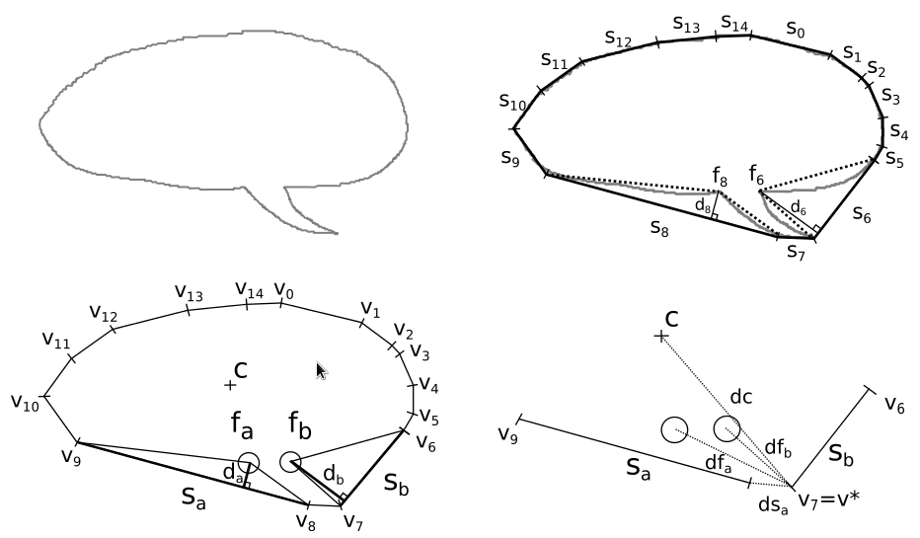
Tail extraction: tip position
Balloon contour
Convex hull
(ds_{b}=0)
Two biggest convexity defects
Tail tip position
Optimal vertex selection:
v∗ = argmax(max(dc + df_{a} + df_{b}) + min(ds_{a} + ds_{b}))

Slide 45
Tail extraction: tip position
Balloon contour
Convex hull
(ds_{b}=0)
Two biggest convexity defects
Tail tip position
Optimal vertex selection:
v∗ = argmax(max(dc + df_{a} + df_{b}) + min(ds_{a} + ds_{b}))

Slide 46
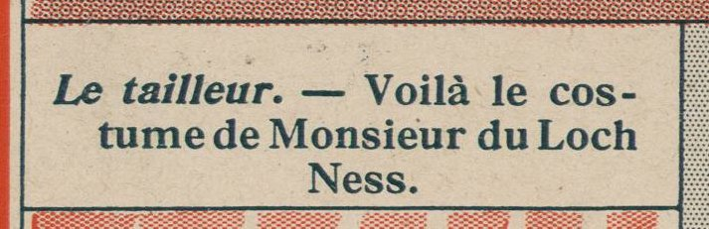
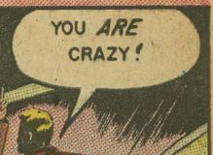
Tail extraction: confidence value
Balloon 1
Balloon 2
Balloon contour (blue)
Convex hull
(red)
d_{a}
d_{b}
Confidence
Presence of tail
NO
YES (>0)

Slide 47
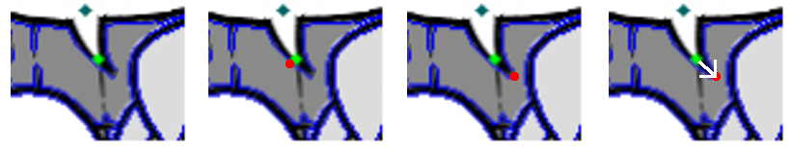
Tail extraction: tail direction
Our definition
  Vector starting from “background” to “external edge” tail tip positions
Approach
  Extract external edge
  Find external edge tail tip coordinates
  Define the tail direction (N, NE, E, SE, S, SW, W, NW)
Background tail tip (green) and external edge (blue)
Closest point on external edge (red)
Farthest point from origin and tip (red)
Direction from tip to farthest point (white arrow)

Slide 48
Comic character extraction
Comic
page
image
Panel
extraction
Text
extraction
Balloon
extraction
Tail
extraction
Character
extraction
Comic
page
description
Literature
  Supervised approaches for manga and cartoon characters
  No public dataset (copyright issues)
Challenges
  Variety of styles of comic books
  Intra and extra class variations of each character instance (e.g. position, scale, pose, occlusion and human-like, invented)
Objectives
  Unsupervised and generic approach for all styles of comic books
  Extraction of the main characters (speaking)

Slide 49
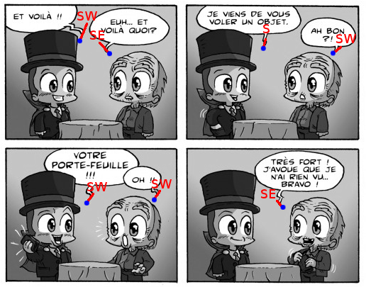
Comic character extraction
Prerequisites
  Position and direction of the tails in the panels
Our proposition
  use already extracted information (panels, balloons and tails) to estimate speaking character region of interests
Notes:
Explain red number and GT (grey BdB)

Slide 50
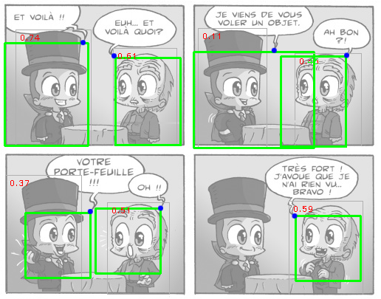
Comic character extraction
Prerequisites
  Position and direction of the tails in the panels
Our proposition
  use already extracted information (panels, balloons and tails) to estimate speaking character region of interests
Rectangle ROI
Squared ROI
Notes:
Explain red number and GT (grey BdB)

Slide 51
Comic character extraction
Conclusion
  Preliminary results
  Highly relies on the quality of the tail tip and direction (error propagation)
  Only for “speaking” characters
  Implicitly retrieves the relationship between balloons and characters

Slide 52
Conclusion
Global
  From simple to complex elements
  Content-driven approach
Pros
  Consistence between extracted elements
Cons
  Error propagation

Slide 53
Outlines
Introduction
Document analysis
State of the art of comics analysis
Contributions (move content one level up???)
  Introduction
  Content-driven approach
  Knowledge-driven approach
  Conclusion
Experimentations
Conclusions

Slide 54
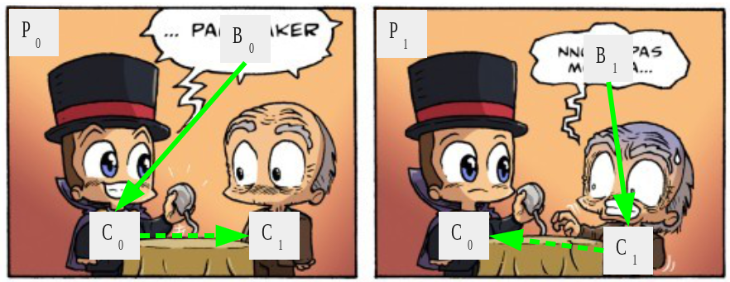
Introduction
Semantic description and comics understanding
Independent element extraction
Image and comics domain knowledge models
Expert system for contextual analysis
Processing sequence
Collaboration with Clément Guérin
Panel
Image
Text
Description
Balloon
Knowledge
Tail
Character
Retrieving and understanding interactions
Notes:
In collaboration with Clément Guérin

Slide 55
Knowledge models
Image domain model
Comics domain model
  Validation
    A panel P is related to one page
    A balloon B is related to one panel
    A character C is related to one panel
    A text line T is related to one balloon
  Inference
    A balloon with a tail Q is a speech balloon SB
    A text contained in a speech balloon is a speech text ST
    A comic character associated to a speech balloon is a speaking character SC

Slide 56
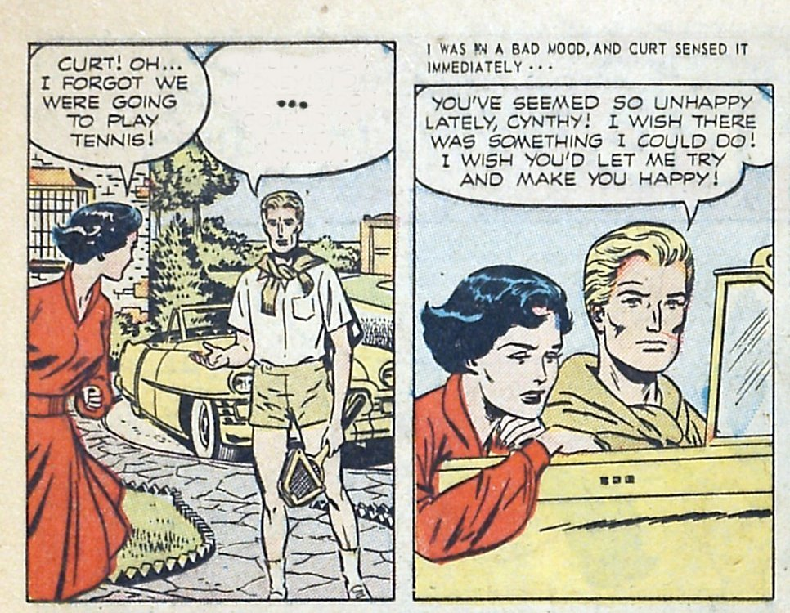
Processing sequence
Process loop
  Step 1: formulate hypothesis
  Step 2: validate hypothesis
  Step 3: infer new information
Study case
  Iteration 1
    Step 1: hypotheses of simple element positions
    Step 2: validation of the positions
    Step 3: inference a new information
  Iteration 2
    Step 1: hypotheses of more complex elements
    Step 2: validation of the positions
    Step 3: inference a new information
  ...
Step 1:
Formulate hypothesis
Step 3:
Infer new information
Step 2:
Validate hypothesis

Slide 57
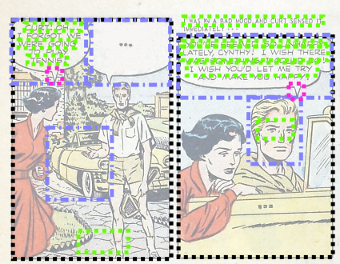
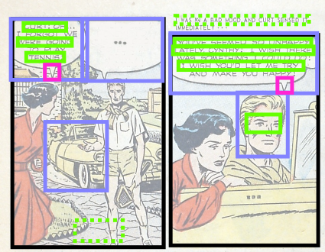
Processing sequence 1/2
Step 1: formulation of hypotheses
Step 2: validate hypothesis

Slide 58
Processing sequence 1/2
Step 1: formulation hypothesis
Step 2: validation of the hypotheses

Slide 59
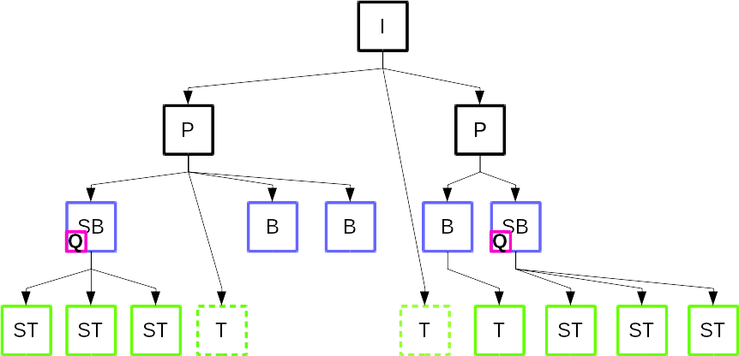
Processing sequence 1/2
Step 3: inference of new information

Slide 60
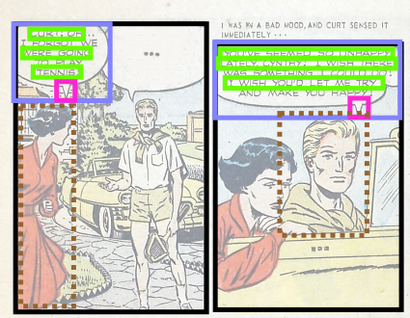
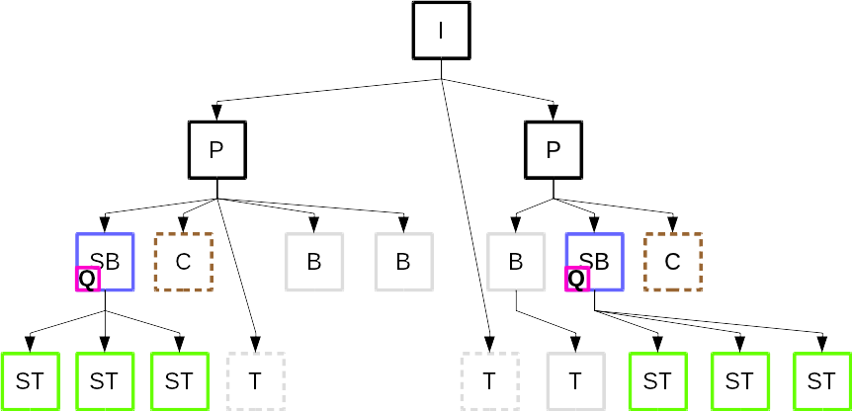
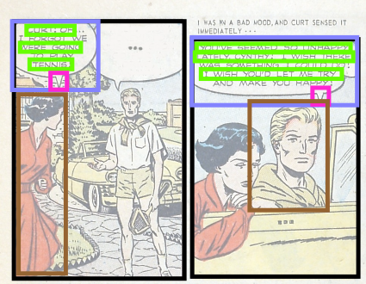
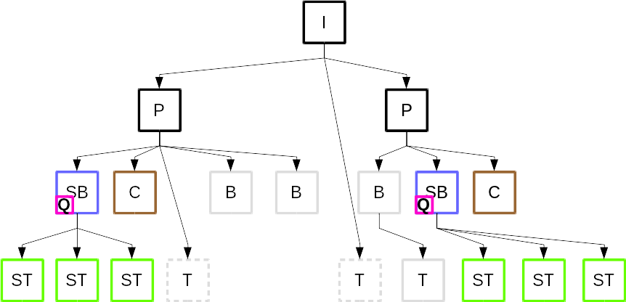
Processing sequence 2/2
Step 1: formulation of hypotheses
Step 2: validation of the hypotheses

Slide 61
Processing sequence 2/2
Step 1: formulation of hypotheses
Step 2: validation of the hypotheses

Slide 62
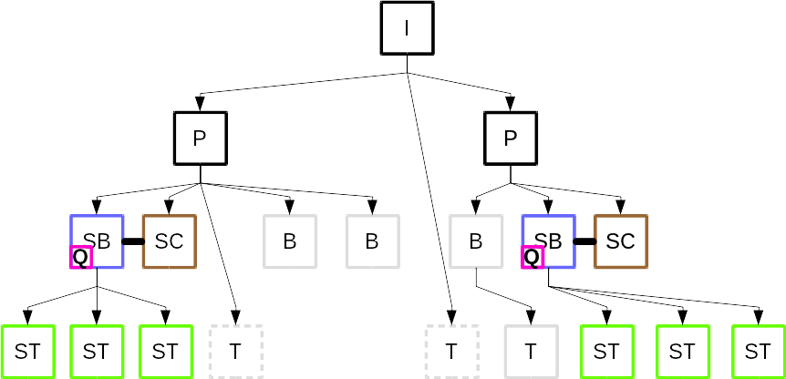
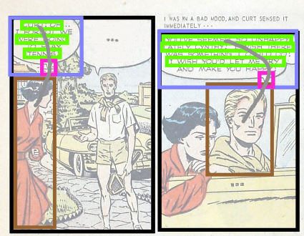
Processing sequence 2/2
Step 3: inference of new information
Final information about the image

Slide 63
Conclusion
Contributions
  Generic, unsupervised and expandable framework for comics understanding (pending acceptance IJDAR)
  Formalization of image and comic book domains
Limitations
  Validation process (deletion only)

Slide 64
Outlines
Introduction
Document analysis
State of the art of comics analysis
Contributions
Experimentations
Conclusions

Slide 65
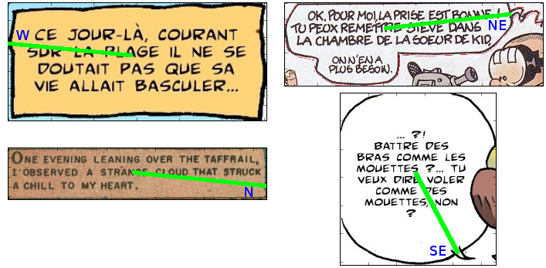
Evaluations
Examples of result

Slide 66
Outlines
Introduction
Document analysis
State of the art of comics analysis
Contributions
Experimentations
Conclusions

