Slide 1




Segmentation and indexation of complex objects in comic book images
European Ph.D. defense
Segmentation and indexation of complex objects in comic book images
Christophe Rigaud
December 11th, 2014
Co-supervised by:
Jean-Christophe Burie¹
Dimosthenis Karatzas²
Jean-Marc Ogier¹
¹L3i – Université de La Rochelle
²CVC - Universitat Autònoma de Barcelona
Notes:
Thank you Mr. the president, thanks to all the other members for being in the jury of my Ph.D. defence.
Thank you to the public and online people for .
I'm Christophe Rigaud, Ph.D. student in computer science and document image analysis.
Today I will present my work about “segmentation and indexation of complex objects in comic book images”.
This work have been co-supervised by JCB and JMO from L3i and DK from CVC
SEGMENTATION
In computer vision, image segmentation is the process of partitioning a digital image into multiple segments (sets of pixels, also known as superpixels). The goal of segmentation is to simplify and/or change the representation of an image into something that is more meaningful and easier to analyze.
INDEXATION
SVG images and their behaviours are defined in XML text files. This means that they can be searched, indexed, scripted, and compressed.

Slide 2
Comic books
“One of the most popular and familiar forms of graphic content”
Hiroaki Tobita, Sony CSL Interaction Laboratory, 2014
“a visual medium used to express ideas via images, often combined with text or visual information”
Wikipédia, 2014
Problematic
COMICS
- Fast evolution
- Massive digitization
- Digital images contain poor information (pixel position + colour)
- Need human-readable description to be searched and retrieved by humans
- but...
- Cost is to high if done by hand
SOLUTION: COMPUTER SCIENTISTS
- Provide methods for generating automatic description of digital images
SIENTIFIC ISSUES RELATED TO COMICS
- Locate and identify image content → low level description
- Understand image content to produce →high level description
Koichi
- What would be the impact of this research on people daily life?
- Introduce comics entities and relationship, panel/balloon/text/characters category and usage/relationship (what is/do we call panel (separated only), text (speech only), comic characters () )
- Define the studied domain limits (our focus) within the whole comics world
Notes:
Pre-history: painting of animals and hunters in caves [Marx, 2007]
1846: Rodolphe Töpffer, the inventor of the “bandes dessinées”
1930s: magazine-style comic books production in the US
1950s: massive production of manga in Japan (Osamu Tezuka)
1971: the term of ninth art is attributed to comics art (Francis Lacassin)
1996: explosion of the Internet bubble and webcomics
2007: adaptation to social media sites and mobile devices

Slide 3



Comic books
“One of the most popular and familiar forms of graphic content”
Hiroaki Tobita, Sony CSL Interaction Laboratory, 2014
“a visual medium used to express ideas via images, often combined with text or visual information”
Wikipédia, 2014
Problematic
COMICS
- Fast evolution
- Massive digitization
- Digital images contain poor information (pixel position + colour)
- Need human-readable description to be searched and retrieved by humans
- but...
- Cost is to high if done by hand
SOLUTION: COMPUTER SCIENTISTS
- Provide methods for generating automatic description of digital images
SIENTIFIC ISSUES RELATED TO COMICS
- Locate and identify image content → low level description
- Understand image content to produce →high level description
1900
1995
2000
Koichi
- What would be the impact of this research on people daily life?
- Introduce comics entities and relationship, panel/balloon/text/characters category and usage/relationship (what is/do we call panel (separated only), text (speech only), comic characters () )
- Define the studied domain limits (our focus) within the whole comics world
Notes:
Pre-history: painting of animals and hunters in caves [Marx, 2007]
1846: Rodolphe Töpffer, the inventor of the “bandes dessinées”
1930s: magazine-style comic books production in the US
1950s: massive production of manga in Japan (Osamu Tezuka)
1971: the term of ninth art is attributed to comics art (Francis Lacassin)
1996: explosion of the Internet bubble and webcomics
2007: adaptation to social media sites and mobile devices

Slide 4
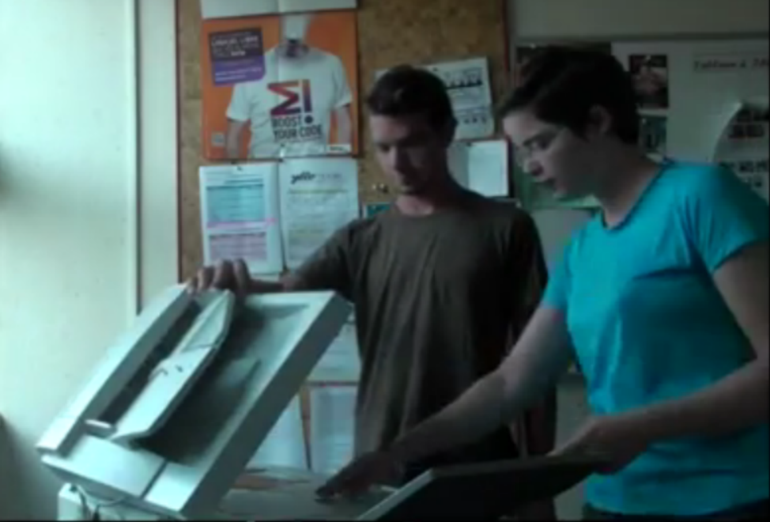
Comic books
“One of the most popular and familiar forms of graphic content”
Hiroaki Tobita, Sony CSL Interaction Laboratory, 2014
“a visual medium used to express ideas via images, often combined with text or visual information”
Wikipédia, 2014
Problematic
COMICS
- Fast evolution
- Massive digitization
- Digital images contain poor information (pixel position + colour)
- Need human-readable description to be searched and retrieved by humans
- but...
- Cost is to high if done by hand
SOLUTION: COMPUTER SCIENTISTS
- Provide methods for generating automatic description of digital images
SIENTIFIC ISSUES RELATED TO COMICS
- Locate and identify image content → low level description
- Understand image content to produce →high level description
1900
1995
2000
Massive digitization
Koichi
- What would be the impact of this research on people daily life?
- Introduce comics entities and relationship, panel/balloon/text/characters category and usage/relationship (what is/do we call panel (separated only), text (speech only), comic characters () )
- Define the studied domain limits (our focus) within the whole comics world
Notes:
Pre-history: painting of animals and hunters in caves [Marx, 2007]
1846: Rodolphe Töpffer, the inventor of the “bandes dessinées”
1930s: magazine-style comic books production in the US
1950s: massive production of manga in Japan (Osamu Tezuka)
1971: the term of ninth art is attributed to comics art (Francis Lacassin)
1996: explosion of the Internet bubble and webcomics
2007: adaptation to social media sites and mobile devices

Slide 5
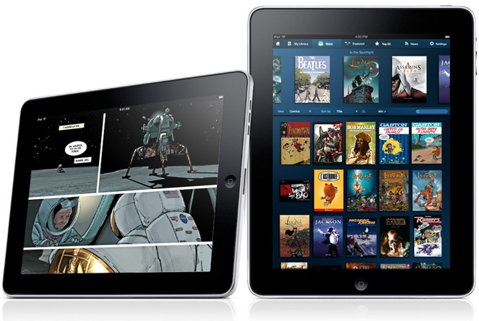
Comic books
“One of the most popular and familiar forms of graphic content”
Hiroaki Tobita, Sony CSL Interaction Laboratory, 2014
“a visual medium used to express ideas via images, often combined with text or visual information”
Wikipédia, 2014
Problematic
COMICS
- Fast evolution
- Massive digitization
- Digital images contain poor information (pixel position + colour)
- Need human-readable description to be searched and retrieved by humans
- but...
- Cost is to high if done by hand
SOLUTION: COMPUTER SCIENTISTS
- Provide methods for generating automatic description of digital images
SIENTIFIC ISSUES RELATED TO COMICS
- Locate and identify image content → low level description
- Understand image content to produce →high level description
1900
1995
2000
2008
Massive digitization
Koichi
- What would be the impact of this research on people daily life?
- Introduce comics entities and relationship, panel/balloon/text/characters category and usage/relationship (what is/do we call panel (separated only), text (speech only), comic characters () )
- Define the studied domain limits (our focus) within the whole comics world
Notes:
Pre-history: painting of animals and hunters in caves [Marx, 2007]
1846: Rodolphe Töpffer, the inventor of the “bandes dessinées”
1930s: magazine-style comic books production in the US
1950s: massive production of manga in Japan (Osamu Tezuka)
1971: the term of ninth art is attributed to comics art (Francis Lacassin)
1996: explosion of the Internet bubble and webcomics
2007: adaptation to social media sites and mobile devices

Slide 6
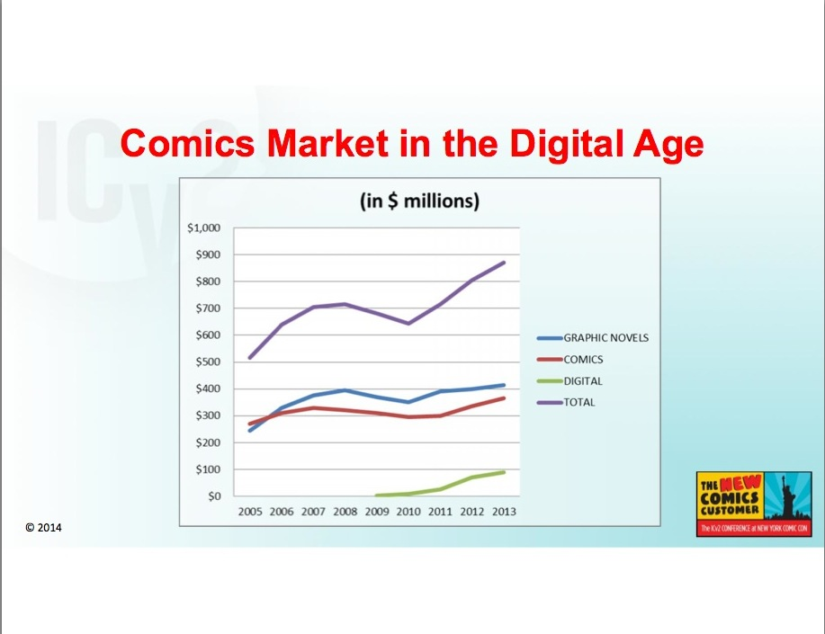
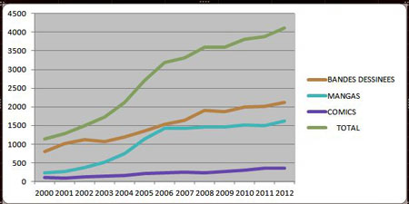
Comic books
Bandes dessinées
Japanese manga
American comics
Total
Francophone comics production
Infographie (c) L’Agence BD d’après les chiffres de Gilles Ratier/ACBD.
Comics market in the US
Milton Griepp's White Paper, ICv2 Conference 2014
Koichi
- What would be the impact of this research on people daily life?
- Introduce comics entities and relationship, panel/balloon/text/characters category and usage/relationship (what is/do we call panel (separated only), text (speech only), comic characters () )
- Define the studied domain limits (our focus) within the whole comics world
Notes:
Pre-history: painting of animals and hunters in caves [Marx, 2007]
1846: Rodolphe Töpffer, the inventor of the “bandes dessinées”
1930s: magazine-style comic books production in the US
1950s: massive production of manga in Japan (Osamu Tezuka)
1971: the term of ninth art is attributed to comics art (Francis Lacassin)
1996: explosion of the Internet bubble and webcomics
2007: adaptation to social media sites and mobile devices

Slide 7
Context of the thesis
eBDthèque project (since 2011)
  Add value to digitized comics using the new technologies
    Content extraction (thesis of Christophe Rigaud)
    Knowledge representation (thesis of Clément Guérin)
  Public founding CPER 2007-2013
  2 Ph.D. students, 1 engineer, 1 post doc, 6 professors (L3i)
Scientific challenges
  Mixed contents of a graphical and textual nature
  Combination of the difficulties of free-form and complex background documents
  Recent field of research with a largely unknown
Objectives
  Propose generic approaches able to retrieve as many elements as possible from any comic book image
  Provide a first dataset and ground truth
eBDthèque project (since 2011)
  Add value to paper-based comics using the new technologies
  Public founding: CPER 2007-2013 (State-Region Project Contract)
Applications
  Browse digitalized heritage
  New reading experiences
  Speed up translation
Notes:
Challenges:
- no regular structure allowing to extract easily the layout and to predict the location of text and graphics
- authors are entirely free in their layout choices (few conventions widely adopted by comic book’s authors in order to avoid the reader to be confused)

Slide 8
Context of the thesis
eBDthèque project (since 2011)
  Add value to digitized comics using the new technologies
    Content extraction (thesis of Christophe Rigaud)
    Knowledge representation (thesis of Clément Guérin)
  Public founding CPER 2007-2013
  2 Ph.D. students, 1 engineer, 1 post doc, 6 professors (L3i)
Scientific challenges
  Mixed contents of a graphical and textual nature
  Combination of the difficulties of free-form and complex background documents
  Recent and unexplored field of research
Objectives
  Propose generic approaches able to retrieve as many elements as possible from any comic book image
  Provide a first dataset and ground truth
eBDthèque project (since 2011)
  Add value to paper-based comics using the new technologies
  Public founding: CPER 2007-2013 (State-Region Project Contract)
Applications
  Browse digitalized heritage
  New reading experiences
  Speed up translation
Notes:
Challenges:
- no regular structure allowing to extract easily the layout and to predict the location of text and graphics
- authors are entirely free in their layout choices (few conventions widely adopted by comic book’s authors in order to avoid the reader to be confused)

Slide 9
Context of the thesis
eBDthèque project (since 2011)
  Add value to digitized comics using the new technologies
    Content extraction (thesis of Christophe Rigaud)
    Knowledge representation (thesis of Clément Guérin)
  Public founding CPER 2007-2013
  2 Ph.D. students, 1 engineer, 1 post doc, 6 professors (L3i)
Scientific challenges
  Mixed contents of a graphical and textual nature
  Combination of the difficulties of free-form and complex background documents
  Recent and unexplored field of research
Objectives
  Propose generic approaches able to retrieve as many elements as possible from any comic book image
  Provide a first dataset and ground truth
eBDthèque project (since 2011)
  Add value to paper-based comics using the new technologies
  Public founding: CPER 2007-2013 (State-Region Project Contract)
Applications
  Browse digitalized heritage
  New reading experiences
  Speed up translation
Notes:
Origin:
- master thesis of NGO HO Anh Khoi
Challenges:
- no regular structure allowing to extract easily the layout and to predict the location of text and graphics
- authors are entirely free in their layout choices (few conventions widely adopted by comic book’s authors in order to avoid the reader to be confused)

Slide 10
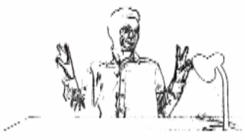
Outlines
Introduction
Background
Contributions
Experiments
Conclusion
Panel extraction
Balloon extraction
Text extraction & recognition
Comic character extraction
Conclusions
Pencil drawing. Image credits: Le cycle des bulles, Christophe Rigaud, 2012
Notes:
Announce the plan here

Slide 11
Outlines
Introduction
Background
Contributions
Experiments
Conclusion
Comic book image analysis
Content extraction
  Panels
  Balloons
  Text
  Comic characters
Pencil drawing. Image credits: Le cycle des bulles, Christophe Rigaud, 2012
Notes:
Announce the plan here

Slide 12
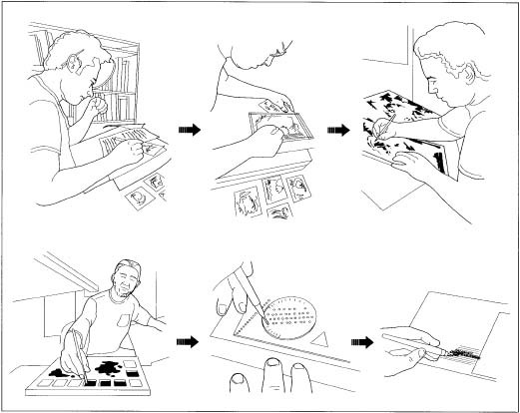
Comic book image analysis
Challenges:
  Recent field of research with a largely unknown
  Semi-structured and free-form document mixing text and graphics
Design process:
Production process
  Synopsis and scenario
  Pencil drawing
  Inking
  Flatting and colouring
  Lettering and sound effects
1) Scenario
2) Pencil drawing
3) Inking
4) Flatting/colouring
5) Lettering
Image source: http://www.madehow.com/Volume-6/Comic-Book.html

Slide 13
Comic book image analysis
Challenges:
  Recent field of research with a largely unknown
  Semi-structured and free-form document mixing text and graphics
Design process:
Production process
  Synopsis and scenario
  Pencil drawing
  Inking
  Flatting and colouring
  Lettering and sound effects
1) Scenario
2) Pencil drawing
3) Inking
4) Flatting/colouring
5) Lettering
Image source: http://www.madehow.com/Volume-6/Comic-Book.html

Slide 14
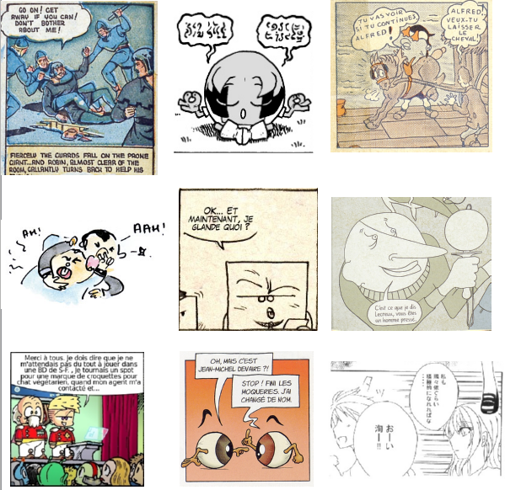
Panel extraction
Challenges
  Diversity of styles (gutter, implicit)
  Semi-structured layout
Panel extraction
  White line cut [Chung07]
  Recursive X-Y cut [Eunjung07]
  Density gradient [Tanaka07]
  Connected-components [Arai10, Pang14]
  Polygon detection [Li14a]
  Corners and line segments [Stommel12]
Conclusions
  Specific approaches not appropriate for other type of comics
  Remaining difficulties for non-rectangle and implicit panels
  Copyrighted images (not shareable)
Notes:
Insist on panel border style differences

Slide 15
Panel extraction
Challenges
  Diversity of styles (gutter, implicit)
  Semi-structured layout
Panel extraction
  White line cut [Chung07]
  Recursive X-Y cut [Eunjung07]
  Density gradient [Tanaka07]
  Connected-components [Arai10, Pang14]
  Polygon detection [Li14a]
  Corners and line segments [Stommel12]
Conclusions
  Specific approaches not appropriate for other type of comics
  Remaining difficulties for non-rectangle and implicit panels
  Copyrighted images (not shareable)
Notes:
Stommel12
Able to extract gutter-free and overlapped panels
Output only rectangle regions

Slide 16

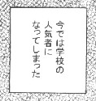
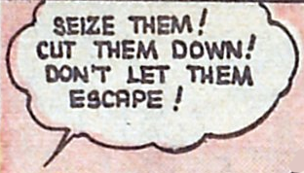
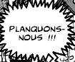
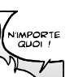
Balloon extraction
Image Shape Contour
Challenges
  Difference between shape and contour
  Implicit balloon positions
  Semantics related to text
Extraction
  Connected-components [Arai11, Ho12]
Conclusions
  Closed balloon with text inside
  Several unexplored fields (e.g. implicit balloon positions, balloon, classification, tail detection)
Oval Smooth
Rectangle Smooth
Oval Wavy
Oval Spiky
Oval /
implicit
Smooth / Implicit
Notes:
Intro on contour/shape difference
Arai [8] proposed a blob detection method based
on connected component detection with four filtering rules applied to manga analysis.
The rules are based on blob minimum size, white pixel occurrence, inclusion of vertical
straight lines and width to length ratio (Figure 2.6). Another connected component
approach proposed by Ho [68] uses HSV colour space to make a first selection of bright
blobs and then consider as balloons the blobs with a ratio between the text area and
the blob bounding box higher than sixty per cent.
Implicit balloons: nor studied yet but active contour model initialised from text seems to be a good approach

Slide 17
Balloon extraction
Image Shape Contour
Challenges
  Difference between shape and contour
  Implicit balloon positions
  Semantics related to text
Extraction
  Connected-components [Arai11, Ho12]
Conclusions
  Closed balloon with text inside
  Several unexplored fields (e.g. implicit balloon positions, balloon, classification, tail detection)
Oval Smooth
Rectangle Smooth
Oval Wavy
Oval Spiky
Oval /
implicit
Smooth / Implicit
Notes:
Intro on contour/shape difference
Arai [8] proposed a blob detection method based
on connected component detection with four filtering rules applied to manga analysis.
The rules are based on blob minimum size, white pixel occurrence, inclusion of vertical
straight lines and width to length ratio (Figure 2.6). Another connected component
approach proposed by Ho [68] uses HSV colour space to make a first selection of bright
blobs and then consider as balloons the blobs with a ratio between the text area and
the blob bounding box higher than sixty per cent.
Implicit balloons: nor studied yet but active contour model initialised from text seems to be a good approach

Slide 18
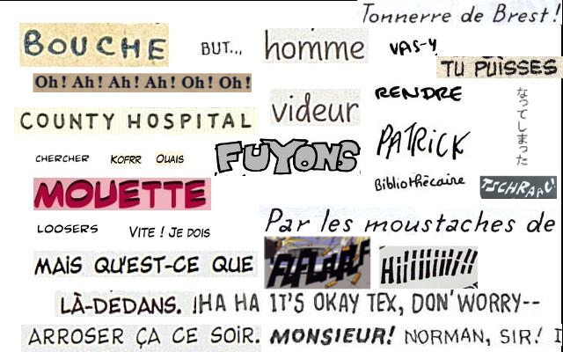
Text extraction & recognition
Challenges
  Non-standard fonts
  Multi-script/orientation/scale
  Complex background (sound effects)
  Hyphenation, voluntary spelling mistakes
Extraction
  Sliding Concentric Windows + SVM [Su11]
  Connected-components [Ho12, Pang14]
  SVM and Bayesian classifier [Li14b]
Recognition
  OCR trained for a specific comics font [Ponsard12]
Conclusions
  Speech text (from balloons)
  Captions and sound effects unexplored
  Text recognition very poor

Slide 19
Text extraction & recognition
Challenges
  Non-standard fonts
  Multi-script/orientation/scale
  Complex background (sound effects)
  Hyphenation, voluntary spelling mistakes
Extraction
  Sliding Concentric Windows + SVM [Su11]
  Connected-components [Ho12, Pang14]
  SVM and Bayesian classifier [Li14b]
Recognition
  OCR trained for a specific comics font [Ponsard12]
Conclusions
  Speech text only (from balloons)
  Captions and sound effects unexplored
  Text recognition very poor
Notes:
Mention onomatopoeia
Mention that scene text methods may be appropriate for complex background text (not tested yet) but not optimal for speech text (our first intention).
It is like document-like text inside scene-like complex background
2 in 1 is not obvious, otherwise scene text method would perform better document analysis methods.

Slide 20
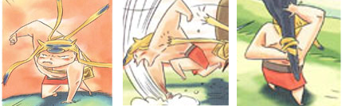



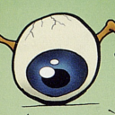
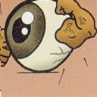
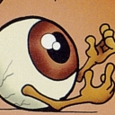

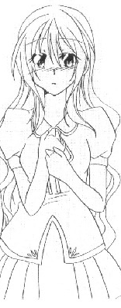
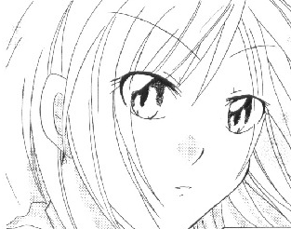
Comic character extraction
Challenges
  Hand-drawn, stroke-based
  Intra/inter class variability
  Scale, deformation, posture, occlusion
Extraction & recognition
  Manga faces [Cheung08, Sun10, Kohei12]
  Cartoons [Khan12]
Conclusions
  Preliminary results
  Complex and versatile structure
  Contains most of the interesting information

Slide 21
Comic character extraction
Challenges
  Hand-drawn, stroke-based
  Intra/inter class variability
  Scale, deformation, posture, occlusion
Extraction & recognition
  Manga faces [Cheung08, Sun10, Kohei12]
  Cartoons [Khan12]
Conclusions
  Preliminary results
  Complex and versatile structure
  Contains most of the interesting information

Slide 22
Conclusions
Element | Process type | Advancement
Panel | Localisation | 60%
 | Classification | 0%
Balloon | Localisation | 20%
 | Classification | 0%
 | Tail detection | 0%
Text | Localisation | 30%
 | Recognition | 10%
Comic character | Localisation | 5%
 | Identification | 10%
 | Face/pose | 0%
Context | Inter-element link | 0%
 | Situation retrieval | 0%
 | Timestamps | 30%
Dataset | Localisation | 0%
 | Semantic | 0%
Element | Process type | Before | After
Panel | Localisation | 60% | 70% | 10%
 | Classification | 0% | 0% | 0%
Balloon | Localisation | 20% | 50% | 30%
 | Classification | 0% | 80% | 80%
Text | Localisation | 30% | 60% | 30%
 | Recognition | 10% | 10% | 0%
Comic character | Localisation | 5% | 10% | 5%
 | Identification | 10% | 10% | 10%
 | Face/pose | 0% | 0% | 0%
Context | Inter-element link | 0% | 10% | 10%
 | Situation retrieval | 0% | 0% | 0%
 | Timestamps | 30% | 30% | 30%
Dataset | Localisation | 0% | 70% | 70%
 | Semantic | 0% | 20% | 20%

Slide 23
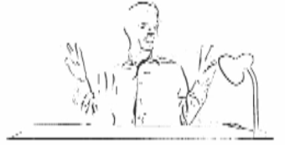
Outlines
Introduction
Documents
Contributions
Experiments
Conclusion
Introduction
Sequential approach
(Independent approach)
Knowledge-driven approach
Inking. Image credits: Le cycle des bulles, Christophe Rigaud, 2012

Slide 24
Outlines
Introduction
Documents
Contributions
Experiments
Conclusion
Introduction
Sequential approach
(Independent approach)
Knowledge-driven approach
Inking. Image credits: Le cycle des bulles, Christophe Rigaud, 2012

Slide 25
Introduction
In this thesis we propose three approaches in order to cover the widest possible
scope of study, from a sequential and supervised approach to an knowledge-driven and
unsupervised method.
The first approach profits from the relations between elements
to guide the retrieval process.
For instance, the panels are first extracted then balloons containing text that are inside panels and finally comic character regions of interest are defined from the speech balloon tail indications. This approach is quite intuitive but also very sensitive to error propagation issue between the different extraction
Steps [8,67].
The second approach consists in making the extraction independent from
each other, in order to avoid error propagation issues.
The third proposition adds contextual information to the independent extractions. The context is retrieved by matching extracted element relations with a generic model of the domain knowledge.
This last approach allows a semantic description of the images. For instance, text
regions that are detected inside balloons are inferred as being speech text regions and
comic characters that are pointed by a tail as speaking characters.
Two (content-driven) approaches and 1 knowledge-driven.
- introduce by explaining the advantage and disadvantages of the 3 approaches, why 3, which one first... (sequential in literature, limitation, advantage/inconvenient of independent, same for knowledge-driven (current trends)) "recover the main drawback of the first approach: error propagation", show where are ALL the contributions of the thesis
Objective: cover the widest possible scope of study
Content-driven
  Sequential approach
    Similar to literature
    Intuitive
    Sensible to error propagation
  Independent approach
    Avoid error propagation
Knowledge-driven
  Knowledge-driven approach
    Based on domain knowledge
    Retrieve context
Comic
page
image
Panel
& text
Balloon
Tail
Character
Page
description
Panel
Text
Comic
page
image
Page
description
Balloon & Tail
Character
Notes:
Explain why these three approaches

Slide 26
Introduction
In this thesis we propose three approaches in order to cover the widest possible
scope of study, from a sequential and supervised approach to an knowledge-driven and
unsupervised method.
The first approach profits from the relations between elements
to guide the retrieval process.
For instance, the panels are first extracted then balloons containing text that are inside panels and finally comic character regions of interest are defined from the speech balloon tail indications. This approach is quite intuitive but also very sensitive to error propagation issue between the different extraction
Steps [8,67].
The second approach consists in making the extraction independent from
each other, in order to avoid error propagation issues.
The third proposition adds contextual information to the independent extractions. The context is retrieved by matching extracted element relations with a generic model of the domain knowledge.
This last approach allows a semantic description of the images. For instance, text
regions that are detected inside balloons are inferred as being speech text regions and
comic characters that are pointed by a tail as speaking characters.
Two (content-driven) approaches and 1 knowledge-driven.
- introduce by explaining the advantage and disadvantages of the 3 approaches, why 3, which one first... (sequential in literature, limitation, advantage/inconvenient of independent, same for knowledge-driven (current trends)) "recover the main drawback of the first approach: error propagation", show where are ALL the contributions of the thesis
Objective: cover the widest possible scope of study
Content-driven
  Sequential approach
    Similar to literature
    Intuitive
    Sensible to error propagation
  Independent approach
    Avoid error propagation
Knowledge-driven
  Knowledge-driven approach
    Based on domain knowledge
    Retrieve context
Comic
page
image
Panel
& text
Balloon
Tail
Character
Page
description
Panel
Text
Comic
page
image
Page
description
Balloon & Tail
Character
Notes:
Explain why these three approaches

Slide 27

Introduction
In this thesis we propose three approaches in order to cover the widest possible
scope of study, from a sequential and supervised approach to an knowledge-driven and
unsupervised method.
The first approach profits from the relations between elements
to guide the retrieval process.
For instance, the panels are first extracted then balloons containing text that are inside panels and finally comic character regions of interest are defined from the speech balloon tail indications. This approach is quite intuitive but also very sensitive to error propagation issue between the different extraction
Steps [8,67].
The second approach consists in making the extraction independent from
each other, in order to avoid error propagation issues.
The third proposition adds contextual information to the independent extractions. The context is retrieved by matching extracted element relations with a generic model of the domain knowledge.
This last approach allows a semantic description of the images. For instance, text
regions that are detected inside balloons are inferred as being speech text regions and
comic characters that are pointed by a tail as speaking characters.
Two (content-driven) approaches and 1 knowledge-driven.
- introduce by explaining the advantage and disadvantages of the 3 approaches, why 3, which one first... (sequential in literature, limitation, advantage/inconvenient of independent, same for knowledge-driven (current trends)) "recover the main drawback of the first approach: error propagation", show where are ALL the contributions of the thesis
Objective: cover the widest possible scope of study
Content-driven
  Sequential approach
    Similar to literature
    Intuitive
    Sensible to error propagation
  Independent approach
    Avoid error propagation
Knowledge-driven
  Knowledge-driven approach
    Based on domain knowledge
    Retrieve context
Comic
page
image
Panel
& text
Balloon
Tail
Character
Page
description
Panel
Text
Comic
page
image
Page
description
Balloon & Tail
Character
Knowledge
Notes:
Explain why these three approaches

Slide 28
Outlines
Introduction
Documents
Contributions
Experiments
Conclusion
Introduction
Sequential approach
(Independent approach)
Knowledge-driven approach
Inking. Image credits: Le cycle des bulles, Christophe Rigaud, 2012

Slide 29
Outlines
Introduction
Documents
Contributions
Experiments
Conclusion
Introduction
Sequential approach
  Panel & text extraction
  Balloon extraction
  Tail extraction
  Comic character extraction
(Independent approach)
Knowledge-driven approach
Inking. Image credits: Le cycle des bulles, Christophe Rigaud, 2012

Slide 30
Outlines
Introduction
Documents
Contributions
Experiments
Conclusion
Introduction
Sequential approach
  Panel & text extraction
  Balloon extraction
  Tail extraction
  Comic character extraction
(Independent approach)
Knowledge-driven approach
Inking. Image credits: Le cycle des bulles, Christophe Rigaud, 2012

Slide 31
Panel & text extraction
Comic
page
image
Panel
& text
extraction
Balloon
extraction
Tail
extraction
Character
extraction
Comic
page
description
Literature
  Panel with frame, separated by gutters or black line
  Text located inside balloons
Contribution
  Simultaneous panel and text extraction
  Consider implicit and non-rectangle panels
  Location-independent text extraction
Notes:
Justify connected-component analysis because it is a simple approach that have been used until recently for panel and text extraction

Slide 32
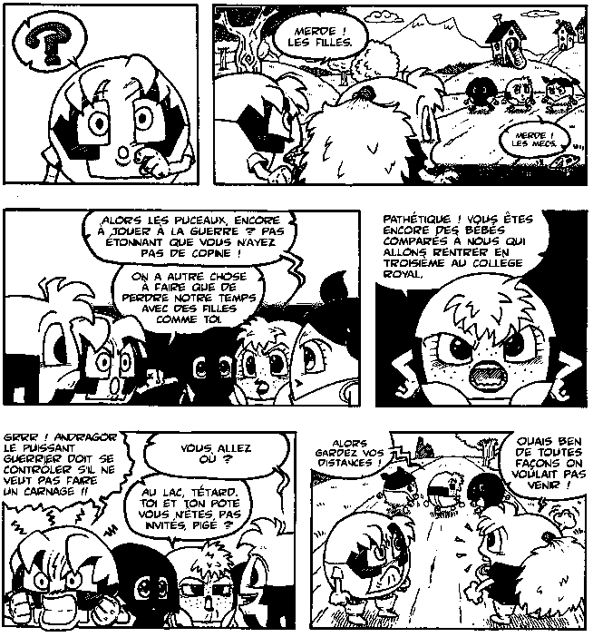
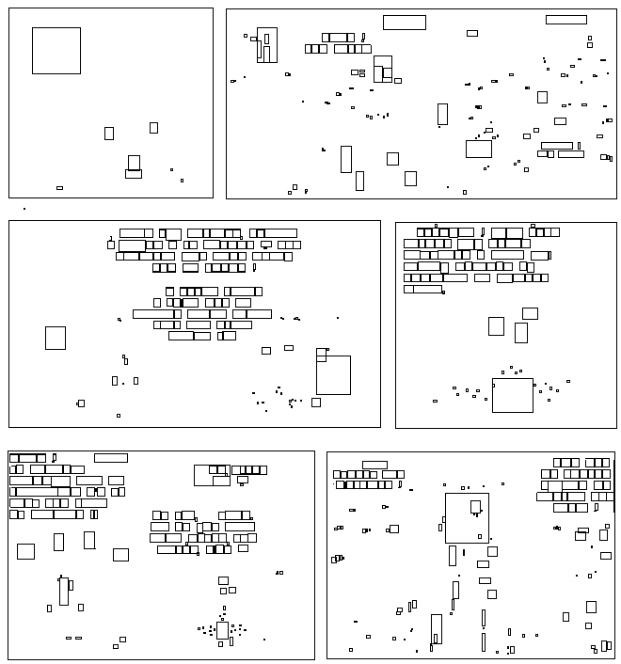
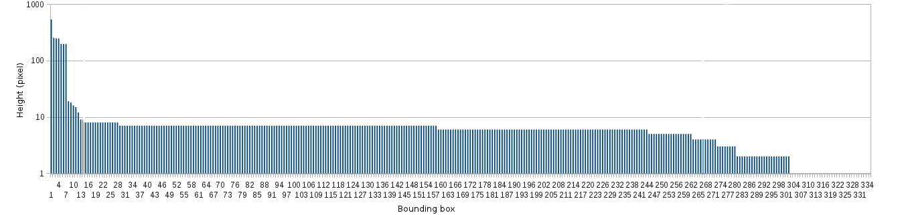
Panel & text extraction
Binary image
Connected-component (CC) bounding boxes
Histogram of heights of CC
CC height (pixel)
Histogram of heights (descendent order)
Notes:
Justify connected-component analysis because it is a simple approach that have been used until recently for panel and text extraction

Slide 33
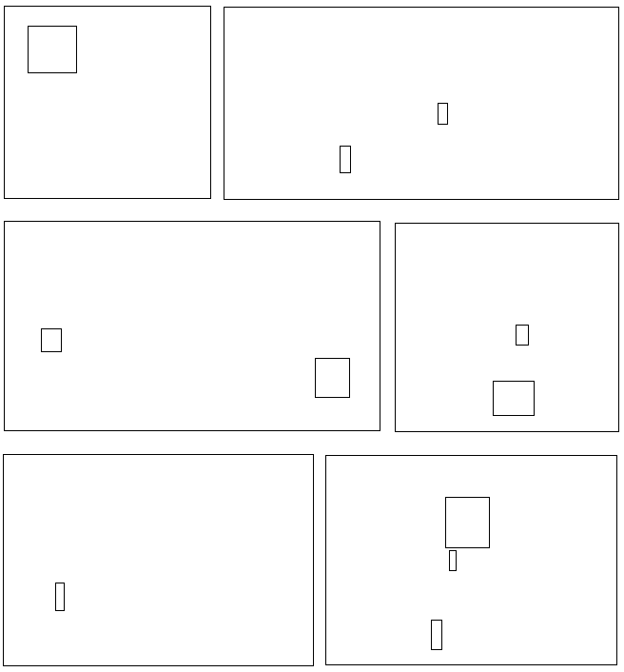
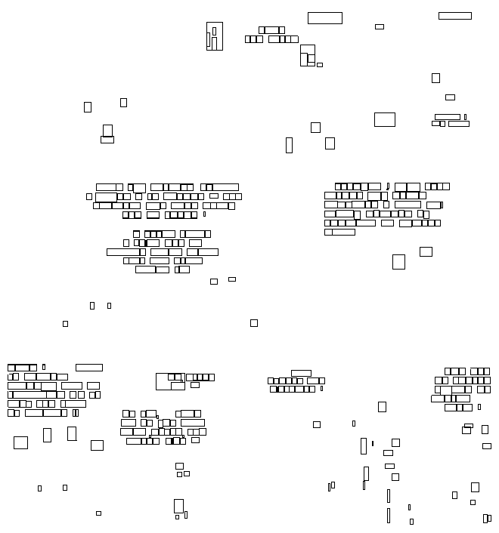

Panel & text extraction
K-means clustering (k=3)
CC height (pixel)
Panels
Text
Noise

Slide 34
Outlines
Introduction
Documents
Contributions
Experiments
Conclusion
Introduction
Sequential approach
  Panel & text extraction
  Balloon extraction
  Tail extraction
  Comic character extraction
(Independent approach)
Knowledge-driven approach
Inking. Image credits: Le cycle des bulles, Christophe Rigaud, 2012

Slide 35


Balloon extraction
Comic
page
image
Panel
& text
extraction
Balloon
extraction
Tail
extraction
Character
extraction
Comic
page
description
Regular balloon
Implicit balloon
Literature
  Top-down approaches: extract white blobs and then text inside
  Limited to regular balloons
Contribution
  Bottom-up approaches: extract text and then surrounding balloons
  Appropriate for regular and implicit balloons

Slide 36
Balloon extraction
Comic
page
image
Panel
& text
extraction
Balloon
extraction
Tail
extraction
Character
extraction
Comic
page
description
Regular balloon
Implicit balloon
Literature
  Top-down approaches: extract white blobs and then text inside
  Limited to regular balloons
Contribution
  Bottom-up approaches: extract text and then surrounding balloons
  Improvement of regular and a first approach for implicit balloon extractions

Slide 37
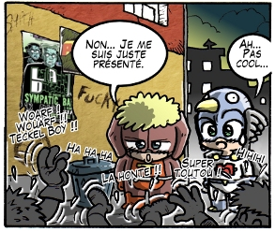

Balloon extraction: regular
Assumptions
  Panels and text block positions are known
  Regular balloons contain centred text
Proposition → structural analysis
  Extract closed contours that fully include centred text
Original image
Expected result
Notes:
Justify contour extraction:
- Commonly used for balloon extraction
- Pixel level segmentation
“We use connected-component extraction because it is a simple and common approach for regular balloon extraction”

Slide 38
Balloon extraction: regular
Assumptions
  Panels and text block positions are known
  Regular balloons contain centred text
Proposition → structural analysis
  Extract closed contours that fully include centred text
Original image
Expected result

Slide 39
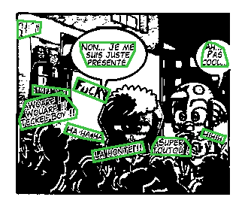
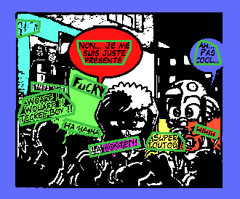

Balloon extraction: regular
Original image
Text block positions (green)
Regions including text blocks (coloured)
Regions including aligned text blocks

Slide 40

Balloon extraction: implicit
Assumptions
  Panel and text blocks positions are known
  Implicit balloons contain centred text
Proposition
  Extract implicit balloons from text regions by inflating a deformable contour
  Adaptation of active contour model (snake)
Original image and text locations
Expected result
Notes:
Justify the choice of active contour:
- Deformable to fit balloon contour
- Balloon-like shape given from internal energies

Slide 41
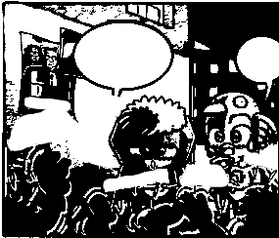
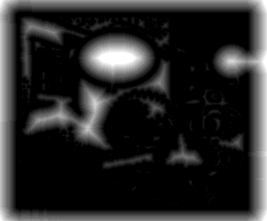
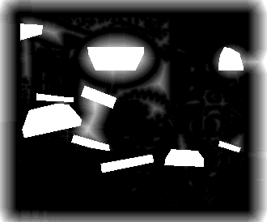
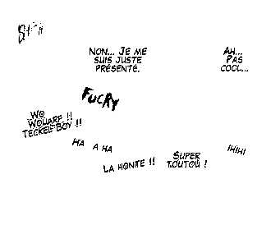

Balloon extraction: implicit
Energy function:
E = E_{int} + E_{ext}
E_{int} = E_{cont} + E_{curv}
E_{ext} = E_{edge} + E_{text}
Notes:
Eint = curvature and continuity
Our contribution: Etext from domain knowledge

Slide 42
Balloon extraction: implicit
Energy function:
E = E_{int} + E_{ext}
E_{int} = E_{cont} + E_{curv}
E_{ext} = E_{edge} + E_{text}
External energy E_{ext}

Slide 43
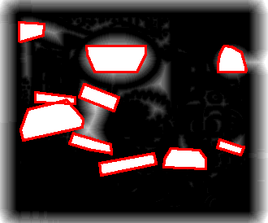
Balloon extraction: implicit
Energy function:
E = E_{int} + E_{ext}
E_{int} = E_{cont} + E_{curv}
E_{ext} = E_{edge} + E_{text}
Initial snake positions

Slide 44
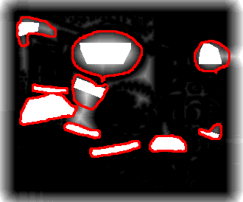
Balloon extraction: implicit
Energy function:
E = E_{int} + E_{ext}
E_{int} = E_{cont} + E_{curv}
E_{ext} = E_{edge} + E_{text}
Final snake positions
The snake is attracted to the “dark side”

Slide 45
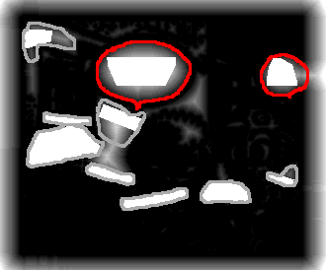
Balloon extraction: implicit
Energy function:
E = E_{int} + E_{ext}
E_{int} = E_{cont} + E_{curv}
E_{ext} = E_{edge} + E_{text}
Final balloon extraction
The snake is attracted to the “dark side”
Notes:
Valid detection if:
- snake did grown (diff between init/final)
- initial text block remains centred

Slide 46
Balloon extraction
General conclusion
  Relies on the performance of text extraction
  First bottom-up approaches for regular and implicit balloons
Regular balloons
  Accurate pixel-level extraction (appropriate for contour analysis)
  Multi-script according to the text extraction abilities
  Not suitable for implicit balloons
Implicit balloons
  First time studied
  Appropriate for all type of balloons containing text (regular and implicit)
  Over-detection if not only speech text blocks are given as input
  Not able to extract details on the contour (tail, peaks, etc.)
  Time consuming (active contour)

Slide 47
Outlines
Introduction
Documents
Contributions
Experiments
Conclusion
Introduction
Sequential approach
  Panel & text extraction
  Balloon extraction
  Tail extraction
  Comic character extraction
(Independent approach)
Knowledge-driven approach
Inking. Image credits: Le cycle des bulles, Christophe Rigaud, 2012

Slide 48
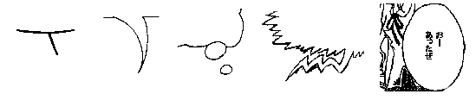
Tail extraction
Comic
page
image
Panel
& text
extraction
Balloon
extraction
Tail
extraction
Character
extraction
Comic
page
description
Stroke
Comma
Circle
Zigzag
Absent
Literature
  First time studied in document image analysis
Objectives
  Extraction of tail tip position and direction
  Focus on comma, zigzag and absent types
Notes:
Definitions
Tail: a pointer that indicates where is the emitter (speaker) of the balloon
Tail tip: the extremity of the tail, the closest part to the emitter
Tail direction: direction pointed by the tail

Slide 49
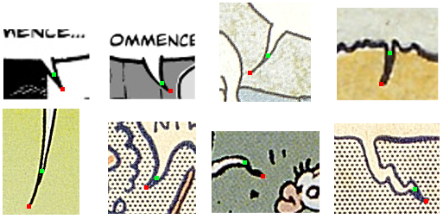
Tail extraction
Tip from background
Tip from contour
Direction of the tail
Different interpretation of tail tip positions and directions
Notes:
Position: in background or edge border
Direction: origin2tip, last part of the tip

Slide 50
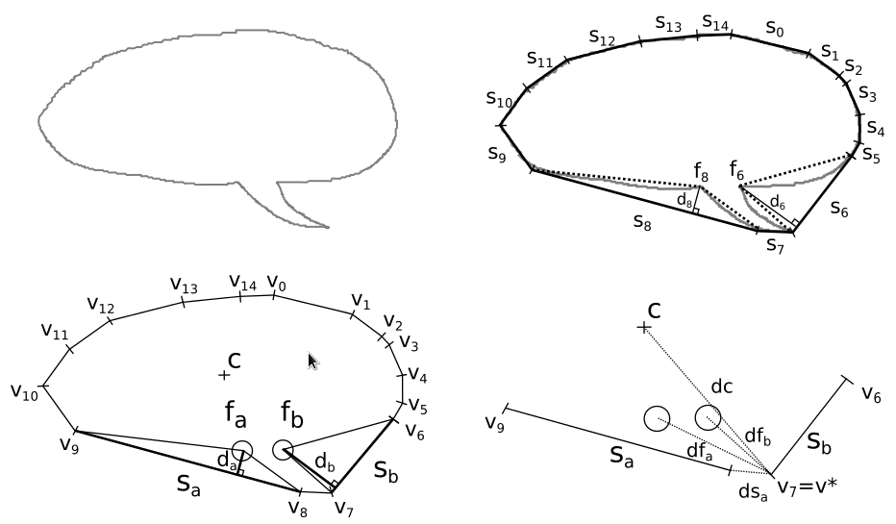
Tail extraction: tip position
Balloon contour
Convex hull
(ds_{b}=0)
Two biggest convexity defects
Tail tip position
Optimal vertex selection:
v∗ = argmax(max(dc + df_{a} + df_{b}) + min(ds_{a} + ds_{b}))
Notes:
Justify contour analysis:
- Tail is in the extension of the contour
- Local deformation going outside of the balloon (convexity defect)

Slide 51
Tail extraction: tip position
Balloon contour
Convex hull
(ds_{b}=0)
Two biggest convexity defects
Tail tip position
Optimal vertex selection:
v∗ = argmax(max(dc + df_{a} + df_{b}) + min(ds_{a} + ds_{b}))

Slide 52
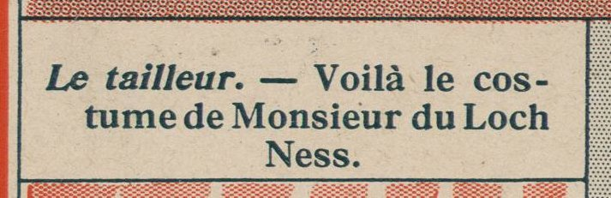
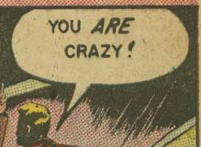
Tail extraction: confidence value
Balloon 1
Balloon 2
Balloon contour (blue)
Convex hull
(red)
d_{b}
d_{a}
d_{b}
d_{a}
Confidence
Presence of tail
NO
YES (>0)

Slide 53
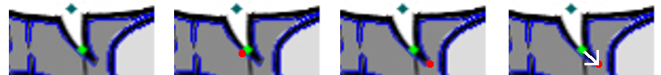
Tail extraction: tail direction
Definition
  Vector starting from “background” to “external edge” tail tip positions
Approach
  Extract external edge
  Find external edge tail tip coordinates
  Define the tail direction (N, NE, E, SE, S, SW, W, NW)
Background tail tip (green) and external edge (blue)
Closest point on external edge (red)
Farthest point from origin and tip (red)
Direction from tip to farthest point (white arrow)

Slide 54
Outlines
Introduction
Documents
Contributions
Experiments
Conclusion
Introduction
Sequential approach
  Panel & text extraction
  Balloon extraction
  Tail extraction
  Comic character extraction
(Independent approach)
Knowledge-driven approach
Inking. Image credits: Le cycle des bulles, Christophe Rigaud, 2012

Slide 55
Comic character extraction
Comic
page
image
Panel
& text
extraction
Balloon
extraction
Tail
extraction
Character
extraction
Comic
page
description
Literature
  Supervised approaches for manga and cartoon characters [TODO]
  No public dataset (copyright issues)
Challenges
  Variety of styles of comic books
  Intra and extra class variations of each character instance (e.g. position, scale, pose, occlusion and human-like, invented)
Objective
  Unsupervised and generic approach for all styles of comic books

Slide 56
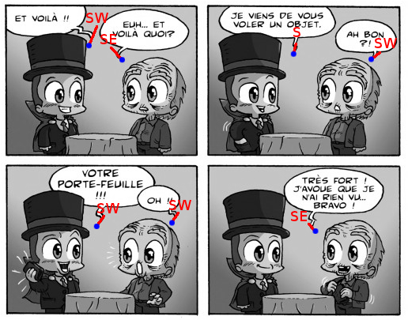
Comic character extraction
Panels + Tails = ?
Notes:
Explain red number and GT (grey BdB)

Slide 57
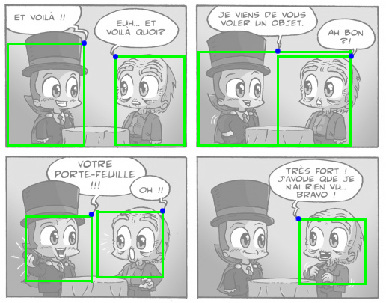
Comic character extraction
Panels + Tails = Comic character ROIs
Large ROI
Small ROI
Notes:
Explain red number and GT (grey BdB)

Slide 58
Results
Performances
Comic
page
image
Panel
& text
extraction
Balloon
extraction
Tail
extraction
Character
extraction
Comic
page
description
Publications

Slide 59
Comic character extraction
Conclusion
  Preliminary results
  Highly relies on the quality of the tail tip and direction (error propagation)
  Only for “speaking” characters
  Implicitly retrieves the relationship between balloons and characters

Slide 60
Conclusion
Panel & text extraction
  Simple and fast
  Disconnected panels only
Balloon extraction
  Accurate for closed balloons
  Implicit balloons would require more contextual information
Tail extraction
  Relies on the balloon contour extraction
  Limited to certain types of tail
Comic character extraction
  Highly relies on the quality of the tail extraction
  Implicitly retrieves the relationship between balloons and characters
  Only for “speaking” characters
Global
  Content-driven approach
  Sequential element processing
  From simple to complex elements
Pros
  Consistence between extracted elements
Cons
  Error propagation
TO DIVIDE INTO TWO SLIDES IF RE-USED

Slide 61
Outlines
Introduction
Documents
Contributions
Experiments
Conclusion
Introduction
Sequential approach
(Independent approach)
Knowledge-driven approach
  Introduction
  Knowledge representation
  Processing sequence
Inking. Image credits: Le cycle des bulles, Christophe Rigaud, 2012

Slide 62
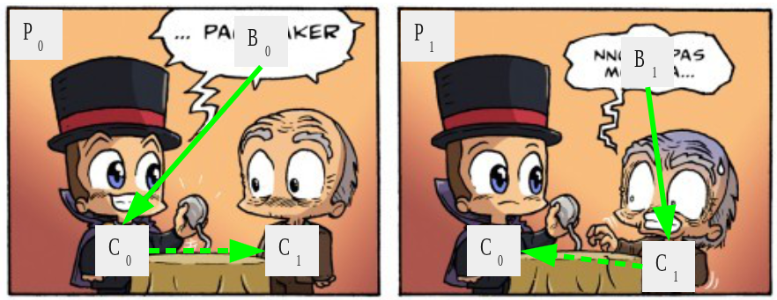
Introduction
High level image description
Independent element extraction
Framework for comics understanding
Collaboration with Clément Guérin
Panel
Comic
page
image
Text
Comic
page
description
Balloon & tail
Knowledge
Character
Illustration of high level description
Notes:
In collaboration with Clément Guérin

Slide 63
Knowledge representation
Image model
  Physical support
  Regions of interest
Comics model
  Validations
    A panel P is related to one page
    A balloon B is related to one panel and may have a tail Q
    A character C is related to one panel
    A text line T is related to one balloon
  Inferences
    B + Q + T => speech balloon SB
    SB + T => speech text ST
    SB + C => speaking character SC

Slide 64
Knowledge representation
Image model
  Physical support
  Regions of interest
Comics model
  Validations
    A panel P is related to one page
    A balloon B is related to one panel and may have a tail Q
    A character C is related to one panel
    A text line T is related to one balloon
  Inferences
    B + Q + T => speech balloon SB
    SB + T => speech text ST
    SB + C => speaking character SC

Slide 65
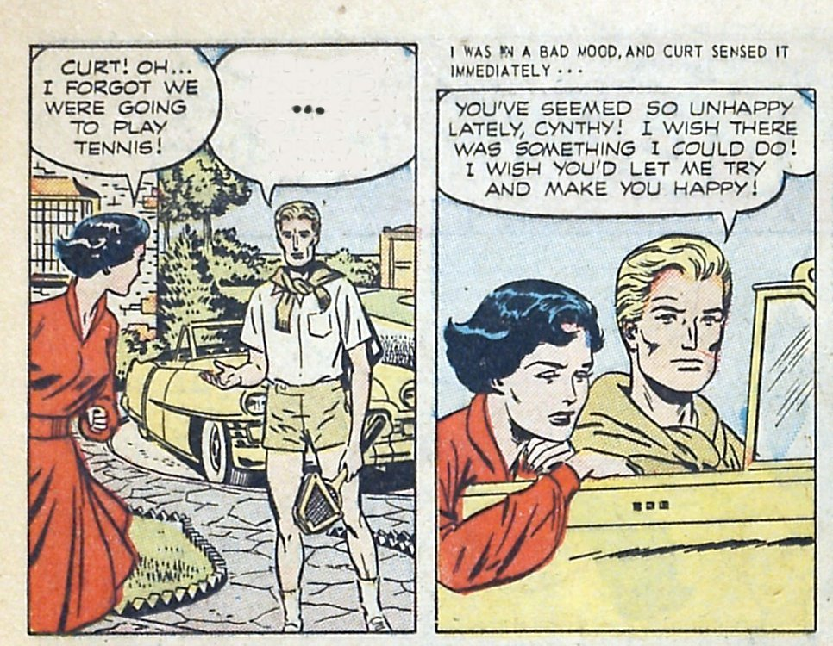
Processing sequence
Process loop
  Step 1: formulate hypothesis
  Step 2: validate hypothesis
  Step 3: infer new information
Study case
  Iteration 1
    Step 1: hypotheses of simple element positions
    Step 2: validation of the positions
    Step 3: inference a new information
  Iteration 2
    Step 1: hypotheses of more complex elements
    Step 2: validation of the positions
    Step 3: inference a new information
  ...
Step 1:
Formulate hypothesis
Step 3:
Infer new information
Step 2:
Validate hypothesis

Slide 66
Processing sequence
Formulate hypotheses
Validate
hypotheses
Infer new information
Iteration 1
  Step 1: hypotheses of simple element positions
  Step 2: validation of the positions
  Step 3: inference a new information
Iteration 2
  Step 1: hypotheses of more complex elements
  Step 2: validation of the positions
  Step 3: inference a new information
  ...

Slide 67
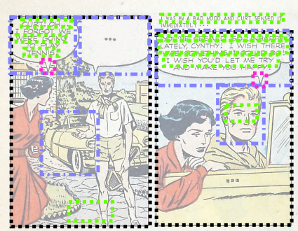
Processing sequence
Hypotheses of
panels, balloons
and text lines

Slide 68
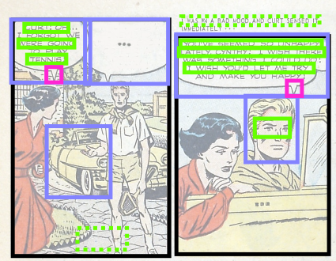
Processing sequence
Hypotheses of
panels, balloons
and text lines
Validation of the
hypotheses

Slide 69
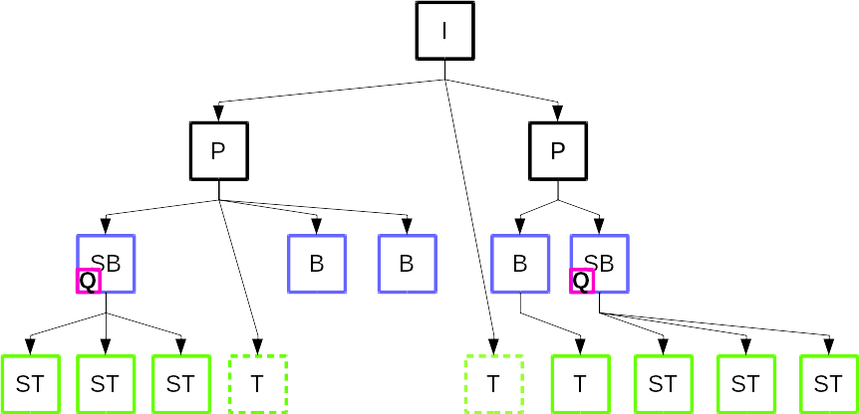
Processing sequence
Hypotheses of
panels, balloons
and text lines
Validation of the
hypotheses
Inferences of
specific types

Slide 70
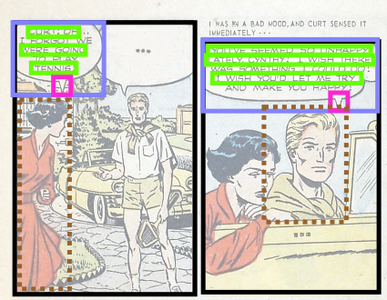
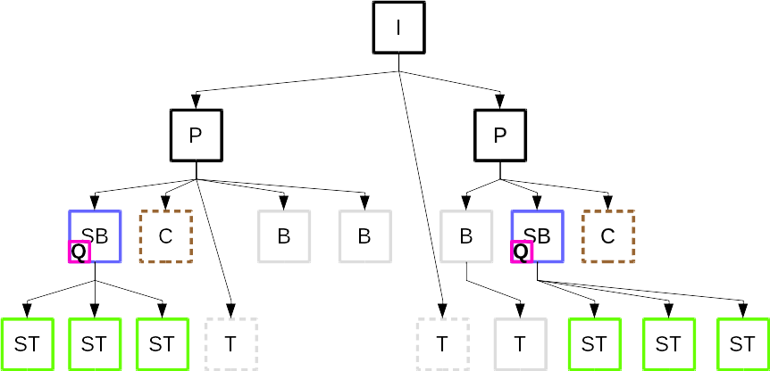
Processing sequence
Hypotheses of
comic characters
Validation of the
hypotheses
Inferences of
specific types

Slide 71
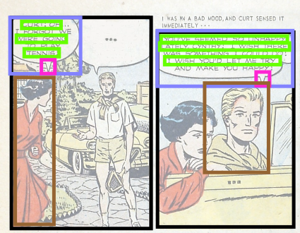

Processing sequence
Hypotheses of
comic characters
Validation of the
hypotheses
Inferences of
specific types

Slide 72


Processing sequence
Hypotheses of
comic characters
Validation of the
hypotheses
Inferences of
specific types
+ semantic links

Slide 73
Results
Performances
Publications

Slide 74
Conclusion
Contributions
  Generic, unsupervised and expandable framework for comics understanding (pending acceptance IJDAR)
  Formalization of image and comic book domains
Limitations
  Validation process (deletion only)

Slide 75

Outlines
Introduction
Background
Contributions
Experiments
Conclusion
Dataset and ground truth
Evaluations
Overall contribution
Ready for experiments?
Lettering. Image credits: Le cycle des bulles, Christophe Rigaud, 2012

Slide 76

Dataset and ground truth
Composition
  100 mixed pages
  From 1905 to 2012
  Franco-Belgium, American, Japanese
Visual annotations
  850 panels
  1092 balloons
  1550 comic characters
  4691 text lines
Semantic annotations
  Text type (e.g. speech, thought, narrative)
  Character ↔ balloon relationships
Absence of public dataset
Creation of heterogeneous dataset
  100 mixed pages from 20 albums
  Franco-Belgium “bandes dessinées”, American comics and Japanese manga
  From 1905 to 2012, paper and webcomics
  Rights holder permissions agreement
Online: http://ebdtheque.univ-lr.fr
Bibliographic annotations
Visual and semantic annotations
(100)
(850)
(1092)
(4691)
(1550)
Notes:
Annotations
– Visuelles : segmentation des éléments
– Sémantiques : numérotation, forme des bulles, orientation des flèches,
type et transcription du texte
– Liens bulle <> texte et bulle <> personnage

Slide 77

Evaluations
B_{p} = predicted region
B_{gt} = ground truth region
B_{p} is valid if a₀ > 0.5
TODO??? Define TP,TN, FP, FN
Extraction results on the eBDtheque dataset (F-score)
Notes:
Presentation of result summary only.
Detailed results in the thesis
More experiments about balloon classification, text recognition and character spotting are in the thesis.
Low comic character
- last step in the sequence
- speaking only (over all in GT)

Slide 78
Overall contribution
Element | Process type | Before | After
Panel | Localisation | 60% | 70% | +10%
 | Classification | 0% | 0% | 0%
Balloon | Localisation | 20% | 50% | +30%
 | Classification | 0% | 80% | +80%
 | Tail detection | 0% | 80% | +80%
Text | Localisation | 30% | 60% | +30%
 | Recognition | 10% | 10% | 0%
Comic character | Localisation | 5% | 10% | +5%
 | Identification | 10% | 10% | +10%
 | Face/pose | 0% | 0% | 0%
Context | Inter-element link | 0% | 10% | +10%
 | Situation retrieval | 0% | 0% | 0%
 | Timestamps | 30% | 30% | +30%
Dataset | Localisation | 0% | 70% | +70%
 | Semantic | 0% | 20% | +20%

Slide 79
Conclusion
Content-driven approach
Pros
  Efficient for “common” comics
  Easily reusable for specific needs
  Short processing time
Cons
  Rigid when used as a processing sequence
  Error propagation
Knowledge-driven approach
Pros
  Extensive, standard and exchangeable content description
  Allows information recovery
  No error propagation
  Consistent information
Cons
  Validation process by deletion only
  Processing time (reasoning)

Slide 80
Outlines
Introduction
Background
Comics
Experiments
Conclusion
Global conclusions
Global perspectives
Publications
Soon finish...
Lettering. Image credits: Le cycle des bulles, Christophe Rigaud, 2012

Slide 81
Global conclusions
Reached objectives
  Efficient panel, balloon, text and tail extraction methods
  First approaches for comic character extraction and context retrieval
  Public dataset and ground truth (http://ebdtheque.univ-lr.fr)
Publications
  1 journal, 2 book series , 4 conferences, 5 workshops (3 national)
  6 local seminars
Research impacts
  L3i is now a main actor of comic book analysis in Europe
  New Ph.D. thesis started in 2013 (Nam Le Thanh)
  Dataset used by international peers (Germany, India, China, Japan)
  National projects (PIA BigData Actialuna/LIP6, ANR EXPION 2015)
  International project on manga analysis (PHC-SAKURA with Japan)
Notes:
Use “the last but not least” if needed
PHC = Partenariats Hubert Curien (Hubert Curien Partnerships)

Slide 82
Global perspectives
Content extraction
  Consider overlapping panel extraction
  Investigate text recognition
  Improve implicit balloon extraction and evaluation
  Extract and identify non-speaking comic characters
Content understanding
  Situation retrieval
  Object interaction retrieval
  Label elements from text analysis
Dataset
  Increase the number of pages
  Add more annotation (e.g. panel situation, character names and roles)
  Annotate multi-parts of comic characters

Slide 83
Publications
JOURNAL
Christophe Rigaud, Clément Guérin, Dimosthenis Karatzas, Jean-Christophe Burie and Jean-Marc Ogier. “Knowledge-driven understanding of images in comic books”. International Journal on Document Analysis and Recognition (IJDAR), 2015 (accepted with minor reviews).
BOOK SERIES
Christophe Rigaud, Dimosthenis Karatzas, Jean-Christophe Burie and Jean-Marc Ogier. “Adaptive contour classification of comics speech balloons”. In Graphic Recognition. New Trends and Challenges. Lecture Notes in Computer Science (LNCS), Vol. 8746, 2014.
Christophe Rigaud, Norbert Tsopze, Jean-Christophe Burie and Jean-Marc Ogier. “Robust frame and text extraction from comic books”. In Graphic Recognition. New Trends and Challenges. Lecture Notes in Computer Science (LNCS), Vol. 7423, pp. 129-138, 2013.

Slide 84
Publications
CONFERENCES
Christophe Rigaud, Dimosthenis Karatzas, Jean-Christophe Burie and Jean-Marc Ogier. “Color descriptor for content-based drawing retrieval”. In the Proceedings of the 11th IAPR International Workshop on Document Analysis Systems (DAS), pp. 267-271 , Tours, France, April, 2014.
Christophe Rigaud, Dimosthenis Karatzas, Joost Van de Weijer, Jean-Christophe Burie and Jean-Marc Ogier. “An active contour model for speech balloon detection in comics”. In the Proceedings of the 12th International Conference on Document Analysis and Recognition (ICDAR), pp. 1240-1244, Washington DC, USA, August, 2013.
Clément Guérin, Christophe Rigaud, Antoine Mercier, Farid Ammar-Boudjelal, Karell Bertet, Alain Bouju, Jean-Christophe Burie, Georges Louis, Jean-Marc Ogier and Arnaud Revel. “eBDtheque: a representative database of comics”. In the Proceedings of the 12th International Conference on Document Analysis and Recognition (ICDAR), pp. 1145-1149, Washington DC, USA, August, 2013.
Christophe Rigaud, Dimosthenis Karatzas, Joost Van de Weijer, Jean-Christophe Burie and Jean-Marc Ogier. “Automatic Text Localisation in Scanned Comic Books”. In the Proceedings of the 8th International Conference on Computer 153 Vision Theory and Applications (VISAPP), pp. 814-819, Barcelona, Spain, February, 2013.

Slide 85
Publications
WORKSHOPS
Clément Guérin, Christophe Rigaud, Karell Bertet, Jean-Christophe Burie, Arnaud Revel and Jean-Marc Ogier. “Réduction de l’espace de recherche pour les personnages de bandes dessiné́es”. In the Proceedings of the 19ème congrès national sur la Reconnaissance de Formes et l’Intelligence Artificielle (RFIA), Rouen, France, July, 2014.
Christophe Rigaud, and Clément Guérin. “Localisation contextuelle des personnages de bandes dessinées”. In the Proceedings of the 13ème Colloque International Francophone sur l’Ecrit et le Document (CIFED), pp. 367–370, Nancy, France, March 2014.
Christophe Rigaud, Dimosthenis Karatzas, Jean-Christophe Burie and Jean-Marc Ogier. “Speech balloon contour classification in comics”. Proceedings of the 10th International Workshop on Graphics RECognition (GREC), pp. 23-25, Bethlehem, USA, August, 2013.
Hoang Nam Ho, Christophe Rigaud, Jean-Christophe Burie and Jean-Marc Ogier. “Redundant structure detection in attributed adjacency graphs for character detection in comics books”. In the Proceedings of the 10th IAPR International Workshop on Graphics RECognition (GREC), pp. 109-113, Bethlehem, PA, USA, August, 2013.
Christophe Rigaud, Norbert Tsopze, Jean-Christophe Burie and Jean-Marc Ogier. “Extraction robuste des cases et du texte de bandes dessinées”. In the Proceedings of the 10ème Colloque International Francophone sur l’Ecrit et le Document (CIFED), pp. 349-360, Bordeaux, France, March 2012.

Slide 86
References
[Arai10] Kohei Arai and Herman Tolle. Method for automatic e-comic scene frame extraction for reading comic on mobile devices. In Seventh International Conference on Information Technology: New Generations, ITNG ’10, pages 370–375, Washington, DC, USA, 2010. IEEE Computer Society.
[Cheung08] S.C.S. Cheung, City University of Hong Kong. Run Run Shaw Library, and City University of Hong Kong. Face Detection and Face Recognition of Human-like Characters in Comics. Outstanding academic papers by students. Run Run Shaw Library, City University of Hong Kong, 2008.
[Chung07] ChungHo Chan, Howard Leung, and Taku Komura. Automatic panel extraction
of color comic images. In HoraceH.-S. Ip, OscarC. Au, Howard Leung, Ming-Ting Sun, Wei-Ying Ma, and Shi-Min Hu, editors, Advances in Multimedia Information Processing - PCM 2007, volume 4810 of Lecture Notes in Computer Science, pages 775–784. Springer Berlin Heidelberg, 2007.
[Eunjung07] Eunjung Han, Kirak Kim, HwangKyu Yang, and Keechul Jung. Frame seg-
mentation used mlp-based x-y recursive for mobile cartoon content. In Proceedings of the 12th international conference on Human-computer interaction: intelligent multimodal interaction environments, HCI’07, pages 872–881, Berlin, Heidelberg, 2007. Springer.
[Ho12] Anh Khoi Ngo Ho, Jean-Christophe Burie, and Jean-Marc Ogier. Panel and speech balloon extraction from comic books. In 2012 10th IAPR International Workshop on Document Analysis Systems, pages 424–428. IEEE, 2012.
Notes:
Here are the references I mentioned throughout this presentation.

Slide 87
References
[Khan12] Fahad Shahbaz Khan, Muhammad Anwer Rao, Joost van de Weijer, Andrew D.
Bagdanov, Maria Vanrell, and Antonio Lopez. Color attributes for object detection. In 25th IEEE Conference on Computer Vision and Pattern Recognition (CVPR 2012), 2012.
[Li14a] Luyuan Li, Yongtao Wang, Zhi Tang, and Liangcai Gao. Automatic comic page segmentation based on polygon detection. Multimedia Tools Applications, 171–197, 2014, Kluwer Academic Publishers.
[Li14b] Luyuan Li, Yongtao Wang, Zhi Tang, Xiaoqing Lu, and Liangcai Gao. Unsuper-
vised speech text localization in comic images. In Proceedings of International Conference on Document Analysis and Recognition (ICDAR), pages 1190–1194, Aug 2013
[Pang14] Xufang Pang, Ying Cao, Rynson W.H. Lau, and Antoni B. Chan. A robust panel extraction method for manga. In Proceedings of the ACM International Conference on Multimedia, MM ’14, pages 1125–1128, New York, NY, USA, 2014.
[Ponsard12] Christophe Ponsard, Ravi Ramdoyal, and Daniel Dziamski. An ocr-enabled
digital comic books viewer. In Computers Helping People with Special Needs, pages 471–478. Springer, 2012.
[Stommel12] Martin Stommel, Lena I Merhej, and Marion G Müller. Segmentation-free
detection of comic panels. In Computer Vision and Graphics, pages 633–640, 2012.
Notes:
Here are the references I mentioned throughout this presentation.

Slide 88
References
[Su11] Chung-Yuan Su, Ray-I Chang, and Jen-Chang Liu. Recognizing text elements
for svg comic compression and its novel applications. In Proceedings of International Conference on Document Analysis and Recognition (ICDAR), pages 1329–1333, Washington, DC, USA, 2011
[Sun10] Weihan Sun and Koichi Kise. Similar partial copy detection of line drawings using a cascade classifier and feature matching. In Hiroshi Sako, Katrin Franke, and Shuji Saitoh, editors, ICWF, volume 6540 of Lecture Notes in Computer Science, pages 126–137. Springer, 2010.
[Tanaka07] Takamasa Tanaka, Kenji Shoji, Fubito Toyama, and Juichi Miyamichi. Layout
analysis of tree-structured scene frames in comic images. In IJCAI’07, pages 2885–2890, 2007.

Slide 89


Authors, publishers, CIBDI
Founding: Communauté d'Agglomération de La Rochelle
Time for demo on easy case with comic character ROI computation?
Image credits: @carenalfaro
https://github.com/crigaud/thesis/tree/master/presentation
http://www.christophe-rigaud.com

Slide 90
Complementary information

Slide 91






History of comics art
Pre-history: painting of animals and hunters in caves [Marx, 2007]
1846: Rodolphe Töpffer, the inventor of the “bandes dessinées”
1930s: magazine-style comic books production in the US
1950s: massive production of manga in Japan (Osamu Tezuka)
1971: the term of ninth art is attributed to comics art (Francis Lacassin)
1996: explosion of the Internet bubble and webcomics
2007: adaptation to social media sites and mobile devices
Pre-history and ancient Egypt
Rodolphe Töpffer, Histoire de Monsieur Cryptogame (1830)
Ted McCall, Robin Hood And Company (1946)
Tezuka Osamu, Manga Classroom (1953)
Marion Montaine, Tu mourras moins bête (2013)
Notes:
Pre-history
Ancient Egypt
Rodolphe Töpffer is a Francophone Swiss artist
Francis Lacassin, auteur du livre Pour un neuvième art, la bande dessinée17, mais ce livre ne date que de 1971, 7 ans après les articles de Spirou

Slide 92
GT validation

Slide 93
Knowledge-driven analysis detail
Comic character region refinement

Slide 94

Production to interpretation
Image source: Handbook of Document Image Processing and Recognition. Springer, 2014
Notes:
Low-level: pre-processing, feature extraction
Middle-level: classification, recognition
High-level: interpretation, understanding

Slide 95

Result examples
TODO

Slide 96
Element | Process type | Analysis method | Method | Publication | Before | After
Panel | Localisation | Histogram | S | CIFED'12 LNCS'13 | 60% | 70% | +10%
 |  | Topology | I, K | IJDAR'15
Balloon | Localisation | Topology | S | - | 20% | 50% | +30%
 |  | Region | I, K | -
 |  | Edge | S | ICDAR'13
 | Classification | Contour | S, I, K | GREC'13 LNCS'14 | 0% | 80% | +80%
Text | Localisation | Topology | S |  | 5% | 60% | +55%
 |  | Structure | I, K | VISAPP'13
 | Recognition | - | - | - | 10% | 10% | 0%
Comic characters | Localisation | Graph | - | GREC'13 (2nd) | 5% | 10% | +5%
 |  | Context | S, K | CIFED'14 RFIA'14 (2nd)
 | Spotting | Colour | I | DAS'14
 | Identification | - | - | - | 10% | 10% | 0%
 | Face/pose | - | - | - | 0% | 0% | 0%
Context | Inter-element | Proximity | S, K | CIFED'14 RFIA'14 (2nd) IJDAR'15 | 0% | 10% | +10%
 | Situation | - | - | - | 0% | 0% | 0%
 | Timestamps | Reading order | - | - | 30% | 30% | 0%
Dataset | Localisation | Visual elements | S, I, K | ICDAR'13 | 0% | 70% | +70%
 | Semantic | Relations | S, I, K | ICDAR'13 | 0% | 20% | +20%

Slide 97

Thinking about the scenario. Image credits: Wissam Shekhani, 2010

