Slide 1
Interprétation de documents techniques (1)
Write - Draw
Document producing process
Conception
Page setting
Draw
Conceptual schema
Logic
representation
Physical
representation
Document
papier
?
Paper
document
Schéma
conceptuel
Schéma
logique
Physical
analysis
Conceptual
schema
Logic
analysis
Capture
and Segmentation
Interpretation
Recognition
Interpretation
Document Interpretation Process
<number>

Slide 2
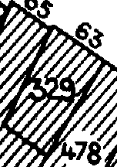
1950-1980
Digitizing process : poor format
Image
1980-2000
Fully manual process : prohibitive costs
CAD database
Industrial
Solutions
1990-2005
Fully automatic interpretation process :utopic approaches
CAD database
2003-2012
Information spotting approaches : partial interpretation
CAD database
<number>

