Slide 1
Outlines
Introduction
Document analysis
State of the art of comics analysis
Contributions
Experimentations
Conclusions

Slide 2
Outlines
Introduction
Document analysis
State of the art of comics analysis
Contributions
  Introduction
  Sequential approach
  Independent approach
  Knowledge-driven approach
  Conclusion
Experimentations
Conclusions

Slide 3

Three different approaches
Sequential
Comic
page
image
Panel
extraction
Text
extraction
Balloon
extraction
Tail
extraction
Character
extraction
Comic
page
description
Independent
Knowledge-driven
Panel
Panel
Image
Image
Text
Text
Description
Description
Balloon
Balloon
Tail
Knowledge
Tail
Character
Character
Notes:
Explain why these three approaches

Slide 4
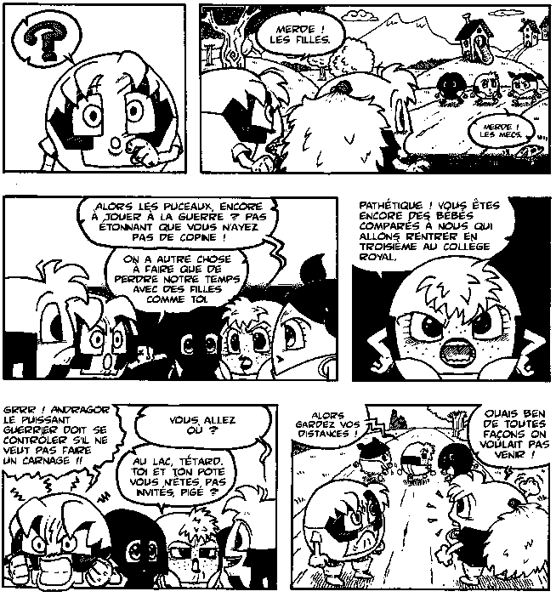
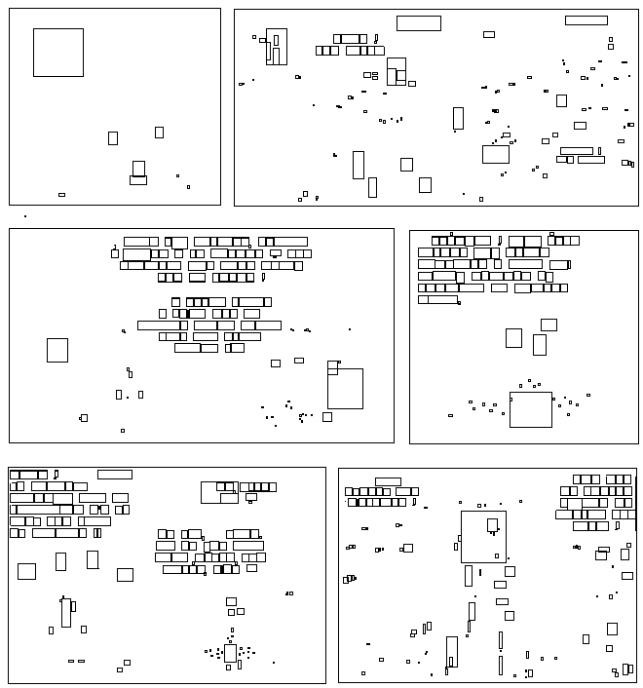
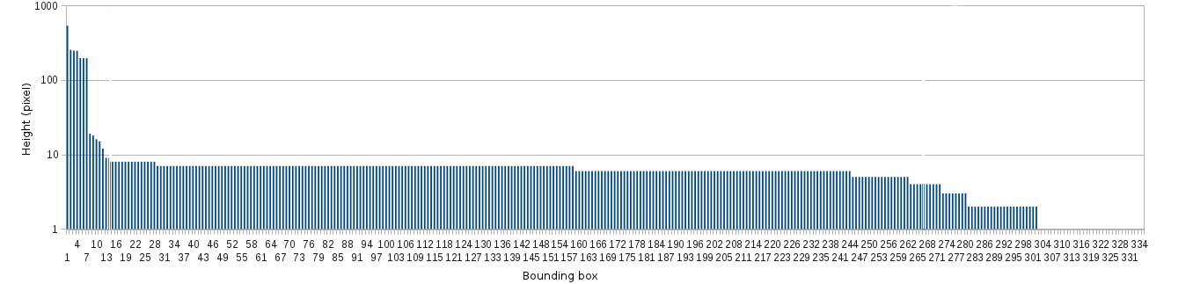
Panel and text extraction
Comic
page
image
Panel
extraction
Text
extraction
Balloon
extraction
Tail
extraction
Character
extraction
Comic
page
description
Binary image
Connected-component (CC) bounding boxes
Histogram of heights of CC
Notes:
Explain why these three approaches

Slide 5
Panel and text extraction
CC height (pixel)
Histogram of height (descendent order)
Notes:
Explain why these three approaches

Slide 6
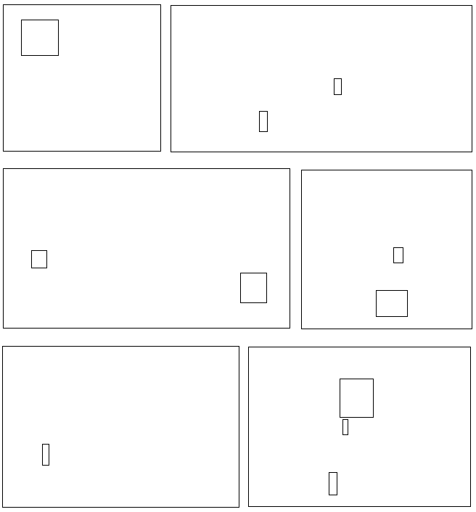
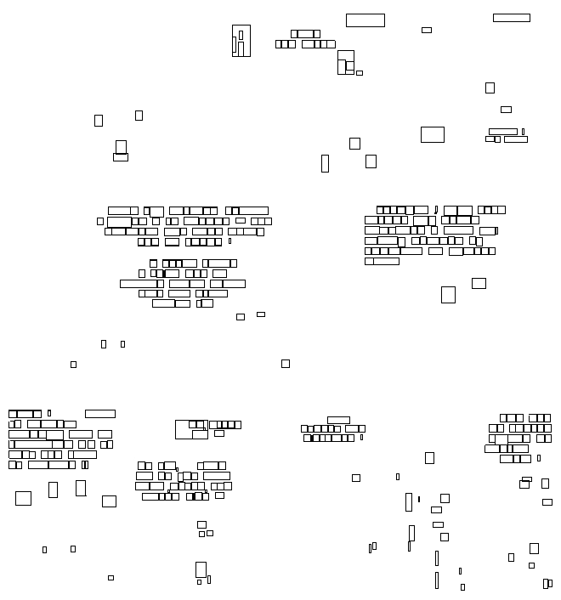

Panel and text extraction
K-means clustering (k=3)
CC height (pixel)
Panels
Text
Noise
Notes:
Explain why these three approaches

Slide 7


Balloon extraction
Comic
page
image
Panel
extraction
Text
extraction
Balloon
extraction
Tail
extraction
Character
extraction
Comic
page
description
Regular balloon
Implicit balloon
Literature
  Top-down approaches: extract white blobs and then text inside
  Limited to regular balloons
Contribution
  Bottom-up approaches: extract text and then surrounding balloons
  Appropriate for regular and implicit balloons

Slide 8
Balloon extraction
Comic
page
image
Panel
extraction
Text
extraction
Balloon
extraction
Tail
extraction
Character
extraction
Comic
page
description
Regular balloon
Implicit balloon
Literature
  Top-down approaches: extract white blobs and then text inside
  Limited to regular balloons
Contribution
  Bottom-up approaches: extract text and then surrounding balloons
  Appropriate for regular and implicit balloons

Slide 9
Regular balloon extraction
Assumptions
  Panels and text block positions are known
  Balloons contain text
  Text is fully contained and centred in balloons
Proposition → structural analysis
  Extract closed contours that includes centred text

Slide 10
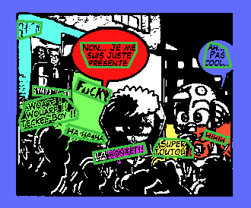

Regular balloon extraction
Assumptions
  Panels and text block positions are known
  Balloons contain text
  Text is fully contained and centred in balloons
Proposition → structural analysis
  Extract closed contours that includes centred text

