Slide 1
Using Deep Feed-forward Neural Networks to Extract the language from a Sentence
By: Christian Yeganeh

Slide 2
What is the problem
Algorithm based approach more databases, and lengthy checking
Neural networks are very efficient and fast at learning
Neural network are portable and can be easily shared

Slide 3
Program Design
Deep feed forward neural network with 19, 60, 30, 19, then 3 nodes in each layer
Trained using large data set of sentences
Takes in a word in a array form with letters as value for each index
Takes the number of words that are classified as each language and assigns the sentence the most common language

Slide 4
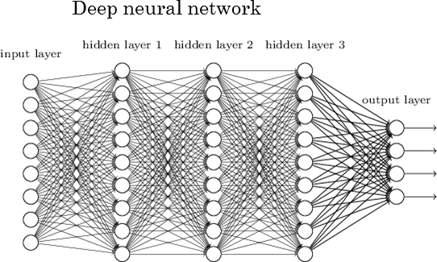
Neural network layout

Slide 5
Information about the data
There are 3 languages, English, French, German
The books were downloaded from Gutenberg
20 books in each language
160 sentences were extracted from each book
3200 sentences per language, 9600 in total

Slide 6
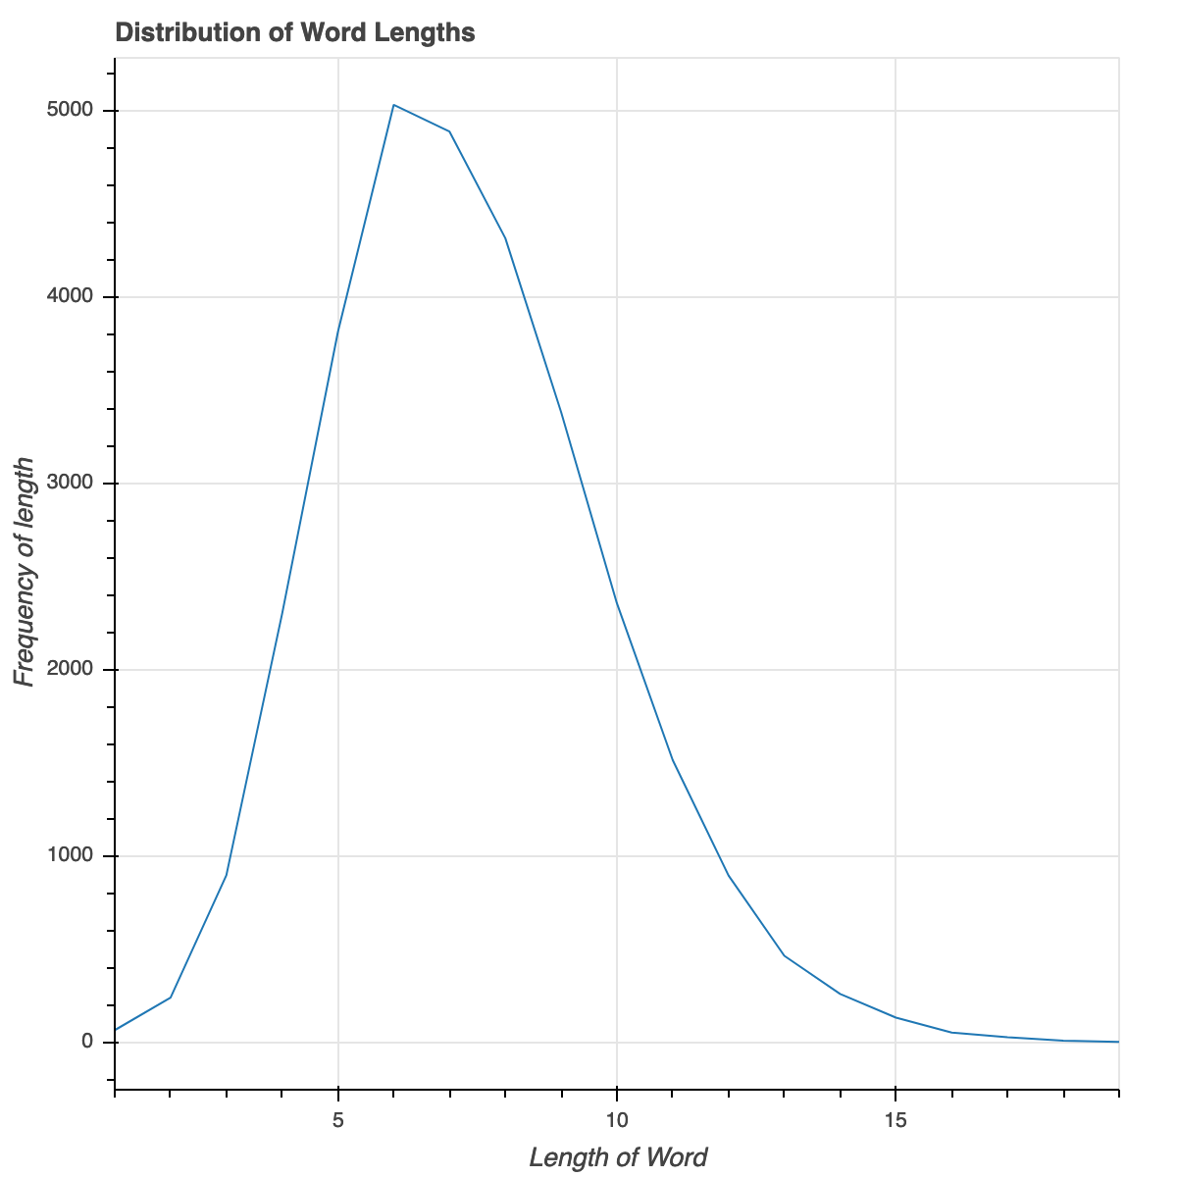
Word length

Slide 7
Training
Training took about 8 hours until the loss function wasn’t changing significantly.
I trained 4 different layouts for the hidden layers. [19,19,19] , [19,14], [60,60], and the one I found was best [60,30,19]
Took around 143,000 training sessions in TensorFlow to achieve the minimal loss of 7,300

Slide 8
Results
I was able to achieve acceptable accuracy in the detection of the language.
English was correct 67.82% of the time
French was correct 75.63% of the time
German was correct 68.35% of the time
Total was correct 70.60% of the time in any given input
Consider guessing would be 33.33%

Slide 9
Tools used
Used Tensorflow for modeling and training the neural network
Used Gutenberg for the acquiring of books and thus sentences
NumPy for processing
TextBlob for text preprocessing
Json for saving data for less preprocessing.

