Slide 1
Heaps
CSC220|Computer Programming 2

Slide 2
Last Time…

Slide 3
Recap
Heap versus priority queue
Priority queue: a description of a set of operations
Heap: one possible efficient way of implementing those operations

Slide 4
A binary heap is a binary tree with two special properties
Structure: it is a complete tree
Order: the data in any node is less than or equal to the data of its children
This is also called a min-heap
A max-heap would have the opposite property

Slide 5
Add

Slide 6
Adding 14
Put it at the end of the tree
Percolate up the tree to fix the order
22
3
6
31
43
17
92
100
56
45 14

Slide 7
Adding 14
Put it at the end of the tree
Percolate up the tree to fix the order
22
3
6
31
43
17
92
100
56
45 14

Slide 8
Adding 14
Put it at the end of the tree
Percolate up the tree to fix the order
14
3
6
31
22
17
92
100
56
45 43

Slide 9
Remove

Slide 10
Let’s remove the smallest item
Take out 3
Fill with last item on last level. why?
14
3
16
31
22
17
92
100
56
45 43

Slide 11
Let’s remove the smallest item
Take out 3
Fill with last item on last level. why?
14
43
16
31
22
17
92
100
56
45

Slide 12
Let’s remove the smallest item
Take out 3
Fill with last item on last level. why?
22
Percolate
14
16
down
31
43
17
92
100
56
45

Slide 13
The average cases for a priority queue implemented with a binary heap:
add
O(1): percolate up (average of 2.6 compares)
findMin
O(1): just return the root
deleteMin
O(logN): percolate down (rarely terminates before near the bottom of the tree)
17

Slide 14
Heap implementation
As a linked list
How to look for parent during bubbling?
How to access the rightmost leaf?
Any complete tree can be stored as an array!

Slide 15
Array heap implementation
1
2
3
4
5 6
7
1 | 2 | 3 | 4 | 5 | 6 | 7
73

Slide 16
Array heap implementation
1
2
3
4
5 6
7
1 | 2 | 3 | 4 | 5 | 6 | 7
root
74

Slide 17
Array heap implementation
1
2
3
4
5 6
7
1 | 2 | 3 | 4 | 5 | 6 | 7
The left child of index i is stored at index 2i+1
75

Slide 18
Array heap implementation
1
2
3
4
5 6
7
1 | 2 | 3 | 4 | 5 | 6 | 7
The right child of index i is stored at index 2i+2
76

Slide 19
a
b
c
d
e
f
g
h i
j
array index
a | b | c | d | e | f | g | h | i | j
0 1 2 3 4
5 6 7 8 9
How can we compute the index of any node’s parent?
77

Slide 20
a
b
c
d
e
f
g
h i
j
array index
a | b | c | d | e | f | g | h | i | j
0 1 2 3 4
5 6 7 8 9
Luckily, integer division automatically truncates
Any node’s parent is at index (i-1) / 2
78

Slide 21
Complete trees as an array
Keep track of a currentSize variable
Holds the total number of nodes in the tree
The very last leaf of the bottom level will be at index currentSize - 1
When computing the index of a child node, if that index is >= currentSize, then the child does not exist
79

Slide 22
traversal helper methods
int leftChildIndex(int i) {
return (i*2) + 1;
}
int rightChildIndex(int i) { return (i*2) + 2;
}
int parentIndex(int i) { return (i-1) / 2;
}
80

Slide 23
Add
10
Insert 37
50
20
70
60
44
90
80
99
65
10 | 50 | 20 | 70 | 60 | 44 | 90 | 80 | 99 | 65

Slide 24
Add
10
Insert 37
50
20
70
60
44
90
80
99
65
37
10 | 50 | 20 | 70 | 60 | 44 | 90 | 80 | 99 | 65 | 37

Slide 25
Add
10
Insert 37
50
20
70
60
44
90
80
99
65
37
10 | 50 | 20 | 70 | 60 | 44 | 90 | 80 | 99 | 65 | 37

Slide 26
Add
10
Insert 37
50
20
70
37
44
90
80
99
65
60
10 | 50 | 20 | 70 | 37 | 44 | 90 | 80 | 99 | 65 | 60

Slide 27
Add
10
Insert 37
50
20
70
37
44
90
80
99
65
60
10 | 50 | 20 | 70 | 37 | 44 | 90 | 80 | 99 | 65 | 60

Slide 28
Add
10
Insert 37
37
20
70
50
44
90
80
99
65
60
10 | 37 | 20 | 70 | 50 | 44 | 90 | 80 | 99 | 65 | 60

Slide 29
EXAMPLE

Slide 30
Today…

Slide 31
Generic heaps
Basic operation for heap

Slide 32
Generic heaps
Basic operation for heap
comparison
How to perform comparison for objects?

Slide 33
Generic heaps
Basic operation for heap
comparison
How to perform comparison for objects?
Use compareTo method

Slide 34
Heap sort

Slide 35
Heap sort
A simple sorting algorithm that takes advantage of the ordering of heaps to arrange data quickly.

Slide 36
Heap sort
A simple sorting algorithm that takes advantage of the ordering of heaps to arrange data quickly.
How?

Slide 37
Heap sort
A simple sorting algorithm that takes advantage of the ordering of heaps to arrange data quickly.
Add all elements of an array to a priority queue
Then remove them!
You have sorted array ☺

Slide 38
Heap sort
A simple sorting algorithm that takes advantage of the ordering of heaps to arrange data quickly.
Add all elements of an array to a priority queue
Then remove them!
• You have sorted array ☺
Why?!

Slide 39
Pseudo code…
A = array to be sorted
H = create new heap For each element n in A
add n to H While (H not empty)
remove element from H
add element back into A
28

Slide 40
Heap sort complexity
For sorting an array of size N heap sort performs:
N add
N remove

Slide 41
Heap sort complexity
For sorting an array of size N heap sort performs:
N add
N remove
Each add or remove is log(N)

Slide 42
Heap sort complexity
For sorting an array of size N heap sort performs:
N add
N remove
Each add or remove is log(N)
N log(N)

Slide 43
Heap sort complexity
For sorting an array of size N heap sort performs:
N add
N remove
Each add or remove is log(N)
N log(N)
• Drawback?!

Slide 44
Heap sort complexity
For sorting an array of size N heap sort performs:
N add
N remove
Each add or remove is log(N)
N log(N)
• Drawback: require extra space

Slide 45
In-place heap sort
Use the original array itself as the heap
The idea is to treat the array as an initially invalid heap and repair it into a proper heap
Bubbling elements into their proper position
Remove elements from the heap and put them at the end of the array.
min-heap gives you descending order and max- heap gives you ascending order
34

Slide 46
In-place heap sort
1 | 9 | 2 | 4 | 6 | 8

Slide 47
In-place heap sort
1
9
2
4
6 8
1 | 9 | 2 | 4 | 6 | 8

Slide 48
In-place heap sort
1
9
2
4
6 8
1 | 9 | 2 | 4 | 6 | 8
Not a heap → Need to heapify
37

Slide 49
In-place heap sort
1
9
2
4
6 8
1 | 9 | 2 | 4 | 6 | 8
Start at the last parent node → continually sift down the
smallest descendent at each level

Slide 50
In-place heap sort
1
9
2
4
6 8
1 | 9 | 2 | 4 | 6 | 8
Start at the last parent node → continually sift down the
smallest descendent at each level

Slide 51
In-place heap sort
1
9
2
4
6 8
1 | 9 | 2 | 4 | 6 | 8
Start at the last parent node → continually sift down the
smallest descendent at each level

Slide 52
In-place heap sort
1
9
8
4
6 2
1 | 9 | 8 | 4 | 6 | 2
Start at the last parent node → continually sift down the
smallest descendent at each level

Slide 53
In-place heap sort
1
9
8
4
6 2
1 | 9 | 8 | 4 | 6 | 2
Start at the last parent node → continually sift down the
smallest descendent at each level

Slide 54
In-place heap sort
1
9
8
4
6 2
1 | 9 | 8 | 4 | 6 | 2
Start at the last parent node → continually sift down the
smallest descendent at each level

Slide 55
In-place heap sort
1
9
8
4
6 2
1 | 9 | 8 | 4 | 6 | 2
Start at the last parent node → continually sift down the
smallest descendent at each level

Slide 56
In-place heap sort
9
1
8
4
6 2
9 | 1 | 8 | 4 | 6 | 2
Start at the last parent node → continually sift down the
smallest descendent at each level

Slide 57
In-place heap sort
9
1
8
4
6 2
9 | 1 | 8 | 4 | 6 | 2
Start at the last parent node → continually sift down the
smallest descendent at each level

Slide 58
In-place heap sort
9
6
8
4
1 2
9 | 6 | 8 | 4 | 1 | 2
47

Slide 59
In-place heap sort
9
6
8
4
1 2
9 | 6 | 8 | 4 | 1 | 2
Not yet sorted array!
48

Slide 60
In-place heap sort
9
6
8
4
1 2
9 | 6 | 8 | 4 | 1 | 2
Remove the max, put it at the end
Don’t forget to sift down if need be

Slide 61
In-place heap sort
8
6
2
4
1 9
8 | 6 | 2 | 4 | 1 | 9
Remove the max, put it at the end
Don’t forget to sift down if need be

Slide 62
In-place heap sort
8
6
2
4
1 9
8 | 6 | 2 | 4 | 1 | 9
Remove the max, put it at the end
Don’t forget to sift down if need be

Slide 63
In-place heap sort
6
4
2
1
8 9
6 | 4 | 2 | 1 | 8 | 9
Remove the max, put it at the end
Don’t forget to sift down if need be

Slide 64
In-place heap sort
6
4
2
1
8 9
6 | 4 | 2 | 1 | 8 | 9
Remove the max, put it at the end
Don’t forget to sift down if need be

Slide 65
In-place heap sort
4
1
2
6
8 9
4 | 1 | 2 | 6 | 8 | 9
Remove the max, put it at the end
Don’t forget to sift down if need be

Slide 66
In-place heap sort
2
1
4
6
8 9
2 | 1 | 4 | 6 | 8 | 9
Remove the max, put it at the end
Don’tt forgett tto siftt down if need be

Slide 67
In-place heap sort
1
2
4
6
8 9
1 | 2 | 4 | 6 | 8 | 9
Remove the max, put it at the end
Don’tt forgett tto siftt down if need be

Slide 68
In-place heap sort
1
2
4
6
8 9
1 | 2 | 4 | 6 | 8 | 9
Remove the max, put it at the end
Don’t forget to sift down if need be

Slide 69
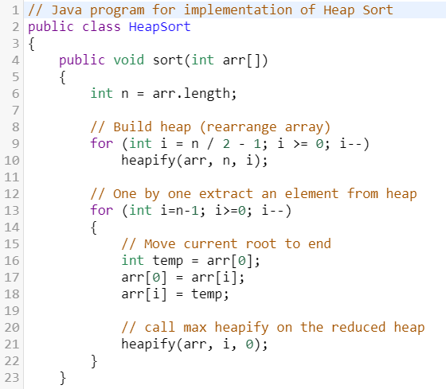

Slide 70
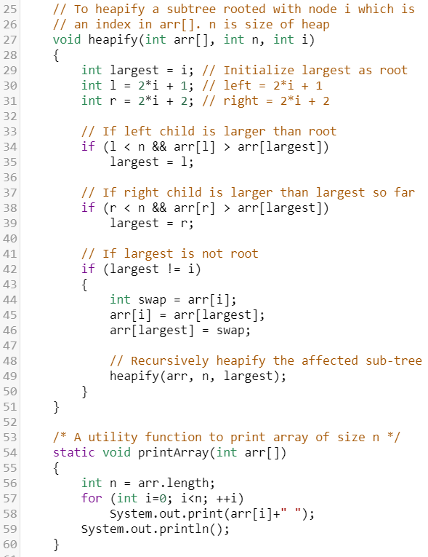

Slide 71
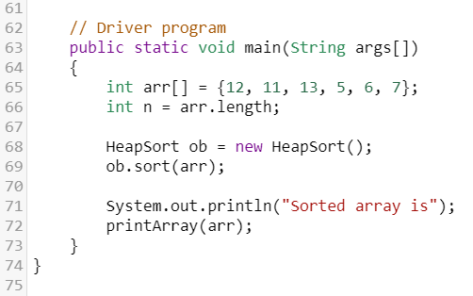

Slide 72
https://www.youtube.com/watch?v=2DmK_H7IdTo

Slide 73
Implementation
You’ll do for your assignment this week!

Slide 74
Next time…

Slide 75
Hashing

