Slide 1

Mini Git Tutorial http://git-scm.com/
Cristian Lucchesi <cristian.lucchesi@iit.cnr.it>, @criluc
https://github.com/criluc/mini-git-tutorial
22 novembre 2012

Slide 2
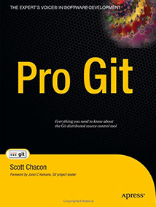
Disclaimer
Tutorial arranged in one day... from a Git end user
Strongly based on:
  Pro Git book, written by Scott Chacon and published by Apress
  is available to read online for free http://git-scm.com/book

Slide 3



Company using Git

Slide 4
Version Control System
a system that records changes to a file or set of files over time so that you can recall specific versions later.
It allows you:
  to revert files back to a previous state
  revert the entire project back to a previous state
  compare changes over time
  see who last modified something that might be causing a problem
  who introduced an issue and when, and more.
  using a VCS also generally means that if you screw things up or lose files, you can easily recover
  you get all this for very little overhead.

Slide 5

Centralized VCS (CVS,SVN..)
have a single server that contains all the versioned files
clients check out files from that central place
everyone knows to a certain degree what everyone else on the project is doing
administrators have fine-grained control over who can do what
it’s far easier to administer
single point of failure that the centralized server represents
whenever you have the entire history of the project in a single place, you risk losing everything

Slide 6

Distribuited VCS (Git, Mercurial, Bazar, ...)
clients don’t just check out the latest snapshot of the files: they fully mirror the repository
if any server dies, and these systems were collaborating via it, any of the client repositories can be copied back up to the server to restore it
deal pretty well with having several remote repositories it can work with
allows you to set up several types of workflows that aren’t possible in centralized systems, such as hierarchical models
you need a tutorial like this to use it :-)

Slide 7
Short History of GIT
Developed since 2005 from Linux development community (and in particular Linus Torvalds, the creator of Linux)
the goals of the new system were:
  Speed
  Simple design
  Strong support for non-linear development (thousands of parallel branches)
  Fully distributed
  Able to handle large projects like the Linux kernel efficiently (speed and data size)

Slide 8


Git Basics
other systems: store information as a list of file-based changes
Git: its data more like a set of snapshots of a mini filesystem
Notes:
it basically takes a picture of what all your files look like at that moment and stores a reference to that snapshot. To be efficient, if files have not changed, Git doesn’t store the file again—just a link to the previous identical file it has already stored

Slide 9
Git Has Integrity
everything is check-summed before it is stored and is then referred to by that checksum
checksumming using a SHA-1 hash
is a 40-character string composed of hexadecimal characters (0–9 and a–f) and calculated based on the contents of a file or directory structure in Git
something like this:
  24b9da6552252987aa493b52f8696cd6d3b00373
Git stores everything not by file name but in the Git database addressable by the hash value of its contents
Notes:
it basically takes a picture of what all your files look like at that moment and stores a reference to that snapshot. To be efficient, if files have not changed, Git doesn’t store the file again—just a link to the previous identical file it has already stored

Slide 10
Three state
Git has three main states that your files can reside in:
  committed, modified, and staged.
Committed means that the data is safely stored in your local database
Modified means that you have changed the file but have not committed it to your database yet
Staged means that you have marked a modified file in its current version to go into your next commit snapshot
Notes:
it basically takes a picture of what all your files look like at that moment and stores a reference to that snapshot. To be efficient, if files have not changed, Git doesn’t store the file again—just a link to the previous identical file it has already stored

Slide 11
Three main area
Git directory
  is where Git stores the metadata and object database for your project.
  the most important part of Git, and it is what is copied when you clone a repository from another computer
working directory
  is a single checkout of one version of the project. These files are pulled out of the compressed database in the Git directory and placed on disk for you to use or modify
staging area (index)
  is a simple file, generally contained in your Git directory, that stores information about what will go into your next commit
Notes:
it basically takes a picture of what all your files look like at that moment and stores a reference to that snapshot. To be efficient, if files have not changed, Git doesn’t store the file again—just a link to the previous identical file it has already stored

Slide 12
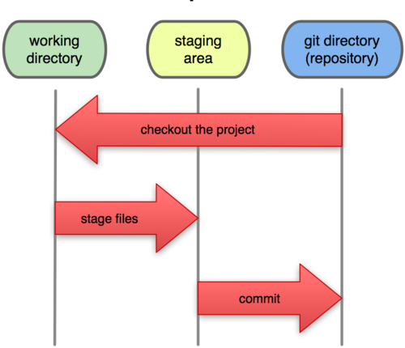
Local operations
Notes:
it basically takes a picture of what all your files look like at that moment and stores a reference to that snapshot. To be efficient, if files have not changed, Git doesn’t store the file again—just a link to the previous identical file it has already stored

Slide 13
Basic Git Workflow
You modify files in your working directory
You stage the files
  adding snapshots of them to your staging area
You do a commit
  which takes the files as they are in the staging area and stores that snapshot permanently to your Git directory.
If a particular version of a file:
  is in the git directory, it’s considered committed
  If it’s modified but has been added to the staging area, it is staged
  if it was changed since it was checked out but has not been staged, it is modified
Notes:
it basically takes a picture of what all your files look like at that moment and stores a reference to that snapshot. To be efficient, if files have not changed, Git doesn’t store the file again—just a link to the previous identical file it has already stored

Slide 14
Installing Git
On a Debian-based distribution like Ubuntu
  $ apt-get install git
On Mac, there are two easy ways to install Git
  use the graphical Git installer
    http://code.google.com/p/git-osx-installer
  via MacPorts (http://www.macports.org)
    $ sudo port install git-core +svn +doc +bash_completion +gitweb
On Windows, the msysGit project has one of the easier installation procedures (download the installer exe file)
  http://code.google.com/p/msysgit
Notes:
it basically takes a picture of what all your files look like at that moment and stores a reference to that snapshot. To be efficient, if files have not changed, Git doesn’t store the file again—just a link to the previous identical file it has already stored

Slide 15
$ git config
get and set configuration variables
  /etc/gitconfig
    contains values for every user on the system and all their repositories
    if you pass the option --system to git config, it reads and writes from this file specifically
  ~/.gitconfig
    specific to your user. Use –-global option to read and write to this file
  .git/config
    config file in the git directory, specific to that single repository
Notes:
it basically takes a picture of what all your files look like at that moment and stores a reference to that snapshot. To be efficient, if files have not changed, Git doesn’t store the file again—just a link to the previous identical file it has already stored

Slide 16
First time Git setup
Your Identity
  $ git config --global user.name "Cristian Lucchesi"
  $ git config --global user.email cristian.lucchesi@iit.cnr.it
Your Editor
  $ git config --global core.editor emacs
Your Diff Tool
  $ git config --global merge.tool vimdiff
Checking Your Settings
  $ git config –list
  user.name=Cristian Lucchesi
  user.email=cristian.lucchesi@iit.cnr.it
  …..
Notes:
it basically takes a picture of what all your files look like at that moment and stores a reference to that snapshot. To be efficient, if files have not changed, Git doesn’t store the file again—just a link to the previous identical file it has already stored

Slide 17
Getting help
In 3 different ways
  $ git help <verb>
  $ git <verb> --help
  $ man git-<verb>
For example
  $ git help config
Notes:
it basically takes a picture of what all your files look like at that moment and stores a reference to that snapshot. To be efficient, if files have not changed, Git doesn’t store the file again—just a link to the previous identical file it has already stored

Slide 18
Getting a Git repository
take an existing project or directory and import it
  $ git init
    creates .git dir containing a repository skeleton
    nothing in your project is tracked yet
    $ git add *.py to start tracking files
clone an existing Git repository from another server.
  $ git clone git://github.com/schacon/grit.git
    creates a directory named grit
    initializes a .git directory inside it
    pulls down all the data for that repository
    checks out a working copy of the latest version
Notes:
it basically takes a picture of what all your files look like at that moment and stores a reference to that snapshot. To be efficient, if files have not changed, Git doesn’t store the file again—just a link to the previous identical file it has already stored

Slide 19
Recording changes
You need to make some changes and commit snapshots of those changes into your repository each time the project reaches a state you want to record.
each file in your working directory can be in one of two states: tracked or untracked
tracked:
  files that were in the last snapshot;
  they can be unmodified, modified, or staged
untracked:
  any files in your working directory that
    were not in your last snapshot
    are not in your staging area
Notes:
it basically takes a picture of what all your files look like at that moment and stores a reference to that snapshot. To be efficient, if files have not changed, Git doesn’t store the file again—just a link to the previous identical file it has already stored

Slide 20
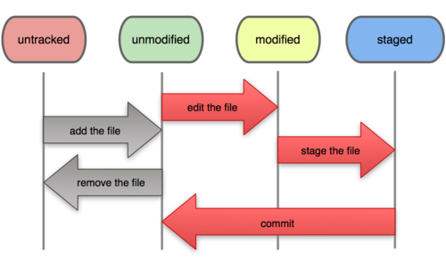
File status lifecicle
Notes:
it basically takes a picture of what all your files look like at that moment and stores a reference to that snapshot. To be efficient, if files have not changed, Git doesn’t store the file again—just a link to the previous identical file it has already stored

Slide 21
Hands
on
Git

Slide 22
Undoing Things
Changing Your Last Commit
  $ git commit –amend
    as an example, if you commit and then realize you forgot to stage the changes in a file you wanted to add to this commit:
      $ git commit -m 'initial commit'
      $ git add forgotten_file
      $ git commit --amend
Notes:
it basically takes a picture of what all your files look like at that moment and stores a reference to that snapshot. To be efficient, if files have not changed, Git doesn’t store the file again—just a link to the previous identical file it has already stored

Slide 23
Undoing Things ^{(cont)}
Unstaging a Staged File
  git reset HEAD <file>...
    or example, let’s say you’ve changed two files and want to commit them as two separate changes, but you accidentally type git add * and stage them both
      $ git reset HEAD benchmarks.py
        the benchmarks.py file is modified but once again unstaged.
Notes:
it basically takes a picture of what all your files look like at that moment and stores a reference to that snapshot. To be efficient, if files have not changed, Git doesn’t store the file again—just a link to the previous identical file it has already stored

Slide 24
Undoing Things ^{(cont)}
Unmodifying a Modified File
  git checkout -- <file>...
    can you easily unmodify a file revert it back to what it looked like when:
      you last committed
      or initially cloned
      or however you got it into your working directory
    git status tells you how to do that, too
Notes:
it basically takes a picture of what all your files look like at that moment and stores a reference to that snapshot. To be efficient, if files have not changed, Git doesn’t store the file again—just a link to the previous identical file it has already stored

Slide 25
Working with Remotes
Remote repositories are versions of your project that are hosted on the Internet or network somewhere
you can have several of them
$ git remote
origin
  origin is the default name Git gives to the server you cloned from
$ git remote -v
origin git://github.com/schacon/ticgit.git
Notes:
it basically takes a picture of what all your files look like at that moment and stores a reference to that snapshot. To be efficient, if files have not changed, Git doesn’t store the file again—just a link to the previous identical file it has already stored

Slide 26
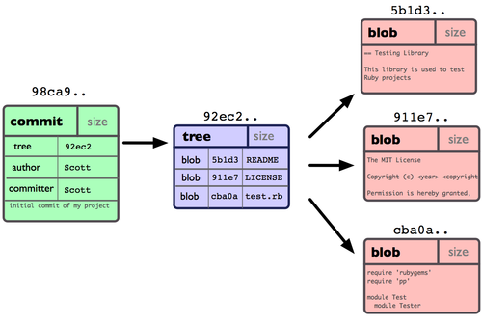
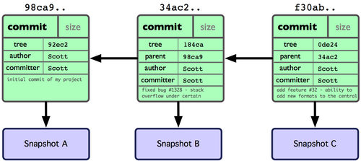
Git repository objects
single commit repository
Git object data for multiple
commits
Notes:
it basically takes a picture of what all your files look like at that moment and stores a reference to that snapshot. To be efficient, if files have not changed, Git doesn’t store the file again—just a link to the previous identical file it has already stored

Slide 27
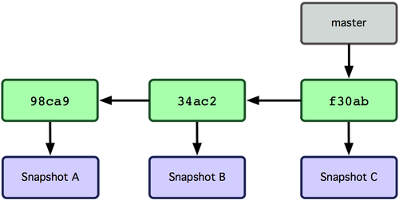
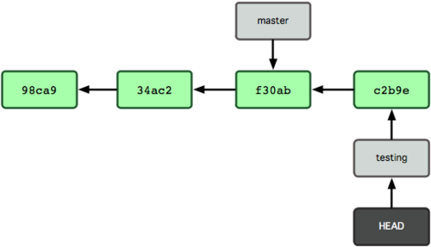
Git branching
Branch pointing into the
commit data’s history
the branch that HEAD
points to moves forward with each commit
Notes:
it basically takes a picture of what all your files look like at that moment and stores a reference to that snapshot. To be efficient, if files have not changed, Git doesn’t store the file again—just a link to the previous identical file it has already stored

Slide 28
GIT basic HTTP Auth
at least on Linux the HTTP Basic Auth doesn't work well
Workaround:
  create a .netrc file in your home dir
$ cat ~/.netrc
machine wiki.iit.cnr.it
login your-username
password your-password
Notes:
it basically takes a picture of what all your files look like at that moment and stores a reference to that snapshot. To be efficient, if files have not changed, Git doesn’t store the file again—just a link to the previous identical file it has already stored

Slide 29

This tutorial is on github
http://bit.ly/UJNcI1
Notes:
it basically takes a picture of what all your files look like at that moment and stores a reference to that snapshot. To be efficient, if files have not changed, Git doesn’t store the file again—just a link to the previous identical file it has already stored

