Slide 1
AC 3.1- Examine information for validity

Slide 2
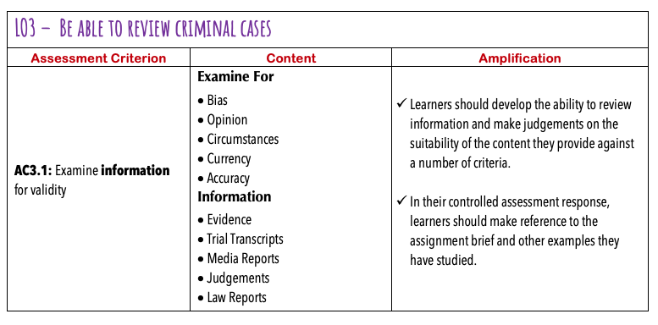

Slide 3
Introduction:
This section is worth 15 marks- one of the biggest mark scorers
You need to examine:
Evidence
Trial transcripts
Media reports
Law reports
Judgements
For:
Bias
Opinion
Circumstances
Currency
Accuracy

Slide 4
Typical Question
Giving a range of examples (inc. the brief) examine sources of information for validity.

Slide 5
Some Terms (that might need explaining)
Bias –
Is the evidence, judgment affected by race, gender, gut feeling, professional judgement and so on
Currency -
Is the evidence collected in an up-to-date manner?
How current is that evidence?
How much value does that information hold ?
Is this a a reliable source (like a pathologist)
Circumstance -
Is the evidence circumstantial? (circumstance)
What were the circumstances that the evidence was collected?

Slide 6
SOURCES OF INFORMATION IN CRIMINAL TRIALS
Evidence is the physical and testimonial evidence presented in the court room in a case
Trial transcripts are written record of the spoken word in a court room, usually words spoken by the judge or lawyers
Media reports are any reports given in any form of media, e.g. Newspaper articles or social media reports
Judgements are the outcome of a case (guilty, not guilty etc.) and sentences if found guilty. This can be disputed through appeal
Law reports are the written evidence of all legal interpretations and reasoning for judgements and sentencing

Slide 7

AREAS WHERE THERE MAY BE A PROBLEM WITH VALDITY
Bias – The validity of information may be lessened when it comes from a biased source such as the police or the intelligence services.
Opinion – An opinion is not fact; it is one person’s point of view.
Circumstances – Our understanding of information about a crime may be altered by the circumstances of the offence, for example, the age of the accused or whether they were provoked.
Currency – What is the impact that this information has on the case, for example some experts have such as pathologists have high value, others especially those who may have a reason to give certain evidence will have less ‘currency’.
Accuracy – Information sources can vary in terms of accuracy, for example finger prints may only be a partial match and therefore have less reliable and possibly not valid.

Slide 8
TASK – In your booklets page 2 and 3
Read through the two tasks Sally Clark (Evidence) and Barry George (Judgements)
These case show various features that might affect the validity of the original trial
The Evidence in the Sally Clark Case Show
Currency
Circumstance
accuracy/inaccuracy
opinion
bias.
The Judgement in the Barry George Case shows
Currency
Circumstance
accuracy/inaccuracy
opinion
bias.

Slide 9
TASK – In your booklets page 2 and 3
Now fill in the table you were given earlier for the rows for evidence and judgments
Then complete the tasks in the the rest of the booklet (media, law reports and trial transcripts) and complete the rest of the table

Slide 10
