Slide 1

Writing Up Your Campaign
3.1 (Planning)

Slide 2
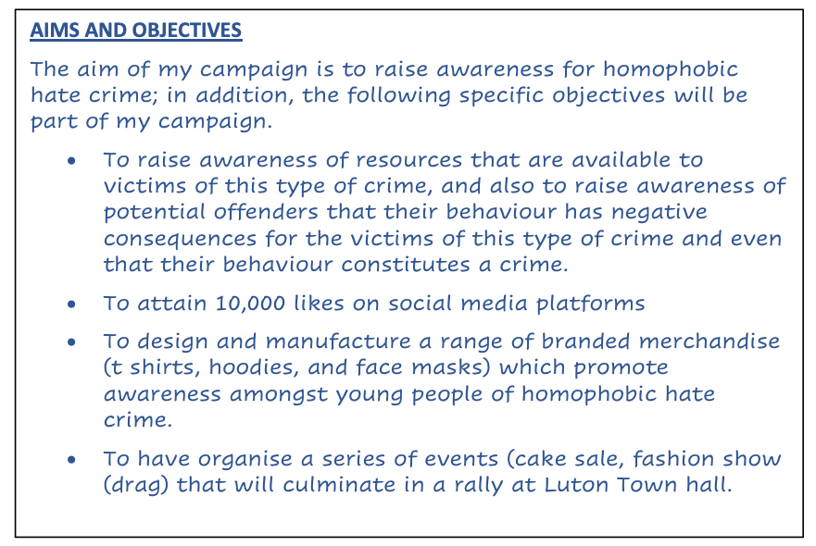

Slide 3
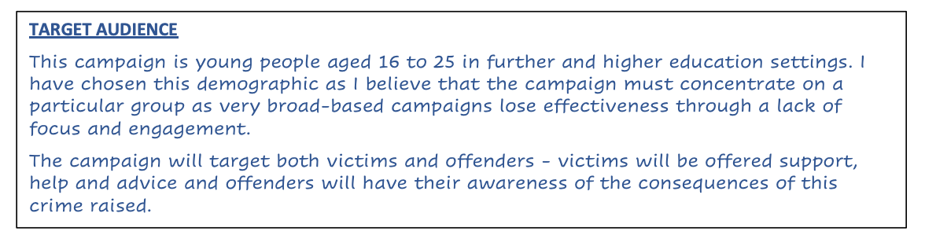

Slide 4
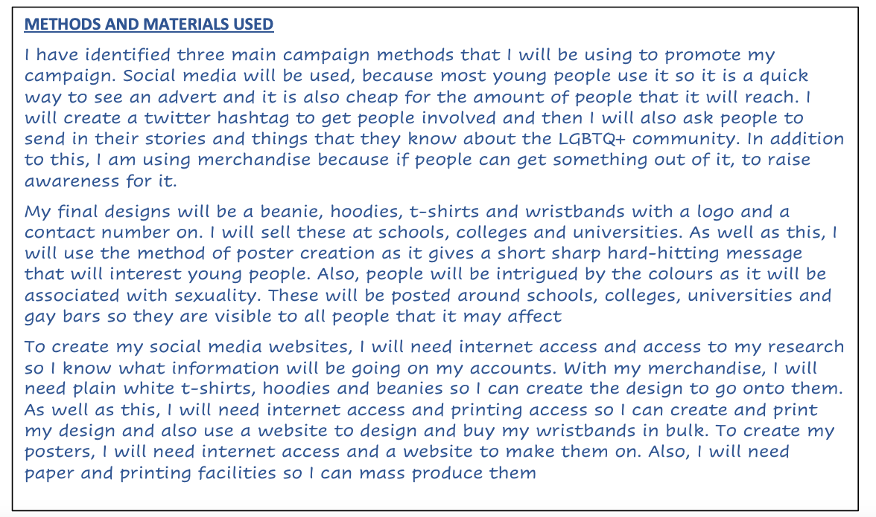

Slide 5
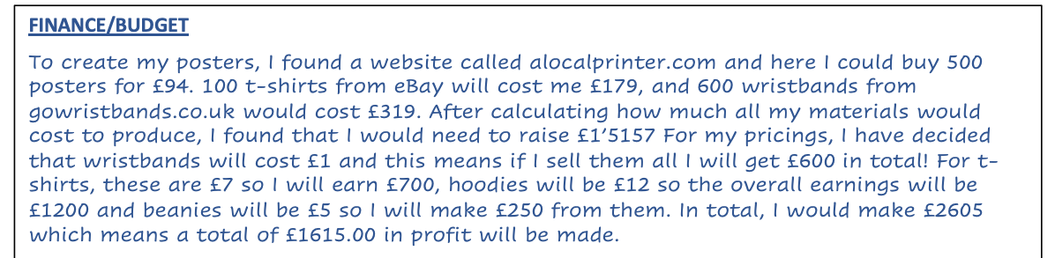

Slide 6
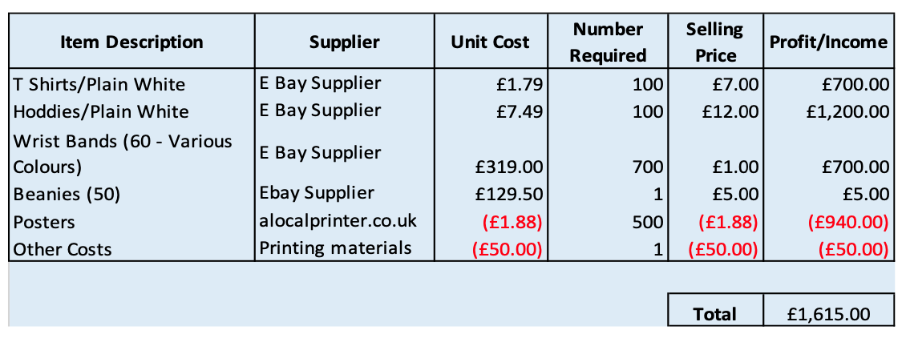

Slide 7
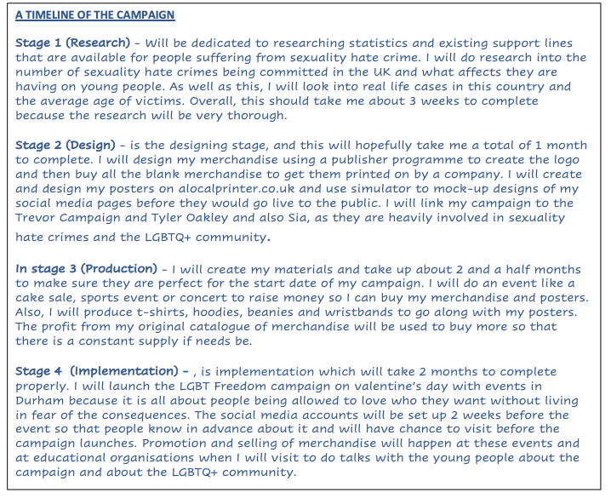

Slide 8
Making Your Campaign
3.2

Slide 9
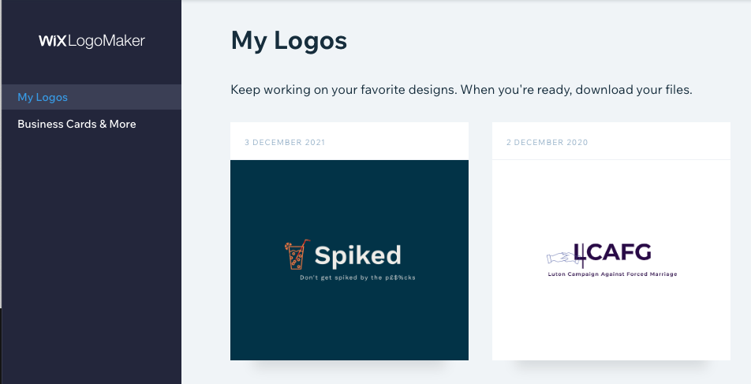
Wix Logo Maker
(website) – Link Here

Slide 10

The Logo I made

Slide 11

Made with the t shirt studio (website) – Link Here

Slide 12

Made with the t shirt studio (website) – Link Here)

Slide 13
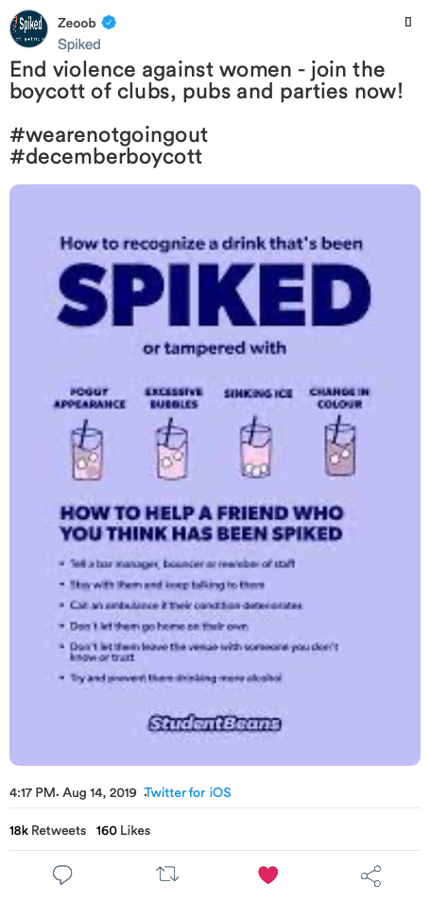
Made with the zeoob.com website) – Link Here

Slide 14
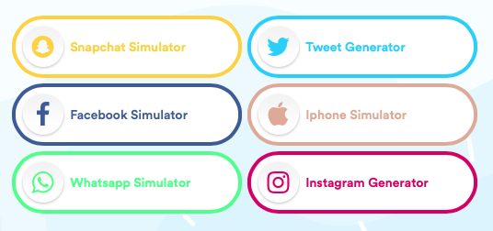
Made with the zeoob.com website
Link Here

Slide 15
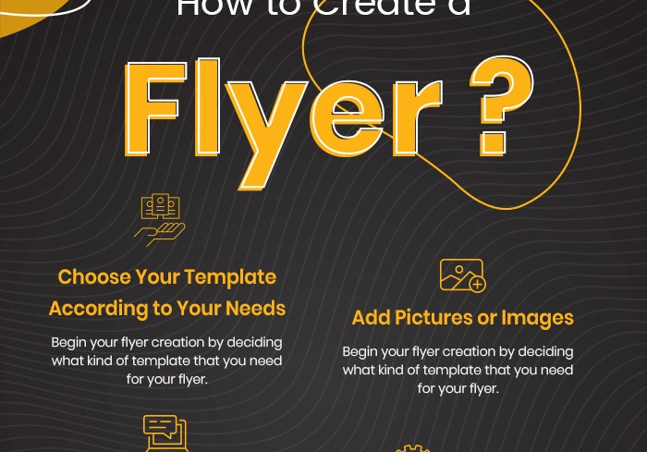

Make A Flyer and Poster (in Word?)

Slide 16
Evaluating Your Campaign
3.3 (Justifying/Evaluation)

Slide 17

Justification Section (AC3.3)
Go through each component of your campaign
Say why you chose the crime, you chose
Evaluate your logo (is it eye-catching, it it effective)
Evaluate your slogan – is it powerful, persuasive or clever (all of these?)
Evaluate your design – colours used
Justify your target audience
Explain why you used the social media, you used
Finances – was your money well spent
What impact will your campaign have on this crime
What worked, what would you change

Slide 18
Remember!
Justify Everything you have done (target audience; social media and materials; any other methods; name, logo and slogan)
1
Include a timeline
2
Include finance
3
Evaluate your campaign
4

Slide 19
Campaigns for Change
Compare some campaigns for change. You should make reference to your own planned campaign.

